Slide 1
School board meeting
Feb. 24, 2026

Slide 2
Superintendent’s report
SUPT. DR. KIM HIEL
Notes:
Good evening Chair Prince, Vice Chair Brooks, Board members, staff, families, students, and community partners.
While the events of recent weeks remains on our hearts, I want you to know that I’m continually inspired by the learning spaces our dedicated Osseo Area Schools staff have - AND continue to create. Our team is working in a human-centric fashion every day – focusing on the safety and belonging of each and every scholar. Individual needs are being met because of this approach.
As a leader, being grounded in our schools is the best part of our work. Recently I had the wonderful opportunity to attend events like the high-energy Winter Pepfest at Osseo Senior High to engaging with our student board representatives to a site visit at Oak View Elementary. In each of these experiences, and so many others, I can tell you that our scholars are brilliant. I believe their vibrance is a constant reminder of our purpose. Osseo Area Schools WILL remain the premier place for them to learn and reach their dreams - they certainly deserve it.
Our strength extends into our community. Whether connecting with local legislators like recently or celebrating SRO Missy Parker’s Officer of the Year recognition. We’re leaning into our greater Osseo Area Schools family to ensure that success for our scholars continues year after year.
We move forward as we always do: together, with purpose, unity, and a shared commitment to the well-being of our entire community. Thank you for your continued partnership in that effort.

Slide 3
Points of Pride
SUPT. DR. KIM HIEL AND CABINET MEMBERS
Notes:
A regular part of the superintendent’s report is to share Points of Pride in our district.
By sharing our Points of Pride, we are taking time to recognize and celebrate, the scholars, staff and community members who are contributing to the accomplishment of our mission.
I have members of our District Cabinet here to assist in sharing some examples from the last month.

Slide 4

Notes:
In the area of ACHIEVING DREAMS
Congratulations to the students from Maple Grove, Osseo and Park Center whose hard work and creativity earned them recognition in the Minnesota Scholastic Art Awards. Each year, high school students across Minnesota submit artwork for consideration. The art is submitted in 16 different categories from ceramics to photography to fashion.
Check out all of our winners on the district website!

Slide 5
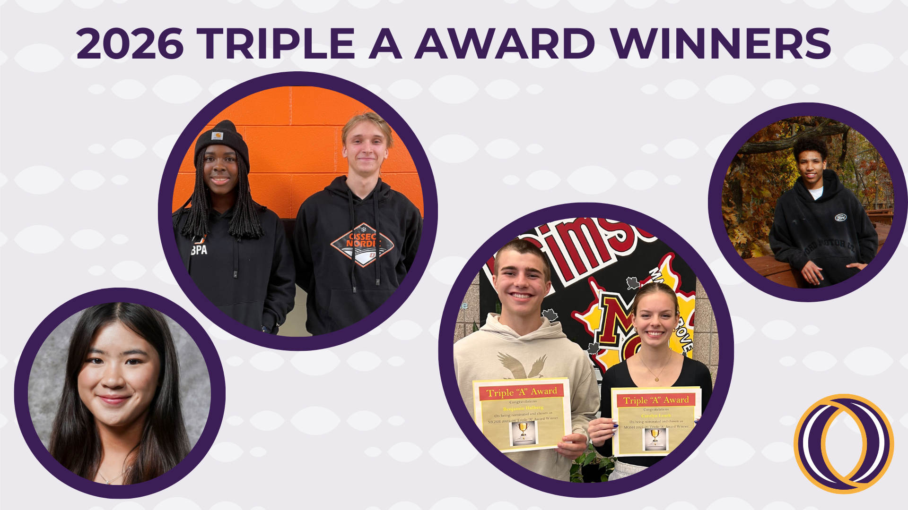
Notes:
The Triple A Award is sponsored by the Minnesota State High School League and recognizes outstanding students who perform at a high level academically while also participating in athletics and the arts. Congratulations to Maple Grove Senior High School’s Carolyn Leach and Ben Halberg, Osseo Senior High School’s Myriam Akakpo and Logan Boekhoff and Park Center Senior High School’s Jamison Adams and Gisele Vo.

Slide 6
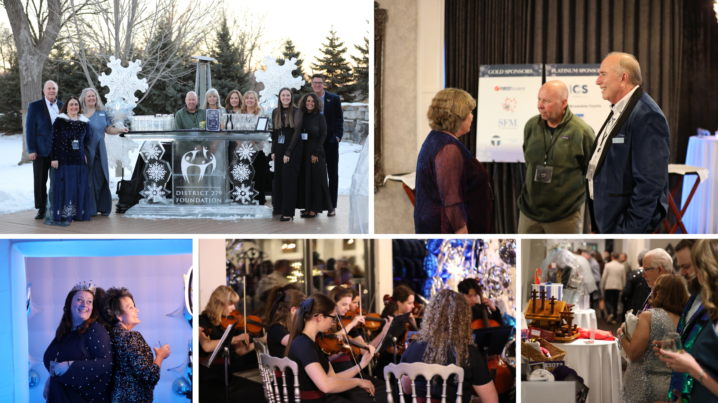
Notes:
In the area of CONTRIBUTING TO COMMUNITY:
On Friday, Feb. 6 District 279 Foundation’s annual ‘A Night Out- Winter Wonderland gala’ was held at Leopold’s Mississippi Gardens event center. The magical evening included shimmering décor, 360- photo booth, silent/live auction, and a formal dinner and program.
The event raised $80,000 that will go toward grant programs and enriching experiences for students in Osseo Area Schools.

Slide 7
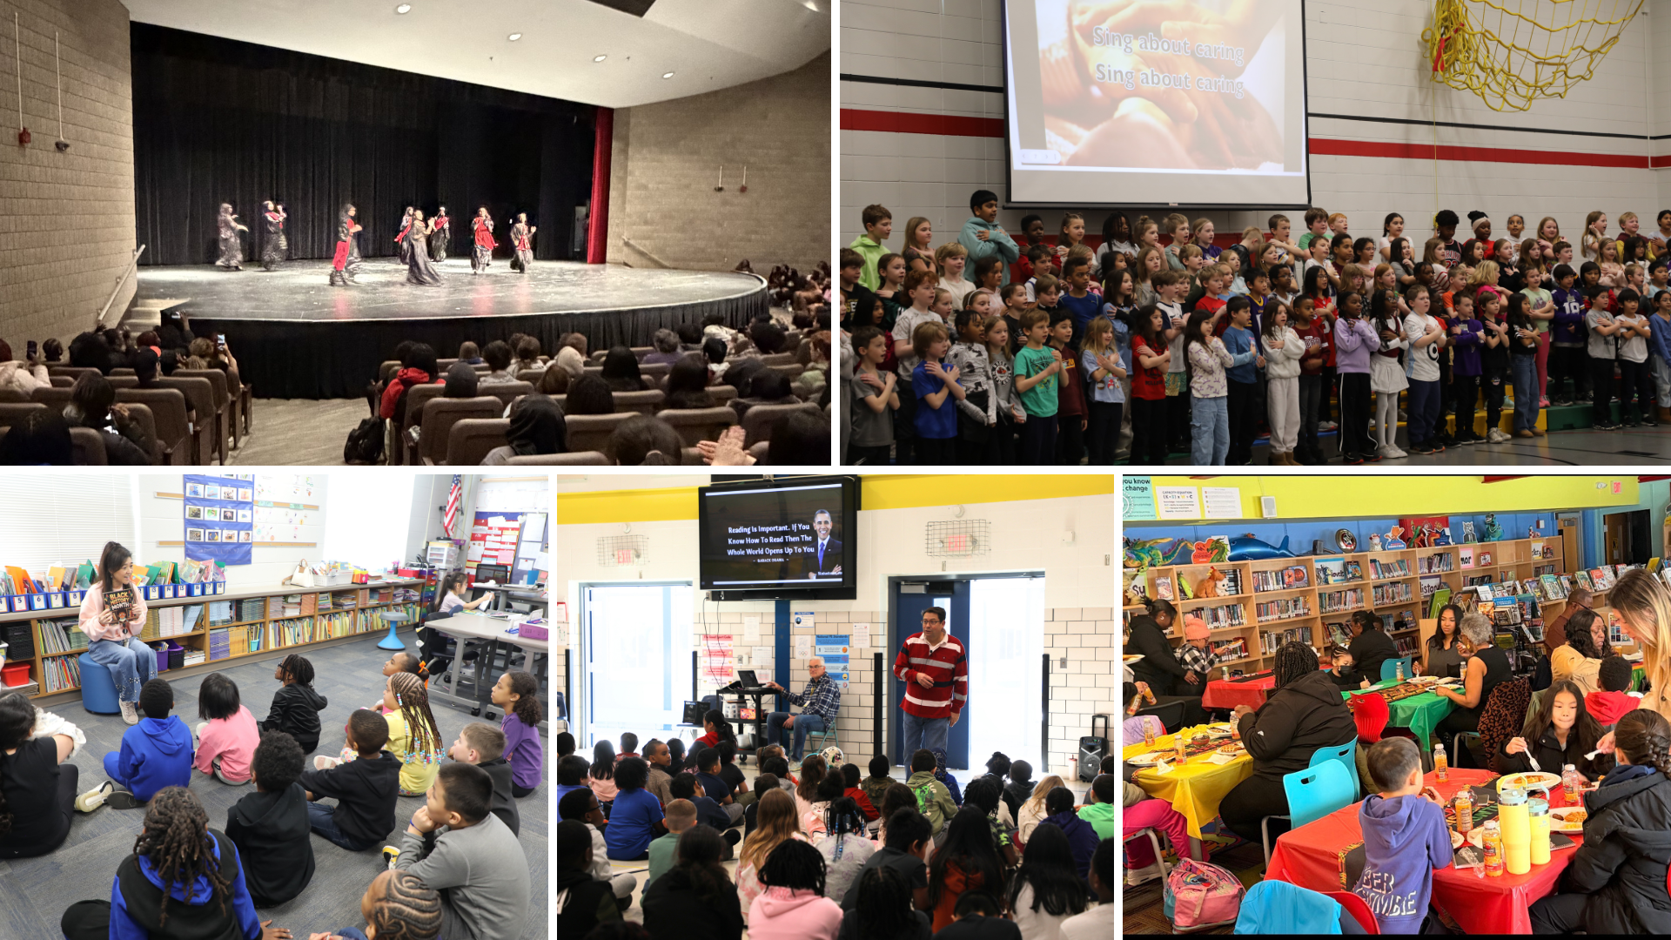
Notes:
In the area of LIFELONG LEARNING
Each February, Osseo Area Schools recognizes Black History Month. Throughout the month, schools and students across the district dedicate time to celebrate, honor and learn about people or events that have impacted Black culture in our country’s history.
At Basswood Elementary School, students in all grades gathered on Feb. 6 to celebrate. Their event was a huge hit amongst students and staff and featured a number of songs sung by third graders and students in the Black Joy leadership group speaking about a number of Black figures, both historical and current.
Park Brook Elementary School hosted an all-school assembly Feb. 6 that focused heavily on the beginning of Black History Month. Principal Scott Taylor shared a quote from former President Barack Obama about the importance of reading. Taylor then shared about additional prominent African American leaders in the past and present.
Students in the Black Student Union at Osseo Senior High School presented Osseo Speaks: A Black History Month Showcase on Feb. 13. The student-led performances included songs, poems, fashion shows, skits and various dance performances.
At Fair Oaks Elementary School, students read a book about Black History Month before discussing themes that stood out to them.
Garden City Elementary School hosted a soul food breakfast for students and families catered by Run Tell That Barbeque on Feb. 19. Following the breakfast, the entire student body gathered for a community-building harambee and read aloud. Harambee is a Swahili term meaning "all pull together."

Slide 8
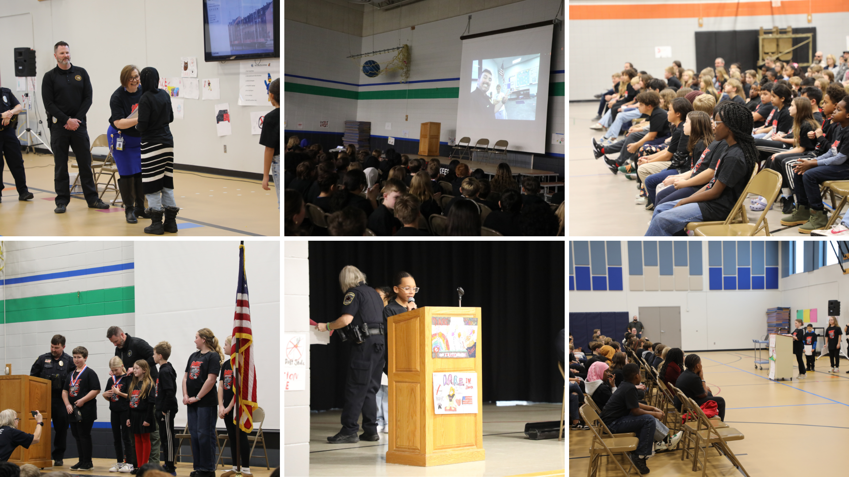
Notes:
Fifth graders at Elm Creek, Fernbrook and Rice Lake elementary schools recently celebrated their graduation from the DARE program. DARE is a drug abuse prevention program intended to give elementary school children skills to resist peer pressure to use tobacco, drugs and alcohol.
The ceremonies, attended by parent/caregivers and community members, included a welcome from Maple Grove Police Department DARE officers Smith and Slawson, a message from the principal about all they have accomplished, followed by a message from Acting Commander Matt Brost.

Slide 9
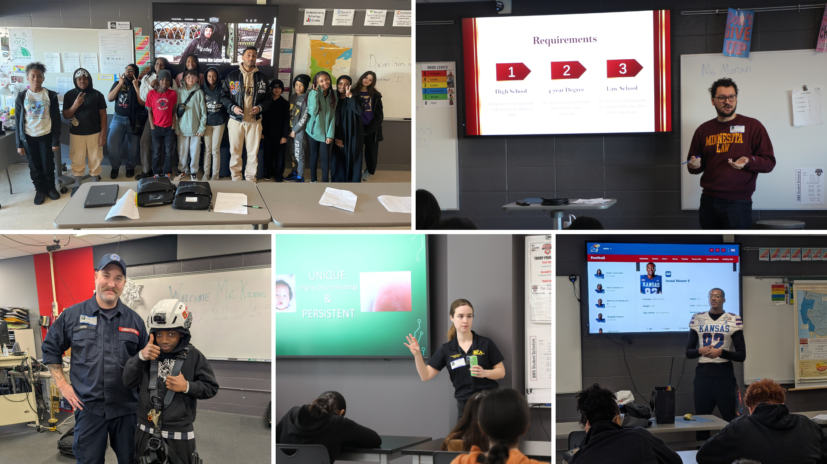
Notes:
Last month, Brooklyn Middle STEAM School welcomed over 40 community members into the building as guest speakers for their annual College and Career Day. The school’s career fair is an all-school event.
Students learned about different career pathways from a variety of career professionals. The presenters’ careers spanned a wide range, including construction trades, police officers, librarians, a law student, a nurse, a personal trainer, chefs and different business roles such as graphic design, human resources and marketing, among others.

Slide 10
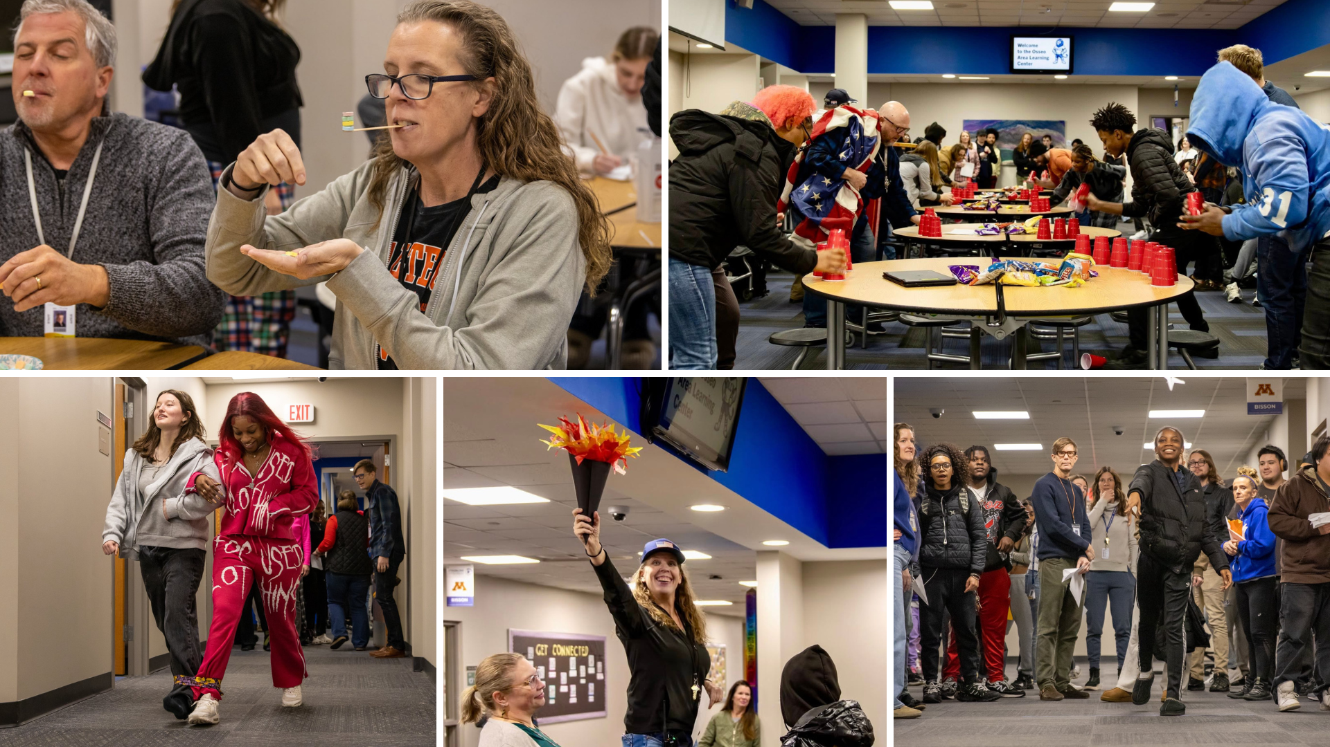
Notes:
Students and staff at the Osseo Area Learning Center got into the competitive spirit when teacher Ms. Monahan organized a fantasy Olympics, including a “draft” to pick teams Competitions have included cup-stacking, Marshmallow scooping, heart stacking, paper airplanes and a three-legged race.

Slide 11
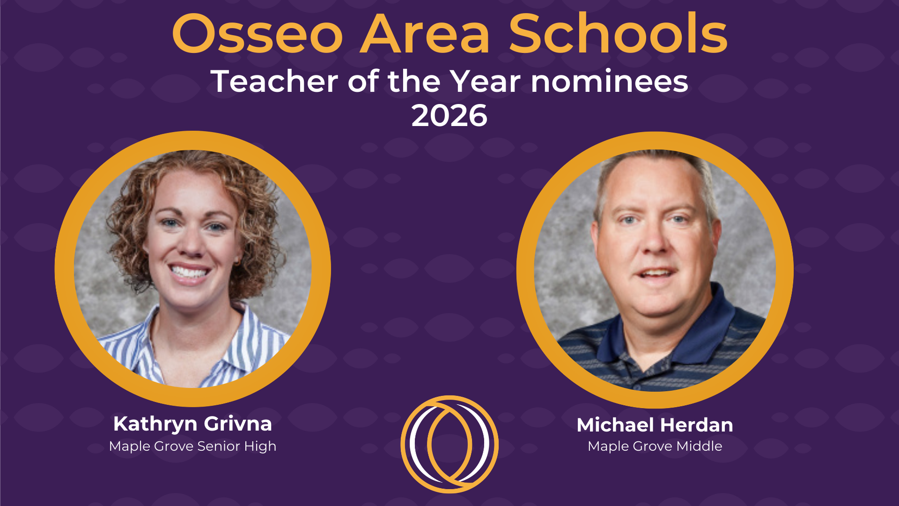
Notes:
In the area of MISSION DRIVEN EMPLOYEES
Two teachers from Osseo Area Schools are among the list of candidates for the 2026 Minnesota Teacher of the Year award! Huge congrats to Kathryn Grivna from Maple Grove Senior High and Michael Herdan from Maple Grove Middle School! Additionally, Herdan has been named as one of 30 semifinalists and will be judged in the next few weeks to be named a finalist.

Slide 12

Notes and reminders
March 6: No school for students
Notes:
A few final notes and reminders for tonight.
There will be no school for students on March 6.

Slide 13
School board meeting
Feb. 24, 2026

