Slide 1
The Financial Aid Process
Westminster College
501 Westminster Ave.
Fulton, MO 65251
Aimee Bristow
Associate Vice President of Enrollment Management & Financial Aid
Aimee.Bristow@wcmo.edu

Slide 2
Apply early
Apply early - funds are often awarded on a first come, first serve basis
Be aware of deadlines
Requirements may vary from school to school
Notes:
It is important to apply for financial aid and scholarships early. Make sure you are aware of the deadlines because if you miss a deadline, you might miss out on financial aid that might make the difference between you being able to afford to go to the college of your choice or not.

Slide 3
Free Application for Federal Student Aid - The FAFSA
Complete and submit as soon as possible after it opens on October 1, 2026 – will use 2025 tax info
Westminster College’s FAFSA Priority Deadline is February 1st, 2027
Contact all colleges you are applying to find out their priority deadline
Determines eligibility for Federal, State, and sometimes private aid
The only cost is your time
Notes:
The financial aid application is called the Free Application for Federal Student Aid, or more commonly referred to as the FAFSA. The Department of Education has made some updates to the FAFSA, so it is not scheduled to open until December 2023. The exact date will be released at a later time. The FAFSA includes financial information for the student and their parents, so it will collect 2022 Federal income tax data. Westminster’s priority deadline to submit the FAFSA is February 15, 2024 which will allow students to be considered for the maximum forms of financial aid that is available. The State of Missouri’s deadline to submit the FAFSA is February 1, 2024 to be considered for State funded financial aid. It is FREE to apply for financial aid, so don’t pay anyone to help you complete the FAFSA, including your tax preparer. If you need assistance completing the FAFSA, contact the college’s financial aid office, attend a FAFSA Frenzy event at an area high school (JCHS and CCHS will host FAFSA Frenzy events in January), or contact the Department of Education.

Slide 4
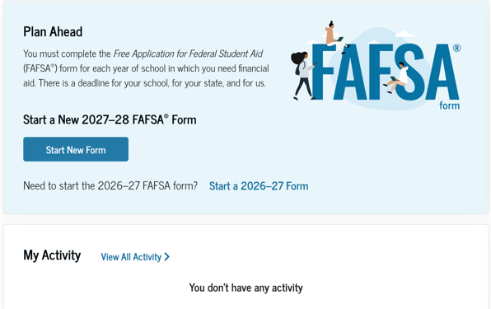
FAFSA
https://studentaid.gov/h/apply-for-aid/fafsa
Notes:
This is the website to complete the FAFSA. You will click on “Start a New Form” to start the original FAFSA, or “Edit Existing Form” to make a correction.

Slide 5
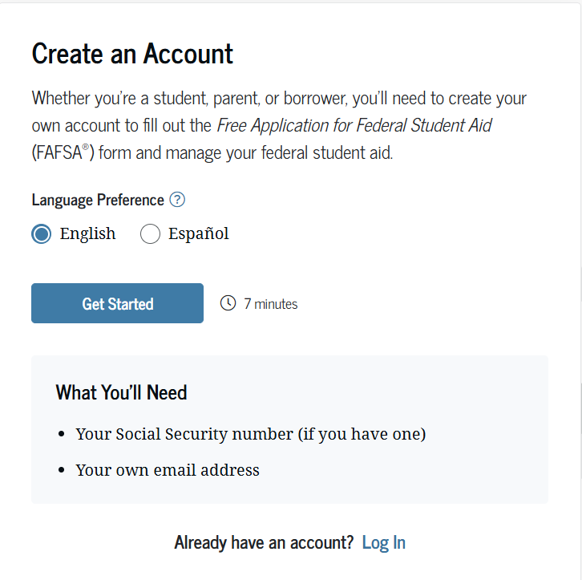
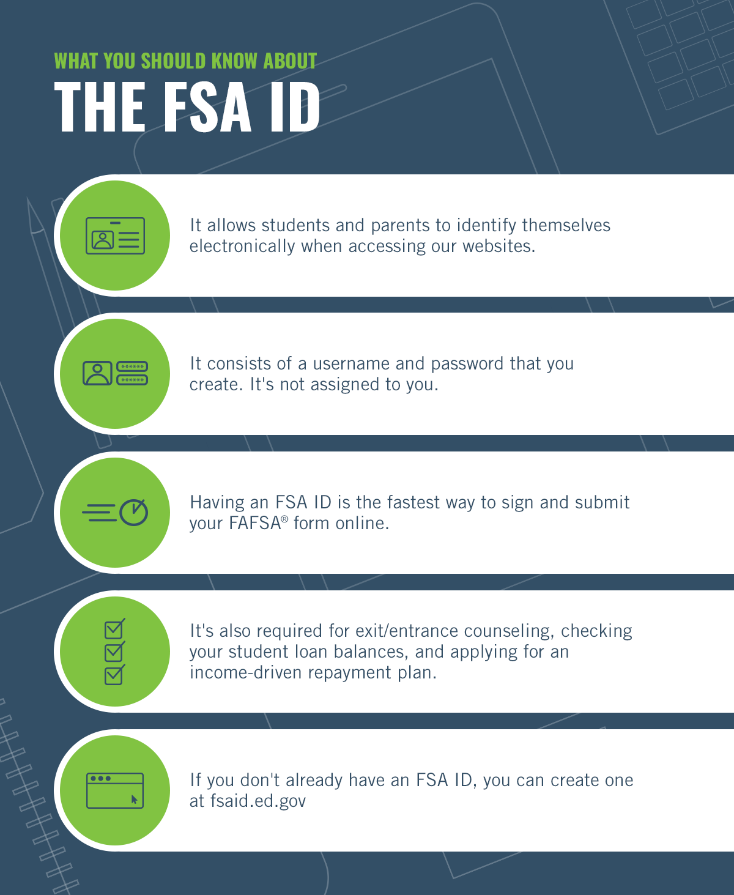
1st Step – students and parents apply for FSA ID
https://studentaid.gov/fsa-id/create-account/launch
Notes:
Before you start your FAFSA, the student and their parents (also referred to as a contributor on the FAFSA) must apply for an FSA ID which is the user name and password to use for FAFSA website. You need to make sure each person has a unique email address and mobile phone number when applying for an FSA ID. Please keep track of your FSA ID and password because it will be used for the initial FAFSA, FAFSA corrections, student and parent loans applications, and FAFSA applications for future academic years.

Slide 6
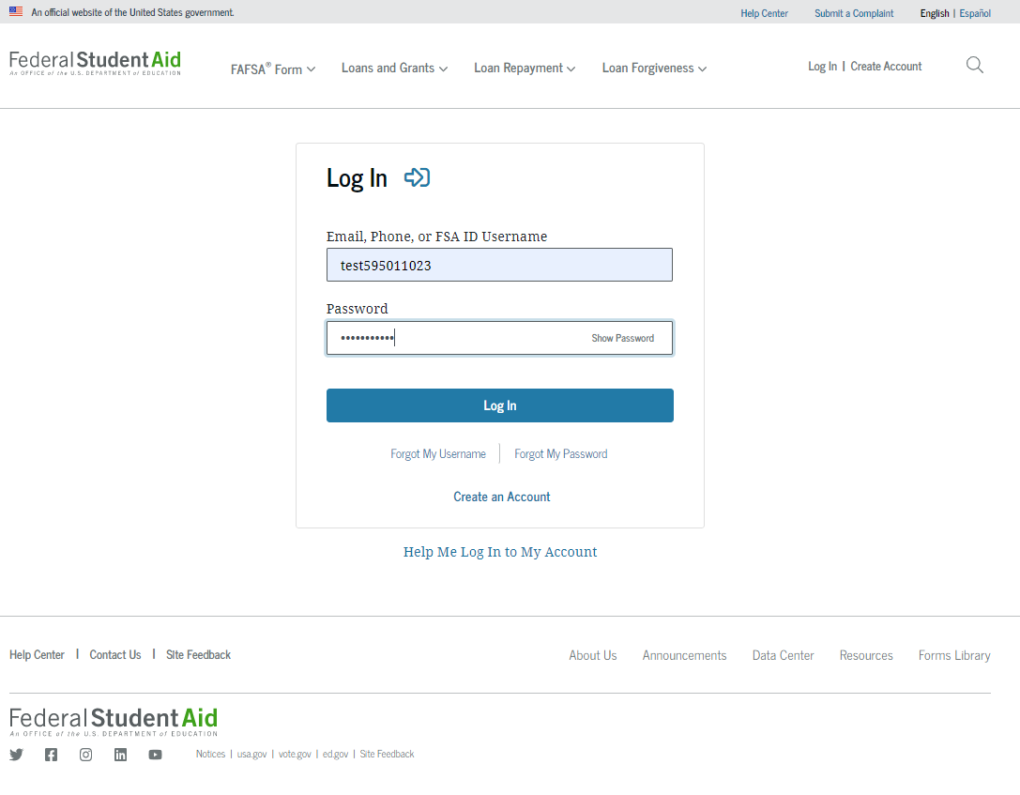
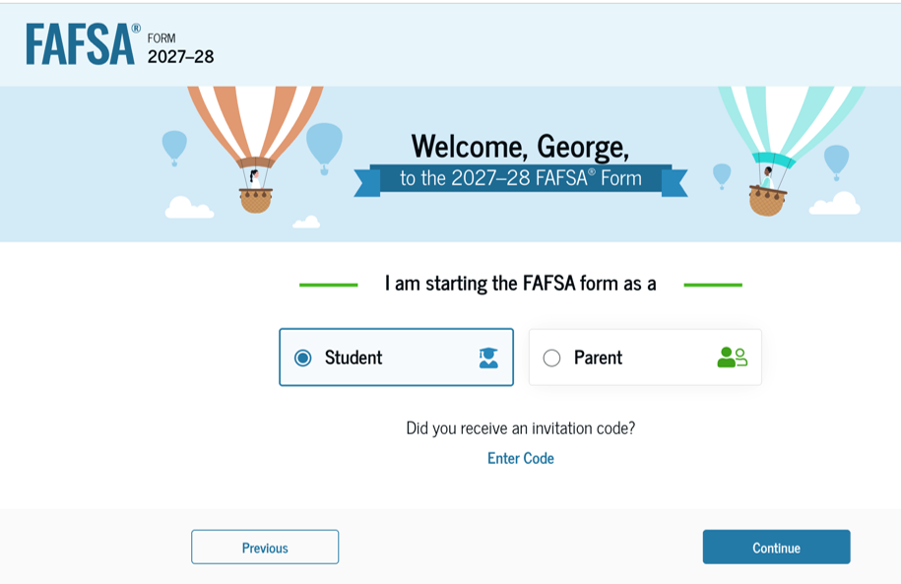
Dependent students will log in to start the fafsa
Reminder to parents – the FAFSA is the STUDENT application, so the STUDENT logs into the FAFSA
Notes:
The STUDENT logs in using their FSA ID. PARENTS will log in later to complete the parent section.

Slide 7
Documents needed to complete the FAFSA
  Student’s driver’s license and Social Security card
  Parents’ Social Security card
  W-2 forms and other records of money earned in 2025
  2025 federal income tax returns
  Records of untaxed income
  Current bank statements
  Business and farm records
  Records of stocks, bonds and other investments
Notes:
Students and parents need to gather these documents to answer questions on the FAFSA. When you are reporting checking and savings account information, report an average amount that is in those accounts every month. If you received recently received your paycheck, but haven’t paid your monthly bills yet, don’t report the full amount in your bank account at that time.

Slide 8
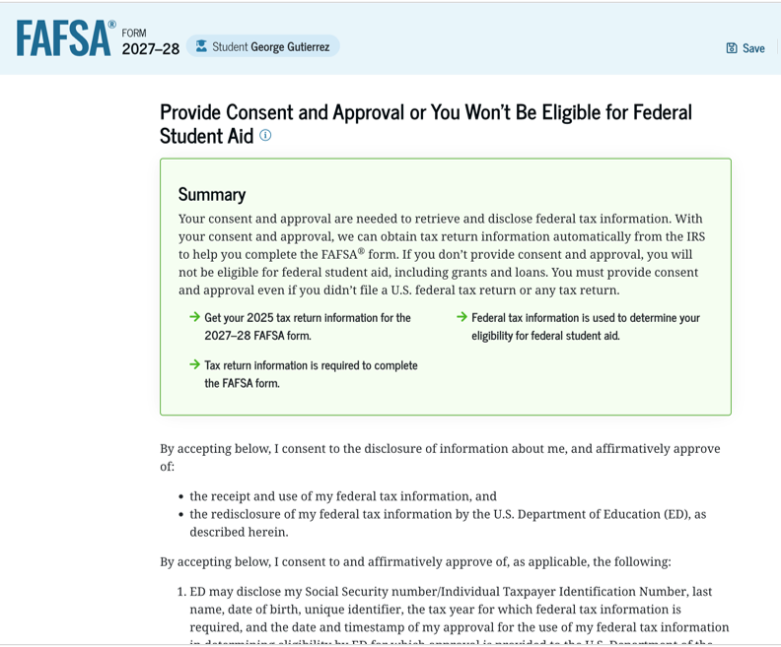
Consent required to transfer IRS Data into fafsa for student and contributors
This page informs the student about consent, approval, and the use of federal tax information. Once the student provides consent and approval, their federal tax information is transferred directly from the IRS into the FAFSA® form to help complete the "Your Finances" section. The student selects "Approve" to provide consent and approval and is taken to the next page.
.
Parents will also be required to provide consent when they complete the Parent Financials section.
Notes:
Students and parents must provide CONSENT to automatically transfer the Federal income tax data from the IRS into the FAFSA. If CONSENT isn’t granted, the FAFSA will reject and financial aid eligibility cannot be determined.

Slide 9
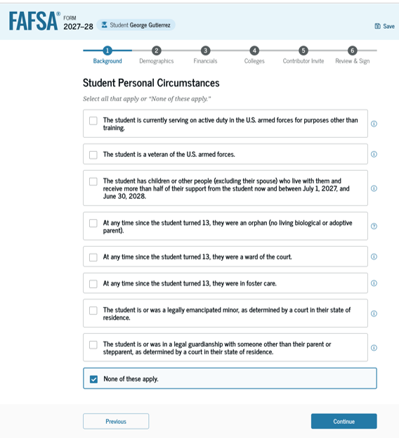
Dependent ≠ Independent
Notes:
Most students who attend college directly from high school are dependent students for financial aid purposes, so they will be required to provide parental information on the FAFSA. If a student can check at least one item on this list, they will be classified as an independent student on the FAFSA, and will not be required to include parental information on the FAFSA.

Slide 10
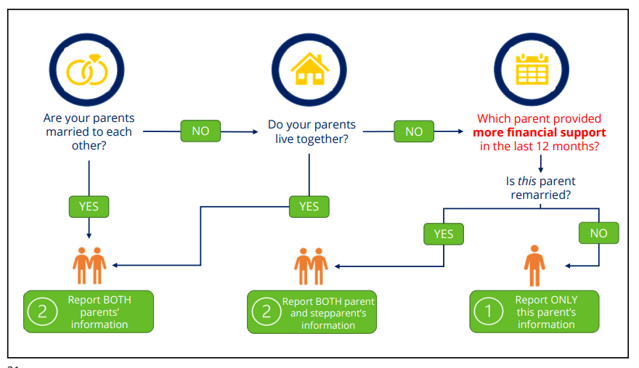
Parent/contributor information on fafsa
Notes:
Every family situation is different, so this chart helps students confirm which parents’ information will be included on the FAFSA. On the FAFSA, parents are also referred to as contributors.

Slide 11
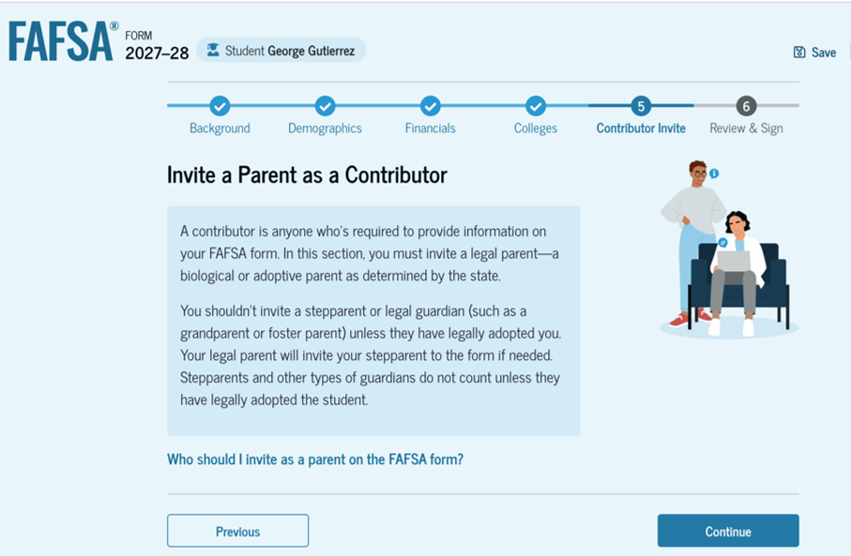
Parent/contributor information on fafsa
Notes:
Parents/contributors will need to provide their financial information on the FAFSA and provide CONSENT to transfer their Federal income tax information into the FAFSA from the IRS.

Slide 12
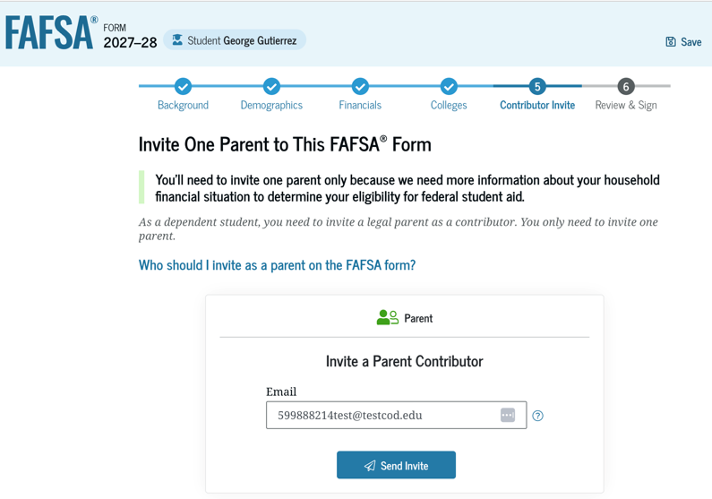
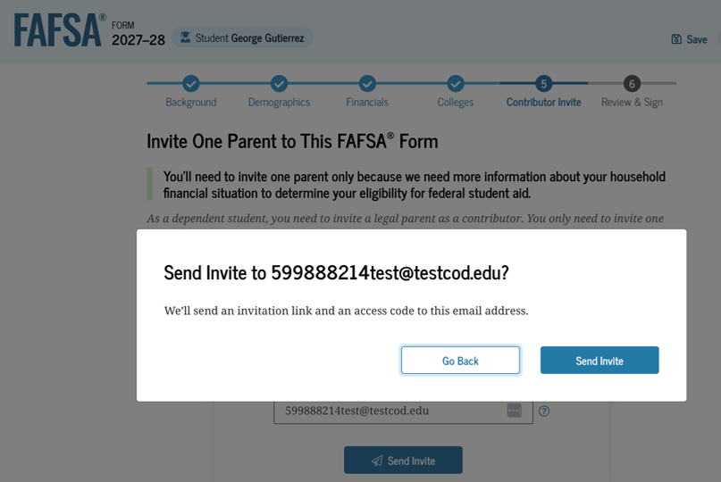
Information about Parent/contributor student needs to know
Notes:
Students will send an invitation to the parents to be contributors on the FAFSA. Students will need to know the following information about EACH parent/contributor: first name, last name, date of birth, social security number and email address.

Slide 13
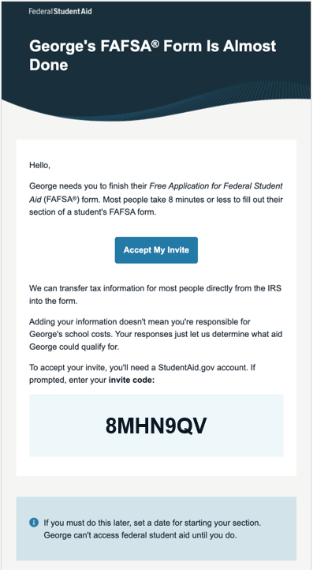
Parent/contributor invitation
This is NOT a view within StudentAid.gov or the FAFSA® form. This view demonstrates a parent opening the FAFSA invitation from their email. The parent selects "Accept Invitation" and is taken to StudentAid.gov.
Notes:
The parent/contributor will receive an email inviting them to provide their information on the student’s FAFSA.

Slide 14
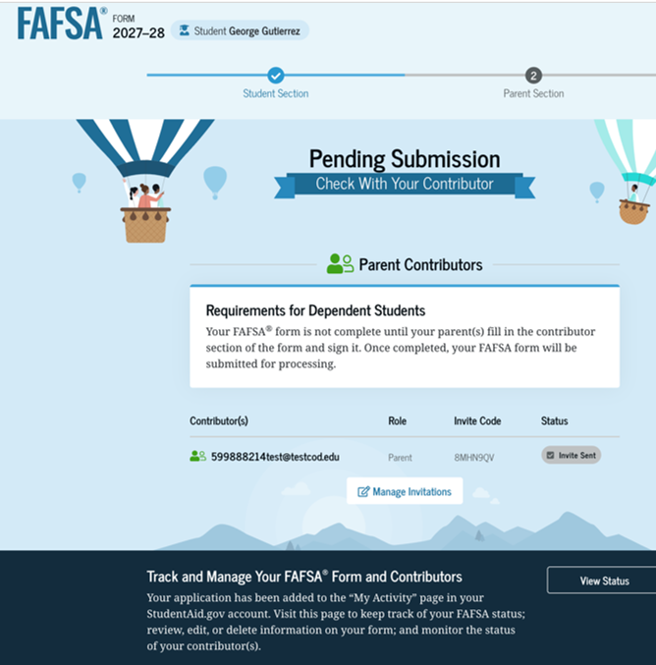
Next step: Contributors log in and enter their information
Upon digitally signing the student section, the student is presented with the "Pending Submission" page. The student is reminded that their FAFSA® form is not completed and can’t be submitted until the parent completes the contributor section of the form and signs it. This page also displays next steps the student can take, including tracking and managing their form.
Notes:
This page confirms the STUDENT completed the student section, so now it is time for the student to log out. The PARENT will log in to complete the parent section.

Slide 15
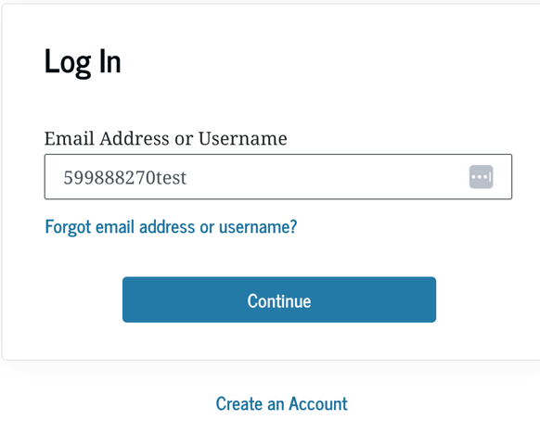
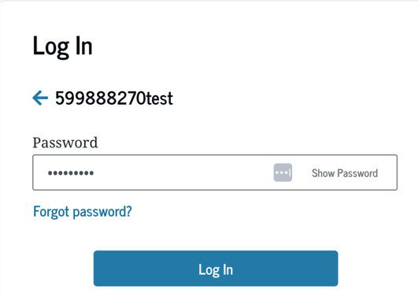
Parent/contributor Log In
The parent is taken from their email to the “Log In” page to enter their log-in credentials. To access the FAFSA® form, all users are required to have an FSA ID (account username and password). If the parent doesn't have an FSA ID, they can select "Create an Account."
Notes:
The PARENT will log in using their FSA ID, and they will indicate they are the parent after they log in.

Slide 16
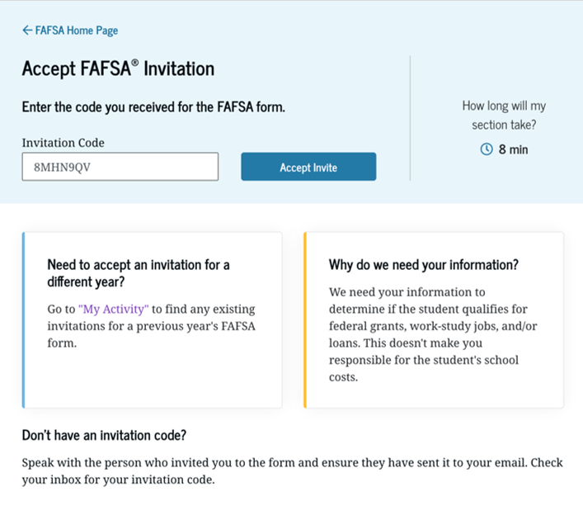
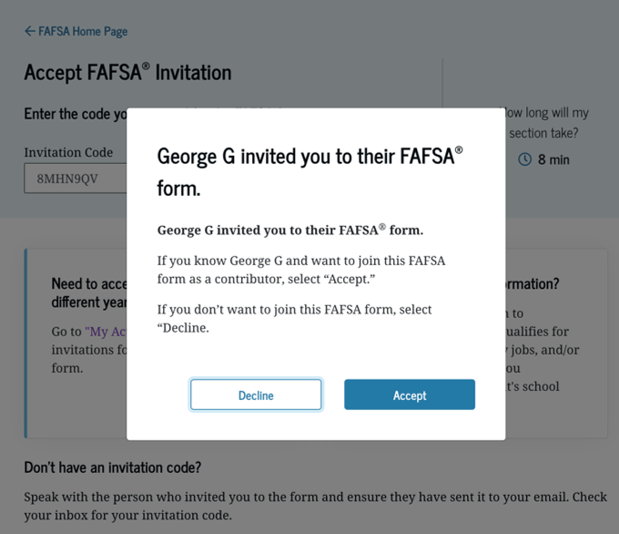
Parent/contributor status center
After logging in, the parent is taken to the "Accept 2027–28 FAFSA® Invitation" page. The invitation code from the parent’s email automatically fills in the text box if the parent used the link from the email.
Notes:
After the PARENT logs in, the parent will click on “Get Started” to complete the parent section.

Slide 17
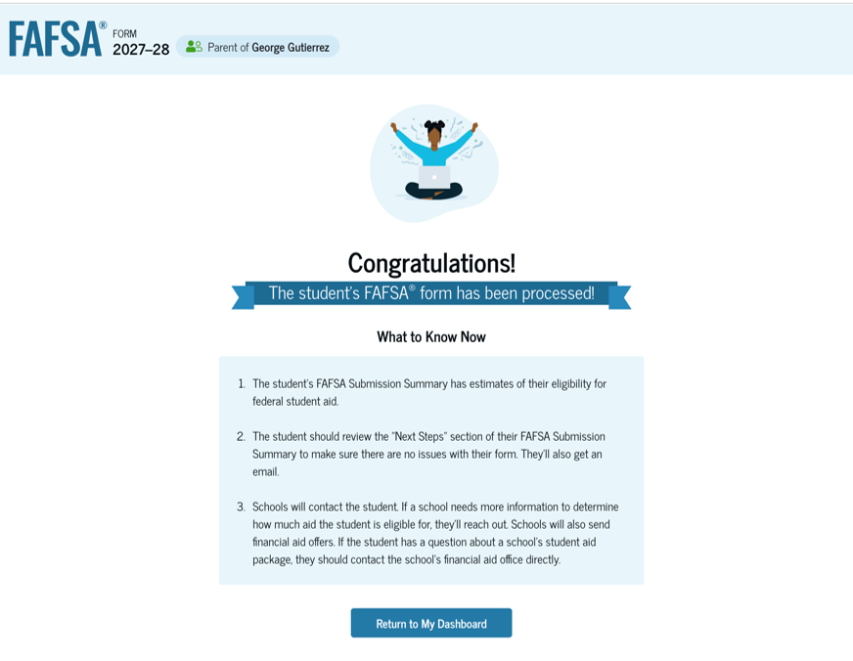
FAFSA Submission Confirmation
Upon submitting the student’s FAFSA® form, the parent is presented an abbreviated confirmation page. This page displays information about tracking the student’s FAFSA form and next steps. The student will receive an email with the full, detailed confirmation. With the student and parent sections completed and signed, the FAFSA form is now considered complete and submitted for processing.
Notes:
After the PARENT section is completed, the FAFSA is submitted, and the STUDENT will receive an email confirming the FAFSA has been submitted. The FAFSA is usually processed within 1-3 days, and the STUDENT will receive an email when the FAFSA has been processed. At that time, each school listed on the FAFSA will have access to the FAFSA results.

Slide 18
Frequent FAFSA Errors
Not creating a StudentAid.gov account before starting your FAFSA form
Not completing the FAFSA form by your state or school deadline
Not providing consent and approval to have federal tax information transferred into the FAFSA form
Not inviting a required contributor and making sure they complete their sections of the FAFSA form
Forgetting to sign or submit the FAFSA form
Parent and student Social Security Numbers
Divorced/remarried parental information
Household size
Real estate and investment net worth
Notes:
Here is a list of common FAFSA errors. The income tax related questions will be eliminated from this list if the income taxes have been submitted prior to completing the FAFSA, and the tax filers provides consent to transfer income tax data into the FAFSA from the IRS.

Slide 19
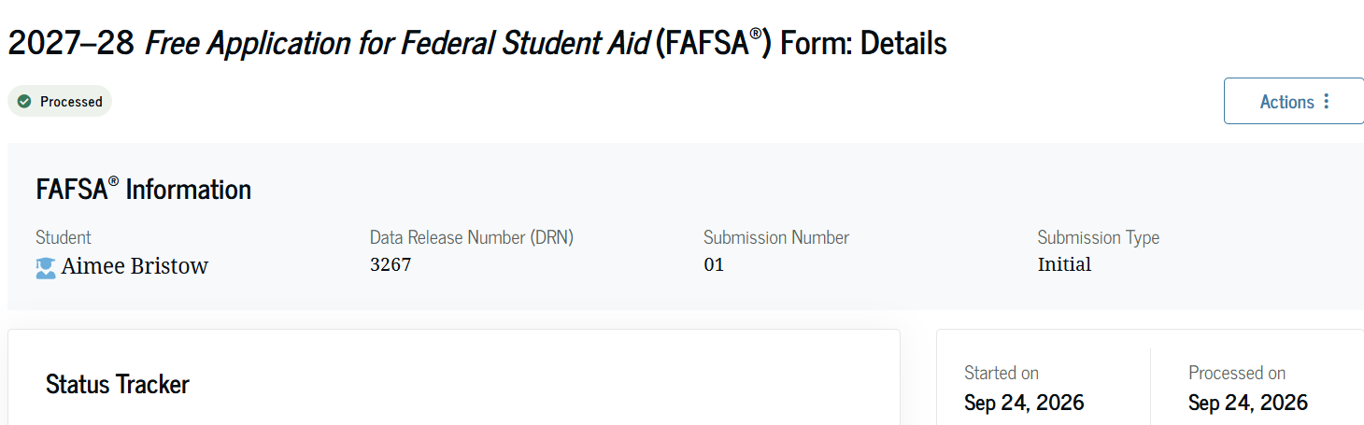
The fafsa submission summary(Fss)
The results of the FAFSA
Student will receive an email from the Department of Education when the FSS is available on-line - review and submit corrections, if necessary
SAI – Student Aid Index is used by the Financial Aid Office to determine financial need
Verification Process
Notes:
The results of the FAFSA is called the FAFSA Submission Summary, and the STUDENT can log back into the FAFSA to view the FSS after they receive the email confirming the FAFSA has been processed. After reviewing the FSS, the STUDENT needs to submit a FAFSA correction if errors are identified. The FSS will identify the Student Aid Index (SAI) which is used to determine the student’s eligibility for financial aid. The FSS will also indicate if the FAFSA has been selected for verification which is an audit of the FAFSA application data.

Slide 20

Student aid index
Calculation Components
Parents’ 2025 income and assets
Student’s 2025 income and assets
Number in household
Age of the older parent
Notes:
The SAI is calculated by taking the income, asset and household size reported on the FAFSA into consideration. The SAI doesn’t reflect the amount a student will owe, but it is used by the Financial Aid Office to determine eligibility for financial aid.

Slide 21

A Professional Judgment
Special circumstances which may initiate professional judgment:
Unemployment
Underemployment
Divorce
Unusually high medical bills
National disasters
Other significant changes in family’s finances
Notes:
The FAFSA includes 2022 income for students and parents. Occassionaly, the FAFSA doesn’t accurately reflect the current financial situation in the household. If your family experiences any of these special circumstances, you need to contact the Financial Aid Office to discuss the special circumstance. The Financial Aid Administrator will request additional documentation to support your special circumstance, and the Financial Aid Administrator has the authority to make a correction to the FAFSA, so that the FAFSA more accurately reflect the current household financial situation. The purpose of re-evaluating the FAFSA is to determine if the student is eligible for additional financial aid. The Financial Aid Office cannot assist if they aren’t aware of your situation, so it is important that you share the special circumstances with the Financial Aid Office before the student makes a decision that they can’t afford to attend the College of their choice or can’t afford to attend college at all.

Slide 22

Verification
At sample of applications will be selected for verification by the Department of Education
Financial aid eligibility can not be finalized until the Financial Aid Office has completed verification
The following documents are usually requested by the Financial Aid Office:
  2027-2028 Verification Worksheet
  A transcript from the IRS confirming 2025 Federal income tax information for student and parents if tax data isn’t transferred from the IRS
  Copy of student and parents’ 2025 W-2 forms (non-tax filers only)
Notes:
At least 1/3 of all FAFSA applications will be selected for verification which is an audit of the FAFSA application conducted by the Financial Aid Office. The student will be notified by the Financial Aid Office of the additional documentation they are required to submit to the Financial Aid Office before the student’s financial aid eligibility can be finalized.

Slide 23

Financial Need Equation
COA - SAI = FN (Financial Need)
Cost of Attendance
  Tuition & Fees
  Housing
  Food
  Books & Supplies
  Transportation
  Living Expenses
Note:
  COA varies
  SAI remains constant
Notes:
Every college will establish a cost of attendance which takes into consideration direct (billed by the College) and indirect costs (costs incurred by the student as a result of them being a college student). Once the Financial Aid Office receives the FAFSA Summary Sheet and know the Student Aid Index (SAI), they will be able to calculate the financial need which is a simple formula subtracting the SAI from the COA.

Slide 24
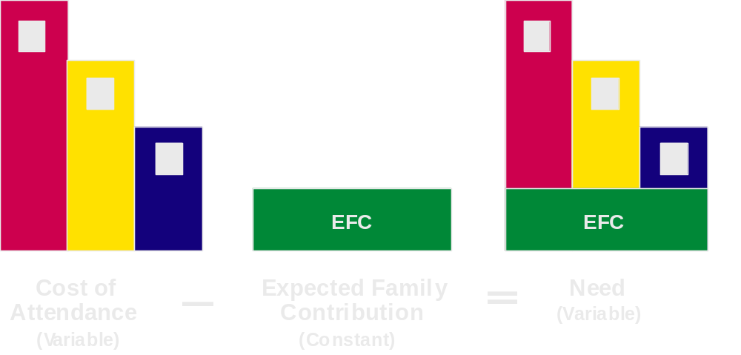
Need Varies Based on Cost
1
1
2
2
3
3
3
SAI
SAI
Cost of Attendance - Student Aid Index = Financial Need
Notes:
This slide demonstrates that that financial need is higher at schools that have a higher COA because the SAI is constant no matter what school they apply to. When students are researching schools, they will notice every school costs a different amount. Before you rule out the most expensive college, make sure the student goes through the entire financial aid process to determine how much financial aid they are eligible to receive and confirm the outstanding balance. A college with the highest “price tag” might not be the most expensive college since the student will demonstrate higher financial need, and they may qualify for additional financial aid. The amount a student is required to pay is going to be dependent on the financial aid they are eligible to receive from Federal, State and institutional sources. The outstanding balance will also be dependent on whether the student accepts student loans or not. By declining student loans, students will not qualify for additional grants or scholarships or everyone would decline the student loans. When students make a final college selection, they are looking for the best fit – academically, athletically, performance, financial, social, etc. If students always enrolled at the cheapest option, everyone would enroll at community colleges; however, that isn’t the right fit or everyone.

Slide 25

How is (FA) Financial Need met?
Gift Aid: scholarships, grants, tuition waivers – these do not have to be paid back
Self-Help Aid: funds from family, loans, work programs
Notes:
Once the Financial Aid Office has calculated the financial need, they will look for financial aid programs the student is eligible for. They will first start with gift aid which is grants and scholarships that don’t require repayment. Secondly, they will award self-help aid which is loans and work study programs. Self-help programs require repayment or require the student to work to earn the funds.

Slide 26
Sources of Financial Aid
State Government: Access MO Grant, Bright Flight Scholarship, A+
Federal Government: Pell Grant, Supplemental Educational Opportunity Grant, TEACH Grant, Work Study, Student Loan, PLUS Loan
Institutional: Scholarships, Grants, Loans, College Employment
Private: scholarships from civic groups, businesses, churches, scholarship searches, high school guidance counselors; student loans
Notes:
The student completes the FAFSA, and the Financial Aid Office will determine all of the Federal, State and Institutional financial aid programs they are eligible for. Some scholarships may require an application to be considered, so it is important to confirm the deadline and application processes. Students are encouraged to work with their high school guidance counselor to apply for private scholarships they are eligible to be considered for. Don’t ignore the scholarship applications which require an essay. Most students will skip the applications which require an essay, so there are less applicants to compete against. For detailed information about Federal and State funded financial aid programs, review The Source which is included in your packet. Students and parents who choose to apply for student and parent loans will be required to complete applications on-line.

Slide 27
Thank you
WESTMINSTER COLLEGE
OFFICE OF FINANCIAL AID
573-592-5364
Questions?

