Slide 1

Our official colors include the last 4 on this row in the color palette. I recommend not using the super dark blue - second from right - and opt for black instead to match the theme of this slide deck.
September 30, 2026
GISD Future Ready Complex

Slide 2





GISD Strategic Direction
[Adopted August 2026]

Slide 3
The purpose of the GISD Ambassador Program is to inform, engage and collaborate with a group of Georgetown ISD community members to provide valuable district-wide information and foster a well-informed school community.
What is the GISD Ambassador Program?

Slide 4
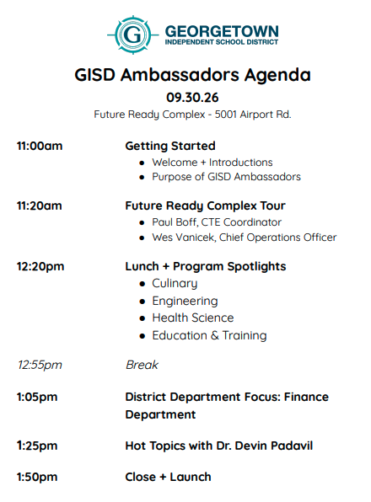
Future Ready Complex
September 30, 2026

Slide 5
Housekeeping
WiFi
Closest Restrooms
Need a quiet space?

Slide 6
Tell us a little about you!
What’s your name?
What are your connections/affiliations to Georgetown ISD, if any?
You know it is Fall when …
  Also, thumbs/down on Pumpkin Spice?

Slide 7
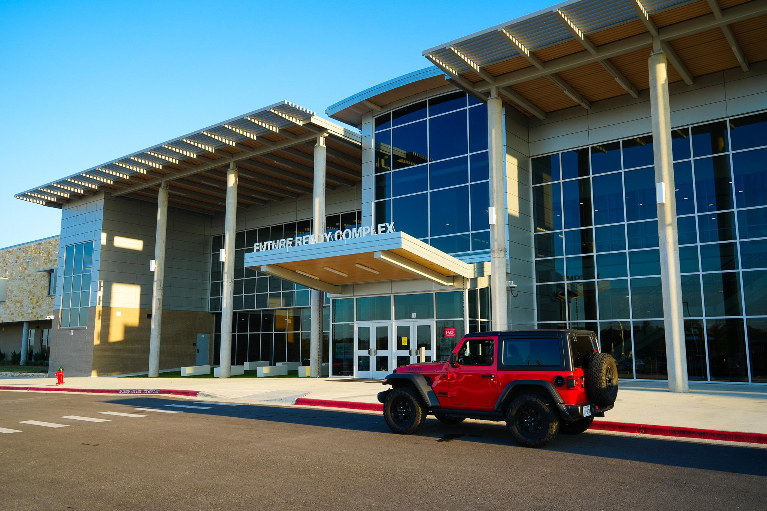
Serving grades 9 - 12+
1075
Advanced
CTE
96
Richarte HS
42
Bridges 18+
See your packet for the latest district-wide enrollment report
ESTABLISHED YEAR

Slide 8

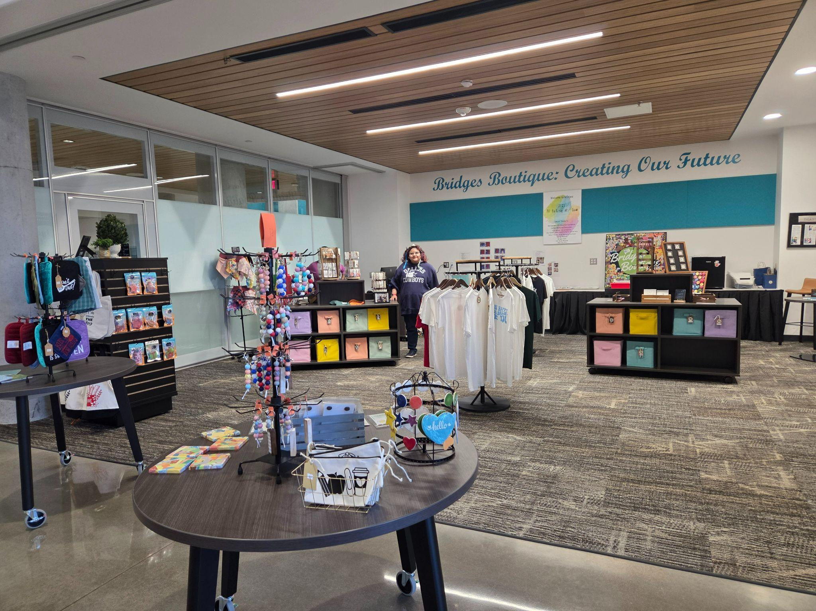
Visit the Bridges Boutique!
Daily Hours: 9:20am-10:30am
Everything is student made and all profits support Bridges students.

Slide 9
The GISD Future Ready Complex
Reflection of our beliefs
Opened in August 2024
Home to:
  Advanced CTE Programming
  Richarte High School
  BRIDGES 18+ Program
  GISD Health & Wellness Center (in partnership with Lone Star Circle of Care)
  GISD Early Learning Center
Notes:
Consider talking about the economics of this facility: shared facility reduces the need to duplicate programs, including machinery, software, equipment, while scaling programs to serve more students.

Slide 10
Let’s Tour the FRC!
We need to return to this space
by 12:20pm.

Slide 11

Lunch
Prepared by the GISD Culinary Arts Program,
Led by Chef Emily Jimenez
Garlic herb butter chicken
Mashed golden potatoes
Garden salad with an Italian dressing
Dinner rolls
Blondie platter

Slide 12
CTE
Program Spotlight
Culinary
Teacher: Emily Jimenez
Engineering
Teacher: Terri Henry
Health Science
Teacher: Meredith Brown
Education & Training
Teacher: Kelly Gunn

Slide 13
Break

Slide 14
GISD Department Focus:
Finance
Notes:
Devin

Slide 15
GEORGETOWN ISD AMBASSADORS
What Finance is responsible for
event_note
payments
account_balance
assessment
Plan
Build and monitor the annual budgets
Operate
Pay employees and vendors; support campuses
Account
Record transactions and safeguard district funds
Report
Provide Board financial reports and coordinate the annual audit
Notes:
Finance supports the daily work of the district while accounting for public resources. Emphasize campus connection rather than reading the list. Ask for a quick example of a school expense the audience thinks crosses this team. About 2 minutes.

Slide 16
GEORGETOWN ISD AMBASSADORS
Three annual budgets, three purposes
account_balance_wallet
restaurant
account_balance
General Fund
Day-to-day district operations, including employee pay
Food Service
School meal program revenues and expenses
Debt Service
Payments on bonds issued for capital projects
Notes:
These are the three annual budgets highlighted in last year’s Finance Department presentation. The distinction is important when residents ask why construction funding cannot simply be used for salaries. The categories serve different purposes. About 2.5 minutes.
Source supplied by presenter: prior-year Finance Department slides.

Slide 17
GEORGETOWN ISD AMBASSADORS
People are the core operating cost
published_with_changes
pie_chart
Every pay cycle
Payroll turns staffing decisions into accurate, timely pay for district employees.
Every budget cycle
Finance works with campuses and departments to match available resources to student needs.
Notes:
Last year’s slide estimated that 86% of its $196 million General Fund budget was payroll. Those prior-year figures are deliberately omitted from the current-year slide pending a current adopted-budget source. You can mention them only if you verify the year and the definition of payroll. Talk about teacher and staff compensation, benefits, and the recurring nature of operating expenses. About 2 minutes.

Slide 18
GEORGETOWN ISD AMBASSADORS
How Finance supports a campus
assignment
01
shopping_cart
02
payments
03
Planning
Work with campuses and departments to build budgets and monitor spending throughout the year.
BUDGETS & MONITORING
Purchasing
Help staff get what they need while following purchasing rules and protecting public funds.
COMPLIANCE & FUNDS
Payroll
Make sure district employees are paid accurately and on time.
ACCURATE COMPENSATION
Notes:
The prior-year department list included accounting, accounts payable, bonds, budgets, finance, mail, payroll, purchasing, textbooks and fixed assets, and treasury. Use an everyday example such as classroom supplies to explain the chain. About 2 minutes.
Source supplied by presenter: prior-year Finance Department slides.

Slide 19
GEORGETOWN ISD AMBASSADORS
Stewardship continues after the purchase
account_balance
receipt_long
analytics
verified_user
Cash & investments
Manage district funds and cash needs
Bonds & debt
Issue or refund bonds and schedule repayment
Board reporting
Prepare monthly financial information
Independent review
Coordinate the annual financial audit
Notes:
The prior-year slides mentioned investing over $500 million of district funds and managing $1.8 billion in debt payments. These figures need a current date, definition and reconciliation before public reuse. Explain the roles without quoting those prior-year totals. About 2 minutes.
Source supplied by presenter: prior-year Finance Department slides.

Slide 20
GEORGETOWN ISD AMBASSADORS
The 2026–27 budget context
account_balance
payments
Balanced budget
The Board adopted a balanced budget in June.
ADOPTED STATUS
Approved in June 2026
Compensation & benefits
The District was unable to fund a general pay raise for 2026–27. Rising employee health costs were a significant factor.
~$2.0 Million
Dedicated to absorbing rising employee health costs
Notes:
The board adoption announcement describes the budget as balanced, compensation adjustments of approximately $668,000, and nearly $2 million for rising employee health insurance costs. Clarify that these are elements of the adopted plan, not totals for the full General Fund. About 2.5 minutes.
Sources:
https://www.georgetownisdnews.org/news/georgetown-isd-trustees-adopt-balanced-budget-for-2026-27

Slide 21
GEORGETOWN ISD AMBASSADORS
Two parts of the school tax rate
settings
M&O
account_balance
I&S
MAINTENANCE & OPERATIONS
Maintenance and operations: recurring school expenses.
Examples: Salaries, Utilities, Bus Fuel
INTEREST & SINKING
Interest and sinking: repayment of voter-authorized debt. (Bonds)
Bonds are used to fund capital projects.
Examples: Buildings, Land, Technology, Buses
Notes:
Make the distinction in plain language. The district’s election page describes Prop A as an M&O measure and bonds as funded through I&S. Avoid tax-rate projections here because Dr. Padavil will cover the election specifics next. About 2 minutes.
Sources:
https://www.georgetownisdnews.org/2026-gisd-vatre

Slide 22

GEORGETOWN ISD AMBASSADORS
How school operating funding works
Local taxes and state funding work together under the school finance formula.
home_work
calculate
published_with_changes
Local property taxes
GISD collects property taxes for maintenance and operations (M&O).
State funding
The state calculates the district’s funding entitlement and provides aid when local revenue falls short.
Georgetown ISD receives $0 state funding.
Recapture
When eligible local revenue exceeds that entitlement, the district pays the excess into the state system.
Notes:
Explain this as a funding calculation for M&O, the operating side of the tax rate. Local collections and state aid are calculated together. When eligible local revenue exceeds a district’s state-determined entitlement, the district is subject to excess local revenue recapture. For the transition to Dr. Padavil, Georgetown ISD estimates that Prop A would generate roughly $17.5 million in additional M&O tax revenue and that the district would retain approximately $8.4 million per year after state recapture. The Prop A figures are estimates, not the current-year operating budget.
Sources: https://tea.texas.gov/about-tea/state-funding/excess-local-revenue ; https://tea.texas.gov/about-tea/state-funding/foundation-school-program/summary-finances ; https://www.georgetownisdnews.org/2026-gisd-vatre

Slide 23
Hot Topics/Q+A with Dr. Padavil

Slide 24

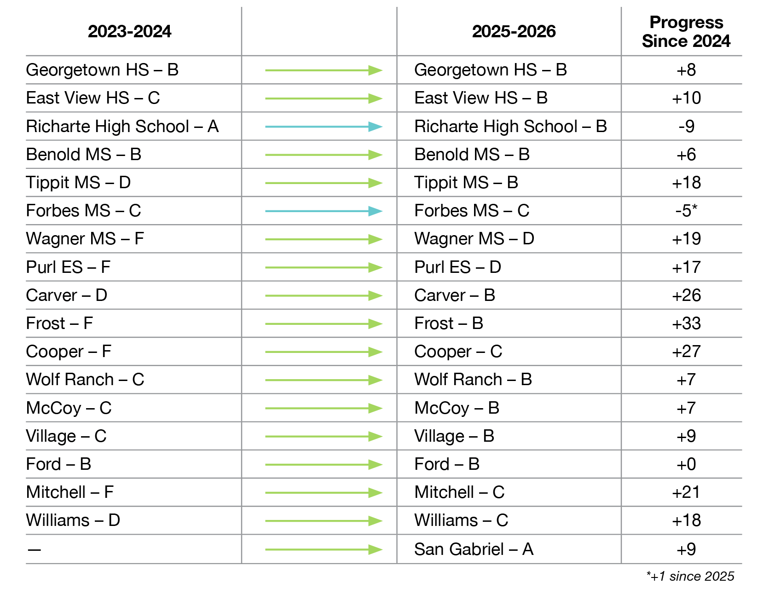
2 YEARS OF ACADEMIC PROGRESS WITHIN A BALANCED BUDGET
B
2026
District Accountability Rating
Top 25% designations from the Texas Education Agency :
Academic Growth
English Language Arts
Post-Secondary Readiness

Slide 25




ACADEMIC ACHIEVEMENT DISTINCTIONS EARNED FROM TEA in 2026
Top 25%
Academic Growth:
Georgetown HS
Benold MS
Tippit MS
Carver ES
Frost ES
San Gabriel ES
Top 25%
Closing Gaps:
Tippit MS
Carver MS
Frost ES
Post secondary
Readiness:
Tippit MS
Ford ES
Reading/
Language Arts:
Benold MS
Frost ES

Slide 26
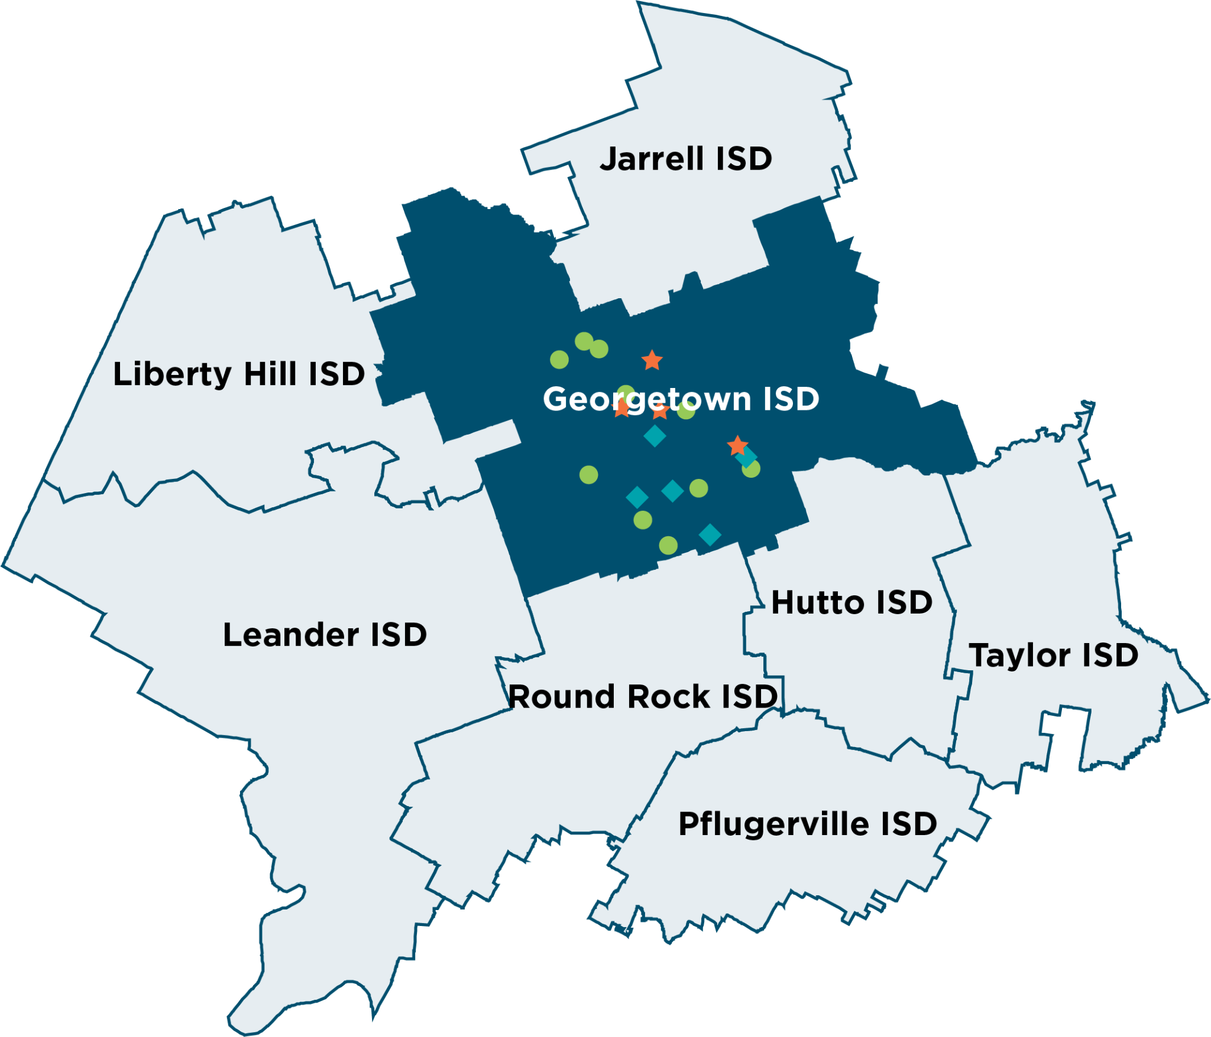
SALARIES FOR 15-YEAR TEACHERS
$66,450
$69,939
$67,100
$67,700
$67,567
$71,236
$67,250
$67,400
*2026-2027 pay scale
Notes:
On every level 5-20 years, under market median — Note Jarrell ISD includes $8k “HB2 allotment” AND Benefits of nearly $6k in their salary totals

Slide 27

ACTUAL COST FOR THE MEDIAN HOME VALUE
2025
2026
$461,094
$321,094
1.0506
$3,373
Decreased Median Appraised Value
Taxable Value
Tax Rate
Tax Bill
$444,465
$304,465
1.1106
$3,381
Calculations include median appraised values and taxable values after applicable Homestead Exemption as provided by the Williamson Central Appraisal District.
Cost increase for typical homeowner with reduced appraised value
$7.97/year

Slide 28
2025
2026
COST FOR THE TYPICAL HOMEOWNER
$444,000
$304,000
1.0506
$3,193.82
Typical Appraised Value
Taxable Value
Tax Rate
Tax Bill
$444,000
$304,000
1.1106
$3,376.22
Cost increase for typical homeowner with steady appraised value
$15.20/month

Slide 29
What’s one thing that you’ll remember from today’s experience or learning?

Slide 30

Next Session
We’ll post agendas + slides online
www.georgetownisd.org/community/gisd-ambassadors
Our next meeting:
November 5 11am-2pm
San Gabriel Elementary School
880 Tierra Rosa Blvd, Liberty Hill, TX 78642
Nov. 5 11am-2pm

