Slide 1
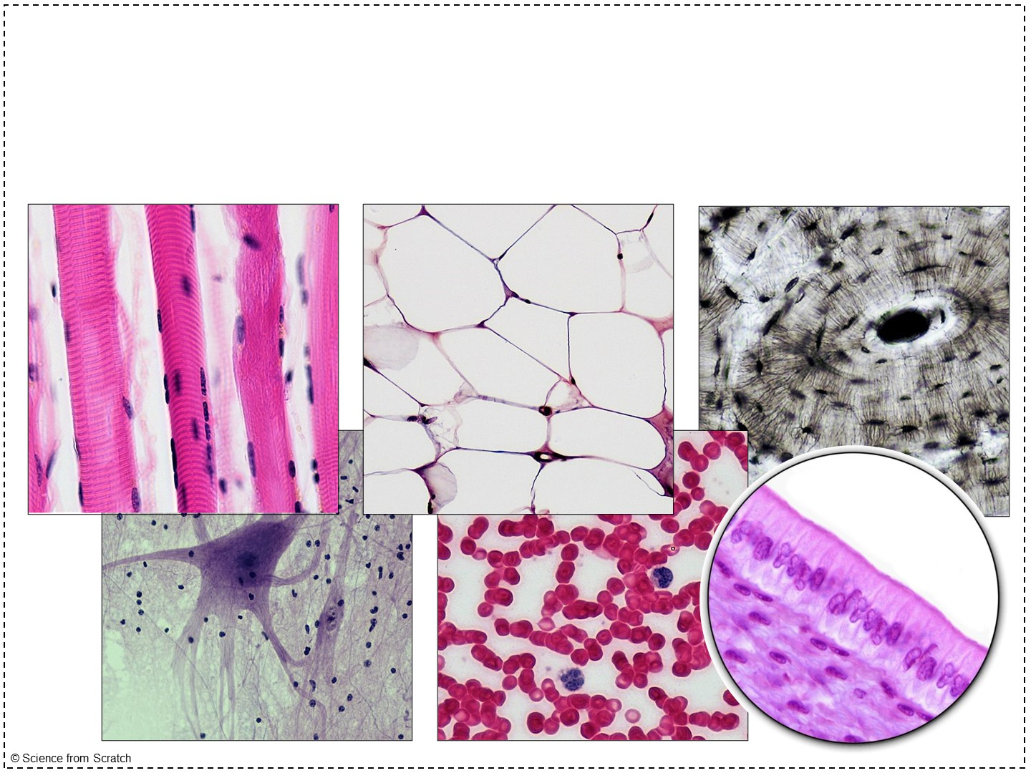
Tissues

Slide 2
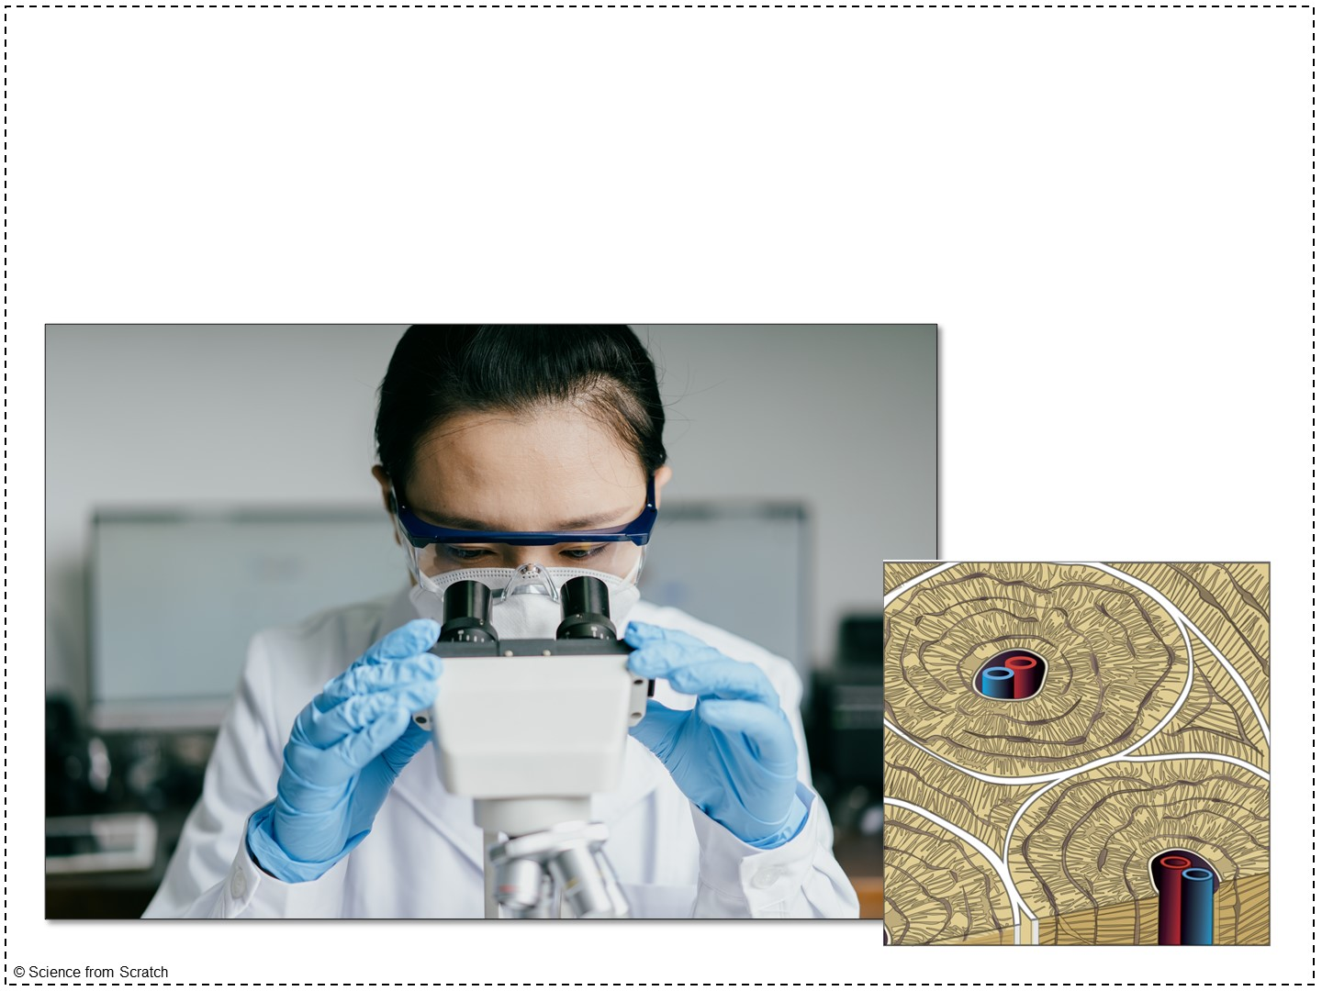
Tissues
Histology: the study of the tissues
Notes:
I often share some details on what a histology technician does with my students so that they can better understand what histology actually is.
Here’s a link to a job description: https://college.mayo.edu/academics/explore-health-care-careers/careers-a-z/histology-technician/#:~:text=Histology%20technicians%20(HTs)%2C%20also,of%20microscopic%20structures%20of%20tissues.

Slide 3

Challenge: put these terms in order from smallest to largest
Organ
Organism
Cell
Organ system
Tissue
Notes:
You can give your students an individual dry erase board or allow them to raise hands or call out answers.
I always start with asking, “ Which is the smallest?” and then just keep asking “What comes next?”
The correct order is cell – tissue – organ – organ system – organism
The main one students goof up is tissue (which is why we are going to be spending a lot of time talking about tissues this unit)
Tissues are a group of cells of a similar type that work together to perform a similar function

Slide 4
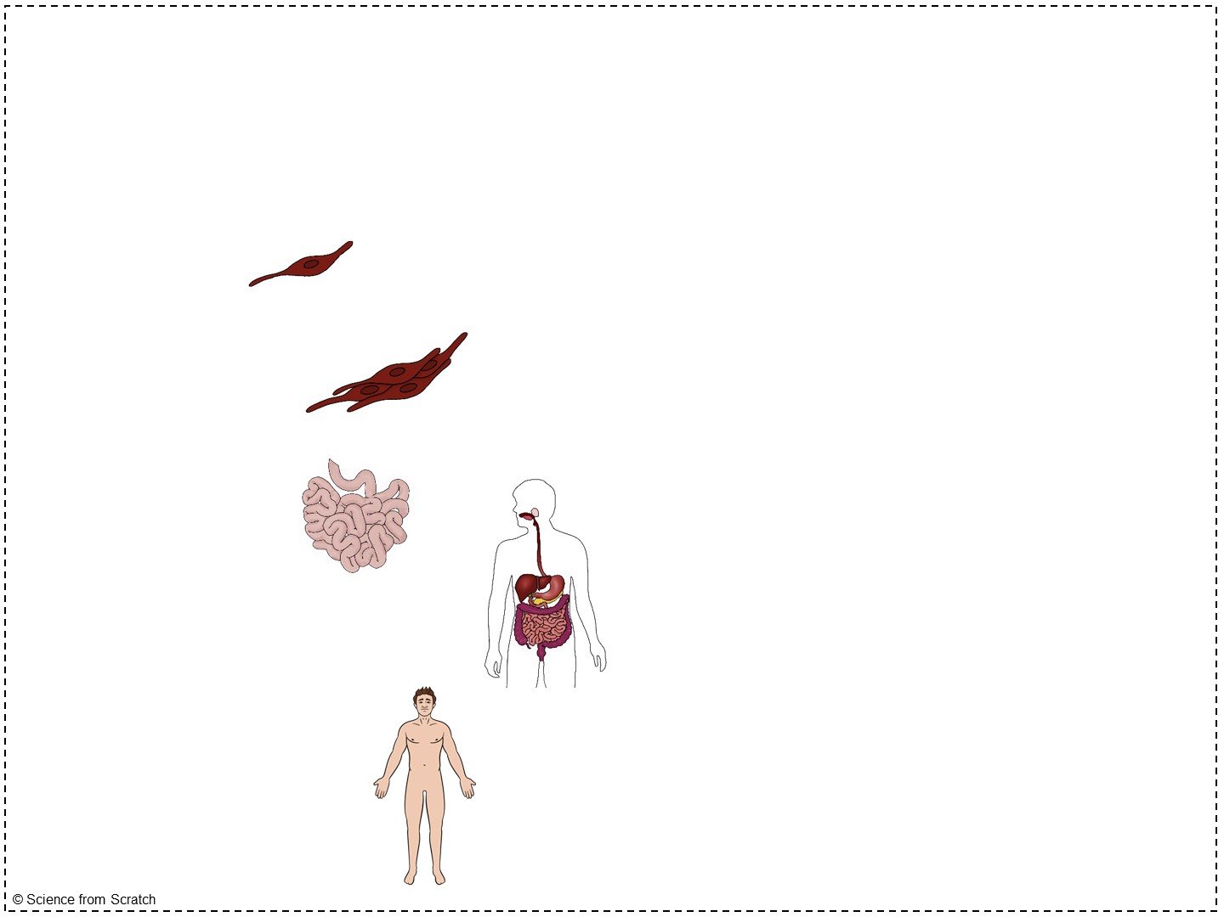
Challenge: put these terms in order from largest to smallest
Cell
Tissue
Organ
Organ System
Organism
Notes:
Make sure to instruct your students to LABEL this graphic in the doodle notes while on this slide

Slide 5
Which level of organization?
Digestive system
Human
Erythrocyte
Brain
Muscle
Skeletal system
Osteocyte
Cat
Stomach
Bone
Myocyte
Muscular system
Cardiovascular system
Skin
Sloth
Fat
Tendon
Biceps brachii
Notes:
To apply the levels of organization, use different colors of dry-erase markers to circle all the different levels of organization in different colors.
You can start with organism and work your way down to cells.
For example, ask students which bullets on this list represent organisms. As they call out cat, human, and sloth, circle those in blue.
Then ask them which bullets represent organ systems. As they call them out, circle the organ systems in green.
Continue with organs (red), tissues (orange or yellow), and cells (black)

Slide 6
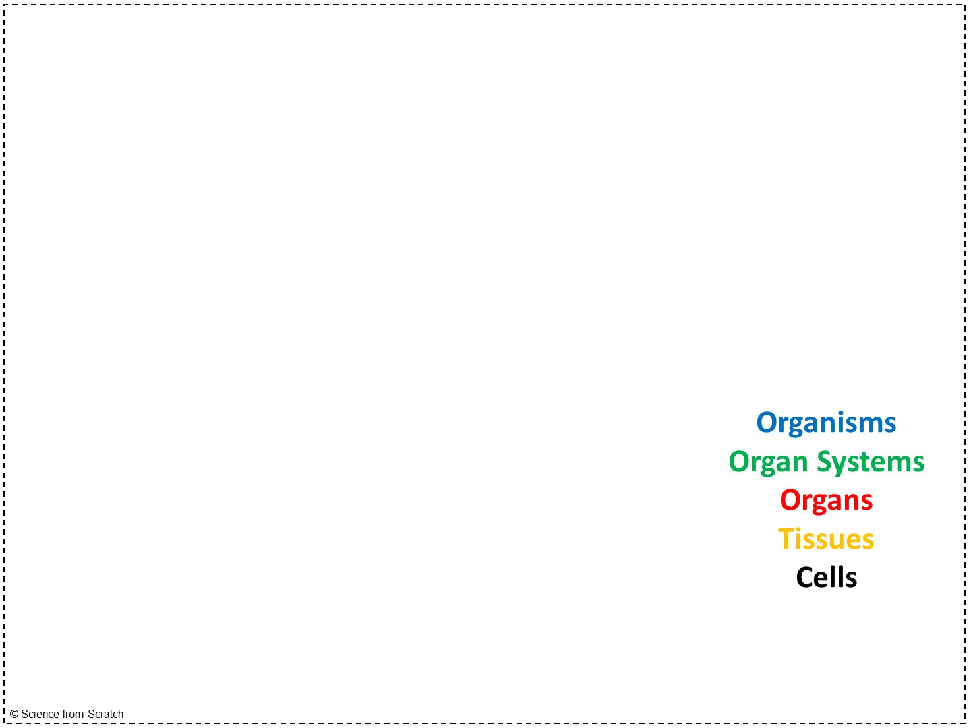
Which level of organization?
Digestive system
Human
Erythrocyte
Brain
Muscle
Skeletal system
Osteocyte
Cat
Stomach
Bone
Myocyte
Muscular system
Cardiovascular system
Skin
Sloth
Fat
Tendon
Biceps brachii

Slide 7
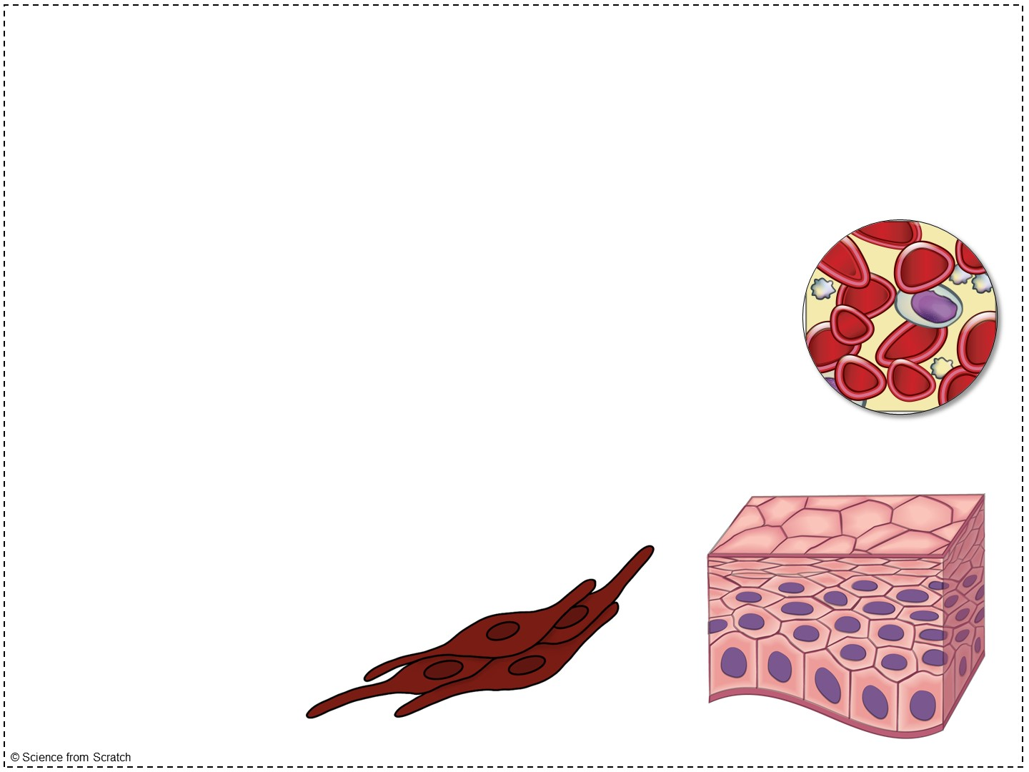
Examples of Tissues
Muscle
Bone
Tendon
Fat
Blood
Nervous tissue
Cartilage
Ligament
Epithelial tissue
Notes:
Students do not need to write this down, but I think it is helpful for them to see a general list of tissues moving forward.

Slide 8
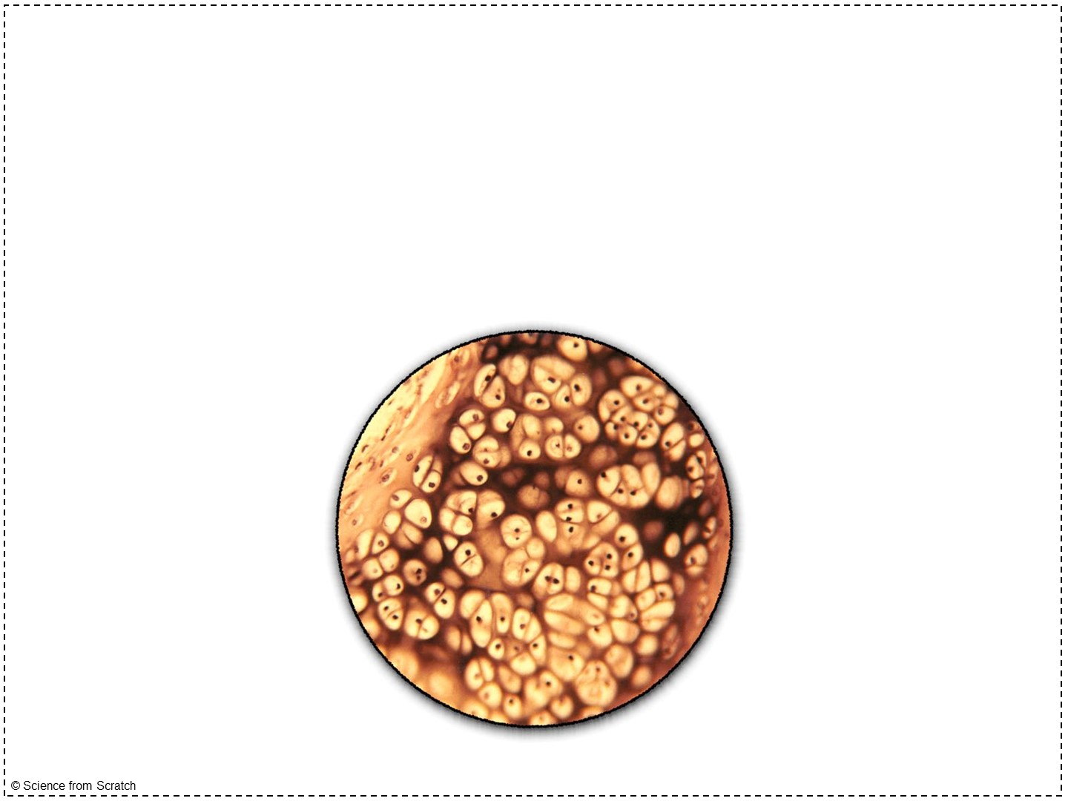
Tissues
Tissue: a group of cells with similar structure working together to perform a similar job
Look similar!
Act similar!

Slide 9
Tissues
The anatomy of a cell matches its physiology
In other words, how a cell is structured determines what it can do
Notes:
I use the analogy of scissors, a cell phone, and a paper clip here. I hold the three items up in class and simply ask, “Which one has the anatomy that makes it best suited for cutting?” I then ask, “Which one has the anatomy that makes it best suited for holding things together?” Lastly I ask, “Which one has the anatomy that makes it best suited for contacting someone outside of the school?”

Slide 10
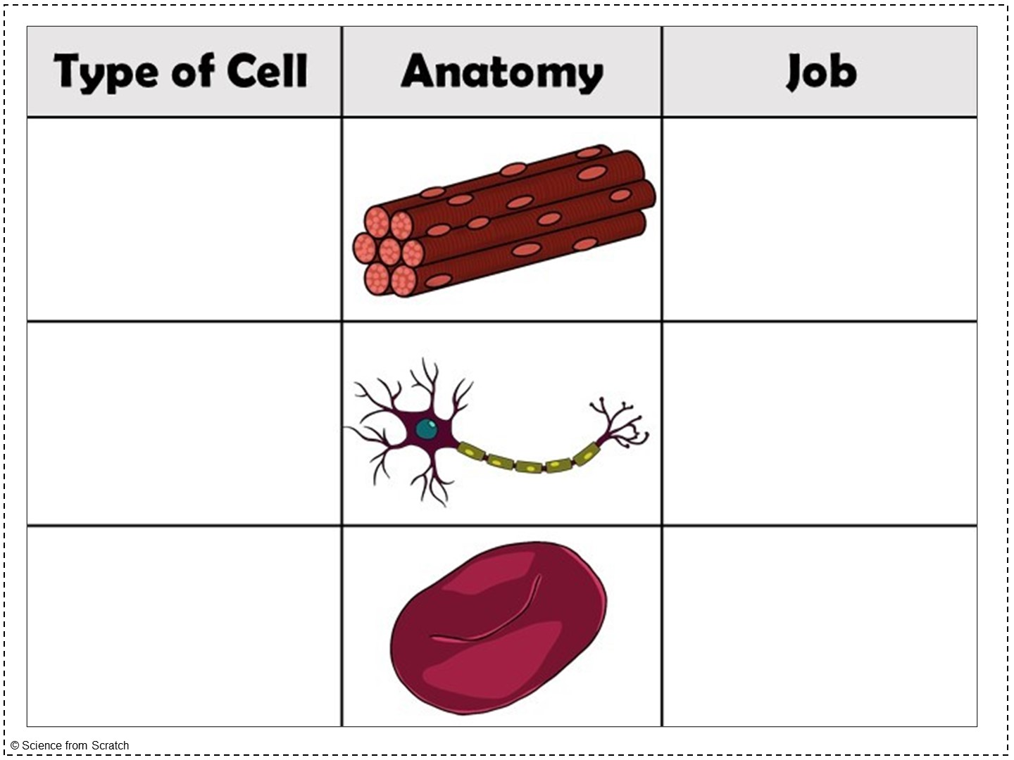

Slide 11
Muscle cell

Slide 12
Muscle cell
Contract & relax
Notes:
Being long and skinny suits this physiology (job). If it was a more rounded cell, it wouldn’t be very effective at contracting and relaxing. The anatomy matches the physiology!

Slide 13
Muscle cell
Contract & relax
Neuron

Slide 14
Muscle cell
Contract & relax
Receive & pass impulses
Neuron
Notes:
Branching suits this physiology (job). Having branches enables it to both receive and pass electrical impulses. The anatomy matches the physiology!

Slide 15
Muscle cell
Contract & relax
Receive & pass impulses
Neuron
Red blood cell

Slide 16
Muscle cell
Contract & relax
Receive & pass impulses
Neuron
Red blood cell
Carries oxygen through the bloodstream
Notes:
Red blood cells are filled with hemoglobin. This allows them to carry bind oxygen in the blood and carry it. The anatomy matches the physiology!

Slide 17
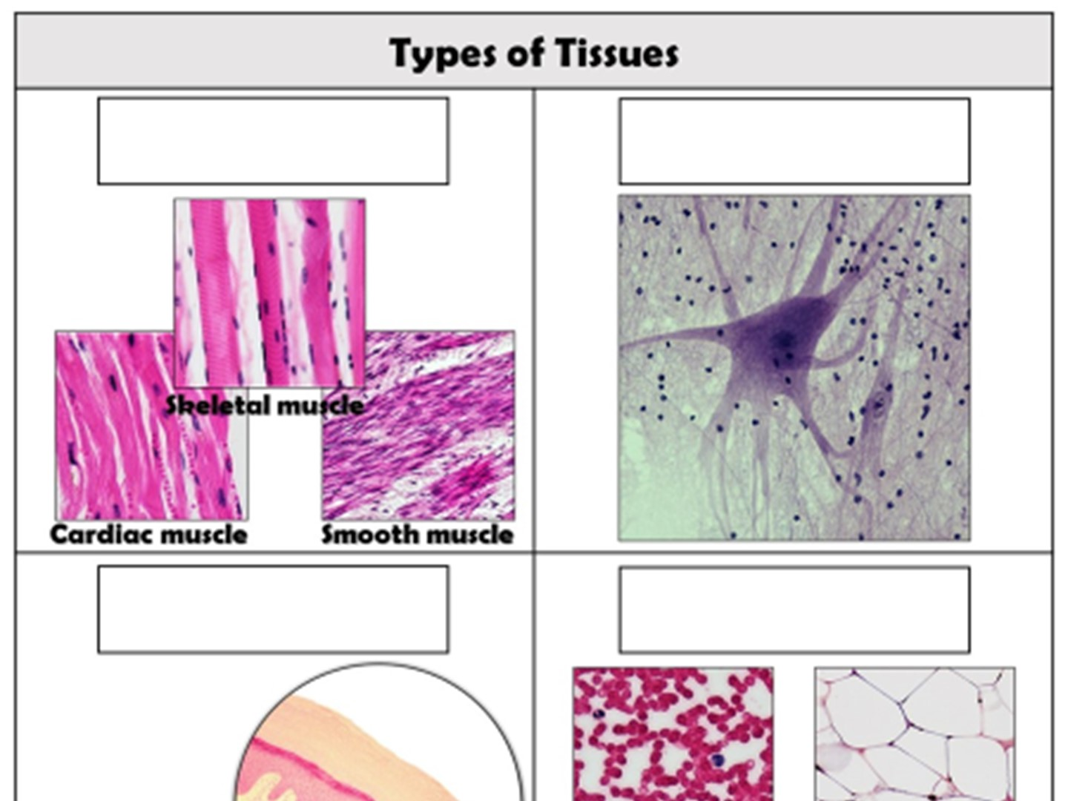
Muscle Tissue
Notes:
If we were to dissect a cadaver, we would run into four types of tissue.
There are 3 types of muscle tissue. They all contract and relax to cause movements in our body.

Slide 18
Muscle Tissue
Nervous Tissue
Notes:
Nervous tissue composes the brain, spinal cord, and nerves.

Slide 19
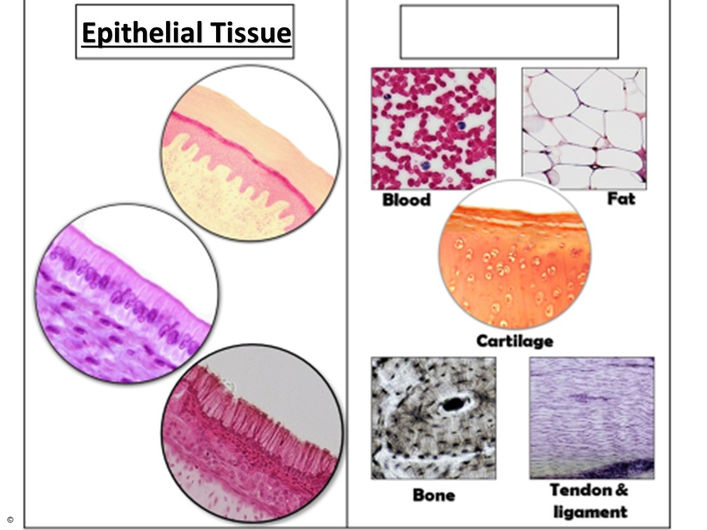
Notes:
Epithelial tissue lines and covers our organs. When you look at the top layer of your skin, you are looking at epithelial tissue.

Slide 20
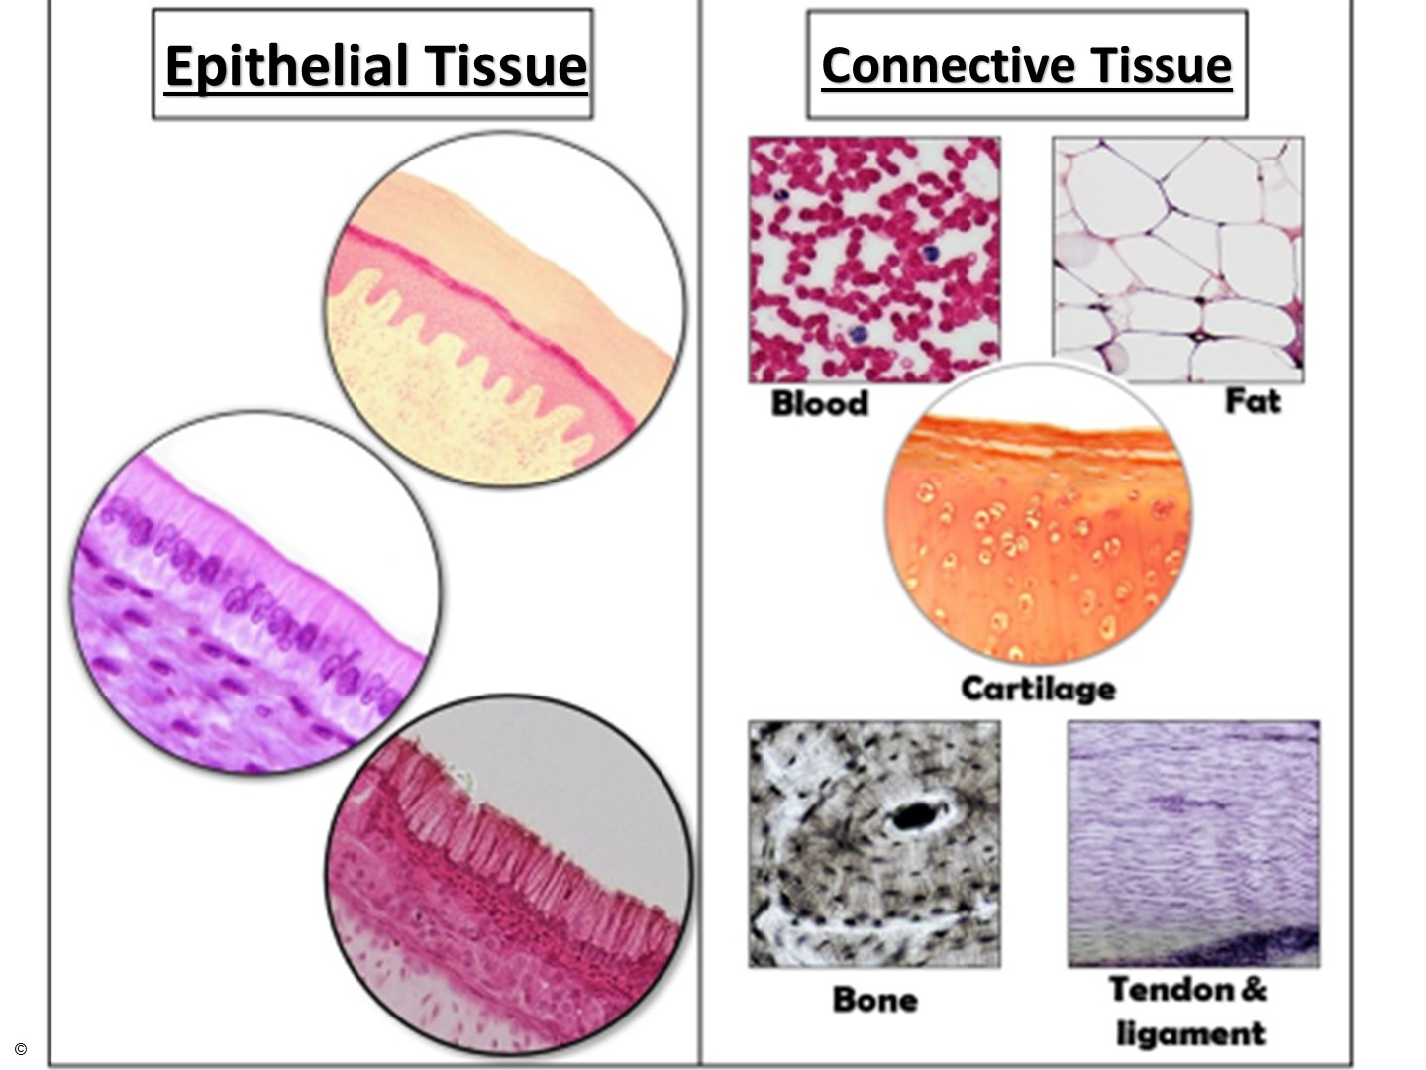
Notes:
Connective tissue ends up being the “junk drawer” where the remaining types of tissue fall. Don’t be mistaken though – these types of tissue do ALL have things in common that cause them to be grouped together, but that is a conversation for another day.

