Slide 1
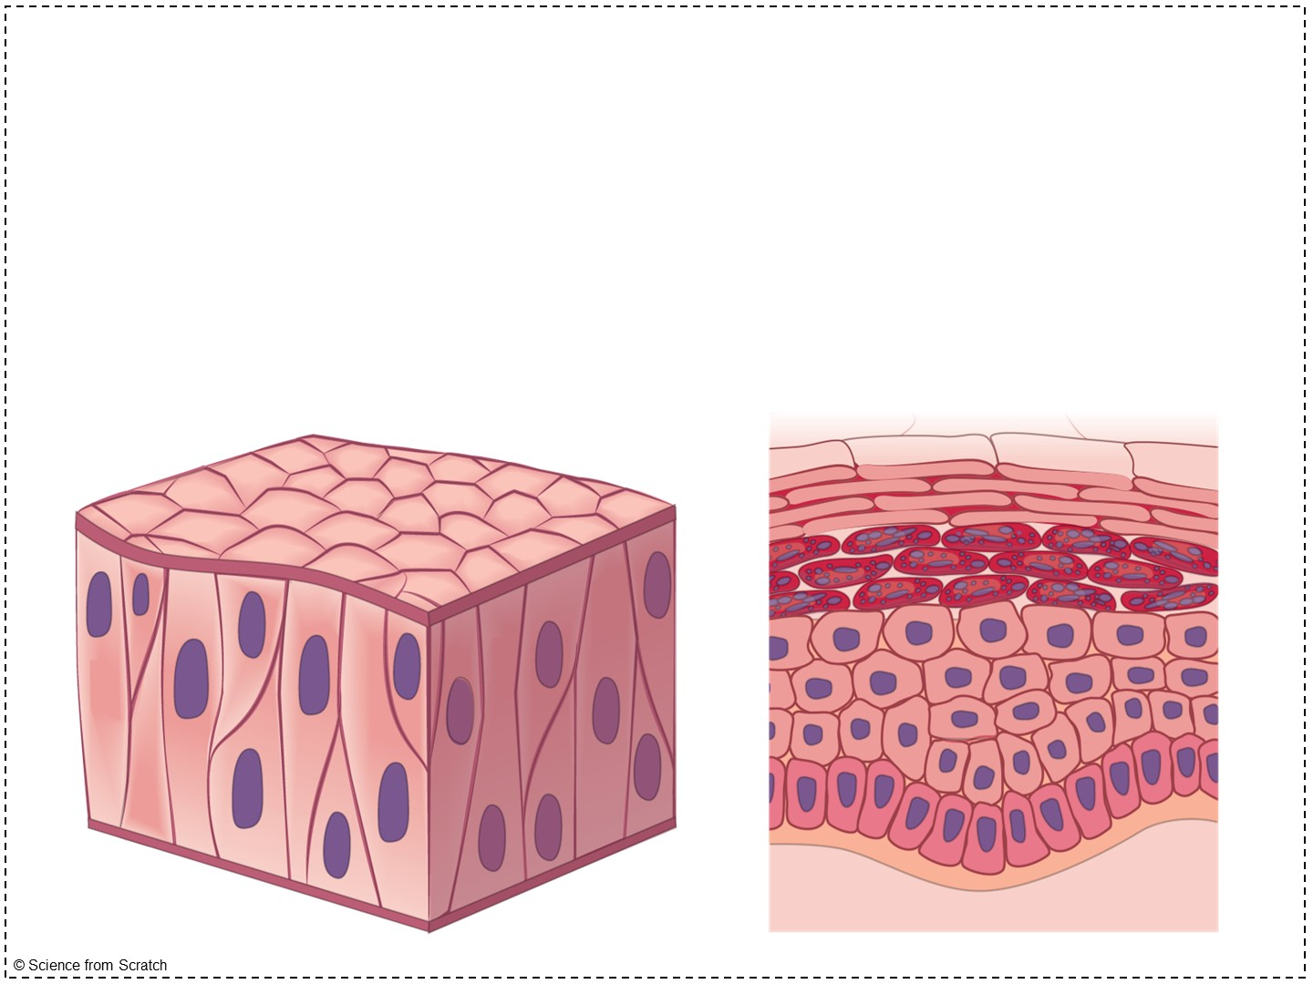
Epithelial Tissues

Slide 2

Review Questions
Put the following in order from largest to smallest: organ, cell, organism, organ system, tissue
The study of tissues is known as ________.
True or False: A tissue is a group of cells that look and act similar.
Notes:
Prior to epithelial tissues, my students have already learned some basics behind tissues, such as the definition of a tissue and what the four major types of tissues are. If you haven’t taught this information yet, feel free to delete slides #2 → #11 OR you can add my Histology Introduction Doodle Notes prior to completing these notes. You can find the link here: https://www.teacherspayteachers.com/Product/Histology-Tissues-Introduction-Doodle-Notes-Anatomy-8122512?st=4f57f6e00f685537e0e79b7f8105f83d
Answers:
Cell – Tissue – Organ – Organ System – Organism
Histology
True!

Slide 3
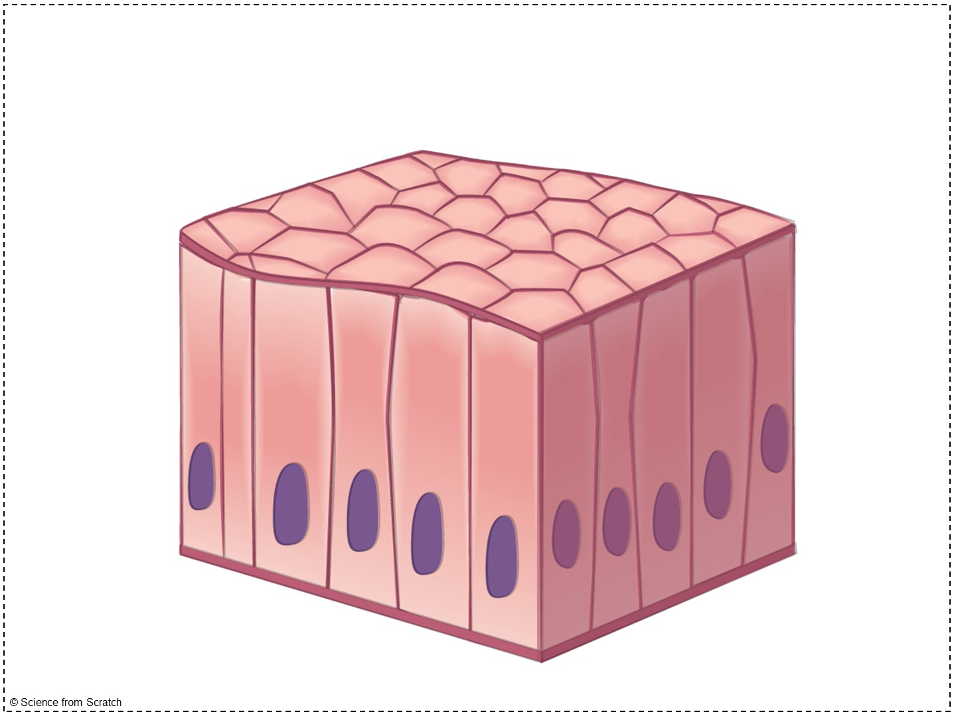
Review: is this a tissue?
Notes:
I continue review by focusing on the definition of a tissue: a group of cells that LOOK similar and perform a similar function.
YES – it is a group of cells that look and act similar
Specifically this is simple columnar epithelial tissue, a type of epithelial tissue that we will learn about today

Slide 4
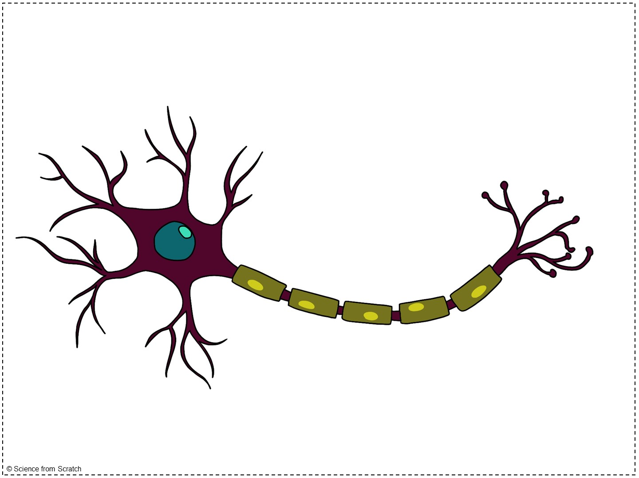
Review: is this a tissue?
Notes:
Tissue: a group of cells that LOOK similar and perform a similar function.
No – this is an individual cell – tissues are made of cells
Specifically this is a neuron, or nerve cell, the dominant type of cells in nervous tissue.

Slide 5
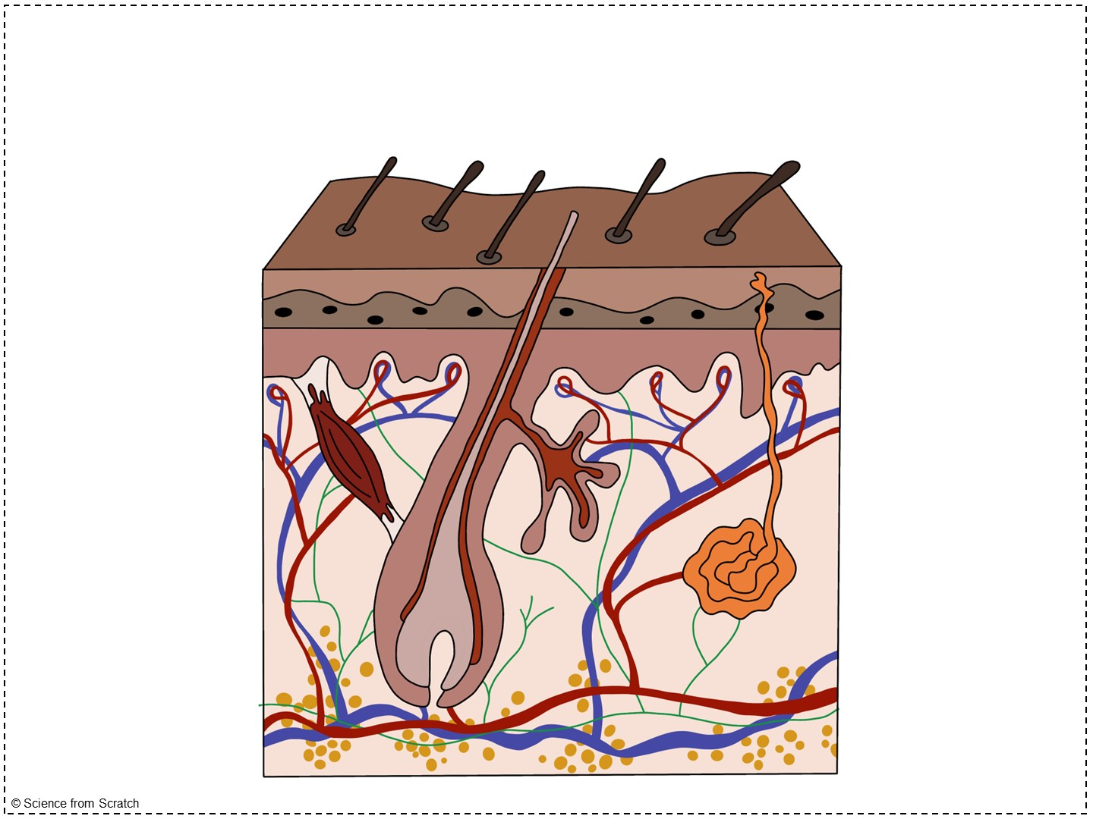
Review: is this a tissue?
Notes:
Tissue: a group of cells that LOOK similar and perform a similar function.
No – this is an organ (or a compilation of many tissues together)
If it were a tissue, the cells would look and act alike, but many of these cells look different (ex. Fat cells vs. cells at the surface of the skin) and many of these cells have different functions.

Slide 6
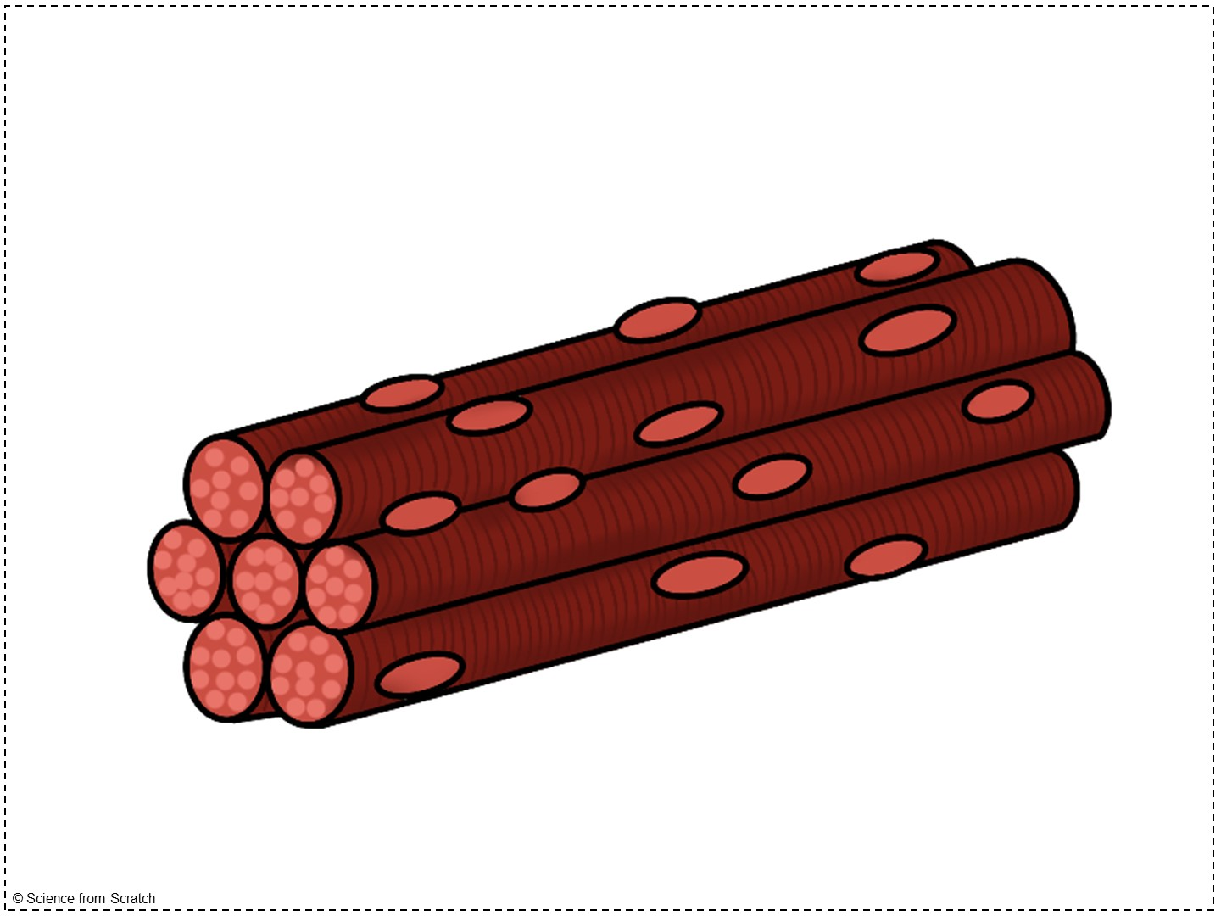
Review: is this a tissue?
Notes:
Tissue: a group of cells that LOOK similar and perform a similar function.
YES – it is a group of cells that look and act similar
Specifically this is skeletal muscle tissue

Slide 7
Review Questions
Put the following in order from largest to smallest: organ, cell, organism, organ system, tissue
The study of tissues is known as ________.
True or False: A tissue is a group of cells that look and act similar.
What are four types of tissues?
Notes:
On this slide, students only need to answer questions #4 (they already answered #1 - #3)
The four types of tissue are: muscle, nervous, epithelial, and connective

Slide 8
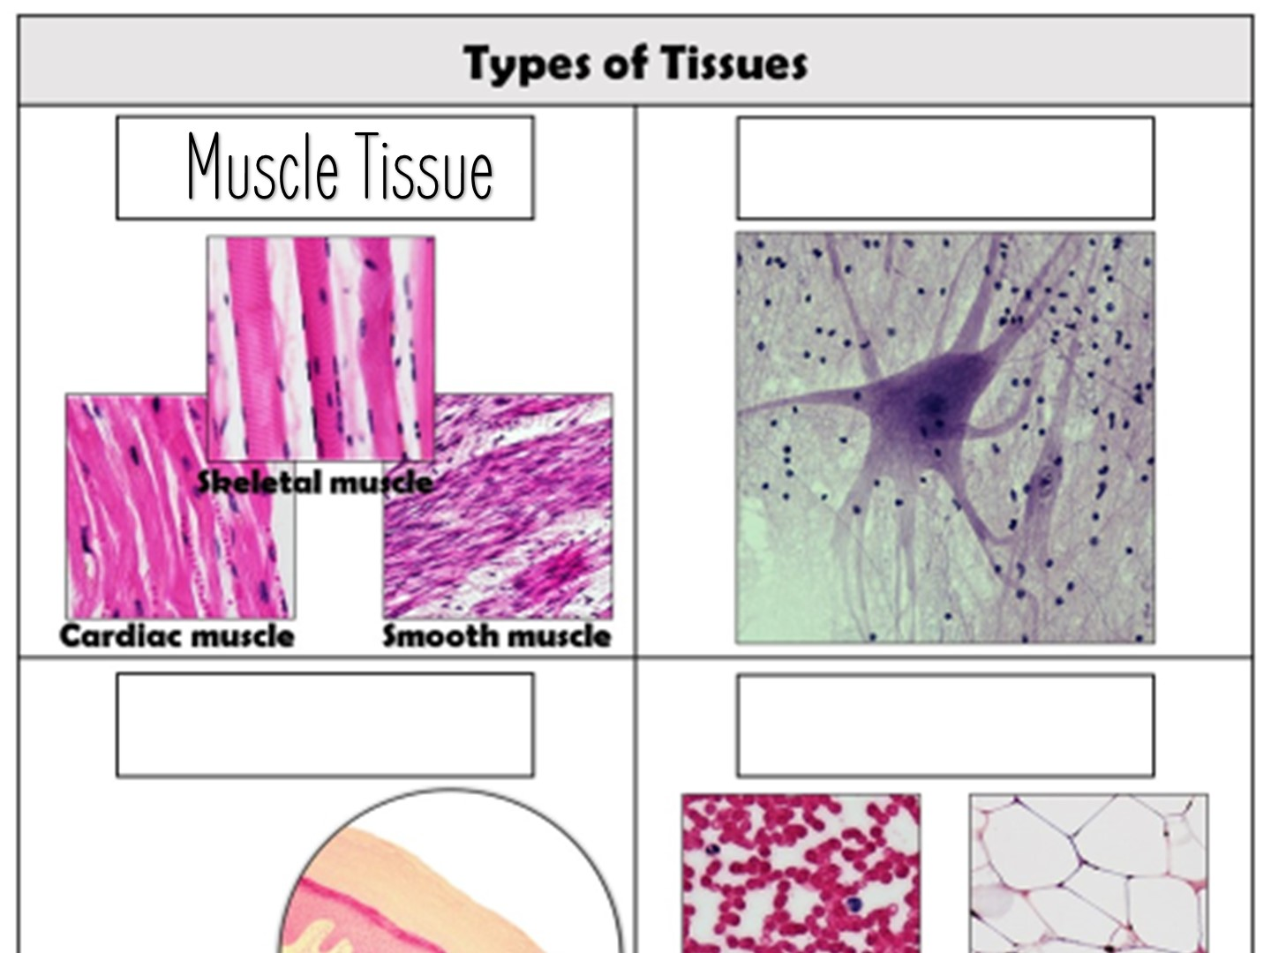
Notes:
Includes skeletal muscle attached to our bones, cardiac muscle of our heart, and smooth muscle that slowly contracts within our intestines, esophagus, stomach, blood vessels, and more!

Slide 9
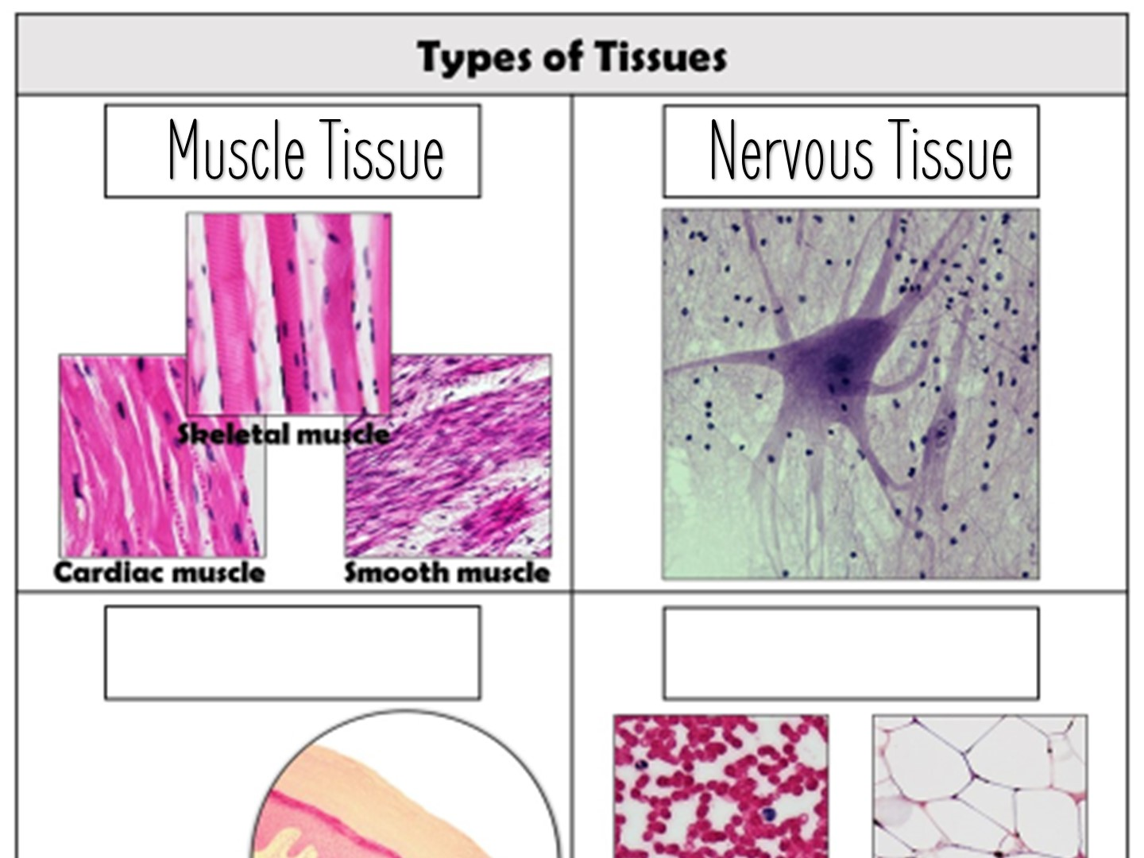
Notes:
Nervous tissue makes up our brain, spinal cord, and nerves

Slide 10
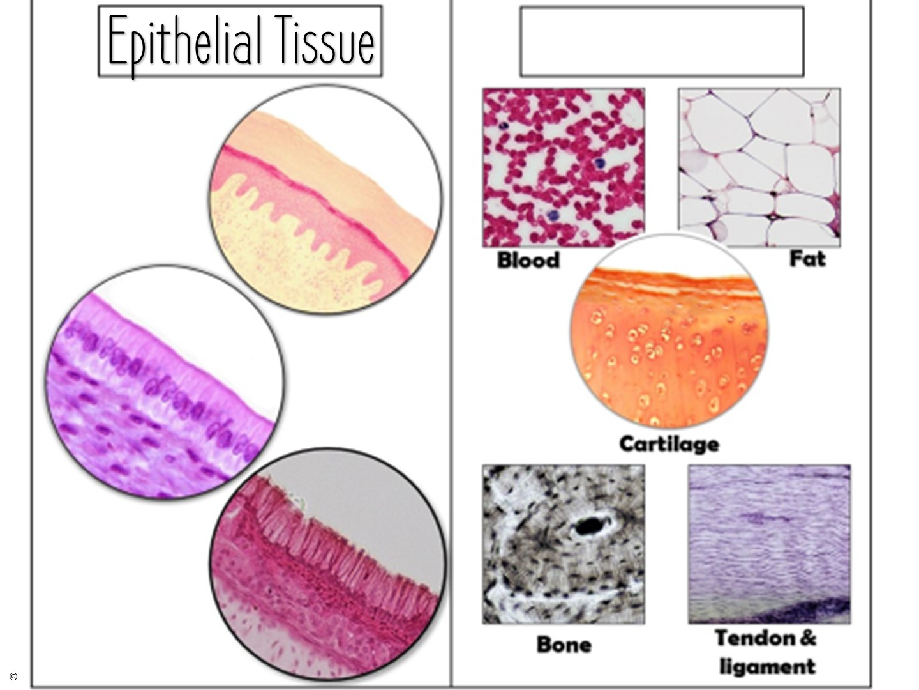
Notes:
Epithelial tissue is the covering and lining tissue which covers and lines our internal organs

Slide 11
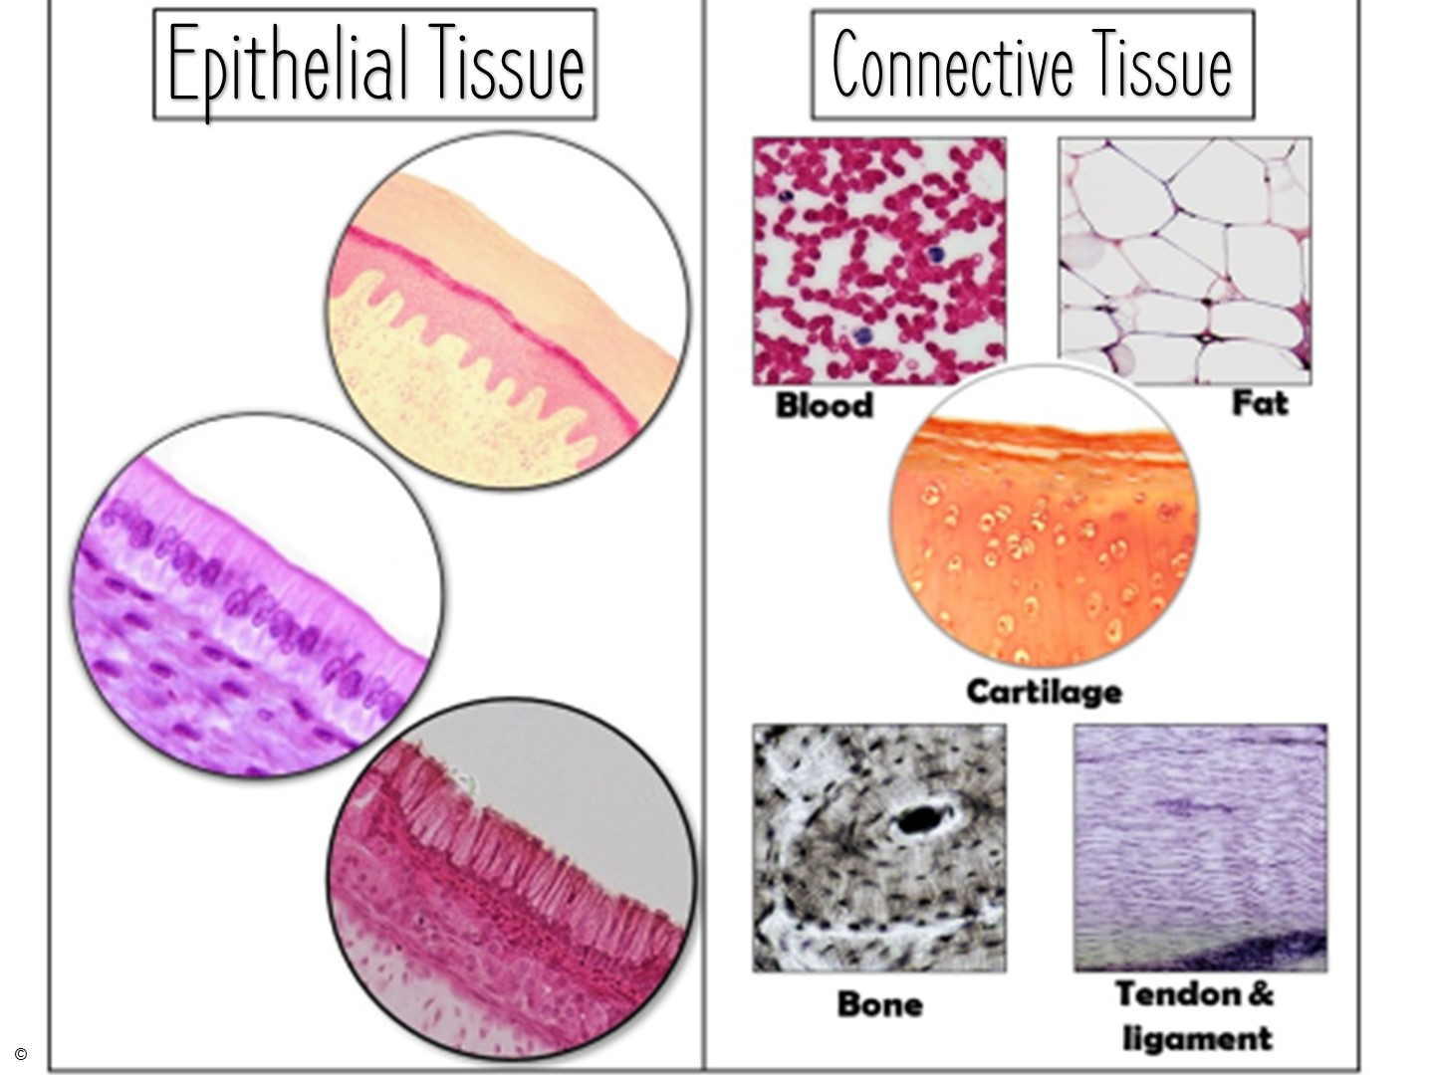
Notes:
Connective tissues seem very different, but they are grouped together for a number of reasons that we will cover in the connective tissue notes.

Slide 12

What is epithelial tissue?
Definition: type of tissue that covers all internal and external body surfaces, lines body cavities, and makes up glands
Notes:
I like to think of epithelial tissue like the walls of a house.
You have external walls (ex. Skin) and internal walls separating rooms (ex. Lining of stomach, lining of uterus).
Epithelial tissue is a sheet of cells covering both the inside and outside body surfaces, such as the skin or lining the body cavities.
It is boundary forming tissue.

Slide 13
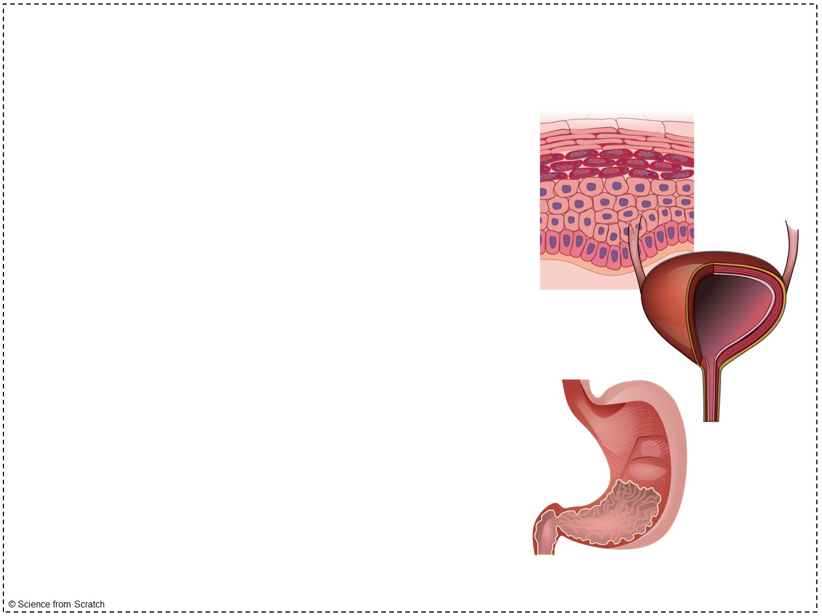
What is epithelial tissue?
Examples of epithelial tissue:
  Outer layer of skin
  Lining of the stomach
  Lining of the urinary bladder
Forms boundaries in the body
Notes:
Epithelial tissue lines SO much – our kidneys, reproductive organs, body cavities, lungs.
Epithelial tissue lines all hollow organs (ex. esophagus, uterus, intestines)
It performs many functions in its various locations, such as protection, absorption, filtration, excretion, secretion, sensory reception, and more!

Slide 14
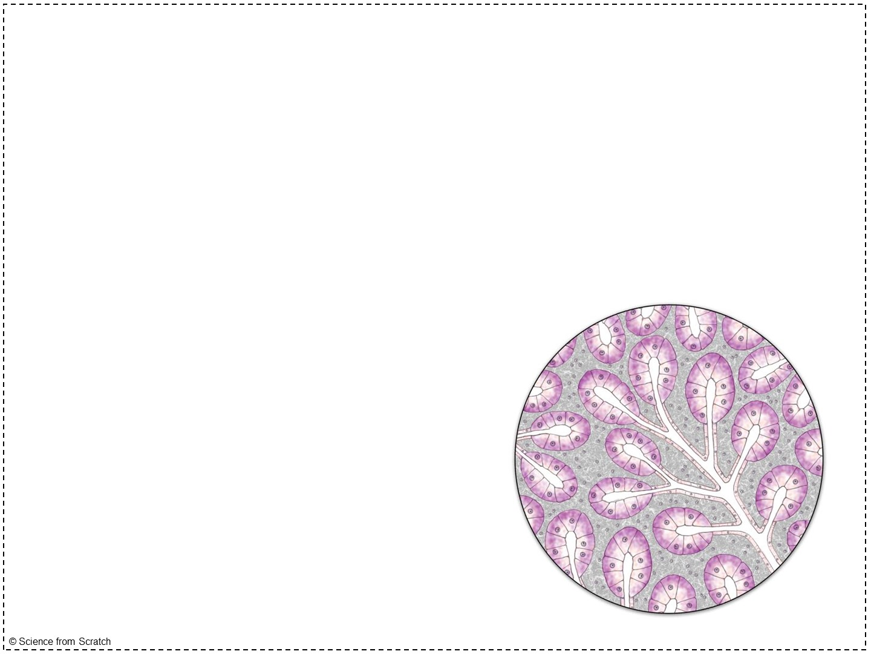
What is epithelial tissue?
Two forms of epithelial tissue:
  Covering and lining epithelium (ex. Skin, stomach)
  Glandular epithelium
Notes:
For our lesson today, we are going to focus only on covering and lining epithelium.
Covering and lining epithelium forms the outer layer of skin, lines the body cavities (ex. Abdominal cavity), and lines the urinary tract, digestive tract, respiratory tract, and reproductive tracts.
Glandular epithelium makes up glands, such as sweat glands, salivary glands, and mammary glands.
Glandular epithelium is involved in the production and release of many different products, such as sweat, saliva, breast milk, digestive enzymes, and hormones, among many other substances. It lines the organs that these products are produced in.

Slide 15
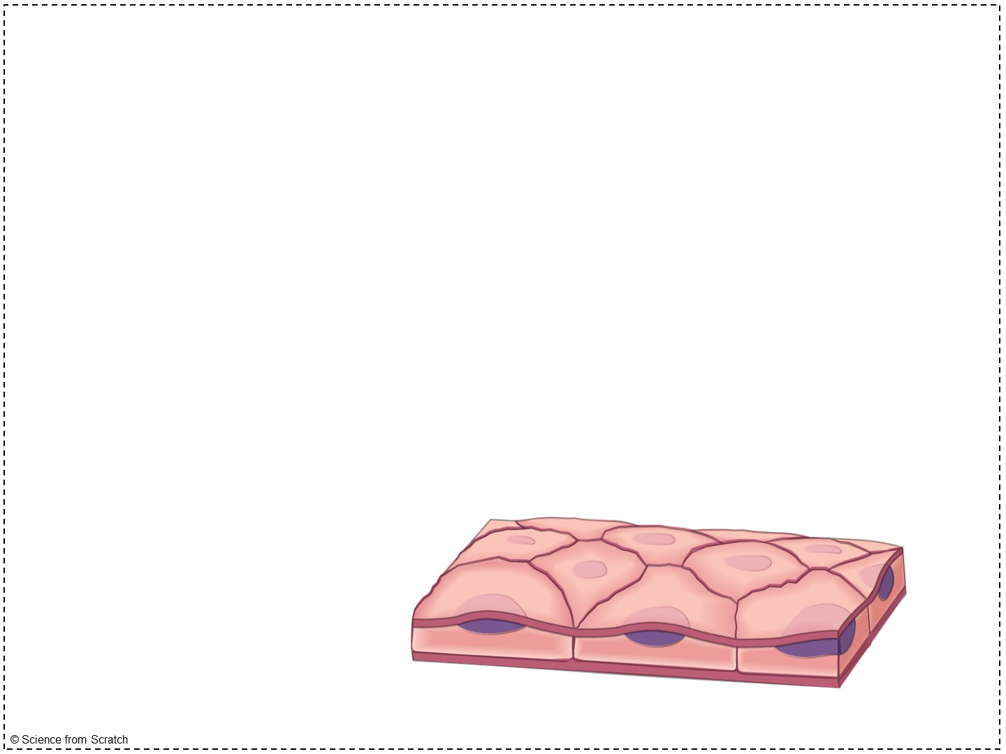
Structure
Has two surfaces:
  Apical surface: not attached to surrounding tissue and exposed to either the outside of the body or the lining of an organ
apical surface
Notes:
Epithelial tissue is said to have apical-basal polarity (two surfaces that differ in structure and function)
Some apical surface are smooth, while others have microvilli along them (increasing their surface area)

Slide 16
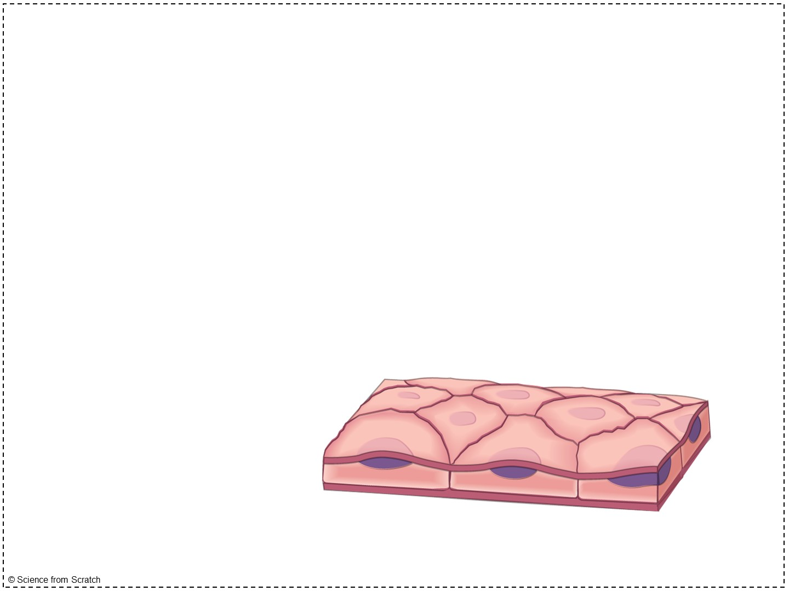
Structure
Basal surface: attached to underlying connective tissue
  Basement membrane: in between the epithelial tissue and connective tissue
apical surface
basal surface
basement membrane

Slide 17
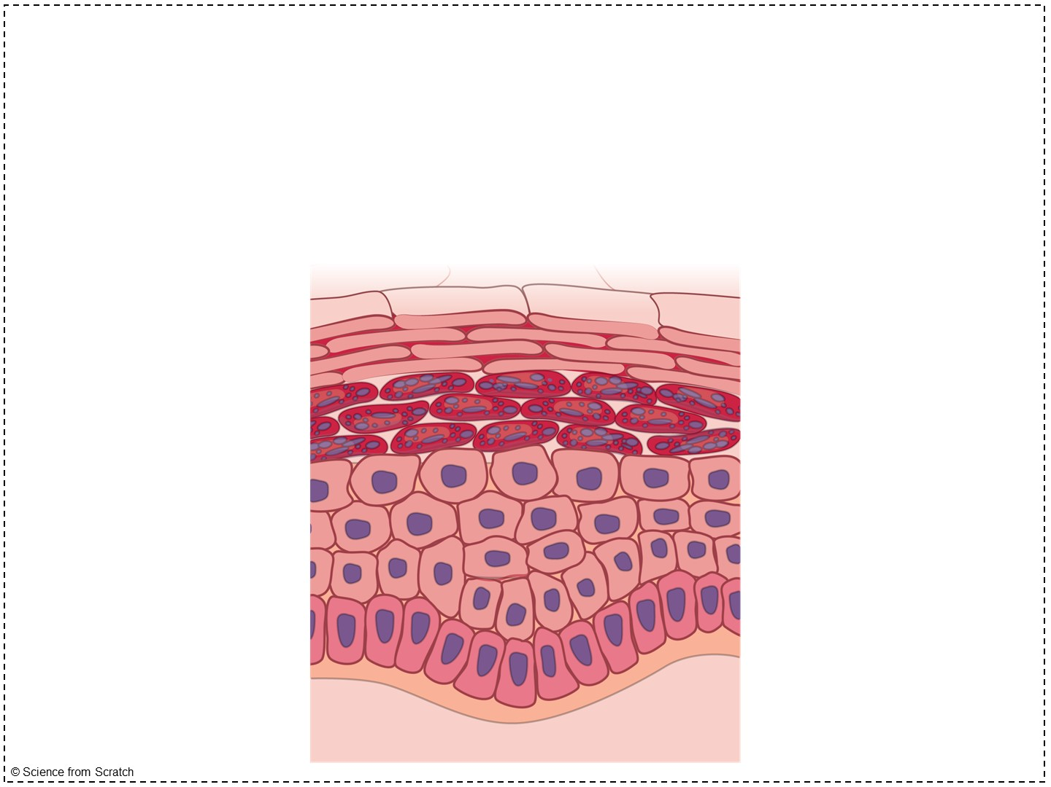
Structure
Avascular but innervated
Notes:
No blood vessels, but has nerves present in many situations.
When you get a paper cut and it doesn’t bleed, you have penetrated epithelial tissue! It hurts, but there is no blood.
When you get a paper cut and it does bleed, you have gone deeper than epithelial tissue.
A blister is when the layer of epithelial tissue separates and rises from the skin beneath it. Typically blisters do not have blood and you can see the pure epithelial tissue holding the pus in.

Slide 18
Extension video
Why is epithelial tissue important? What happens if it falls apart?
Epidermolysis bullosa is a medical condition that causes epithelial tissue in the skin and mucus membranes to fall off easily.
https://www.youtube.com/watch?v=iuYxGtuBSgk&t=1s
Notes:
Teachers – you will definitely want to preview this video. My students learn a lot from it, but are also humbled and inspired by it; however, it can be hard to watch.
If you are following the full year curriculum, I recommend saving this video for another day or fully skipping it for timing reasons. If we have free time on day 3 after finishing the epithelial tissue modeling activity, I show this video. You can feel free to replace this link with a picture of a person with epidermolysis bullosa to discuss the condition.
In EB, a genetic condition, the proteins that make up the basement membrane in the skin are very fragile due to the mutations. This causes the cells to easily rupture, breaking the connection between the epidermis and dermis, allowing the epidermis to slough off forming blisters.
These blisters can appear on the skin and in some cases can appear in the mouth, esophagus, stomach, intestines, airway, bladder, and genitals (all places where epithelial tissue is found).
It is highly fatal and there is no cure.
Most individuals die of infection due to a loss of the protective nature of epithelial tissue. Pathogens, such as bacteria, can easily enter the skin and gain a stronghold in the body.

Slide 19
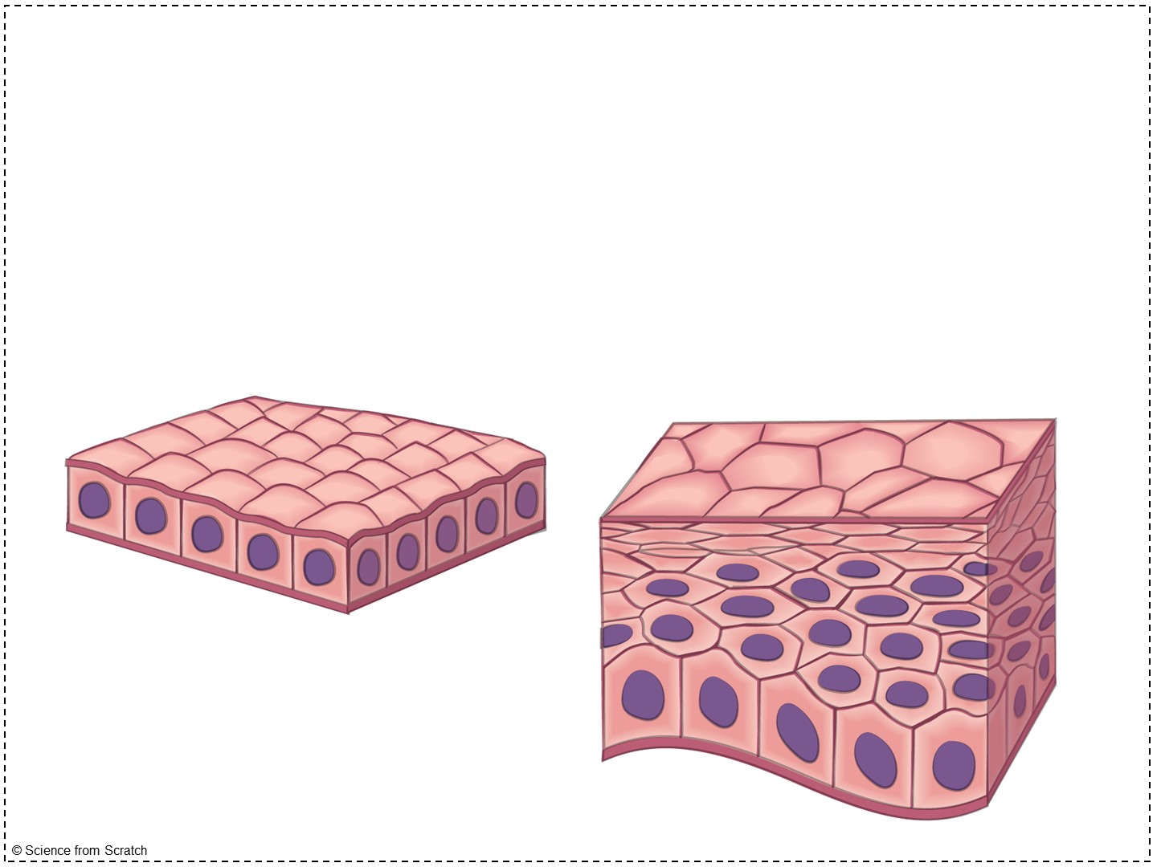
Classifications
Epithelial cells are classified based upon their shape and layers
Notes:
The name of each epithelial tissue has two parts, like a first and last name.
First name: layers
Last name: shape of cells

Slide 20
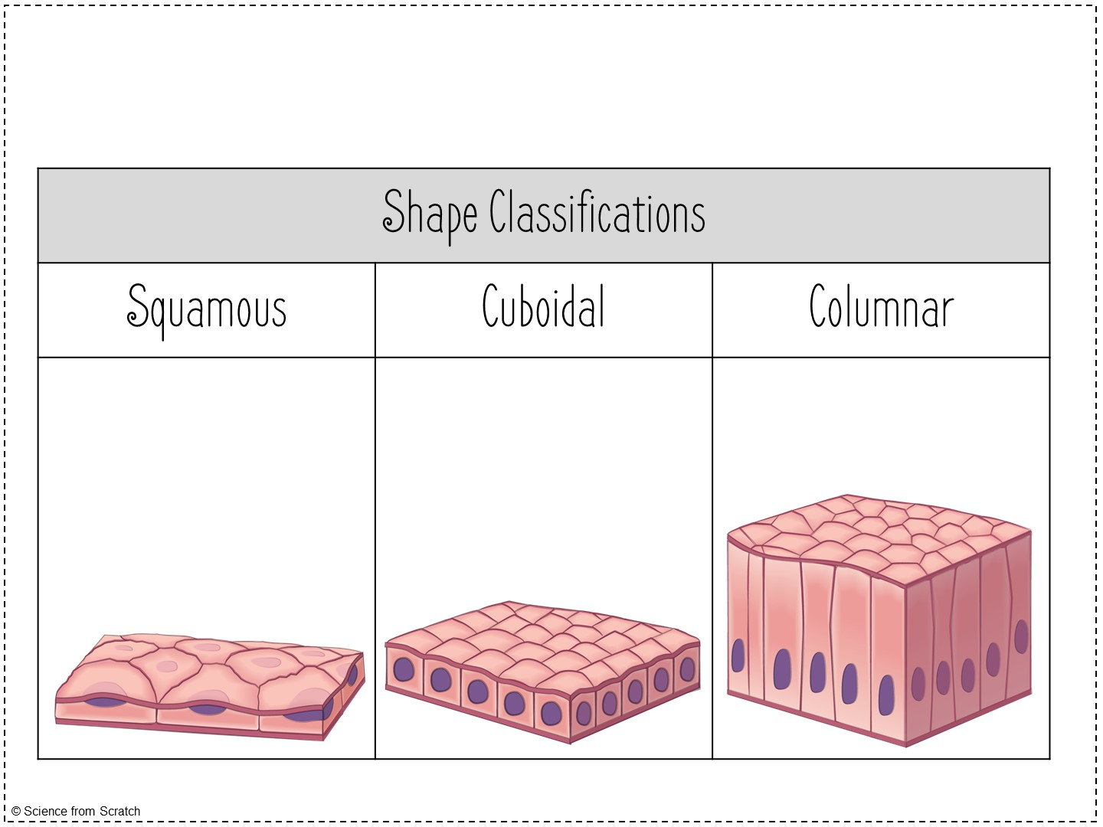
Classifications
Flat cells
Box-like cells
Tall & skinny cells
Notes:
Squamous: For some reason, when I say that these cells are “squatting” down as low as they can, it works for my students to remember squamous. These cells are like roof shingles or floor tiles. They are flat and wide.
Cuboidal: pretty self-explanatory; these cells are as tall as they are wide (like when our students would draw ice cubes on their notebooks!)
Columnar: tall and column shaped; also self-explanatory; these remind me of the lockers in our school.
Note: It is a great time to remind students that these are CELLS. The purple dot in the middle of each cell is a…. NUCLEUS!

Slide 21
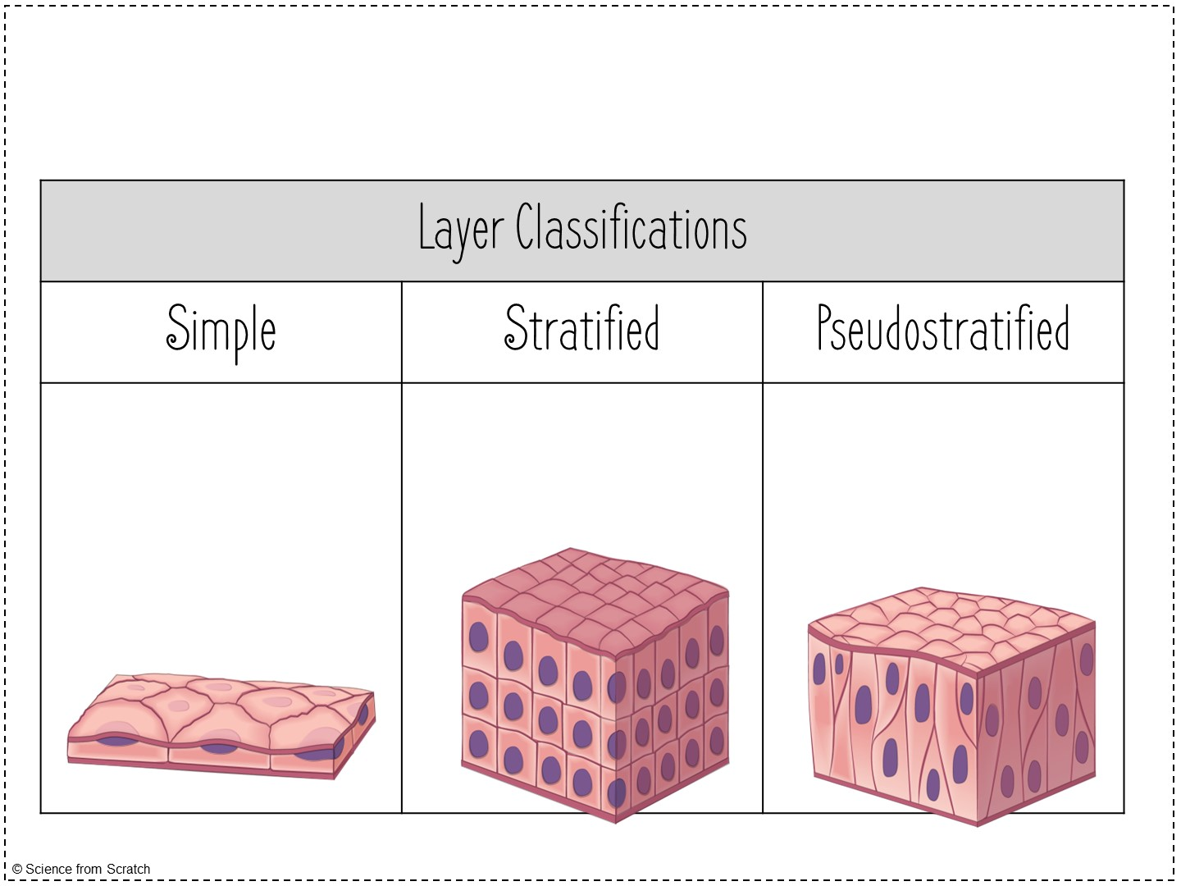
Classifications
One layer of cells
Two or more layers of cells
Appears layered, but is only one layer
Notes:
Simple: it’s simple! Just one layer! These epithelial tissues are very thin and often involved in secretion and absorption (it is easy for substances to pass through them)
Stratified: We recall other words that have strat- as a root word in them (stratosphere, strata (the breakfast casserole), substrate); all of these things are layered
Pseudostratified: “fake-stratified;” You can remind your students that a pseudonym is a fake name that somebody takes. The reason pseudostratified epithelium appears pseudostratified is due to the location of the nuclei. The cells are columnar, but not perfectly uniform. Some of them have wider tops; some have wider bottoms; some are uniform. The nuclei are in the largest position of the cell and create a layered appearance. Pseudostratified epithelium is ALWAYS columnar.

Slide 22
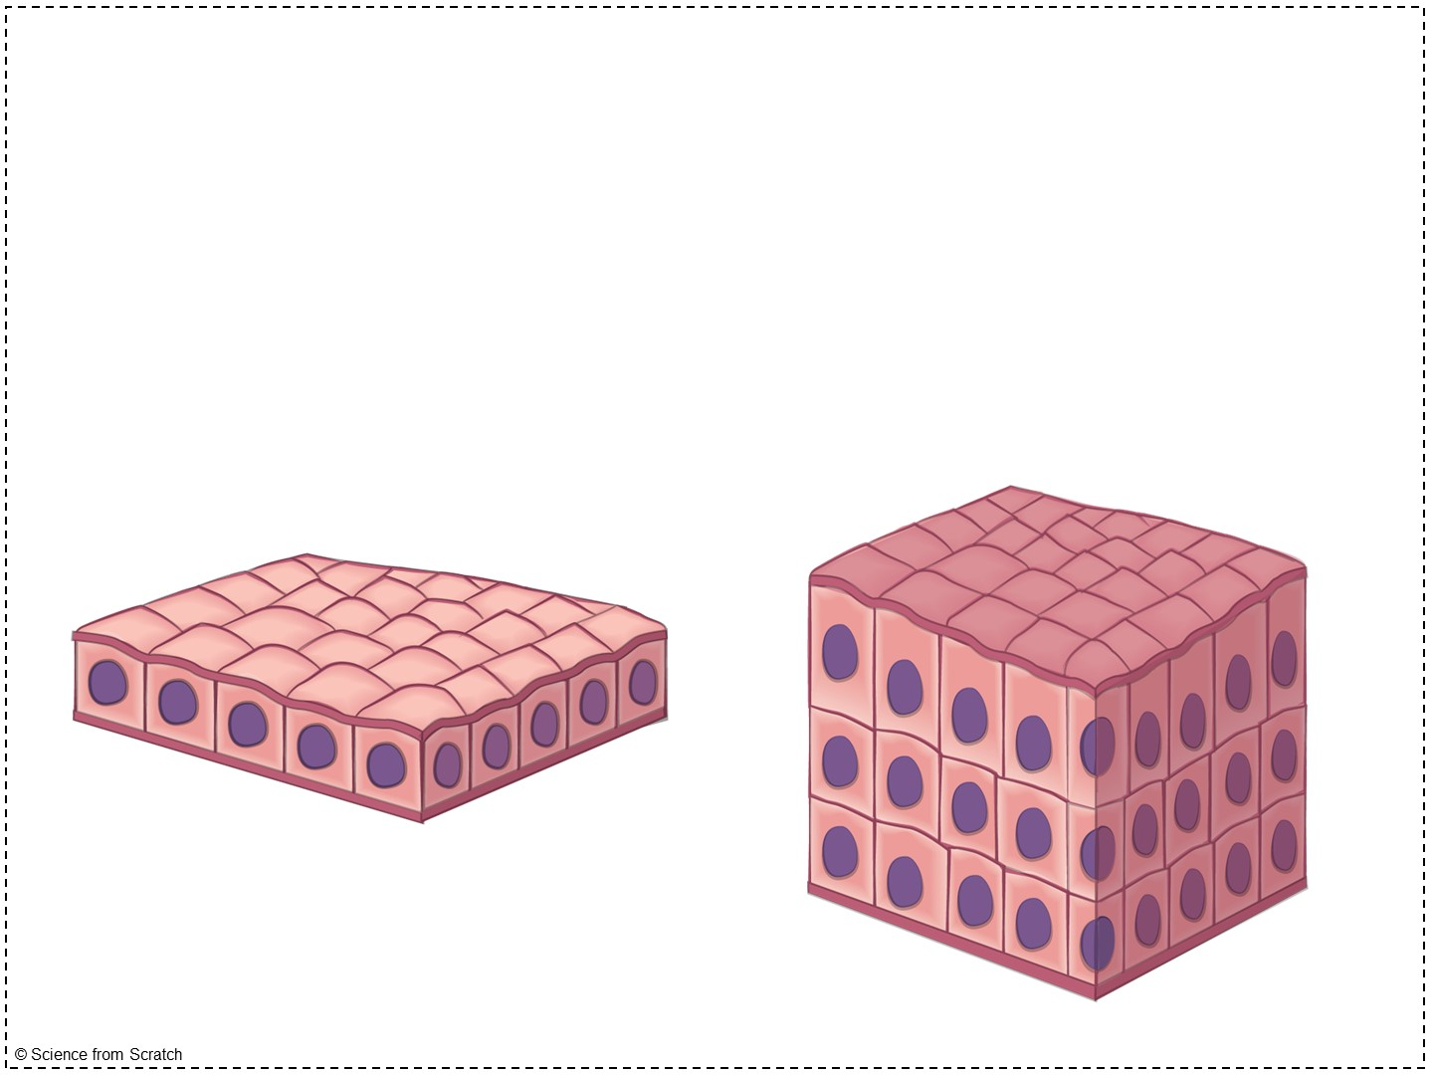
Classifications of Epithelial Tissue
Simple: one layer of cells
Stratified: 2 or more layers of cells
Notes:
Make sure your students turn to the next page of notes, Classifications of Epithelial Tissue.

Slide 23
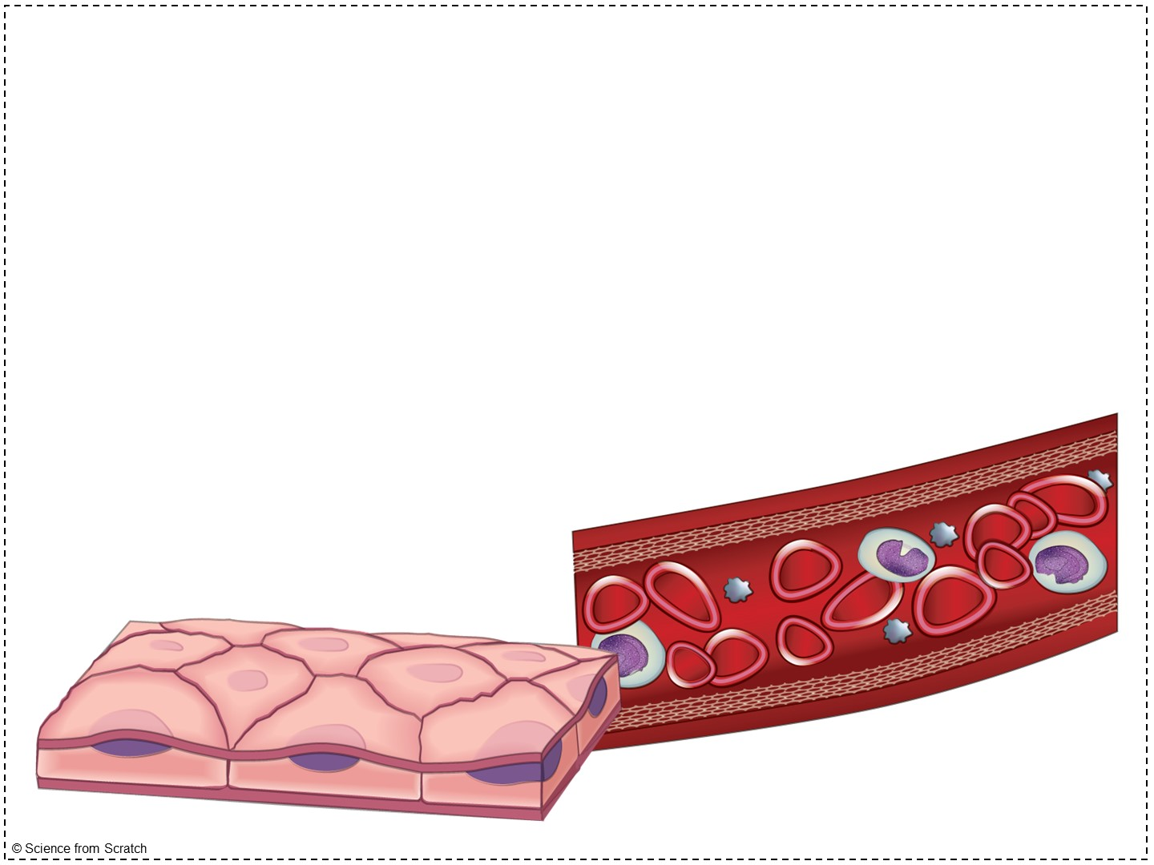
Simple Squamous
Resembles a tiled floor
Function: thin to allow for diffusion
Found in the lungs and blood vessels
Notes:
Cells are flattened with little cytoplasm
The cells look a bit like fried eggs!
They are thin and permeable, so they are found places where substances need to pass.
For example, oxygen and carbon dioxide must diffuse between the lungs and blood vessels in the lungs (gas exchange). If the lungs had stratified epithelium, these gases couldn’t pass. Simple squamous is perfect for the lungs!
When our blood carries oxygen to our tissues, it must be able to pass the oxygen through its wall and into the tissues.

Slide 24
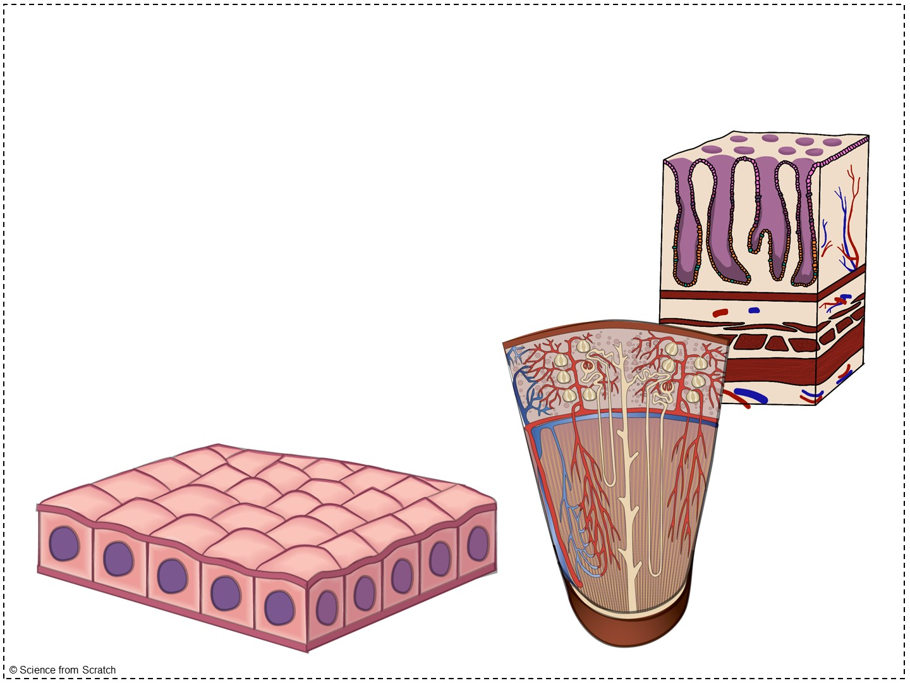
Simple Cuboidal
Functions: secretion and absorption
Found in the walls of glands and kidney tubules
Notes:
Glandular epithelium (which we discussed previously) is made of cuboidal and columnar cells. Glandular epithelium is found in salivary glands, oil glands, etc. It is important that these glands are lined with simple epithelium because it allows the substances produced in those glands to pass through.
In the kidney tubules, water and other substances are absorbed into the kidney tissue or secreted into the tubules to create urine. It is important for this epithelium to be simple so that absorption and secretion can occur.
Cuboidal epithelium provides added protection that squamous does not have.

Slide 25
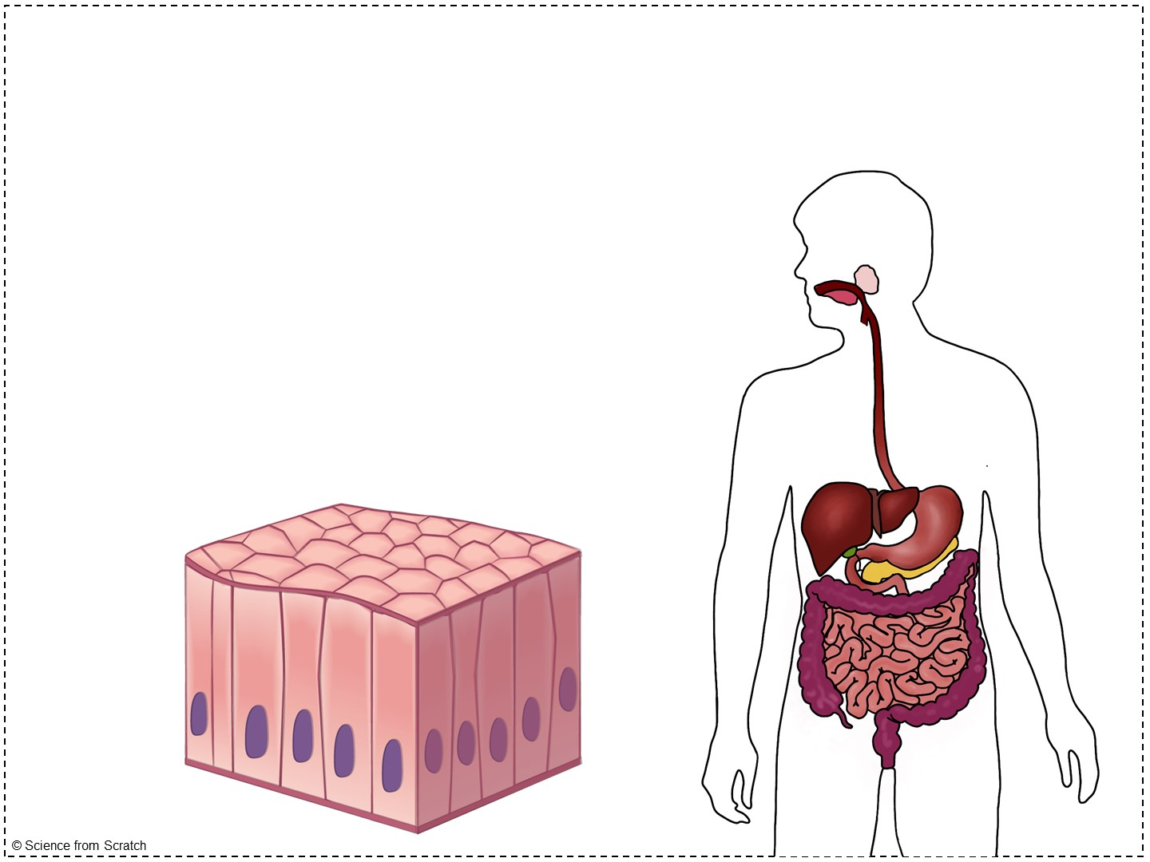
Simple Columnar
Tall, closely packed cells
Lines the digestive tract
Functions: absorption & secretion of mucus
Notes:
Each day, your intestines create nearly a liter of mucus (which allows digested food to pass through the intestines smoothly).
The intestines are also responsible for the absorption of nutrients and water.
As a reminder, simple epithelium is excellent for secretion and absorption because it is only one layer!

Slide 26
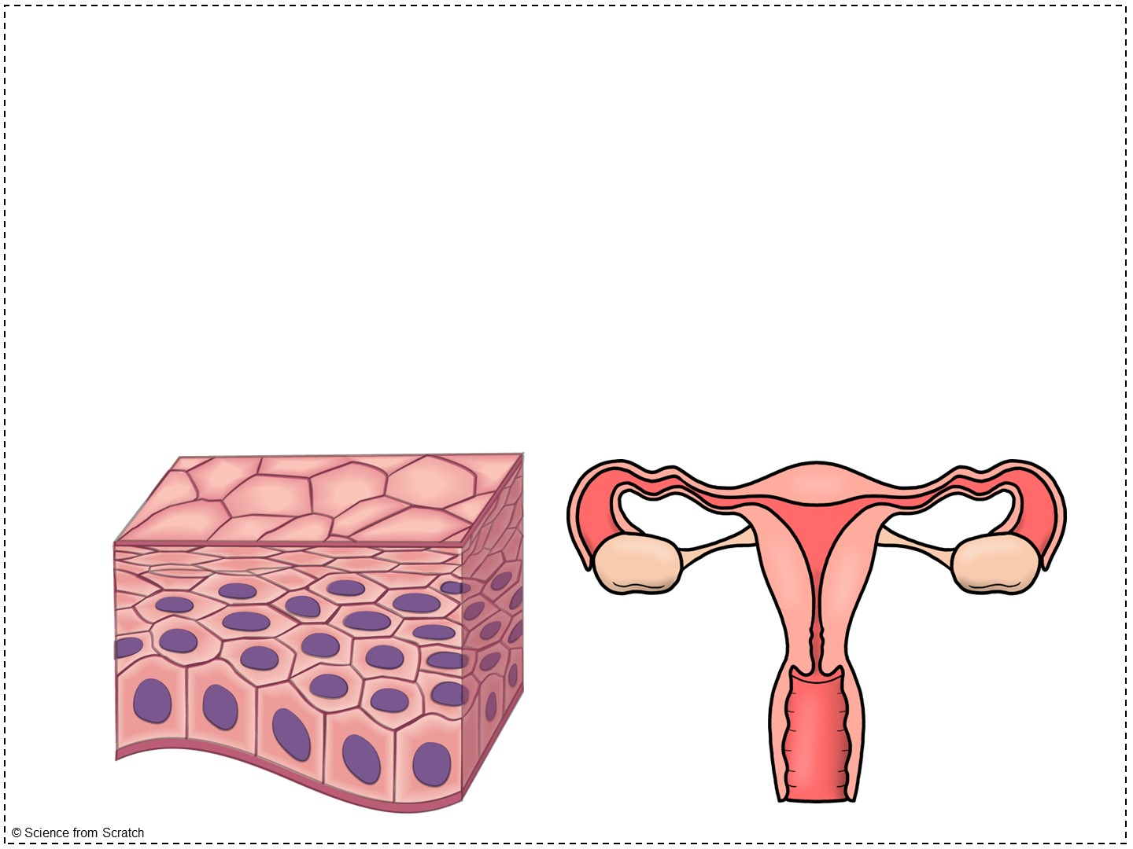
Stratified Squamous
Many layers of flat cells
Function: protection from abrasion
Locations: skin, mouth, esophagus, vagina
Notes:
Now that we add layers, we are adding protection! This type of epithelium reminds me of piles and layers of sandbags, protecting the precious and sensitive areas that undergo a lot of trauma.
If there were only one layer of cells in these areas, it would be terrible!
For example, imagine eating a triangular shaped tortilla chip. As the sharp edges hit against the walls of your mouth, if they were one layer of cells they would rupture immediately. What if you didn’t chew that tortilla chip fully and a large piece went down your esophagus (we’ve ALL experienced this before!). It would tear your entire esophagus!
The skin undergoes a battle every day, even just with the friction of our clothes!
The vagina must have layers for both intercourse (there is a lot of friction) and birth.

Slide 27
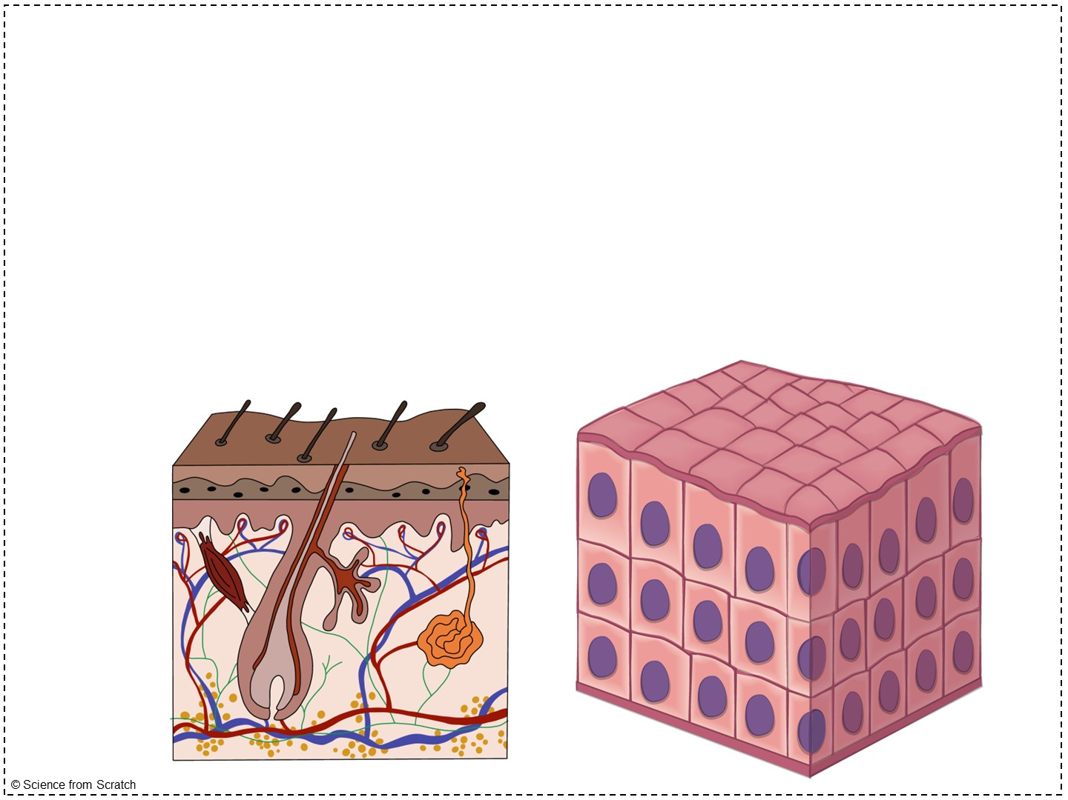
Stratified Cuboidal
Very rare
Found in the ducts of sweat glands & mammary glands
Notes:
Typically only has 2 layers of cells
Sweat glands and mammary glands are larger glands compared to others. Stratified cuboidal is typically only found in larger glands.
Layers protect the ducts of these glands.

Slide 28
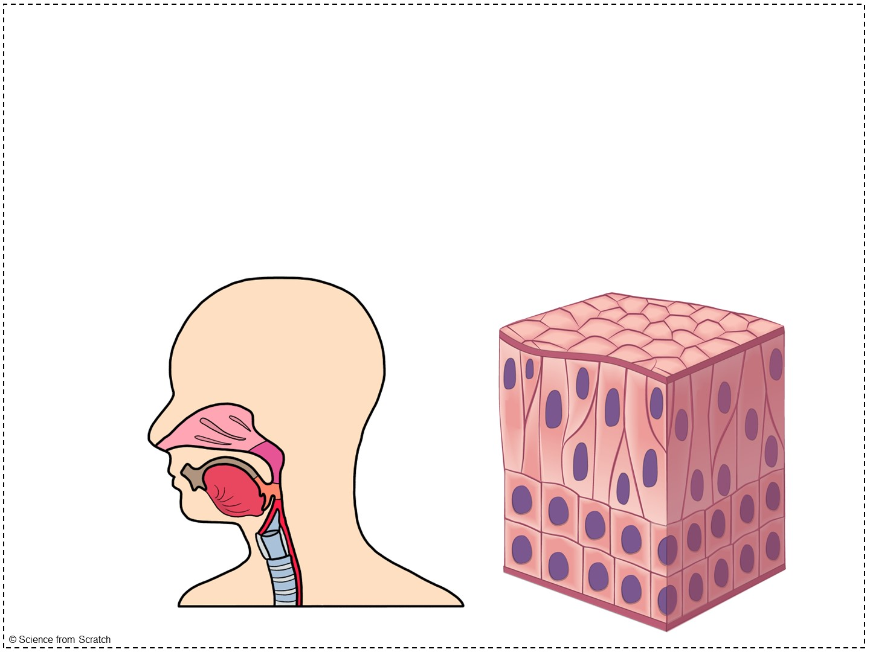
Stratified Columnar
Rare
Found in pharynx & male urethra
Notes:
Layers protect the male urethra from physical or microbial damage.
Pharynx = throat; having layers protects the pharynx from damaged caused by food moving through

Slide 29
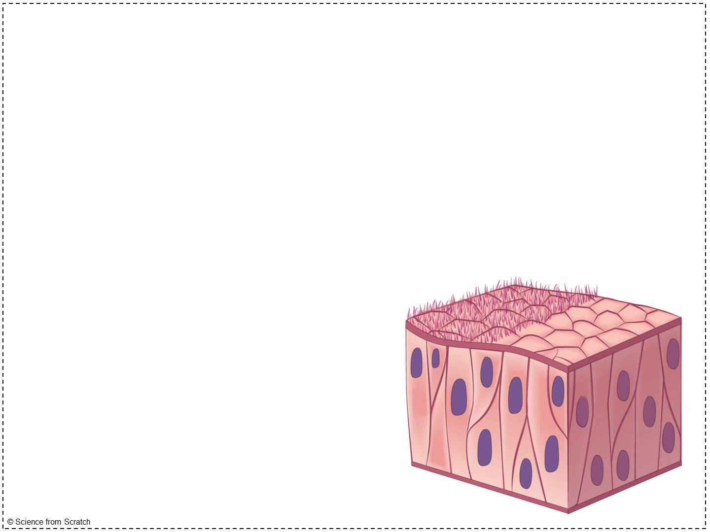
Pseudostratified Columnar
Secretes substances, such as mucus
Propels particles forward using cilia
Found in the trachea and fallopian tubes
Notes:
Single layer of cells with varying sizes and heights, as well as the position of the nuclei.
Not actually stratified! Fake stratified!
This type of epithelium is good at moving things.
In the trachea, dust and debris are captured by the cilia and mucus and coughed up.
In the fallopian tubes, egg cells are passed from the ovary to the uterus, where a fertilized egg cell can implant and develop into an embryo and fetus.

Slide 30
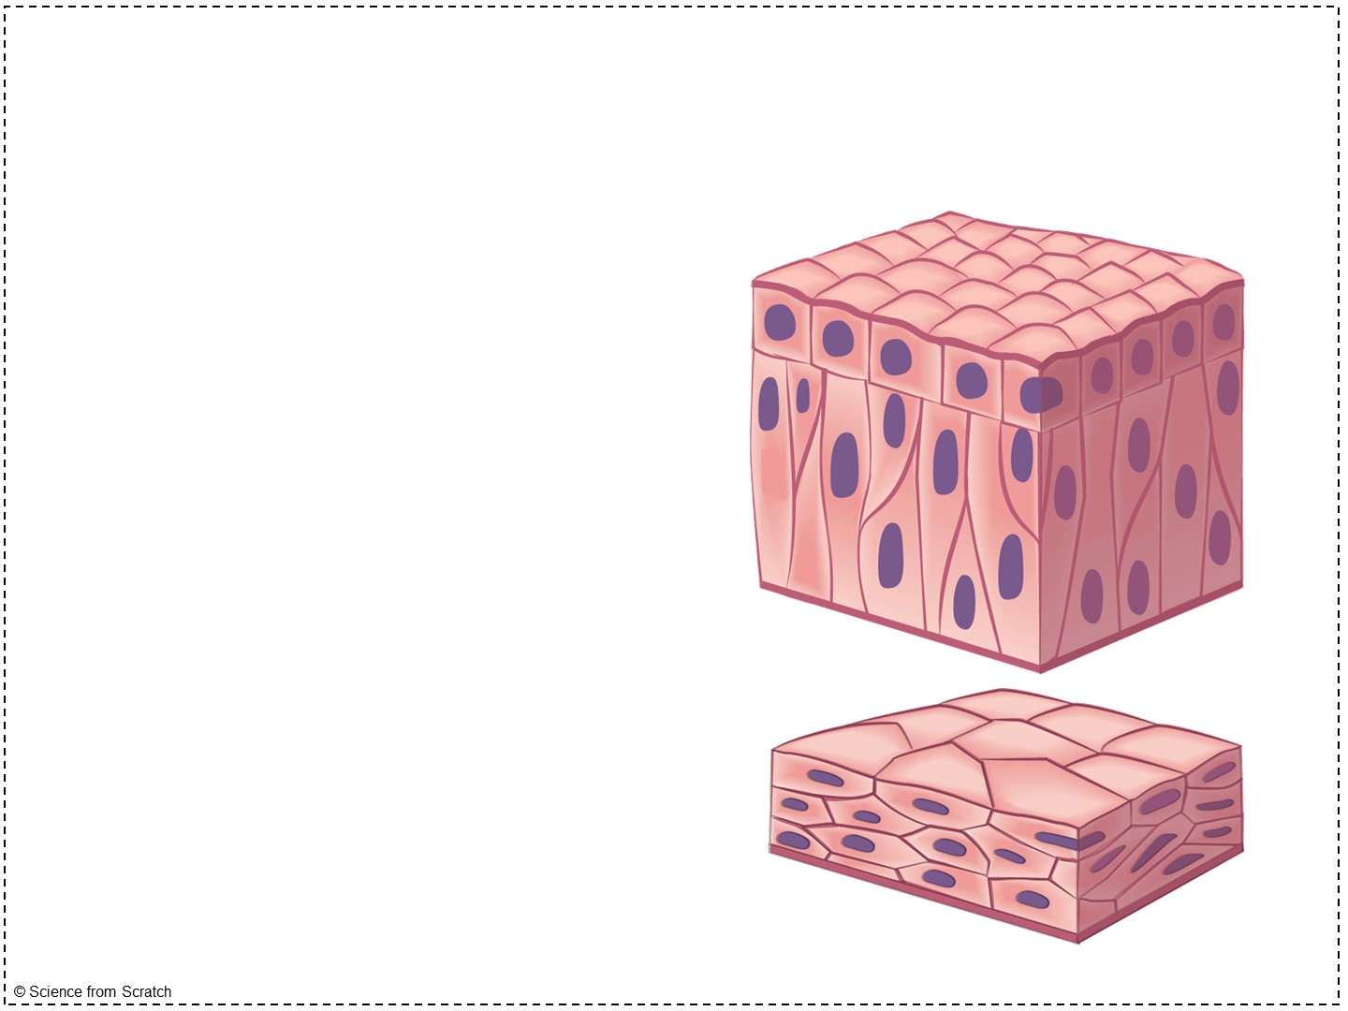
Transitional
Forms the lining of urinary organs – ureters, urinary bladder, & part of the urethra
Functions: stretches easily (to allow urine to stretch the bladder)
Notes:
It changes shape in response to stretching, like when a balloon blows up and the walls get thinner and thinner.
The urinary bladder is not always stretched out! If they dissect fetal pigs, rats, or cats, they will see this later in the year. When the bladder is empty, it is shrunken down and almost feels muscular. When it is full, it feels like a water balloon.
The bladder can hold up to 500 ml of urine and women and 700 ml of urine in men.

