Slide 1




Wellness policy/ Triennial Assessment
Presented by: Jordan Classen, Ethan Larsen
Consulted with Kathy Beckman
Annual Public Notice
June 8, 2026 BOE Meeting

Slide 2




School Wellness Program
Nutrition Promotion and Education
Promote healthy food and beverage choices to students.
Health and nutrition will be incorporated into classroom curriculum.
Physical activity
Encourage students to be physically active and healthy on and off premises.
◤
School based activities
District will support staff and student continued learnings and efforts toward overall school health.
Items sold on campus
USDA Smart Snack compliance

Slide 3


Triennial Wellness Assessment Update
Wellness Committee
Meeting Schedule
◤
Kathy Beckman- Food and Nutrition Director
Ethan Larsen- Continuous Improvement Director
Jen Molt- Nurse / Parent
Angie Flinn- Counselor
Leann Aldana – Family Consumer Sciences Teacher
Whitney Paulson– EHA Representative/ Music Teacher / Parent
Jordan Classen– Business Manager
The District Wellness Committee will meet twice a year: Once in the fall to review policy and set goals, then again in late spring to evaluate work and prepare for the Board of Education presentation in June.
SY2026-2027 Meeting Dates
1. December 2026
2. May 2027

Slide 4
Current Goals &
Efforts
Staff Focus
  EHA - Wellness Wednesday
  Continuing to make benefits available for staff that assist with other areas of health such as mental health.
Student Focus
  The power of choice only grows each year as students become increasingly independent. Knowledge is a powerful part of students learning to make good choices from lifestyles, to foods and activity. Incorporating good modeling for students and guiding them to solid information about the impact of their choices is a key strategy for helping to build healthy citizens beyond high school.
    Preschool snacks- compliant with the state, these snacks are encouraging our students to explore new foods and increase their protein.
    Elementary school- afternoon milk break
      Secondary grade level classes- Performance Nutrition
Building Focus
  Healthy Smart Snack- vending machines
  Nutrition presentation- cycles in the commons area.
  Well maintained commons area for students to eat breakfast and lunch.

Slide 5
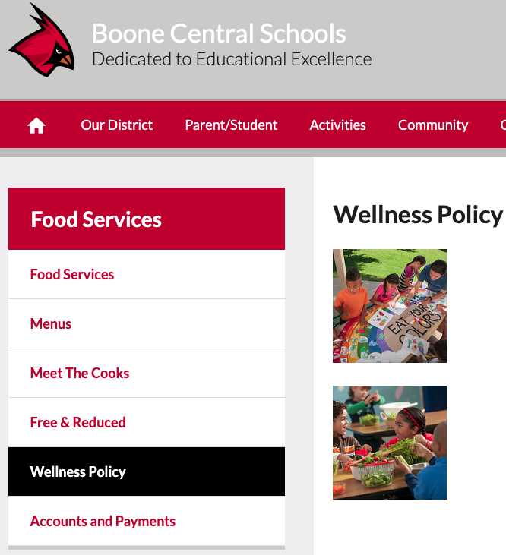
Record Keeping Compliance
Located online.
  Boone Central Home Page > Departments > Food Services > Wellness Policy

Slide 6




S.W.O.T. Analysis
Strengths
Staff Knowledge
Menu Flexibility / Variety
Weaknesses
Social media
Harvest of the Month
Opportunities
Breakfast
Small appliances- smoothie machine, salad spinner, etc.
Threats
Vacant positions
Rising cost of goods

Slide 7

SY 2025-2026 at a Glance
Breakfast
  Number of Operating Days: 173
  Total Reimbursable Meals Served 11,584
    Free 4,027 /Reduced 1,823 /Paid 5,734
  Averages 66 meals per day
Lunch
  Number of Operating Days: 175
  Total Reimbursable Meals Served 70,219
    Free 14,627/Reduced 8,405/Paid 47,187
  Averages 401 meals per day

Slide 8
Triennial Wellness Assessment Update
• Boone Central completed the required USDA Local Wellness Policy Triennial Assessment on 6/4/2026.
• The district's wellness policy was reviewed and found to be aligned with federal wellness policy requirements.
• The district continues to meet wellness goals related to nutrition education and promotion, physical activity, school meals, and student wellness across all grade levels.
• No major policy revisions are recommended at this time. The Wellness Committee will continue to monitor implementation and identify opportunities to strengthen student and staff wellness initiatives.

