Slide 1

Senior year planning
Class of 2027

Slide 2

TONIGHT’S GOAL:
HOW TO ACCESS RESOURCES!

Slide 3
Bellingham
High
School
Website…
Senior Checklist
Post-Secondary Resources
4-year college
2-year college
Military
Apprenticeship
Employment
Financial Aid
Senior Manual (PDF of topics above)

Slide 4
What information can I find…
Timelines
Application How to’s
Financial Aid
Scholarships
Field Trip Opportunities
College Admissions

Slide 5
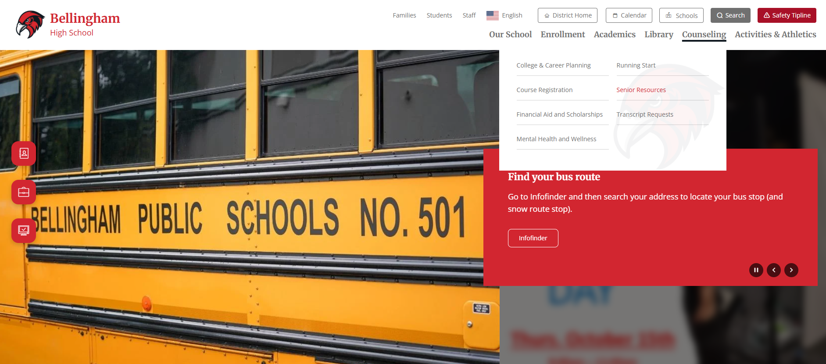
Bellingham High School Website…

Slide 6
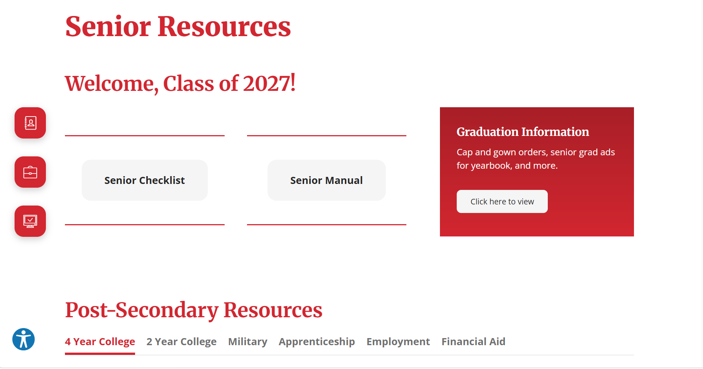

Slide 7
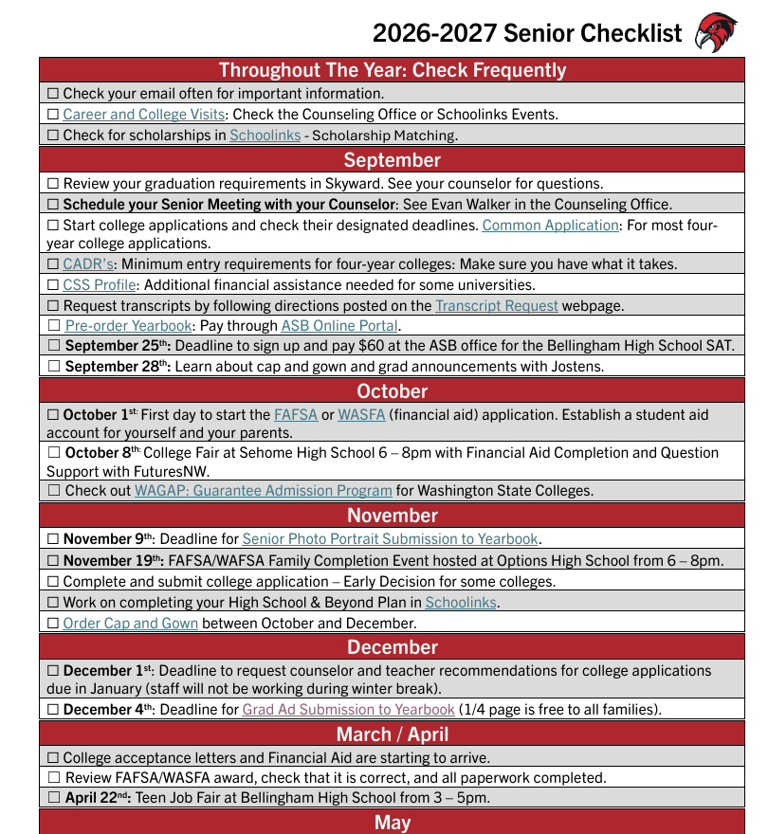
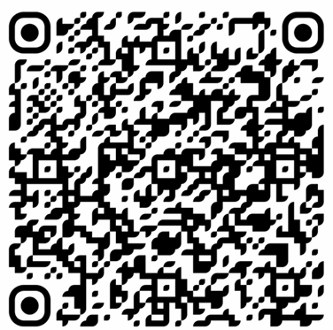
Senior Checklist
Provided to students during their Senior Meeting
Order Cap and Gown now
Order Yearbook now
Senior photos upload by Nov. 9
Grad Ad upload by Dec. 4
FAFSA opens Oct. 1
QR Code for senior checklist

Slide 9
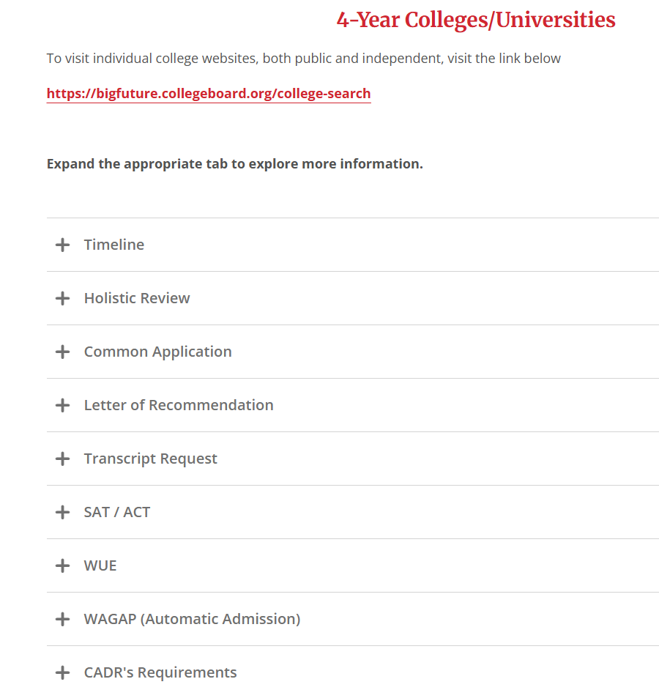
4-year college resources…

Slide 10
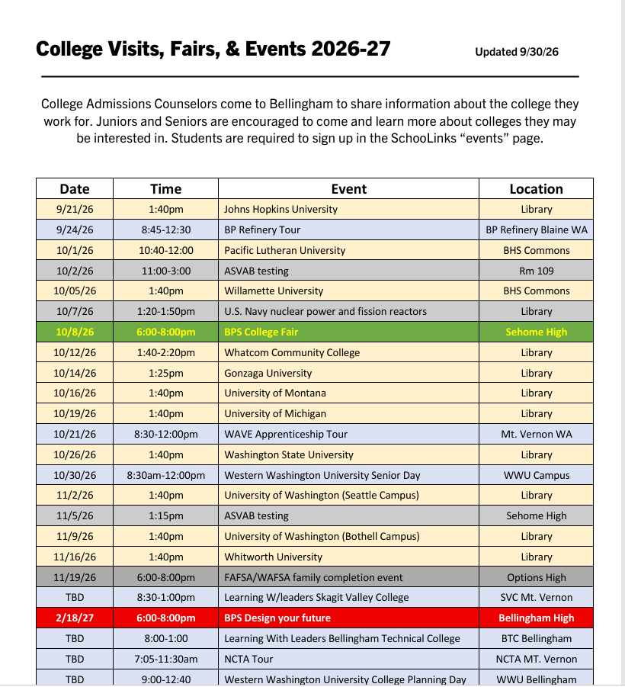
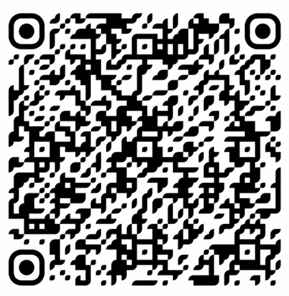
College visits and field trips….
Sign up in SchoolLinks under EVENTS. Student must add event to their personal calendar as a reminder

Slide 11
$$$ for Post Secondary….
All information is on the Senior Checklist and on website under Financial Aide
FAFSA- Free Application for Federal Funding
Help sessions 6 -8
Oct. 8 @ Sehome 6 to 8
Nov. 19 @ Options
WAFSA – Washington Free Application –
only WA state funding
CSS - The CSS Profile is an online application used by colleges and scholarship programs to award non-federal institutional aid. (only for participating colleges)
School Links – Bellingham School District Platform for Scholarship $$$. Parents and students have access

Slide 12
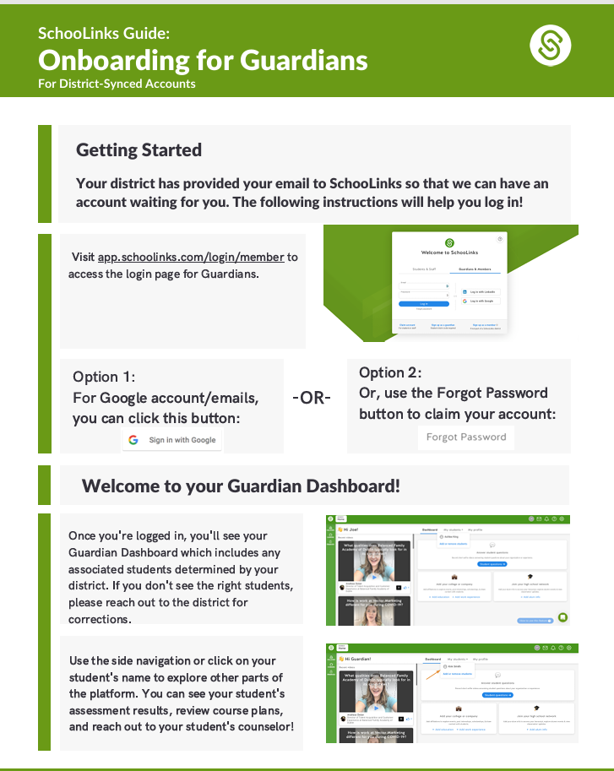
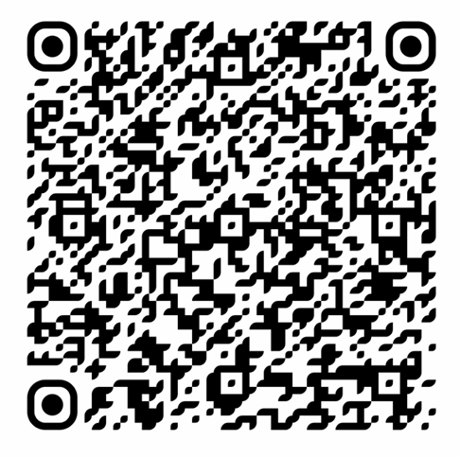
School Links
Guardian access to work alongside student as they search for post high school opportunities and scholarships

Slide 13
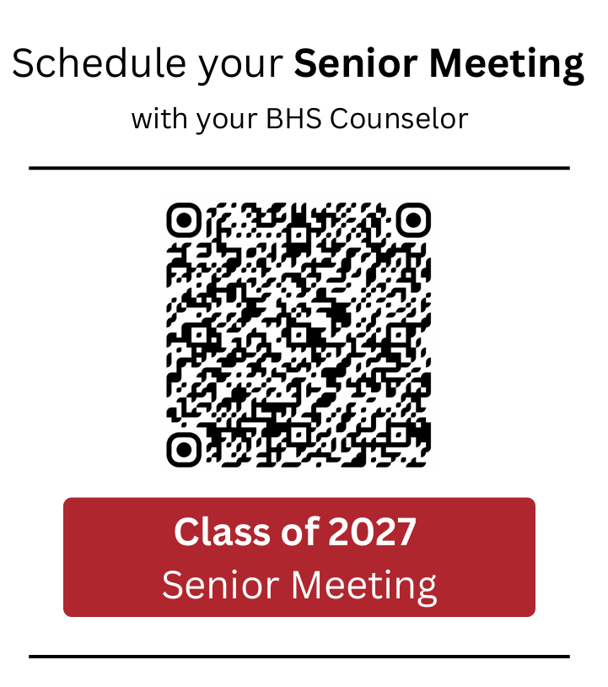
Please encourage your student to schedule their meeting by October 31

Slide 14
Question and Answer
Thank you

