Slide 1


Beaufort County
School District
Beaufort, South Carolina

Slide 2
TITLE I ANNUAL PARENT MEETING
2026-2027
Hilton Head Island Elementary School for the Creative Arts
Sss

Slide 3


Agenda
What is Title I?
  Beaufort County Title I Schools
  How are funds are determined
School Goals
How our Title I Funds are Used/Program Evaluation
School Performance
School Curriculum
Parent Policy and Compact
Notification of Parent’s Right to Know
Parent Comments

Slide 4
What is Title I?
Title I is the largest federal assistance program for our nation’s schools.
Title I is designed to provide all children significant opportunity to receive a fair, equitable, and high-quality education, and to close educational achievement gaps. (ESEA section 1001)
The program serves millions of children in elementary and secondary schools each year.
There are currently 18 Title I Schools in the Beaufort County School District.

Slide 5
Beaufort County Title I Schools
Beaufort Elementary
Beaufort Middle School
Broad River Elementary
Hilton Head Island Early Childhood Center
Hilton Head Island School for
the Creative Arts/Daufuskie
Hilton Head Island Elementary
Lady’s Island Elementary
Lady’s Island Middle School
MC Riley Elementary
Mossy Oaks Elementary
Port Royal Elementary
Red Cedar Elementary
Robert Smalls International Academy
Shanklin Elementary
St. Helena Elementary
Whale Branch Early College High School
Whale Branch Elementary
Whale Branch Middle

Slide 6
How does Title I Work?
The federal government provides funding to states based on census and poverty data each year for Title I.
The South Carolina Department of Education sends the money to the local school districts.
The school district identifies eligible schools based off of their percentage of Pupils in Poverty and provides a Title I allocation.

Slide 7
A Title I Schoolwide Program
All Title I schools in the BCSD implement a schoolwide program.
  In a schoolwide program, a school may use Title I funds to implement reforms to upgrade the entire educational program of the school.
  There are three requirements of a Title I Schoolwide program and the school must:
    Conduct a comprehensive needs assessment through a broad range of stakeholders.
    Create a comprehensive School Renewal Plan that describes how the school will improve academic achievement throughout the school
    Annually, evaluate the schoolwide plan to determine if the schoolwide program has been effective in addressing the major problem areas and, in turn, increasing student achievement, particularly for the lowest-achieving students. Schools must revise the plan as necessary.

Slide 8
Determining How Title I Funds Are Used
Each school has a school advisory committee composed of parents, teachers, other staff that work at the school, community representatives and the principal.
In Beaufort County School District, the School Improvement Council (SIC) usually serves as the school advisory committee
A comprehensive needs assessment is completed each year
Goals are developed for the school year and a School Renewal Plan is written
The SIC approves the Title I budget for the school which is a funding source to support the School Renewal Plan.

Slide 9
School Goals Developed from Needs Assessment
Student Achievement in Reading: By May of 2027, students in grades 3, 4, and 5 will demonstrate an increase by a measure of 10% on average across the three grade levels in academic proficiency (on grade level) when comparing Reading i-Ready diagnostic scores from Spring 2025-26 to Spring 2026-27. (this entails an average increase from 49% across the three grade levels to 59%).
Student Achievement in Math: By May of 2027, students in grades 3, 4, and 5 will demonstrate an increase by a measure of 12% on average across the three grade levels in academic proficiency (on grade level) when comparing Math i-Ready diagnostic scores from Spring 2025-26 to Spring 2026-27. (this entails an average increase from 40% across the three grade levels to 52%).
School Climate: By Spring of 2026-27, the Teacher Perception of Working Conditions segment of the School Climate Survey will increase by at least one point, from 7 (in Spring 2026) to 8 (in Spring of 2027).

Slide 10
Our School’s Title I Activities – Program Evaluation
Open House/Title I Meeting
Family Literacy Nights
Family Math Nights
Hispanic Heritage Celebration
Thanksgiving Lunch
Family Movie Nights
MLP Learning Nights
Grade Level Shows
STEAM/Arts Night for Grades 2 and 4
GT Arts Dessert Theater
Spring Musical

Slide 11

School Performance
On the last state report card our overall rating was Average.
In Academic Achievement and Student Progress we earned an average rating.
In Preparing for Success, Multilingual Learner Progress and School Climate we earned a below average rating.
We are a CSI school for the area of Students with Disabilities.

Slide 12
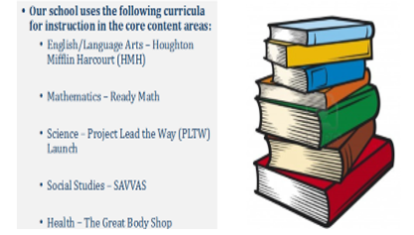
School Curriculum

Slide 13
Parent and Family Engagement
The Title I law requires that all Title I schools and families work together.
How our school works with our families is listed in the following documents
  Parent-School Compact
  Parental and Family Engagement Policy
  Each of these documents are distributed to parents each year and your feedback on these documents is very much appreciated because they are reviewed each Spring and updated if necessary.

Slide 14
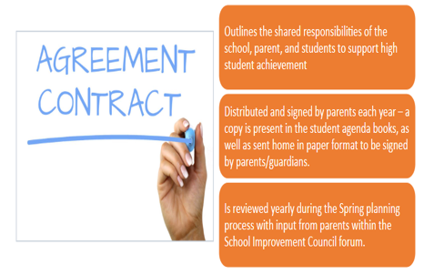
Parent and Family Engagement:
School Compact

Slide 15
Parent and Family Engagement
Includes activities intended to engage parents, in a meaningful way in the development, implementation, and review of the parental involvement program.
Development allows for parents to give input on important issues pertaining to school and community.
Parents work with school staff to write the Parent and Family Engagement Policy
Distributed and posted to school’s website each year
Evaluated in the spring and any revisions are made with SIC

Slide 16
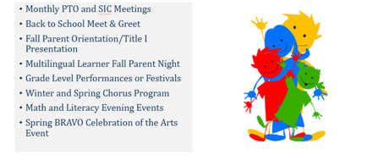
Planned Parent Engagement Activities

Slide 17
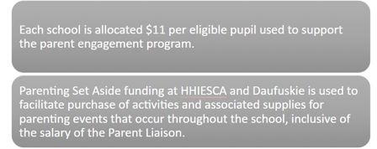
Parenting Set Aside

Slide 18
Parents’ Rights Under Title I
Each year Title I schools are required to provide certain notifications to parents.
Parents may request regular meetings to express opinions and concerns – Annual Parent Conferences are required in Title I elementary schools
Parents must be provided information on their child’s level of achievement on local and state assessments.
Parents must be provided information on their child’s level of achievement in Reading/Language Arts, Mathematics, Social Studies, and Science;
Parents may request and receive information on the qualifications of their child’s teacher; and
Parents must be informed if their child is taught by a non-certified teacher for four or more consecutive weeks.

Slide 19
Parent and Family Engagement
Your engagement is KEY to your child’s success
You are your child’s first teacher.
You can influence your child’s education more than any teacher or school.
Choose to volunteer in your child’s classroom or participate in other ways such as committee members. (See your school’s principal)
You know your child best:
  Share information about your child’s interests and abilities with teachers; and
  Ask to see progress reports on your child and the school.

Slide 20
Simple Ways to Support Your Child’s Education
Share
  Share a love of learning;
Read
  Read to your child;
Ask
  Ask your child to read to you;
Limit
  Limit TV and computer time;
Take
  Take advantage of the public library and the school media center;
Ask
  Ask questions and show interest in your child’s school day;
Review
  Review homework;
Praise
  Praise their efforts; and
Encourage
  Encourage good study habits.

Slide 21
Simple Ways Know Your School and
Communicate With Teachers
Attend
  Attend parent teacher conferences, school events, special parent trainings
Visit
  Visit the classroom
Volunteer
  Volunteer at the school
Join
  Join parents’ organizations
Keep
  Keep teachers informed
Engage
  Engage in discussion about your child’s school work and behavior
Reflect
  Reflect on the responsibilities as stated in the parent-school compact

Slide 22
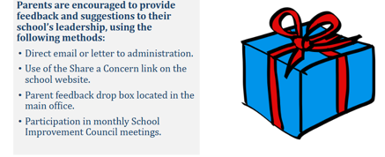
Feedback

Slide 23
Questions?
Let’s have an amazing school year!

Slide 24

Last slide - BCSD Logo.

