Slide 1
MANSFIELD ISD COMMUNITY TOWN HALL
Exploring Single-Member Trustee Districts
Notes:
Welcome. Purpose of tonight: share clear information about the single-member trustee district process and hear from the community. The seven circles represent the seven members of the Board of Trustees.

Slide 2
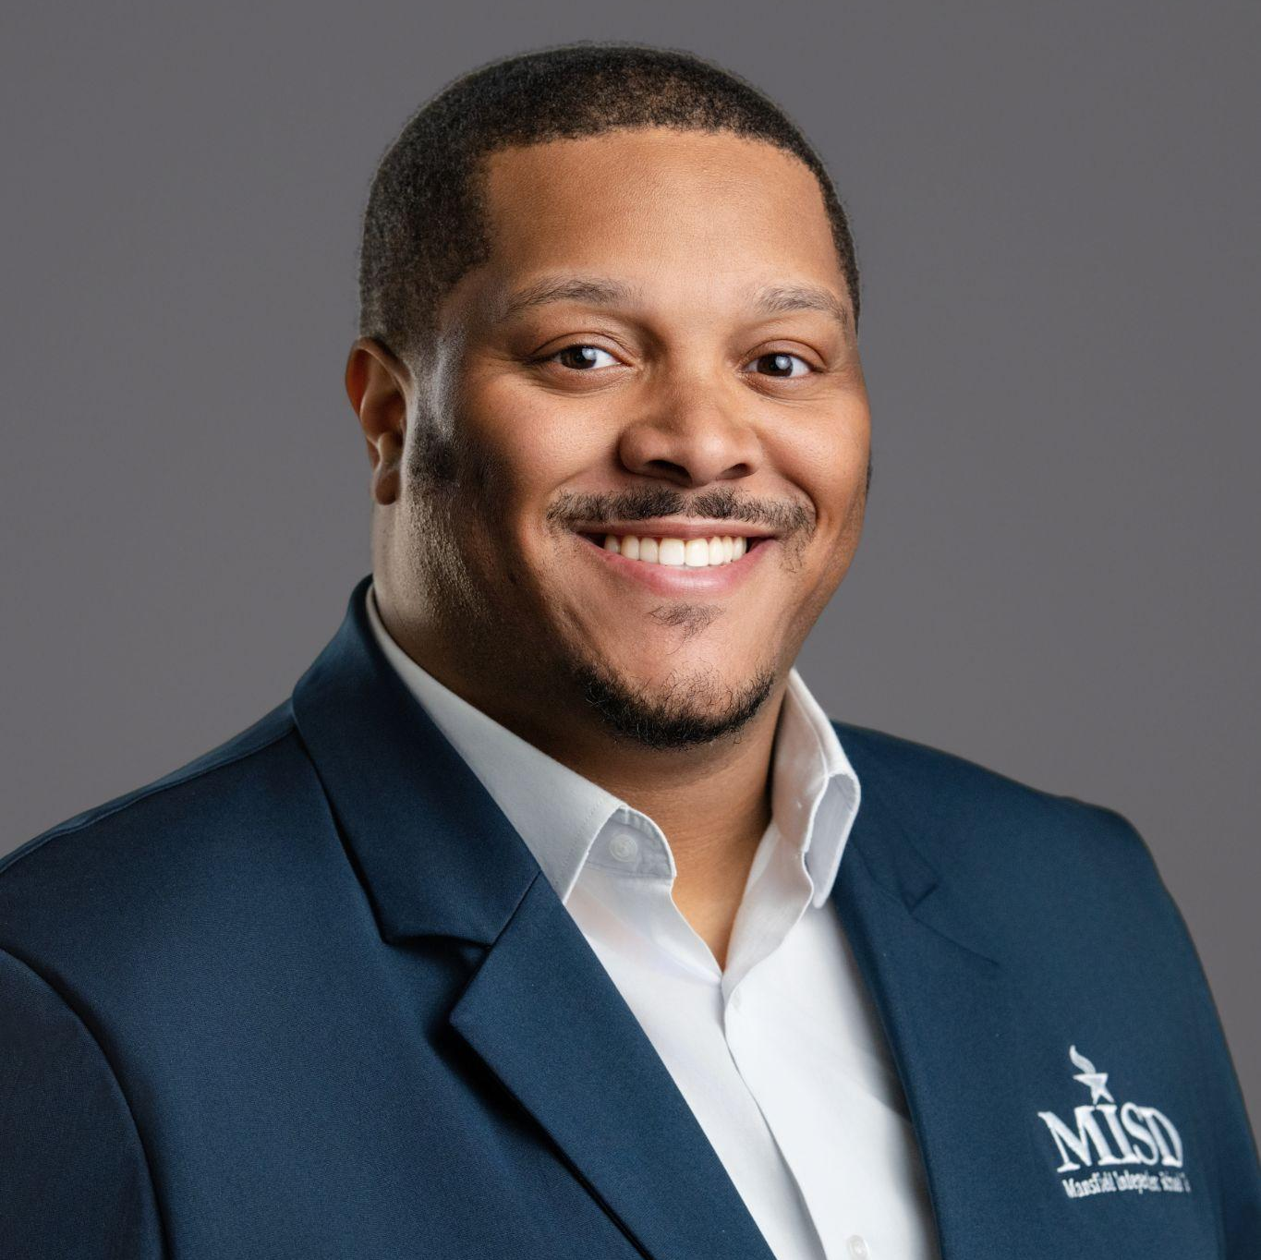
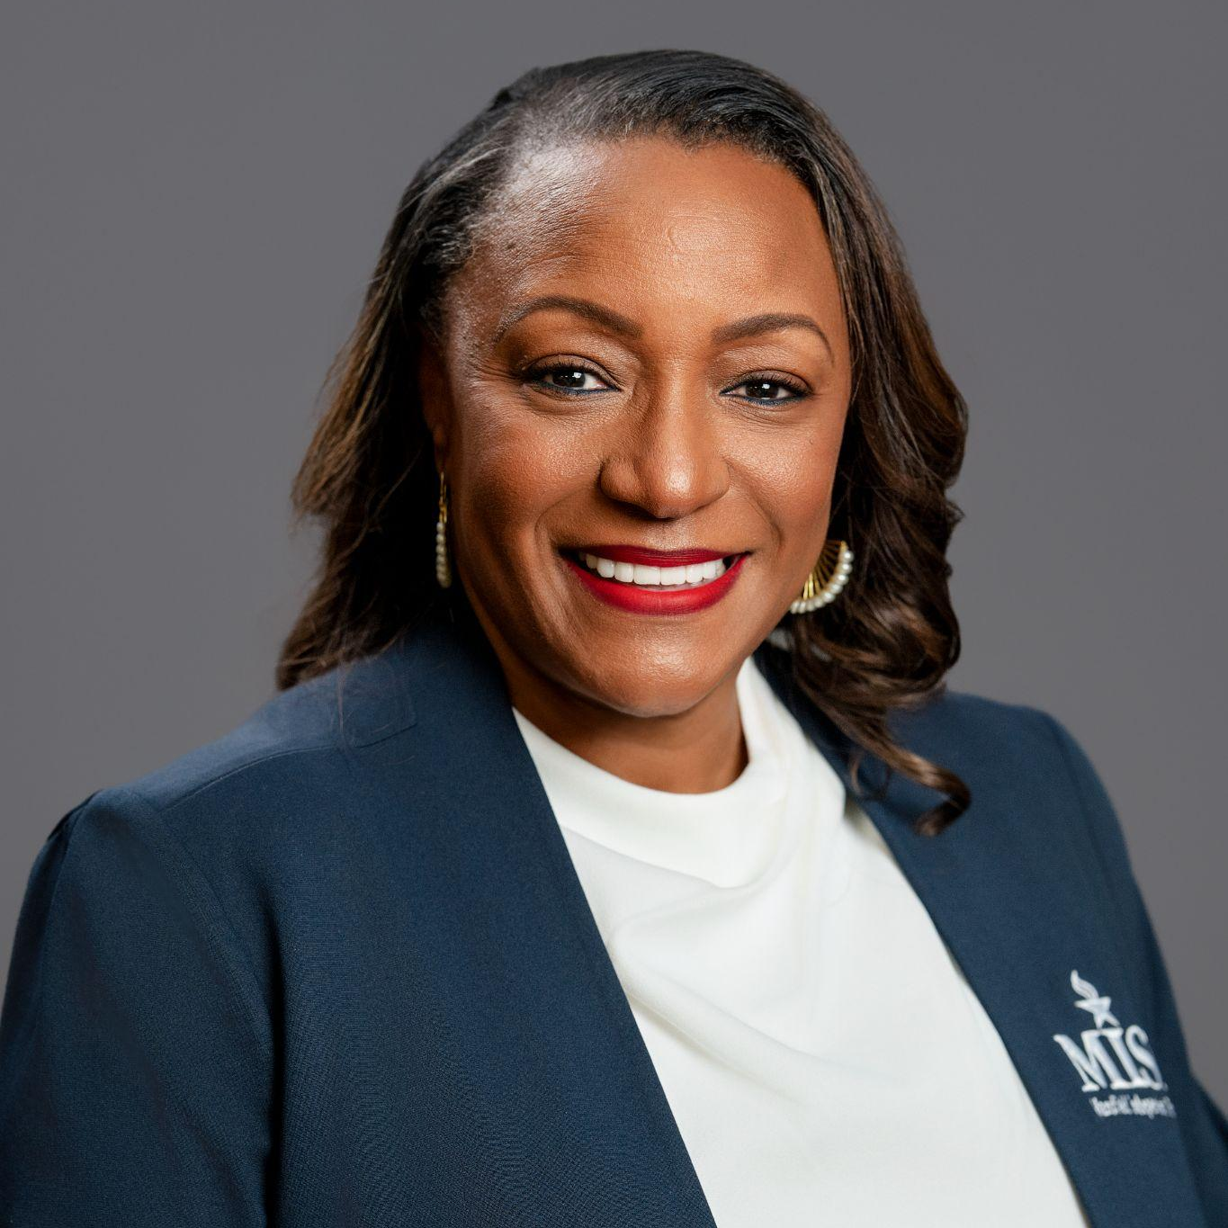
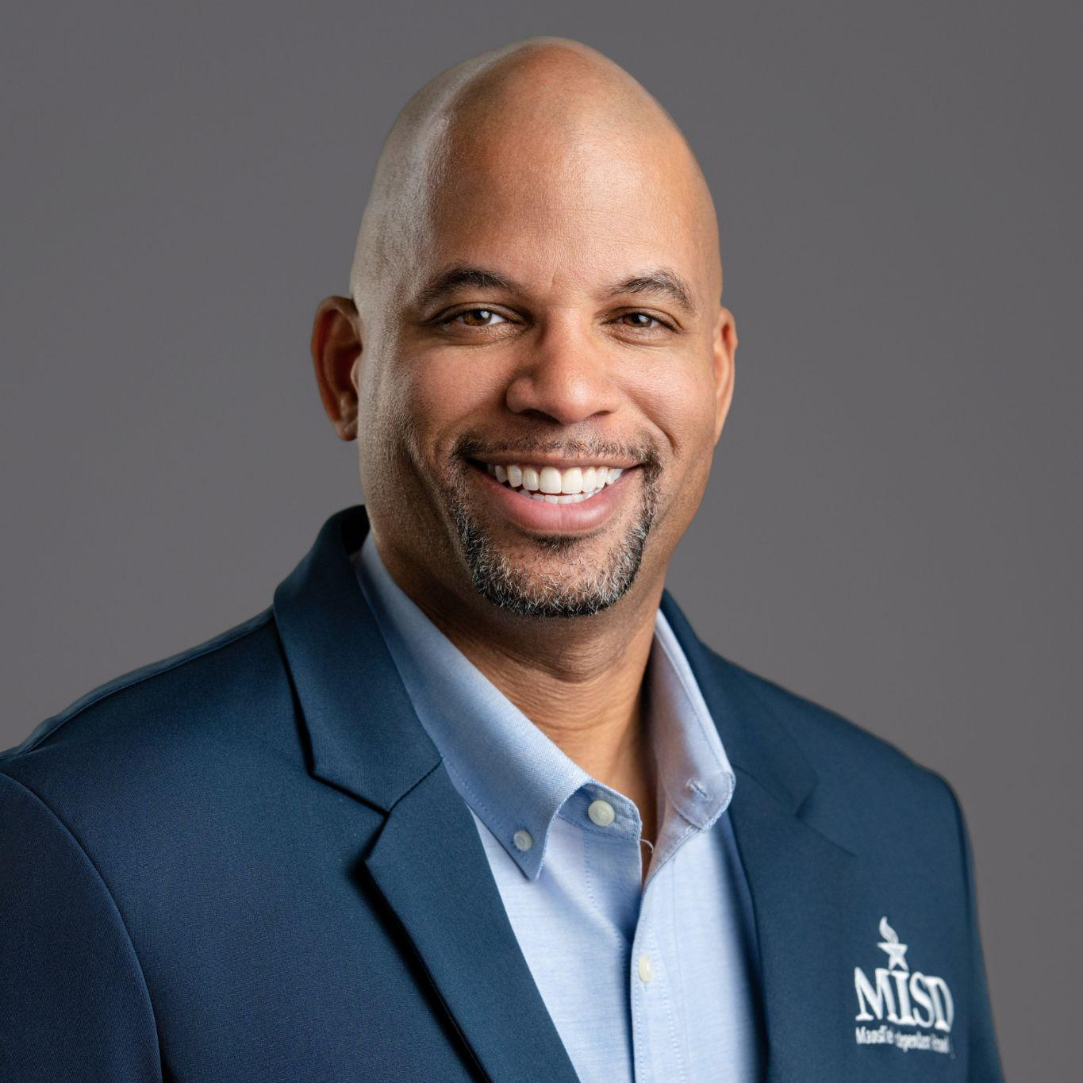
Mansfield ISD Board Members
JESSE CANNON II
BENITA REED
JASON THOMAS
Place 5
Place 6
Secretary
Place 3

Slide 3
Meeting Norms
Remember why we're here:
students come first at MISD.
Speak openly and honestly.
Let everyone participate.
Listen with an open mind.
Don't interrupt.
Think before speaking.
Attack the problem, not the person.
Board policy prohibits the discussion of complaints against employees during an open forum.
Capturing Community
Voice
2

Slide 4
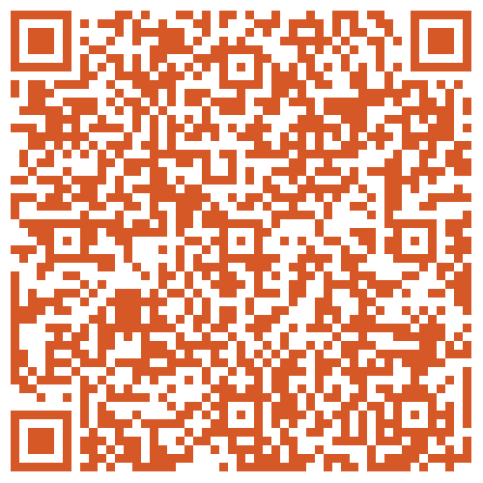
Town Hall Engage Process
Formal Presentation
Please hold comments until the Q&A section of discussion.
Questions & Answers
Each community member must approach mic for comments to be recognized.
Feedback
Feedback form will remain live 30 minutes after conclusion of tonight’s meeting.
Notes:
On August 25, 2026, the Board approved a resolution to start the process of evaluating a single-member trustee district election system. The Board will work with legal counsel and demographic experts as it considers potential district configurations and boundaries.

Slide 5



Where are we now
Legal counsel
AUGUST 25, 2026
The Board will work with legal counsel throughout the process.
Board approves a resolution
Community input
Town halls give residents a chance to understand the options and be heard.
The Board of Trustees voted to initiate the process of evaluating, developing and potentially adopting a single-member trustee district election system.
Demographic experts
Demographers help develop potential district configurations and boundaries.
Notes:
On August 25, 2026, the Board approved a resolution to start the process of evaluating a single-member trustee district election system. The Board will work with legal counsel and demographic experts as it considers potential district configurations and boundaries.

Slide 6
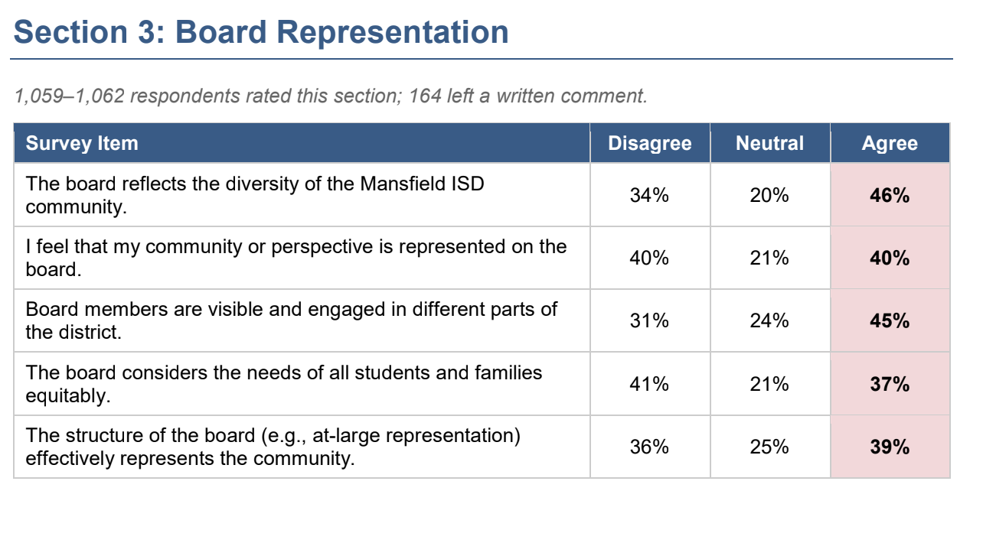
The Survey

Slide 7
The Survey
Key Themes in Written Comments
A substantive, two-sided debate over at-large vs. single-member districts.
This was the most policy-substantive theme in the entire survey. A large number of respondent-across the political spectrum-argued that at-large elections allow a single geographic area, community, or well-funded interest group to dominate every board seat, leaving other parts of the district frequently named as Arlington area, Grand Prairie-area, and south Mansfield/Summit feeder patterns) underrepresented. Proposed alternatives included single-member districts aligned to feeder patterns, a hybrid of district and at large seats, and requirements that candidates demonstrate geunine residency. A smaller group opposed single-member districts, arguing they would encourage parochial “my constituents only” politics instead of districtwide stewardship.
3. Limited board visibility outside of select campuses or events
A recurring complaint was that the same few board members are visible in the community, while others are rarely seen outside of board meetings or election season. Several respondents specifically noted unequal attention to Arlington, Grand Prairie, and other non-Mansfield-proper feeder patterns.

Slide 8
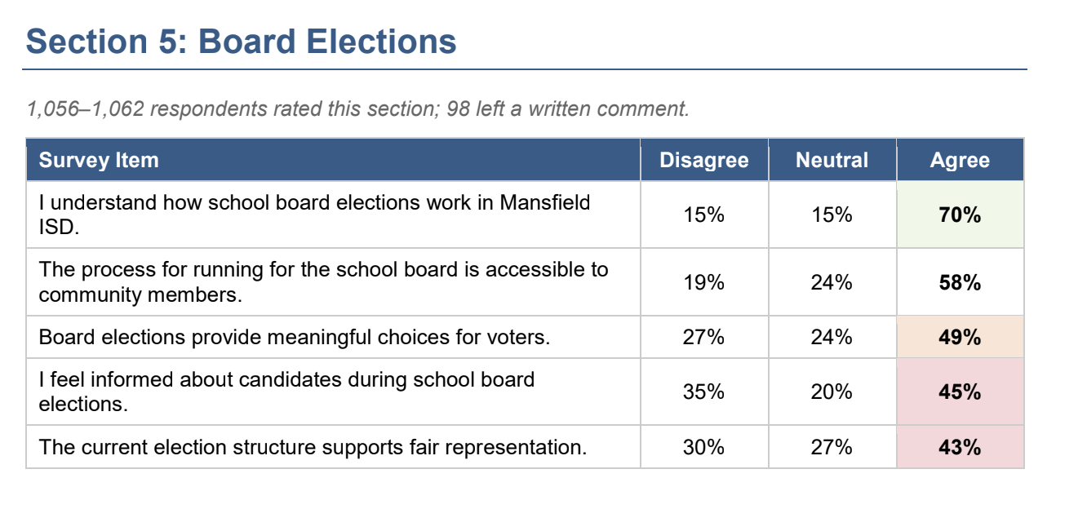
The Survey

Slide 9
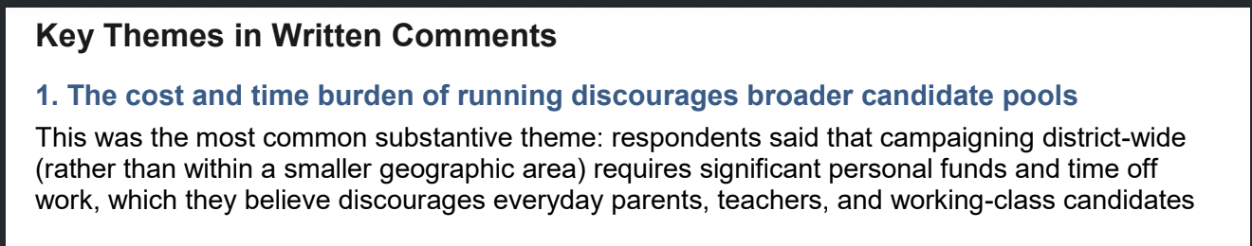
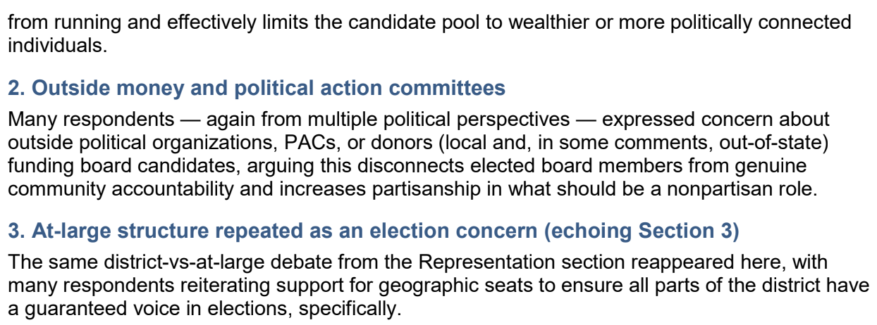
The Survey

Slide 10




Today: seven trustees, elected at-large
7 trustees
At-large
3-year terms
Live anywhere
Seven volunteers serve on the Board of Trustees.
Every trustee is elected by voters across the entire district.
Terms are staggered, so not every seat is up at once.
Trustees may live anywhere within MISD boundaries.
Under this system, voters throughout Mansfield ISD may vote for candidates for each trustee position.
Notes:
Current system: seven trustees elected at-large to three-year staggered terms. Trustees may live anywhere inside the boundaries of MISD, and all voters in the district vote on every trustee position.

Slide 11

What would change?
AT-LARGE (TODAY)
SINGLE-MEMBER DISTRICTS
All eligible voters across MISD vote on each trustee seat
Trustees may live anywhere in the district
No geographic districts within the Board
MISD is sectioned into geographic districts
Voters in each district elect that district's trustee
Candidates must live in the district they seek to represent
Notes:
The Board is also evaluating whether some trustees would continue to be elected at-large as part of a hybrid system, which is the next slide.

Slide 12
Two structures under evaluation
OPTION A
OPTION B
All single-member districts
Hybrid system
All seven trustees are elected from geographic districts by the voters who live inside the district’s boundaries.
At least 70% of trustees (5 of 7) come from single-member districts; the remainder are elected at-large.
Single-member district seat
At-large seat
Texas districts vary: some are all at-large, some hybrid, some all single-member. Authority: Texas Education Code §11.052.
Notes:
Texas Education Code §11.052 allows a board to order that trustees be elected from single-member districts, or that at least 70% be elected from single-member districts with the remainder at-large. Seventy percent of seven is at least five. Option B shows the minimum hybrid (5 district seats + 2 at-large). The Board has not adopted a final configuration and has not determined how many districts there would be.

Slide 13


What would stay the same?
One Board, one district
COMMON QUESTION
The Board of Trustees continues to govern all of Mansfield ISD. No change to anything operationally or structurally under the Superintendent’s duties.
Would a district trustee represent only the people who live in that district?
Responsibility to everyone
All trustees have responsibilities to the district as a whole. Governance and voting will be on all issues. The same as we have done for years.
No.
Votes work the same way
Trustees deliberate and vote on all matters for the entire district, just as they do now and in accordance with Roberts Rules.
Notes:
Key message: a trustee elected from a single-member district must live in and be elected by that district, but the Board continues to govern the entire district. Governance will not change.

Slide 14
How the process works
1
2
3
Conduct community meetings
Engage a demographer
Review input with the Board
Town halls share information and give residents a chance to be heard.
Demographic experts develop potential district maps that meet legal requirements.
The Board reviews what it heard from the community and decides on next steps.
The process will generally include these steps. The Board has not yet decided whether to transition.
Notes:
This is the exploration phase. Community meetings (like tonight), engagement of a demographer on maps, and a review of community discussion information with the Board and next steps.

Slide 15
If the Board chooses to transition
1
Public notice
TEXAS LAW
Newspaper/media posting announces the public hearing.
Education Code §11.052
2
Proposed maps presented
Permits a board to order single-member districts, or at least 70% single-member with the rest at-large.
Proposed map(s) are shared.
3
Public hearing
Held during a scheduled Board meeting.
A public hearing and required notice must come before the order is adopted.
4
Board vote
Vote on a resolution to move to single-member districts.
Notes:
These steps apply only if the Board decides to move forward. Texas law requires a public hearing and proper notice before the Board adopts an order establishing single-member trustee districts.

Slide 16


If a resolution passes
Public information sessions
Update documentation
Community sessions explain the new system and how it works.
Official district documents are updated to reflect the new system.
Publish before the election
Conduct the election
Maps and information are published on the district website prior to the election.
Trustees are elected under the new system.
Texas law requires the order to be adopted at least 120 days before the first election under the new system.
Notes:
If the resolution passes: public information sessions, update district documentation, publish to the district website prior to the election, and conduct the election. The election date has not been finalized.

Slide 17



Map Criteria Requirements
Compact
Contiguous
Near-equal population
Under 10% gap
Consistent with law
As geographically tight as the registered voting population density will allow
One connected, continuous area.
As nearly equal in registered voter population as practicable.
Between the largest and smallest district's voting population.
Applicable federal and state law.
Trustees and District would consult with counsel and demographer on requirements.
Notes:
Proposed trustee districts must be compact, contiguous, and as nearly equal in population as practicable, with less than a 10% difference between the largest and smallest district voting population, and consistent with applicable federal and state law. Boundaries are developed using population and demographic information.

Slide 18


Timing, voters and current trustees
When would it take effect?
Will voters vote on the change?
Not yet set. The order must be adopted at least 120 days before the first election under the new system.
Under Texas law, the Board may initiate the change on its own motion after following the required process.
What about current trustees?
Where must candidates live?
Every sitting trustee’s current residence may be considered for single-member district lines. Barring resignation, all trustees remain on the board.
Candidates for a single-member seat must live in the district they seek to represent.
Notes:
The election date has not been finalized. Texas law allows a board adopting a redistricting plan to provide for trustees in office to serve the remainder of their existing terms. Candidates for a single-member trustee position must reside in the district they seek to represent.

Slide 19
Board Considerations
Additional cost on top of deficit budget
Less risk of territorial division
Fewer candidate possibilities
Gerrymandering of maps
Fragmentation and inconsistent policy
Notes:
Proposed trustee districts must be compact, contiguous, and as nearly equal in population as practicable, with less than a 10% difference between the largest and smallest district voting population, and consistent with applicable federal and state law. Boundaries are developed using population and demographic information.

Slide 20
Board Considerations
Geographic representation on the board (7 cities in MISD)
Broader pool of candidates due to lower costs
Prevent outside money from determining local candidates
Deeper knowledge and relationship to community
Other types of diversity able to be reflected on the board
Notes:
Proposed trustee districts must be compact, contiguous, and as nearly equal in population as practicable, with less than a 10% difference between the largest and smallest district voting population, and consistent with applicable federal and state law. Boundaries are developed using population and demographic information.

Slide 21
FAQs from Website
Single-Member and At-Large District Performance
Dallas ISD - 85 (B)
Fort Worth ISD - 77 (C)
Grand Prairie ISD - 80 (B)
Lamar Consolidated ISD - 87 (B)
Lewisville ISD - 83 (B)
Richardson ISD - 83 (B)
Arlington ISD - 78 (C)
Alvin ISD - 87 (B)
Denton ISD - 76 (C)
Midlothian ISD - 89 (B)
Burleson ISD - 83 (B)
Keller ISD - 84 (B)
8
Notes:
This is the exploration phase. Community meetings (like tonight), engagement of a demographer on maps, and a review of community discussion information with the Board and next steps.

Slide 22
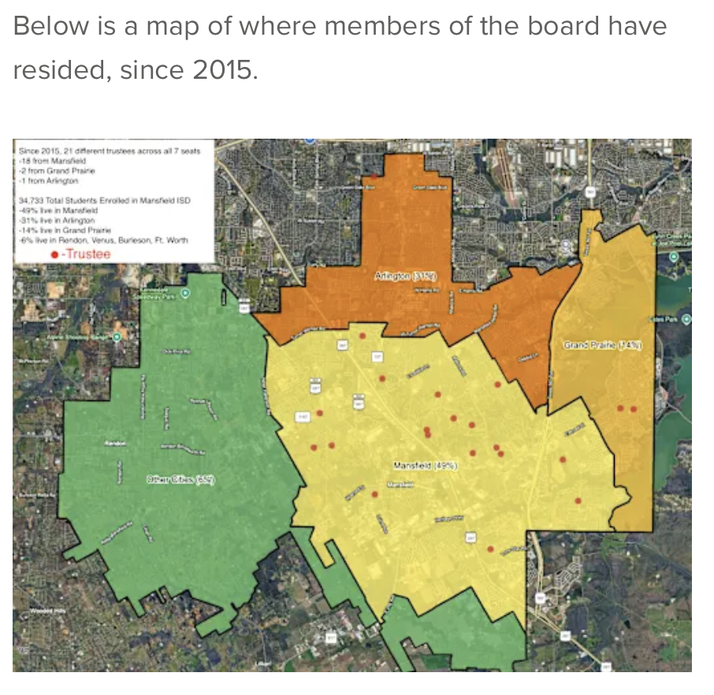
Notes:
This is the exploration phase. Community meetings (like tonight), engagement of a demographer on maps, and a review of community discussion information with the Board and next steps.

Slide 23
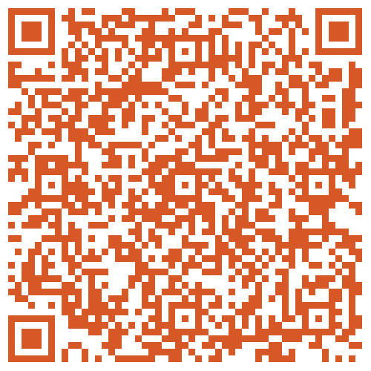
Considerations/Questions?
UPCOMING TOWN HALL MEETINGS
10/1-Lake Ridge
Watch the district website and Board agendas for dates.
Notes:
Residents will have opportunities to attend town halls, review maps, submit written comments and/or speak publicly, get questions answered, and participate in the public hearing. Only registered MISD voters can speak at the hearing. Upcoming meeting dates are still to be announced; add dates here once confirmed.

