Slide 1
Welcome to Fifth Grade!

Slide 2
CCPS Security and Emergency Response

Slide 3
Goal
To provide a safe and secure learning environment for all students.
Security can be inconvenient
Balance security and efficiency
Cannot completely lockdown schools and operate
Notes:
It is important to stress that we do our best to provide a safe learning environment.
We take reasonable measures and follow best practices

Slide 4
Visitor Management
Standard practice for ALL visitors and parents
Visitors are expected to use the intercom system
  No answer - call the schools main number (posted by the intercom)
  Will be asked your reason for the visit
  Report directly to the main office
Do not hold the door open for other visitors
Beyond the main office
  Will be required to show valid govt. issued photo ID
  No ID – not permitted to go beyond main office without escort
Notes:
Stress the importance of consistency in our practices
This vetting process is our first line of defense

Slide 5
Special Circumstances
Visitor management system might not be used for large events like assemblies, etc.
Schools may require a RSVP for such events
Elem. Schools may use blocks of time for visits during events like field day
Notes:
Due to the number of visitors during assemblies, concerts, etc. it is impractical to check everyone in through the VMS
This is justified by an increase in parental supervision

Slide 6
Standard Response Protocol (SRP)
Critical incidents trigger one of 5 actions
  Hold
  Secure
  Lockdown
  Evacuate
  Shelter
Administrators and staff are trained on the SRP annually
Staff also receives additional training for active assailants
Schools to drill these actions in various forms (required by law)
Most actions precautionary

Slide 7
Parent Expectations
Receive notification from Central Office
  As soon as possible – accurate information must be obtained
  Remain by phone or email for updates/instructions
DO NOT GO TO THE SCHOOL UNLESS INSTRUCTED
  Many actions are precautionary - school will return to normal activity
  No access to students until situation is rendered safe
  Responding to school compounds issues for staff and emergency responders
DO NOT CALL THE SCHOOL FOR INFORMATION
  Staff are busy handling incident
  Updates will be sent via School Messenger

Slide 8
26 – 27 Drill Schedule
Two (2) lockdown drills between 9/8 - 11/20
Minimum of five (5) fire evacuation drills
Two (2) secure drills
One (1) earthquake drill
One (1) severe weather drill
One (1) gas leak evacuation drill
One (1) hold drill
***Any student who experiences an adverse reaction to the drill or any incident that occurs will be provided appropriate mental health resources.

Slide 9

HOLD
Internal situation (medical emergency, hazmat spill, etc.)
Actions:
Clear the hallways and remain in room
No one enters the area in which isolation has been implemented
Conduct business as usual within held room or area
May be localized to one area or entire school
Notes:
You will remain in your class even if the bell rings. If you’re in the hallway, public address might be made to go to the nearest classroom. Or proceed to your next scheduled class.
With the Hold protocol, we just don’t want what’s happening in the hallway to spill into the classroom. Students remain in their seats, continue lessons, or if lessons are done, students may be given time to read or study

Slide 10

SECURE
External Threats or Police Activity in Area
Actions:
Verify all exterior doors are closed and locked
No outside activity
No one comes in or out of building
Classes may change – students may move around in building
*THIS REPLACED THE OLD SRP TERM OF LOCKOUT*
Notes:
It is important to stress that this is not a LOCKDOWN
Predominantly this is done as precaution at the direction of the police

Slide 11

LOCKDOWN
Internal Threats – Trespasser or Assailant
Actions:
Close doors (doors are staged in the locked position)
Fortify doors – barricade or tie off as appropriate
Move away from doorway – out of sight from hallway
Quiet – phones silenced and no talking
Evacuate through primary or secondary exit - if safe
Students stuck in hallway – evacuate through nearest safe exit
Notes:
Remind guardians during the initial stages of a lockdown they may not hear from their child due to the silence requirement.
Students will eventually be allowed to text their parent to let them know they are ok.
It is also important to remind guardians that not everything transmitted via social media by students and staff is accurate.

Slide 12

EVACUATE
Directed - fire, gas leaks, bomb threat or other internal issues
Actions:
Evacuate through nearest safe exit
Move to predesignated locations
May reenter building if determined safe by fire department
Notes:
No need to spend a lot of time on this.

Slide 13

SHELTER
External – Chemical spill, severe weather
Actions:
Remain inside the building
Take specific actions due to threat i.e., tornado
Depending on incident students may eventually be evacuated
Notes:
No need to spend a lot of time on this other than reinforce that this is not a term used for an action during active assailant incident.

Slide 14
Reunification
If students are evacuated to another location:
Guardians will receive specific instructions for student pick up or transportation via school messenger
Make sure you bring photo identification when picking up your student
Accountability is very important
Guardians should exercise patience

Slide 15
School Resource Officers (SRO)
Primary Responsibilities:
Provide security
Handle crimes that schools would normally request police response
Develop positive relationships with students (mentor)
Will not be used for or in lieu of school discipline
See CCPS - Security website for specific roles and authority for SROs

Slide 16
Security Initiative
Middle schools without a permanent SRO’s will have deputies assigned on overtime
All schools will continue to receive routine patrols by law enforcement officers

Slide 17
“See Something, Say Something”
“Don’t Repost”
Reporting
  Don’t delay
  During normal schools hours – report to school administrators
  After hours – report to local law enforcement
  Social media threats should be photographed, or screen shot
  Never repost or spread rumors
All threats are treated seriously
  Collaborative Investigations – school admin., school security and local law enforcement
  Most are unsubstantiated
Notes:
Stress how seriously we take all threats
Most end up not being a real threat and are statements taken out of context.
We look at the totality of the circumstances
Drive home the necessity to report immediately – many threats are not reported until very late in the evening, which reduces the amount of time for investigation before school reopens.
Also mention that it is typical to see patrol cars around the school in the morning
We are limited on what we able to communicate to guardians due to FERPA

Slide 18

The 5th Grade Team:
Jennifer(Carpenter)Childers
Alex Clizbe
Jessica Krantz
Amy Glascock
Karen Marroquin
Denise Sharbaugh
Support team: Christine Amundson, Tina Sellers, and Kate Foster

Slide 19
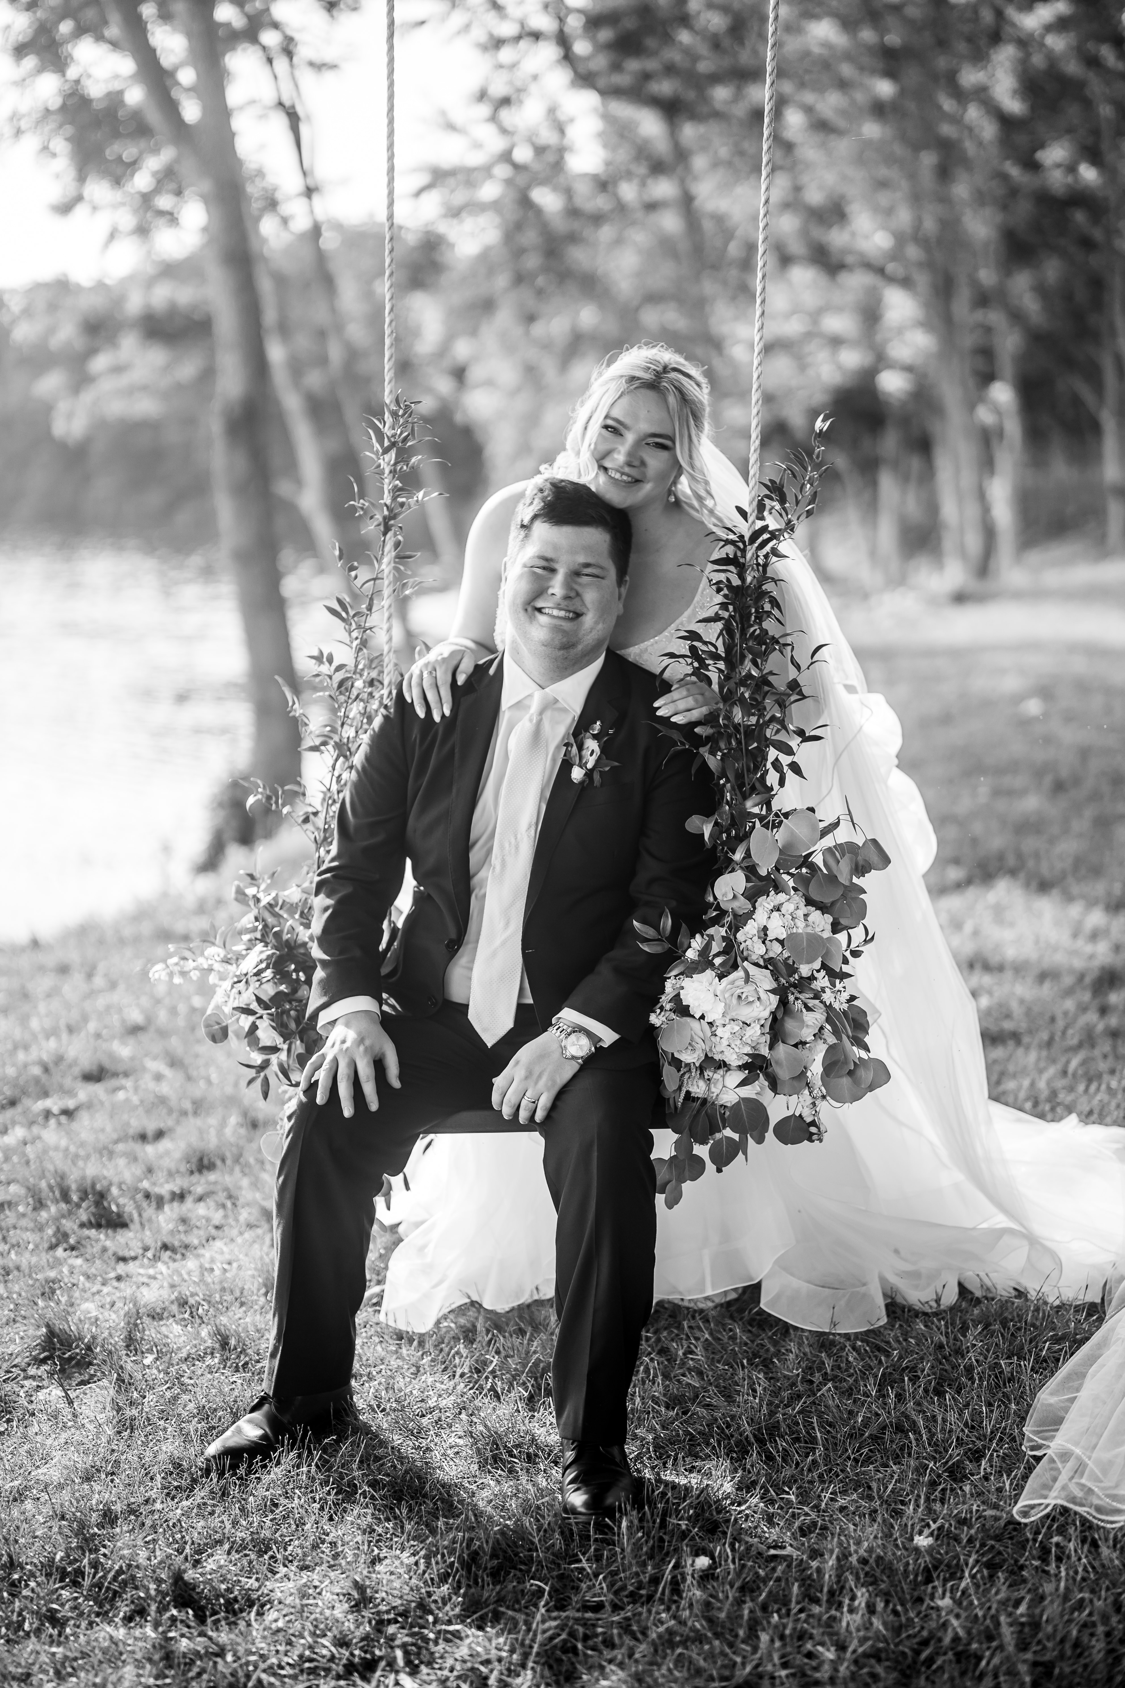
Jennifer Carpenter (Childers)
This is my 7th year of teaching, and I have spent all 7 years here at Winfield in 5th grade. I am currently working towards masters in Instructional Technology and becoming national board certified. I am married and have 16 nieces and nephews!

Slide 20
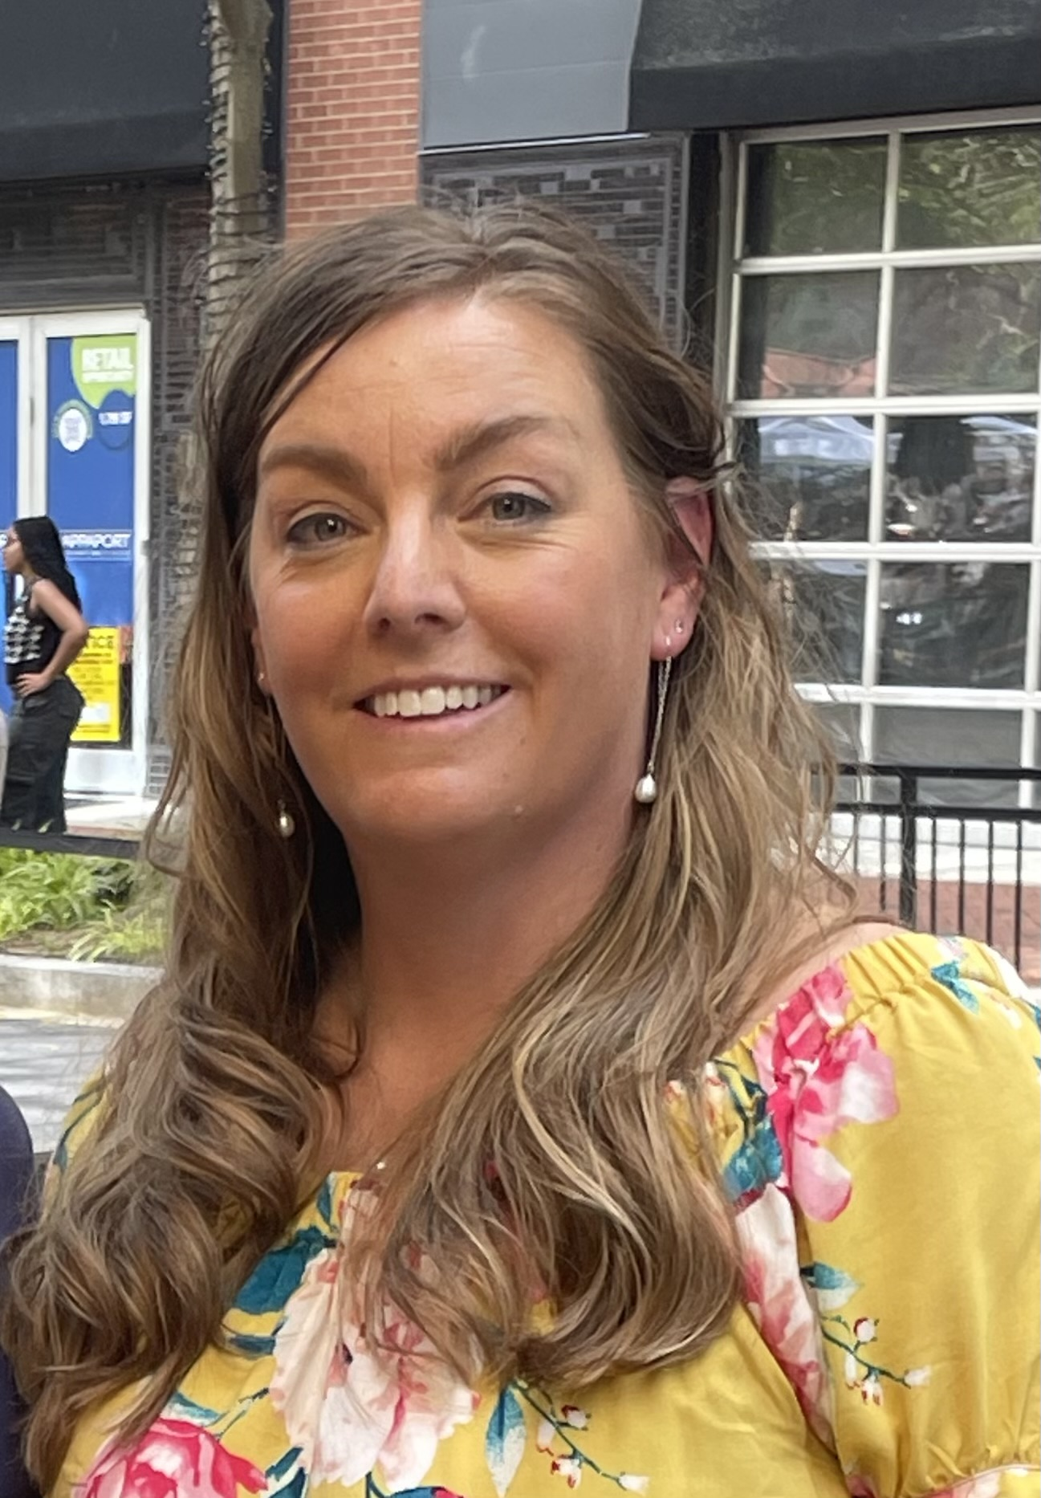
Jessica Krantz
This is my 23 year of teaching and my 10th year at Winfield. I have Master’s degree in Curriculum and Instruction, administration certification, and am nationally board certified. I have two sons, who both play baseball.

Slide 21
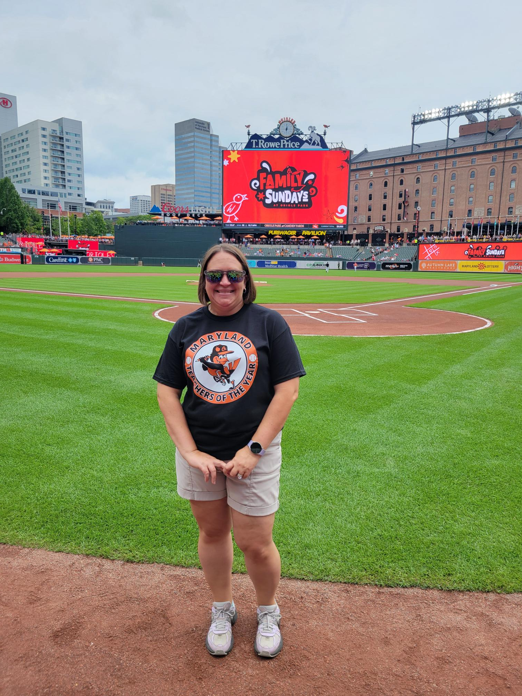
Amy Glascock
This is my 23rd year of teaching and my 9th year at Winfield. I have a master's degree in technology integration in the classroom and am a national board certified teacher. I have a 6th grader at MAMS and an 9th grader at SCHS. They both enjoy being outside riding dirt bikes. I have taught 1st, 2nd, 3rd, and 5th grade. I look forward to this new group of 5th graders!

Slide 22
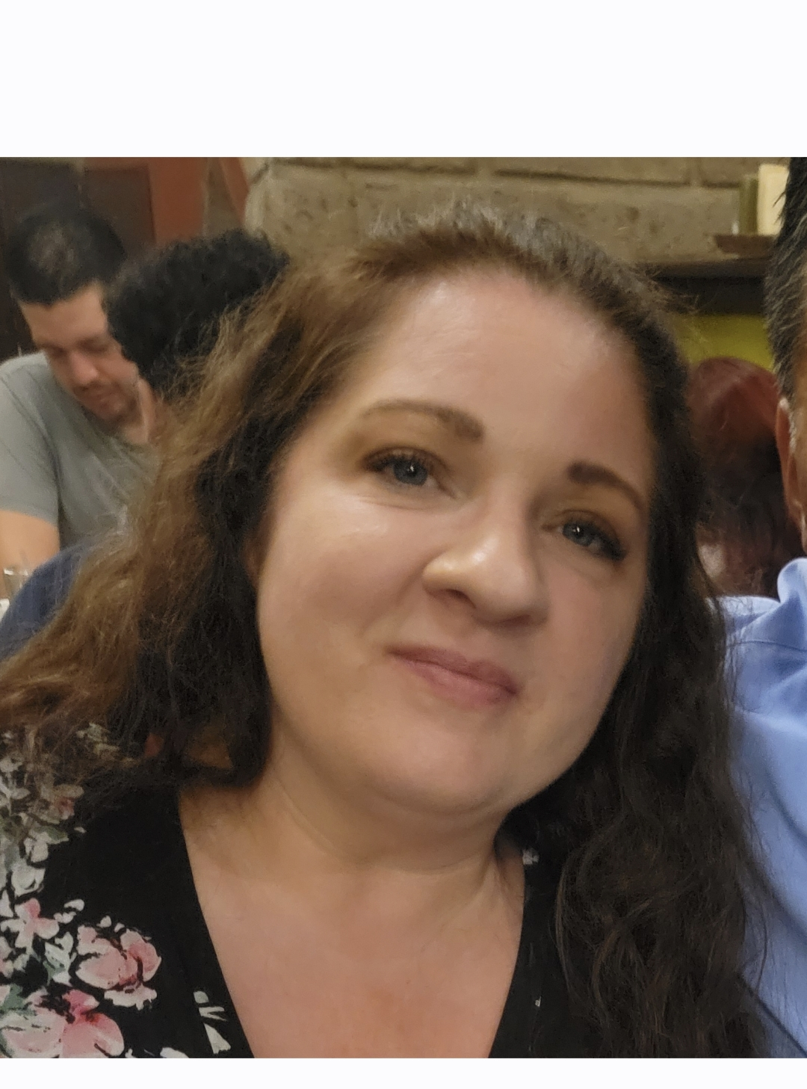
Karen Marroquin
This is my second year at Winfield Elementary. I am one of the STEMS teachers for fifth grade this year. I have taught for eleven years. I have a Bachelor's degree in Psychology and my Master's Degree in Elementary Education. I have four children of my own. Two boys and two girls. I also have a sweet little grandson who is three -years-old.

Slide 23
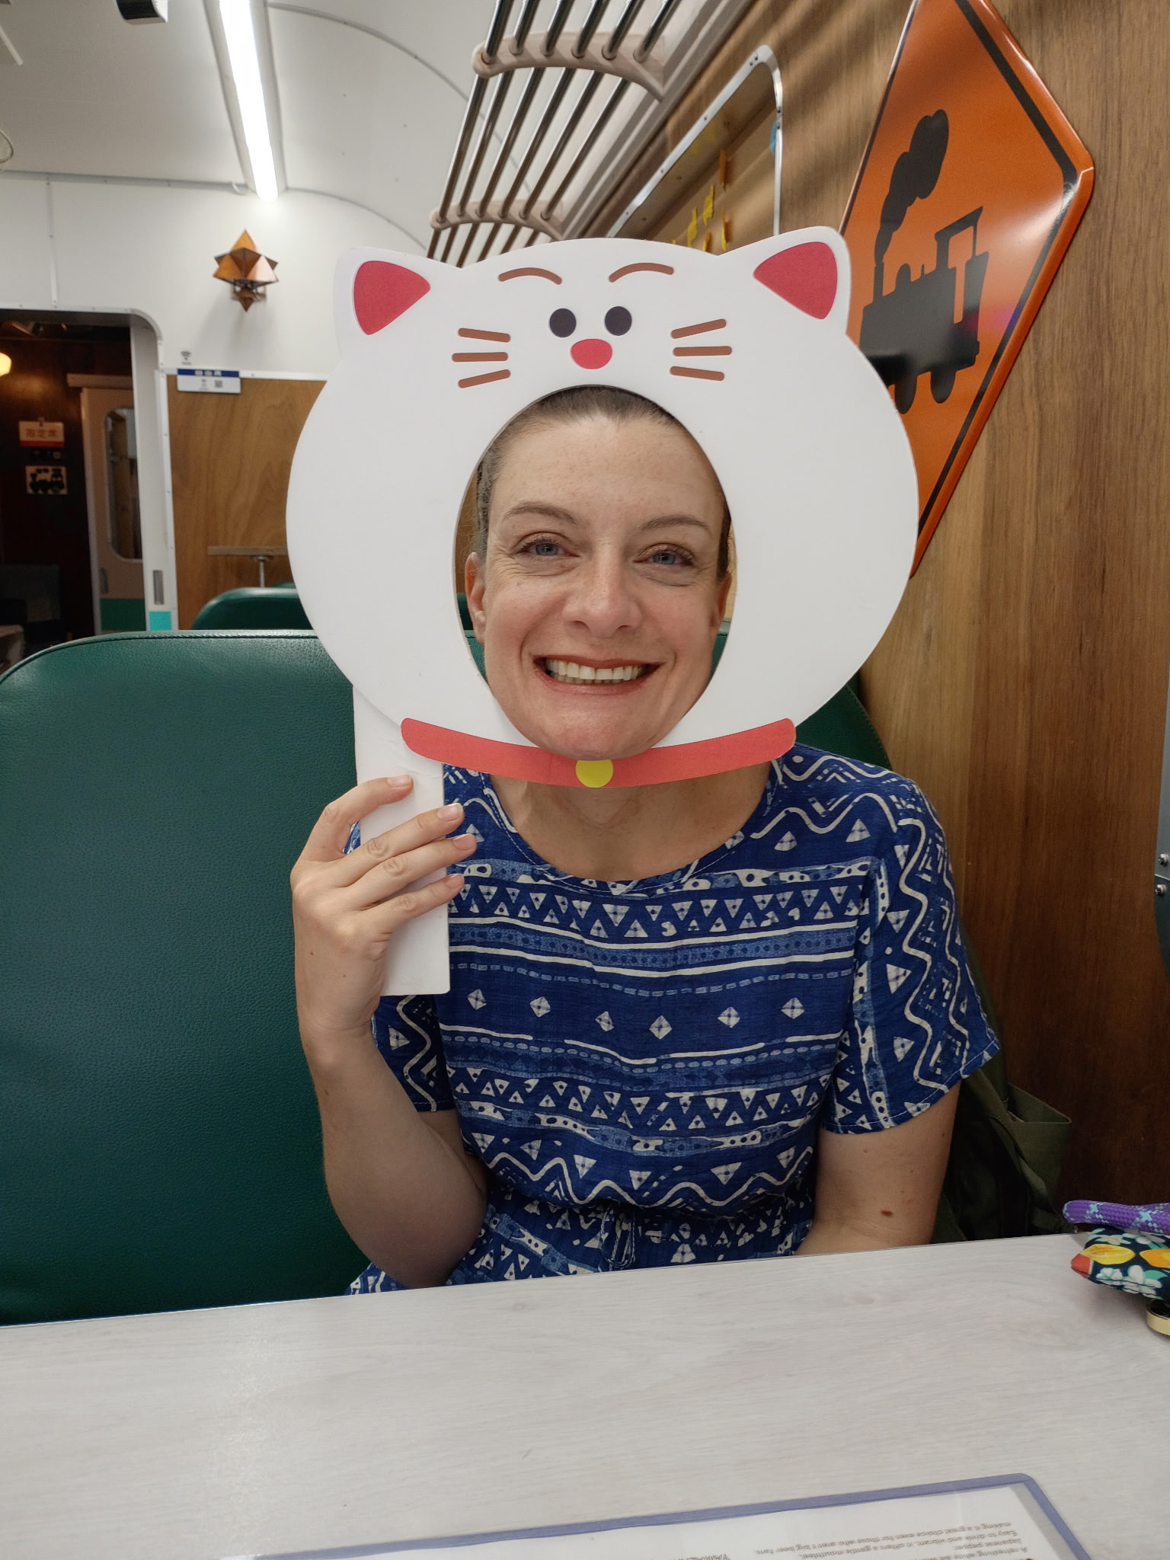
Denise Sharbaugh
This is my 17th (!) year teaching at Winfield. I started in 5th grade, moved to 3rd and then to 4th and now I’ve come full circle!
I have a Master’s Degree in curriculum and instruction and two teaching endorsements; STEM Leadership and ESOL. I am looking forward to working with your child (again?) this year!

Slide 24
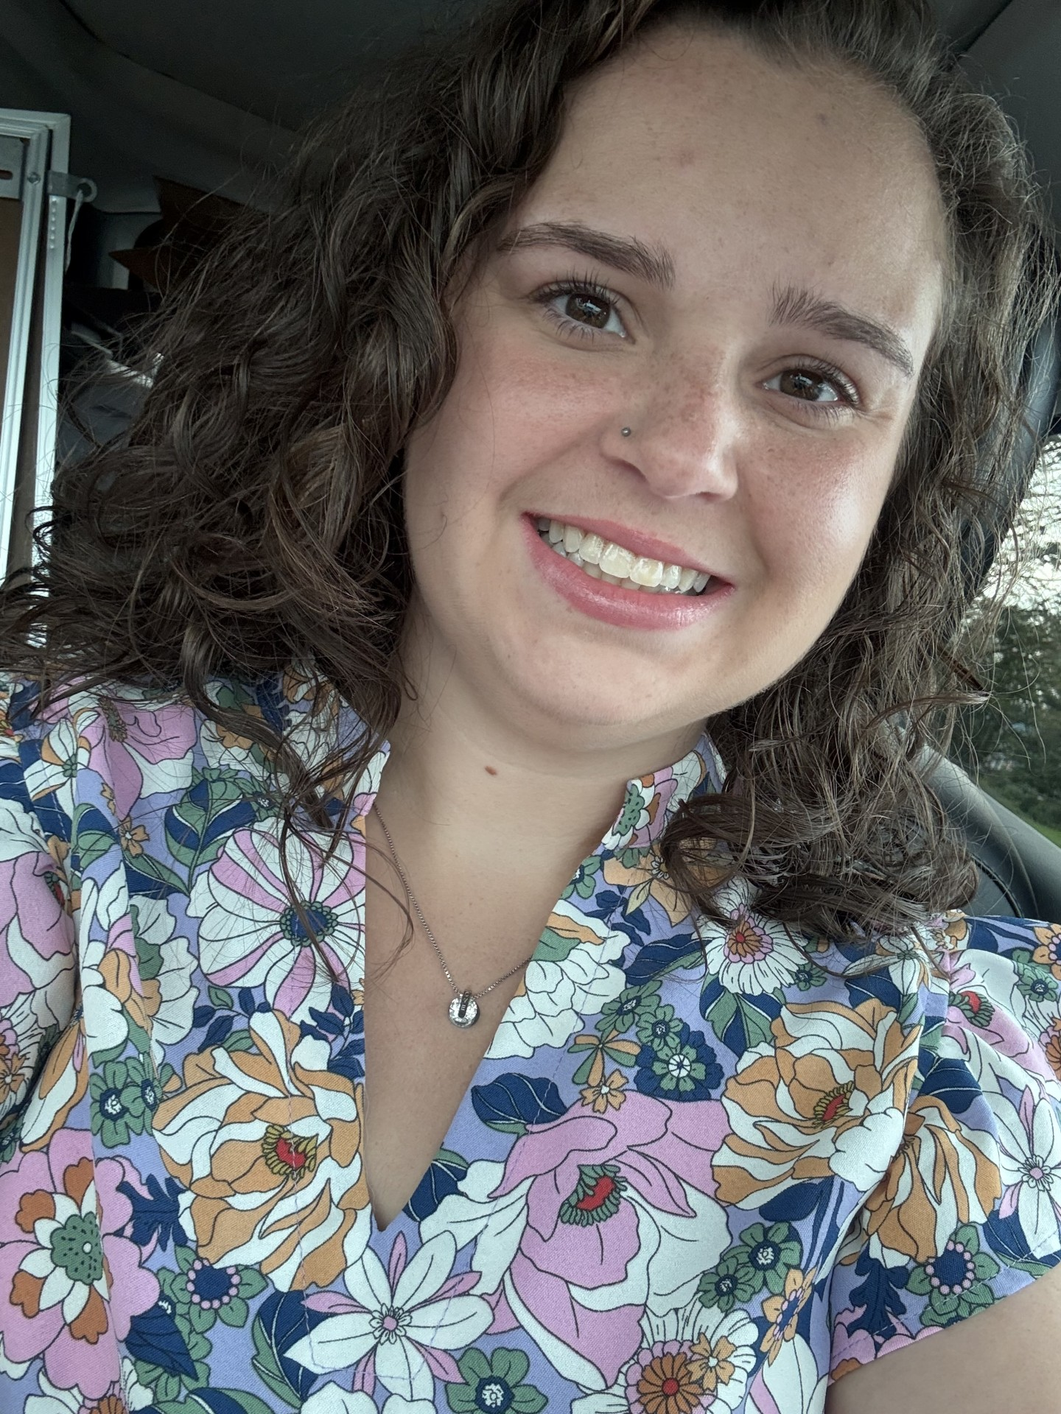
Alex Clizbe
My name is Ms. Clizbe. I may be new to Winfield, but I am not new to working with students from a variety of ages and backgrounds. I have over seventeen years of experience working with children, and I am passionate about helping students learn, grow, and feel supported.
I earned my master’s degree in Elementary Education, graduating at the top of my class. I am also a lifelong Girl Scout, and I look forward to becoming more involved in the Winfield community and building meaningful connections with students and families.

Slide 25

Daily Schedule
Arrival 9:00 - 9:30
Specials 9:35-10:35
WEN Time 10:35-11:10
Session 1 11:10-12:15
Lunch 12:15- 12:45
Recess 12:45 – 1:15
Session 1 1:15 – 2:00
Session 2 2:00-3:50
Dismissal 4:00
Notes:
Karen

Slide 26
Fifth Grade Expectations
Come to class with all materials
Remain in their assigned seats during instruction
Use respectful language to teachers and classmates
Actively participate during instruction
In our classroom, personal fidgets are not part of our general classroom materials because they can sometimes become a distraction for the student or others. We do, however, follow any accommodations that are documented in a student’s IEP, 504 Plan, or other school-approved support plan.

Slide 27
WEN (What Everyone Needs) Time
Students identified through screening (STAR Assessment) will receive additional support beyond core classroom instruction.
Students receiving additional support will get:
Targeted, evidence-based structured literacy interventions
Instruction aligned with the Science of Reading and Structured Literacy practices
Ongoing progress monitoring to guide next steps
Students not receiving additional support may work on the following:
AA curriculum extensions/Benchmark extensions
Handwriting practice (cursive)
Freckle (reading comprehension, vocabulary, phonics, word study)
Inquiry & research projects

Slide 28
5th Grade Math
Carroll County Math Curriculum
Unit 1- Understanding the place value system with whole number and decimals
Unit 2- Decimal Computation- Addition and Subtraction
Unit 3- Whole number and decimal multiplication and volume
Unit 4- Division of whole numbers and decimals
Unit 5- Operations, expressions, and measurement conversions
Unit 6-Addition and Subtraction of fractions
Unit 7-Multiplication and division of fractions
Unit 8- Geometry

Slide 29
Social Studies Units
Unit 1 – Constitution and The Bill of Rights (1780-1800)
Unit 2 – Challenges of an Expanding Nation (1800-1865)
Unit 3 – Post Civil War America (1865-1930)
Unit 4 – Challenges of the 20th Century (1900-Today)
Notes:
Jen

Slide 30
Science Units
Earth Systems
Survivor
Earth and Space
Notes:
Karen

Slide 31

All students in grades 2-5 will be taught curricular standards using Benchmark Advance resources.
Benchmark Advance is aligned to the Science of Reading- It is based on current research.
Students will be engaged in developing their vocabulary and background knowledge, understanding language structure, literacy knowledge and verbal reasoning. Developing these skills will help students comprehend texts.
Students will have the opportunity to broaden their knowledge by reading multiple texts on a topic.
Students will be engaged in writing that is connected to their current reading.
Benchmark Advance integrates Literary, Social Science, and Science topics.
Benchmark Advance provides assessments to monitor progress.
Notes:
Amy
Explain the purpose of reading and writing to learn the content (knowledge)

Slide 32

UNITSNITs
2nd 3rd 4th 5th 6th
Benchmark Advance provides the opportunity to build knowledge within the grade level as well as across grades.
Benchmark Advance Program Guide, 2022
Notes:
Amy
Grades 4-5- as written in Benchmark (tied into writing) these lessons are short and do not occur every day.
The scope and sequence will help to reinforce skills in FUNdations and expand into more advanced word study.

Slide 33

Family letters and
classwork magazines
will be coming home for each unit.
Notes:
Set the Intention of Benchmark Advance
Explain the purpose of reading and writing to learn the content (knowledge)

Slide 34
Every day in ELA class students will:
~listen to read aloud
~participate in reading/vocabulary lessons
~write about their reading in writing/language lessons
~focus on phonics/word study lessons (a few times a week)
Notes:
Amy
Explain the purpose of reading and writing to learn the content (knowledge)

Slide 35

Small groups are:
*Daily
*Flexible (changing often)
*Based on need
Needs could be:
~reading
~writing
~phonics
~extension
Notes:
Amy
Explain the purpose of reading and writing to learn the content (knowledge)

Slide 36

Formal Assessments
Science- MISA (Maryland Integrated Science Assessment)
MCAP- Will be given once (Spring) this year in math and reading/writing.
Reading/Writing | Math and Science
STAR- given three times One Social Studies Informational Assessment 2 Benchmark Advanced Assessments (1 Pre and 1 Post) | County Jan./May benchmarks on Performance Matters Unit assessments on Performance Matters
Notes:
jen

Slide 37

Band/Chorus
Please know that your student will be missing instruction during band practice. It is the student’s responsibility to make up the missed work. Arrival is also a good opportunity to make-up missed work.
Notes:
jen

Slide 38
Home-School Communication
Jennifer Childers jennifercarpenter@carrollk12.org
Jessica Krantz jessicakrantz@carrollk12.org
Amy Glascock amyglascock@carrollk12.org
Karen Marroquin karenmarroquin@carrollk12.org
Denise Sharbaugh denisesharbaugh@carrollk12.org
Alex Clizbe AlexandraClizbe@carrollk12.org
*You can always communicate by a note or a phone call if you do not have email.
Winfield: 410-751-3242
Notes:
amy

Slide 39
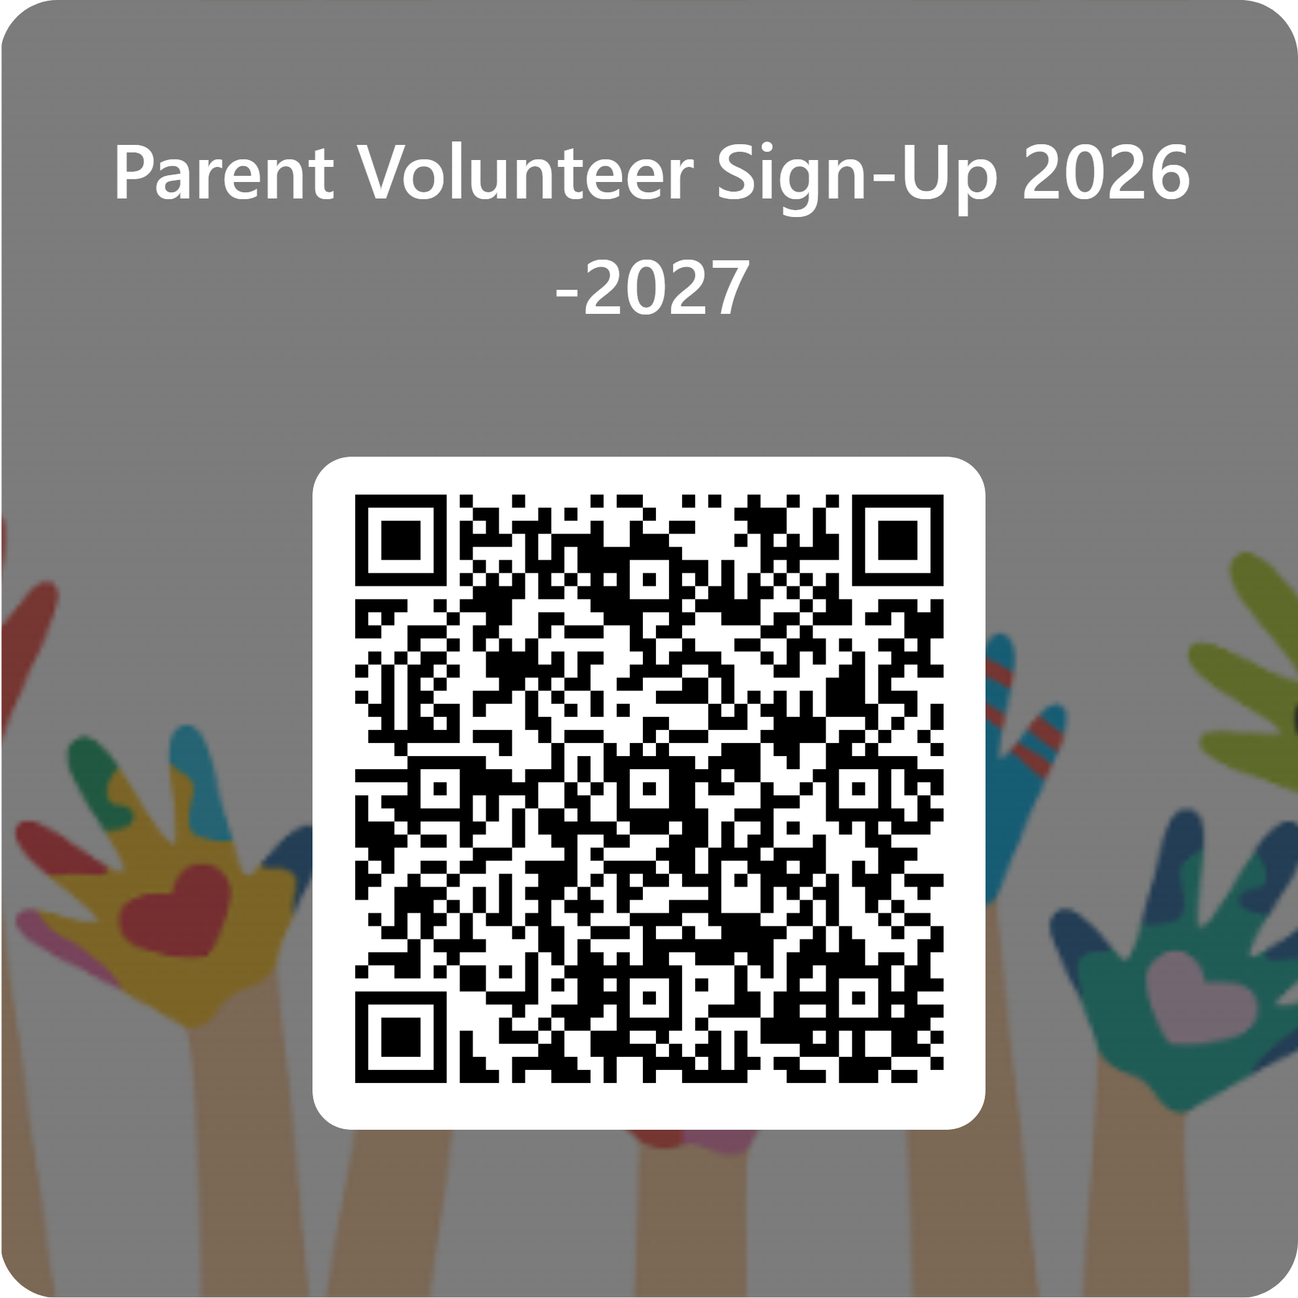
Parent Volunteers
Please volunteer!
All volunteers must be trained 7 school days before you are able to volunteer, this includes field trips.
If you are interested in volunteering, please complete the Microsoft Form that is posted with the QR code.
Notes:
amy

Slide 40
Grades
Students’ responsibility
Parent’s responsibility
Check home access center frequently
  We input grades weekly
Check with your child if assignments are marked NHI (not handed in) or are blank. As the year processes, we will be stricter on the time frame for redos and missing work. This is to prepare your child for middle school
When in doubt, contact us as soon as possible
Check the agenda for missing assignment and test dates
Complete assignments in a timely manner
Have a positive attitude
Always try his or her best
If assignments are missing or incomplete, take them home or use arrival time to finish
Check on TAC to see if they are missing assignments.
Notes:
Karen

Slide 41
Field Trips
We are planning two field trips this year. A STEM trip will be in the fall and a Social Studies trip in the spring.

Slide 42
How to Connect to Your Child’s Schoology Classes?
Log in to Home Access Center
On the registration page will be a code for your child’s account
Log into Schoology.com and sign in as a parent using the code

Slide 43
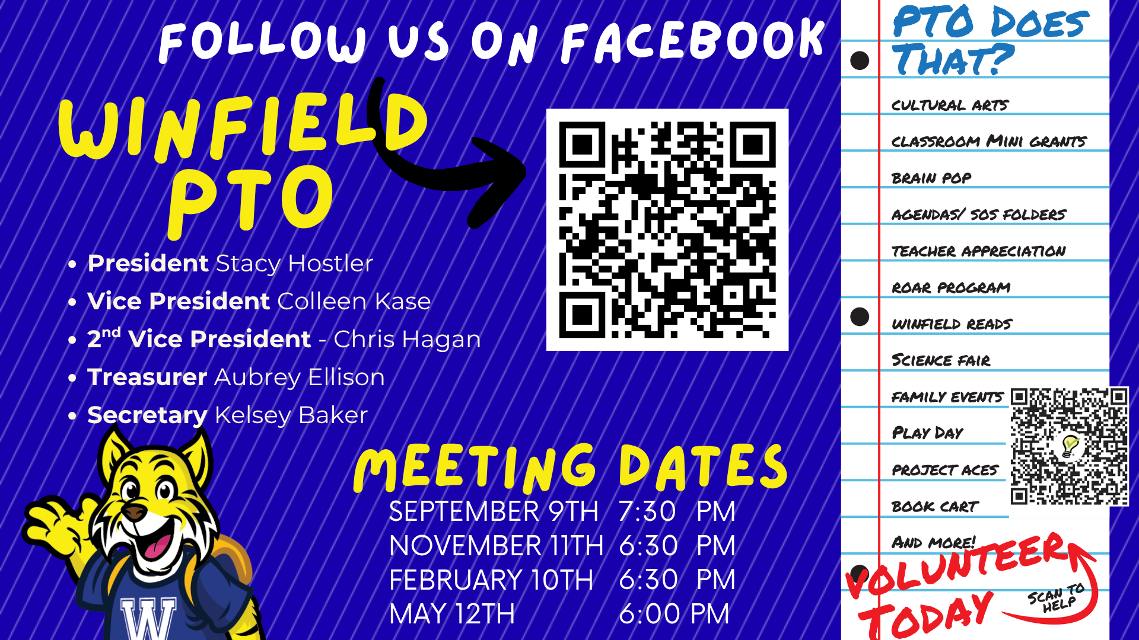
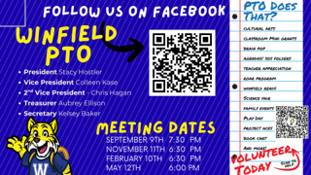

Slide 44
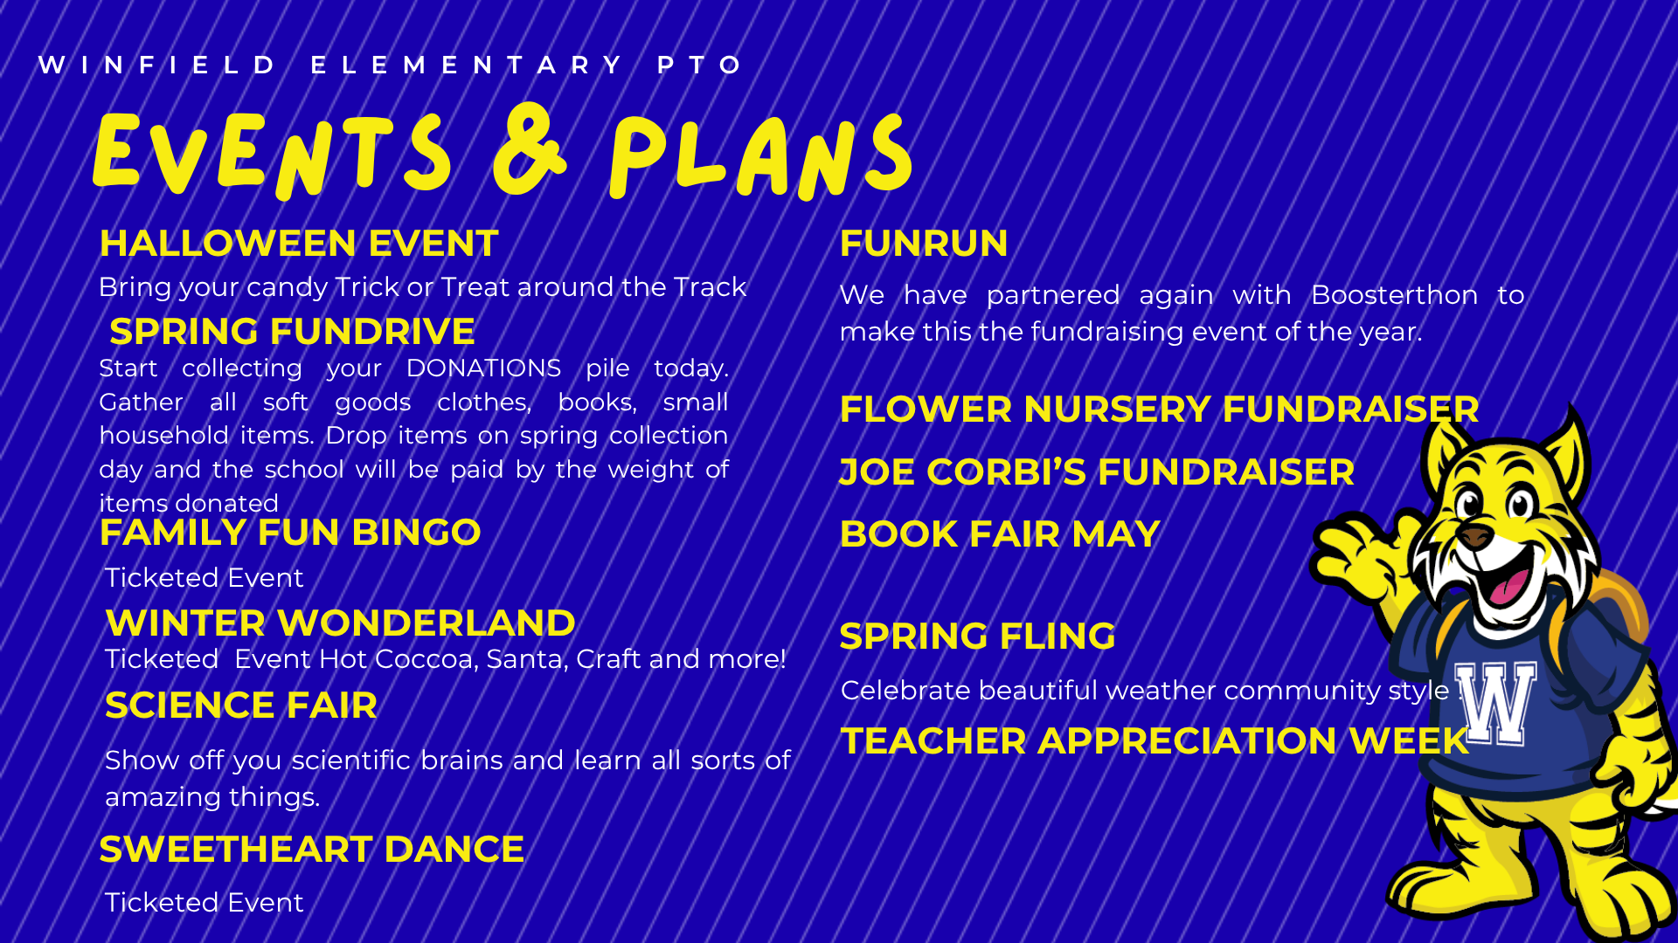

Slide 45
Questions?
Thank you for coming!
We look forward to a great year with your kids ☺ .

