Slide 1
Winfield Elementary School
Back to School Night
4th Grade

Slide 2
CCPS Security and Emergency Response

Slide 3
Goal
To provide a safe and secure learning environment for all students.
Security can be inconvenient
Balance security and efficiency
Cannot completely lockdown schools and operate
Notes:
It is important to stress that we do our best to provide a safe learning environment.
We take reasonable measures and follow best practices

Slide 4
Visitor Management
Standard practice for ALL visitors and parents
Visitors are expected to use the intercom system
  No answer - call the schools main number (posted by the intercom)
  Will be asked your reason for the visit
  Report directly to the main office
Do not hold the door open for other visitors
Beyond the main office
  Will be required to show valid govt. issued photo ID
  No ID – not permitted to go beyond main office without escort
Notes:
Stress the importance of consistency in our practices
This vetting process is our first line of defense

Slide 5
Special Circumstances
Visitor management system might not be used for large events like assemblies, etc.
Schools may require a RSVP for such events
Elem. Schools may use blocks of time for visits during events like field day
Notes:
Due to the number of visitors during assemblies, concerts, etc. it is impractical to check everyone in through the VMS
This is justified by an increase in parental supervision

Slide 6
Standard Response Protocol (SRP)
Critical incidents trigger one of 5 actions
  Hold
  Secure
  Lockdown
  Evacuate
  Shelter
Administrators and staff are trained on the SRP annually
Staff also receives additional training for active assailants
Schools to drill these actions in various forms (required by law)
Most actions precautionary

Slide 7
Parent Expectations
Receive notification from Central Office
  As soon as possible – accurate information must be obtained
  Remain by phone or email for updates/instructions
DO NOT GO TO THE SCHOOL UNLESS INSTRUCTED
  Many actions are precautionary - school will return to normal activity
  No access to students until situation is rendered safe
  Responding to school compounds issues for staff and emergency responders
DO NOT CALL THE SCHOOL FOR INFORMATION
  Staff are busy handling incident
  Updates will be sent via School Messenger

Slide 8
26 – 27 Drill Schedule
Two (2) lockdown drills between 9/8 - 11/20
Minimum of five (5) fire evacuation drills
Two (2) secure drills
One (1) earthquake drill
One (1) severe weather drill
One (1) gas leak evacuation drill
One (1) hold drill
***Any student who experiences an adverse reaction to the drill or any incident that occurs will be provided appropriate mental health resources.

Slide 9

HOLD
Internal situation (medical emergency, hazmat spill, etc.)
Actions:
Clear the hallways and remain in room
No one enters the area in which isolation has been implemented
Conduct business as usual within held room or area
May be localized to one area or entire school
Notes:
You will remain in your class even if the bell rings. If you’re in the hallway, public address might be made to go to the nearest classroom. Or proceed to your next scheduled class.
With the Hold protocol, we just don’t want what’s happening in the hallway to spill into the classroom. Students remain in their seats, continue lessons, or if lessons are done, students may be given time to read or study

Slide 10

SECURE
External Threats or Police Activity in Area
Actions:
Verify all exterior doors are closed and locked
No outside activity
No one comes in or out of building
Classes may change – students may move around in building
*THIS REPLACED THE OLD SRP TERM OF LOCKOUT*
Notes:
It is important to stress that this is not a LOCKDOWN
Predominantly this is done as precaution at the direction of the police

Slide 11

LOCKDOWN
Internal Threats – Trespasser or Assailant
Actions:
Close doors (doors are staged in the locked position)
Fortify doors – barricade or tie off as appropriate
Move away from doorway – out of sight from hallway
Quiet – phones silenced and no talking
Evacuate through primary or secondary exit - if safe
Students stuck in hallway – evacuate through nearest safe exit
Notes:
Remind guardians during the initial stages of a lockdown they may not hear from their child due to the silence requirement.
Students will eventually be allowed to text their parent to let them know they are ok.
It is also important to remind guardians that not everything transmitted via social media by students and staff is accurate.

Slide 12

EVACUATE
Directed - fire, gas leaks, bomb threat or other internal issues
Actions:
Evacuate through nearest safe exit
Move to predesignated locations
May reenter building if determined safe by fire department
Notes:
No need to spend a lot of time on this.

Slide 13

SHELTER
External – Chemical spill, severe weather
Actions:
Remain inside the building
Take specific actions due to threat i.e., tornado
Depending on incident students may eventually be evacuated
Notes:
No need to spend a lot of time on this other than reinforce that this is not a term used for an action during active assailant incident.

Slide 14
Reunification
If students are evacuated to another location:
Guardians will receive specific instructions for student pick up or transportation via school messenger
Make sure you bring photo identification when picking up your student
Accountability is very important
Guardians should exercise patience

Slide 15
School Resource Officers (SRO)
Primary Responsibilities:
Provide security
Handle crimes that schools would normally request police response
Develop positive relationships with students (mentor)
Will not be used for or in lieu of school discipline
See CCPS - Security website for specific roles and authority for SROs

Slide 16
Security Initiative
Middle schools without a permanent SRO’s will have deputies assigned on overtime
All schools will continue to receive routine patrols by law enforcement officers

Slide 17
“See Something, Say Something”
“Don’t Repost”
Reporting
  Don’t delay
  During normal schools hours – report to school administrators
  After hours – report to local law enforcement
  Social media threats should be photographed, or screen shot
  Never repost or spread rumors
All threats are treated seriously
  Collaborative Investigations – school admin., school security and local law enforcement
  Most are unsubstantiated
Notes:
Stress how seriously we take all threats
Most end up not being a real threat and are statements taken out of context.
We look at the totality of the circumstances
Drive home the necessity to report immediately – many threats are not reported until very late in the evening, which reduces the amount of time for investigation before school reopens.
Also mention that it is typical to see patrol cars around the school in the morning
We are limited on what we able to communicate to guardians due to FERPA

Slide 18

Safe Schools Maryland Tip Line

Slide 19
Security is Everyone’s Responsibility
Concerns should be brought immediately to the attention of:
Your respective school administrators
SROs or other local law enforcement
Chief of Security and Emergency Management
  Curtis Pierce (410) 751-3073 or clpierc@carrollk12.org
Coordinator of School Security
Brian Elliott (410) 751-3171 or Blellio@carrollk12.org

Slide 20
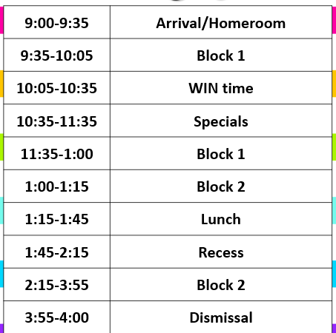
WEN

Slide 21
ROAR Behavior and Expectations
Respect
On-task
Attitude
Responsibility
Students will
receive positive reinforcement
ROAR tickets can be used to purchase prizes
Monthly grade wide drawings
Quarterly reward as a grade

Slide 22
SOS Folder
All mail, homework and graded work will be in the SOS folder.
It will go from school to home and back to school every day.
**PLEASE help your child to take responsibility in checking this folder every evening. The “Keep at Home” side should be emptied at home.

Slide 23
Second Chance Learning
Second Chance Learning Policy
2nd Chance assessment is to be done after 2nd chance learning.
This could include graded classwork, quizzes, and unit test.
2nd chance assessments are to be done only when the student receives a grade below 80% on the assignment.
Students may then have the opportunity to make corrections to the work.
Students will not be able to earn a grade higher then 80% on the second chance assessment. Grades in HAC will reflect this.
  SECOND CHANCE IS AT TEACHER DISCRESSION AND WILL NOT BE AVAILABLE FOR EACH ASSIGNMENT AND/OR ASSESSMENT.

Slide 24

All students in grades 2-5 will be taught curricular standards using Benchmark Advance resources.
Benchmark Advance is aligned to the Science of Reading- It is based on current research.
Students will be engaged in developing their vocabulary and background knowledge, understanding language structure, literacy knowledge and verbal reasoning. Developing these skills will help students comprehend texts.
Students will have the opportunity to broaden their knowledge by reading multiple texts on a topic.
Students will be engaged in writing that is connected to their current reading.
Benchmark Advance integrates Literary, Social Science, and Science topics.
Benchmark Advance provides assessments to monitor progress.
Notes:
Set the Intention of Benchmark Advance
Explain the purpose of reading and writing to learn the content (knowledge)

Slide 25

UNITS
2nd 3rd 4th 5th 6th
Benchmark Advance provides the opportunity to build knowledge within the grade level as well as across grades.
Benchmark Advance Program Guide, 2022
Notes:
FUNdations K to 3- 30 min daily
Grades 4-5- as written in Benchmark (tied into writing) these lessons are short and do not occur every day.
The scope and sequence will help to reinforce skills in FUNdations and expand into more advanced word study.

Slide 26


Family letters and
classwork magazines
will be coming home.
Notes:
Set the Intention of Benchmark Advance
Explain the purpose of reading and writing to learn the content (knowledge)

Slide 27

Everyday in ELA class students will:
~listen to read aloud
~participate in reading/vocabulary lessons
~write about their reading in writing/language lessons
~focus on phonics/word study lessons (a few times a week)
Notes:
Set the Intention of Benchmark Advance
Explain the purpose of reading and writing to learn the content (knowledge)

Slide 28

Small groups are:
*Daily
*Flexible (changing often)
*Based on need
Needs could be:
~reading
~writing
~phonics
~extension
~ comprehension
Notes:
Set the Intention of Benchmark Advance
Explain the purpose of reading and writing to learn the content (knowledge)

Slide 29

Want to help your student succeed?
Having your child practice reading and writing at home
will help their academic growth this year.
If you need suggestions, email us!
This Photo by Unknown Author is licensed under CC BY-NC-ND
Notes:
Set the Intention of Benchmark Advance
Explain the purpose of reading and writing to learn the content (knowledge)

Slide 30
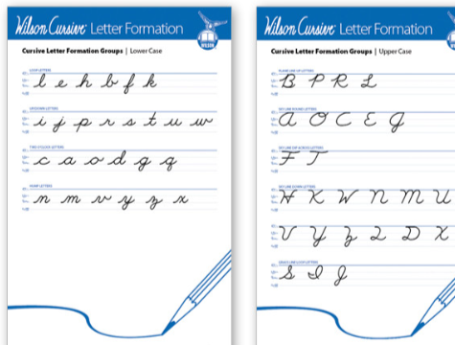
Cursive
-- Wilson Cursive Letter formation
--short writing pieces in cursive will be given once all letters are taught (Qtr 4)

Slide 31
What is the timing for STAR Reading?
What Information will it provide?
Fall (by the 4th week of school), Winter, and Spring
An overall score is provided, that is based on difficulty and accuracy. It is used to track individual growth over time.
Students will be able to receive individualized practice on skills they need support on through Freckle and Lalilo which is linked to STAR - uses their assessment results
Students are assessed on vocabulary, word knowledge, comprehension, and analysis (close reading skills).
A Lexile range is also reported.

Slide 32
What is WEN Time?
How will it help my child?
Daily small group time – all classes provide
Focus on ELA skills that students in 4th grade need - needs could be fluency, comprehension, phonics, spelling, grammar, extension
This will help provide your student with extra practice or teacher support

Slide 33

Social Studies Units
Family letters coming home will give more information.

Slide 34
Math Units
Unit 1- Addition and Subtraction-place value and base 10 ideas
Unit 2- Multiplication and Division- conceptual understanding, alternative algorithms, representations
Unit 3- Decomposing/Composing, Identifying and Comparing Equivalent Fractions
Unit 4- Adding/Subtracting Fractions, Decimal Equivalencies
Unit 5- Geometry and Patterns
Unit 6- Multiplicative Comparison and Measurement
Unit 7- Multiplying Fractions by Whole numbers
Unit 8- Measurement- Problem Solving

Slide 35
Fact Fluency
Research shows the brain works 80 to 90% harder when students don’t have fact fluency!!!
Every child should have mastery of Addition and Subtraction facts (2nd grade mastery)
Mastery of Multiplication and Division is now a 4th grade skill.
Students will spend time in class learning and practicing our basic facts.
Students who have not mastered are STRONGLY encouraged to continue to work on mastery each evening for 5-10 mins.

Slide 36
Science Units
Energy
Waves
Earth Systems
Interdependent Relationships in Ecosystems
Hands-on exploration during small, cooperative group work
Collecting data
Writing about observations
Application of math skills
Reading and responding, in writing, to non fiction text

Slide 37
Computers
Computers will not be going home on a regular basis.
Students may bring home computers to finish work. This will only be at the teachers request.
Students may use the following. However, teachers are not responsible and can not fix these items.
    Wireless or wired mouse
    Headphones, must be wired

Slide 38
Homework
Nightly reading-20 min.
Unfinished classwork that should have been completed at school
Review Sheets for math, science, and social studies unit tests
January and May Math Benchmark Calendars
Make up work due to absences/missed class time
Frequency will vary:
Vocabulary/Word Study
Revising and editing writing pieces
Long-term independent research projects

Slide 39

Schoology
Students use Schoology every day.
This is accessible through clever
Parents received an email allowing them to “connect” to their child’s Schoology account.
Grades will still be given in HAC and should be checked regularly.

Slide 40
Grading in Home Access Center
Students’ grades available via home access (no interim reports are sent home)
Accessible for parents at any time
Codes may be used to communicate the status of student work:
    EXC-excused (not included in grade)
    NHI-Not handed in (is calculated as a zero until handed in)
    ABS-Absent (is calculated as a zero until handed in)
    INC-Incomplete (is calculated as a zero until it is completed)
Any issues with Home Access should be directed to the email at the bottom of the log in page (mystudent@carrollk12.org)

Slide 41
Gifted & Talented and Advanced Academics
The Advanced Academics teacher at Winfield is Kerrie Butler. She will be working closely with your child's ELA and math teachers to plan and present instruction that extends the grade level curriculum.
Your child's teacher or the GT/AA teacher may deliver this instruction within their regular classroom or in a small group setting in the GT/AA classroom.
Any student in the classroom who requires curricular extensions will have opportunities to participate in advanced academic lessons as needed.
Contact information: Kerrie Butler kerriebutler@carrollk12.org

Slide 42
Instrumental Music and Chorus
-Ms. Messinger and Mr. Vyskocil sent home information
-Students may choose from different time slots to prevent missing important lessons.
Students are responsible for remembering the times of their lessons.
Students are responsible for completing assignments they missed.

Slide 43


Slide 44
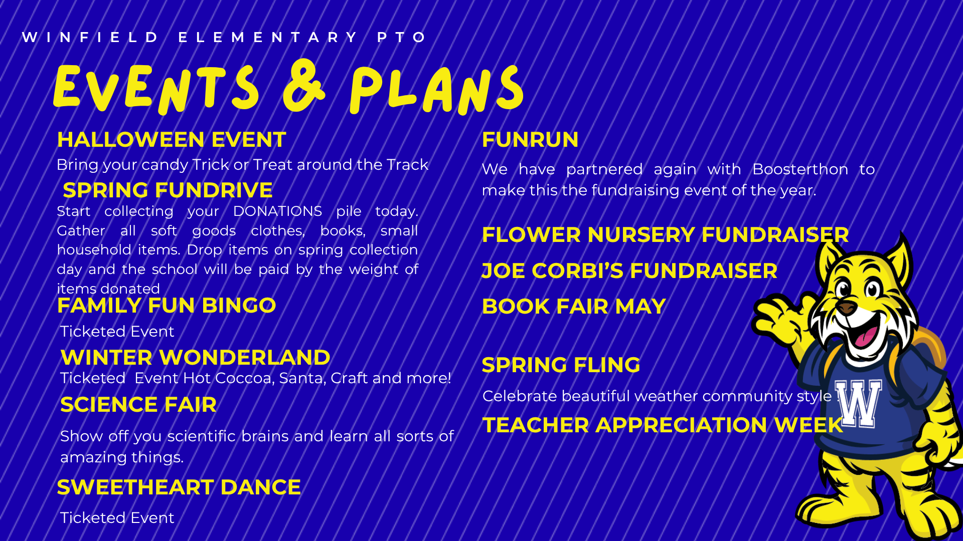

Slide 45

Questions

