Slide 1

2026 - 2027

Slide 2

Kelly Pocasangre
Nicole Beckwith
Tracey Bridge
Alicia Bloom
Megan Kolenda
Judith Boldosser --- Instructional Assistant
Miranda Uhrig , Alicia Gray--- Special Eduation
Molly Wood--- SUCCESS Teacher
Notes:
2

Slide 3

Third Grade Schedule
9:30-9:35 Announcements
9:35-10:05 “WEN” and SRIP time
10:05-11:40 Math
11:45-12:45 Specials
12:45-1:45 Lunch and Recess
1:45 -4:00 Humanities
4:00 SOS, Pack-Up, Dismissal

Slide 4




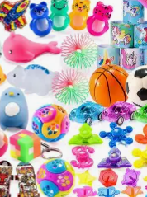
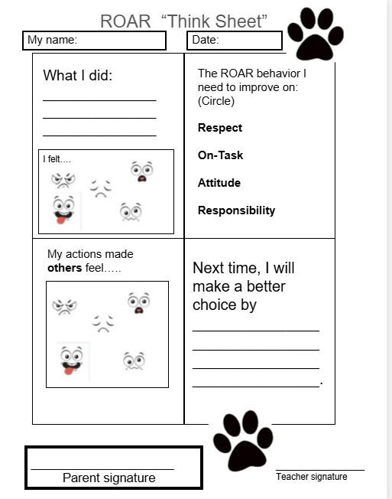
ROAR expectations
PBIS School: ROAR --Positive Reinforcement:
ROAR--Monthly grade wide drawings
Cat Cash (3rd grade incentive prizes)
(donations are always accepted)
Calming Area in each classroom
ROAR “Think Sheet”

Slide 5

Agenda and SOS folder
Homework, upcoming tests, and events are written in agenda together as a whole class.
Mail, student homework and returned work will be in the SOS folder. It goes from school to home and back to school every day.
**PLEASE help your child to take responsibility in checking this folder every evening. The “Keep at Home” side should be emptied at home.

Slide 6


Reading
Benchmark Advance
--vocabulary and background knowledge, understanding language structure, literacy knowledge of author’s craft
--annotating texts and responding to text dependent questions
--completing a ‘blueprint’ of knowledge learned in an organizer for each unit magazine
Literary becomes integrated with Social Studies, and Science topics (Animal Adaptations, Force and Motion, Communities, Historical Figures)

Slide 7

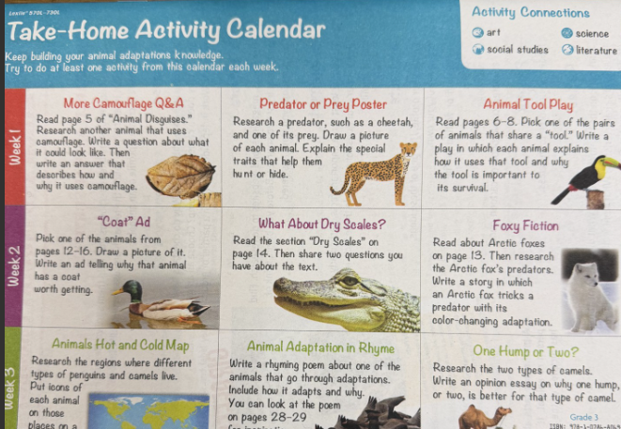

Slide 8

Writing
Text based and self selected
“On Demand” vs “Process”
Narrative, Informative, Opinion
12 point county rubric

Slide 9

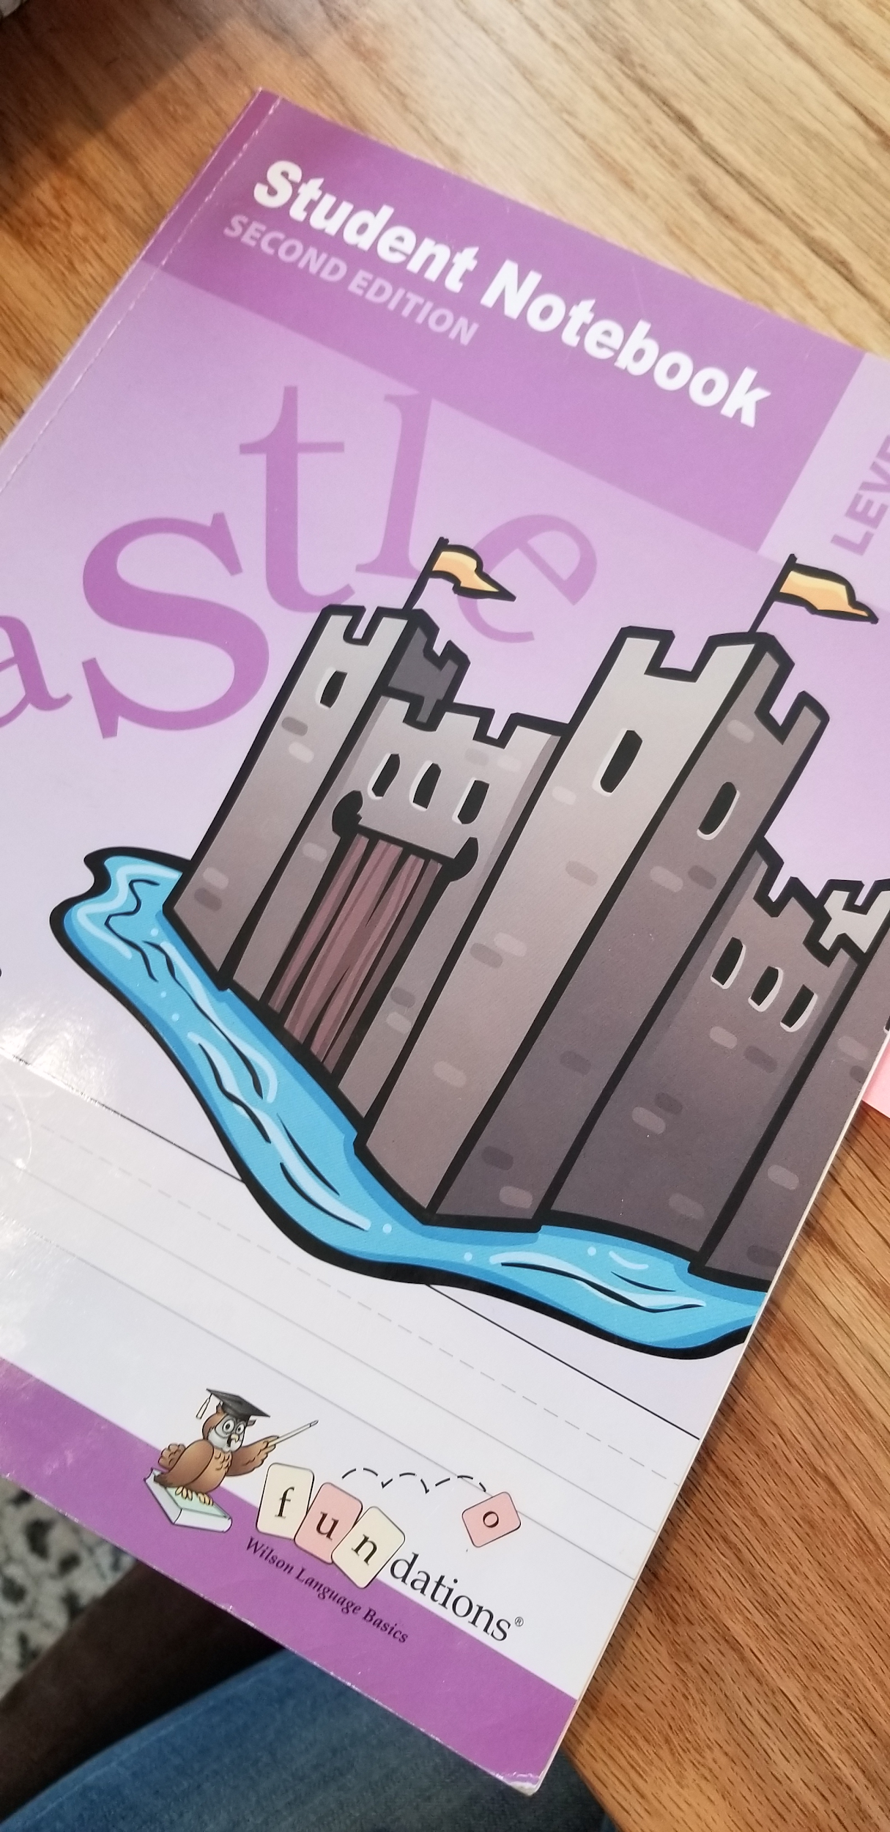
Word Study
FUNdation---Level 3
We’ve begun with a review from last year-
same strategies, new patterns
--no word list will go home
--parent letters will go home at the beginning of each unit with review/trick words
--student notebooks used in class are allowed during a unit test

Slide 10

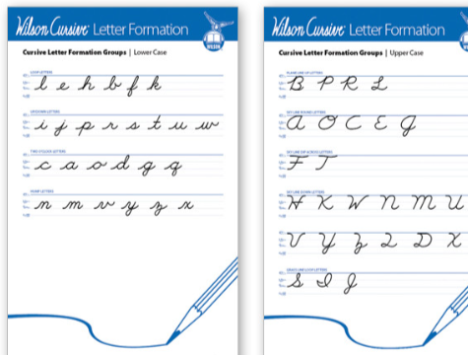
Cursive
-- Wilson Cursive Letter formation
--integrated with Fundations/Word Study
--practice sheets in class

Slide 11

Third Grade Assessments
keyboarding skills!
Benchmark Advance-(on-line)
Reading- STAR Oral fluency, rapid naming, comprehension
Math Benchmark January and May
MD State Testing in the Spring

Slide 12

Social Studies Units
Parent letter to go home for each Unit!
Civics
Geography
History
Economics
**Econ Fair- in the Spring

Slide 13

Novel Study
Integrates with Economics
Spring: Quarter 4

Slide 14

MATH
Eight Units
Foundations of multiplication, division, and area
Strategies for addition, subtraction, and measurement
Equal partitions and naming of fractions
Multiplication, division and area
Equivalence and comparing fractions and measurement/data
Geometry and measurement
Place Value to 10,000
*Demonstrates computational fluency
(multiplication and division facts)
Parent letter to go home for each Unit!

Slide 15
Fact Fluency
Students are expected to practice their facts:
x and ÷
Fact practices can be found on the Carroll County Math Website
Facts are taught in a strategic progression throughout the year:
*Foundational Facts (0, 1, 2, 5, 10 and square products)
*Adding or subtracting a group
*Decomposing a factor

Slide 16

UNITS
Weather/Climate
Inherited Traits
Force and Motion
Matter and Interactions
Collecting data
Writing about observations
Application of math skills
Reading and responding, in writing, to non-fiction text
Parent letter to go home for each Unit!

Slide 17
Grading
Transition from O, S, N to A, B, C, D, F
Reading, Writing—combined into one grade
Math, Science, Social Studies all given individual grade
Grades available anytime via Home Access
No interim reports are given

Slide 18
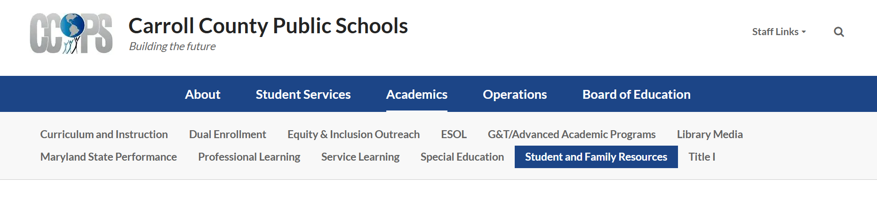

Grading
www.carrollk12.org

Slide 19

Homework
Reading
Read 20 minutes nightly
Vocabulary review-list in agenda
Math
Practice math facts daily. Once mastered, revisit to maintain fact understanding.
Math, Science, Social Studies
Study guides for unit tests are sent home several days before the test.
*review student’s agenda book daily for homework assignments and school/class notices

Slide 20

Field Trips
Spring- Econ Fair
May- Annapolis
**dates to be determined

Slide 21

Calling all
Volunteers!
Check your child’s SOS folder for a form to sign up!

Slide 22

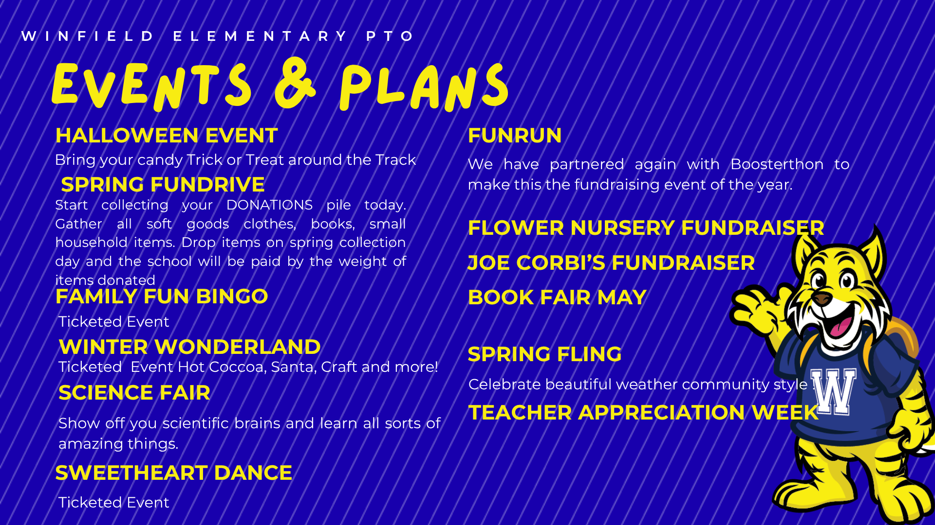
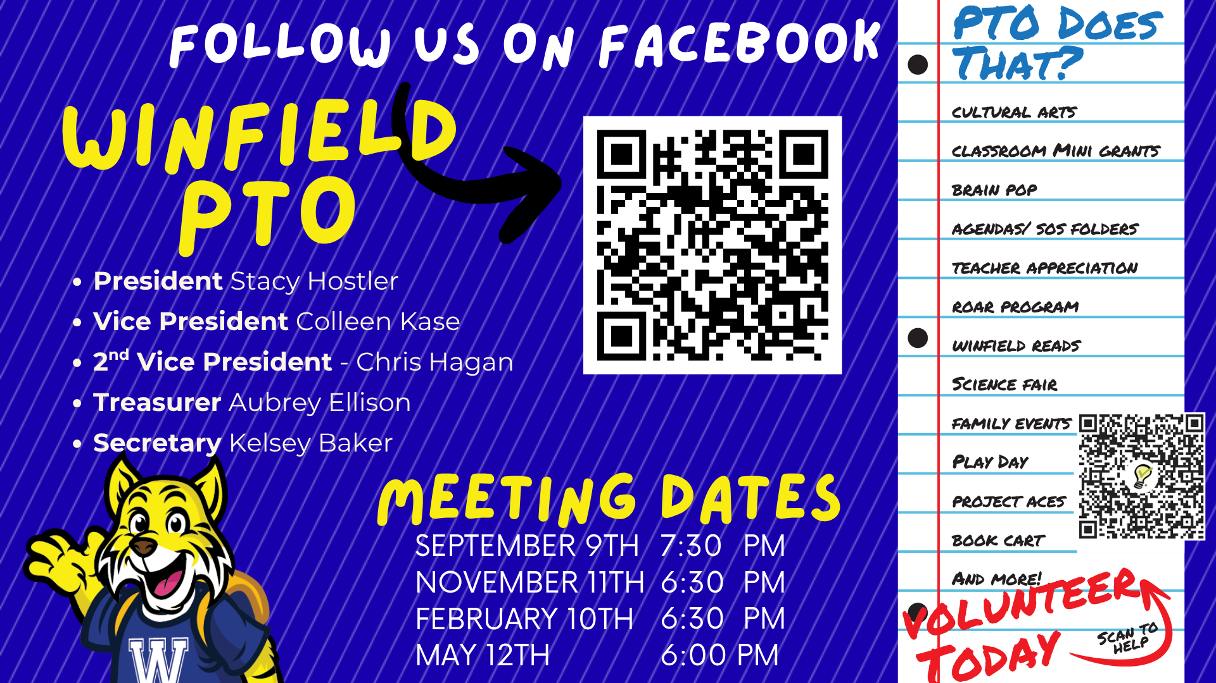
GT notifications went home at the end of 2nd grade.

Slide 23
Additional Information
Computers (1:1)
Headphones - keep here at school.
--NO earbuds.
Volunteers - there will be opportunities throughout the year, homeroom teachers will reach out as needed –Forms will go home this week to sign up!

Slide 24

Questions?

Slide 25


Slide 26
ADMINISTRATION sharing the following slides

Slide 27

Back to School Night:
Literacy Policy and Student Reading Improvement Plan
K-3rd Grade Students
Maryland State Department of Education Literacy Policy

Slide 28


Supporting Students with Reading Difficulties (COMAR 13A.03.08)
The Ready to Read Act of 2019, Students with Reading Difficulties, and The Code of Maryland Regulation, 13A.03.08, Students at Risk for Reading Difficulties, requires local education agencies (LEAs) to provide screening for all kindergarten students and identify first-grade, second-grade, and third-grade students who may be at risk for reading difficulties. It includes a provision of supplemental reading instruction for identified students; progress monitoring; annual reporting requirements; and evaluation of the screening program.

Slide 29
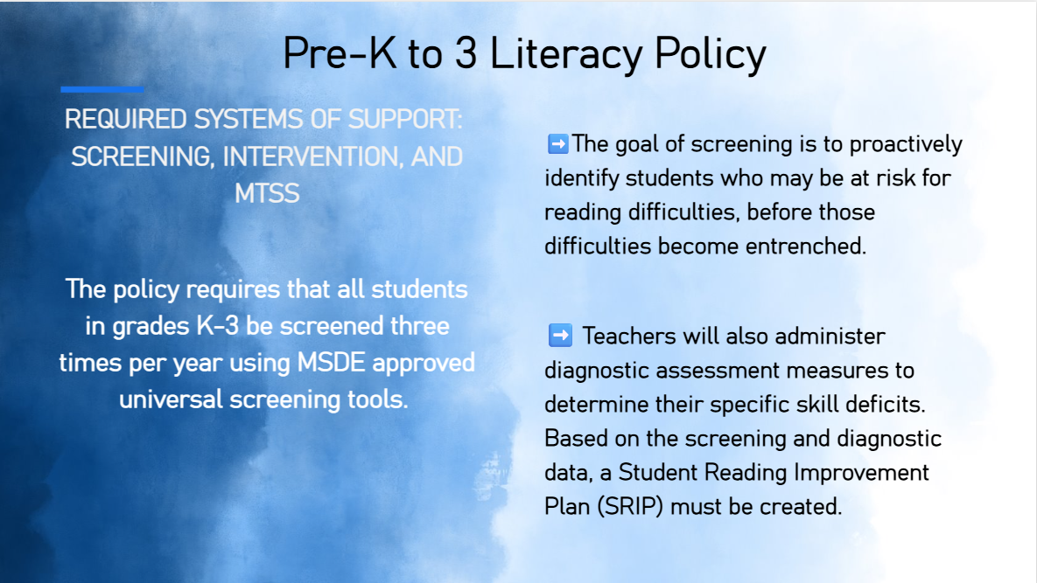

Slide 30
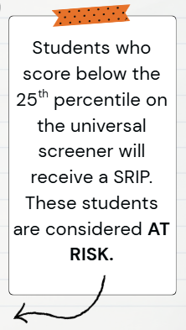
Qualifications for a Student Reading Improvement Plan
Universal Screening
3 Times Per Year
(K-3 students)
Determine Instructional Next Steps
Meeting/Exceeding Expectations- Continue/Extend Curriculum
Approaching Expectations- Targeted Small Group
Below Expectations- SRIP and Intervention

Slide 31

Student Reading Improvement Plan (SRIP)
Students in Kindergarten – 3rd grade who are identified as "at risk" as measured by the screener will receive a Student Reading Improvement Plan.

Slide 32
Student Reading Improvement Plan Process
Students in grades Kindergarten – 3rd grade will receive a screener assessment.
If student is identified as needing a SRIP, the school will notify and meet with families in October and the end of the school year.
If needed a midyear meeting may be requested to discuss changes or needs.
Student progress will be monitored throughout the year and communicated with parents 2x per quarter.
Students will not be identified for retention, under the Literacy Plan, until the 27-28 school year and not officially retained until the 28-29 school year.

Slide 33
What will the intervention look like?
Intervention block may vary from school to school, however, it can include, interventions, extensions for students, advanced academics, etc. focused around literacy.
Students may be regrouped based on student needs.

Slide 34
Upcoming SRIP Informational Nights
CCPS Regional SRIP Nights
9/30 Parrs Ridge, Mt. Airy, Winfield
10/6 Elmer Wolfe, Robert Moton, Cranberry Station, Westminster, Taneytown, William Winchester
10/7 Mechanicsville, Friendship Valley, Sandymount, Runnymede
10/8 Hampstead, Spring Garden, Ebb Valley, Manchester, Carroll Springs
10/13 Linton Springs, Eldersburg, Freedom, Carrolltowne, Piney Ridge
Family Guides for Student Success
Family Literacy Night
Finksburg Branch 11/4
Mt Airy Branch 11/10
North Carroll Branch 11/12
Eldersburg Branch 11/17
Taneytown Branch 11/18
Westminster Branch 11/19
Parent Resources
Updates pertaining to the Comprehensive Literacy Plan can also be found on the CCPS website:
English Language Arts - Carroll County Public School District

Slide 35
CCPS Security and Emergency Response

Slide 36
Goal
To provide a safe and secure learning environment for all students.
Security can be inconvenient
Balance security and efficiency
Cannot completely lockdown schools and operate
Notes:
It is important to stress that we do our best to provide a safe learning environment.
We take reasonable measures and follow best practices

Slide 37
Visitor Management
Standard practice for ALL visitors and parents
Visitors are expected to use the intercom system
  No answer - call the schools main number (posted by the intercom)
  Will be asked your reason for the visit
  Report directly to the main office
Do not hold the door open for other visitors
Beyond the main office
  Will be required to show valid govt. issued photo ID
  No ID – not permitted to go beyond main office without escort
Notes:
Stress the importance of consistency in our practices
This vetting process is our first line of defense

Slide 38
Special Circumstances
Visitor management system might not be used for large events like assemblies, etc.
Schools may require a RSVP for such events
Elem. Schools may use blocks of time for visits during events like field day
Notes:
Due to the number of visitors during assemblies, concerts, etc. it is impractical to check everyone in through the VMS
This is justified by an increase in parental supervision

Slide 39
Standard Response Protocol (SRP)
Critical incidents trigger one of 5 actions
  Hold
  Secure
  Lockdown
  Evacuate
  Shelter
Administrators and staff are trained on the SRP annually
Staff also receives additional training for active assailants
Schools to drill these actions in various forms (required by law)
Most actions precautionary

Slide 40
Parent Expectations
Receive notification from Central Office
  As soon as possible – accurate information must be obtained
  Remain by phone or email for updates/instructions
DO NOT GO TO THE SCHOOL UNLESS INSTRUCTED
  Many actions are precautionary - school will return to normal activity
  No access to students until situation is rendered safe
  Responding to school compounds issues for staff and emergency responders
DO NOT CALL THE SCHOOL FOR INFORMATION
  Staff are busy handling incident
  Updates will be sent via School Messenger

Slide 41
26 – 27 Drill Schedule
Two (2) lockdown drills between 9/8 - 11/20
Minimum of five (5) fire evacuation drills
Two (2) secure drills
One (1) earthquake drill
One (1) severe weather drill
One (1) gas leak evacuation drill
One (1) hold drill
***Any student who experiences an adverse reaction to the drill or any incident that occurs will be provided appropriate mental health resources.

Slide 42

HOLD
Internal situation (medical emergency, hazmat spill, etc.)
Actions:
Clear the hallways and remain in room
No one enters the area in which isolation has been implemented
Conduct business as usual within held room or area
May be localized to one area or entire school
Notes:
You will remain in your class even if the bell rings. If you’re in the hallway, public address might be made to go to the nearest classroom. Or proceed to your next scheduled class.
With the Hold protocol, we just don’t want what’s happening in the hallway to spill into the classroom. Students remain in their seats, continue lessons, or if lessons are done, students may be given time to read or study

Slide 43

SECURE
External Threats or Police Activity in Area
Actions:
Verify all exterior doors are closed and locked
No outside activity
No one comes in or out of building
Classes may change – students may move around in building
*THIS REPLACED THE OLD SRP TERM OF LOCKOUT*
Notes:
It is important to stress that this is not a LOCKDOWN
Predominantly this is done as precaution at the direction of the police

Slide 44

LOCKDOWN
Internal Threats – Trespasser or Assailant
Actions:
Close doors (doors are staged in the locked position)
Fortify doors – barricade or tie off as appropriate
Move away from doorway – out of sight from hallway
Quiet – phones silenced and no talking
Evacuate through primary or secondary exit - if safe
Students stuck in hallway – evacuate through nearest safe exit
Notes:
Remind guardians during the initial stages of a lockdown they may not hear from their child due to the silence requirement.
Students will eventually be allowed to text their parent to let them know they are ok.
It is also important to remind guardians that not everything transmitted via social media by students and staff is accurate.

Slide 45

EVACUATE
Directed - fire, gas leaks, bomb threat or other internal issues
Actions:
Evacuate through nearest safe exit
Move to predesignated locations
May reenter building if determined safe by fire department
Notes:
No need to spend a lot of time on this.

Slide 46

SHELTER
External – Chemical spill, severe weather
Actions:
Remain inside the building
Take specific actions due to threat i.e., tornado
Depending on incident students may eventually be evacuated
Notes:
No need to spend a lot of time on this other than reinforce that this is not a term used for an action during active assailant incident.

Slide 47
Reunification
If students are evacuated to another location:
Guardians will receive specific instructions for student pick up or transportation via school messenger
Make sure you bring photo identification when picking up your student
Accountability is very important
Guardians should exercise patience

Slide 48
School Resource Officers (SRO)
Primary Responsibilities:
Provide security
Handle crimes that schools would normally request police response
Develop positive relationships with students (mentor)
Will not be used for or in lieu of school discipline
See CCPS - Security website for specific roles and authority for SROs

Slide 49
Security Initiative
Middle schools without a permanent SRO’s will have deputies assigned on overtime
All schools will continue to receive routine patrols by law enforcement officers

Slide 50
“See Something, Say Something”
“Don’t Repost”
Reporting
  Don’t delay
  During normal schools hours – report to school administrators
  After hours – report to local law enforcement
  Social media threats should be photographed, or screen shot
  Never repost or spread rumors
All threats are treated seriously
  Collaborative Investigations – school admin., school security and local law enforcement
  Most are unsubstantiated
Notes:
Stress how seriously we take all threats
Most end up not being a real threat and are statements taken out of context.
We look at the totality of the circumstances
Drive home the necessity to report immediately – many threats are not reported until very late in the evening, which reduces the amount of time for investigation before school reopens.
Also mention that it is typical to see patrol cars around the school in the morning
We are limited on what we able to communicate to guardians due to FERPA

Slide 51

Safe Schools Maryland Tip Line

Slide 52
Security is Everyone’s Responsibility
Concerns should be brought immediately to the attention of:
Your respective school administrators
SROs or other local law enforcement
Chief of Security and Emergency Management
  Curtis Pierce (410) 751-3073 or clpierc@carrollk12.org
Coordinator of School Security
Brian Elliott (410) 751-3171 or Blellio@carrollk12.org

