Slide 1

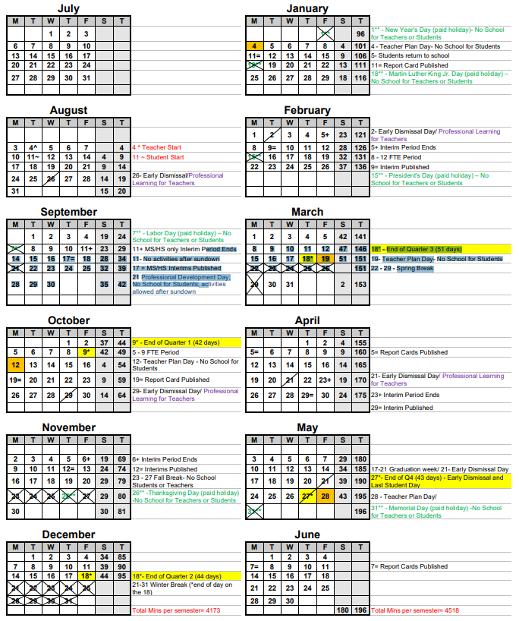






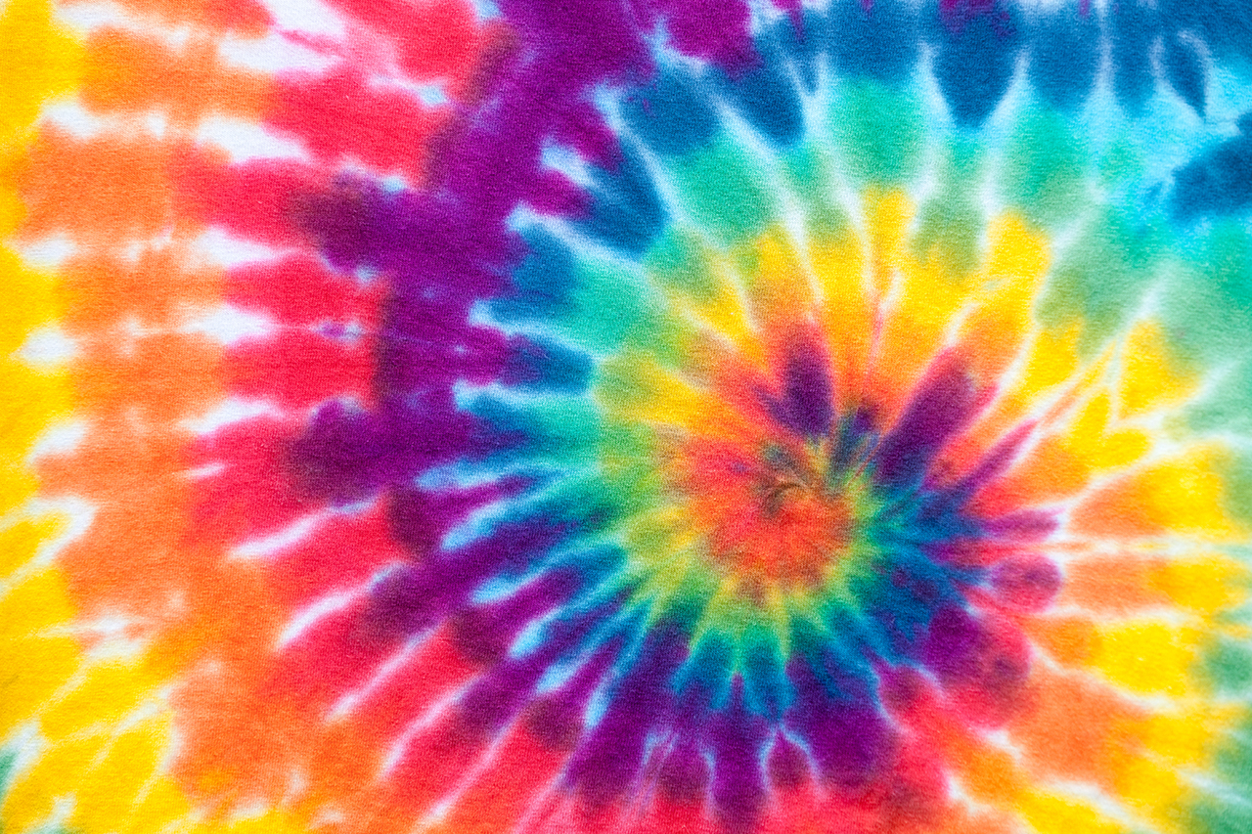
Family Gaynor gazette
October 2026
SUN | MONDAY | TUESDAY | WEDNESDAY | THURSDAY | FRIDAY | SAT
 |  |  |  | 1 | 2 | 3
4 | 5 | 6 | 7 | 8 | 9 | 10
11 | 12 | 13 | 14 | 15 | 16 | 17
18 | 19 | 20 | 21 | 22 | 23 | 24
25 | 26 | 27 | 28 | 29 | 30 | 31
A NOTE FROM… Your Principal
Read Every
Night!
October will be a busy month here at LGE! Students can dress in orange to help us say NO to bullying, have fun at our Fall Festival, smile for picture day and will bring their first quarter report card home.
Please take advantage of the many opportunities to become involved.
Wear Orange
for
Anti-Bullying Day
End of Quarter 1
PTO Fall Festival &
Book Fair Shopping!
Tuesday, October 13th
5:30 PM—7:00 PM
Please join us for a night full of FALL FUN! We will have games, food, our bookfair and fun for all.
Stop by and eat lunch with your child October 8-16 and shop during recess!
Fall Book Fair October 8-16
Teacher Plan Day
No School
PTO Fall Festival
5:30-7:00
Fall Picture Day!
Fall Book Fair October 8-16 – Eat Lunch with your student and shop at the book fair during recess!!
Book Fair Shopping Times Recess/Lunch
KG: 10:40-11:20 | 3rd: 11:50-12:30
1st: 12:30-1:10 | 4th: 11:30-12:10
2nd: 12:30-1:10 | 5th: 11:10-11:50
Repot Cards Published
Car Line Safety is our priority!
CELL PHONES OFF….SEAT BELTS ON
Please be sure your child is seated with seatbelt secured while on campus. This includes entering and leaving the car line.
Reminder—cars must refrain from parking around the perimeter of the school.
PTO/SAC
6:00 PM
Family
Turtle Tidbit 7:40AM
Early Dismissal 11:50AM
Red Ribbon Spirit Week!: Be a Hero. Stay Drug Free.
Spanish: para traducción llama al 239-377-6800 Creole: Pou tradiksyon rele nan 239-377-6800

