Slide 1

GISD
District Performance Committee
September 30, 2026

Slide 2
Agenda
Good Things & Introductions
District Updates from Dr. Padavil
DPC Overview
26-27 School Year Calendar
Possible Update to District of Innovation Plan
Future Work

Slide 3
Good Things &
Introductions
Who are you?
What’s your connection to Georgetown ISD?
In your opinion, what’s the best thing about it being October?

Slide 4
District Welcome + Updates
Dr. Devin Padavil

Slide 5


Slide 6
What is the District Performance Committee?
Established by Policy [Legal + Local] BQA
  Meet at least twice annually
  Representation of stakeholders:
    ⅔ of committee is required to be classroom teachers
    At least 2 parents
    At least 2 community members
    At least 2 business representatives
    At least 1 district level professional staff member
    2 year terms; Maximum of 2 consecutive terms
Purpose/Role
  Provide recommendations to district leadership + school board
    School year calendar
    District Improvement Plan
    District of Innovation Plan
    District’s Priority Work

Slide 7
2027-2028 School Year Calendar
Wes Vanicek

Slide 8
Calendar Creation Process
Tonight
You will review the survey feedback and help us decide on most important
factors to consider when creating calendar options
Oct 1-13
We will meet and review the DPC’s input and create several calendar options to bring to the October 14th meeting
Meeting Oct 14
You will help us select 3 calendar options
Oct 15 - N0v 4
You will present the 3 calendar options to those you represent (i.e. campus, other parents, etc.) and land on a calendar selection
Meeting Nov 5
You will vote for the calendar as selected by your constituents
Early Dec
We will present the selected calendar to the Board and expect to have final approval at the board meeting on December 14th

Slide 9
Calendar Notes
Student Time: Texas Education Code requires that students are in
school for a minimum of 75600 minutes per year.
Staff Days: GISD teacher contracts are 187 days which includes 4 exchange days.
Professional Learning Time: We are allowed to count up to 2100 minutes professional development to be counted as student minutes.
Weather days/minutes: Before the state will consider waiving days missed for weather events, we must exhaust 2 days worth of minutes in the calendar - so we build at least 2 days worth of weather time into the calendar.
Length of day: The length of the school day impacts the number of school days needed to hit the target minute amount of 76500 (+900 mins).
-Current full days are 435 minutes and ½ days range are 245 minutes.

Slide 10
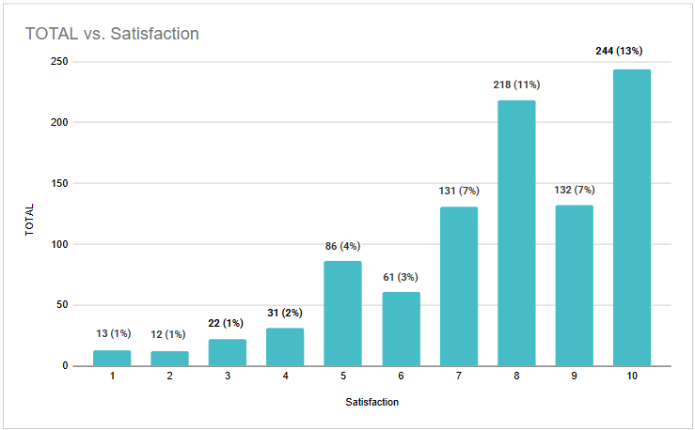
Calendar Survey Feedback
Participation: 1,307 Responses
Staff:
241
Parents:
1066
Overall satisfaction: 8 out of 10

Slide 11
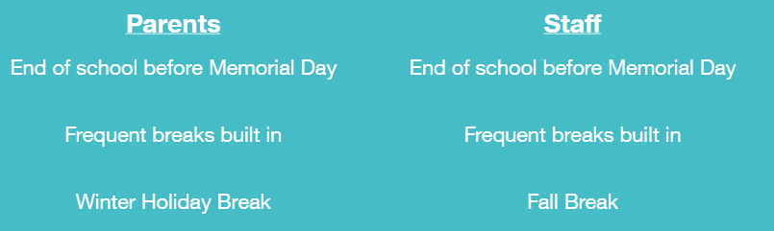
Calendar Survey Feedback
TOP 3
MOST LIKED about the 23-24 Calendar . . .

Slide 12
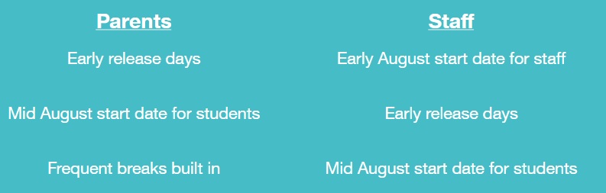
Calendar Survey Feedback
TOP 3
LEAST LIKED about the 23-24 Calendar . . .

Slide 13
Review Survey Feedback
Individually: take a packet of comments to review.
10 min
As a table group: share what stood out to you from the comments you reviewed.
Use sticky notes to jot down key considerations
10 min

Slide 14
Whole Group Discussion
…build a calendar that…

Slide 15

Calendar Next Steps
We will develop options and bring those for your consideration at 10/14 meeting.

Slide 16
Introduction/Information:
Possible Adjustments to GISD’s District of Innovation Plan
Lindsay Harris

Slide 17
What is a District of Innovation Plan?
The District of Innovation concept, passed by the 84th Texas Legislative Session in House Bill 1842, gives traditional public-school districts the flexibility available to Texas charter schools. The law is intended to give districts more local control to suit their individual needs. To be granted these flexibilities, the district must adopt a District of Innovation plan. The term of the designation as a District of Innovation may not exceed 5 years and a renewal must be made to continue as a District of Innovation.
The GISD Board of Trustees unanimously approved the first GISD District of Innovation plan in February of 2017.
Our plan and additional information about it can be found on our website at https://www.georgetownisd.org/about-gisd/about-us/district-of-innovation

Slide 18
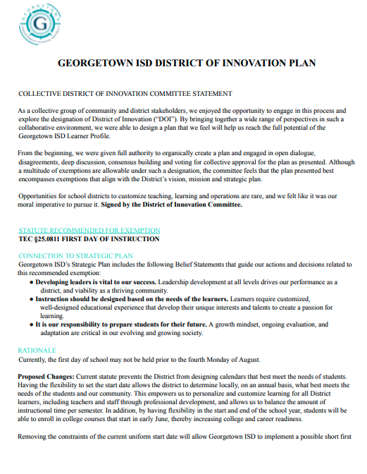

Slide 19
Senate Bill 12 + Changes to
TEC §26A
SB12 is the “Parent Bill of Rights”
Intent is to “create a clear appeals process for parent grievances”
GISD implemented new policy as created by legislation for the 25-26 school year
  Many changes are positive
  Some changes reduce efficiency and effectiveness

Slide 20
Changes to TEC §26A
Changes we plan to continue to implement:
Delegated authority to a committee of 3 or more board members
  Allows a committee of Trustees to hear a Level 3 grievance
New reporting duties for the superintendent
  Requirement to appear before the SBOE if the Commissioner finds against the district in five cases in one year
Posting grievance forms online
  Forms are accessible on the GISD website

Slide 21
Changes to TEC §26A
Changes we hope to exempt from:
Mandatory record requirement
Allowance to add additional claims and evidences
Elimination of procedural requirements
Mandate to allow a grievant to demand an open hearing
Expanded timelines
Automatic movement to next level
Annual Report to TEA
Additional policy requirements

Slide 22
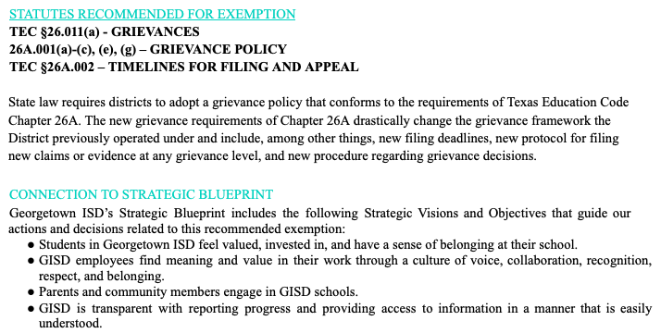
SB12 + §26A
Grievances
What our current DOI Plan says:
How we propose to adjust the plan to reflect the new legislation and approach:
Nothing

Slide 23
Next Steps
Email DPC the DOI plan + policy with the proposed changes made to it
  We’ll also include the current plan and policies in the same email
Lindsay is available to answer questions via email or schedule a quick phone/virtual call
Vote on these adjustments at next DPC Meeting
If DPC approves these additions, the Board of Trustees will consider your recommendation at October Board Meeting

Slide 24
Closing Out the Meeting
Next Meeting:
October 14 @ 5:30pm
Calendar Work Continues
Vote: Addition to the District of Innovation Plan
GISD Strategic Blueprint + Improvement Plans

