Slide 1

Santa Paula Unified School District
Measure C High School Facilities Bond Presentation
2026

Slide 2
To Clear the Ambiguity of Funds Use
Stakeholders brought to our attention that there was confusion about how the Measure C Funds would be used and at which school sites.
The SPUSD Board of Trustees have always intended that the funds be used for:
  Rebuild of Bryden Gym
  New Aquatics Complex
  A performance center for Band, Theater, Etc.
  The project list was developed over the course of a year with community stakeholders, parents, staff and students. RNT our architectural firm developed plans and did a cost analysis on the project list.
  On 9/30/2026 the SPUSD Board of Trustees approved resolution 2026-2027:04 which states: “Measure C Funds will only be spent at the District’s high school facilities and not any other district facilities. Specifically, the board has prioritized rebuilding of Bryden Gym, building a new aquatics complex, and new performing arts center.”

Slide 3
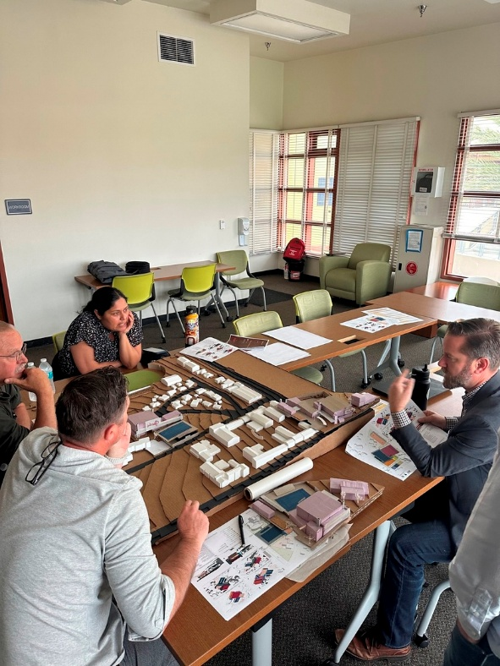
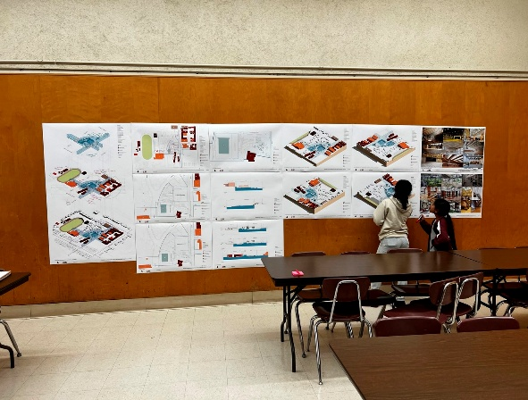
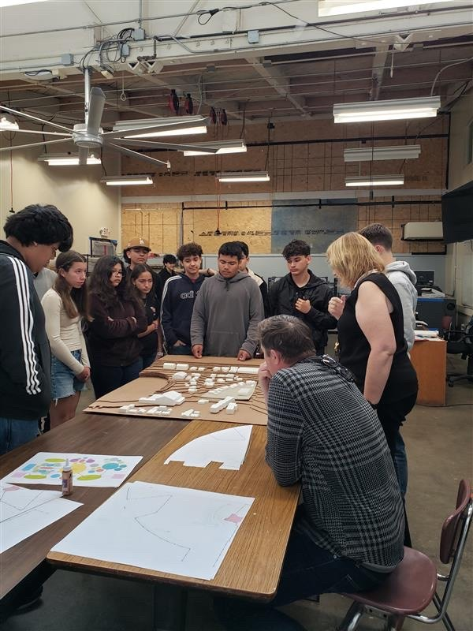
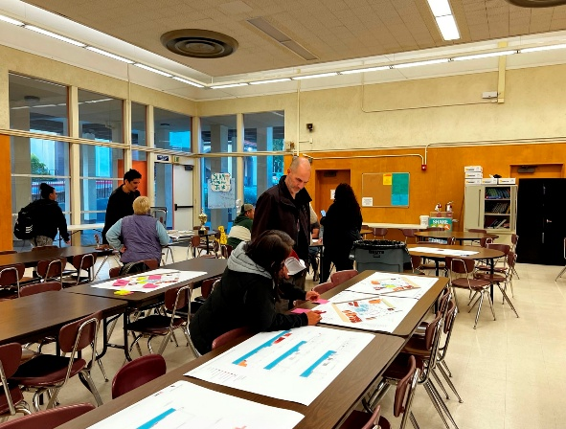
Design process to date
District / Campus staff outreach
Stakeholder / community outreach
Student design input
Programming document
Concept development
Building schematic design

Slide 4
Why do we need funds for Bryden Gym?
The district received a net insurance settlement of $22,827,377. This is net of costs for fire damage mitigation, personal property replacement, and destroyed equipment.
RNT has estimated the cost of rebuilding Bryden Gym at $36,486,739 based on plans submitted to the Department of State Architecture (DSA).
Leaving a short fall of $13,659,362.
This does not take into consideration the escalation of construction costs which is about 8% per year.

Slide 5
What about the bond funds after the shortfall?
The total project cost of the Bryden Gym rebuild, new pool complex, and performing arts complex is estimated at $73,271,018.
Leaving $36,784,279 costs to be covered.
Construction escalation costs could be as high as $5,861,681 per year or $11,723,362 for construction starting in the summer of 2028.
Measure C funding would be $48,600,000
Leaving a short fall of $13,659,362.
This does not take into consideration the escalation of construction costs which is about 8% per year.

Slide 6
Costs without escalation of construction costs
Scope of Work | Area | $/SF | Total Cost | Grand Total
Area 1
Building 1 Bryden Gym & Wresting/ Multipurpose | 25,164 | $959 | $24,121,371 | $32,001,270
Site Development | 28,959 | $272 | $7,880,349
Area 2
Pool Equipment Building | 1,704 | $1,450 | $2,470,657 | $7,798,876
Pool Deck & Site Development | 22,840 | $233 | $5,328,219
Area 3
Aquatics Weights/ Cardio | 4,244 | $924 | $3,920,147 | $3,920,147
Performing Arts | 12,863 | $870 | $11,188,778 | $13,410,655
Site Development | 16,230 | $137 | $2,221,877
Total Construction Cost |  |  |  | $57,131,398
Soft Costs |  |  |  | $16,139,620
Total Construction Cost w/ Soft Costs |  |  |  | $73,271,018

Slide 7
Insuring these funds will be spent correctly
Each bond measure passed by the community has a separate Bond Committee made up of community members who insures that funds are spent as planned.
Each year an independent auditing firm conducts an annual audit of all bond expenditures insuring that funds are spent as planned.
This audit is accepted by the SPUSD Board each year and is published for the pubic to review

Slide 8
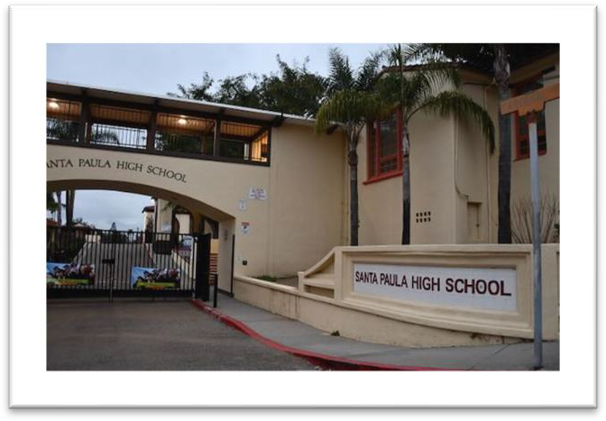
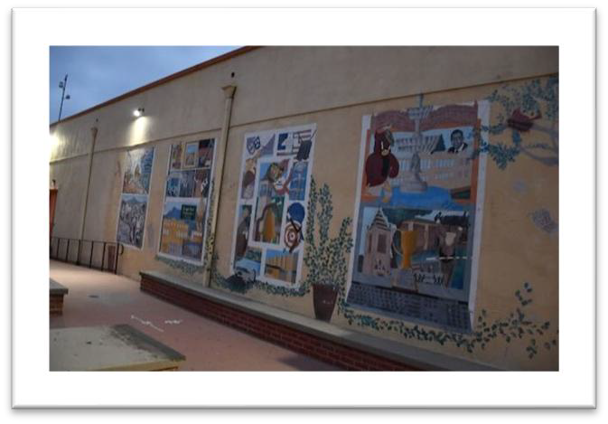
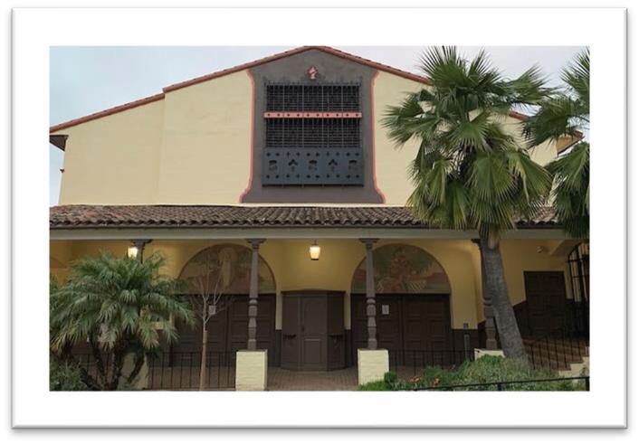
While our high schools look
good …

Slide 9
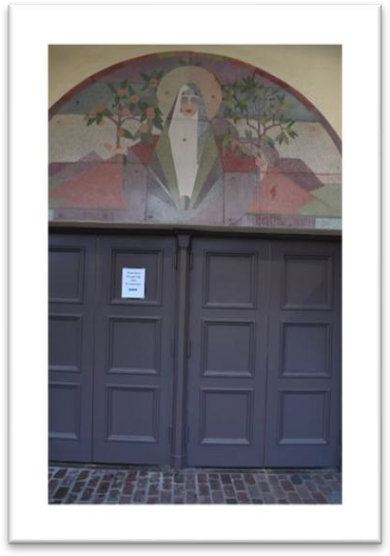
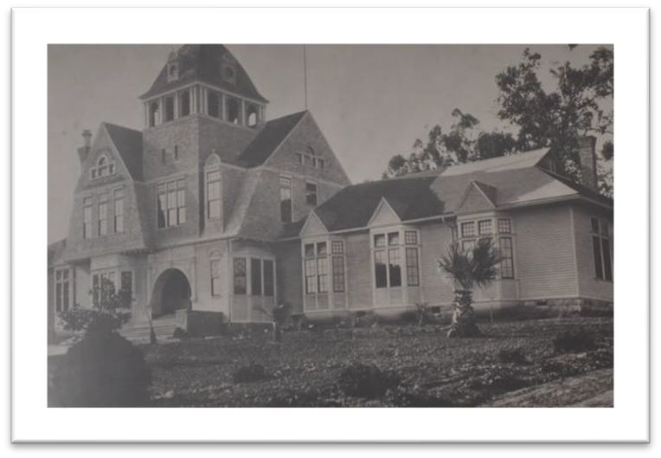
…some were built over 85 years ago.

Slide 10


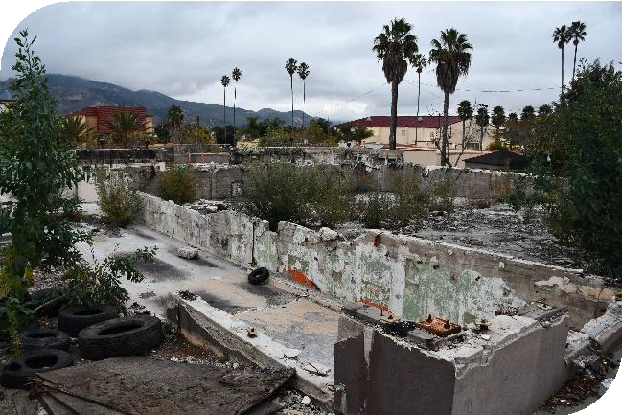
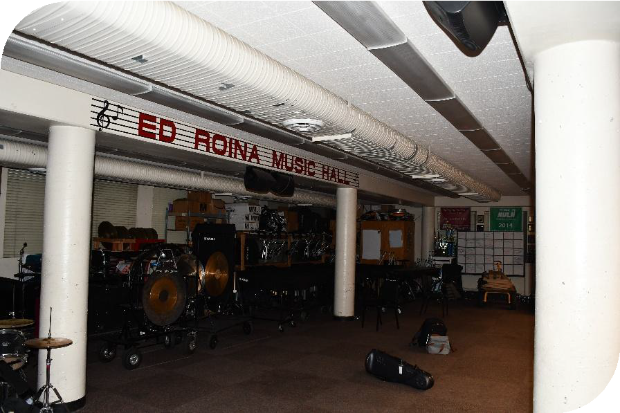

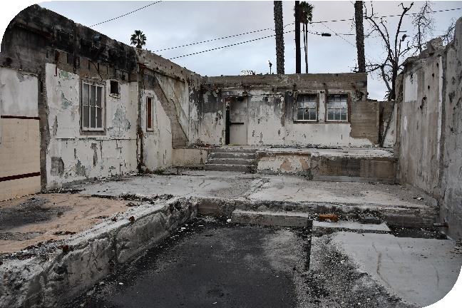

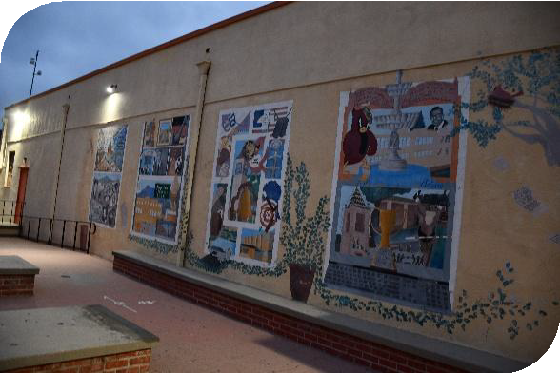
Student Support Facilities
Music, Arts, and Athletics
Santa Paula Unified School District
Bryden Gym replacement, music and band rooms, the arts

Slide 11
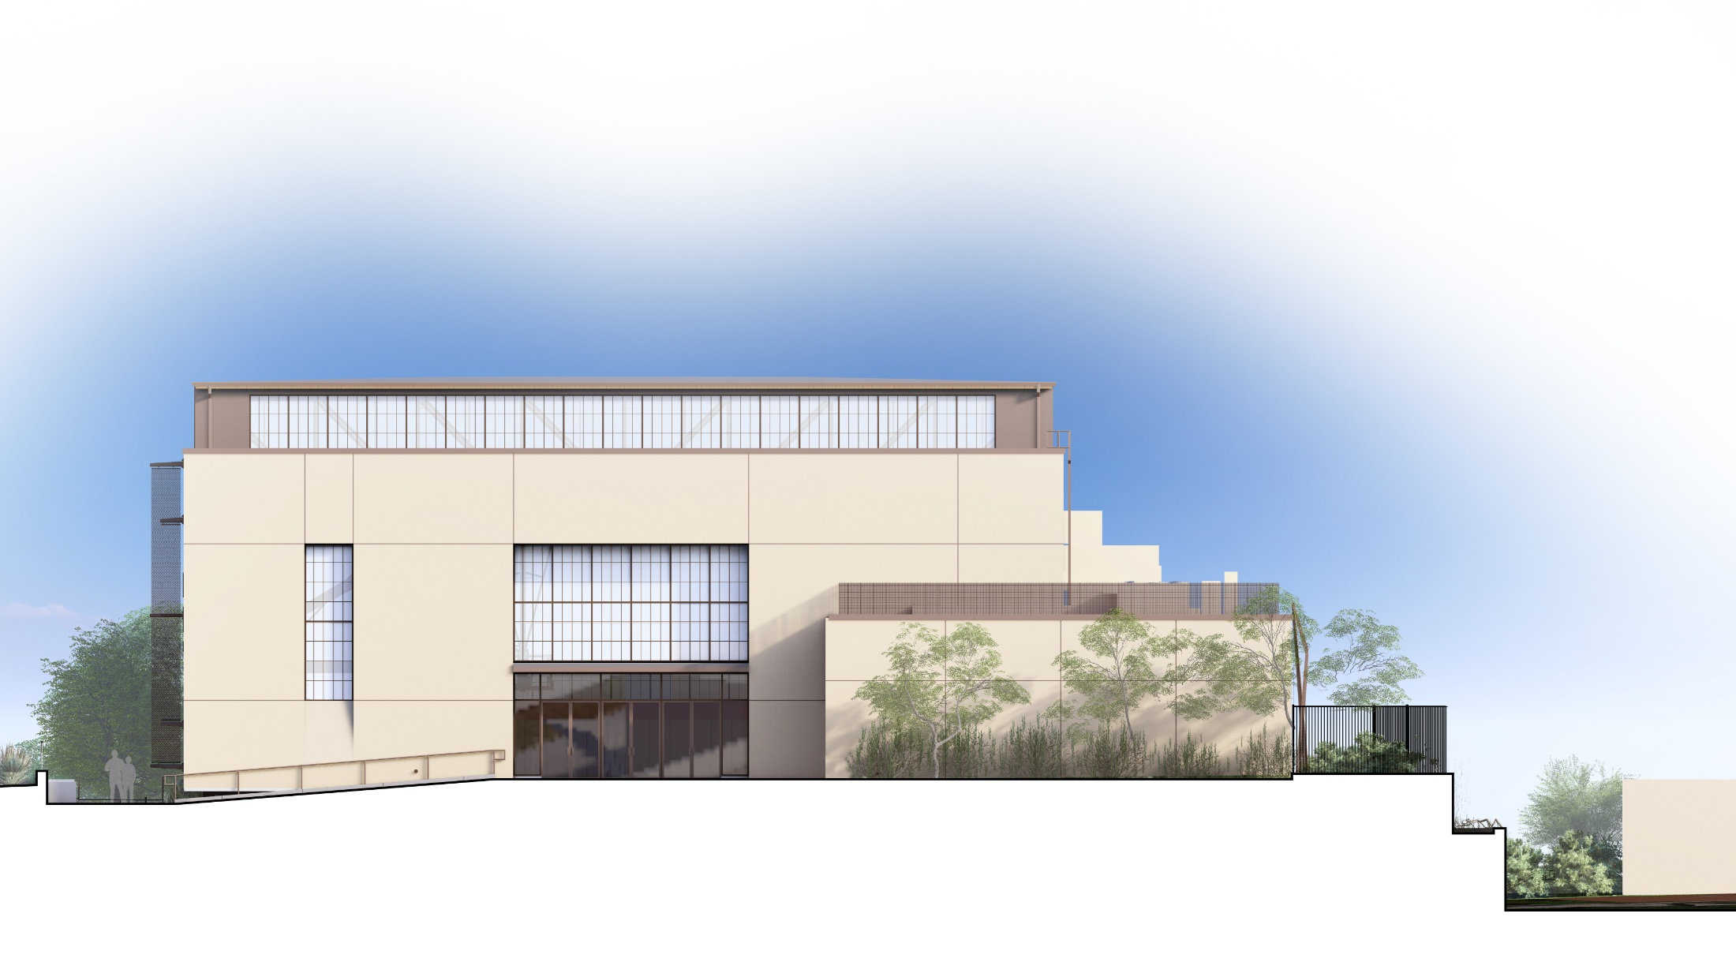
NORTH BUILDING ELEVATION

Slide 12
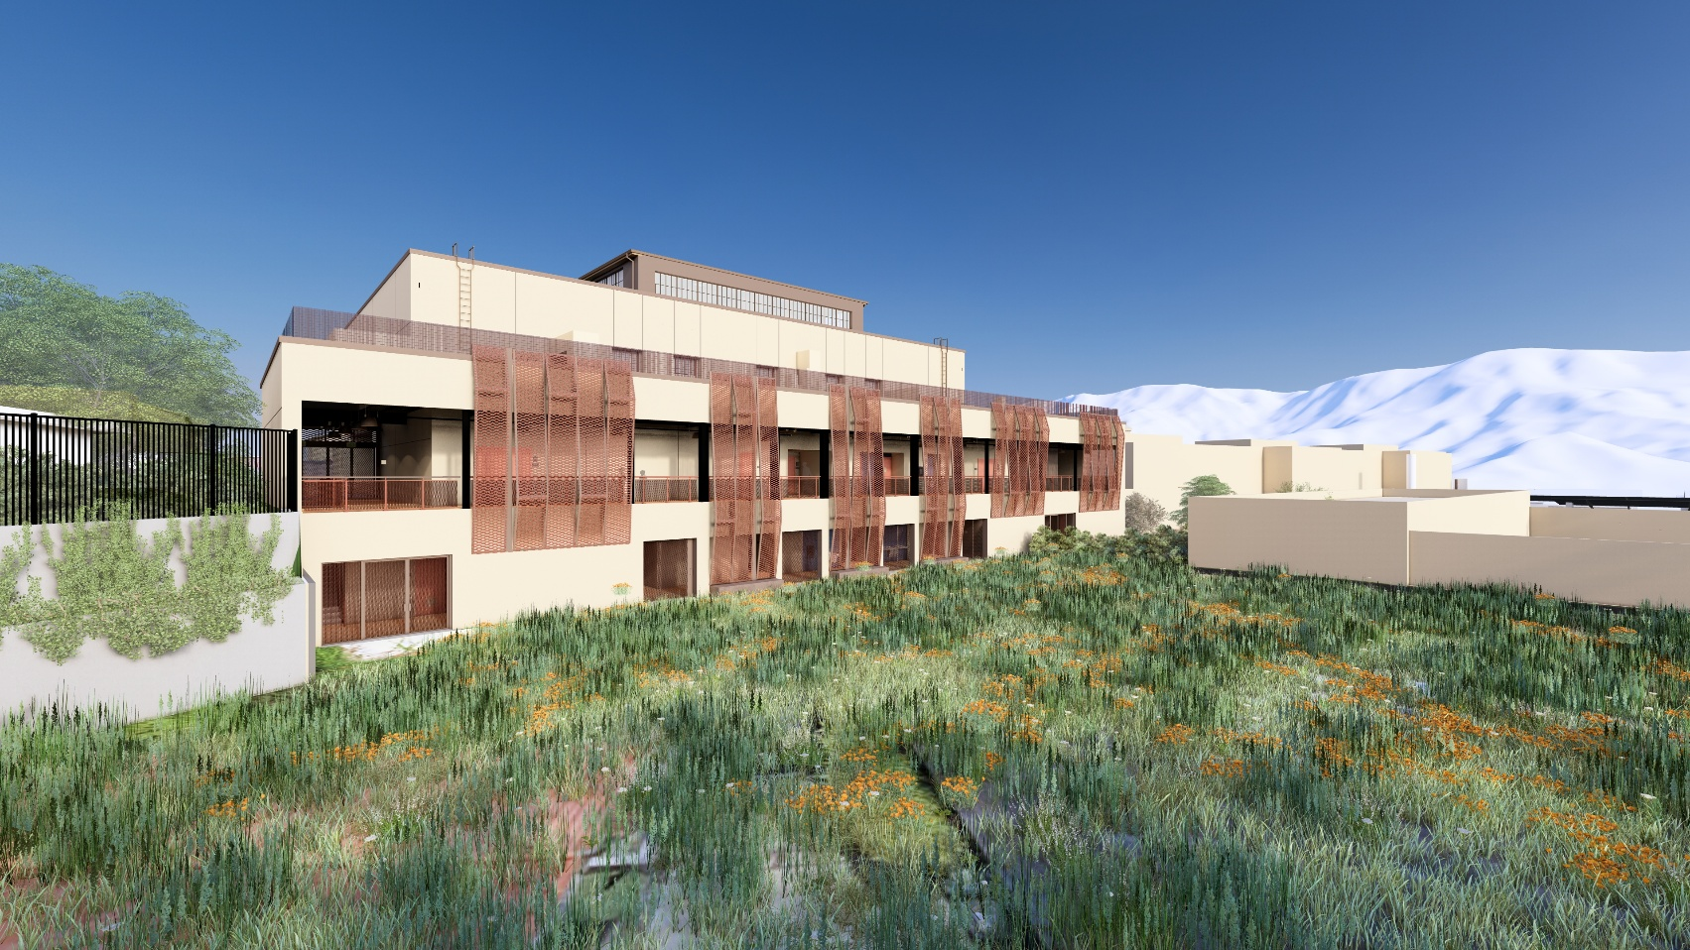
East Elevation W/ Expanded Metal Mesh Panels
DESIGN IMPACTS

Slide 13
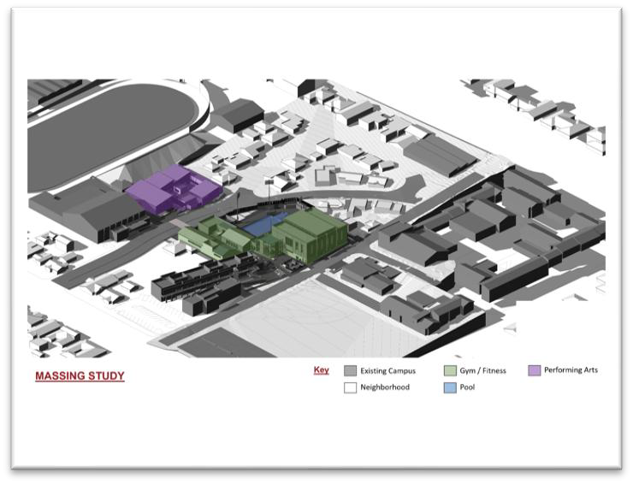
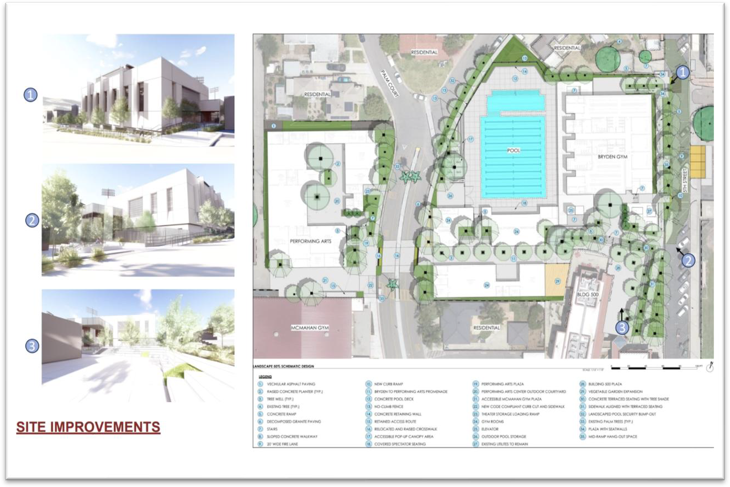
Student Support Facilities
Music, Arts, and Athletics
Santa Paula Unified School District

Slide 14
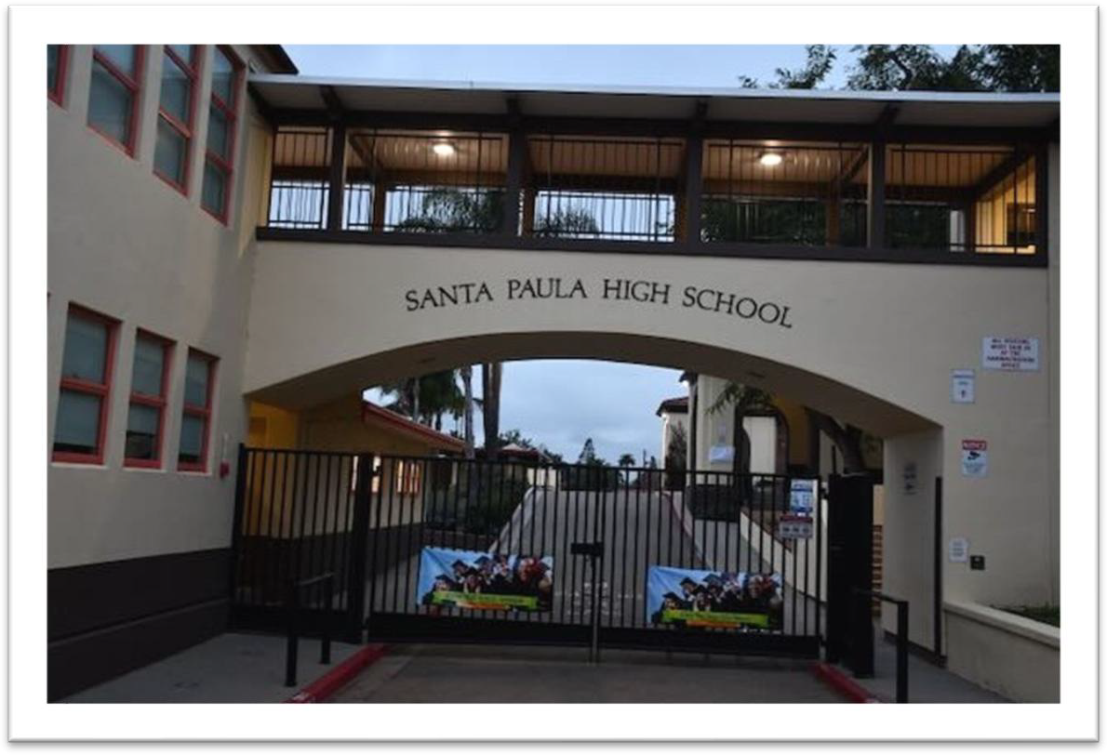
Questions?

