Slide 1

Avon Public Schools
To Educate All Students to be Life Long Learners and Responsible Citizens in a Global Society
FY2019 Operating Budget

Slide 2
Enrollment 2008 - 2017
 | OCT 1, 2008 | OCT 1, 2009 | OCT 1, 2010 | OCT 1, 2011 | OCT 1, 2012 | OCT 1, 2013 | OCT 1, 2014 | OCT 1, 2015 | OCT 1, 2016 | OCT 1, 2017
RESIDENT STUDENTS | 563 | 568 | 587 | 577 | 573 | 552 | 553 | 541 | 533 | 558
CHOICE STUDENTS | 190 | 181 | 187 | 179 | 174 | 188 | 188 | 193 | 181 | 168
TOTAL STUDENTS | 753 | 749 | 774 | 756 | 747 | 740 | 741 | 734 | 714 | 726

Slide 3
Local Contribution 2013 - 2018
FUNDING | 2013 | 2014 | 2015 | 2016 | 2017 | 2018
ANNUAL TOWN MEETING | $ 6,152,322.000 | $ 6,496,720.000 | $ 6,786,758.000 | $ 7,055,328.000 | $ 7,457,481.000 | $ 7,883,879.000
SPECIAL TOWN MEETINGS | $ - | $ - | $ - | $ - | $ - | $ -
Total FY Local Spending | $ 6,152,322.00 | $ 6,496,720.00 | $ 6,786,758.00 | $ 7,055,328.00 | $ 7,457,481.00 | $ 7,883,879.00
 | 4% | 5.6% | 4.5% | 4% | 5.7% | 5.8%

Slide 4

FY19 Budget Request
Total Town Request - $8,422,293
Total Choice Funds - $1,135,959
Total Operating Budget – $9,558,252

Slide 5

Other Anticipated Funds Applied to Operating Budget
* Numbers are approximations at this time
Tuitions: $10,000*
State and Federal Grants: $296,000*

Slide 6

Avon’s District Improvement Plan
Goal 1: Fully implement with fidelity a tiered system of supports and services to meet the needs of all learners
Goal 2: Improve student outcomes by emphasizing the importance of student growth and engagement.
Goal 3: Ensure that all professional development engaged in by staff is of high quality and has a direct and substantial impact on student growth and achievement

Slide 7

Areas of Focus of the FY19 Budget
Maintain level of service and programming
Address issues associated with MCAS Performance
Support high quality learning through professional development
Maintain small class sizes
Address issues of building maintenance
Address issues of increases in fixed costs
Maintain currency in technology

Slide 8

Areas of Focus of the FY19 Budget
Support athletic programs and extracurricula activities
Meet the requirements under special education law and regulations
Address federal and state mandates specifically the educator evaluation system, the Massachusetts Common Core Curriculum, and the new testing initiatives
Ensure educational opportunities for all students

Slide 9
Fixed Costs vs. Supplies & Expenses
DESCRIPTION OF FIXED COST | TOTAL TOWN | TOTAL CHOICE | TOTAL BUDGET
 | REQUEST FY2019 | FY2019 | FY2019
CONTRACTURAL SALARIES - (Admin, Teachers, Stipends contractual,long,sick) | $ 4,179,828.00 | $ 1,080,000.00 | $ 5,259,828.00
OTHER SALARIES - (Cent Off,Secr,Facilities, Custodial,Aides non sped) | $ 815,260.00 | $ - | $ 815,260.00
SERVICE CONTRACTS | $ 65,700.00 | $ - | $ 65,700.00
TRANSPORTATION - (Includes reg salaries) | $ 120,520.00 | $ - | $ 120,520.00
SPECIAL EDUCATION - (Salaries, Transportation, Tuitions) | $ 2,175,809.00 | $ - | $ 2,175,809.00
TOTAL FIXED COSTS | $ 7,357,117.00 | $ 1,080,000.00 | $ 8,437,117.00
MAKE UP OF DIFFERENCE AMOUNT
SUPPLIES AND EXPENSES
ADMINISTRATION - School Committee expenses, Central Office supplies/expenses | $ 66,684.00 | $ - | $ 66,684.00
TEACHING SERVICES - Teaching supplies/expenses, Principals Office supplies/expenses | $ 239,314.00 | $ - | $ 239,314.00
 |  |  | $ -
INSTRUCTIONAL TECHNOLOGY | $ 96,462.00 | $ - | $ 96,462.00
HEALTH SERVICES - SUPPLIES | $ 9,700.00 |  | $ 9,700.00
ATHLETICS AND EXTRACURRICULAR | $ 48,420.00 | $ 55,959.00 | $ 104,379.00
OPERATION AND MAINTENANCE - All contracted services/supplies | $ 149,500.00 |  | $ 149,500.00
PROFESSIONAL DEVELOPMENT | $ 37,500.00 | $ - | $ 37,500.00
TRANSPORTATION GAS AND MAINTENANCE | $ 29,000.00 |  | $ 29,000.00
UTILITIES - Heat, Elec, & Telephone | $ 345,800.00 | $ - | $ 345,800.00
ACQUISITION , IMPROVEMENT - 7000 - All new and replacement of equipment - LEASE | $ 42,796.00 | $ - | $ 42,796.00
TOTAL SUPPLIES/EXPENSES | $ 1,065,176.00 | $ 55,959.00 | $ 1,121,135.00
TOTAL BUDGET FY2019 | $ 8,422,293.00 | $ 1,135,959.00 | $ 9,558,252.00

Slide 10
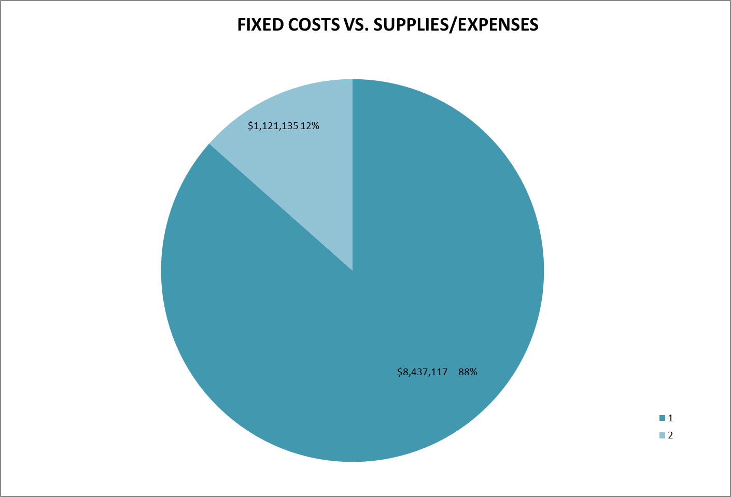

Slide 11

Thank you to the Town of Avon
Because of your generous support, the Avon Public Schools is able to continue offering its students a “World Class” education.

