Slide 1

Teaching and Learning Update
Enrollment
Early Learning
UFLI
Cursive
Collins Writing
State Assessments – On-line
Results October
Science – New Standards – Results Delayed (Jan.)
NWEA MAP Diagnostic K-12
Aviation Course Implementation
Instructional “Coach” Implementation

Slide 2
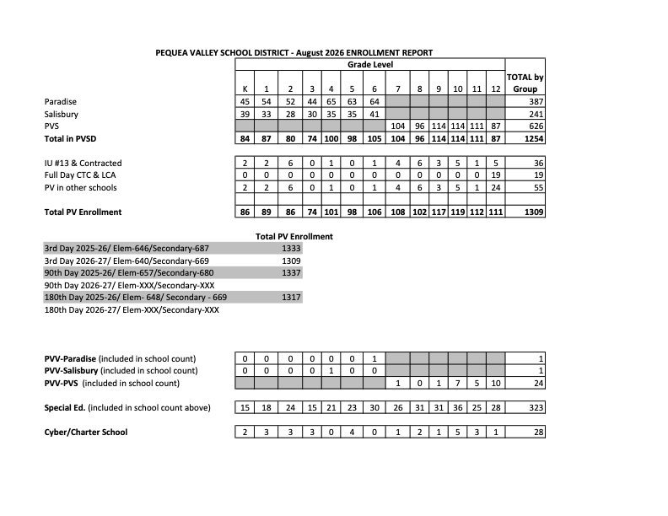

Slide 3
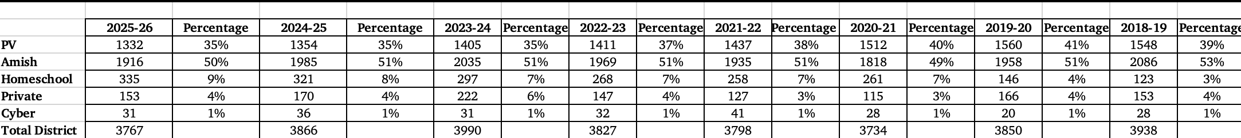
Longitudinal Enrollment

Slide 4
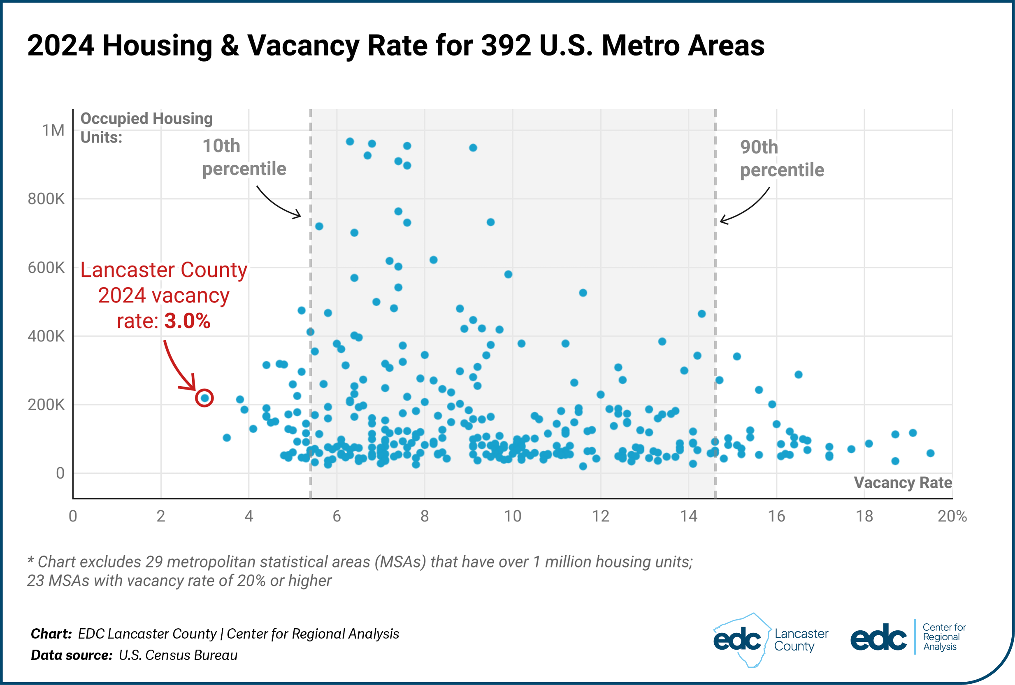
TIN Housing
Vacancy Rate

Slide 5
Pequea Valley Real Estate Vacany Rate
 | Owner Occupied |  | Vacancy Rate |  | Renter Occupied |  | Vacancy Rate
 | 4861 | 71% | 0.40% |  | 1939 | 28% | 2.80%
 |  |  | 19 units |  |  |  | 54 units
 |  |  |  | Total Vacancy Rate |  | 74 out of 6800
 |  |  |  |  | 1.07%

Slide 6


Slide 7
UFLI AND CKLA CORE ELA
Feature / Aspect | UFLI Foundations | CKLA Skills Strand
Primary Focus | Phonics-only Tier 1 core & intervention program | Foundational literacy component of a comprehensive ELA curriculum
Instructional Daily Time | 30–45 minutes daily | 45–60 minutes daily (part of a ~2-hour total ELA block paired with Knowledge)
Scope & Sequence | Highly systematic, incremental, and explicit phonics routines | Speech-to-print phonics approach, sound-first organization
Cost & Accessibility | Open-access printables & resources; affordable manual (~$90–$100) | Commercial licensing through Amplify; higher per-student/district cost
Ease of Implementation | Turnkey, highly structured, 8-step routine per lesson | Requires significant teacher prep, navigating multiple teacher guides/student workbooks
Decodable Texts | Relies on supplemental decodable passages/books | Fully integrated decodable readers built directly into each unit

Slide 8
Cursive Writing – Act 2
Learning cursive helps build fine motor skills, hand-eye coordination, and memory retention.

Slide 9
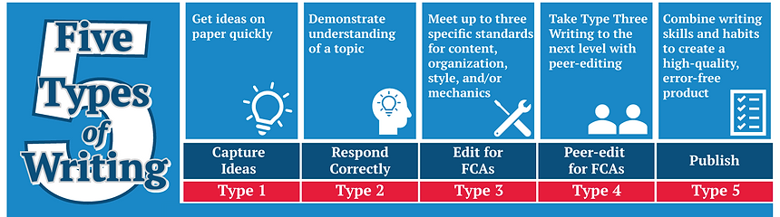
Collins Writing
The Collins Writing Program drastically improves learning retention by using writing as a tool to active-recall and consolidate information across all school subjects. Instead of passively reading or listening, students use specific writing frameworks that force the brain to retrieve, synthesize, and permanently store knowledge.
The Five Types of Writing Framework

Slide 10
Collins Writing Continued
Core Benefits for Memory and Learning
Transfers Knowledge to Long-Term Memory: Summarizing and paraphrasing subject matter transforms passive recognition (seeing information) into active production (explaining information).
Closes Knowledge Gaps Instantly: Because these quick writes serve as instant formative assessments, teachers can see immediately what students think they know versus what they actually retained, correcting misconceptions before they are memorized incorrectly.
Works in All Subjects: The program is designed for "Writing Across the Curriculum," meaning students apply these memory-boosting habits in science, math, history, and physical education, rather than just English class.

Slide 11
On-Line Assessments
No, online standardized assessments like the PSSA (Pennsylvania System of School Assessment) generally do not align with how students learn and retain information best.
While digital testing offers administrative convenience, quick scoring, and lower printing costs, educational research and cognitive science highlight several key disconnects between digital standardized testing and optimal learning practices. - Backes and Cowan (2020) - TAO Testing Analysis (2026)
Shallow Reading ("Paging & Skimming"): Reading complex text on screens often leads to lower deep-comprehension scores compared to physical paper, as digital environments encourage scanning rather than deep analytical reading. – Delgado et al. (2018), Salmerón et al., (2023)
Spatial Memory Disruption: When reading a physical booklet, students form a visual-spatial mental map of where information is on a page. Navigating via scrolling or clicking through separate digital tabs/windows breaks this spatial context, placing an extra load on working memory. - Mangen et al. (2019), Sakai et al. (2026)

Slide 12
New Science Standards
STEELS - Science Technology Engineering Environmental Literacy & Sustainability
Shift science education away from passive, rote memorization toward hands-on, real-world problem solving.
  Science and Engineering Practices: Designing experiments, analyzing data, constructing arguments, and modeling solutions.
  Disciplinary Core Ideas: Key concepts in life, physical, and Earth/space sciences.
  Crosscutting Concepts: Identifying overarching themes like cause-and-effect, systems, and patterns across all scientific disciplines.
Phenomenon-Based Learning: Classroom instruction centers around explaining real-world phenomena (e.g., investigating why a local watershed flooded or how energy transfers during a collision). This keeps learning relevant, contextual, and engaging.

Slide 13
Example
Under the old standards, questions typically asked students to identify a definition or recall a memorized facts. Under STEELS, questions are scenario-driven ("3D Learning"): students are presented with data or a model showing a real-world event and must apply science and engineering practices to explain why or how it happens.

Slide 14
Old Science Standards (2002 Assessment Anchors)
Focus: Rote recall, isolated facts, single-correct-answer multiple choice.
Sample Question:
Which of the following best describes runoff?
A) Water evaporating from leaves into the atmosphere
B) Water soaking into the underground water table
C) Water flowing over the land surface into lakes and streams
D) Water forming clouds high in the atmosphere
Answer: C
Why it fits the old standard: This question only tests whether a student can memorize and retrieve a definition. It requires no analysis, data interpretation, or connection to real-world impact.

Slide 15
Sample Scenario:
Phenomenon: A city in Pennsylvania paved over a large field to construct a new shopping center parking lot. Local residents noticed that during heavy rainstorms, a nearby creek turned brown and murky, and several downstream yards flooded.
Part 1 (Data Analysis):
Below is a map showing the town before and after construction, along with a graph measuring stream flow rate during a 2-inch rainfall event.
[Graph provided showing stream flow peaking much higher and faster after construction]
Based on the data, explain how replacing soil with asphalt affected the water cycle in this ecosystem. Use evidence from the graph to support your claim.
Part 2 (Engineering Solution):
The town council wants to reduce local flooding and stream pollution without removing the parking lot. Which modification would best solve the problem using natural systems?
A) Installing permeable pavement and a rain garden to increase water infiltration
B) Paving over the remaining grass to make runoff move faster into the storm drains
C) Building higher walls along the stream banks to prevent overflow
D) Spraying fertilizer on the remaining lawns to help plants absorb more rain
Answer: Part 1: Student constructs a short response explaining that non-porous asphalt prevents water infiltration, turning ground absorption into rapid surface runoff that carries sediment into the creek. Part 2: A

Slide 16
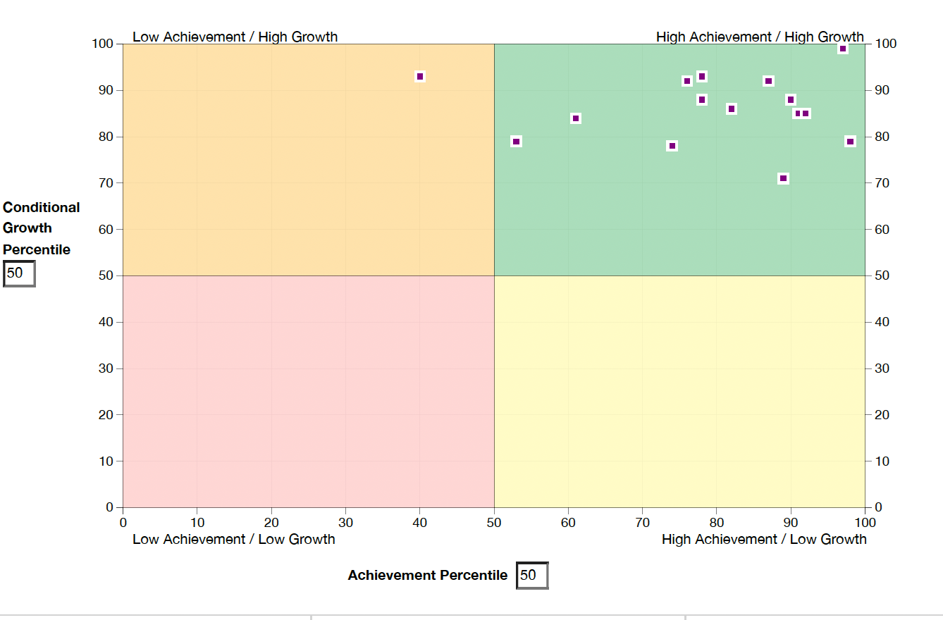
NWEA MAP DIAGNOSTIC K-12

Slide 17
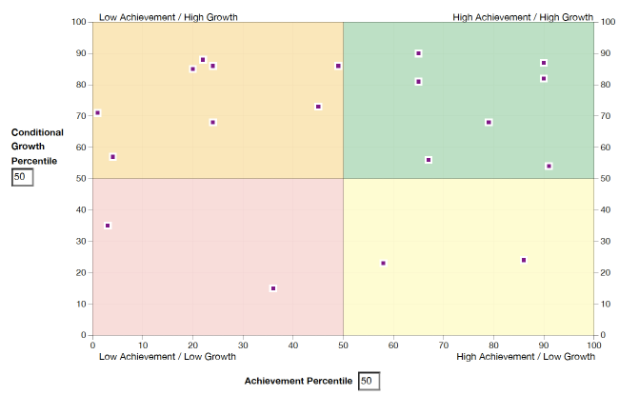

Slide 18

Aviation Learning Targets

Slide 19
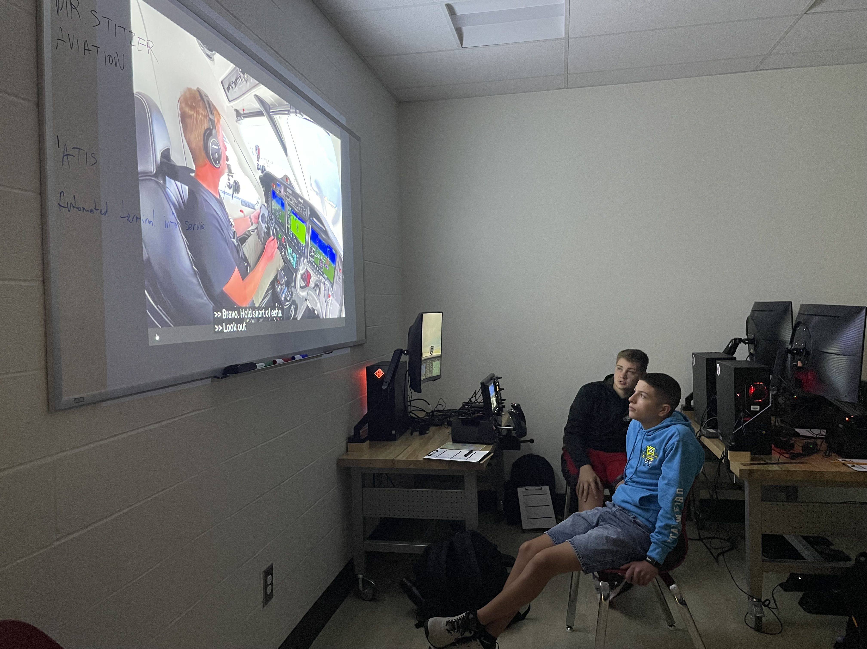

Slide 20


Slide 21


Slide 22


Slide 23


Slide 24


