Slide 1

Test Proctor Training
Fall 2026
Cognitive Ability Testing – CogAT7
Testing Window
October 12 – November 12, 2026

Slide 2
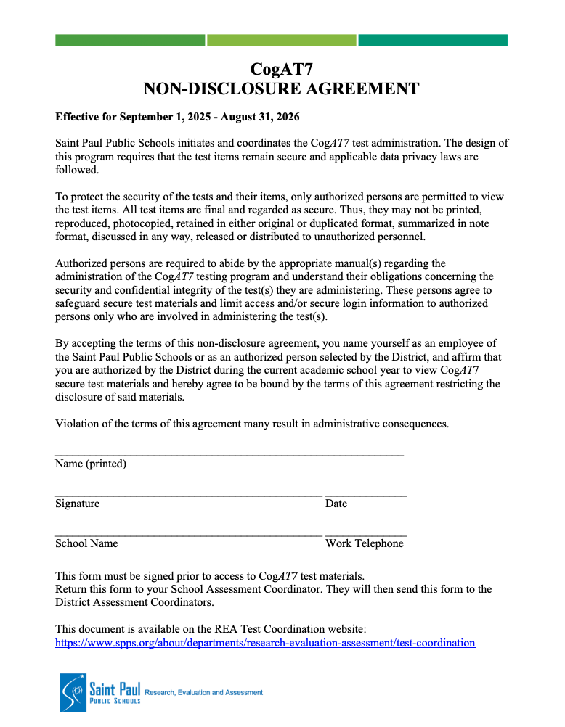
Non-Disclosure Agreement
Please sign a Non-disclosure Agreement:
Give completed form to SAC
Notes about Test Security:
Test items and student tests are not allowed to be reviewed by teachers, building staff or parent helpers
Parents and parent volunteers are not allowed in testing rooms
Test items may not be reproduced in any form

Slide 3
What is CogAT: Introduction and Test Overview
The CogAT7 is one of the tools we use in SPPS to identify students as accelerated learners, Gifted & Talented (GT). The CogAT7 Complete can also be used to help understand how a student thinks and learns.
Form 7 of the Cognitive Abilities Test (CogAT) evaluates the level and pattern of verbal, quantitative, and spatial (nonverbal) reasoning abilities for students from kindergarten through grade 12. These abilities reflect the overall efficiency of cognitive processes and strategies that enable individuals to learn new tasks and solve problems.
CogAT7 has three batteries – Verbal, Quantitative, and Nonverbal. Within each battery contains three subtests. The abilities evaluated are those that enable students to acquire, organize, store in memory, and recall information; to make inferences; to detect relationships; to comprehend and analyze problem situations; to form concepts; to discover and remember sequences; to recognize patterns; to classify or categorize objects, events, and concepts; to infer rules and principles; and to relate and use previous experience to accomplish new learning tasks or solve novel problems.
From Riverside (publisher of the CogAT): When we understand more about a student’s cognitive abilities, we open a whole new realm of possibilities for addressing the needs of the whole child. The result is that teachers can more easily tailor instruction, uncover gaps in student achievement and ability, encourage and motivate students to participate, as well as using the results for admission to enrichment programs.

Slide 4
Who Takes the CogAT: Grade Specific Test Requirements
  Who takes the CogAT7:
  All Kindergarten students
  All Grade 2 students
    2nd grade students who were previously identified can NOT be unidentified, also they will not be re-identified
    Taking CogAT in 2nd grade gives a fuller picture of a student’s cognitive abilities
  For students in grades 1, 3, 4 and 5, they may be nominated to take the CogAT if they have not been previously identified
    Identified students have a ‘GT’ flag in Campus
    Nominations are due by October 21 to ensure SACs have time to schedule needed test sessions (date noted in CogAT7 family announcement letter)
      Give any nomination information to the SAC
Grade | Assessment Given
Kindergarten | Screening Form, Level 5/6
1st | Complete, Level 7
2nd | Complete, Level 8
Grade | Assessment Given
3rd | Complete, Level 9 (Timed)
4th | Complete, Level 10 (Timed)
5th | Complete, Level 11 (Timed)

Slide 5
What’s New for Fall 2026
From Riverside Insights – the CogAT testing company:
What Happened Last Year?
2024-25 was stable but DM was operating on old infrastructure
Focus on shipping 2024 Norms meant load testing was delayed
Upgrades introduced problems that weren’t identified until late load tests (no time to fix)
As a result:
Students faced latency and disruptions
Testing windows restricted and disrupted
How We Fixed the Problem
Made DM Performance our #1 priority for 2026-27
Began performance remediation and load testing planning in December
Rebuilt our load testing process from the ground up – better approximation of reality; more frequent
Set performance targets and deadlines
The Results: A Performant DM
Hit our performance targets in load testing:
Simulated a full peak day - 43,000 students logging in within 15 minutes
Response times held under 1 second, even under added stress with fewer servers than we’ll use when live
We're ready for this fall.
What This Means For You
We’re confident you’ll experience smoother, more reliable testing on DM this fall.
This isn’t a one-time improvement – we’ve set up infrastructure to continuously maintain performance
Field Test Items:
Riverside Insights is field testing some new items this year. Students taking the operational test may see 2-4 items at the end of a test section, but it won't count against them or affect their scores. Testing experience will be seamless for students.
Additional note: No change to how students login to the test (Clever login still in pilot and is having bugs already this fall)

Slide 6
How: Proctor Training
  Training Requirements:
  Attend training provided by School Assessment Coordinator
  Review and sign the Non-Disclosure Agreement
  Watch applicable video on the Riverside CogAT training site
    Guide on how to access video available
  Review Directions for Online Administration manual
  Links and resources are all available on the SPPS Test Administrator website (select Cogat)
  Websites:
Test Preparation and Management:
  DataManager: https://www.riversidedatamanager.com/
  Site for online test management, all SACs and Test Proctors/Administrators need access
  SPPS Test Administrator: spps.org/about/departments/research-evaluation-assessment/assessments/test-coordination/test-administrator-resources
  Select COGAT
  Resources for Proctors and Student Preparation
  DataManager Training: https://riversideinsights.com/dm-complimentary-training
  Required videos
After Testing:
  Cogat.com: https://cogat.com/
  Resources for Teachers and Families (e.g. Ability Profile guides, Report guides, Ability & Achievement Tools)
  Riverside Insights Webinars: https://riversideinsights.com/training-resources/webinars
  Webinars for educators on interpreting and using CogAT data

Slide 7
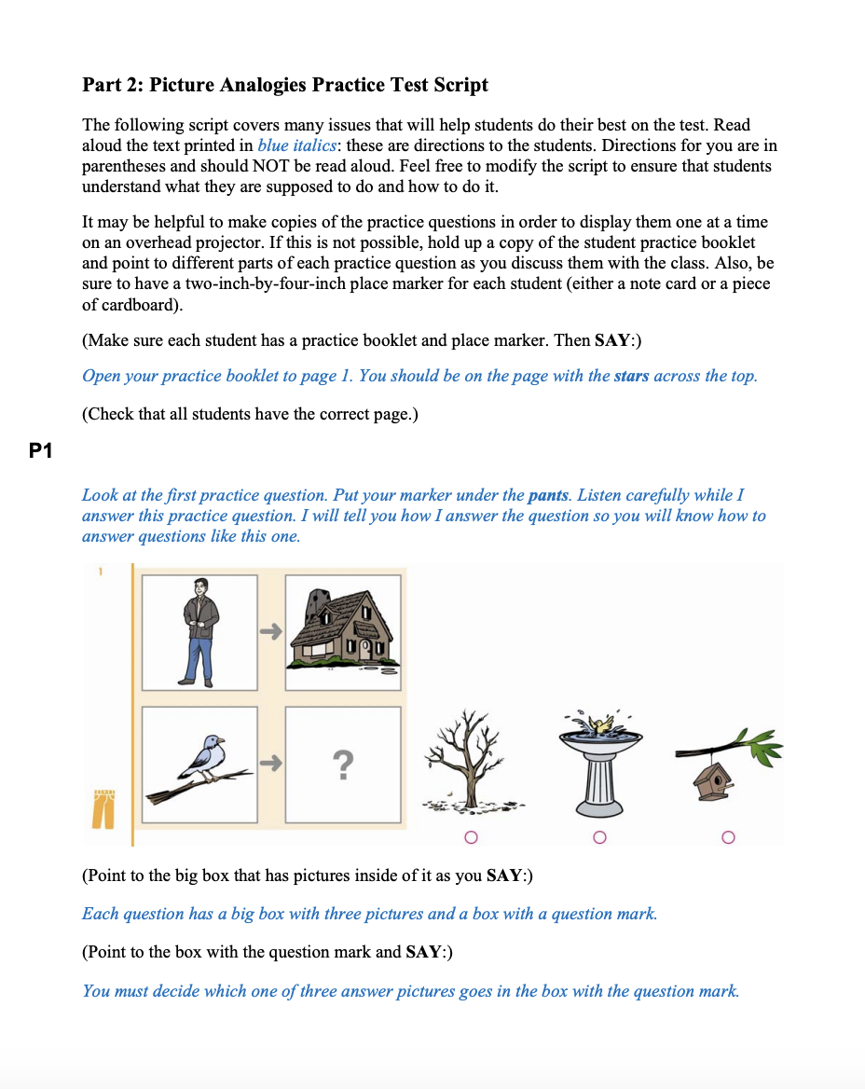
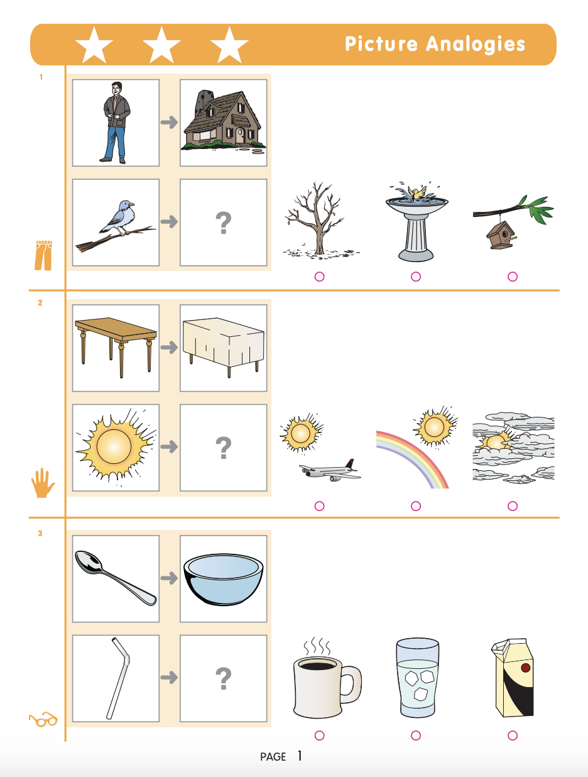
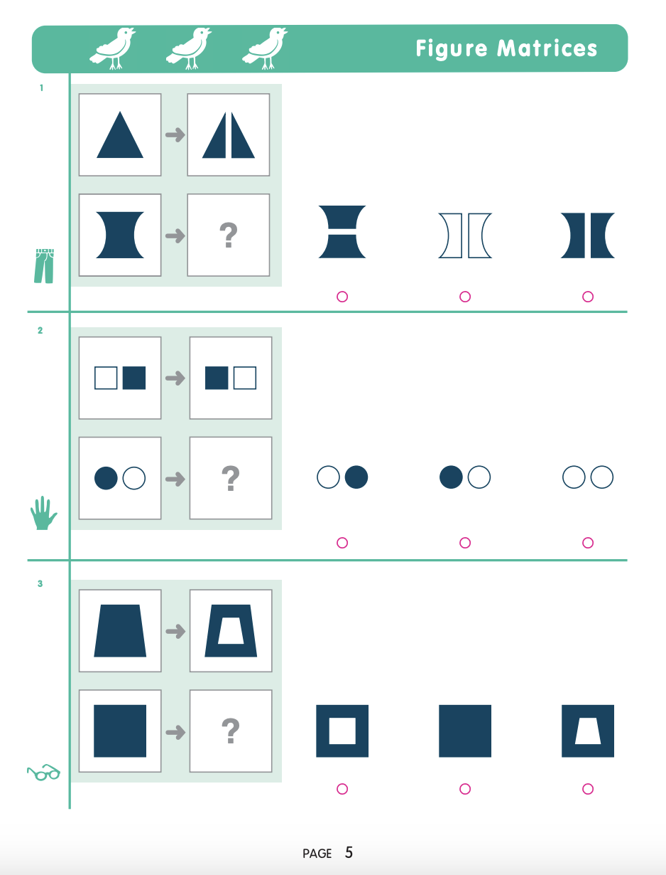
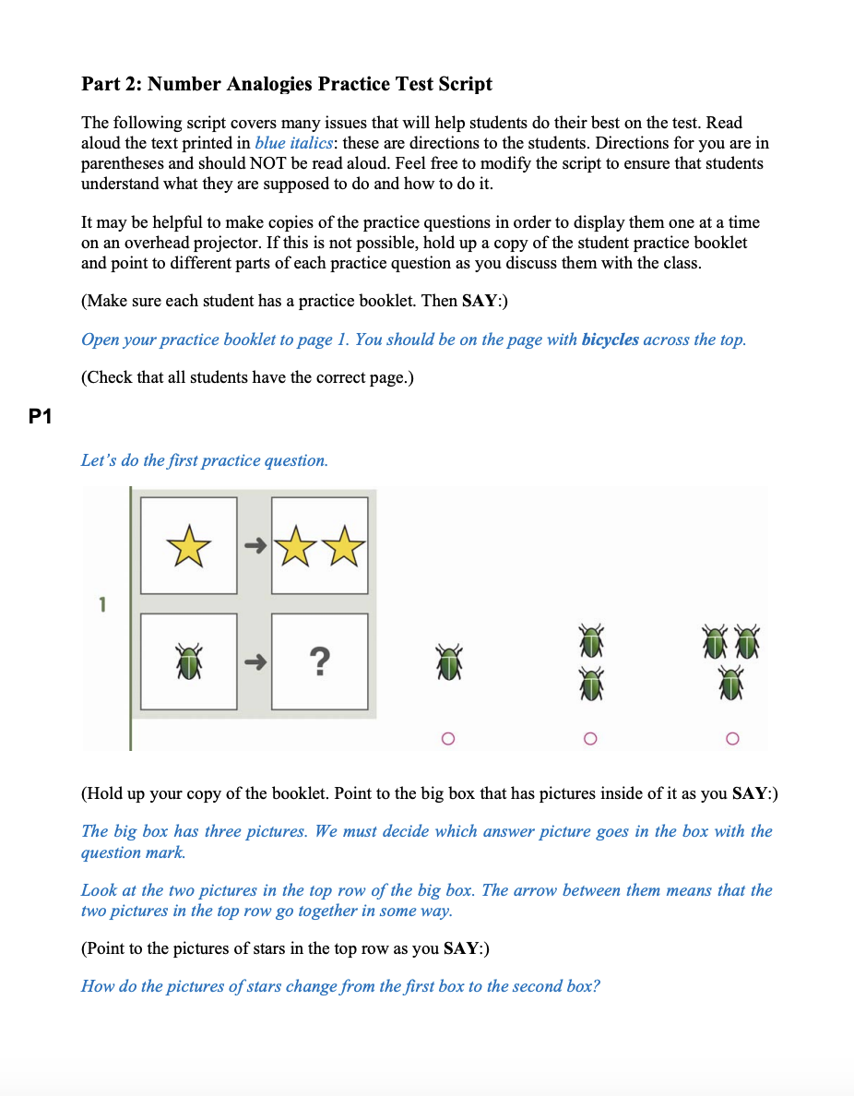
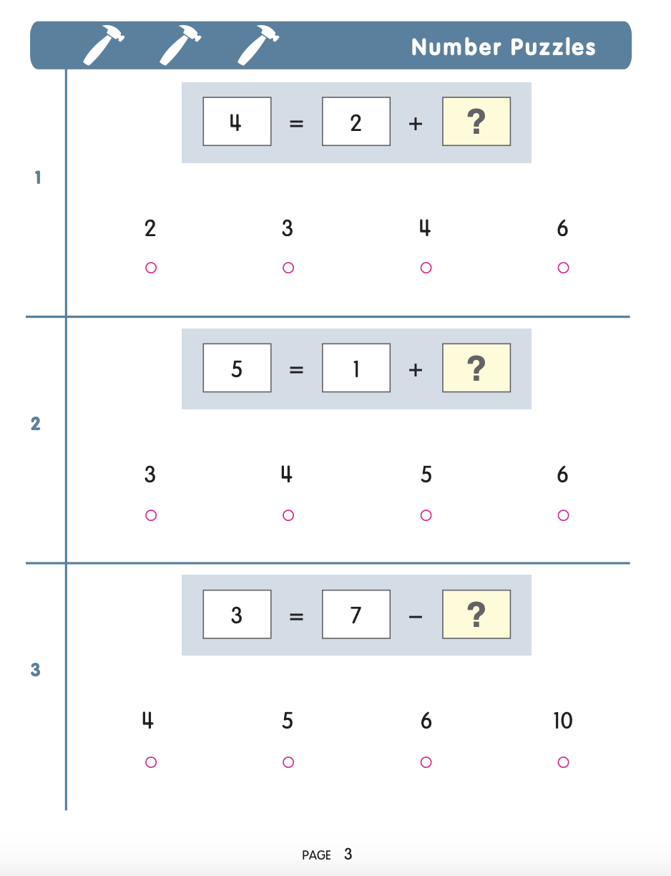
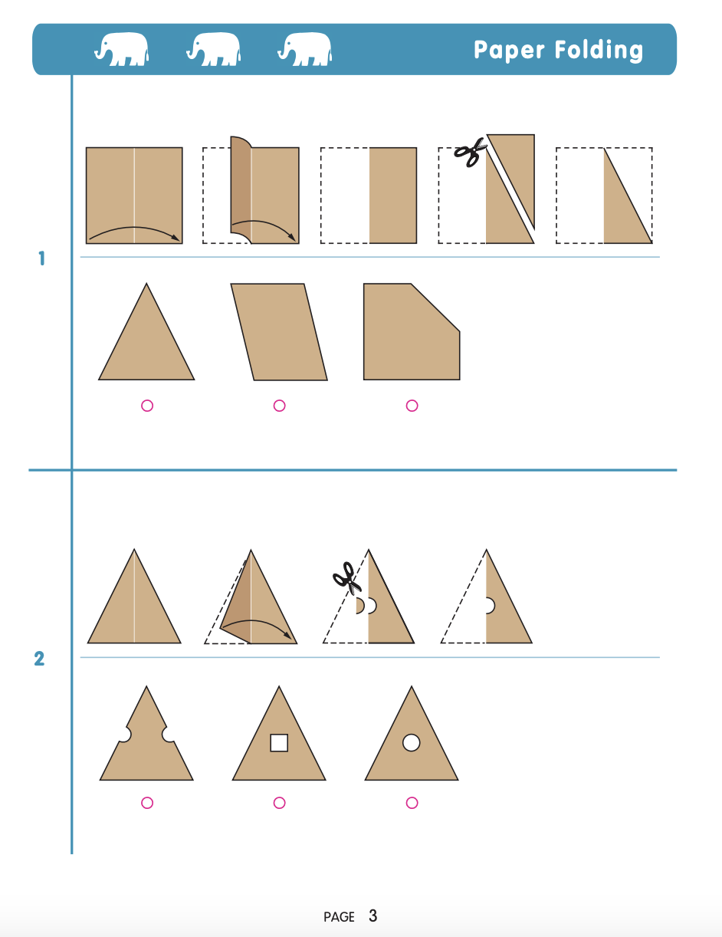
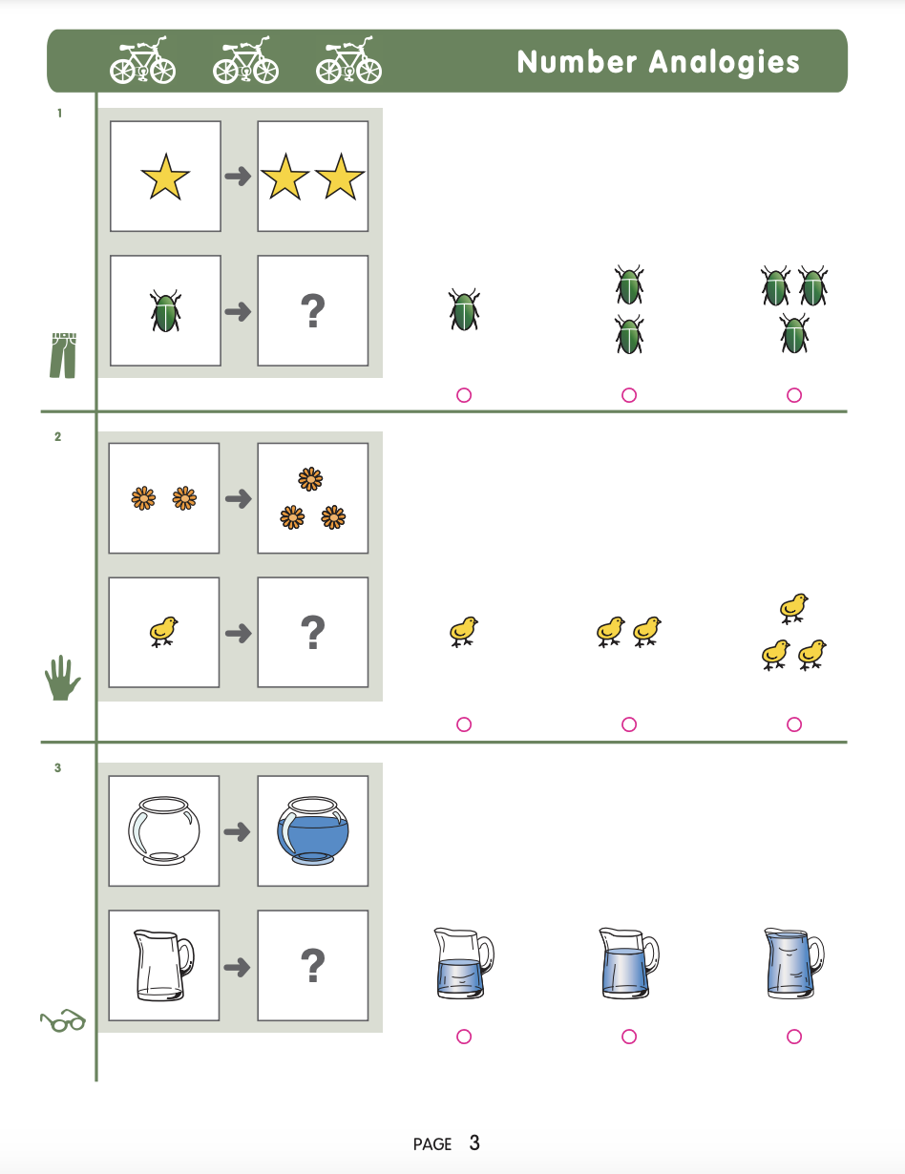
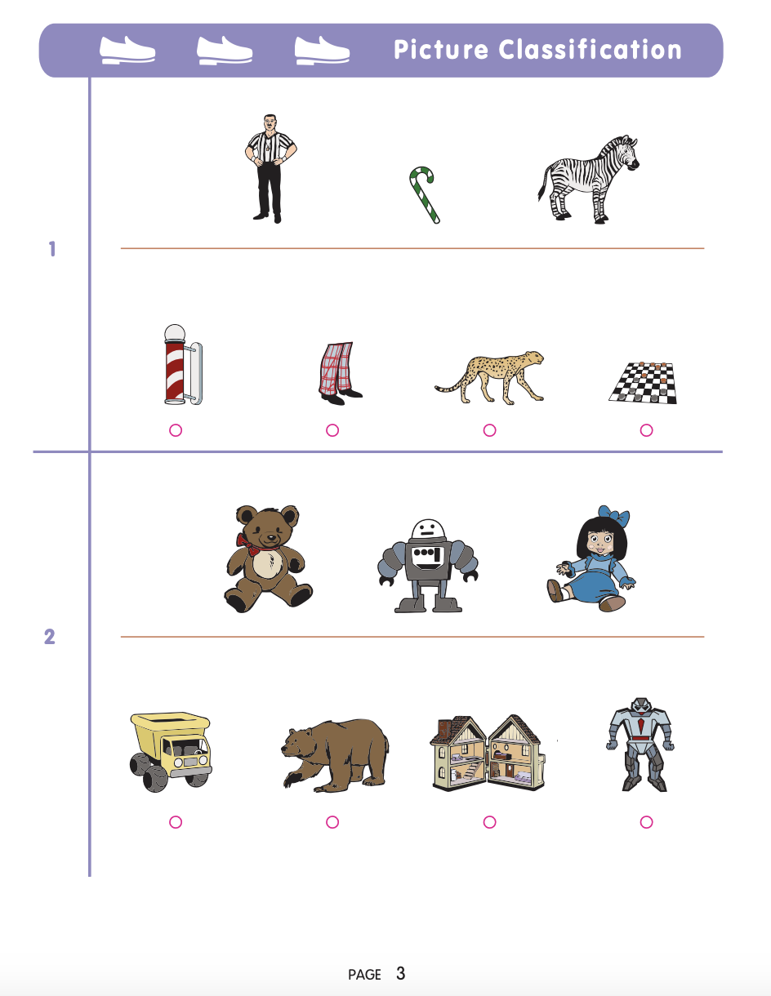
How: Student Preparation
Practice Materials/Sample Questions
Introduces students to the types of questions they will be completing in each subtest, must be done prior to test day
Can be presented to the whole class digitally (projected) or printed
All levels and subtests/batteries available on the SPPS Test Administrator website under ‘Student Preparation’
  Teacher guides/scripts and student practice materials
Can be shared with families – but the Overview of CogAT for Families (available on the SPPS CogAT Family Info website) is a better resource
Note: when testing, each subtest has two built in Practice questions to orient students
PowerPoint versions of KG and 2nd grade practice also available
Online resources
Do NOT use the ‘Getting Started’ tutorial – it is buggy and not necessary
Show the Video guide – linked on SPPS Test Administrator website
Available: How to login (for students) slide deck – linked on SPPS Test Administrator website
We recommend additional staff in the testing room to support student login, especially for Kindergarten

Slide 8
When: Scheduling
Calendar
All testing must occur during the testing window: October 12 – November 12, 2026
  The last week of the window is for make-up testing only
Breaks
Students taking the CogAT Complete in grades 1 – 5 should be given short breaks between each Subtest
  Example: brief group stretch
Timing
Students generally complete 1 Battery each test day (Verbal, Quantitative, and Nonverbal)
Estimated test administration times are available on the next page
Untimed vs. Timed
  Level 5/6 through 8 are Untimed (grades K – 2)
  Level 9 through 11 are Timed (grades 3 – 5), must abide by the time limits
Makeups
Proctors MUST communicate absences to SAC so they can plan for makeup sessions
Proctoring Modes
Audio-Led (recommended)
  Students hear the directions and questions via their iPads (headphones required)
    For Kindergarten and 2nd grade: available in English and Spanish
  Students work independently, advancing through the questions at their own pace
    Students all work on the same subtest at the same time
  Preferred mode to support active test monitoring
  The test administrator/proctor can administer more than one Audio-led test session simultaneously
Proctor-Led
  The test administrator/proctor reads a script of the directions and questions (English: embedded in DataManager Proctor test session; Spanish: request paper script from Jess) while students respond on their iPads
  Students move together through the test; proctor advances the students to the next question after they have had time to answer
  The test administrator/proctor can only administer one Proctor-Led test session at a time
Students must complete all subtest in the same mode they started testing in

Slide 9
When: Scheduling Time Estimates
Kindergarten – Level 5/6 Screening Form
Administer only one subtest per day
Task Estimated time
Subtest 1: Verbal/Picture Analogies
Distribute testing materials 5-7
Review directions and sample items 5
Administer Picture Analogies 15
27 minutes
Subtest 2: Quantitative/Number Analogies
Distribute testing materials 5-7
Review directions and sample items 5
Administer Number Analogies 13
25 minutes
Subtest 3: Nonverbal/Figure Matrices
Distribute testing materials 5-7
Review directions and sample items 5
Administer Figure Matrices 11
23 minutes
Grade 2 – Level 8 Complete
Administer only one battery per day
Task Estimated time
Test 1: Verbal Battery
Distribute testing materials 5-7
Practice items and answer questions 5
Subtest 1: Picture Analogies 13
Subtest 2: Sentence Completion 14
Subtest 3: Picture Classification 13
52 minutes
Test 2: Quantitative Battery
Distribute testing materials 5-7
Practice items and answer questions 5
Subtest 4: Number Analogies 15
Subtest 5: Number Puzzles 15
Subtest 6: Number Series 15
57 minutes
Test 3: Nonverbal Battery
Distribute testing materials 5-7
Practice items and answer questions 5
Subtest 7: Figure Matrices 13
Subtest 8: Paper Folding 11
Subtest 9 Figure Classification 13
49 minutes

Slide 10
Test Preparation in DataManager
Actions completed by REA
Actions completed by SAC
Actions completed by Proctors
Add data into DataManager
  Schools
  Class/Grade
  SAC and Proctor accounts
  Students (initial roster & new students)
Create Test Event
Create Test Assignments
Create Test Sessions
Track Testing Completion
  Ensure students are administered makeup sessions as needed
  Makeup test sessions will need to be created
Access Test Sessions
Provide students with Test Session code (for login)
Once all students are logged in, allow access to the test (Approve All)
  Monitor students
Either Continue testing or End testing at the end of the subtests (subtest/level dependent)
Notes:
Test Sessions are created using a standard naming convention: ”School Number Gr Proctor Name Battery”
  Example: 625 KG Smith Verbal
  ‘Spanish’ is added at the end of Test Session name if Audio-Led Spanish
Students are not added to Test Sessions in DataManager
  Students join Test Sessions when logging in using the Session Code
New and Nominated Students:
Send information to the SAC on any new student who joins your class after September 28
New Students
Notes:
Test Event = testing window

Slide 11
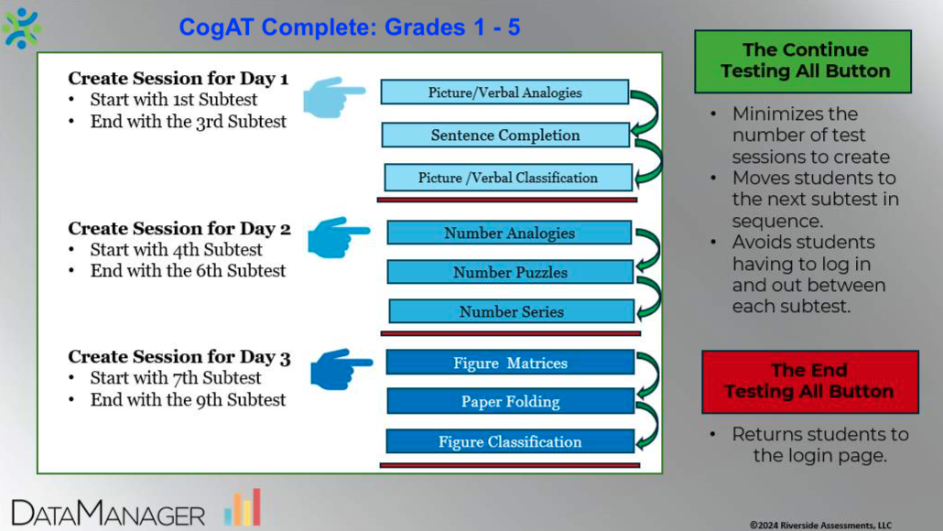


Tips, Tricks, & Notes About Test Sessions
For Kindergarten, students only complete 1 subtest each day, needing 1 Test Session each day
For grades 1-5 complete 3 subtests each day, but also only need 1 Test Session each day:
D1: Verbal/Picture Analogies, D2: Quantitative/Number Analogies, D3: Nonverbal/Figure Matrices
Once all students have completed the 1st subtest of the day, the Proctor selects Continue Testing All to move the students on to the next subtest
Once all students have completed all 3 subtests for the day, the Proctor selects the End Testing All button to close testing for the day
All Test Sessions start with a blank roster
Students will login with a session code, which will then associate them with the Test Session
Once a Test Session has been started, it can only be used that day
Any future testing will need a new Test Session (e.g. Makeup testing)
All students must have the status of “Completed” prior to selecting either Continue Testing All or End Testing All
Tips for Monitoring & Using Action Buttons
Observe each student's progress, make sure students are on task.
Use top buttons for whole group or buttons in each student's row for individuals.
Pause: short break (10 minutes or less) - Resume to return to the test
Exit: leave session with answers and time remaining saved - Create a new session starting with that subtest, and students login with new code to continue in the test.
Cancel: rarely used - does NOT save answers - Start Over, emergency use only
Continue Testing All: Click once, press okay and wait for the group to move to next subtest in sequence. It may take a little bit to close out one test and move the group
End Testing All: Ends testing session for the group and returns to login screen
Additional guidance on the SPPS Test Administrator website > COGAT

Slide 12

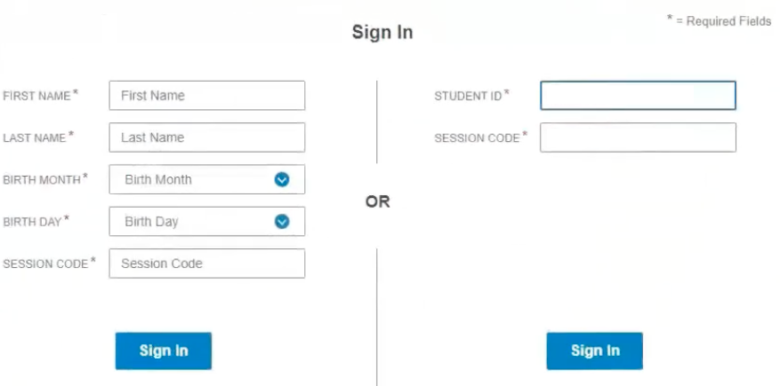
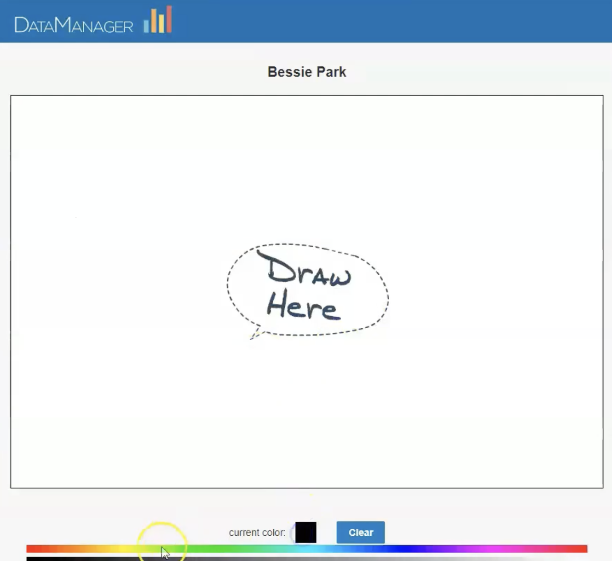

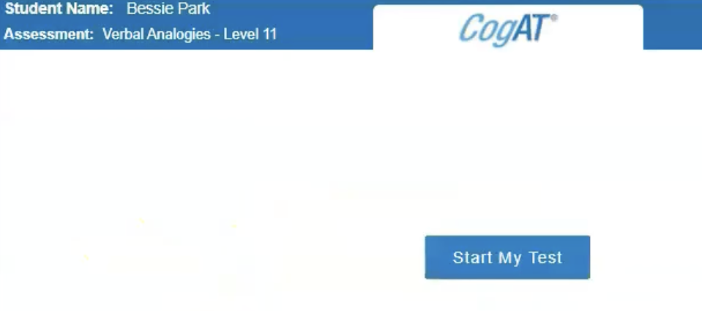
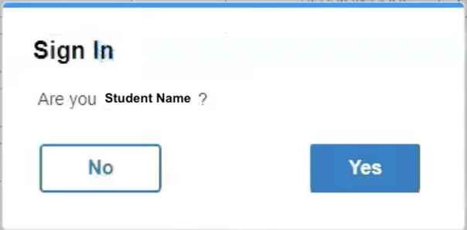
How Students Access the CogAT
Close all apps on iPad and plug in headphones
Open the DataManager app (it will be loaded on most iPads by the start of the testing window, but available in Self Service to install if needed) and select “Take the Test” and then “Yes” to the app Self-Lock question
On the right side of the student login page: enter their Student ID and Session Code
  Student ID is their SPPS student ID
  Session Code is the 7 digit code the Test Administrator/Proctor gives to their students
    Code found in DataManager > Proctoring > Test Session
    Each Test Session has a unique Session Code
After selecting Sign In, students will confirm their name
Students then arrive on a ‘Waiting to Test/Draw’ screen
  Once all students are logged in, Proctors will ‘Approve All’ students in DataManager to begin the students’ test
Once approved, students select Start My Test
Student Name
Student login guide available on SPPS Test Administrator website > CogAT

Slide 13
Getting Ready for Test Day
  Administration
Materials Not Allowed During Testing
All visual aids such as word walls, posters, number lines, and graphics where students will be testing must be covered or removed
  Cell phones, PDAs or translation devices may not be used
    Post testing “Cell Phone Policy” poster – provided by SAC
  Calculators and Dictionaries may not be used
  Proctors are not permitted to eat or drink while testing students
    Guidance
      Arrange the room so that students will be separated from one another as much as possible
      Post “Testing – Do Not Disturb” sign on the door during testing – will be provided by SAC
      Administer subtests/batteries as scheduled
      Login to DataManager website to open test session and then support students logging into DataManager app
      Proctors must be active test monitors and impartial observers during test administrations
      Give students a quick break between subtests, grades 1-5 (e.g. stand up and stretch)
      Ensure all test materials are kept secure at all times
      Proctors must clearly communicate to SAC who was absent and for what parts of the test

Slide 14
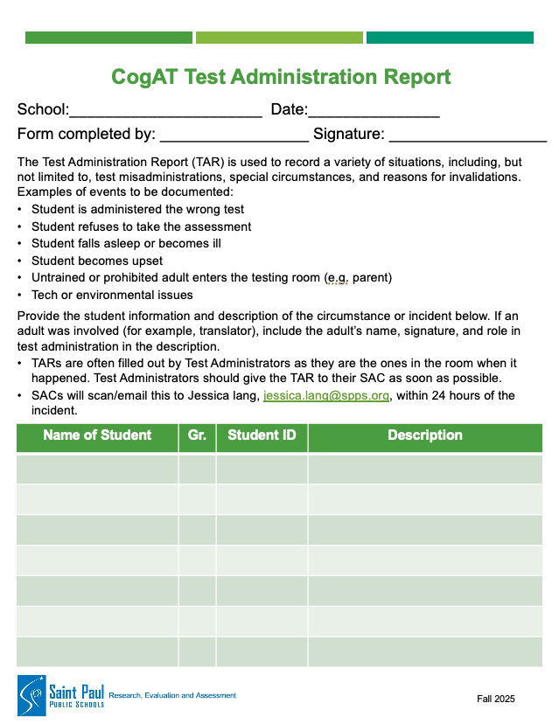
Test Administration Report (TAR)
Form filled out by Proctor to record misadministrations
Examples of misadministrations:
Unusual or unexpected occurrence during testing
Room temperature or other environment issues
No scratch paper provided for grades 3-5 Quantitative Battery only
Student becomes upset or ill
Student is administered the incorrect test level
  Very unlikely with online testing
Student refuses to take or complete the test
Interaction with a parent
Student is disruptive
These are just examples, you may encounter different issues
  Will be provided to Proctors by SAC

Slide 15
Results
A spreadsheet listing all student CogAT scores will be shared with school Principals, SACs, and GT contacts the week of December 14, 2026
  Whether a student was identified as an Accelerated Learner (Gifted & Talented) is included in this spreadsheet
Results letters will go out to families by January 4, 2027
Resources for Teachers:
cogat.com
CogAT Guide for Teachers - https://tinyurl.com/2mn4rkm7
Resources for Families:
cogat.com – parent resources
SPPS: CogAT Family Information website - https://www.spps.org/about/departments/research-evaluation-assessment/assessments/cogat-family-information

Slide 16
Accommodations and Supports
Supports available for all students (does not need to be on an IEP or 504 Plan):
Alternate testing location (often partnered with individual or small group testing)
Individual or Small Group testing
Proctor-Led (instead of Audio-Led)
Repeated Directions
  Audio-Led: students may play the directions and item prompts as many times as needed
  Proctor-Led: the test administrator may read aloud the directions and item prompts as many times as necessary for all students to understand what they are supposed to do
Scratch Paper – grades 3-5 ONLY and Quantitative Battery ONLY (must provide to applicable students)
Note: calculator use is NEVER allowed on the CogAT7 even if indicated on an IEP/504 Plan
Accommodations (must be indicated on IEPs or 504 Plans):
- can be indicated for a different assessment and be applicable for CogAT
Paper test
Scribe – trained staff physically help student navigate the online test system (replay directions/item prompts as requested, select answers as indicated by student, navigate between questions), or indicate answers/turn pages on paper test
  Available for students w/o IEP or 504 Plan if needed due to injury
Accommodations for Grades 3-5 only
  Extended Time – levels 9-11 are timed; some students may need extra time to reduce the effect of a slow work rate on their test performance. Students who have attention disorders or who need help with word identification or reading are examples. Guidance from the student’s IEP should be followed where extended time is needed.
  Read aloud - CogAT is not a reading test. Students with human reader accommodations on their IEP/ 504 Plan can receive assistance reading the questions in the Verbal Battery. Questions in these subtests may be read aloud to students who require such assistance. However, words should not be defined or sentences paraphrased.
    Guide Available
All eligible students should attempt the CogAT – guidance for supporting our students in Fed 3 programs on the SPPS website

Slide 17
Accommodations and Supports continued
Supports for ELL students (in addition to supports available to all):
Directions Administered in a Language other than English –
  Note: there is not a specific EL level that determines if a student should take the CogAT in English or their home language. If a student is understanding oral instructions in English well and consistently - they should take the CogAT in English. If a student does NOT understand oral instructions given to them in English, this student should most likely take the CogAT in their home language.
ELL Supports for Grades 3-5 only
  Read Aloud – for Verbal battery in grades 3-5, words should not be defined or sentences paraphrased
  Word-to-word dictionary –only for grades 3-5 and only if student has experience using a word-to-word dictionary during routine classroom activities. Students may be permitted to use a glossary (no definitions) that translates an English word into the corresponding word in their home language.
All grade levels: Paper | Grades 3-5 only, Online Audio-led
Hmong Karen Somali | Arabic Cantonese Mandarin Russian Somali Vietnamese
Spanish, all grade levels: Online (Audio or Proctor led) and Paper for accommodations

Slide 18
Language Interpreters
The CogAT may be given in a language other than English:
Interpreters are employed with Saint Paul Public Schools
Interpreters speak the language
Get prior approval from your principal
Interpreters must use the translated Directions for Administration
  Email completed Additional Material Request form to Jessica Lang to request translated Directions for Administration
  Available in: Hmong, Karen, Somali, and Spanish
To find an On Call Language Interpreter
  Visit https://www.spps.org/families/interpreter-services
  All On Call Language Interpreters are paid:
    2 hour minimum per visit
    Complete a regular timesheet
    Timesheets need to be sent to payroll with a Supplemental Pay Form
On Call Interpreters are approved for oral interpretation only and cannot perform any written translation.
Online audio options available with DataManager
Levels 5/6 – 8 (KG – 2nd grades) Audio Led available in English and Spanish | Levels 9 – 11 (3rd – 5th grades) Audio Led available in English, Arabic, Cantonese, Mandarin, Russian, Somali, Spanish, and Vietnamese
Any word test content is in English → Verbal battery for Levels 9-11 are all word puzzles

