Slide 1
Monthly Financial Report
as of July 31, 2026
Ann Westbrooks, CPA, RTSBA
Chief Financial Officer

Slide 2
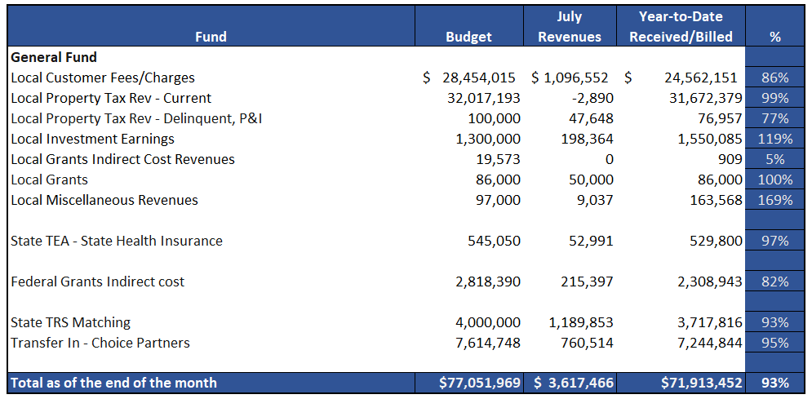


GENERAL FUND
REVENUES (INFLOWS)
Budget to Actual for period ending July 31, 2026

Slide 3
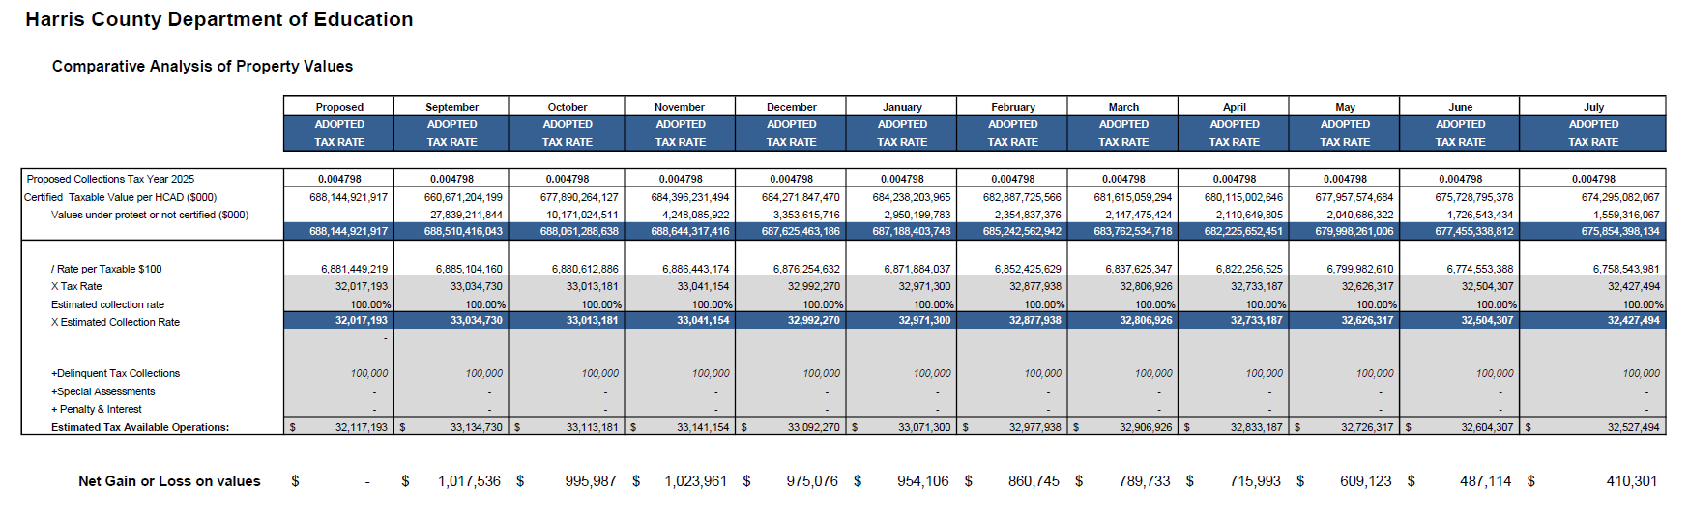

TAX COLLECTIONS COMPARATIVE ANALYSIS
Fiscal Year-To-Date as of July 31, 2026
$675B

Slide 4
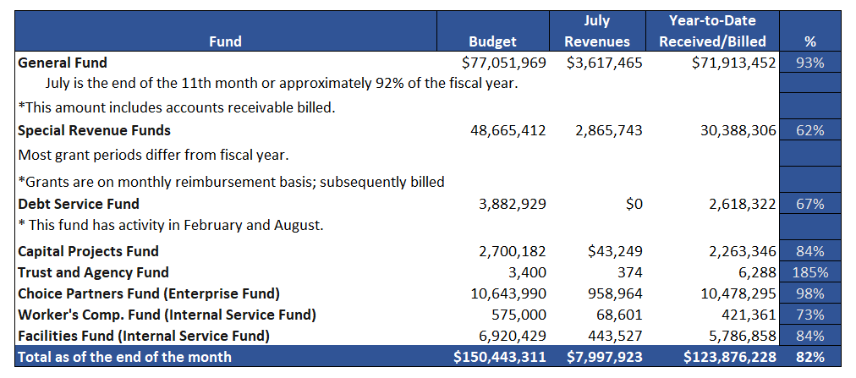
REVENUES (INFLOWS)
Budget to Actual for period ending July 31, 2026

Slide 5
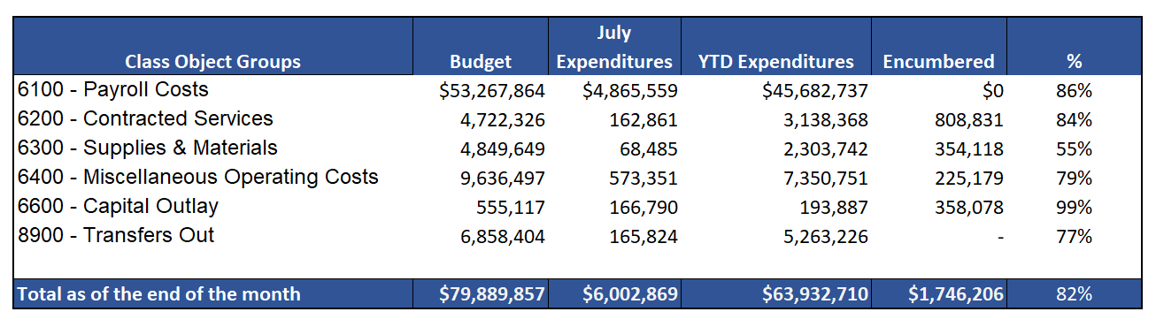

General Funds
Expenditures (OUTFLOWS)
Budget to Actual for period ending July 31, 2026

Slide 6
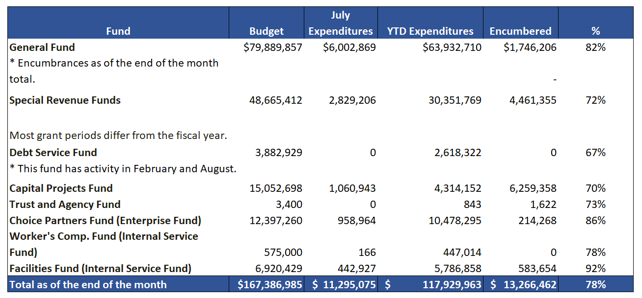
All Funds
Expenditures (OUTFLOWS)
Budget to Actual for period ending July 31, 2026

Slide 7
Education Foundation Update

Slide 8
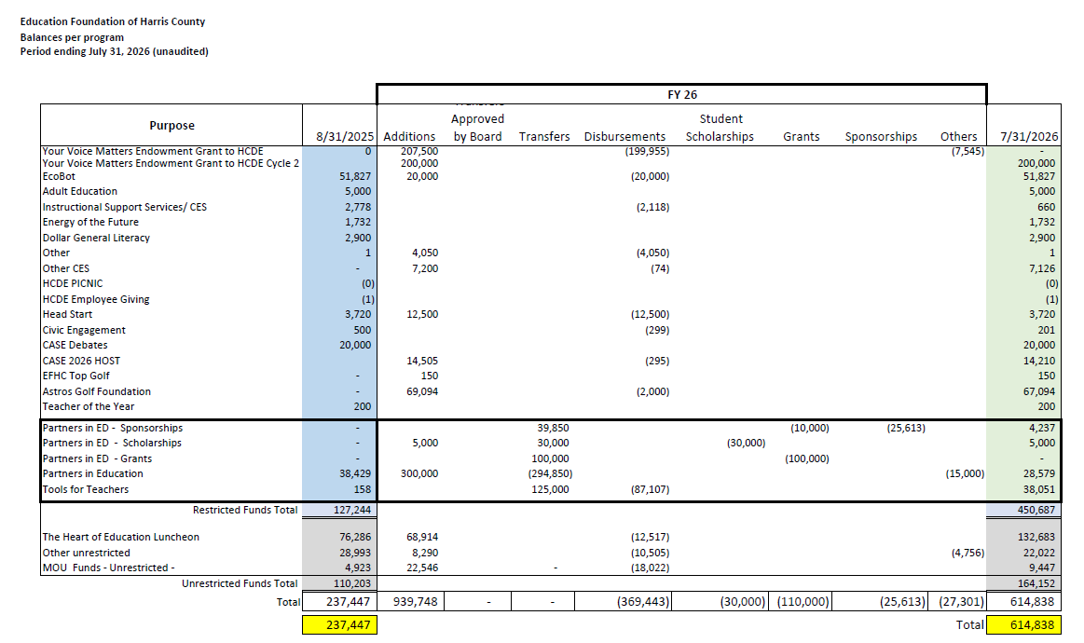

Slide 9
Small Business Report

Slide 10
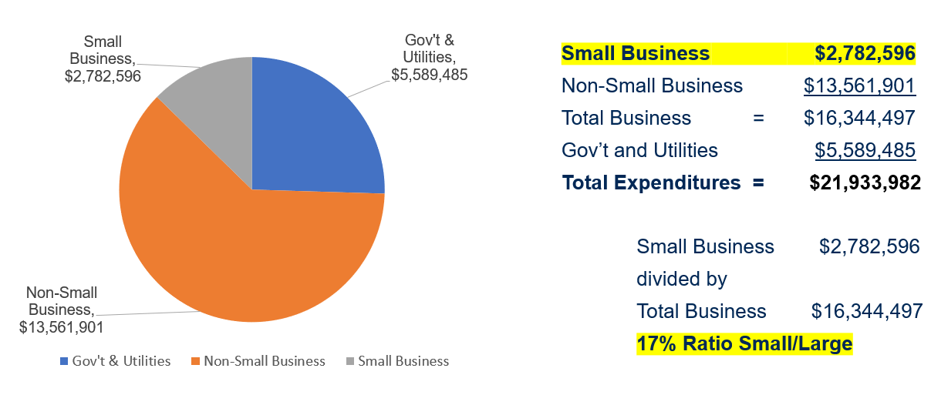
Expenditures FY 2025-26 (09/01/25 to 07/31/2026)

Slide 11
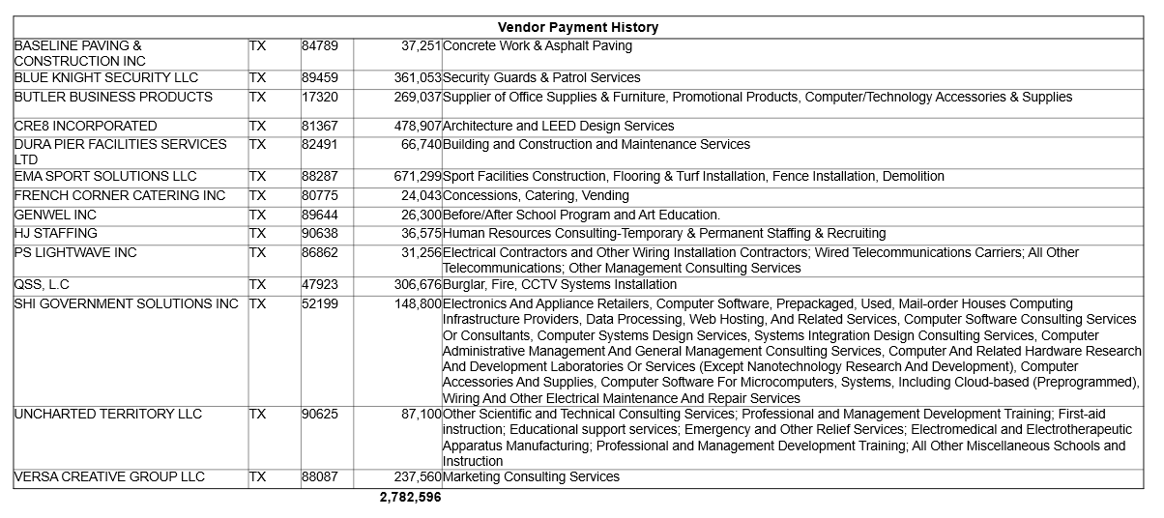
List of Small Businesses FY 2025-26
List of Small Businesses FY 2025-26
11

Slide 12
THANK YOU!
The full report can be found online at:
https://www.hcde-texas.org/financial-transparency/finance/monthly-finance-reports

Slide 13





Q&A
I certify that the following information is true and accurate to the best of my knowledge.
/s/ Ann Westbrooks, CPA, RTSBA
Chief Financial Officer

