Slide 1
Title I Annual Meeting
Sol C. Johnson
September 17 , 2026
Auditorium

Slide 2
What is a Title I School?
Being a Title I school means receiving federal funding (Title I dollars) to supplement the school’s existing programs. These dollars are used for…
  Identifying students experiencing academic difficulties and providing timely assistance to help these student’s meet the State’s challenging content standards.
  Purchasing supplemental staff/programs/materials/supplies
  Conducting parental Involvement meetings/trainings/activities
  Recruiting/Hiring/Retaining Highly Qualified Teachers
Being a Title I school also means family engagement and parents’ rights.

Slide 3

Title I Programs Can Help:
Children do better in school and feel better about themselves
Teachers understand the needs and concerns of students and parents
Parents understand their child and be more involved in the child’s education

Slide 4

Title I Funds
Any Local Educational Agency ( School District) with a Title I Allocation exceeding $500,000 is required by law to set aside 1% of it’s Title I allocation for parental involvement.
Of that 1%, 10% may be reserved at the school district for system-wide initiatives related to family engagement. The remaining 90% must be allocated to all Title I schools in the district. Therefore, each Title I school receives its portion of the 90% to implement school-level family engagement.
You, as Title I parents, have the right to be involved in how this money is spent.

Slide 5
School-wide & Targeted Assistance
We don’t just focus on one specific group; we provide both school-wide and targeted assistance.
School-wide:
Available for all students
Support improved academics for all students
Strengthens parent and family engagement activities
Allows services to be provided to all students based on their academic needs
  (Saturday Academy)
Targeted:
Serves students who are most at risk of not meeting state academic standards.
Uses multiple criteria to identify eligible students
Provides supplemental instruction in reading and/or math
  (Math or reading support & 21st Century)
Progress is monitored throughout the year.

Slide 6
Curriculum
Our school uses Georgia Standards based curriculum to ensure students receive high-quality instruction aligned with state expectations.
Instructions include:
  English Language Arts (ELA)
  Math
  Science
  Social Studies
Curriculum is designed to promote critical thinking, problem-solving, and communication skills
Technology resources are integrated into classroom instruction.
Title I provides supplemental resources and services that help all students meet academic standards and achieve success.

Slide 7
Assessments
MAP testing
Measures growth throughout the year
Georgia Milestones Assessment System (GMAS)
Measures grade-level proficiency
Title I supports our assessment efforts by providing tools and instructional resources that help monitor student progress. Assessment data is used to identify students’ strengths and areas for growth, allowing us to provide additional academic support and targeted interventions for students who need extra assistance

Slide 8

Teacher Professional qualifications
You, as Title I Parents, have the right to request the qualifications of your child’s teachers.

Slide 9
School-Improvement Plan
  Planning team
  Needs Assessment
  Strategic Goals
  Research based strategies
  Evaluation of plan

Slide 10
School-Improvement Plan
  Student academic assessments
  Information on proficiency levels
  Additional assistance provided struggling students
  Coordination and integration of federal funds and programs
  School programs including migrant, pre-school, school choice, and supplemental educational services as applicable.
  Family Engagement Strategies, including the school Family Engagement Policy

Slide 11
Family engagement Input
District Family Engagement Policy
School Family Engagement Policy
School –Parent Compacts
Budget
Volunteer opportunities
Training school staff
Family decision making opportunities

Slide 12
Family engagement
How can families become involved at the school?
Parents have a right to request opportunities for regular meetings for parents to formulate suggestions and to participate, as appropriate, in decisions about the education of their children
The school must respond to any such suggestions from parents as soon as practicably possible

Slide 13
Volunteer Opportunities:
Vista: (Volunteers In School Targeting Achievement)
To become a volunteer, visit the SCCPSS website and look for the “Volunteers” section and follow the prompts on the screen
A background check must be completed before volunteering

Slide 14
Family Engagement Funds
SCCPSS reserves 1% from the total amount of the Title I, Part A funds it receives in FY_26_ to carry out family engagement requirements.
Family/Parent input as sought through the Annual Evaluation Survey and Parent Forum held in the spring on how to spend these funds.

Slide 15
Family Engagement Funds
Through collaboration with parents/families it was decided that for the __26-27_ school year the following items would be funded:
Educational tools and supplies
Educational learning games
Flash Drives
Resources and supplies for the Family/Parent Center

Slide 16




Contacting the Staff
Principal: Jemeela Brown
Assistant Principal: Latasha Lee , David Jackson
Dean of Students: Brandon Lindsey
Title I Family Engagement Facilitator: Autumn Sims
  Autumn.sims@sccpss.com
  912-395-6400 ext. 730501
ESOL Coordinator: Debbi Milligan
  Debbi.Milligan@sccpss.com
  912-395-6400 ext. 730219

Slide 17

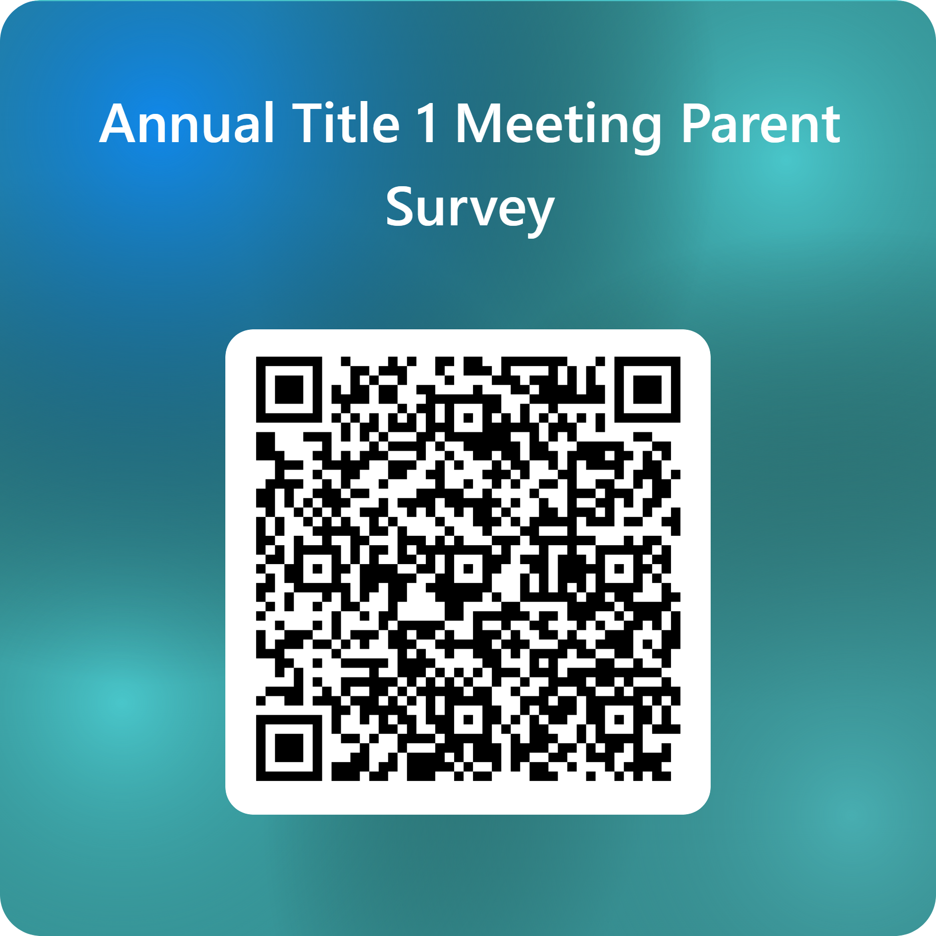
Questions

