Slide 1






Financial Aid

Slide 2
Discussion Topics
What is financial aid, cost of attendance (COA), student aid index (SAI) and financial need?
Categories, types and sources of financial aid
Free Application for Federal Student Aid (FAFSA®)
Special and unusual circumstances

Slide 3

What is Financial Aid?
Financial aid consists of funds provided to students and families to help pay for postsecondary educational expenses

Slide 4
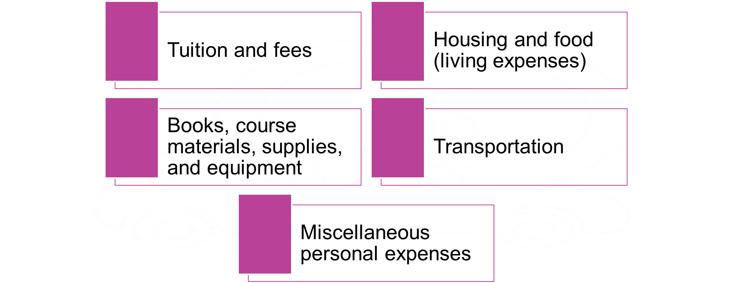





What Is Cost of Attendance (COA)?

Slide 5
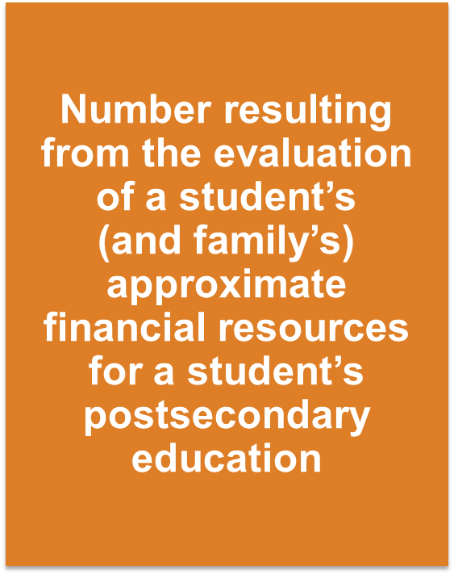


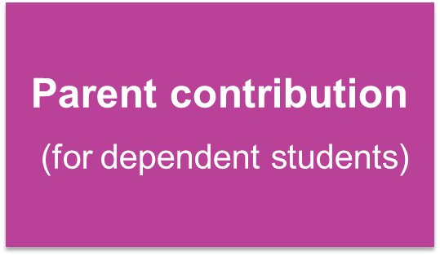
What Is Student Aid Index (SAI)?

Slide 6
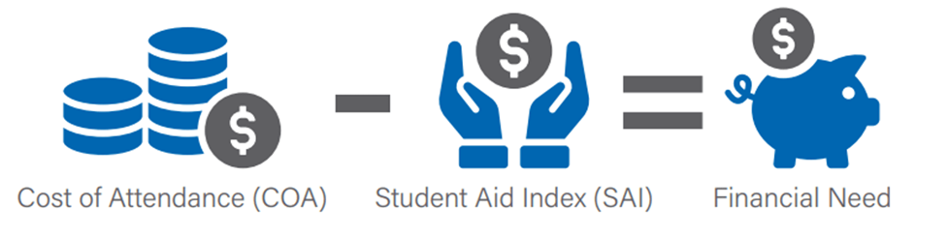
What is Financial Need?

Slide 7


Categories of Financial Aid

Slide 8
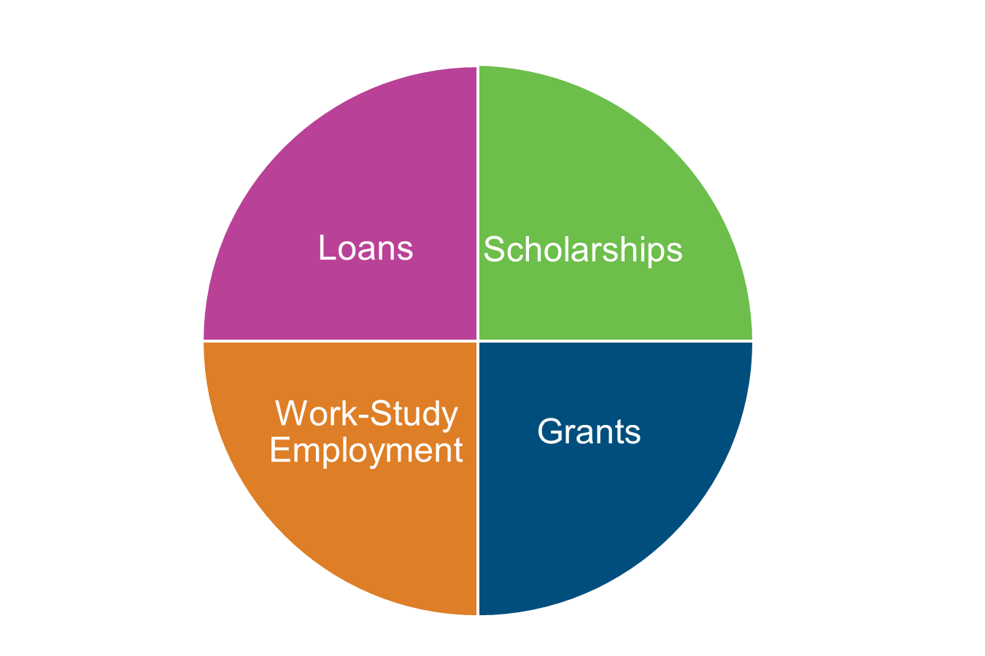
Types of Financial Aid
Self-Help
Aid
Gift Aid

Slide 9





Sources of Financial Aid

Slide 10
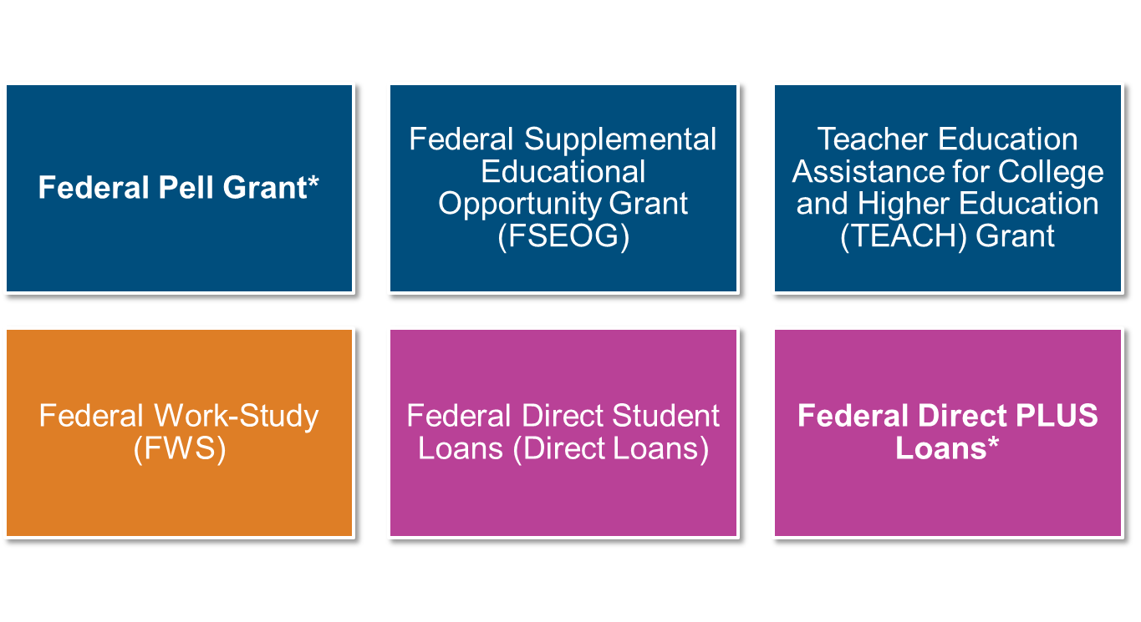
Federal Student Aid Programs
*Changes to program effective with 2026-27 award year

Slide 11
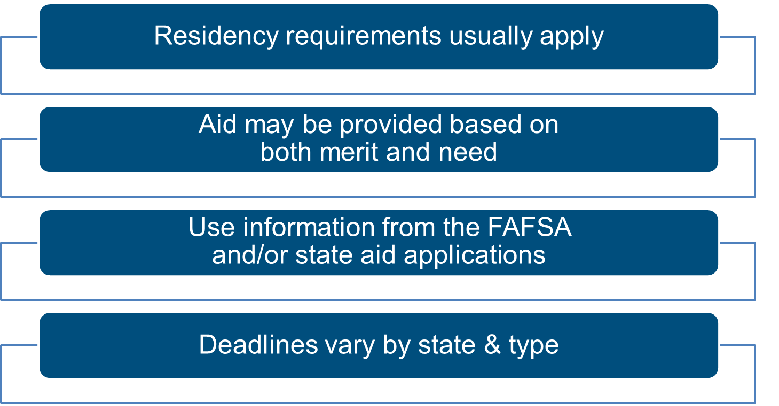
State Aid

Slide 12
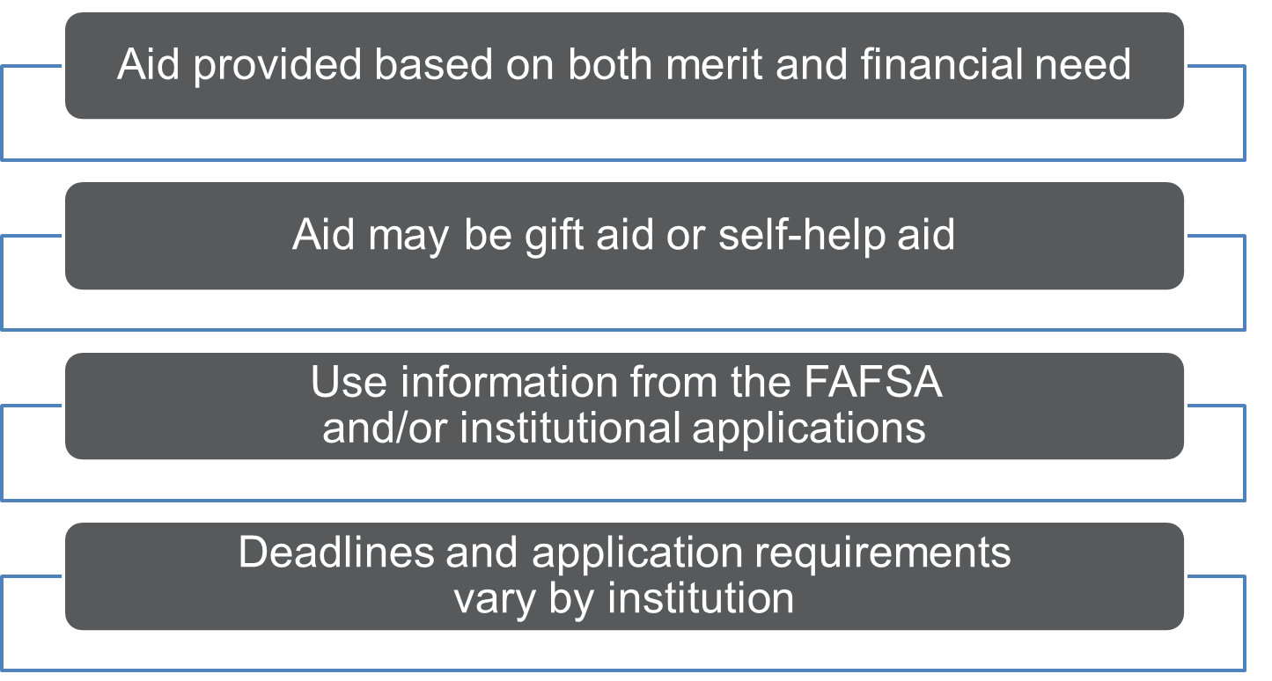
Colleges & Universities

Slide 13
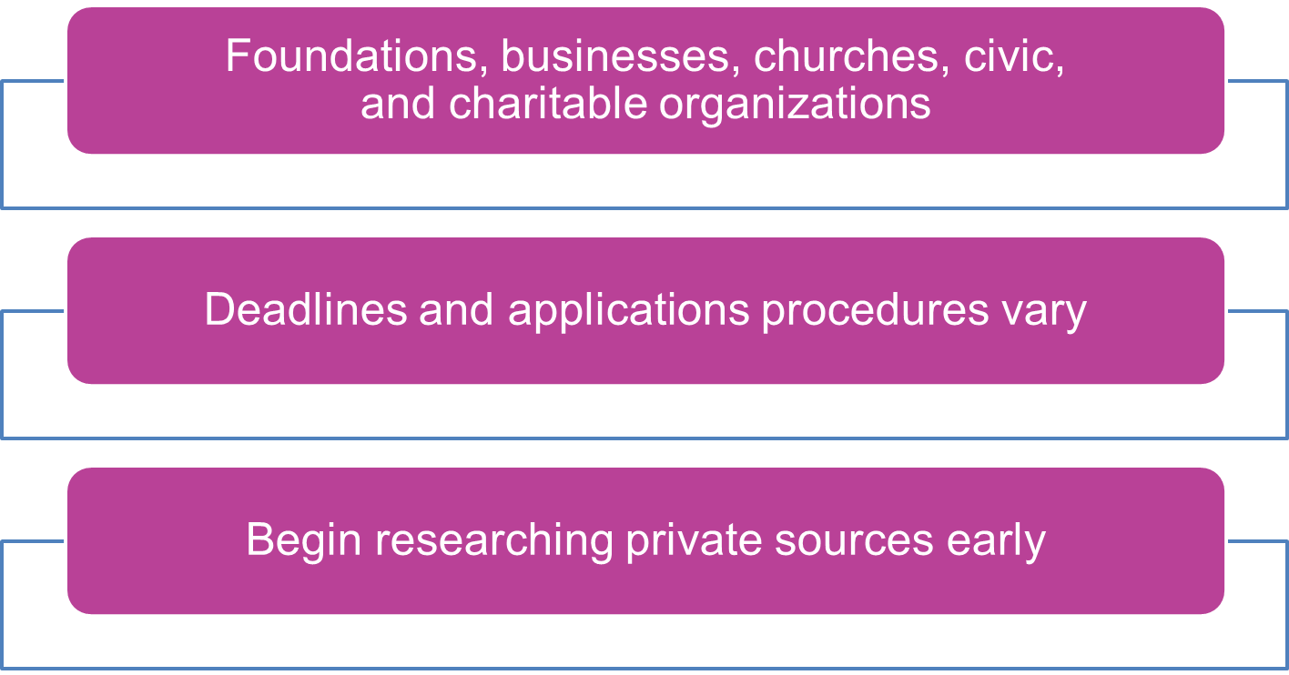
Private Sources

Slide 14
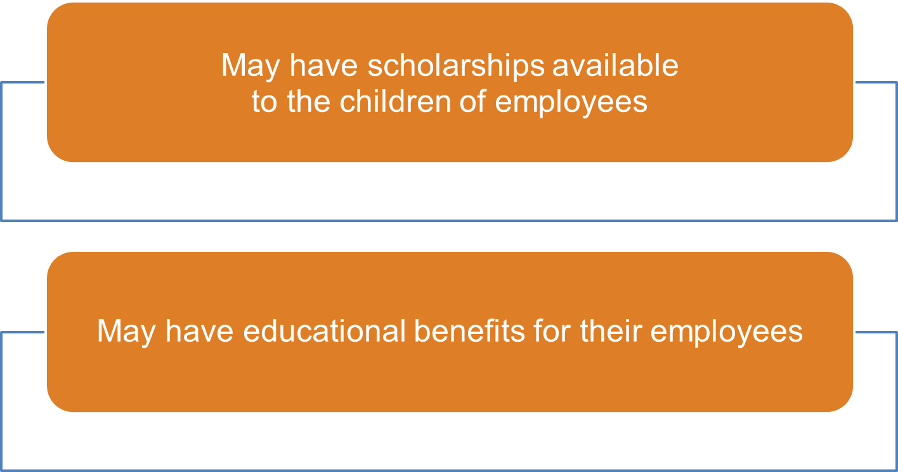
Employers

Slide 15

Veterans’ Education Benefits
Primary programs
  Post-9/11 GI Bill (Chapter 33); can be transferred to the veteran’s spouse or dependent children
  Montgomery GI Bill (Chapter 30 or 1606 for National Guard)
Benefits vary by program: Ch. 33 covers public, in-state tuition & fees, a monthly housing allowance and a book stipend, while Ch. 30 only pays a monthly stipend
Chapter 35 provides monthly payments to eligible spouses and children of veterans who are permanently and totally disabled, died from a service-connected condition or died on active duty
Yellow Ribbon Program partners with universities to cover private school or out of state tuition that exceed the national GI Bill maximum
Eligibility and benefit details, including application procedures, are available at the VA website

Slide 16

Federal Student Aid Estimator
Early estimation regarding SAI and possible Title IV (federal) aid available
Requires demographic, income and asset information
https://studentaid.gov/aid-estimator

Slide 17
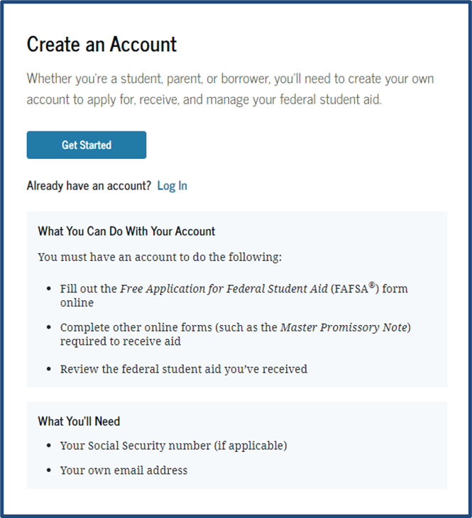
StudentAid.gov Account (FSA ID)
Used for FAFSA completion and access to certain U.S. Department of Education websites
Student and parent must create own FSA ID
May be used throughout financial aid process, including subsequent school years
Only the owner should create an FSA ID
Apply at: https://studentaid.gov/fsa-id/create-account/launch

Slide 18
Free Application for Federal Student Aid (FAFSA)
Available October 1st each year
Colleges may set FAFSA priority dates - be sure to check!
Available in English & Spanish with assistance available in additional languages
Should be completed online; a PDF version is available to complete and mail if necessary
Direct Data Exchange (DDX) allows individuals to transfer federal tax information directly from the IRS to the FAFSA; this eliminates manual entry of income information
Consent is required by all contributors on the FAFSA
Corrections can be made online or via the college’s financial aid office

Slide 19
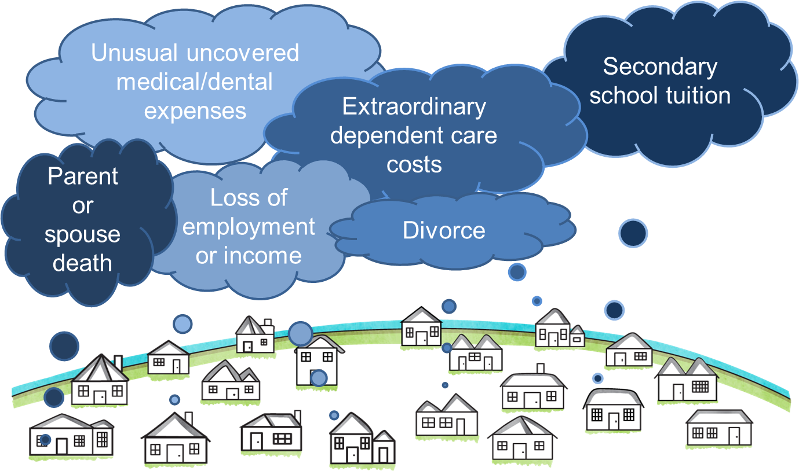
Special Circumstances

Slide 20


