Slide 1


Sawgrass Lake Elementary
Annual Title I Meeting
2026-2027
Sawgrass Lake Elementary
8/26/26
5:15pm
Patricia Galdames, Assistant Principal

Slide 2


Data Resources/Consider
Comprehensive Needs Assessment
School Improvement Plan
District Climate Survey (Title l Items)
PM3 Data/Connection to Phase lll
Notes:
Calling out some data sources to get them started…

Slide 3


All About Title l
Title I is the largest federal assistance program for our nation’s schools.
The program serves many schools in Pinellas County including eligible students non-public schools.
The Title l goal is that every student achieves high levels of academic proficiency.
Notes:
Highlight the Title l Program here in Pinellas County.

Slide 4

Title I Funding Process
2. Florida Department of Education
1. Federal Government
4. Sawgrass Lake Elementary
3. Pinellas County Schools
Notes:
The Florida Department of Education receives funds from the federal government. Districts receive Title I funds from Department of Education, and the school district distributes these funds to schools based on the percentage of children eligible for free/reduced price lunch; however, students do not have to be from low-income families to receive help.

Slide 5


Title l Supplemental Resources
Definition: Provided in addition to what is already present or available to compete or enhance it.
Extra Support & learning opportunities for economically disadvatanged students.
Notes:
Definition: provided in addition to what is already present or available to complete or enhance it extra academic support and learning opportunities for economically disadvantaged students.

Slide 6
Title I Schoolwide Planning and Input
First
Second
Last
Seek Input from school, family, and community members determine how Title I funds are used based on a needs assessment.
Please attend online or in-person meetings/trainings and complete surveys to provide input on Title I funding.
All Title I schools must document that parents are involved in the schoolwide planning process.
Notes:
Evidence for input – input from school can be a survey or notes, which include quotes related to what was shared as feedback AND how this input will be used to inform the PFEP and future engagement activities.
Evidence of Attendance – please include attendance of DIVERSE stakeholder group/s.

Slide 7
Title I Schoolwide Budget
Sawgrass Lake Elementary uses Title I to provide the following resources:
Instructional Materials
Instructional Coach
Parent Engagement
Agendas
Supplies for Parent Events

Slide 8

Parent’s Right to Know
As a parent of a student attending a Pinellas County School Public School, you have the right to…
Be
Be provided information on your child’s level of achievement on assessments in Reading/Language Arts, Writing, Mathematics, and Science.
Request and receive information on the qualifications of your child’s teacher and supplemental personnel working with your child.
Be
Be notified of non-highly qualified or out-of-field teachers at the school.
Be
Be informed if your child is taught by a non-highly qualified teacher for four or more consecutive weeks.

Slide 9
Working Together for Student Success
School
School Improvement Plan (SIP)
Title
Title I Schoolwide Plan
Parent
Parent and Family Engagement Plan
School
School-Parent-Student Compact
Title l is now included as a part of the School Improvement Plan
Notes:
As a Title I parent you have the right to be involved in the development of the following plans and documents for our school which can be found on our website (insert website) to view as well as in the Parent Station located (insert location here).
Our school’s Title I Parent Station is located (insert location or photo of Title I Parent Station (front office and on the webpage). Please include photo as part of the evidence monitoring.
You will find a copy of our School Improvement Plan, Title I Schoolwide Plan, School’s PFEP, the School District’s PFEP, Parent’s Right to Know Memo, Upcoming Events, Compact, (insert other documents at your station)
School Improvement Plan (SIP)
Parent and Family Engagement Plan
Title I Schoolwide Plan
School-Parent-Student Compact

Slide 10

Parent and Family Engagement Plan (PFEP)
The PFEP Sections include information about the following:
  Parent trainings to increase student achievement
  Staff trainings for engaging parents
  Communication methods between home and school
  Flexible meeting times
  Accessibility for parents
  Coordinating with other Federal Programs
  To access the full LEA PFEP, please visit
  www.pcsb.org/titleone
Notes:
Provide information on the specific committees that parents can be involved. Include the purpose, date and time of meetings.
Explain the PFEP and its purpose.
Consider the evidence related Title I Crate, Sample of Evidence,

Slide 11


All curriculum, instruction and assessments are based on student-centered expectations.
Florida Benchmark For Excellent Student Thinking Standards (B.E.S.T). You may read more information by visiting, www.fldoe.org.
Notes:
All curriculum, instruction and assessments are based on student-centered expectations.

Slide 12
School’s Curriculum
Florida Benchmark For Excellent Student Thinking Standards (B.E.S.T). form the framework of everything taught at school.
Core Curriculum
  Reading
  Mathematics
  Writing
  Science
Notes:
This slide is optional if this will be discussed with classroom teacher
School’s Curriculum
Describe and explain the curriculum (Specific names of texts)

Slide 13
Florida Assessments
To learn more about state assessments visit the Florida Department of Education’s website, fldoe.org/accountability/assessments.
VPK STAR Early Literacy
Kinder STAR Early Literacy & STAR Math
1st & 2nd STAR Reading & STAR Math
3rd-5th Grade FAST Reading & Math
4th & 5th Grade FAST Writing
5th grade Only Science
Notes:
This slide is only required, if it applies.

Slide 14

Sawgrass was rated an A!!!
Enrollment
Units – shifts
Gifted
Assessments – English Language Learners
Long-Term Goals and Interim Progress
Available online at https://edudata.fldoe.org/

Slide 15
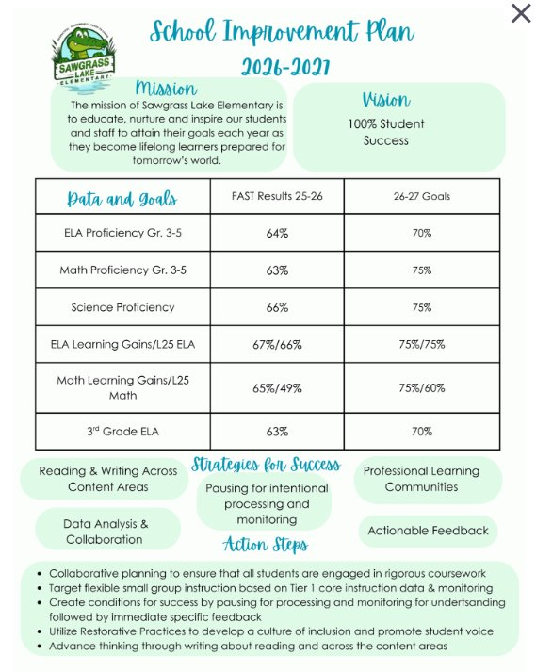

Slide 16

Parent Advisory Council (PAC)
The District has a Parent & Family Engagement Plan. The summary of the plan is in the Title I School & Family Partnership Overview.
You may access the full plan at www.pcsb.org/titleone
The Parent Advisory Council (PAC) is responsible for reviewing and revising the District Parent & Family Engagement Plan.
PAC will meet virtually or in person with the district’s Title I staff.
Each school is committed to having at least one member representative in PAC.
PAC meets twice a year, if you are interested in representing our school please contact the office.
Notes:
Please add your PAC representative in slide and share with your Title I Specialist.
https://forms.office.com/r/r5daaMTENE\

Slide 17

Thank you for your time!

Slide 18
Please welcome our
2026 – 2027
PTA president
Laurabeth winder
Notes:
Please duplicate Microsoft Forms provided or create school survey. To generate a QR code hover over your school’s survey and and right click. Create QR code for this page will be an option.

