Slide 1


College Planning Workshop #1:
“Location, location, location!”
SEPTEMBER 2026

Slide 2
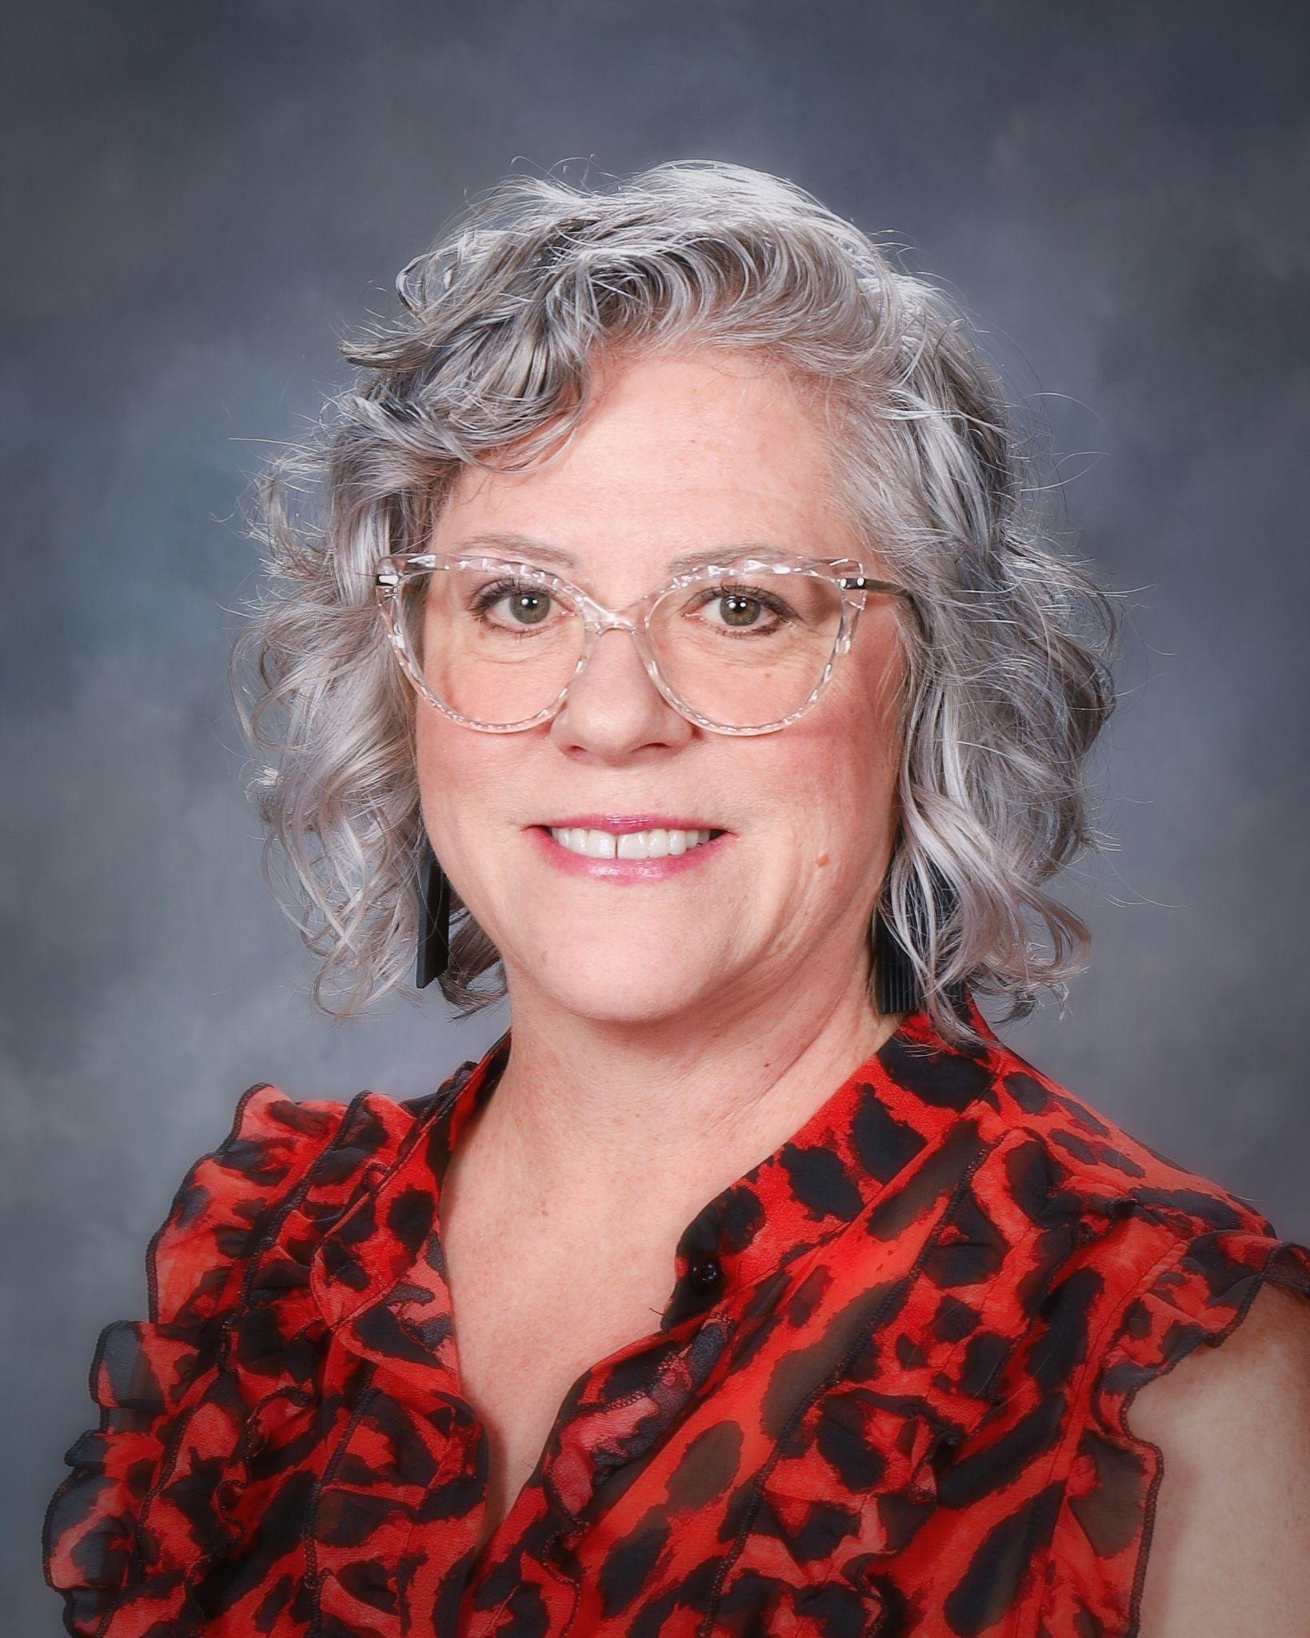
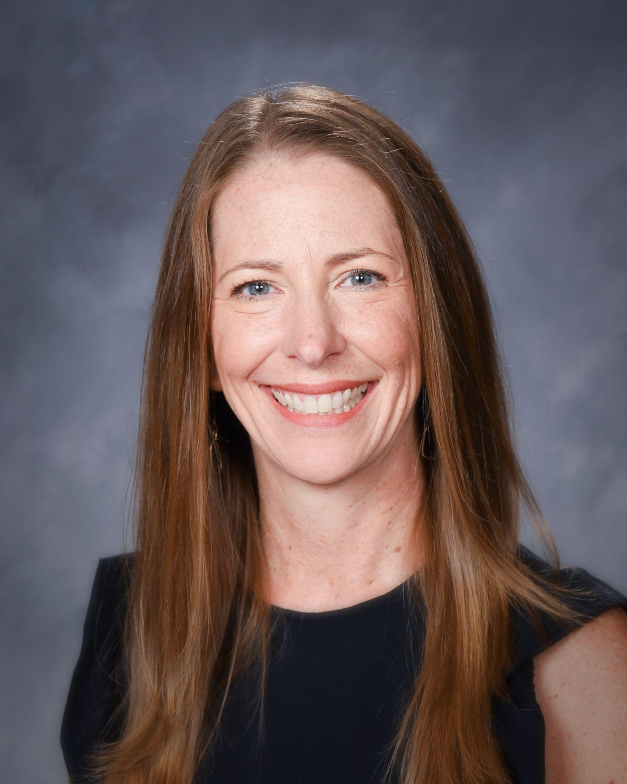

Ms. Semanko Mrs. Pierson Mrs. Niederstadt
Counselor-11/12 Counselor- 8-10 Registrar

Slide 3


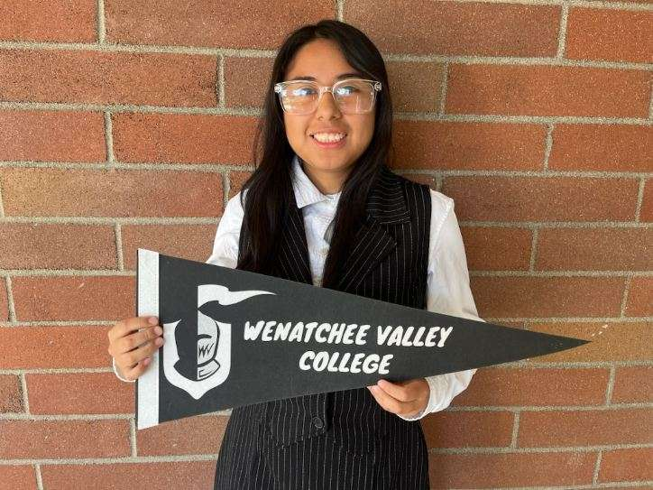


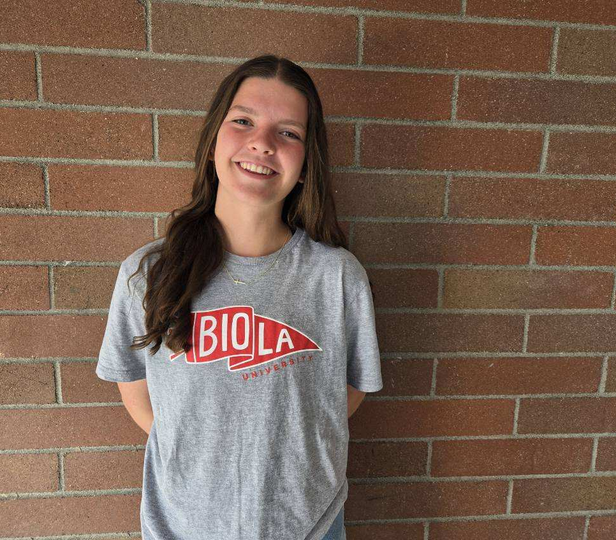
Where will you go?

Slide 4

You may take notes on the pages provided……
Additionally - This slideshow will be posted on the CHS Website, under the Career/Counseling tab!

Slide 5

College Planning #1
The Fit- Selecting A College
The Forms-The Admissions Process
The Finances-Aid & Scholarships
CC B-SA

Slide 6

The Fit
Technical or Trade School
Community College
Private Four Year
Public Four Year

Slide 7

Community and Technical Colleges (2025-26)
Student Profile: 290,140 Faculty/Student Ratio: 1:17
College/University Transfer: 36% (AA degree) Professional-Technical: 28%
                Bates Technical College Bellevue College Bellingham Tech
                Big Bend Community College Cascadia Community College Centralia College
                Clark College Clover Park Technical College Columbia Basin College
                Edmonds Community College Everett Community College Grays Harbor College
                Green River Community College Highline College Lake WA Institute of Tech
                Lower Columbia College North Seattle College Olympic College
                Peninsula College Pierce College Renton Tech College
                Seattle Central College Shoreline Community College Skagit Valley College
                South Puget Sound South Seattle College Spokane Community College
                Spokane Falls Comm College Tacoma Community College Walla Walla Community College
                Wenatchee Valley College Whatcom Community College Yakima Valley Community College

Slide 8
Degrees and Certificates -Community and Technical Colleges
Stand-Alone Certificates - ie: Automotive Technology, Business Computer Technology, Addiction Studies Program, American Sign Language
Transfer Degrees - ie: Associate in Arts Direct Transfer Degree (AA DTA), Associate in Business (Business DTA), Associate of Science (AS-T)
Technical Degrees, not designed for transfer - ie: Accounting, Criminal Justice, Medical Laboratory Tech
Applied Bachelor Degrees - ie: Bachelor of Applied Science/Behavioral Health, Bachelor of Science/Nursing

Slide 9
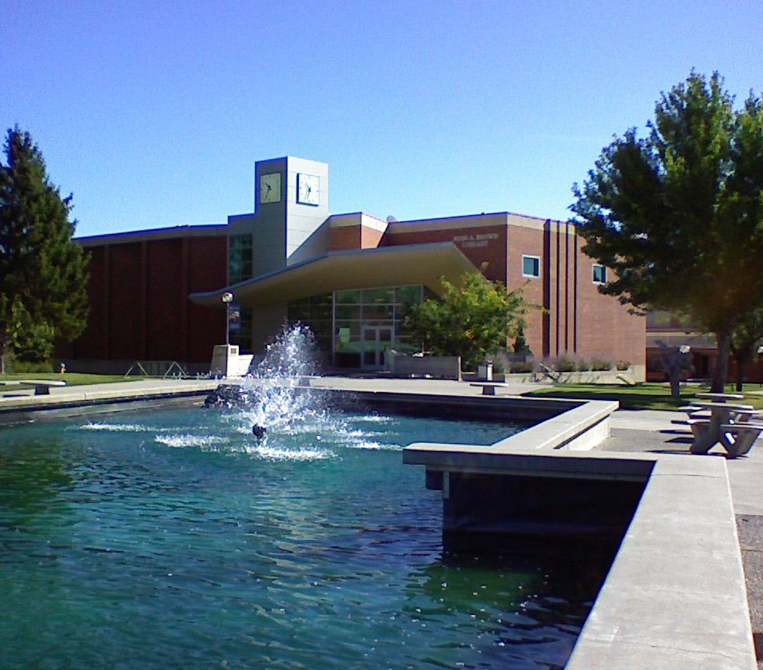
Wenatchee Valley College (2025-26)
  Enrollment 3545 students
  College Transfer 62.81%
  Professional/Technical 29.12%
  Tuition and Fees $4,935
  Room and Board $ -----
  Books/Supplies/Fees $ 900
  Transportation/parking $1,000
  Total $ 6,835 per year

Slide 10

Walla Walla Community College (2025-26)
Enrollment 6,458 Transfer: 25% Technical Certificate: 40%
Tuition & Fees $ 5,279
Room & Board $ 8,928
Books & Supplies $ 528
Transportation $ 2,676
Personal $ 1,848
  Total $ 19,259 per year

Slide 11
Degrees - State and Private Universities
Bachelor of Arts (BA) or Bachelor of Science (BS) Degrees - usually takes 4 years to complete (can transfer with an AA and then finish in 2 years)
and then…….
Master of Arts (MS) or Master of Science (MS) Degrees - usually takes 1-2 years to complete, depending on the program
and then…….
Doctor of Philosophy (PhD) - usually involves research and writing a dissertation, usually takes 5-7 years
OR…….
Doctor of Medicine (MD) - usually takes 4 years of course work and a medical residency which can be 4-7 years

Slide 12

13 Private Four Year Colleges in Washington State
Bastyr University Cornish College of the Arts (@ Seattle University)
Gonzaga University Heritage University
Northwest University Pacific Lutheran University
Saint Martin’s University Seattle Pacific University
Seattle University Trinity Lutheran College
University of Puget Sound Walla Walla University
Whitman College Whitworth University

Slide 13

Gonzaga University-Spokane 2025-26
  Enrollment 7,470 undergrad/grad
  Profile 3.47-3.91 gpa, middle 50% freshman admitted
  Tuition & Fees $56,140
  Room & Board $16,630
  Books & Supplies $ 1,154
  Total $73,924 per year (24/25)

Slide 14

Whitworth University-Spokane 2025-26
Enrollment 2,098 students
Profile 3.47-4.0 gpa, middle 50% freshman admitted
Tuition and Fees $ 55,450
Room/Board $ 14,300
Books/Supplies $528
Total $ 70,278 per year

Slide 15

Public Four-Year Colleges
Central Washington University
Eastern Washington University
Evergreen State College
University of Washington
UW-Bothell
UW-Tacoma
Washington State University
WSU-Tri Cities
WSU-Vancouver
Western Washington University

Slide 16

University of Washington-Seattle 2025-26
Enrollment 51,719
Profile 3.74-3.98 gpa middle 50% Freshman admitted
Tuition $13,406
Personal/Misc $2508
Transportation $519
Room/Board $18,405
Books/Supplies $ 900
Other $3,027
Total $35,738 per year

Slide 17

Washington State University-Pullman 2025-26
Enrollment 16,449 students
Profile 3.27 to 3.86 gpa middle 50% admitted freshmen
  Tuition & Fees $13,391
  Room & Board $13,622
  Books and Supplies $ 762
  Total $27,775 per year

Slide 18

Central Washington University-Ellensburg 2025-26
Enrollment 10,841
Profile 2.79 -3.66 gpa middle 50% admitted freshman
Tuition and Fees $ 9,467
Room/board $ 16,480
Books/supplies $ 900
Total $ 26,797 per year (23/24)

Slide 19


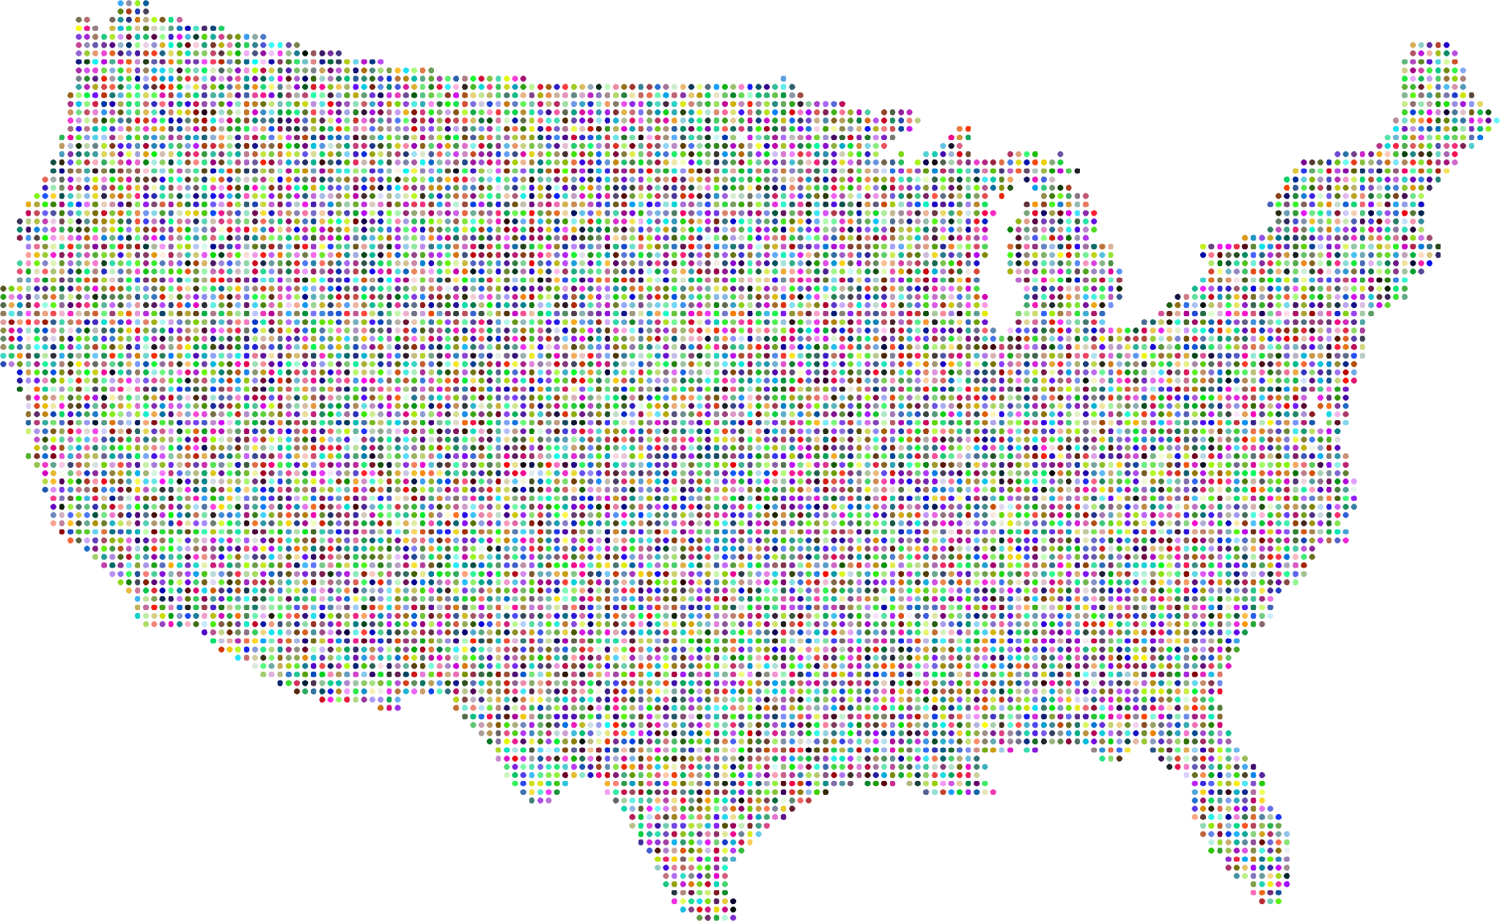



CHS Alumni go far!
Dordt University
Grand Canyon University
Miami University
Mississippi State University
University of British Columbia
University of Chicago
University of Hawaii
University of Idaho

Slide 20

Out of State College Options
Overview of WUE
What it is: The Western Undergraduate Exchange lets students from member states pay 150% (or less) of in-state tuition at select out-of-state public colleges for selected majors.
Eligible regions: 15 western states and 3 U.S. territories.
Savings: Students save an average of over $12,000 per year compared to standard out-of-state tuition.
Participating States/Regions - apply early!
*Alaska * Arizona * California *Colorado *Commonwealth of the Northern Mariana Islands *Guam *Hawai’i *Idaho *Montana *Nevada *New Mexico *North Dakota *Oregon *South Dakota *Utah *Washington *Wyoming

Slide 21

Out of State
College Options
WUE handout in your folder!

Slide 22
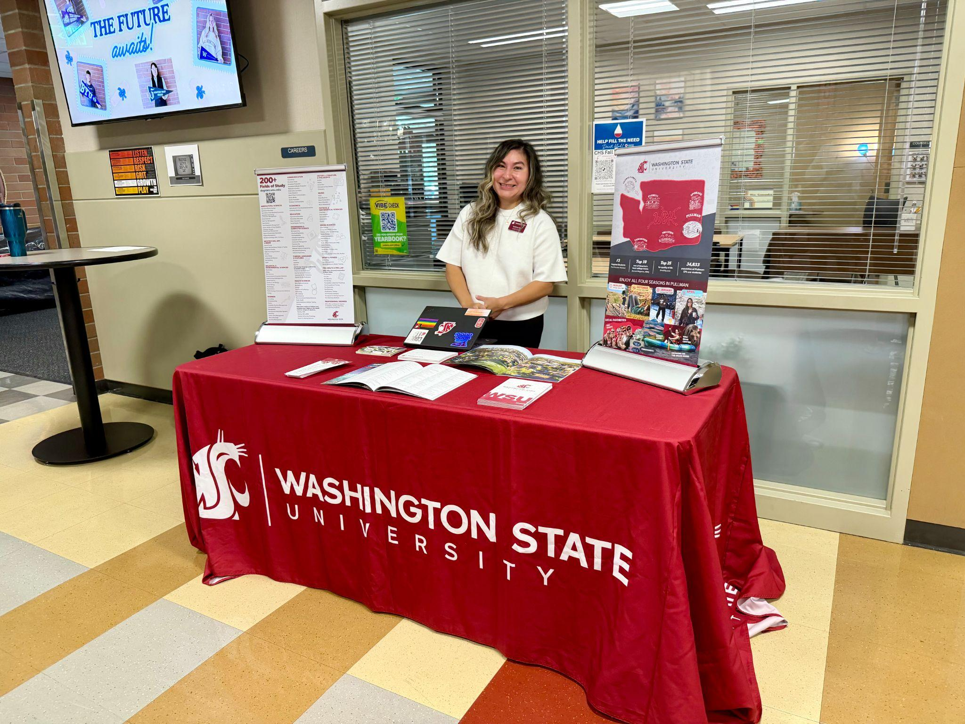
The Fit
Visit with recruiters at CHS
Tour the campus/Fall Preview Days*
Eat the food-see the dorms-attend classes
Talk with CHS Alumni and parents
START TONIGHT!
* Send Mrs Semanko a photo to enter a prize drawing!

Slide 23

Recruiters at CHS

Slide 24
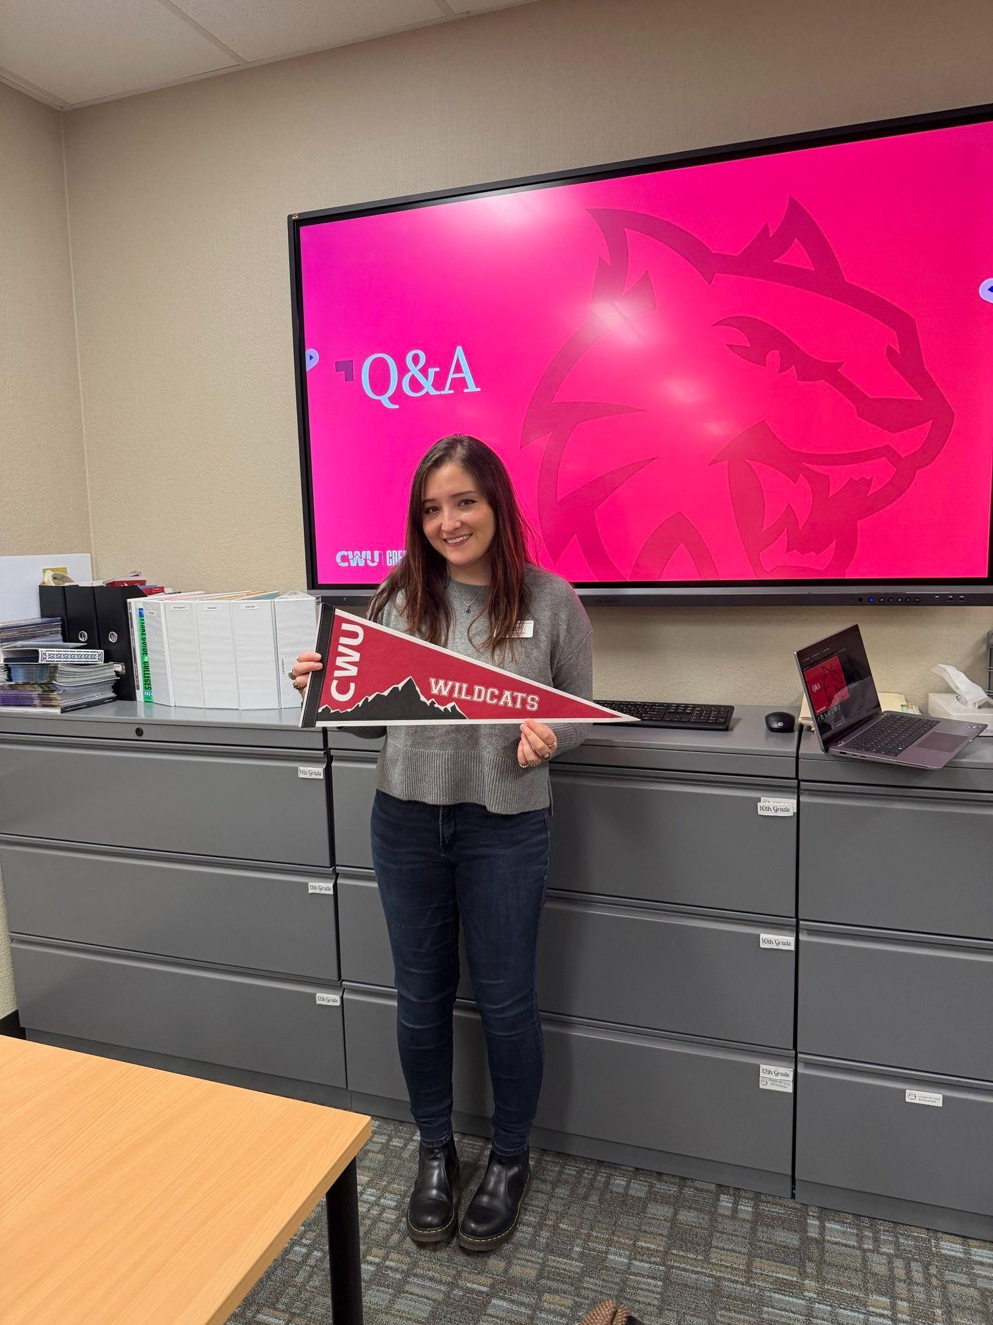
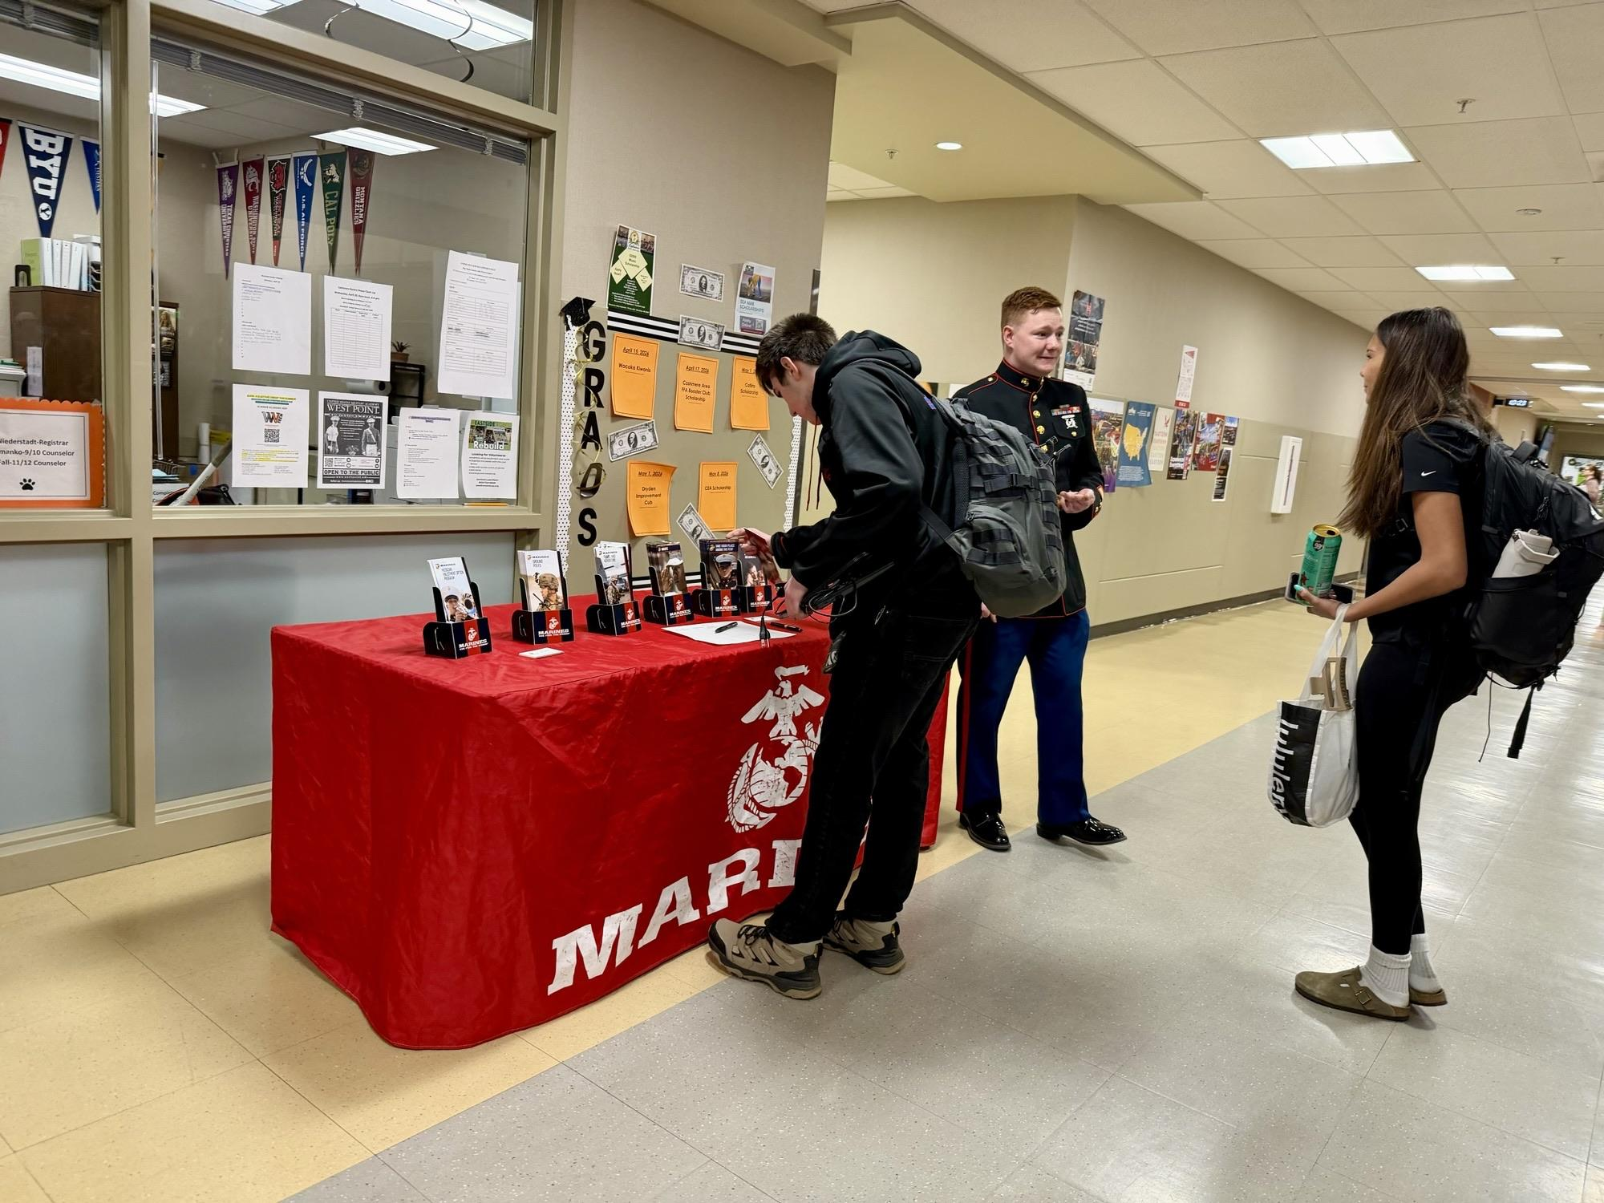
Recruiters at CHS

Slide 25
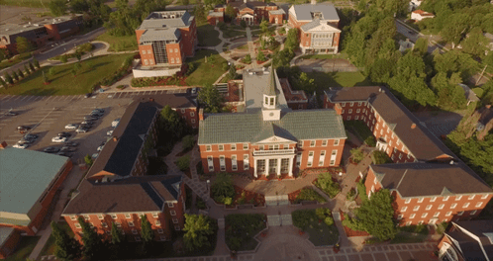
Fall Preview Days- Visit Campus!
October 3 10am-1pm Perry Technical Institute
October 10 9am-3pm Central Washington University
October 17 9am-330pm Eastern Washington University
Oct 17 and Nov 7 8am Washington State University

Slide 26
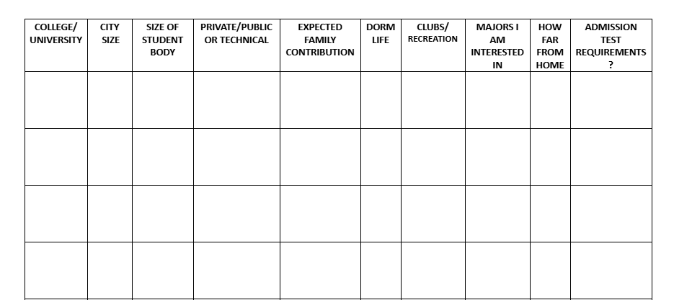

The Fit - Selecting A College
This Photo by Unknown Author is licensed under CC BY-NC

Slide 27

Activity - The Fit
What is on your wishlist ? (ex: big city or small town? choice of major in college? weather? recreation? health needs?)
__________________________
__________________________
__________________________

Slide 28

The Forms

Slide 29

The Forms
Online applications- select “1st Year”
ACT/SAT Test (not for WA State)*
Application Fee (waivers available)*
Transcript Request-CHS only*
Letters of Recommendation*
Personal Statements*
*Not all universities require this….. check first

Slide 30

Applications
Community College Applications
1 FREE Application for all WA Community Colleges
No transcript-no tests-no recommendations
Acceptance to all

Slide 31

The Common App
(4 year schools)
One application that is shared with several colleges.
Fees are charged per school. Some include:
  Eastern WA University (EWU Application is faster)
  Gonzaga University
  Harvard University
  Princeton University
  University of Washington
  Washington State University (WSU Application is faster)
  Whitworth University
  You will need to request a letter of recommendation (on the CHS website) from Mrs. Semanko, via the application, and schedule a time to meet.

Slide 32
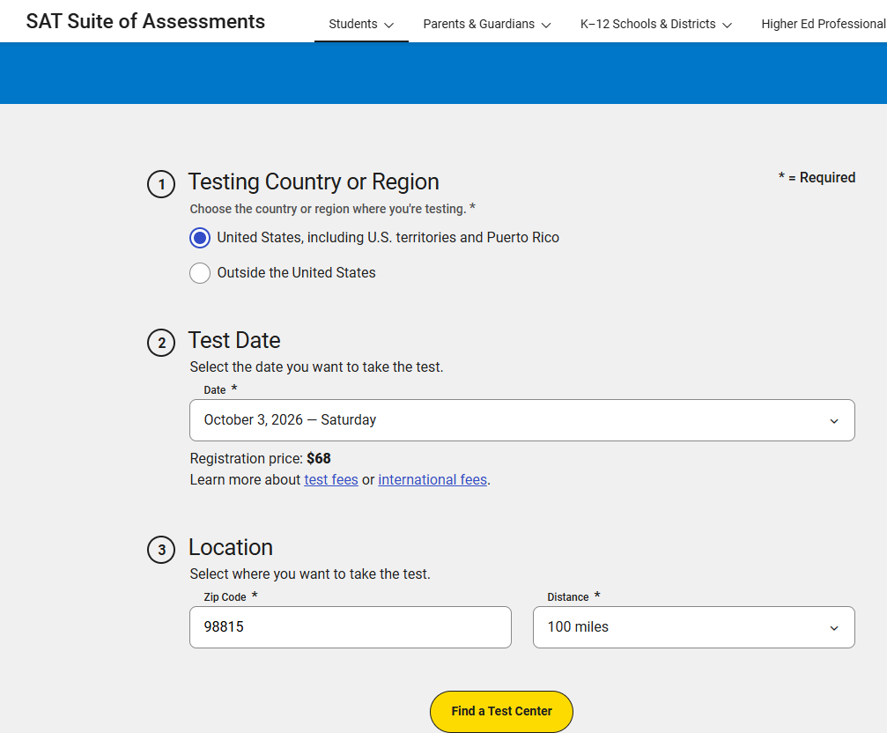
Entrance Tests ACT/SAT (4 year colleges)
Since Fall of 2021 WA State Colleges are “test optional”
  SAT details:
  Saturday test dates (10/3, 11/7, 12/5)
  Register early… space is limited
  $68 fee
  Study and prepare in advance
  Plan ahead for a 3-4 hour exam
  Retake if possible

Slide 33
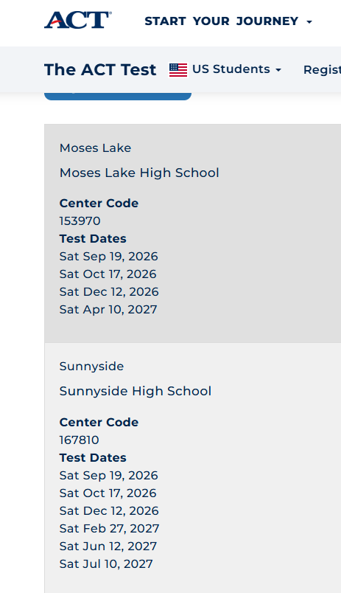
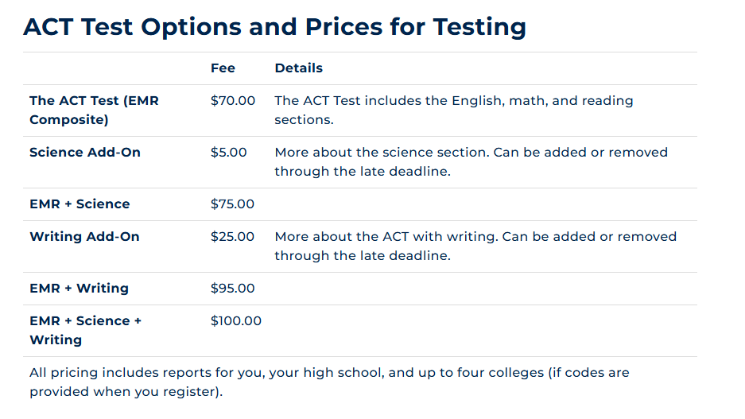
Entrance Tests ACT/SAT (4 year colleges)
Since Fall of 2021 WA State Colleges are “test optional”
  ACT details:

Slide 34

Admissions Offices ~ A Holistic Review
Courses Taken
Employment
Grades/Transcript
Leadership
Service
Extra curricular activities
Contact your university or college admissions office for specific questions

Slide 35
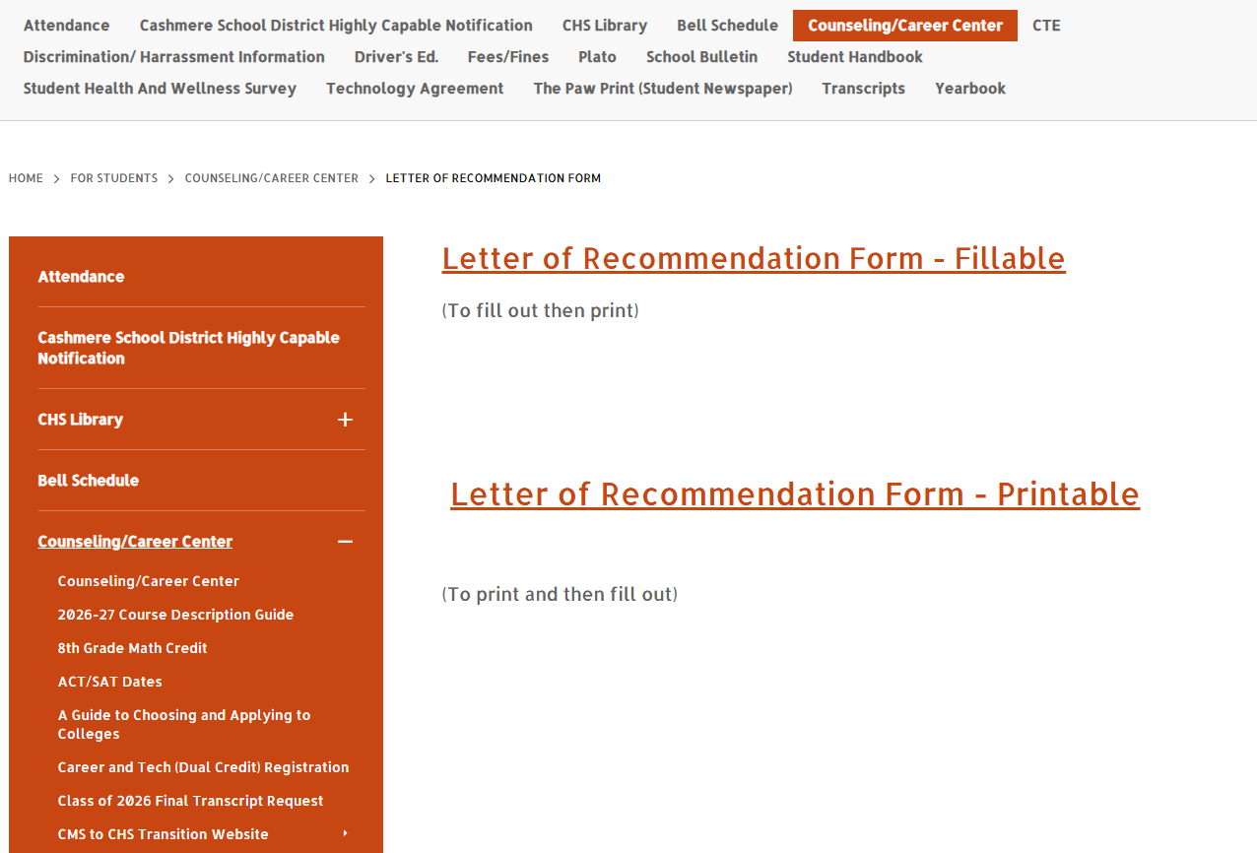

Letters of Recommendation for Scholarships and College - ask early!
QR Code with a link to this site is on your “Road to College Checklist “ Handout

Slide 36
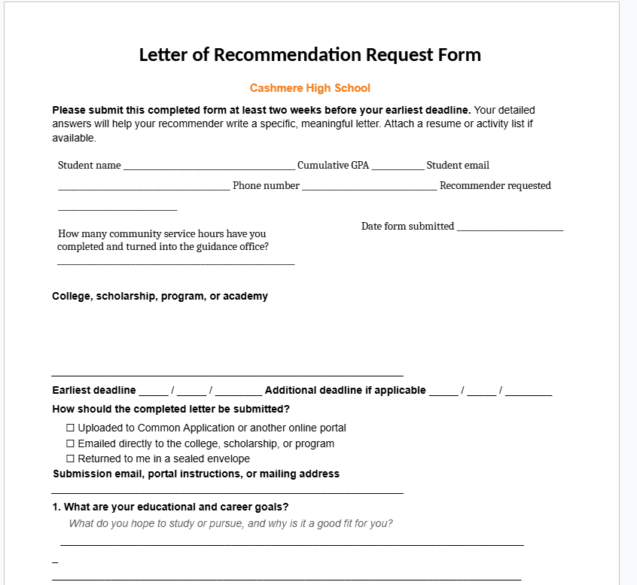
Letters of Recommendation - ask early!

Slide 37
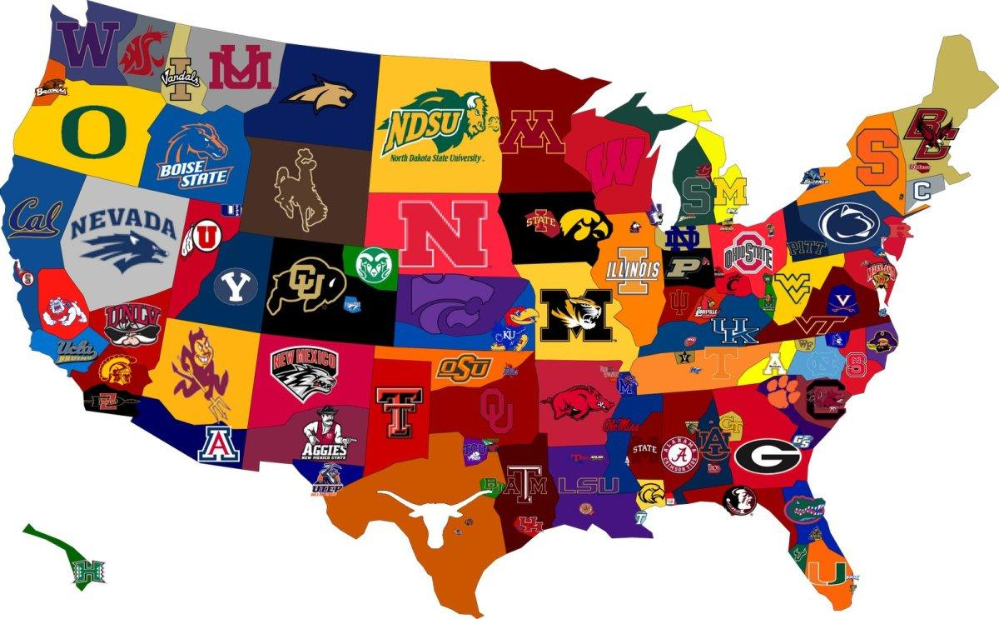
Activity - The Forms
Application Fee- average $70.00
  One “likely” school ______________
  Definitely get accepted
  Tuition is affordable
  One “possible” school ______________
  You will probably get in
  You can probably afford
One or two “reach” schools _______________ _________________
Academic or financial reach-Please circle due dates of applications

Slide 38

The Finances

Slide 39

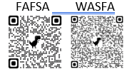
FAFSA/WASFA –Financial Aid**
Work study-job on campus
Loans (pay back with interest)
Grants (free $)
Scholarships (free $)
**All applications are free and open October 1st
** QR Codes to FAFSA and WAFSA Sites are on
Road to College Checklist Handout

Slide 40

The Finances
  October 1 FAFSA/WAFSA - applications open online
  October 2nd FAFSA Friday in the Career Center (7:15am)
  November 4 College Night #2: Parents & Students - FinAid&Scholarships
  November 20 Students-Scholarship Training 7:30am
  Oct-Dec FREE Financial Aid Nights on Zoom from WSAC
  Dec-March Apply for Scholarships
  May 26 Senior Recognition Program 6pm

Slide 41

The Finances

Slide 42

The Finances

Slide 43

WA Apple Education Foundation Scholarships Open Oct 20-March 2/notifications end of May

Slide 44
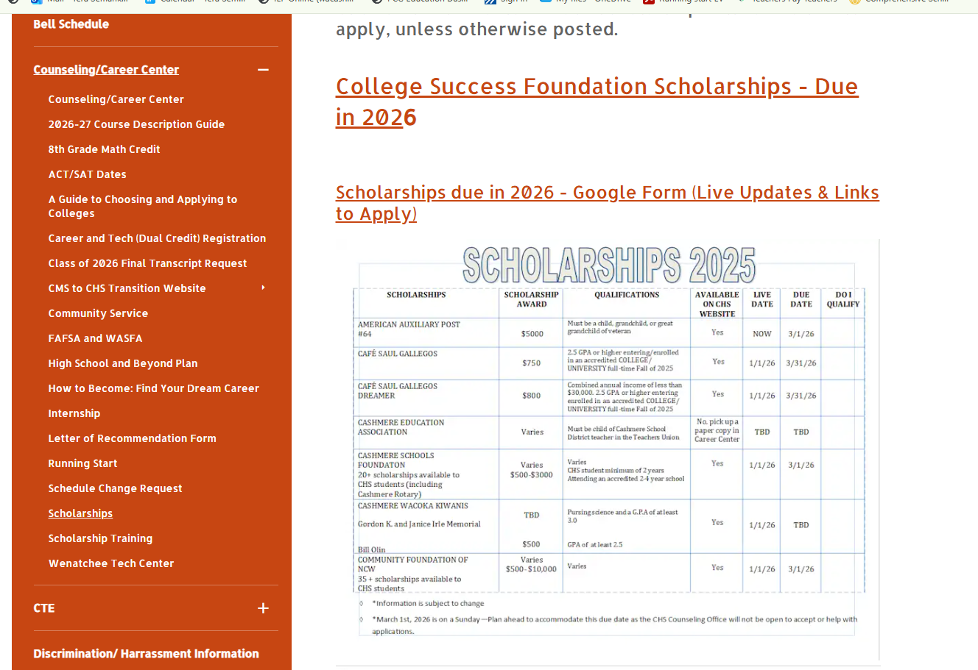
Scholarships - application links updated in Dec/Jan on the CHS Website

Slide 45



Activity-The Finances
List two things that you can do now
1.__________________ 2.__________________

Slide 46
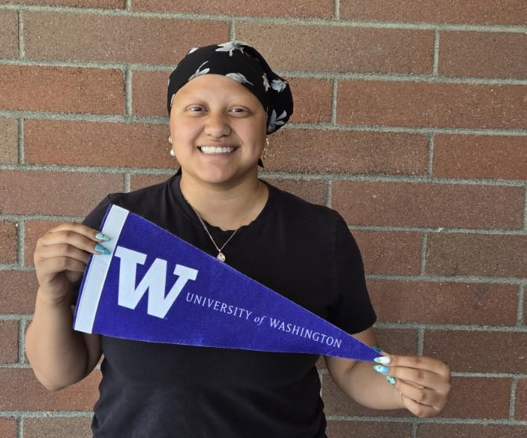

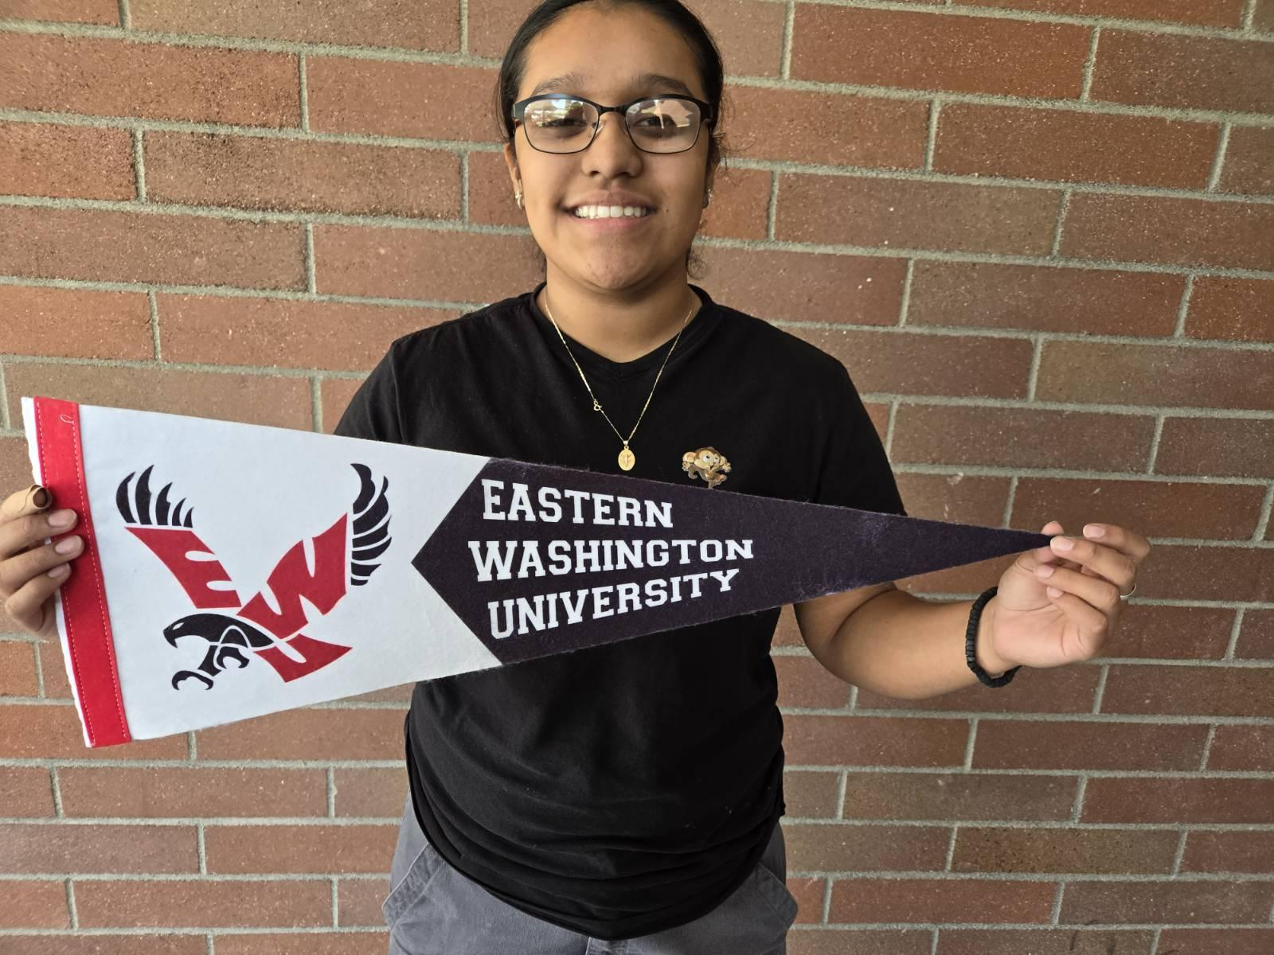
College Signing Day-May 1st
TO DO List before starting college:
Confirm acceptance
Pay deposit
Accept Financial Aid Award
Apply for housing
Pay housing deposit
Submit immunization records
Request final transcripts from UW, CWU, WVC and CHS
Pay for final college transcripts
Attend Summer Orientation
Attend Academic Advising
Register for classes
Pay for tuition

Slide 47

To Do Before Nov. 6th College Planning Night #2: “Show Me the Money!”
___Attend recruiter presentation
___Plan a college tour*
___Complete 1 college application
___ Start FAFSA (open Oct 1)
___
* Send Mrs Semanko a photo to enter a prize drawing!

Slide 48

College Planning Summary
The Fit
The Forms
The Finances
Questions? Email tsemanko@cashmere.wednet.edu

