Slide 1
How to Conduct a Self-Audit
HR Talent Management-Certification
Revised August 25, 2026

Slide 2
Overview of Topics
Slides 4-10: Florida State Statute and Administrative Code
Slides 12-22: Florida Course Directory must be used to determine acceptable certification for instructional staff based on teaching assignments (subject/grade level).
  Use Self-audit spreadsheet revised on 3/15/24 to verify, keep record, and monitor all instructional staff to ensure they hold a valid educator’s certificate or Florida Department of Health (DOH) license when applicable and comply with Florida State Statute.
Slides 24-29: Qualifications for a FL certificate, Acceptable Degree Majors, and FLDOE Statement Status.
Slides 31-34: Items needed for Certificate Issuance Request with Florida Department of Education or a Career Technical Education Broward Issued Certificate.
Slides 36-44: Items needed to Upgrade from a Temporary to a Professional Certificate including options to satisfy Florida Teacher Certification Exams with CT waiver forms.
Slides 46-54: Items needed to Renew a Professional Certificate and Renewing Process for DLI Opt Out Approved Charter Schools.
Slides 56-60: Determining Out-of-Field Status of Instructional Staff.
Slides 62-64: Reappointment Reminders
Slide 66: District Certification Contact Information

Slide 3
Florida State Statute
Slides 4-10

Slide 4
Florida State Statutes
Florida State Statutes, Administrative Codes, and Federal Acts Relating to Public Schools
1002.33 Charter schools
(12)(f) Teachers employed by or under contract to a charter school shall be certified as required by chapter 1012. A charter school governing board may employ or contract with skilled selected noncertified personnel to provide instructional services or to assist instructional staff members as education paraprofessionals in the same manner as defined in chapter 1012, and as provided by State Board of Education rule for charter school governing boards. A charter school may not knowingly employ an individual to provide instructional services or to serve as an education paraprofessional if the individual’s certification or licensure as an educator is suspended or revoked by this or any other state. A charter school may not knowingly employ an individual who has resigned from a school district in lieu of disciplinary action with respect to child welfare or safety, or who has been dismissed for just cause by any school district with respect to child welfare or safety. The qualifications of teachers shall be disclosed to parents.
http://www.leg.state.fl.us/Statutes/index.cfm?App_mode=Display_Statute&URL=1000-1099/1002/Sections/1002.33.html
1010.215 Educational Funding Accountability
“Instructional personnel” means classroom teachers including substitute teachers.
https://www.flsenate.gov/Laws/Statutes/2024/1010.215

Slide 5
Florida State Statutes
1012.01 Instructional Personnel
(2)(a) “Instructional personnel” means any K-12 staff member whose functions includes the provision of direct instructional services to students. Instructional personnel also include K-12 personnel whose functions provide direct support in the learning process of students. Included in the classification of instructional personnel are the following K-12 personnel: Classroom teacher including exceptional student education, career education and adult education including substitutes teachers.
https://www.leg.state.fl.us/statutes/index.cfm?App_mode=Display_Statute&URL=1000-1099/1012/Sections/1012.01.html
1012.33 Contracts with Instructional Staff, Supervisors, and School Principals
(1)(a) Each person employed as a member of the instructional staff in any district school system shall be properly certified pursuant to s. 1012.56 or s. 1012.57 or employed pursuant to s. 1012.39 and shall be entitled to and shall receive a written contract as specified in this section.
http://www.leg.state.fl.us/statutes/index.cfm?App_mode=Display_Statute&URL=1000-1099/1012/Sections/1012.33.html
1012.42 Teacher Teaching Out-of-Field
(2) NOTIFICATION REQUIREMENTS.—When a teacher in a district school system is assigned teaching duties in a class dealing with subject matter that is outside the field in which the teacher is certified, outside the field that was the applicant’s minor field of study, or outside the field in which the applicant has demonstrated sufficient subject area expertise, as determined by district school board policy in the subject area to be taught, the parents of all students in the class shall be notified in writing of such assignment.
http://www.leg.state.fl.us/statutes/index.cfm?App_mode=Display_Statute&Search_String=&URL=1000-1099/1012/Sections/1012.42.html

Slide 6
Florida State Statutes
1012.55 Positions for which Certificates Required
(b) Each person employed or occupying a position as school supervisor, school principal, teacher, library media specialist, school counselor, athletic coach, or other position in which the employee serves in an instructional capacity, in any public school of any district of this state shall hold the certificate required by law and by rules of the State Board of Education in fulfilling the requirements of the law for the type of service rendered. Such positions include personnel providing direct instruction to students through a virtual environment or through a blended virtual and physical environment.
http://www.leg.state.fl.us/statutes/index.cfm?App_mode=Display_Statute&URL=1000-1099/1012/Sections/1012.55.html
1012.57 Certification of Adjunct Educators
(1) Notwithstanding the provisions of ss. 1012.32, 1012.55, and 1012.56, or any other provision of law or rule to the contrary, district school boards and charter school governing boards shall adopt rules to allow for the issuance of an adjunct teaching certificate to any applicant who fulfills the requirements of s. 1012.56(2)(a)-(f) and (11) and who has expertise in the subject area to be taught. An applicant is considered to have expertise in the subject area to be taught if the applicant demonstrates sufficient subject area mastery through passage of a subject area test or has achieved an industry certification in the subject area to be taught.
(4) Each adjunct teaching certificate is valid through the term of the annual contract between the educator and the school district or charter school. An additional annual certification and an additional annual contract may be awarded by the district or charter school at the district’s or charter school’s discretion but only if the applicant is rated effective or highly effective under s. 1012.34 during each year of teaching under adjunct teaching certification.
http://www.leg.state.fl.us/statutes/index.cfm?App_mode=Display_Statute&Search_String=&URL=1000-1099/1012/Sections/1012.57.html

Slide 7
Florida State Statutes, Administrative Code
6A-1.0502 Non-certificated Instructional Personnel
(10) Notwithstanding the provisions of subsections 6A-1.0502(1) through (9), F.A.C., the school board or charter school governing board may employ non-certificated persons licensed by the State of Florida as occupational therapists or as physical therapists to render services to students in those areas covered by such license. The procedures for employment shall be the same as provided by law for certificated instructional personnel, and each person so employed shall be entitled to a written contract in the form prescribed pursuant to Rule 6A-1.064, F.A.C. Provided, however, that a non-certificated person employed to render services as an occupational therapist or as a physical therapist may be assigned duties of an instructional nature that are not covered within the scope of the person’s license as defined by law.
(11) Notwithstanding the provisions of subsections 6A-1.0502(1) through (9), F.A.C., the school board or charter school governing board may employ persons certified as audiologists or speech pathologists under Chapter 468, Part I, F.S., to render services to students in those areas covered by such certificate of registration. The procedures for employment shall be the same as provided by law for certificated instructional personnel, and each person so employed shall be entitled to a written contract in the form prescribed pursuant to Rule 6A-1.064, F.A.C. Provided, however, that a non-certificated person employed to render services as an audiologist or speech pathologist may not be assigned duties of an instructional nature that are not covered within the scope of the person’s certificate of registration as defined by law.
https://www.flrules.org/gateway/ruleno.asp?id=6A-1.0502

Slide 8
Florida State Statutes, Administrative Code
6A-1.0503 Definition of Qualified Instructional Personnel
(2) A primary instructor must meet one (1) of the following conditions to be considered in-field:
(a) Hold a valid Florida educator’s certificate with the appropriate coverage as provided for in the Course Code Directory as adopted by reference in Rule 6A-1.09441, F.A.C., or
(b) Hold a valid Florida educator’s certificate with coverage other than that deemed appropriate by paragraph (2)(a), but have completed a minor field of study in the subject area to be taught, as per Section 1012.42, F.S., and the minor field of study consists of at least fifteen (15) semester hours in the appropriate subject area, or
(c) Hold a valid Florida educator’s certificate with coverage other than that deemed appropriate by paragraph (2)(a), and have demonstrated sufficient subject matter expertise through passage of a standardized examination,
(d) Holds a valid Florida educator’s certificate with coverage other than that deemed appropriate by paragraph (2)(a) and have previously documented subject matter expertise for the academic course assigned based on a High, Objective, Uniform State Standard of Evaluation (HOUSSE) plan, or

Slide 9
Florida State Statutes, Administrative Code
(3) A primary instructor considered out-of-field per paragraph (1)(c) of this rule, shall have been approved by the school board or charter school governing board to teach out-of-field after determination that a teacher with appropriate certification coverage is not available. All evidence of such qualifications and approval must be reflected in the individual’s official personnel record; provided, however, that such approval may be granted by the school board or charter school governing board only under one (1) of the following conditions:
The individual is in the first year of employment in the out-of-field assignment and has not been granted, during any preceding year in the district or charter school, approval by either the school board or the charter school governing board to be employed out-of-field in an area for which specific certification is otherwise required, or
(b) The individual has been approved to teach in the out-of-field assignment during any preceding year in the district or charter school and has earned the following college credit from an accredited or approved institution pursuant to Rule 6A-4.003, F.A.C., or in-service training in an approved district add-on program or district approved subject content professional development program:
1. Out-of-field assignment other than ESOL (English to Speakers of Other Languages). An individual assigned to teach out-of-field in a subject other than ESOL shall complete at least six (6) semester hours of college credit or the equivalent in-service toward the appropriate certification required in paragraph (2)(a), within one (1) calendar year from date of initial appointment to the out-of-field assignment and each calendar year thereafter until all requirements are completed for the appropriate subject certification;

Slide 10
Florida State Statutes, Administrative Code
2. Out-of-field assignment in only ESOL. An individual assigned to teach out-of-field in only ESOL shall complete at least three (3) semester hours of college credit or the equivalent in-service toward the ESOL requirements within the first two (2) calendar years from date of initial assignment to a class with limited English proficient (LEP) students and three (3) semester hours or the equivalent in-service during each calendar year thereafter until all requirements for certification in ESOL are completed; or
3. Out-of-field assignment in ESOL and another subject. An individual assigned to teach out-of-field in ESOL and another subject shall complete at least six (6) semester hours of college credit or the equivalent in-service toward the appropriate certification required by paragraph (2)(a), within one (1) calendar year from date of initial appointment to the out-of-field assignment and each calendar year thereafter until all requirements are completed for the appropriate subject certification. The training shall be completed in the following manner: During the first two years, at least three (3) of the required twelve (12) semester hours or the equivalent in-service shall be completed in ESOL strategies. Beginning with the third year and each year thereafter, at least three (3) semester hours or the equivalent inservice shall be completed in ESOL strategies and at least three (3) semester hours in the other out-of-field subject requirements. When either ESOL or all other out-of-field subject requirements are completed, a teacher shall comply with the schedule specified in subparagraph (3)(b)1. or 2. of this rule, as appropriate until all requirements are completed for both ESOL and the other out-of-field subject.
https://www.flrules.org/gateway/ruleno.asp?id=6A-1.0503

Slide 11
Florida Course Code Directory & Self-Audit Form
Slides 12-22

Slide 12
Florida Course Code Directory
Florida Course Code Directory (CCD) https://www.fldoe.org/policy/articulation/ccd/index.stml
  All courses funded through the Florida Education Finance Program and courses for which students must earn credit toward high school graduation are included.
  Indicates acceptable certification(s) by course(s).
  To be used in schedule planning and prior to course assignments.
  CCD is separated by sections and includes general information and courses by grade levels.

Slide 13

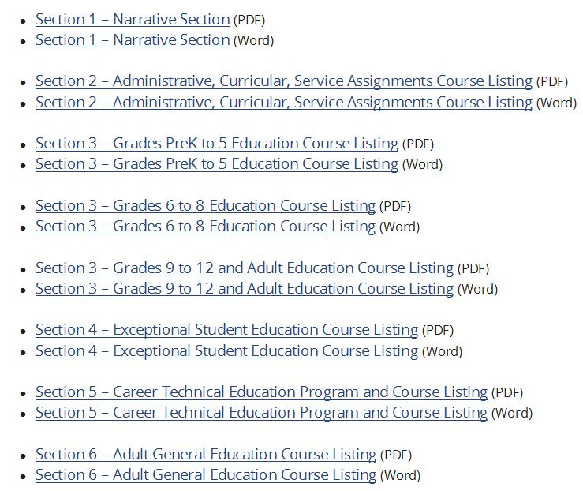

The Florida Course Code Directory
Must Be Used To Determine Acceptable Certification
Florida Course Code Directory (CCD)
https://www.fldoe.org/policy/articulation/ccd/index.stml
Refer to PDF course listing by grade level for easier search option with control find prompts to locate specific course code and acceptable certification.

Slide 14
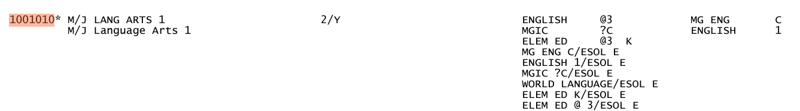
A Closer Look
Course code number
Course title
Acceptable certifications

Slide 15
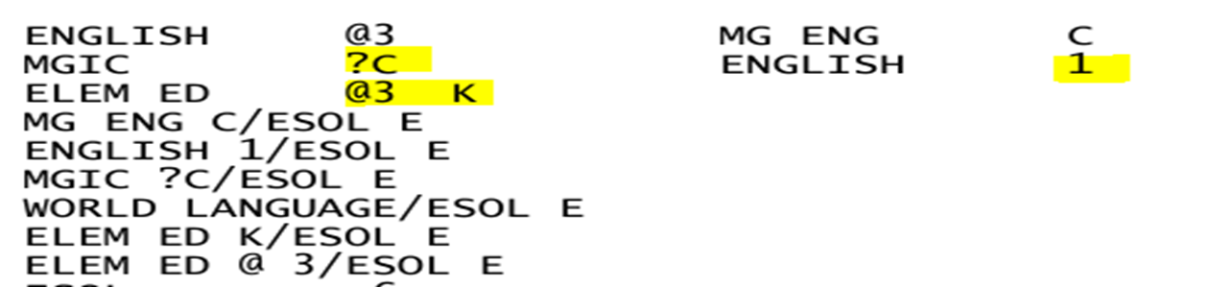

Codes & Symbols
Codes and symbols appearing after a certification provide additional, important information on special conditions
Explanations of codes & symbols are found in the general “narrative” section

Slide 16
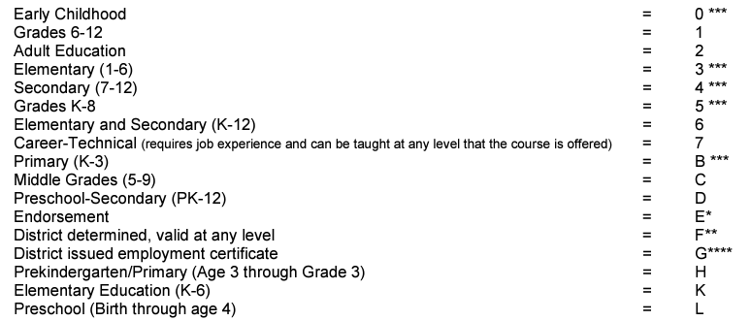

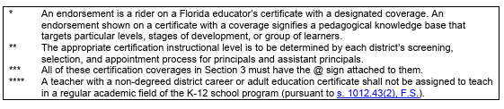
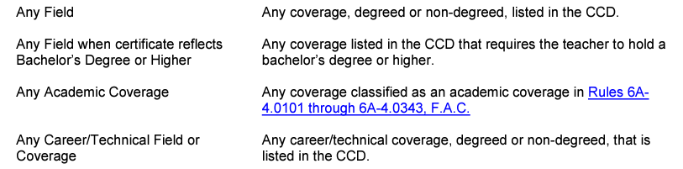
Codes
Indicates the instructional level of certification by group/type

Slide 17
Symbols
Refer to the CCD Narrative Section for Explanation
Is Elem Ed acceptable?
What does the “@” mean?
What does the “3” signify?
Is MGIC acceptable?
What does the “?” mean?
What does the “C” signify?

Slide 18
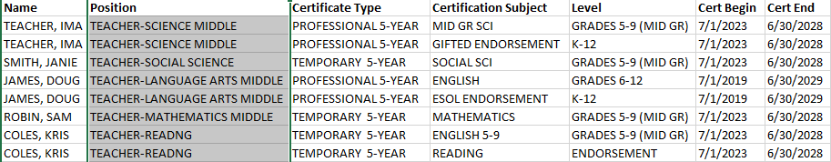
Monitoring
Effective monitoring requires an organized system
Best methods allow sorting by expiration date

Slide 19
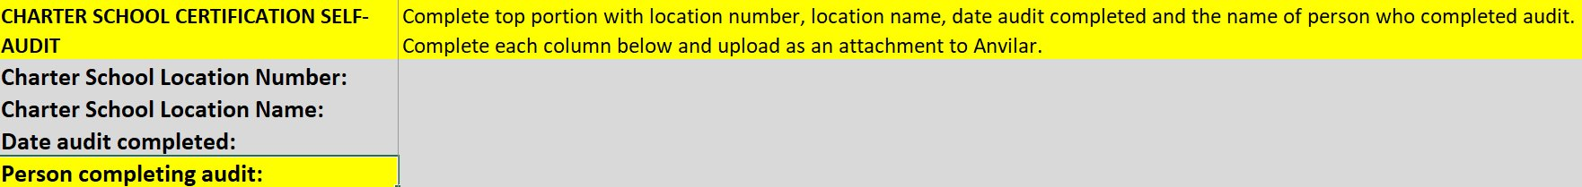
Must Use Revised Self-Audit Excel As of 8/25/26
This form is available to download at https://www.browardschools.com/bcps-departments/human-resources/certification/charter-schools under How to Conduct a Self-Audit and must be uploaded in Anvilar by district's yearly deadline. ​
Section 1-Complete each required field at the top of form. The name of the person completing the form identifies who to contact if there are questions.
Top portion of self-audit must be completed
Must indicate Charter School Location Number
Must indicate Charter School Location Name
Must indicate Date Audit Completed
Must indicate the Person Completing the Audit

Slide 20
Must Use Revised Self-Audit Excel As of 8/25/26
Section 2-Complete each required field. You must list your staff alphabetically by last name so audit can be crossed referenced with alphabetized by last name staff foster uploaded with audit.
Must list instructional staff only by last name coinciding with instructional staff foster and include substitute teachers filling vacant position until position is filled.
Must include ESE Specialist, Media Specialist, Reading and Math Coaches, School Counselors, School Social Workers, School Psychologists, Speech Language Pathologists, Specials (art, music, PE) and Career Technical Education (CTE) positions.
Do not include non-instructional staff since this self-audit for instructional staff only.

Slide 21
Must Use Revised Self-Audit Excel Continued
Section 2-Complete each required field. There is a comments field if needed.
Must list course codes and course titles must be indicated in required column. Do not repeat the same information for the same instructional staff.
Indicate ‘Yes’ or ‘No’ in the Out-of-Field course column.
  If ‘Yes’ for OOF, must indicate a Date OOF Agreement approved by Board, a date Parent Notification provided and must indicate mandated method of satisfying the OOF training requirement via passing appropriate exam, completing required college credits or district in-service.
If providing additional information, indicate in the Comment column.

Slide 22
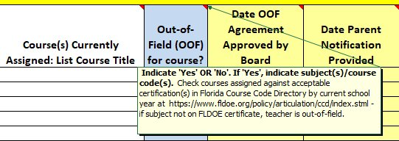
Must Use Revised Self-Audit Excel As of 3/15/24
For detailed explanation of what information is required in each field below, click on the red arrow in upper right corner of each column. ​

Slide 23
Review of Qualifications for a
FLDOE Certificate
Acceptable Degree Majors and
FLDOE Status Statement
Slides 24-29

Slide 24
Qualifying for a FLDOE Educator Certificate
A Statement of Status of Eligibility is not a Florida Educator Certificate
Must have a Statement indicating ‘eligible’
Fingerprint authorization date must be within 12 months of the certificate issuance request. The status statement must be valid and not expired
Ensure timely submission of Certificate Issuance Request Form
Validity end date on the FLDOE certificate once issued is the expiration date not the date on the status statement.
Instructional staff employed in public schools must have a valid Florida educator certificate in accordance with section 1012.55, Florida State Statue 1012.55 and Rule 6A-1.0503, Florida Administrative Code.

Slide 25
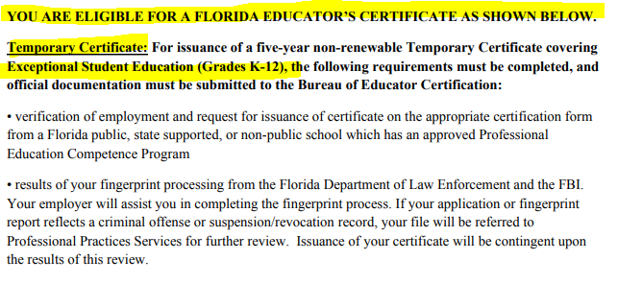
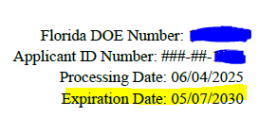
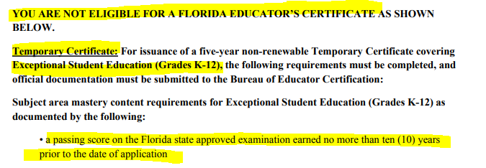
Sample of ‘Eligible’ & “Not Eligible’
Florida Status Statements
Must pass Florida Subject Area Exam to qualify for a
5-year temporary certificate

Slide 26
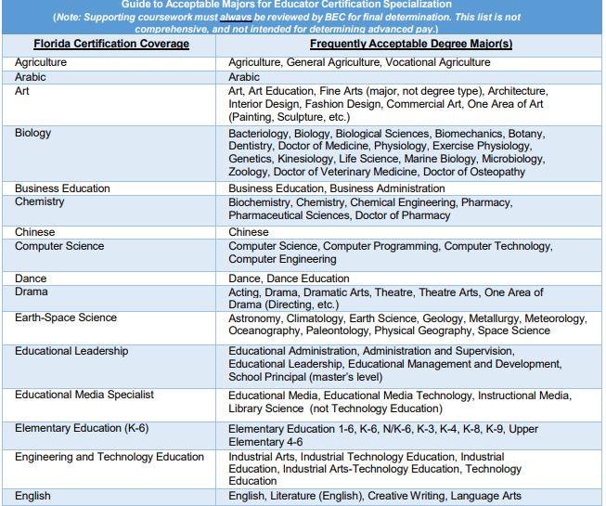
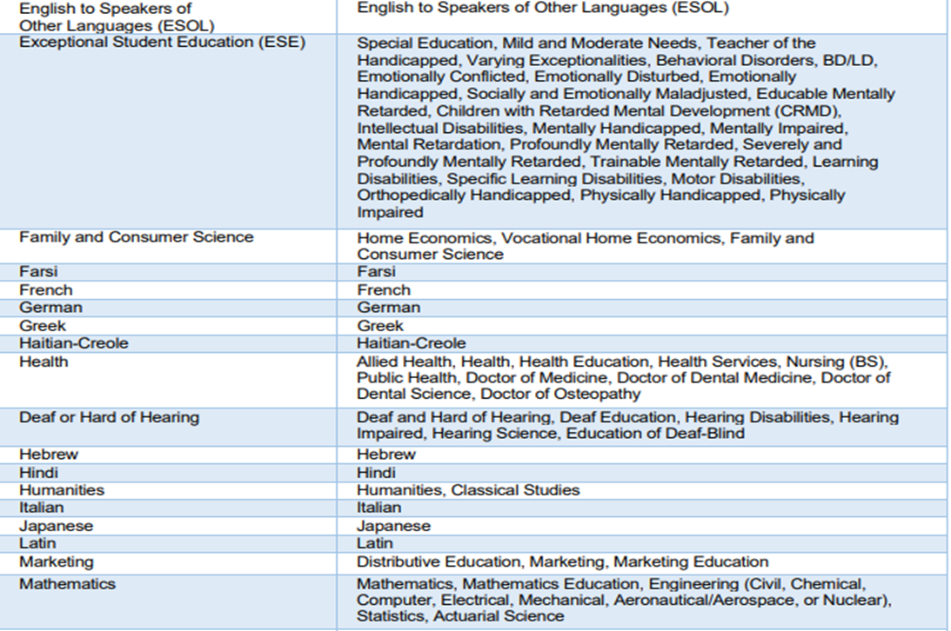
Acceptable Degree Majors to Qualify for a
Florida Educator Certificate
A list of acceptable majors is available on the charter school webpage at https://www.browardschools.com/bcps-departments/human-resources/certification/charter-schools under How to Conduct a Self-Audit

Slide 27
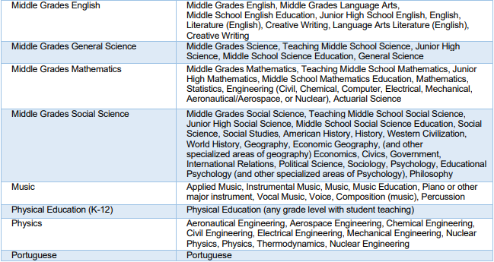
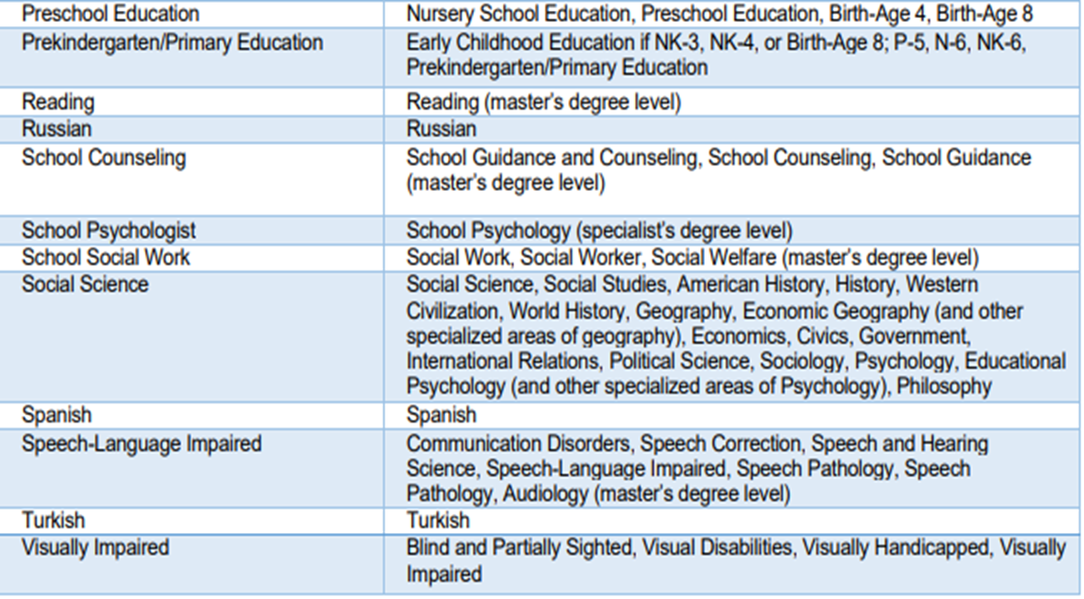
Acceptable Degree Majors to Qualify for a Florida Educator Certificate Continued

Slide 28
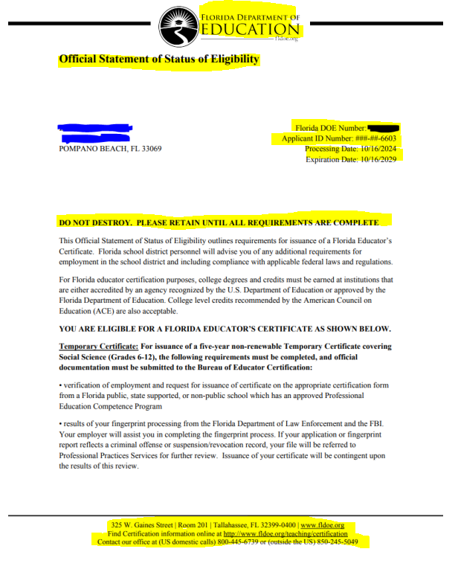
Sample of Authentic
Statement Status of Eligibility
Notice the FLDOE Seal
Florida DOE Number, Application ID Number, Processing and Expiration Date
Standard FLDOE verbiage on all statements
Notice the Font and Size Used
FLDOE Statement of Status no longer refer to CLAST or No Child Left Behind
FLDOE address and contact information

Slide 29
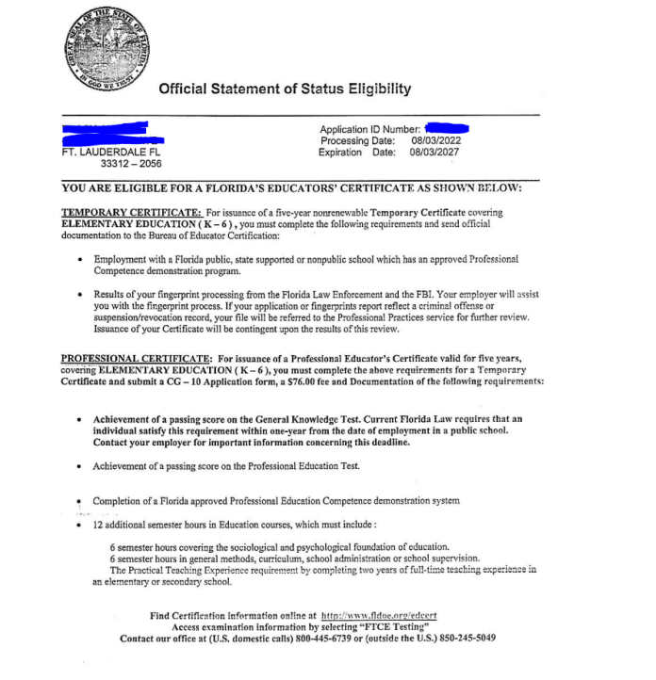
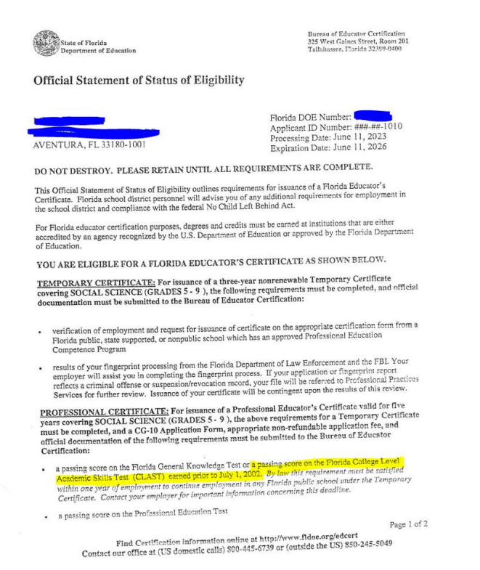
Two (2) Samples of Falsified
Statement Status of Eligibilities

Slide 30
Certificate Issuance Request and
Career Technical Education Broward Issued Certificates
Slides 31-34
These forms are available on the charter school webpage at https://www.browardschools.com/bcps-departments/human-resources/certification/charter-schools

Slide 31
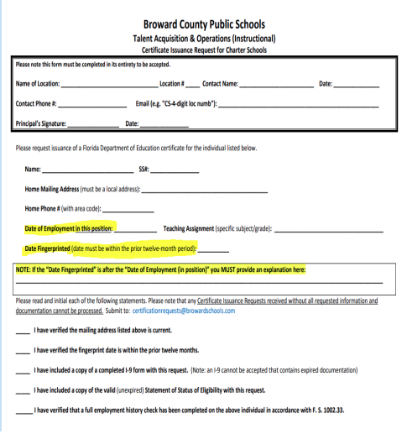
Certification Issuance Request
Certificate Issuance Request Form for Charter School New Hires must have all sections completed with a fingerprint authorization date prior to employment date.
✓ Email completed form at the time of hire to certificationrequests@browardschools.com
✓ Charter School Information including Certification Issuance Request Form and Fingerprints Instructions at https://www.browardschools.com/bcps-departments/human-resources/certification/charter-schools
✓ Please review video guide at link above when completing the Certificate Issuance Request prior to submitting a request to our office to ensure it is filled out correctly and to avoid processing delays.
✓ You will receive an email from our office acknowledging receipt of your request.
✓ It is the charter school’s responsibility to follow up with the educator to ensure FLDOE certificate is issued.

Slide 32
Security Background Check
Fingerprint processing and background checks for charter school applicants will be performed by Field Print. Instructions can be found at http://www.fieldprintflorida.com/
The hiring location must provide the applicant with the Field Print code in advance of the applicant registering to be fingerprinted.
If you have questions regarding the Field Print fingerprinting process, contact Field Print via one of the following methods:
  Phone: (877)614-4364
  Email: CustomerService@fieldprint.com

Slide 33
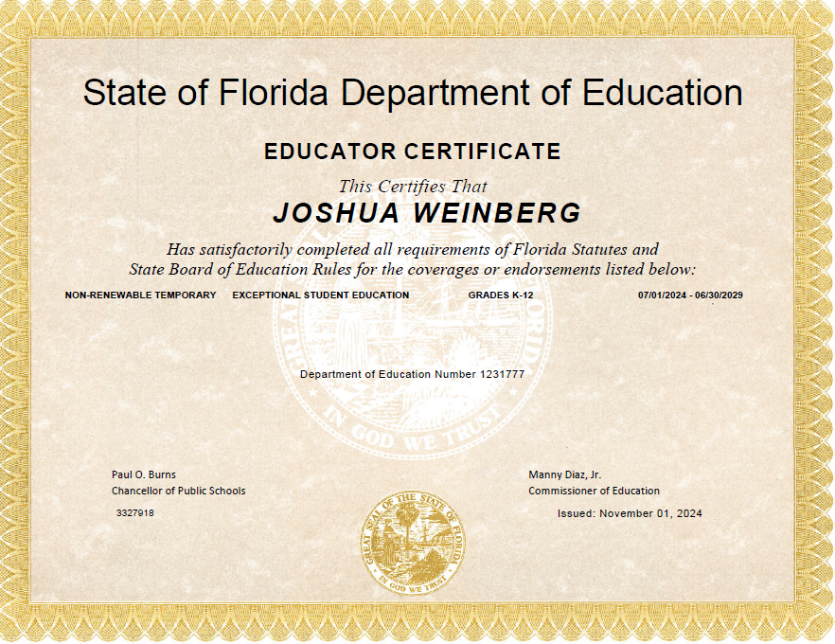
Sample of FLDOE Certificate
It can take FLDOE 60-90 days to issue a certificate once the Talent Acquisition-Certification submits the CT 110 Certificate Issuance Request.
FLDOE will notify the educator via the email they have on file once certificate has been issued so they can access their file on the Quick Start Menu under ‘Documents’ to obtain a copy for their records and to provide a copy to charter school administration.

Slide 34
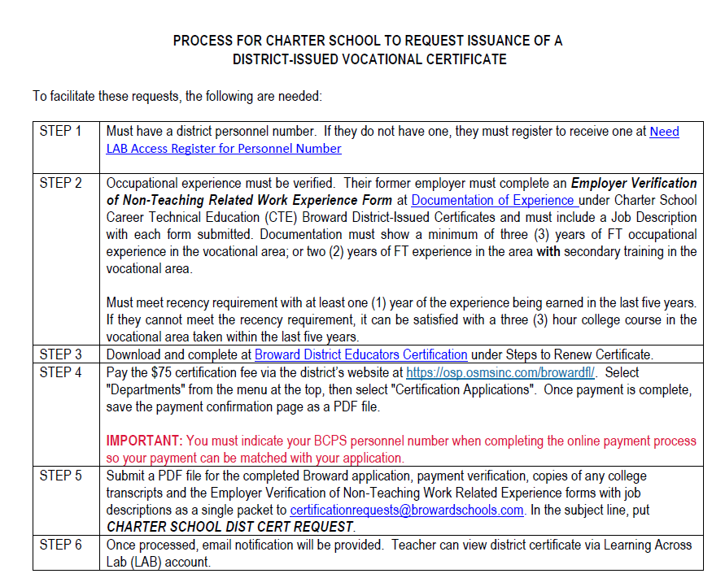


Career Technical Education (CTE) Broward Issued Certificates
Refer to the Florida Course Code Directory https://www.fldoe.org/policy/articulation/ccd/index.stml​ to determine acceptable certification and if district-issued vocational certificate is needed. Access the CTE Form at https://www.browardschools.com/bcps-departments/human-resources/certification/charter-schools
If industry credential is required like Registered Nurse, EMT, Fire Fighter, obtain a copy and email with application and proof of fee payment.

Slide 35
Upgrade Requirements from a Temporary to a Professional Certificate
Options to satisfy Florida Teacher Certification Exams with CT Waivers
Slides 36-44

Slide 36
Educator Certification Rule Amendments
On November 13, 2025, the State Board of Education approved amendments to Rules 6A-4.004 and 6A-4.0181, Florida Administrative Code (F.A.C.) to align with House Bill 809 and 875 which became effective December 21, 2025.
Rule 6A-4.004 F.A.C.-the professional restricted certificates will be modified to a specialized professional certificate for personnel providing student support services. The requirements to demonstrate mastery of professional preparation and educational competence (Professional Education Test) do not apply to certificates for education in media specialist, school counseling, school psychologist, school social work and speech language impaired.
The requirements to demonstrate subject area knowledge does not apply to school social work. However, CT 114 District Verification of Subject Area Competencies must be on file with FLDOE. Once Competency Demonstration Checklist (CDC) is received via certificationrequests@browardschools.com, a CT 114 will be submitted in addition to the CT 118 PEC and CT 113 Verification of Experience, if required.
Subject area coverage and endorsements may not be added to specialized professional certificate areas noted above. Must mail hard copy 6008 Specialized Professional Certification application and check or money order directly to FLDOE at https://www.fldoe.org/teaching/certification/staff-contact/ until online application is created by FLDOE. This application available on charter school webpage at https://www.browardschools.com/bcps-departments/human-resources/certification/charter-schools under Help Guides for Temporary Certificate Holders.
Summary: The subject areas noted above can upgrade sooner to a professional certificate with passing appropriate Florida Subject Area Exam (SAE). The CT 114 District Verification must be on file for school social work since there is no SAE for this subject area. Please note that an upgrade application and fee must be on file indicating experience in the teaching section of the application, so the CT 113 Verification of Experience is not required. The Competency Demonstration Check (CDC) should not be required since this was included in the amendment change. However, if noted on upgrade status statement issued by FLDOE, charter school will need to email the form to certificationrequests@browardschools.com so CT 118 PEC can be submitted.

Slide 37
Upgrading Requirements from a Temporary to a Professional Certificate
Florida state statute and administrative code require that all instructional staff employed at a Florida public school/charter school maintain a valid educator certificate.
Upgrade application and fee should be on file with FLDOE no later than April 30 of the school year the educator’s certificate is expiring at https://www.fldoe.org/teaching/certification/on-line-application-status-lookup-site.stml and teaching experience should be indicated on application so CT 113 Form will not be required. If not, charter school will need to email a CT 113 to certificationrequests@browardschools.com.
Florida Teacher Certification Exams (FTCE) Requirements-Items outlined in the professional section of Status Statement must be on file with FLDOE no later than April 30 of the school year the educator’s certificate is expiring.
  Passing Florida Subject Area Exam (SAE), General Knowledge Test (GKT) and Professional Education Test (PET) unless educator qualifies for waiver (refer to FTCE options help guide)

Slide 38
Upgrading Requirements from a Temporary to a Professional Certificate
  Please note: CT Waiver Forms must be emailed directly to FLDOE.
  When emailing FLDOE the CT 134 General Knowledge Test (GKT) and/or the 135 Professional Education Test (PET) to edcertpartnerline@fldoe.org, it is highly recommended that you put in the email subject line: Process CT 134 GKT or 135 PET on Expiring Year (ie 2027) Temp. Mark email as ‘High Importance’.
  If professional preparation courses are outlined in the professional section of statement status, an official transcript must be sent directly to FLDOE at https://www.fldoe.org/teaching/certification/staff-contact/. It can take 4 to 6 weeks for FLDOE to log in a hard copy transcript. Educator can confirm receipt by accessing the Quick Start Menu under ‘Documents’ so you can be informed.
  Highly recommend you obtain a copy of the official transcript with completed courses and a copy of transcript request payment receipt confirming the date it has been sent to FLDOE so you can follow up with educator to check Quick Start Menu under ‘Documents’.
  Florida State Statute does not allow for the CT 135 PET option if the educator completed an in or out-of-state teacher education college program, used college teaching experience or STEM Pathways to qualify for a temporary certificate.

Slide 39
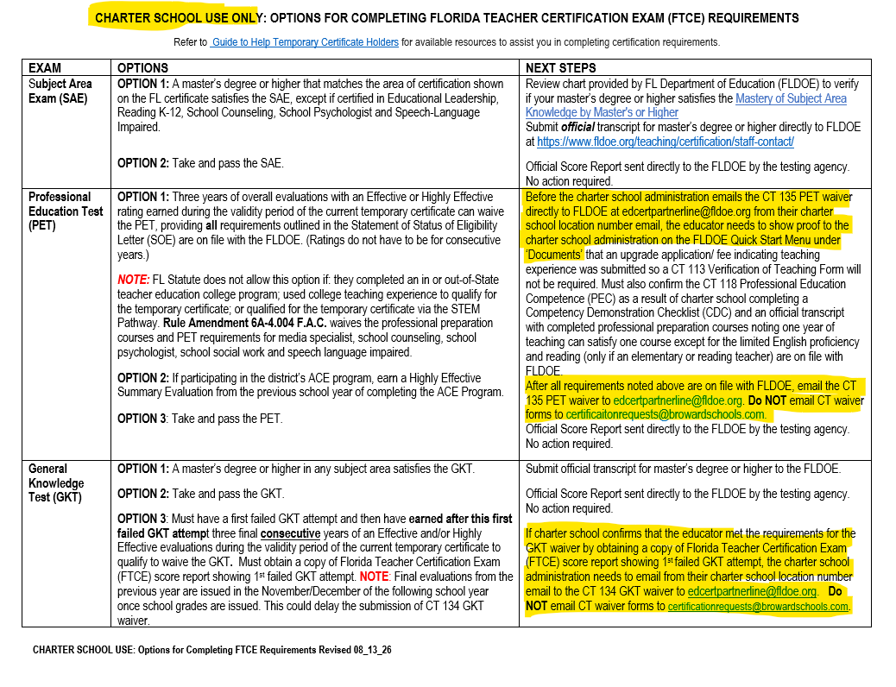
Charter School Use Only-Options to Completing the Florida Teacher Certification Exam (FTCE) Requirements
This revised form will be available to downloaded at https://www.browardschools.com/bcps-departments/human-resources/certification/charter-schools. In the meantime, a copy will be emailed via certificationotice@browardschools.com so you can provide to your instructional employees on temporary certificates.

Slide 40
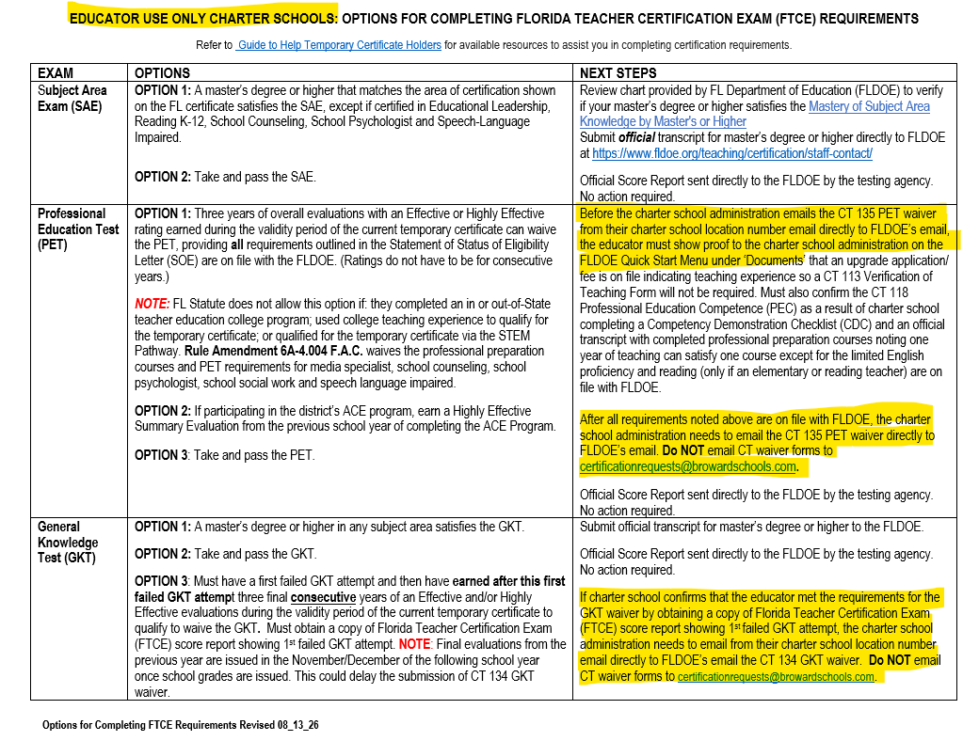
Educator Use Only Charter Schools-Options to Completing the Florida Teacher Certification Exam (FTCE) Requirements
This revised form will be available to downloaded at https://www.browardschools.com/bcps-departments/human-resources/certification/charter-schools. In the meantime, a copy will be emailed via certificationotice@browardschools.com so you can provide to your instructional employees on temporary certificates.

Slide 41
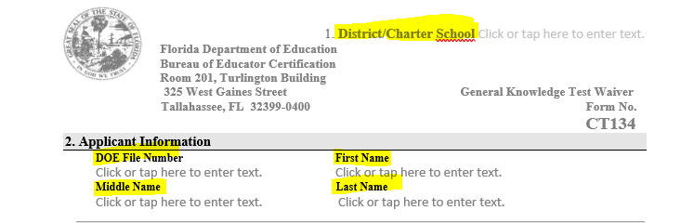
Completing CT 134 General Knowledge Test (GKT) and CT 135 Professional Education Test (PET) Forms for FLDOE Review
These forms are available to downloaded at https://www.browardschools.com/bcps-departments/human-resources/certification/charter-schools. Once completed, email directly to FLDOE at edcertpartnerline@fldoe.org from charter school location number email address.
Sample of CT 134
To edit fields on form, open document in desktop and click on required fields-Charter School Name, DOE File Number, First Name, Middle Name and Last Name.

Slide 42
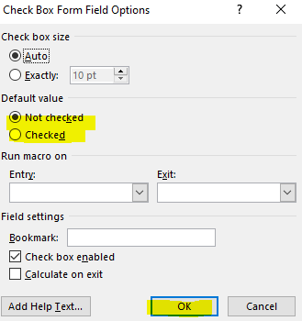
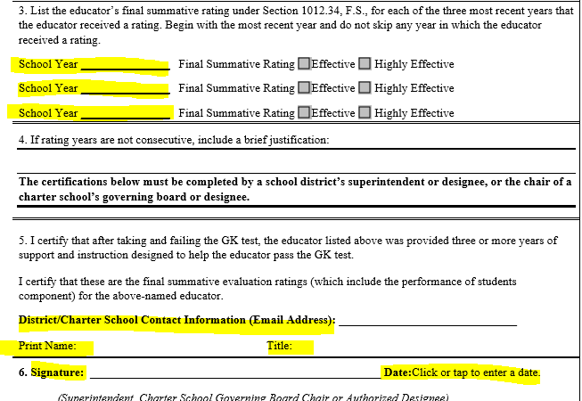
Completing CT 134 General Knowledge Test (GKT) and CT 135 Professional Education Test (PET) Forms for FLDOE Review
When you click on box next to rating, the window above appears to capture an X in the box after you click 'OK'.
Highly recommend for legibility that the school years be typed and not handwritten and the bottom of form must be signed and dated.

Slide 43
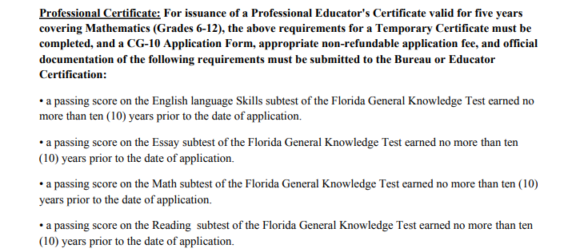

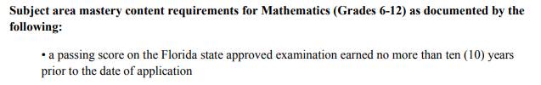

How to Satisfy Requirements in the Professional Section of Statement Status
General Knowledge Test (GKT) Options to Satisfy
Master’s transcript or higher must be on file with FLDOE.
Take and pass all 4 subtests
Educator must provide FTCE score report showing 1st failed attempt and must have earned 3 consecutive years of final effective and/or highly effective evaluations after 1st failed and during the validity of current certificate.
Subject Area Exam (SAE) Options to Satisfy
Master’s or higher that matches area of certification on certificate except
Ed Leadership, Reading K-12,
School Counseling, School Psychologist
and Speech Language Impaired.
Example: MA in Elementary, certified in
Elementary
Take and pass SAE
Subject Area Exam (SAE) Options to Satisfy
Master’s or higher that matches area of certification on certificate except
Ed Leadership, Reading K-12,
School Counseling, School Psychologist
and Speech Language Impaired.
Example: MA in Elementary, certified in
Elementary
Take and pass SAE

Slide 44
How to Satisfy Requirements in the Professional Section of Statement Status
Professional Education Test Options to Satisfy
Take and pass PET
Must have 3 years of final effective and/or highly effective evaluations
FL Statute does not allow this option if: they completed an in or out-of-State teacher education college program; used college teaching experience to qualify for the temporary certificate; or qualified for the temporary certificate via the STEM Pathway. . Rule Amendment 6A-4.004 F.A.C. waived the professional preparation courses and PET requirements for media specialist, school counseling, school psychologist, school social work and speech language impaired.
Professional Education Competence (PEC)
Principal/School Administrator must complete the State Competency Demonstration Checklist (CDC) Form and email to certificationrequests@browardschools.com so our office can submit the required CT 118 PEC Form to FLDOE.
This form should not be required by FLDOE unless noted on upgrade status statement not initials status statement.

Slide 45
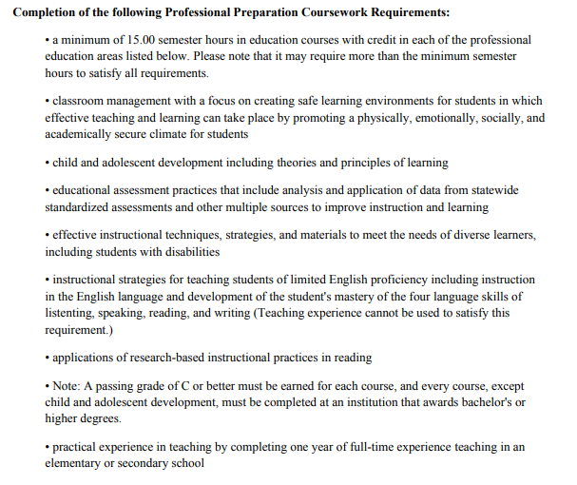
How to Satisfy Requirements in the Professional Section of Statement Status
Professional Preparation Coursework
An official transcript must be on file with FLDOE with completed coursework. It can take 4 to 6 weeks for a hard copy transcript to be logged in to file. Educator can access the Quick Start Menu under Documents to confirm FLDOE’s receipt.
Principal/School Administrator must complete the CT 113 Verification of Teaching Experience Form and email to certificationrequests@browardschools.com unless the teacher submitted an upgrade application indicating their teaching experience.
CT 113 or teaching experience noted on upgrade application can satisfy one of the courses except for the limited English proficiency and only the reading course if a reading or elementary teacher.
Rule Amendment 6A-4.004 F.A.C. waived the professional preparation courses and PET requirements for media specialist, school counseling, school psychologist, school social work and speech language impaired.
Please note: Before emailing CT 135 Professional Education Test waiver to EdCertPartnerLine@fldoe.org, an upgrade application/fee indicating teaching experience so CT 113 will not be required, CT 118 PEC and an official transcript with completed professional preparation courses must be on file with FLDOE for them to process the upgrade. Educator can access their FLDOE file on the Quick Start Menu under ‘Document’s to show you items are on file with FLDOE.

Slide 46
Renewing a Professional Certificate
Renewing Process for DLI Opt Out Approved Charter Schools
Reinstatement of an Expired Professional Certificate
Slides 46-54

Slide 47
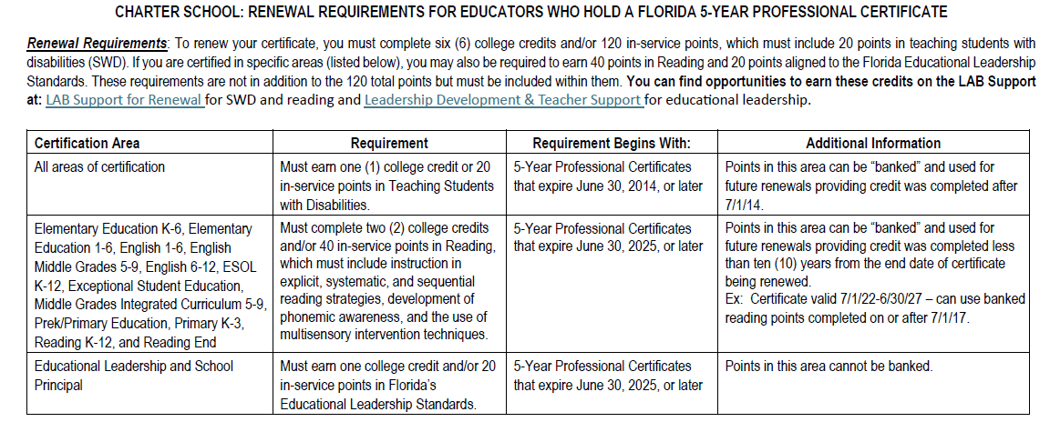
Renewing Professional Certificate
Florida state statute and administrative code require that all instructional staff employed at a Florida public school maintain a valid educator certificate.
Certificates expiring by June 30 within the current school year (ie 6/30/27) must have a renewal application/fee on file with FLDOE no later than April 30 since it can take up to 12 weeks for the processing of renewal.

Slide 48
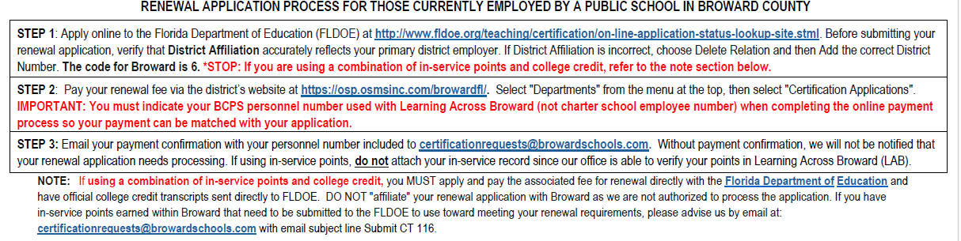
Renewing Professional Certificate
Application Process
This renewal application instruction is available to downloaded at https://www.browardschools.com/bcps-departments/human-resources/certification/charter-schools and email PDF to your instructional employees on expiring professional certificates.
Please note if charter school is part of the Doral Leadership Institute (DLI) Opt-Out, renewal and addition application submitted must affiliate with FLDOE.

Slide 49
DLI Opt Out Renewal and Addition Process for Approved Charter Schools
Educator’s teaching at a DLI approved charter school can pursue professional development from Doral College and/or the Beacon Educator.
If the educator has earned/bankable inservice points in Learning Across Broward (LAB) before entering DLI Opt-Out Renewal effective 7/1/23, they can request their points be submitted to FLDOE by emailing certificationrequests@browardschools.com and put in the subject line: DLI, Doral College, Opt-Out Charter School Teacher.
Educators at one of the identified charter schools for DLI must submit their renewal (or addition) fee directly to FLDOE and will NOT be affiliating with Broward.
DLI will be sending CT 115 and CT 116 forms verifying points obtained from Doral College and/or the Beacon Educator required for FLDOE to process renewal and/or additions.
Questions: DLI Certification-dlicertification@doralleadership.org

Slide 50
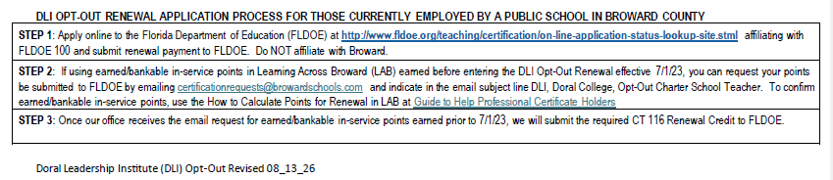
DLI Opt Out Renewal Process for Approved Charter Schools
This renewal application instruction is available to downloaded at https://www.browardschools.com/bcps-departments/human-resources/certification/charter-schools and email PDF to your instructional employees on expiring professional certificates.

Slide 51
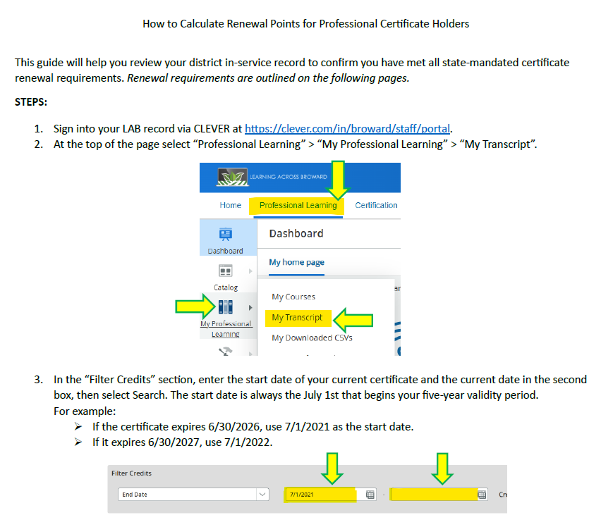
How to Calculate Points for Renewal in
Learning Across Broward (LAB)
A revised guide for educator to calculate their points for renewal will be available at https://www.browardschools.com/bcps-departments/human-resources/certification/ under Guide to Help Professional Certificate Holders. An email will be sent with this revised guide via certificationnotice@browardschools.com until the webpage can be updated with this

Slide 52
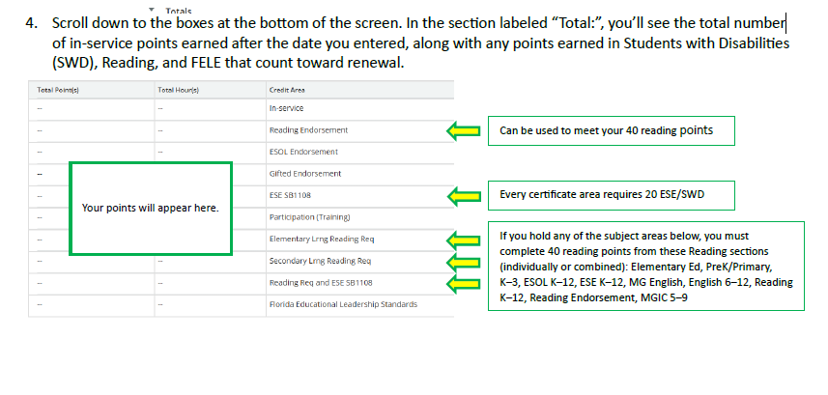
How to Calculate Points for Renewal in
Learning Across Broward (LAB)

Slide 53
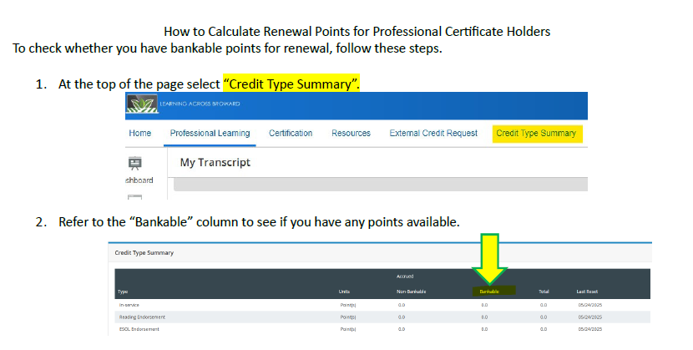
How to Calculate Points for Renewal in
Learning Across Broward (LAB)

Slide 54
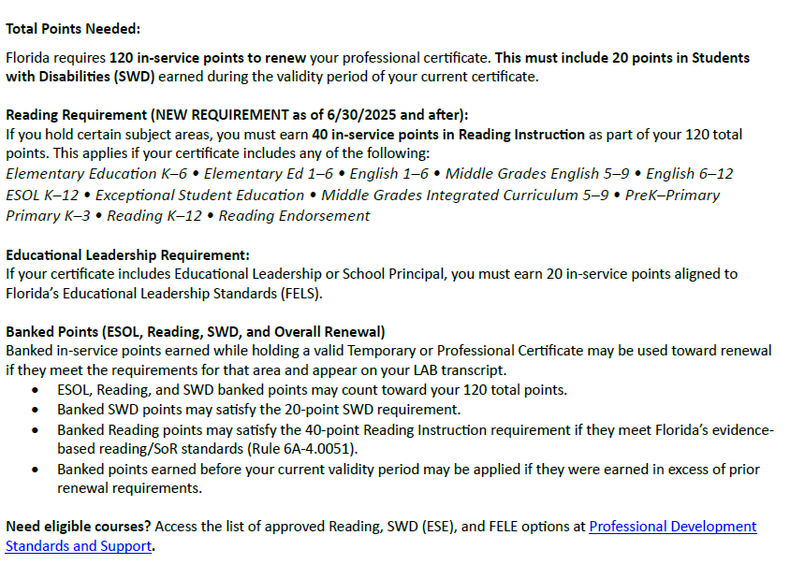
How to Calculate Points for Renewal in
Learning Across Broward (LAB)

Slide 55
Reinstatement of an Expired Professional Certificate
Reinstatement Requirements outlined at https://www.fldoe.org/teaching/certification/renewal-requirements/reinstatement.stml and House Bill 561 at https://info.fldoe.org/docushare/dsweb/Get/Document-10971/2026-51.pdf
Reinstatement applications will be reviewed according to the provisions in the bill on a case-y-case basis. Further implementation assistance and policies of these amendments may be provided in Rulse 6A-4.0051, F.A.C. which is anticipated to go before the State Board for approval in October 2026.
At this time, that passing the Florida Subject Area Exam (SAE), 40 points in reading instruction and 20 in FELE are not required.
120 in-service points or 6 college credits or a combination of in-service and college credit with 20 points or 1 credit in students with disabilities (SWD) is required to reinstate a professional certificate.

Slide 56
Determining Out-of-Field Status for
Instructional Staff
Slides 56-60

Slide 57
What Identifies an Educator as Out-of-Field
Instructional staff assigned a course or student population (i.e. ESOL, ESE, Gifted, Reading) for which they do not hold appropriate certification.
Certification for courses and student characteristics defined by Florida Course Code Director (CCD) are mandated by Florida statute.

Slide 58
Out-of-Field Overview
Florida Administrative Code 6A-1.0503 Definition of Qualified Instructional Personnel, section (4)(a) allows each charter school governing board to grant approval to teachers teaching out-of-field at the charter schools they preside over after determination that a teacher with appropriate certificate coverage is not available.
Please use the following guidelines to assist you with this process at https://www.browardschools.com/bcps-departments/human-resources/certification/charter-schools under Guide to Help Out-of-Field Educators.
Out-of-Field Forms must be submitted before FTE Survey 2 which takes place the 1st week in October and February of each school year. It is suggested that each charter school’s Charter School Governing Board set a deadline by which their respective charter school(s) submit the Out-of-Field Agreement Forms for review.

Slide 59
Out-of-Field Compliance Monitoring
Compliance Monitoring: FTE Audits Summary
Out-of-Field approval should be obtained from the Charter School Governing Board prior to the October and February FTE survey periods.
Parents or guardians must be notified in writing of the out-of-field status of child’s teacher.
  Notifications via the computer or any other electronic means are not acceptable.
Notices to parents must be dated and include the teacher’s name and the out-of-field subject(s) they are teaching.
Announcements must be sent out prior to the FTE Survey (1012.42 F.S.)
and may be by dated school newsletter or dated direct letters to the parents.

Slide 60
Out-of-Field
Instructional employees must be working on out-of-field (OOF) requirements by April of each school year until in compliance with adding required subject area to FL certificate.
OOF for a Subject Area (elementary, ESE, English, etc) must pass the appropriate Florida Subject Area Exam (SAE) and add this subject to their certificate. Please note this is an FLDOE audit exception if not done.
Use the guidelines outlined at https://www.browardschools.com/bcps-departments/human-resources/certification/charter-schools under Guide to Help Out-of-Field Educators to assist you with this process.

Slide 61
Out-of-Field ESOL Training Requirements
ESOL Training Requirements and Timeline for compliance are outlined at https://www.browardschools.com/bcps-departments/human-resources/certification/esol-compliance-and-training-information
  Only ESOL Category 1 must add the esol endorsement to certificate once the 5 specific courses completed. Please note this is an FLDOE audit exception if not done.
    Educators required to complete ESOL Category 2-4 are not eligible to add endorsement, however, will have satisfied OOF requirement.
  If ESOL courses are still needed, they can be completed via Broward Virtual University (BVU), an accredited university (official transcript must be sent directly to FLDOE upon completion of courses), The Schultz Center at https://schultzcenter.org/esol/ or Beacon Educator at https://www.beaconeducator.com/ which require an external credit request to be submitted via Learning Across Broward (LAB) upon completion to get credits into LAB record.
  Educator must show you proof of registration and how they are getting in compliance by April 30 of each school year when reappointment for the next school year takes place.

Slide 62
Reappointment Reminders
Slide 62-64

Slide 63
Reappointment Reminders
Florida State Statute requires all educators must hold a valid Florida Department of Education (DOE) certificate or a valid Florida Department of Health (DOH) license or Career Technical Education Broward Issued Certificate if appropriate for position.
Educators on expiring temporary certificate must meet the requirements to upgrade to professional certificate by the end of April of the expiring year to allow FLDOE 60-90 days to process upgrade.
  If educator has not met the requirements to upgrade, this can affect their employment.
  FLDOE will allow an educator to complete the upgrade requirements and get these items on file with them within one year of expiring temporary.
  Once an upgrade to a professional certificate is issued, the educator can seek re-employment.
  If an educator does not meet the upgrade requirements to get re-employed, they will qualify for another temporary certificate as of July 1st of the next school year.

Slide 64
Reappointment Reminders
Teachers on expired professional certificate that did not meet the renewal requirements by June 30 of their expiring year, must apply for another FLDOE temporary certificate in the subject area they qualify based on official degree conferred transcript in the subject area or passing Florida Subject Area Exam(s) on file with FLDOE that are not older than 10 years to retain employment at a charter school.
  FLDOE must issue a new status statement indicating ‘eligible’ and new fingerprints will be required as part of Certificate Issuance Request. Once issued a temporary certificate, the educator can work on requirements to reinstate their expired professional certificate. Passing the SAE, 40-point reading or 20-point FELE are no longer required on a reinstatement. However, a minimum of 120 in-service points with 20 in students with disabilities (SWD) is required.
  If they earned the required120 in-service points including the 20 points in students with disabilities (SWD), 40 points in reading instruction and 20 points in educational leadership depending on subject areas held on certificate before their professional certificate expired but did not submit the renewal application and fee by June 30 of that school year, they can submit a late renewal application and payment directly to FLDOE at https://www.fldoe.org/teaching/certification/on-line-application-status-lookup-site.stml.

Slide 65
Reappointment Reminders
Professional full-time Broward District-Issued Certificates are valid for five (5) years and can be renewed by emailing a Broward application at https://www.browardschools.com/bcps-departments/certification-incentives/certification-applications and proof of $75 fee submitted via the district e-Store at https://osp.osmsinc.com/browardfl/ under Departments, Certification Application to certificationrequests@browardschools.com with email subject line Renewal of District-Issued Certificate.
A minimum of 120 in-service points or six (6) college credits must be completed within the validity period of the certificate.
If educator completed the 6 college credits, an electronic official transcript must be emailed directly from the accredited university/college to certificationrequests@browardschools.com or a hard copy sent to Talent Acquisition-Certification, 600 SE 3rd Avenue, 3rd Floor, Fort Lauderdale, FL 33301.

Slide 66
Contact Information
Slide 66

Slide 67
Contact Information
Florida Course Code Directory https://www.fldoe.org/policy/articulation/ccd/index.stml​
​
Refer to Charter School webpage at https://www.browardschools.com/bcps-departments/human-resources/certification/charter-schools for helpful information on the following topics:
​
Request Issuance of Certificate including required form that must be emailed to certificationrequests@browardschools.com and fingerprint instructions via FieldPrint.​
​
Guides to Help Temporary Certificate Holders including FTCE Exam Options, CT 134 GK and CT 135 PED Test Waiver Forms, Competency Demonstration Checklist, and CT 113 Verification of Teaching Experience. Reminder: If the educator indicates teaching experience on upgrade application, the CT 113 is not required. ​
Guides to Help Professional Certificate Holders including Renewal and How to Calculate Points in Learning Across Broward (LAB) instructions. ​
Guide to Help Out-of-Field Educators​
How to Conduct a Self-Audit including a PowerPoint and the Self-Audit Excel Form revised 8/25/26.
​
Certification Questions regarding certificate issuance, renewals, additions, and out-of-field should be directed to certificationrequests@browardschools.com ​
​
Questions regarding FLDOE application completion or issues should be directed to FLCertify@fldoe.org ​
​

