Slide 1

Slidell High School
Class of 2028
Junior Information
Junior Counselor
Sharon Chambliss
Sharon.Chambliss@stpsb.org
985-643-2992 Ext. 2357

Slide 2
TOPICS COVERED TONIGHT
Graduation Pathways
Honor Graduates
Top of Class
LEAP / ACT / WorkKeys Requirements
Scholarships
Short Day / Internships / Cooperative Office Education Senior Year

Slide 3
LOUISIANA GRADUATION PATHWAYS
TOPS University Diploma — 24 credits
College-preparatory pathway
Think: “I’m preparing primarily for college.”
The TOPS University Diploma is Louisiana’s college-preparatory diploma. It is designed for students who are planning to attend a four-year college or university and want to keep the broadest range of college options open. The state describes it as a true college-preparatory curriculum.
  4 English
  4 Math
  4 Science
  4 Social Studies
  2 Foreign Language
  1 Fine Arts
  1 Financial Literacy
  0.5 Health
  1.5 P.E.
  2 Electives
TOPS Tech Career Diploma — 23 credits
Career/Technical pathway
Think: “I want to graduate with career skills and a credential.”
The Jump Start TOPS Tech Career Diploma is designed around career and technical education (CTE). It allows students to graduate with academic coursework plus training connected to an actual career field.
Louisiana describes Jump Start as a pathway in which students can graduate having earned industry credentials and be prepared either to enter the workforce or continue their education after high school.
  4 English
  4 Math
  2 Science
  2 Social Studies
  0.5 Health
  1.5 PE
  9 Jump Start/CTE credits
  At least 1 industry-based credential

Slide 4
HONOR GRADUATES
Determined by Cumulative weighted GPA at the end of senior year
TOP 5%: Recognized at graduation with gold tassels, gold cords, and gold stoles
TOP 10%: Recognized at graduation with gold tassels and gold cords
TOP 15%: Recognized at graduation with gold tassels

Slide 5
TOP OF CLASS
Top in Class is determined at the end senior year.
Uses only grades earned in 9th through 12th grades.
Calculated using maximum of 28 credits earned: 16 weighted and 12 unweighted.
Recognition at graduation

Slide 6
LEAP / ACT / WorkKeys Requirements
What assessments do Louisiana high school students need to know about?
Louisiana students may encounter several state-required assessments during high school. The requirements can depend on the student's diploma pathway, courses taken, and assessment program.
The three assessments highlighted in this PowerPoint are:
LEAP 2025 – Course-based state assessments
ACT – College and career readiness assessment
ACT WorkKeys – Career and workplace readiness assessment (TOPS TECH)

Slide 7
🎓 LOUISIANA HIGH SCHOOL
ASSESSMENT
📘 LEAP 2025 — COURSE ASSESSMENTS
Students take state assessments connected to required high school courses for graduation
High School Assessments May Include:
  English I
  English II
  Algebra I
  Geometry
  Biology
  Civics or U.S. History
🎯 ACT — COLLEGE & CAREER READINESS
Louisiana's statewide assessment program includes the ACT for Grade 11.
Sections: English • Math • Reading – Science is optional
ACT can be important for:
☐ College admission
☐ Scholarships
☐ TOPS planning
☐ College & career readiness
Go to ACT.org for testing dates
💼 ACT WORKKEYS — CAREER READINESS
WorkKeys measures skills used in the workplace.
Assessments:
☐ Applied Math
☐ Graphic Literacy
☐ Workplace Documents
Grades: 11–12
A Gold or Platinum WorkKeys certificate can satisfy the nationally recognized exam indicator used in Louisiana accountability.

Slide 8
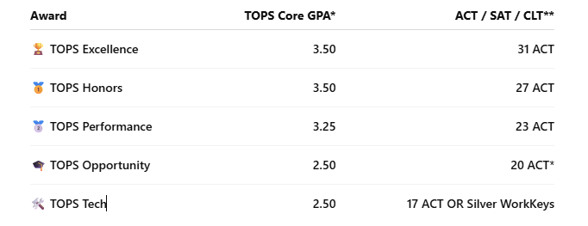
🎓 LOUISIANA TOPS SCHOLARSHIP
TOPS can help eligible Louisiana students pay for college.
GPA is calculated using TOPS Core Curriculum courses, not necessarily the same GPA shown on a student's report card or transcript.

Slide 9
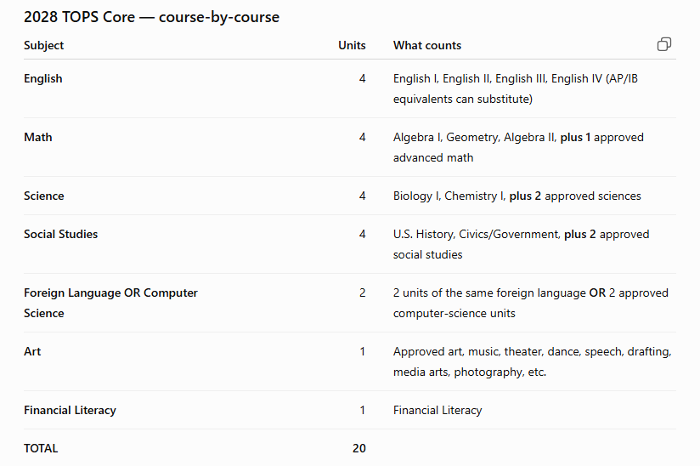
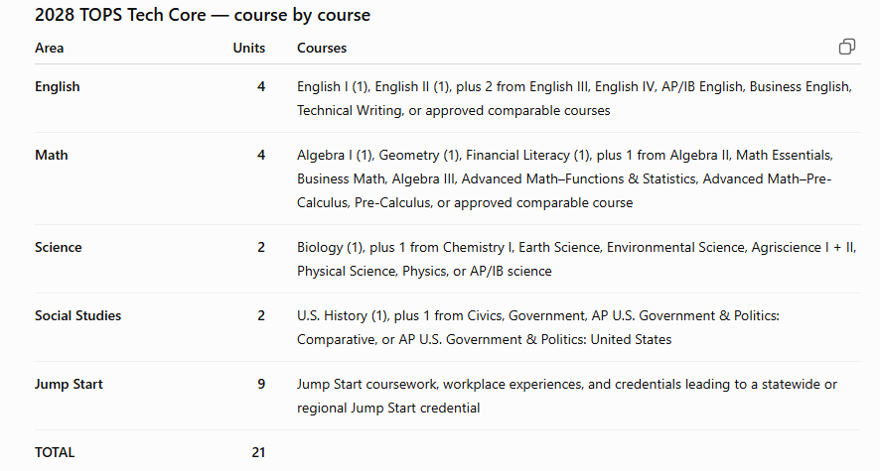
TOPS CURRENT CORE CURRICULUM
The best place to get the current information is the Louisiana Office of Student Financial Assistance (LOSFA): https://mylosfa.la.gov/tops/tops-core-curriculum/
⭐ One important thing for parents/students : A student can have a 3.5 overall GPA but a different TOPS Core GPA. You can create your Student Hub Account to track your TOPS eligibility courses and GPA by going to the LOSFA website www.mylosfa.la.gov. You will register with your LASECID (Louisiana Secure ID) NOT YOUR STUDENT ID
TOPS UNIVERSITY CORE TOPS TECH CORE

Slide 10
SCHOLARSHIPS
Junior year is a great time to start looking. The important distinction is that some scholarships are open to juniors, while many others are specifically for seniors. So juniors should spend this year building a scholarship list, identifying eligibility requirements, and applying to the ones that accept juniors.
What should a junior be doing NOW?
I'd suggest making a simple "Scholarship Folder" and starting to collect:
GPA/transcript
SAT/ACT scores, if applicable
List of extracurricular activities
Volunteer/community service hours
Awards and honors
Leadership positions
Work experience
Sports
Clubs
Community involvement
A basic résumé
A list of colleges they're considering
A few versions of common essays

Slide 11
WHERE CAN I LOOK?
ACADEMIC: Apply through the college/university you are applying to
  Varies but usually based on GPA and ACT/SAT scores
  Admissions and scholarship application deadlines-check college websites
LOCAL SCHOLARSHIPS:
  https://slidellhigh.stpsb.org/our-school/counseling
  In your senior year - Senior Class of 2028 Google classroom
SCHOLARSHIP SEARCH ENGINES
  Examples: www.Fastweb.com , www.goingmerry.com , www.scholarship.com, College Board BigFuture - https://bigfuture.collegeboard.org/scholarships?utm_source=chatgpt.com

Slide 12
Short Day / Internships / Cooperative Office Education Senior Year
Some graduating seniors may be eligible to take only 2 or 3 classes instead of 4 classes each semester. You may qualify if you:
✅ Are on track to graduate and have completed all LEAP graduation requirements.
✅ Do not have excessive absences, tardies, or discipline issues.
✅ Meet the required testing score:
ACT Composite: 20 or higher, OR
SAT: 1040 or higher, OR
WorkKeys: Gold or higher, OR
ASVAB: 59% or higher
✅ Meet ONE of the following areas:
A. College Accelerator Qualify with 2 dual enrollment classes, TOPS-aligned AP Exam score of 3 or higher, or ACT Math: 25+ or ACT English: 26+ may qualify.
B. Career Accelerator Have or scheduled for an Advanced Certification. ( Dig. Media II, CIW Web, Customer Service, etc)
C. US Service Accelerator
Have a signed Military Acceptance Letter, OR
Have been accepted to a U.S. Service Academy.

Slide 13
INTERNSHIPS AND COOPERATIVE OFFICE EDUCATION
INTERNSHIPS are set up with our School to Work Coordinator, Ms. Fontenot. This is requested during scheduling for next school year.
COOPERATIVE OFFICE EDUCATION (COE) is a career-focused program that combines classroom instruction with supervised workplace experience.
🎓 WHO IS COE FOR?
  COE is generally designed for high school seniors.
  3-credit course.
💼 HOW DOES COE WORK
  CLASSROOM INSTRUCTION Approximately 5 hours per week of related career/workplace instruction
  WORK EXPERIENCE At least 15 hours per week of on-the-job training Students are supervised by a teacher/coordinator Work experience is connected to the student's career or office/business training

Slide 14
REMINDERS
Frequently check the Google Classroom Class of 2028 including the Counselor Corner
Check your school email regularly
Junior Counselor Contact Information:
  Email: Sharon.Chambliss@stpsb.org
  Phone: 985-643-2992 ext. 2357

