Slide 1
IB Exams
Registration Guidance

Slide 2
General Information About IB Exams
Eligibility: Any student enrolled in an IB class at SHS is eligible to take IB Exams.
Location/Time/Date: All IB Exams are given in May at SHS. The ONLY reasons dates and times for IB Exams will be rescheduled is for civil unrest or natural disaster, per IBO policy. There are no make-up exams. Dates and times for exams will be posted by February on the SHS IB website.
Cost: $126.50 per exam. Per WA State policy ALL Free and Reduced Lunch Qualified students will pay no fees for exams. Non-F/R Lunch students will pay fees according to their registration status. These fees appear on the Registration Forms. Students that can demonstrate financial need but do not qualify for F/R Lunch may be eligible for some financial support via the PTSA/ISF –if you feel this might be you, please contact the IB Coordinator before the registration window closes October 31. Note: any potential exam fee waivers are void if you do not show up for your exams.
Refunds: Between the dates of November 15 and January 10 a partial refund of exam fees is available by contacting the IB Coordinator. After January 10, no refunds will be available, and the full amount will be due whether you take the exam or not.
University Credit: The ONLY way you can get university credit is by completing an IB Course AND the exam. Universities set their own crediting policies and those can be found by searching “IB Credit Policy” from within the admissions website. NOTE: the WA Legislature passed a law that requires all WA public institutions to grant credit for IB classes at BOTH HL and SL levels at a score of 4 or above or provide evidence for why they do not.

Slide 3
Why Test?
Holds you accountable to classwork across the year
Provides an international, objective measure of learning
Value of practicing high stakes testing in a supportive environment
Provides SHS staff feedback on the quality of our instruction
Junior year scores can be included on college applications
Exams provide the possibility for college credit

Slide 4
Credit Accumulation
Colleges and universities cap the amount of credit you can earn prior to enrollment.
Taking IB AND AP will NOT double your credit
Avoid stress, test overlap and academic burnout – sign up for one or the other, NOT both ☺

Slide 5
Testing Procedures
On-site at Skyline HS
Late April to mid/late May
Timed exams: 45 minutes to 3.5 hours (varies)
Dates are published on the Skyline IB website - times TBD mid-spring

Slide 6
Testing Accommodations
Requests must be submitted during the registration window
Requests must be accompanied by official medical documentation
Contact the IB Coordinator once registered to request accommodations

Slide 7
Test Results
Based on several assignments + culminating exam
Moderated at many levels by trained IBO graders
Scored 1-7
Results available electronically in July; access credentials provided to students before exams

Slide 8
Preparation for Exams
Consistent coursework is the best preparation
Effort and Stamina
Organization & Timeliness
Teacher is your best resource
Student & teacher work together vs. IBO standards
Attend pre-exam study sessions
Health and well-being is REALLY important
Sleep, nutrition, exercise, balance.

Slide 9
SHS May 2026 Results
Career Programme students averaged 4.36 across all exams
Diploma students averaged 5.21 across all exams
Diploma student average score for the Diploma was 33/45
SHS staff & students beat the IB exam score world average in 20/34 subjects offered at SHS
95%+ of World Language IB exam results qualified for the WA State Seal of Bi-literacy – 8th year in a row!☺

Slide 10
2026 School-wide Score Trends
90.2% earned at least a 4 (minimum bar for most college credit)

Slide 11
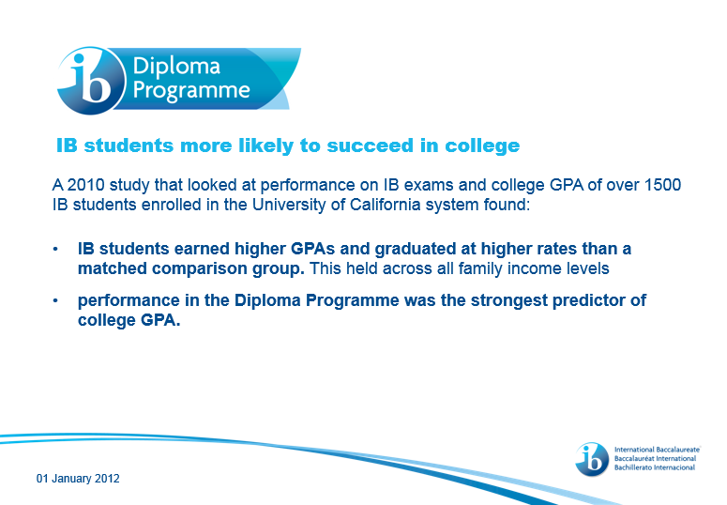
Benefits of IB Coursework (including testing)

Slide 12
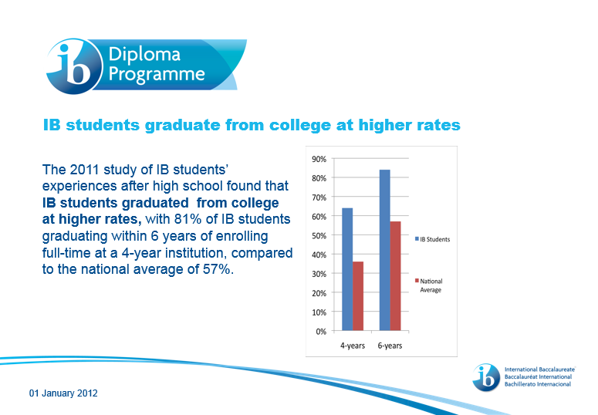
Benefits continued…

Slide 13
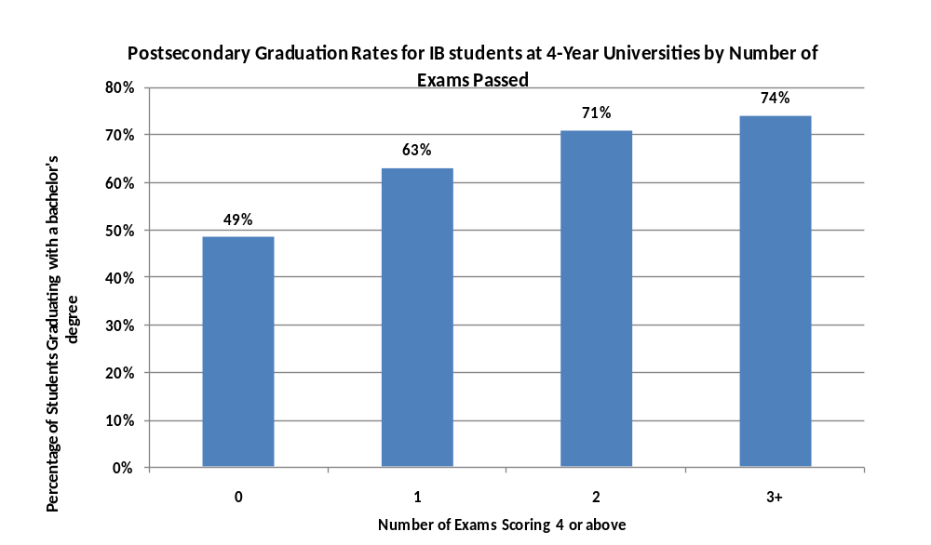
Preparedness & Engagement Benefit

Slide 14
Student Name
Google form - test sign up questions:
It is strongly recommended that students use their full name as it may appear in other school records (SHS, college applications, etc...)

Slide 15
Registration Category
Choose IB COURSE STUDENT if you are only taking individual IB courses not leading to one of the specialized IB degrees (IB Diploma or IB Career). If you have never met to make a 2-year IB course plan with Mr. Phelan, then this is likely the correct category for you. You may be taking between 1-7 IB classes with no restrictions on the subjects or levels (HL/SL)
Choose IB CAREER PROGRAM STUDENT if you have been meeting with Mr. Phelan and have a 2-year IB course plan that includes 2-4 IB courses along with all the other non-course requirements to complete the IB Career Programme requirements.
Choose IB DIPLOMA PROGRAM STUDENT if you have been meeting with Mr. Phelan to develop a 2-year course plan including Theory of Knowledge to complete to complete your 3HL/3SL or 4HL/2SL IB Diploma requirements.

Slide 16
Citizenship
Please enter the country where you hold a passport. If you do not have a travel passport, please indicate the country where you would enjoy the same legal protections and opportunities as native residents. (property ownership, voting, tax paying status, etc...)

Slide 17
Primary & Secondary Language and English Language Fluency
Primary Language: Please enter the language in which you are most fluent, use most often, is your dominant language.
Secondary Language: Only make an entry here if you are bilingual. If you are only studying a second language now you should skip this question.
English Language Fluency: Please rate your fluency with the English language.

Slide 18
A note on Language B exams (Chinese, French, Japanese, Spanish)
IB World Language (Language B) is designed as a language acquisition course. The IBO states that the "...Language B course should be a challenging educational experience for the student, offering not only the opportunity to learn an additional language but also the means of learning, appreciating and effectively interacting in a culture different from the student's own."
As you start planning for your student's World Language pathway, please ask yourself the following guiding questions:
Has the student had more than 2 years of formal instruction in the language?
Does the student speak the language at home on a regular basis?
Could the student travel to a country of origin for this language and navigate their stay without help from translation services or other bilingual people?
If you answered "yes" to any of these questions AND you plan to take any IB level Language B courses, it would be more appropriate to enroll in a different world language to complete the IB course in the spirit in which it was designed. Because every student's experience is unique, please do not hesitate to contact your student's world language teacher, your school counselor, and/or the IB Diploma Coordinator at Skyline High School to help assist you in finding the best possible placement for your student.

Slide 19
Ethnicity & Gender
This data collection is internal to IBO and only used for statistical purposes. The categories provided are those supplied by IBO. Please select the most appropriate choice for you.

Slide 20
Free and Reduced Lunch
To qualify for Free and Reduced Lunch please fill out the application found here: https://www.isd411.org/about-us/announcements/single-announcement/~board/district-announcements/post/applications-available-for-free-and-reduced-lunch
Qualifying for Free and Reduced Lunch can provide many benefits beyond lower IB Exam costs. It does NOT require you to eat school supplied food but does provide that as well should that benefit meet your needs. You may also be eligible for reductions on fees for college entrance exams, college application fees, as well as provide access to some scholarships set aside for qualifying students.
*Note: any potential exam fee waivers are void if you do not show up for your exams.

Slide 21
Exam Selection
Per IBO policy:
HL and ab initio level exams can ONLY be taken senior year.
Juniors are eligible to take up to 2 exams.
Please be careful of your IB exam selection. You can only test in classes you are enrolled in. You need to test in the level (HL/SL) for which you have prepared.

Slide 22
Payment
Please pay your exam balance in full prior to December 6th. By November 15, fees will be placed on the student’s fine account. This may exclude your student’s participation in future SHS events until paid.
There is a late registration window for IB exams from November 15th-January 10th, but there is a $41/subject fee for each late exam registration.
Online payment is preferred but if you need to pay by check those can be brought directly to the SHS Bookkeeper or mailed to SHS care of Spenser Phelan or SHS Bookkeeper. Please be sure to place your student’s name and “IB exam fees” in the memo line.

Slide 23
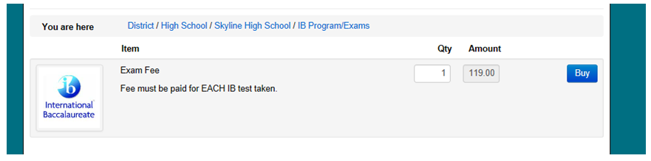

Online Payment Process
Please log-in to the District Online Payment Portal: https://wa-issaquah.intouchreceipting.com/
Select your student
Select “IB Program/Exams”.
Select “Items at Student’s School”
Please select the proper quantity of exams, at the cost of $126.50/exam
Follow instructions to complete payment.

Slide 24
Questions
Questions about exam content should be directed to classroom teachers.
Questions about exam registration should be directed to Spenser Phelan, IB Coordinator: phelans@issaquah.wednet.edu
Questions about the payment process should be directed to the Bookkeeper.

