Slide 1
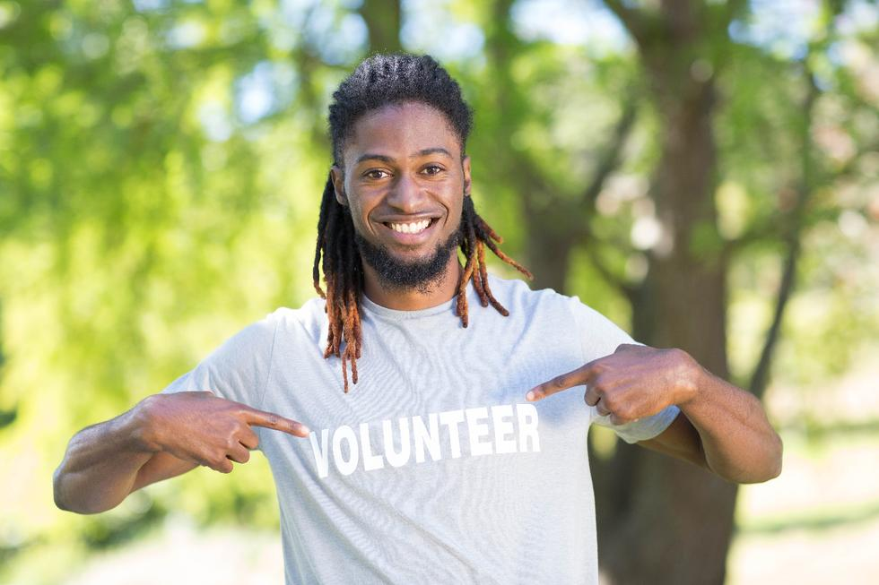
Youth Partnership Program
Student Volunteer Hours Training
Notes:
Welcome to the Youth Partnership Program Student Training

Slide 2
Training Agenda
To explain Youth Partnership Program (YPP)
To discuss value of volunteerism to oneself and one’s community
To explain YPP program requirements and provide tools for compliance (handouts)
To discuss student’s responsibilities and deadlines
To share examples of volunteer opportunities
Notes:
Today we will be discussing the Youth Partnership Program or YPP, including:
the value of volunteering to yourself and your community
what the requirements are and what forms are needed to meet those requirements
What your responsibilities are as a student and the deadlines you need to meet to get credit for your volunteer hours
And finally, examples of volunteer and work opportunities and where to find them

Slide 3

Purpose of YPP
To encourage high school students to serve as volunteers and paid workers
To increase awareness of the needs of their community
To increase awareness of the life-long value of volunteerism and working
To make students knowledgeable about their rights and responsibilities as a community volunteer and paid worker
Notes:
The purpose of the Youth Partnership Program is to:
Encourage you to serve as volunteers or paid workers
Help you to understand the needs of your community
Increase your awareness of the life-long value of volunteering and working
And to make you aware of your rights and responsibilities as a community volunteer and paid worker

Slide 4
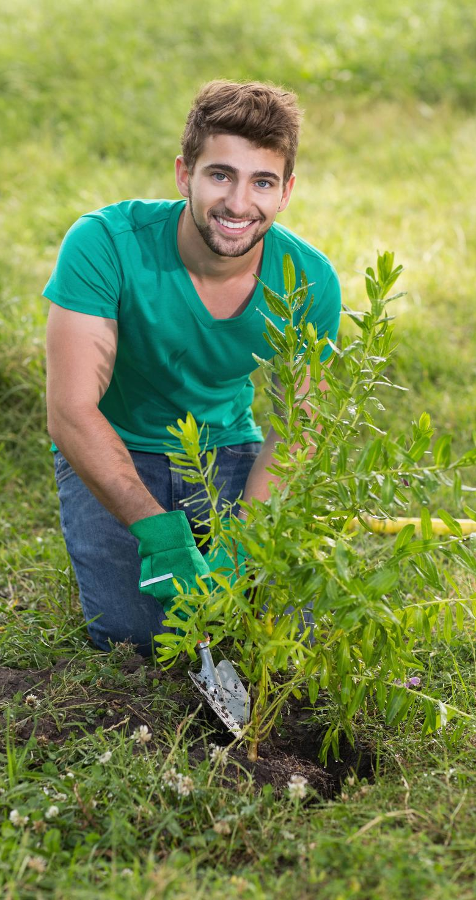
Why Volunteer or Work?
Personal satisfaction
Help others
Career exploration and job experience
Develop leadership skills
Meet new people
Obtain recognition
Document service on high school transcripts for college application and scholarships
FOR FUN!
Notes:
There are many reasons you might choose to volunteer or work in your community
Maybe it’s just something you’ve always wanted to do, or you like helping others and meeting new people
Perhaps you see it as an opportunity to explore a job you might be interested in or to develop leadership skills
Many scholarships require volunteer hours to qualify. It boosts your resume for college applications.
Or maybe you just enjoy it.

Slide 5
Youth Partnership Program Guidelines
Attend this training PRIOR to completing any hours for community service or paid work
Students cannot receive academic credit for volunteer/paid work.
Students may use YPP to meet special program and scholarship requirements.
Notes:
The YPP guidelines require that you take this training before you can start volunteering or working. Students who take the training in 8th grade may begin volunteering during the summer before 9th grade. You must be promoted to 9th grade in order to start counting your volunteer/paid work hours.
These are some very important guidelines to follow:
Students cannot receive academic credit for volunteer or paid work
Students may use the YPP program to meet scholarship requirements
All volunteer and paid work hours must be documented and approved by your school counselor

Slide 6

Requirements for Bright Futures Scholarships
  Academic Scholar – 100 hours community service OR 100 hours of paid work
  Medallion Scholar – 75 hours community service OR 100 hours of paid work
  Gold Seal Vocational Scholar –75 hours community service OR 100 hours of paid work
  **(30 hours of community service will be required for students who entered Grade 9 before 2024-2025)
  Gold Seal CAPE Scholar – 75 hours community service OR 100 hours of paid work
  **(30 hours of community service will be required for students who entered Grade 9 before 2024-2025)
Notes:
The Youth Partnership Program documents service on high school transcripts for college applications and scholarships.
The Florida Bright Futures Scholarship requires 100 hours of paid work for all scholarships or the following for volunteer service:
100 hours of community service or 100 hours of paid work for Academic Scholars;
75 hours of community service or 100 hours of paid work for Medallion Scholars;
30 hours of community service or 100 hours of paid work for Gold Seal Vocational Scholars; and
30 hours of community service or 100 hours of paid work for the Gold Seal CAPE Scholars

Slide 7

Hours That Can Be Counted for volunteer service or paid work
Volunteer/work for a nonprofit community service organization
Business or governmental internship
Activities on behalf of candidate for public office
Performance, rehearsal, practice, club activities (such as service projects, not meetings), competitions (performing arts, special programs, athletics, etc.) that are affiliated with Volusia County Schools.
NOTE: Must NOT be related to course requirements; meaning the hours don’t count if credit is earned.
Notes:
Hours can be completed during school days, if NOT related to the requirements of a course. In other words, you cannot earn course credit for your volunteer or paid work hours.
Hours that can be counted include:
Volunteer service or paid work for a non-profit community service organization
A business or governmental internship (see page 9 of the handbook for the definition of an internship)
Activities on behalf of candidate for public office
Any performance, rehearsal, practice, competition, or service projects associated with a club (not meetings). These activities must be affiliated with Volusia County Schools. Remember, to be counted, these activities must NOT be related to course requirements. Hours will not count if credit is earned.

Slide 8
Changes to Bright Futures since 2022
NEW
  Students can earn hours for community service AND paid work
  Hours from both categories can be combined to meet Bright Futures Scholarship requirements
  The minimum requirements for either community service AND paid work must be met to meet eligibility requirements.
Notes:
A new law was passed in 2022 allowing volunteer service and paid work to count toward eligibility requirements for Bright Futures. Not all paid work hours will be accepted. Paid work is limited to the same places where volunteer service hours can be earned.
These hours can be combined to meet the requirements. In other words, students must complete 100 hours of paid work, or the number of community service hours established for each of the four scholarships offered

Slide 9

Hours That Cannot Be Counted
NCR Study Hall
Student Aide
Babysitting a sibling
If part of a requirement for course credit work
Notes:
You cannot earn hours for study hall, serving as a student aide or a teacher’s assistant, for babysitting a sibling, if the work is part of a requirement for a class or anything for which you are paid aside from the non-profit workplaces.

Slide 10

When Can You Volunteer?
Before school
During school
After school
During school holidays
On weekends
On vacation
ANYTIME!
As long as it is NOT related to course requirements, and you are not earning credit
Notes:
You can volunteer anytime, if it is NOT related to the requirements of a course, meaning you cannot earn credit AND count volunteer hours.
Some examples include: after school practice for Band and AHS sports, after school rehearsals for Theatre, Dance, and Chorus, weekend parades with ROTC, other volunteer activities with your academy/clubs, meetings with AHS clubs/academies –as long as the meetings are working towards volunteering –not general meetings.

Slide 11
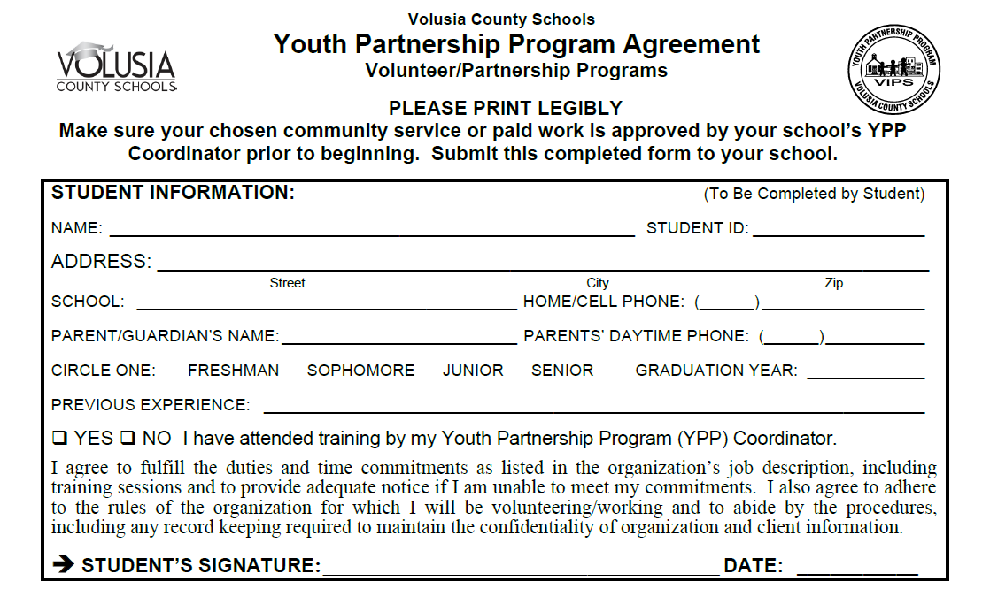
YPP Agreement Form
Student Information
Notes:
When you have selected a business or organization where you would like to volunteer or work, you must have a YPP Agreement Form signed by you, the business or organization, and your parent or guardian. Be sure you speak to your school counselor to make sure that volunteering or working for this business or organization will qualify as appropriate service hours.
There are three sections of the YPP Agreement Form
The top “Student Information” box is to be completed by you.
Please make sure you read the entire box, print legibly, and sign, where needed.

Slide 12
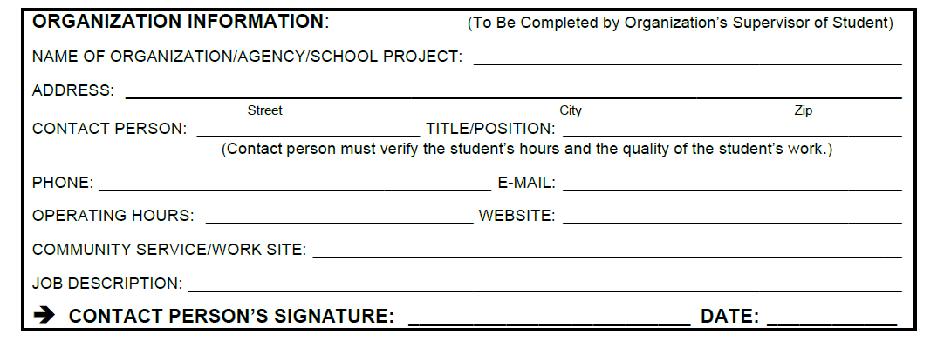
YPP Agreement Form
Organization Information
Notes:
The middle section is to be completed by the supervisor where you plan to volunteer or work. It requires them to provide information regarding their business or organization . Please make sure this portion is filled out and signed by the supervisor.
When you speak to the business or organization where you will volunteer or work, use the YPP Agreement form as an opportunity to clarify any doubts you might have regarding your volunteer duties.

Slide 13
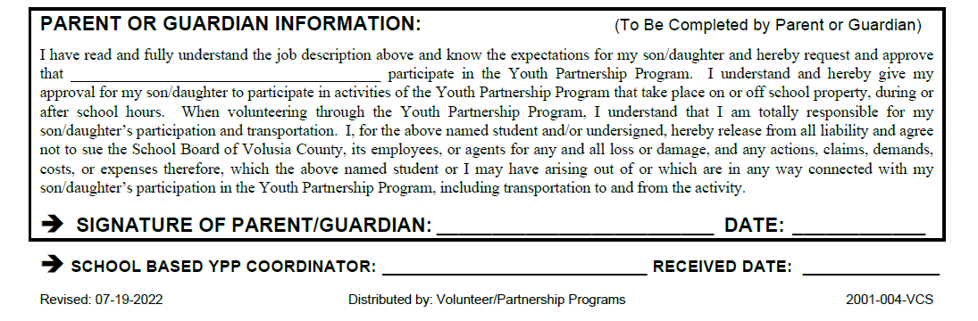
YPP Agreement Form
Parent/Guardian Information
Notes:
The last box requires parent or guardian permission.
Make sure that your parent or guardian reads the entire form and provides approval by signing and dating the form.
This form releases the school board of all liability for any actions that take place while you volunteer or work, including your transportation to and from the volunteer/work site.
When all three sections are completed, the form should be submitted to the YPP coordinator at your school.

Slide 14
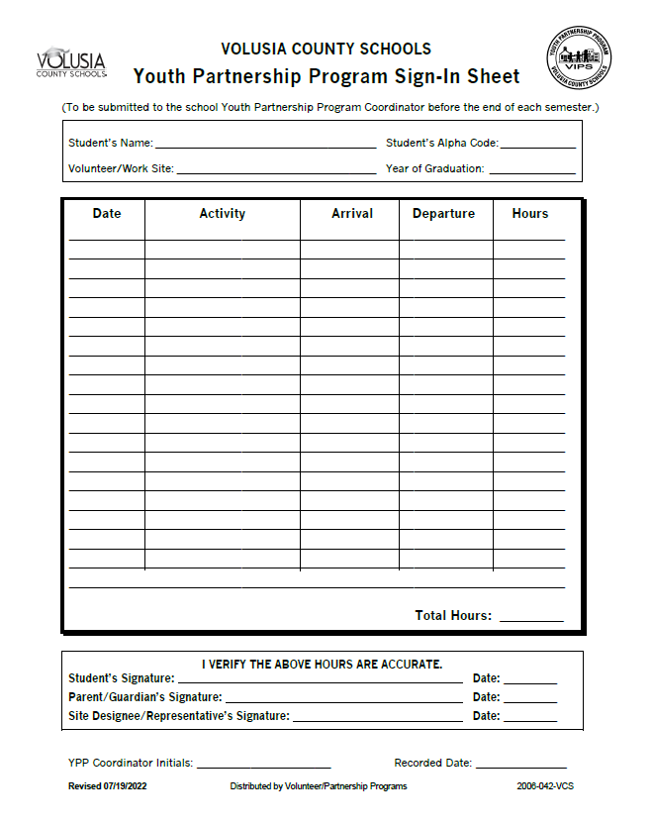
YPP Sign-In Sheet
  Submit hours promptly after completion of volunteer project (quarterly or before end of each semester)
  Completed sheets must be signed and dated by the student, parent/guardian, and the organization
Notes:
Once your YPP agreement has been signed and turned in, you are ready to start volunteering or working.
You must use the “YPP Sign-In Sheet” to record your hours. It is your responsibility to make sure the hours are recorded accurately and turned in on time in order to get credit for your service.
Completed sheets must be signed and dated by you, your parent or guardian and verified by the supervisor at the business or organization where you volunteer or work.
Once the sign-in sheet is signed by everyone, turn it in to your YPP Coordinator
Make sure you submit hours promptly
As a senior, you want to make sure your hours are recorded no later than the last day of your senior school year – this is very important so that your school transcripts reflect all your service hours
Acceptable hours will be entered into your student record and appear on your high school transcript

Slide 15
Where do I find and turn in forms?
Blue Volunteer Forms are located in the Counseling Hallway
Fill out “front” YPP Agreement page ONCE per organization. For example, if you will do Marching Band for all 4 years.

Slide 16
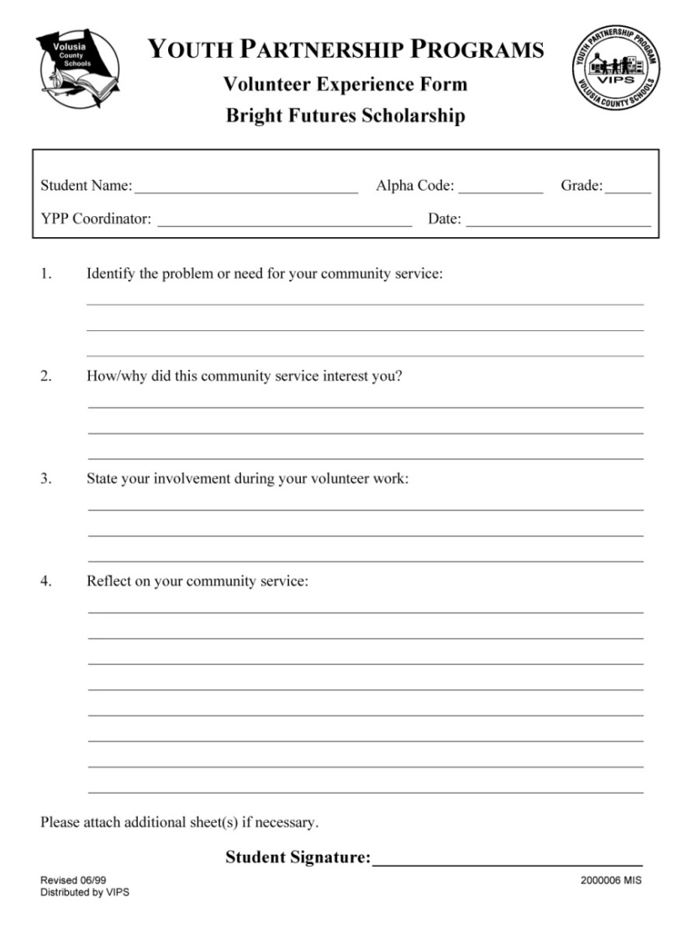
Volunteer/Work Experience Form
To be completed one time, in your senior year
Identify a social or civic issue, or a professional area
Develop a plan to address the issue
State your involvement
Evaluate and reflect on your experience
Submit form to the YPP Coordinator no later than May of your senior year
Notes:
The Volunteer Experience form is a state requirement and is only to be completed once, in your senior year.
For this form, you will
Identify a social or civic issue, or a professional area, that interest you for your volunteer service work;
Develop a plan for your personal involvement in addressing the issue or learning about the area;
State your involvement;
Evaluate and reflect on your volunteer or work service experience;
Once complete, you will submit this form to your YPP Coordinator no later than May of your senior year
This form is available in the back of your YPP Student Handbook or through your YPP Coordinator, and will be used to document awards for Bright Futures Scholarships

Slide 17
Student’s Responsibilities for YPP
Select Volunteer Site
Contact the agency, organization or business selected
Complete Agreement
Complete the YPP Agreement form
Clarify Responsibilities
Clarify dates, times and responsibilities assigned.
Provide Own Transportation
Provide own transportation to and from the volunteer/work site
Document Hours
Perform service without academic credit.
Will the agency provide training? When? Where?
Document hours on YPP Sign-In Sheet
Make sure you get signatures from your parent/guardian and the site contact
If in doubt whether it is acceptable, ask your YPP coordinator
Notes:
To participate in the YPP program, you have several responsibilities:
It is your responsibility to select an appropriate site to volunteer or work; if you aren’t sure, ask your YPP coordinator
You must complete the YPP agreement with required signatures
Be sure to clarify dates, times and expected responsibilities - Ask the business or organization if they will provide you with training. If they will, ask when and where?
You must provide your own transportation to and from the site
The volunteer service or paid work must be performed on your own time, without academic credit, and you must document the hours
It is important that before your start volunteering or working, that you read the YPP Student Handbook. If you do not understand the information, be sure to ask your YPP coordinator to get clarification. You do not want to spend time volunteering or working only to find out the hours will not count because they do not qualify under YPP guidelines.

Slide 18
Student’s Responsibilities to Volunteer/Work Site
Confidentiality
Respect confidentiality of organization and their clients
Behavior
Maintain appropriate behavior while volunteering or working
Attendance
Be prompt– perform service on the day/time agreed
Call organization in advance if you can’t keep your obligation
Sign in at volunteer/work site every time you arrive
Appearance
Wear proper attire for volunteer/work duties
Assignment
Accept direction, ask questions
Document hours on the YPP Sign-In Sheet
Sign In
Never do anything that makes you feel uncomfortable
Notes:
You also have responsibilities toward the business or organization where you will be volunteering or working. These include:
Respect the CONFIDENTIALITY of the business or organization and their clients. What you see and hear is strictly confidential. If you have questions, talk to your supervisor. Maintaining confidentiality is an important responsibility of all volunteers and paid workers, and the breaking of confidentiality can be a prime reason why someone could be let go.
Behave appropriately while volunteering or working.
Make sure you are prompt in attendance and perform your service on the day and time agreed. Do not be late or leave early unless agreed upon with your supervisor.
If you get ill or realize that you are not going to be able to volunteer or work, please notify the business or organization.
Make sure you sign-in and out at the volunteer or work site and document your hours on the YPP Sign-In Sheet
Wear proper attire. Remember the school district enforces a dress code and we certainly hope that you will abide by these guidelines while volunteering or working.
Finally, you should always ask questions if you are unsure in how to do their tasks, and never do anything that makes you feel uncomfortable. If you are asked to do anything that makes you uncomfortable, report it to your parent or guardian, your school counselor, your YPP coordinator, or another trusted adult.

Slide 19
Important Deadlines
SENIORS
Report senior hours no later than the last day of senior school year
9th – 11th GRADE
Must submit hours by the last day of school
Submit completed Volunteer/Work Experience Form by the end of May
Notes:
There are important deadlines you need to meet to make sure you get credit for the volunteer or work hours.
It is best to turn in the hours at the end of your experience with the organization, which could be several days, weeks or months; however, you must submit all hours by the last day of school, each year. It is extremely difficult to document hours if you wait to turn them in your senior year, and you could risk not getting credit for them.

Slide 20
Sample
Volunteer Opportunities
Boys & Girls Club
Business Internship
Churches or Synagogues
City or County Governments
Civic Organizations
Extended Day Programs
Health Department
Homeless
Hospice
Hospital or Nursing Home
Habitat for Humanity
Humane Society/Veterinary Clinic
Non-Profit Organizations
Political Campaign
Public Library
Schools and School Clubs
Teen Court
United Way
YMCA
Boy/Girl Scouts
Notes:
There are many places you could volunteer or work, including
The city governments, such as a special event
Helping senior citizens at a senior center or health fair
Working with the physically or mentally disabled, such as with Special Olympics
With youth, such as Boy scouts or girl scouts, YMCA, the extended day program, after-school tutoring, as part of a school service club
Assisting the homeless with a food or clothing collection
With non-profits, such as the Humane Society, American Red Cross, Habitat for Humanity, food banks
In a health-related field at hospitals, the American Cancer Society or the American Heart Association
You could also intern for a business or work on a political campaign.
This slide shows many examples; Also, you can visit volunteermatch.org for other opportunities.

Slide 21
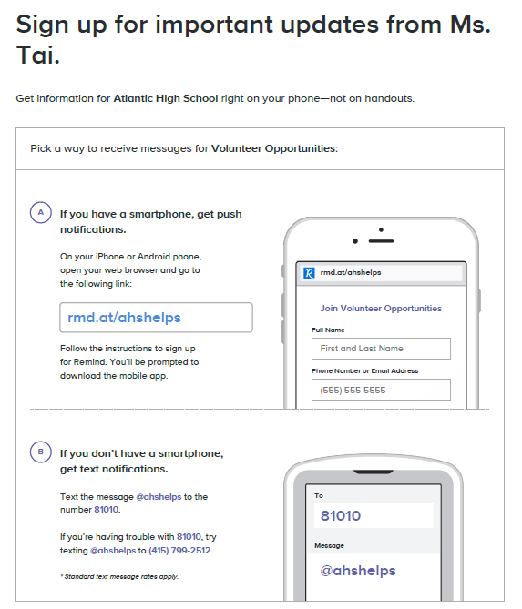
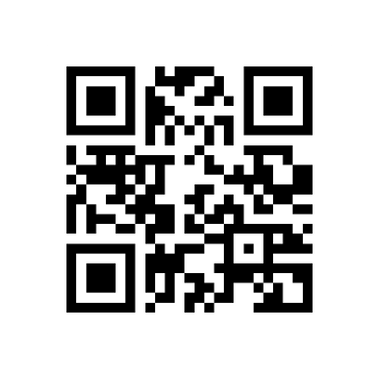
Add the REMIND
Or Check counseling hallway bulletin board

Slide 22

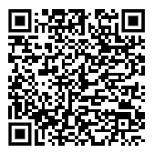
Get a copy of the
YPP Student Handbook
for Detailed Information
Notes:
You are receiving the YPP Student Handbook today. Please make sure you read it and that you understand the guidelines before volunteering or working. Remember: your hours will only count if you are a high school student and have taken the YPP training. Eighth graders may volunteer or work in the summer before their 9th grade year, but only if the training has been completed.
Be sure to take this handbook home and share it with your parent or guardian. They will be responsible for signing off on your YPP agreement and your YPP Sign-In sheet that documents your hours.

Slide 23

Questions?
Please see your counselor or Ms. Tai
Notes:
Your YPP Coordinator can answer any questions and provide any additional forms that you might need.
Best wishes to you!

