Slide 1



End of Year
State Reporting Reminders

Slide 2

2025-26 School Year is CLOSED

Slide 3
2025-26 School Year is CLOSED
EXCEPT……

Slide 4
2025-26 School Year is CLOSED
EXCEPT……
October 16, 2026 - Staff Evaluation Scores and
Ratings Data Due
October 30, 2026 - Staff Eval Rating Verification
Report Certification Due

Slide 5
2025-26 School Year is CLOSED
EXCEPT……
October 16, 2026 - Staff Evaluation Scores and
Ratings Data Due
October 30, 2026 - Staff Eval Rating Verification
Report Certification Due
As of Wednesday 9/16:
33 districts have valid records

Slide 6

New for 2027!

Slide 7
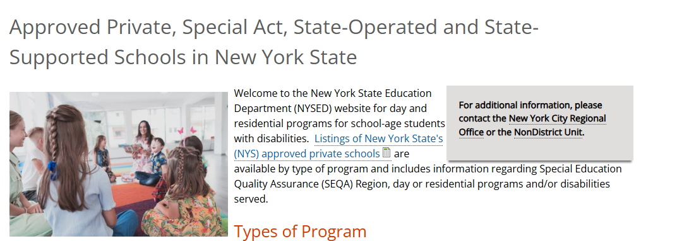
New for 2027!

Slide 8
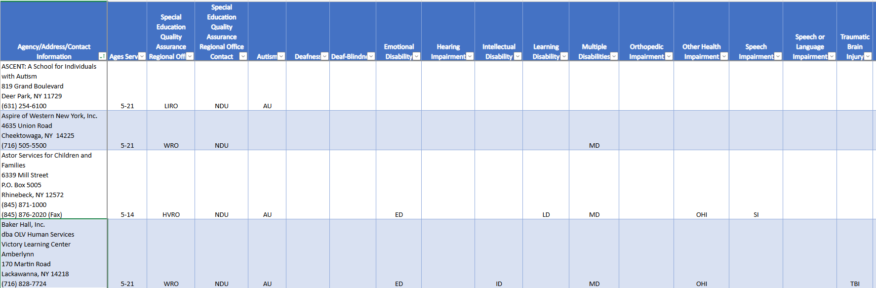
New for 2027!

Slide 9
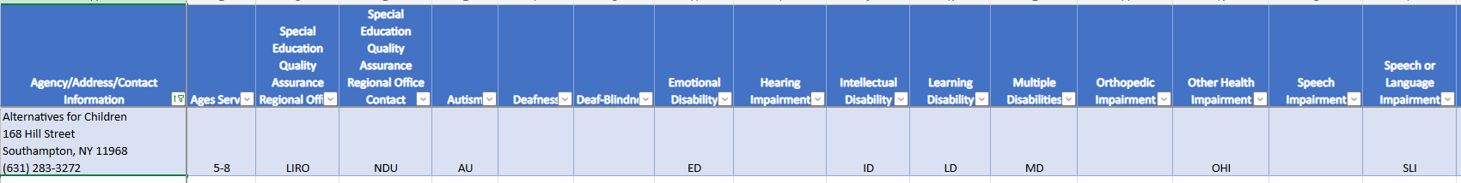
New for 2027!

Slide 10

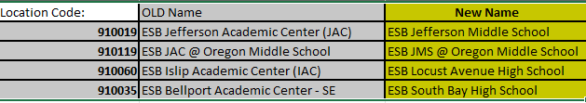
New for 2027!

Slide 11


New for 2027!
Wilson Tech Alternative HS

Slide 12






New for 2027!

Slide 13
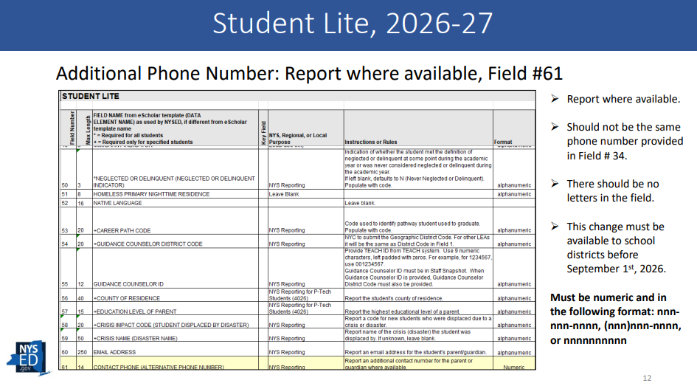
New for 2027!

Slide 14
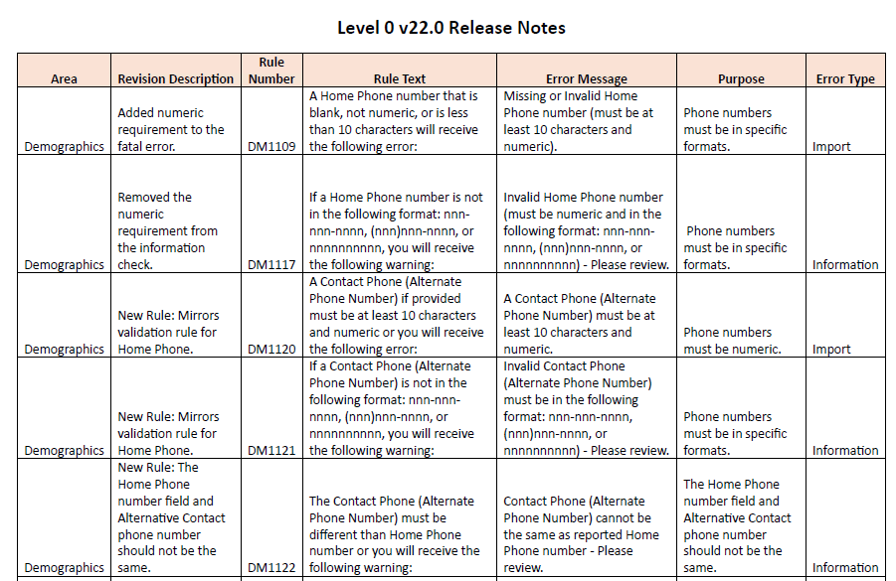
New for 2027!

Slide 15
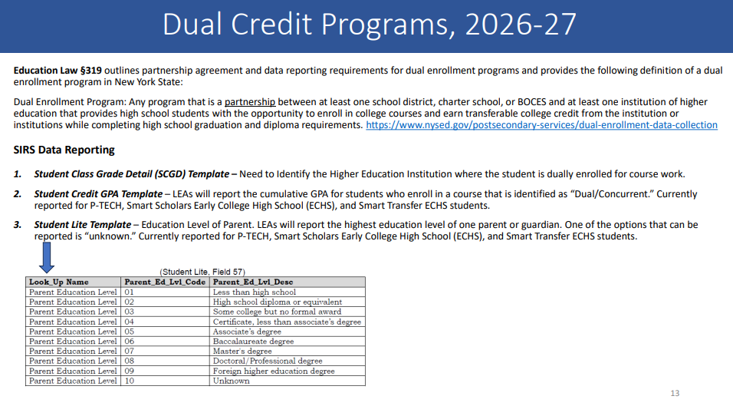
New for 2027!

Slide 16
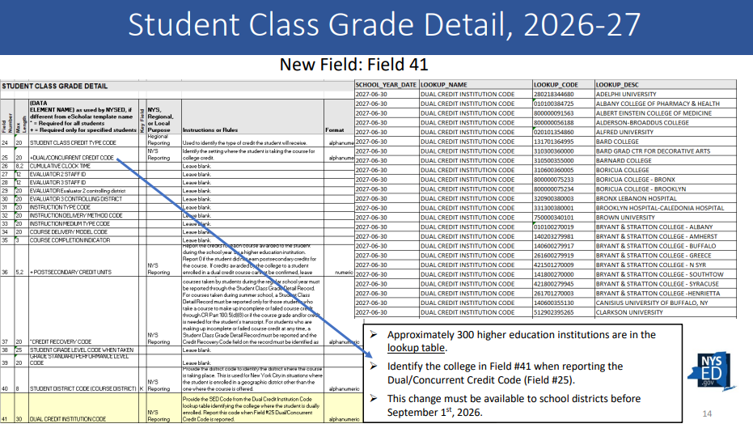
New for 2027!

Slide 17
New for 2027!
Student Class Grade Detail
Must report Institution Credit is earned from

Slide 18


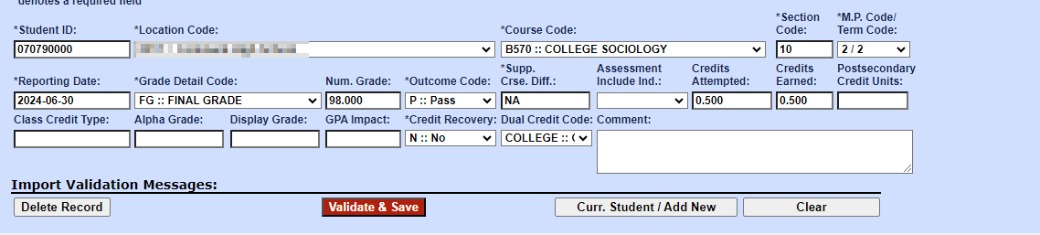
End of Year – Dual Credit Courses!
Report Dual Credit Code in Student Class Grade Detail.
Dual Credit Indicator and Dual Credit Code are dependent data elements.

Slide 19
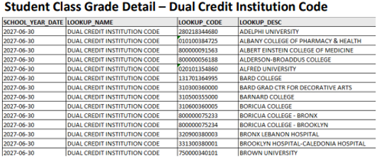
End of Year – Dual Credit Courses!
Report Dual Credit Code in Student Class Grade Detail.
Dual Credit Indicator and Dual Credit Code are dependent data elements.

Slide 20
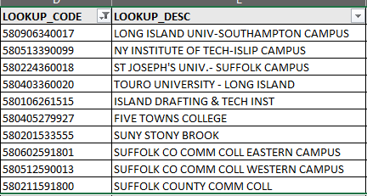
End of Year – Dual Credit Courses!
Report Dual Credit Code in Student Class Grade Detail.
Dual Credit Indicator and Dual Credit Code are dependent data elements.

Slide 21
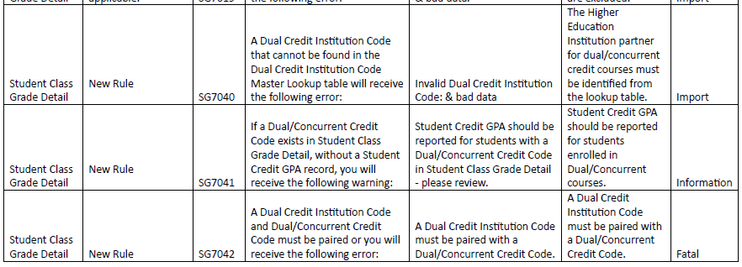
New for 2027!
Student Class Grade Detail
Must report Institution Credit is earned from

Slide 22
New for 2027!
Student Credit GPA
Must report for all students earning dual credit

Slide 23
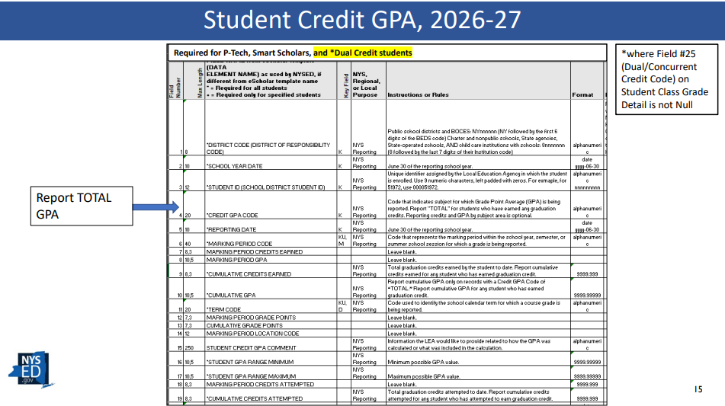
New for 2027!

Slide 24
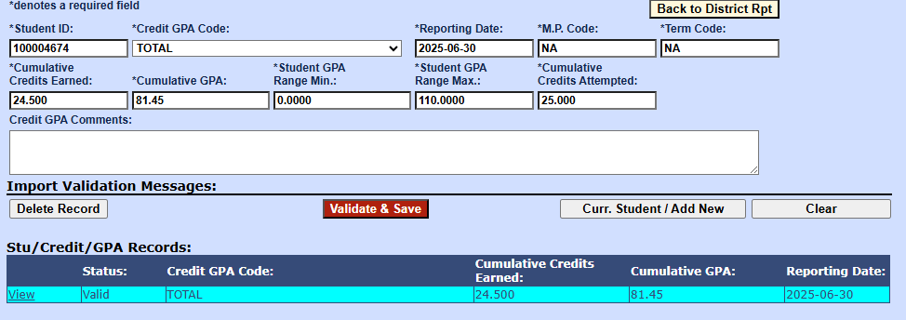
New for 2027!

Slide 25
New for 2027!
Education Level of parent
Should report for all students earning dual credit

Slide 26
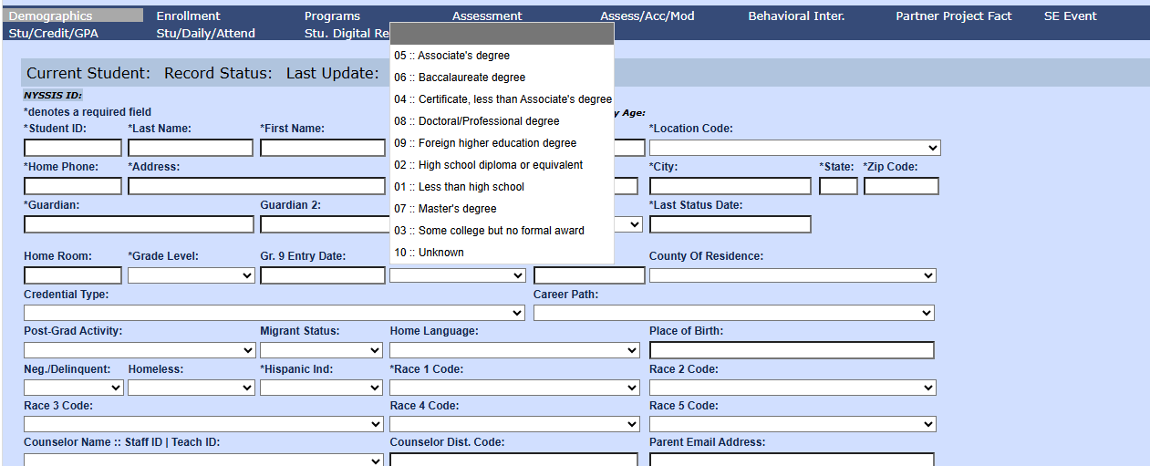
New for 2027!

Slide 27
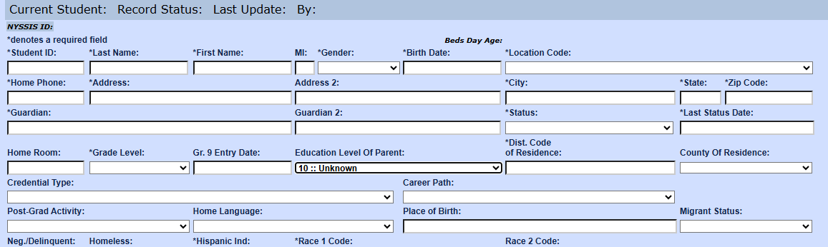
New for 2027!

Slide 28


New for 2027!

Slide 29
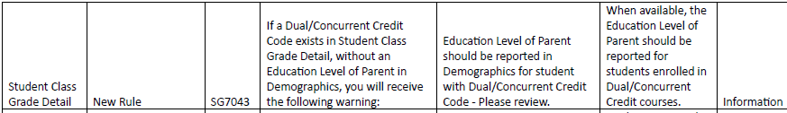
New for 2027!
Education Level of parent
Should report for all students earning dual credit

Slide 30
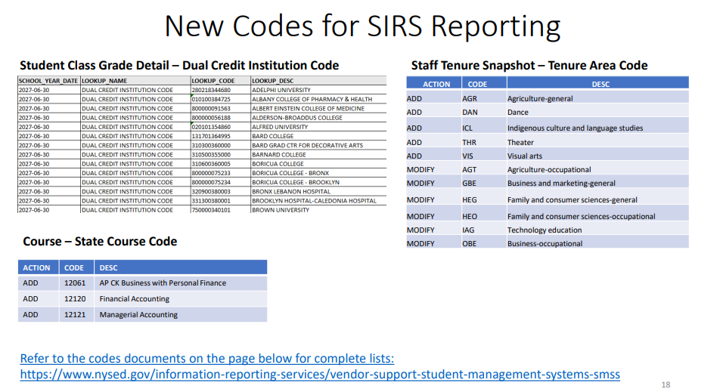
New for 2027!

Slide 31


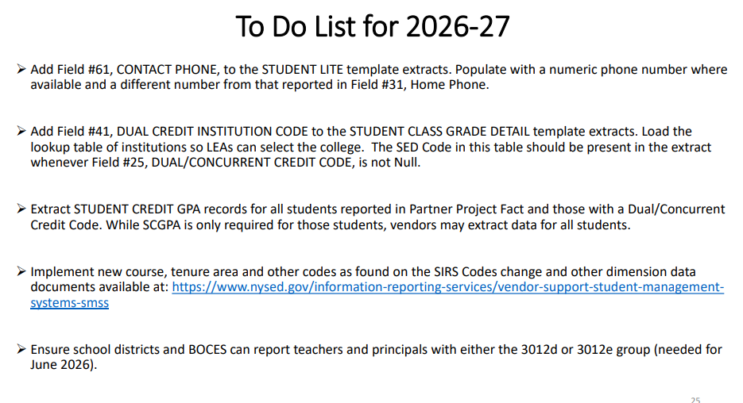
New for 2027!

Slide 32
New for 2027!
New features!

Slide 33
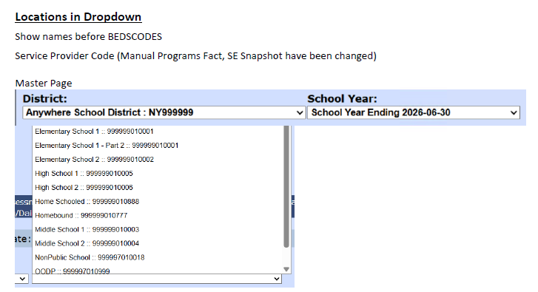
New for 2027!
New features!

Slide 34
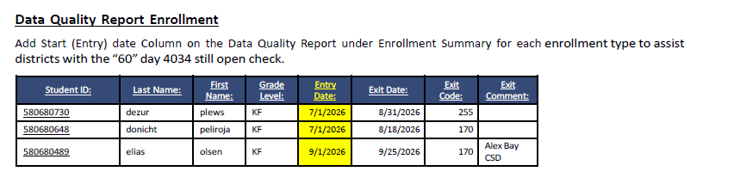
New for 2027!
New features!

Slide 35
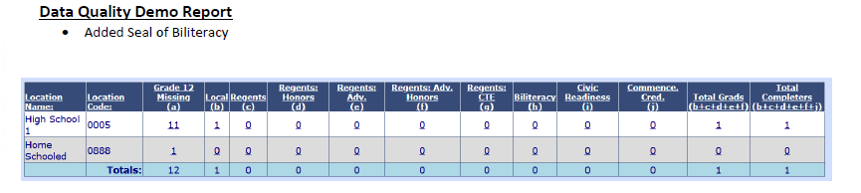
New for 2027!
New features!

Slide 36
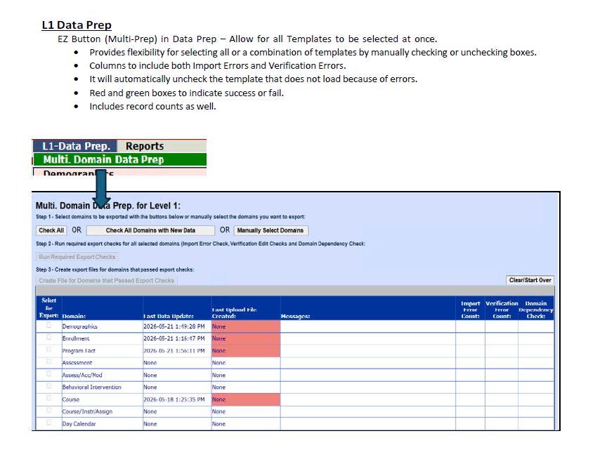
New for 2027!
New features!

Slide 37
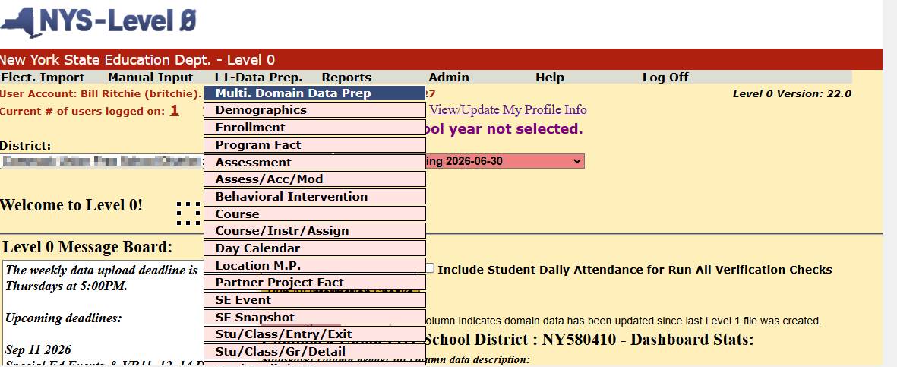
New for 2027!
New features!

Slide 38
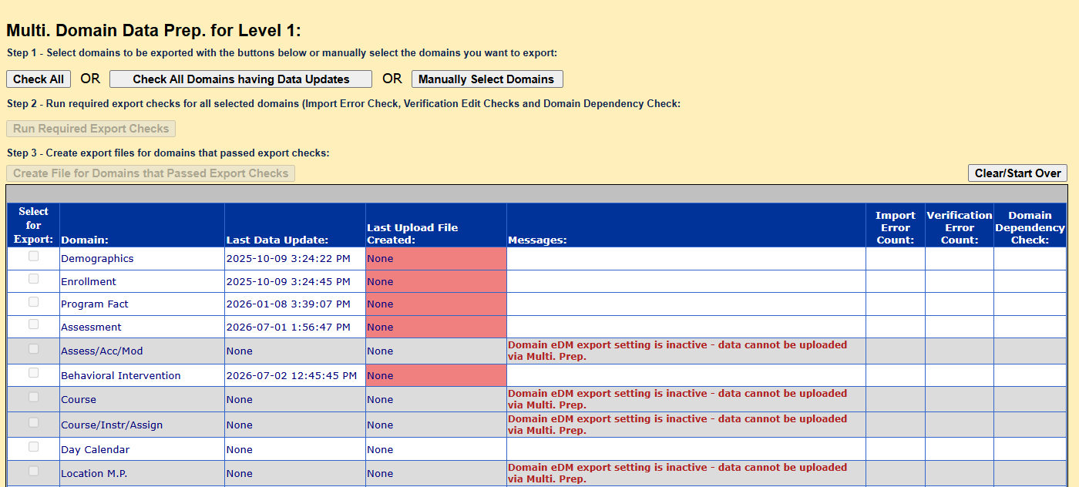
New for 2027!
New features!

Slide 39
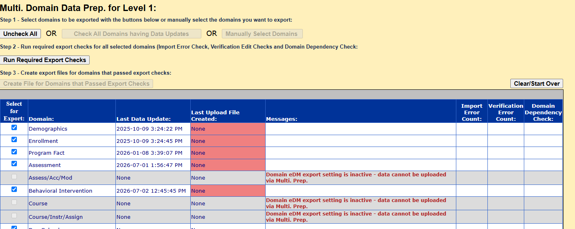
New for 2027!
New features!

Slide 40
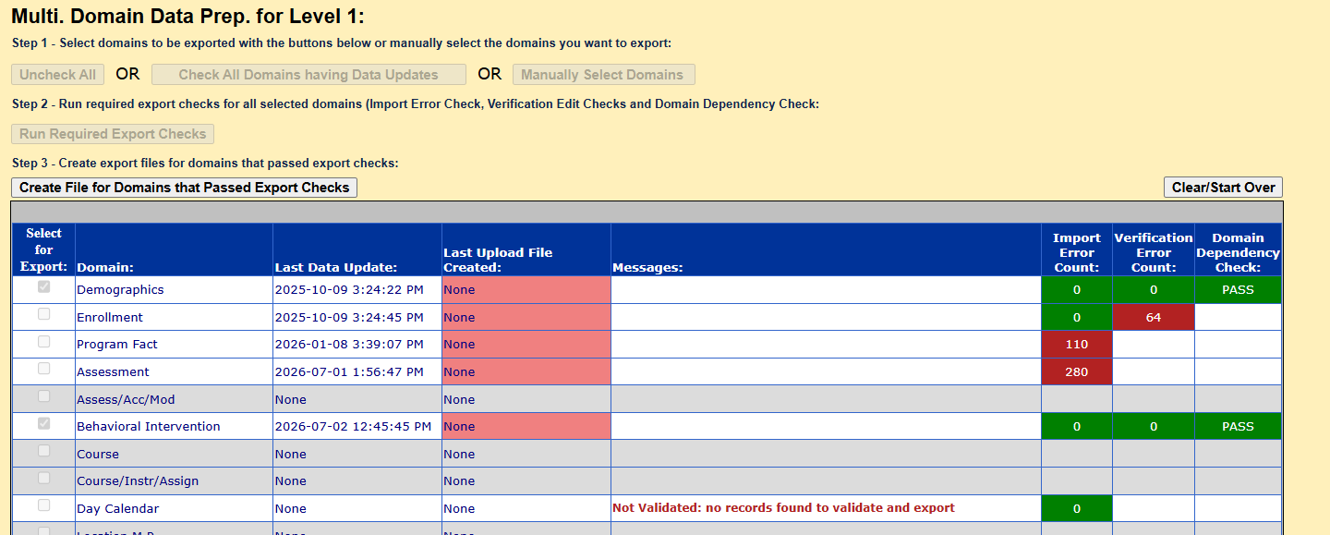
New for 2027!
New features!

Slide 41
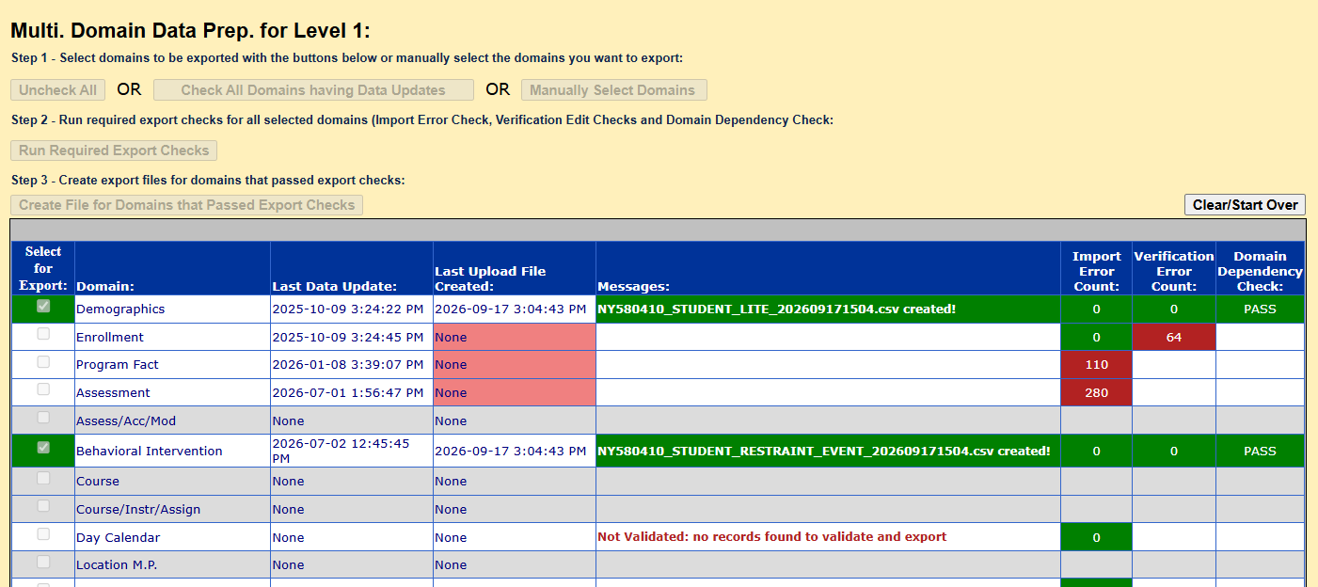
New for 2027!
New features!

Slide 42
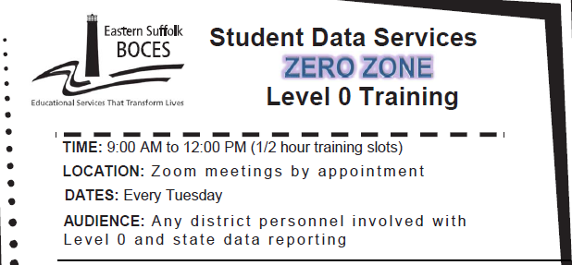




https://calendly.com/dwtshelp

Slide 43

https://calendly.com/dwtshelp

