Slide 1

Benefits Orientation
School Employees Benefits Board
Kelly Jackson – Benefits Specialist
New Employee Orientation

Slide 2
Who is eligible for benefits under SEBB…
Employees
Any employee anticipated to work 630 hours in a school year. A school year is defined as September 1 to August 31
Dependents
Legal spouse or state-registered domestic partner
Children up to age 26
Children with disabilities over age 26
Extended dependents (grandchild, niece, nephew, etc.)
  Legal custody

Slide 3
SEBB Dependent Verification
All dependent documents must be submitted through Benefits 24/7.
Required Verification Documents
Spouse
  Most recent year’s Federal Tax Return, or
  Marriage certificate, and
    Proof of common residence, or
    Proof of financial interdependency (shared bank statement)
State-registered domestic partner
  Certificate of state-registered domestic partnership, and
    Proof of common residence, or
    Proof of financial interdependency (shared bank statement)
Children up to age 26
  Most recent year’s Federal Tax Return, or
  Birth certificate
Disabled Dependent
  Certification of Child With a Disability form (HCA form)
Extended Dependent
  Extended Dependent Certification form (HCA form), and
  Court order
Dependent verification must be completed during enrollment period.

Slide 4
Benefits available under SEBB…
Required
Medical
Dental
Vision
Basic Life and AD&D
Long Term Disability (LTD)
Optional
Flexible Spending Arrangements (FSAs)
Dependent Care Assistance Program (DCAP)
Employee-paid LTD
Health Savings Account (HSA) – must be enrolled in the UMP High Deductible Medical Plan
Supplemental Life/AD&D

Slide 5
When can you enroll or make changes?
Initial eligibility
  31 days from
    New hire start date
    Date became eligible
  Coverage begins the following month
Annual Open Enrollment (OE)
  Typically in October or November
    Coverage changes begin January 1 of the following year
Special Open Enrollment (SOE)
  60 days from the date of qualifying event
  Coverage begins the following month the SOE is completed

Slide 6
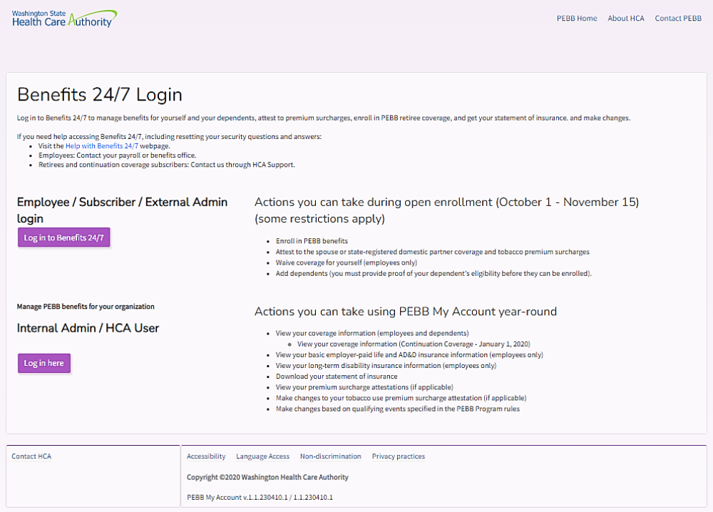
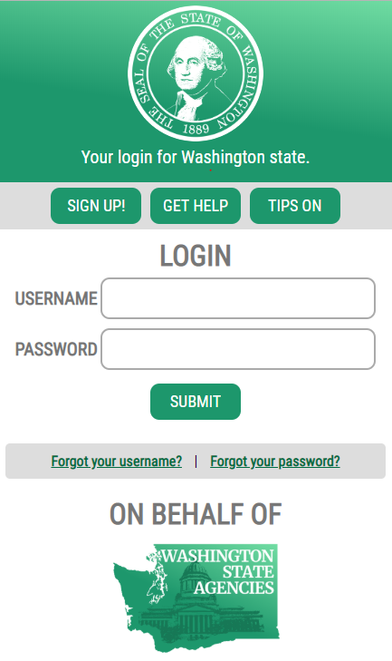
Where to enroll in benefits…
benefits247.hca.wa.gov
Log into Benefits 24/7 by:
Creating or logging into a Secure Access Washington account
You may not enroll prior to your eligibility date listed on your SEBB eligibility worksheet.

Slide 7
Medical Benefits
Plan availability is based on the county you reside or work
Managed-care Plans
3 Kaiser Permanente NW
4 Kaiser Permanente WA
1 Premera Blue Cross
Preferred-provider Organization Plans (PPO)
3 Kaiser Permanente WA Options Summit PPO
2 Premera Blue Cross
3 Uniform Medical Plans (administered by Regence BluesShield)
Waive Medical
Must be enrolled in other employer-based group medical insurance, a TRICARE plan, or Medicare –- Apple Health does not qualify for you to waive SEBB medical.
Medical plans have an employee out-of-pocket monthly premium.

Slide 8
Dental Benefits
Family plans at no cost to the employee.
Managed-care Plans (Must have a primary dental provider in that plan’s network.)
DeltaCare
  Plan administrator: Delta Dental of WA
  Plan network: DeltaCare SEBB
Willamette Dental Group Plan
  Plan administrator: Willamette Dental of WA, Inc
  Plan network: Willamette Dental Group, P.C.
Preferred-provider Organization Plans (PPO) (May choose a dental provider.)
Uniform Dental Plan (UDP)
  Plan administrator: Delta Dental of WA
  Plan network: Delta Dental PPO

Slide 9
Vision Benefits
Family plans at no cost to the employee.
Plan Options
Davis Vision
EyeMed
MetLife
Basic Coverage
Routine eye exams are covered at 100% once per year
Frames and Lenses renew every January 1 on even years

Slide 10
Life and AD&D Benefits
Basic
(district paid)
$35,000 life
Up to $5,000 AD&D
Supplemental Life and AD&D is billed directly to you from MetLife and premiums will not be deducted from your paycheck.
Supplemental
(employee-paid)
Employee: up to $1,000,000
  Guaranteed issuance of $500,000
  Increments of $10,000
Spouse/State-Registered Domestic Partner: up to $500,000
  Not to exceed ½ of employee
  Guaranteed issuance of $100,000
  Increments of $5,000
Child(ren): up to $20,000
  Increments of $5,000

Slide 11
Long Term Disability (LTD) Benefits
Benefit Waiting Period
(which is the longer of…)
90 Days
Period of sick leave, wellness leave, or other salaried continuation plan (excludes vacation leave and shared leave)
Period Washington Paid Family and Medical Leave
Employer-Paid LTD (basic)
Minimum: $100/month
Maximum: $400/month
Employee-Paid LTD
60% plan (automatically enrolled in): Up to 60% of pre-disability salary
  Maximum: $10,000/month
50% plan: Up to 50% of pre-disability salary
  Maximum: $8,333/month
Decline coverage

Slide 12
Medical FSA and DCAP Benefit
Flexible Spending Arragements (FSA)
Medical FSA
  Cannot be enrolled in the UMP High Deductible Medical Plan
Limited Purpose FSA
  Must be enrolled in the UMP High Deductible Medical Plan
Election:
  $120/year up to IRS limit
  Deducted pre-tax
Full amount available on the first day benefits become effective
Carry over subjected to IRS limits
DCAP
(Dependent Care Assistance Program)
Election:
  Up to $7,500/year (single person or married couple filing a joint income tax return)
  Up to $3,750/year (married person filing a separate income tax return)
Use it or lose it – no carry over

Slide 13
SmartHealth Benefit
Incentives
Subscribers only
  High-deductible health plans: One-time deposit into subscriber’s health savings account (HSA)
  All other plans: One-time reduction to subscriber’s medical plan deductible

Slide 14
What if you don’t enroll or waive before the deadline?
Defaulted to
  Employee only coverage
  No dependent coverage
  Unable to change until next annual open enrollment
Monthly cost to employee
  Medical premium
  Tobacco surcharge
  Employee-paid 60% LTD premium
  Default Coverages
    Medical: UMP Achieve 1
    Dental: Uniform Dental Plan
    Vision: MetLife
    Basic Life and AD&D
    Employer-paid LTD
    Employee-paid 60% LTD

Slide 15
WA Cares Fund
Long-Term Care
Important Information
Beginning July 1, 2023, all employers in Washington are required to collect the WA Cares Fund premium via mandatory payroll deduction from all employees, unless they have been granted an exemption from the Employment Security Department.
WA Cares is self-funded by worker contributions and investment earnings on those contributions. The current premium is 0.58 percent of an employee’s gross wages.
Benefits become available July 1, 2026, for those who meet a contribution requirement as well as a care need requirement.
Approved Exemption Letter
The payroll department must receive a copy of an employee’s approved exemption letter prior to the mandatory deduction being stopped from their paycheck.
More information is available at www.wacaresfund.wa.gov

Slide 16
Contact Information
Kelly Jackson – Payroll Benefits - ext. 2060
benefits@fwps.org
Patty McDugle – Payroll Retirement - ext. 2064
retirement@fwps.org
Benefit Resource
WA Health Care Authority
www.hca.wa.gov/sebb-employee

Slide 17
Retirement Information

Slide 18
Retirement
Retirement is mandatory for all eligible employees
TRS – Teachers’ Retirement System
SERS – School Employees’ Retirement System

Slide 19
Prior Members
Plan 2 – Complete the Beneficiary Form
Plan 3 – Complete the Member Information Form and the Beneficiary Form. You have 90 days to select a new contribution rate & investment option.

Slide 20
New Members –
90 Days to Choose your Plan
Plan 2 – Defined Benefit
It is important to note the state automatically places you into plan 2 (their default plan) until you submit your Member Information Form
Benefit is calculated as:
2% x Service Credit Years x Average Final Compensation
Employer & Employee contribution rates are set by the state and are subject to change
(Most current rates may be found on DRS website www.drs.wa.gov)

Slide 21
Plan 3 – Two Components
Defined Benefit
Like Plan 2 - defined benefit guaranteed for life
Benefit calculated as:
1% x Service Credit Years x Average Final
Compensation
Fully funded from the district. Employer rates are set by the sate and are subject to change.
Defined Contribution- Rate & Investments
Portion you (employee) contributes towards
Benefit is based on what you contribute to the plan & how the investments you select perform
You select your contribution rate, rates range from 5 – 15%
Members cannot change rate unless change employers
You choose how your contributions are invested

Slide 22
Plan 3 – Investment Options
WSIB
Washington State Investment Board
Your contributions are invested through the state in a Total Allocation Portfolio (TAP)
TAP is a monthly valued fund that is a diversified portfolio of US & International stocks, bonds, private equity & real estate investments
SELF
Self- Directed Investment Program
You select & monitor your own mix of investment funds. You can be as conservative or aggressive as you’d like.
Build & Monitor - Select your own mix of individual funds and decide how much to invest in each one
One-Step Investing – You pick one of 12 Strategy Funds closest to your target retirement date. Each fund is diversified and automatically rebalances your asset mix as you move towards your retirement date.

Slide 23
Reminder
New Members
Have 90 days to make a plan decision
Will automatically be placed in plan 2
Will default to plan 2 if no choice is made
Returning Plan 3 Members
Have 90 days to select a new rate & investment program
Will not contribute to retirement until forms have been submitted
Will default to 5% with self investing if no choice is made
Once you make your decision or are defaulted you may not make changes.

Slide 24
Resources
Key features of both plans may be found on page 10 of the choice booklet
DRS Website – www.drs.wa.gov
  Financial Modeling Software to compare the projected retirement benefits for Plan 2 & 3
  Online Benefit Estimators to calculate your future benefit allowing you to run a variety of scenarios to see what works best for you

Slide 25
Forms
Member Information Form
Dated within 90 Days after start date
Do not cross anything off or make corrections to the form. Must redo form if any errors
Contact the payroll department for a new form
Beneficiary Form
Make sure to include Social Security Numbers for beneficiaries
Sign into DRS account to update beneficiaries

Slide 26
Optional Retirement Plans
All employees have the opportunity to participate in optional retirement plans
457(b) Deferred Compensation Program (DCP)
  For information, please visit www.drs.wa.gov/dcp
403(b) Tax Sheltered Annuity (TSA)
  For information, please visit www.tsacg.com/individual/plan-sponsor/
You may also visit the payroll department or call extension 2064

Slide 27
Contact Information
Patty McDugle– Payroll Retirement - ext. 2064
retirement@fwps.org
Kelly Jackson – Payroll Benefits - ext. 2060
benefits@fwps.org

