Slide 1







Mr. Shannon
Mr. Hecker
Mrs. Enslein
Mr. McMurtry
Mrs. Lieth
7th Grade Language Arts and Social Studies

Slide 2
Teacher Contact Info
mailto:sjackson@lwsd.org
You can reach any of us on Parent Square. Students may contact on following emails:
  Kate Enslein katenslein@lwsd.org
  Nicholas Hecker nhecker@lwsd.org
  Mary Leith maleith@lwsd.org
  Kyle McMurtry kmcmurtry@lwsd.org
  Lucas Shannon lshannon@lwsd.org

Slide 3




7th grade Language Arts
Reading, Writing, Speaking & Listening
Amplify- Digital Curriculum
Various Short Stories, Poems, Dramas
Red Scarf Girl by Ji-Li Jiang
Nothing But the Truth by Avi
Night John by Gary Paulson
Independent Reading Selections
Literary Elements
Daily prompt writing
In-Text Citations & Analysis

Slide 4




7th grade Social Studies
Study of Early American History
  Beginnings through Reconstruction
  Who?
  What?
  When?
  Where?
  Why?/How?
  So What?
  Geography Skills
  Primary Source analysis
Current Events with New York Times UpFront Magazine

Slide 5



Required supplies
Students should have their laptops fully charged for each class.
Students should always have an independent reading selection with them.
Students need to have their basic school supplies including:
  Pencil
  Highlighter
  Pen
  Lined paper
  A thin folder/binder area to keep documents

Slide 6
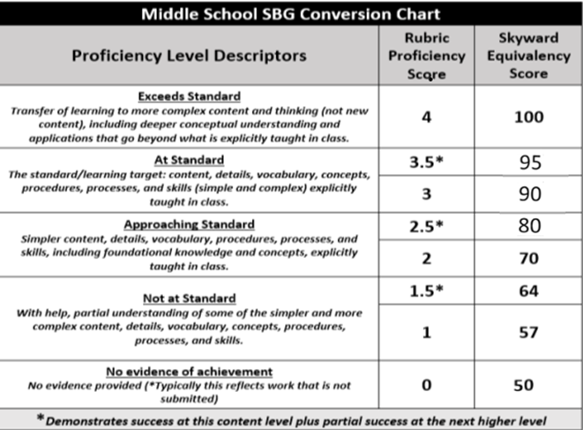
Grading Practices & Homework Expectations
Students need to complete their homework on time. Retakes for major assessments are available provided all unit coursework is turned in and completed prior to the assessment.
Notes:
Grading practices (again, 2-4 highlights of need to know info)

Slide 7
How you can help your child be successful in LA/SS
Help your student build an organizational routine at home such as charging their laptop, checking their agenda, and preparing for the next school day.
Check Skyward for grade progress every two weeks and encourage your student to seek extra help during FLEX.
Encourage students to advocate for themselves by communicating directly with their teacher for help.
Celebrate effort and improvement, not just performance, to build confidence.
Promote daily reading at home to build fluency, vocabulary, and comprehension.

