Slide 1

OXNARD SCHOOL DISTRICT
Ramona Elementary School Update
Board of Trustees | September 23, 2026
Notes:
Sources and internal basis:
Update following prior Board report.

Slide 2
RAMONA ELEMENTARY SCHOOL
Tonight’s update:
1. Interim planning
Review the options, community and staff input
2. Long-term choice
Process for decision making
Notes:
Sources and internal basis:
Prior Board report covered consultant findings and relocation status. Current update focuses on ROM pricing and options.

Slide 3
RAMONA ELEMENTARY SCHOOL
Interim planning is necessary
The District needs a mid-term student-location strategy while repair or rebuild proceeds.
Notes:
Sources and internal basis:
Planning basis: TK/K at Ramona with portables; move Juanita 6-8 to Frank; return Ramona 1st/2nd closer to the neighborhood by placing them at Juanita. Reboundary discussion intentionally omitted.

Slide 4
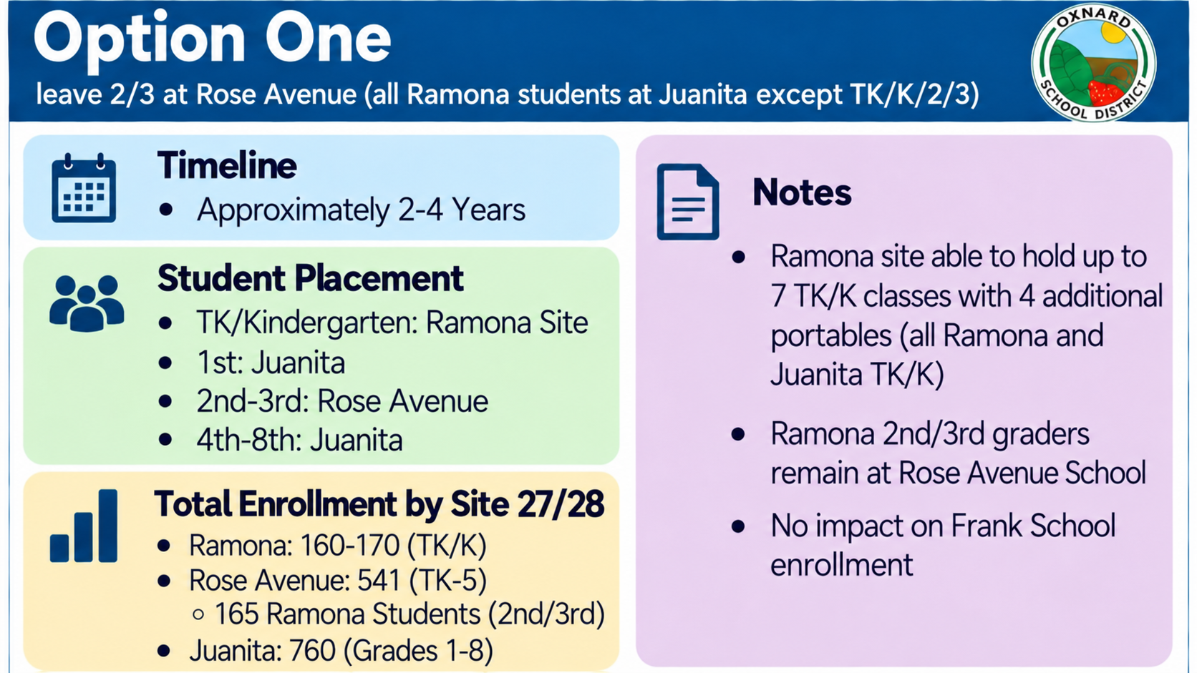

Slide 5
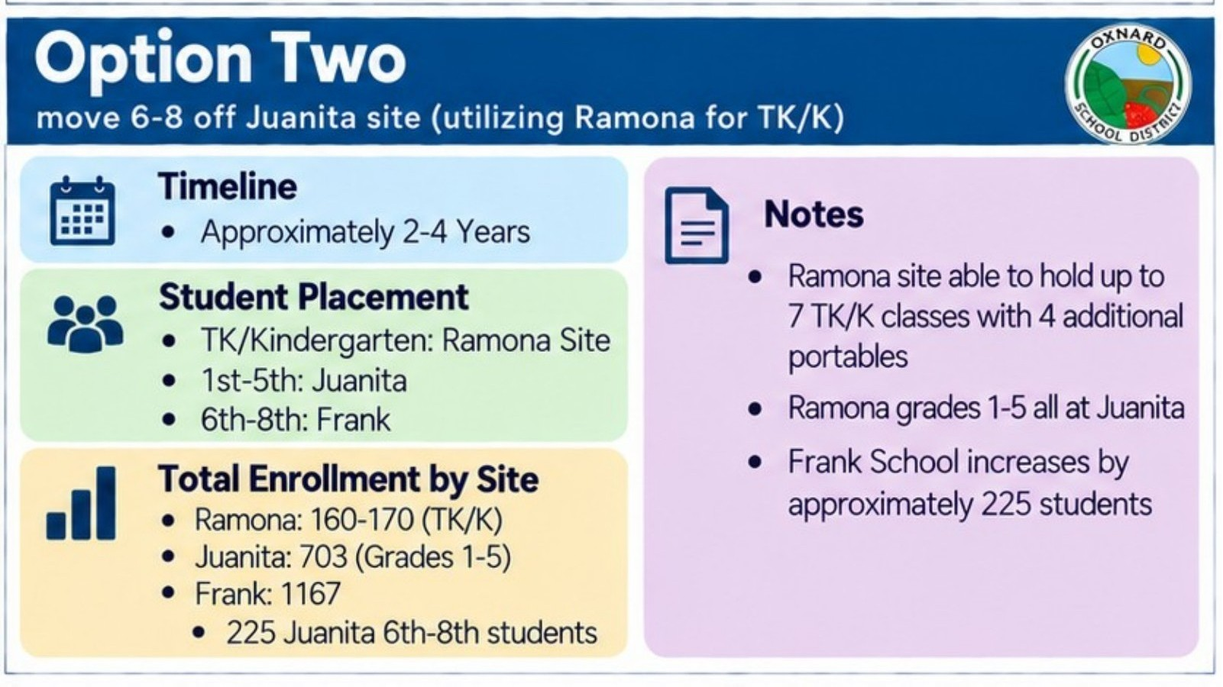

Slide 6
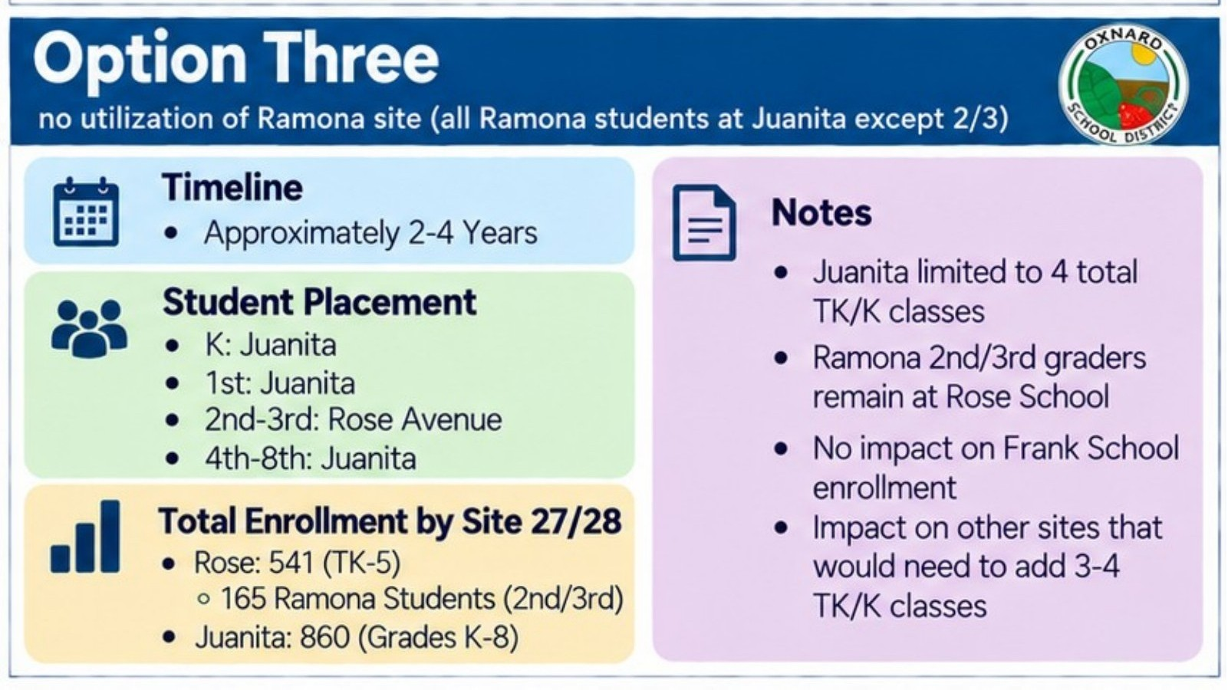
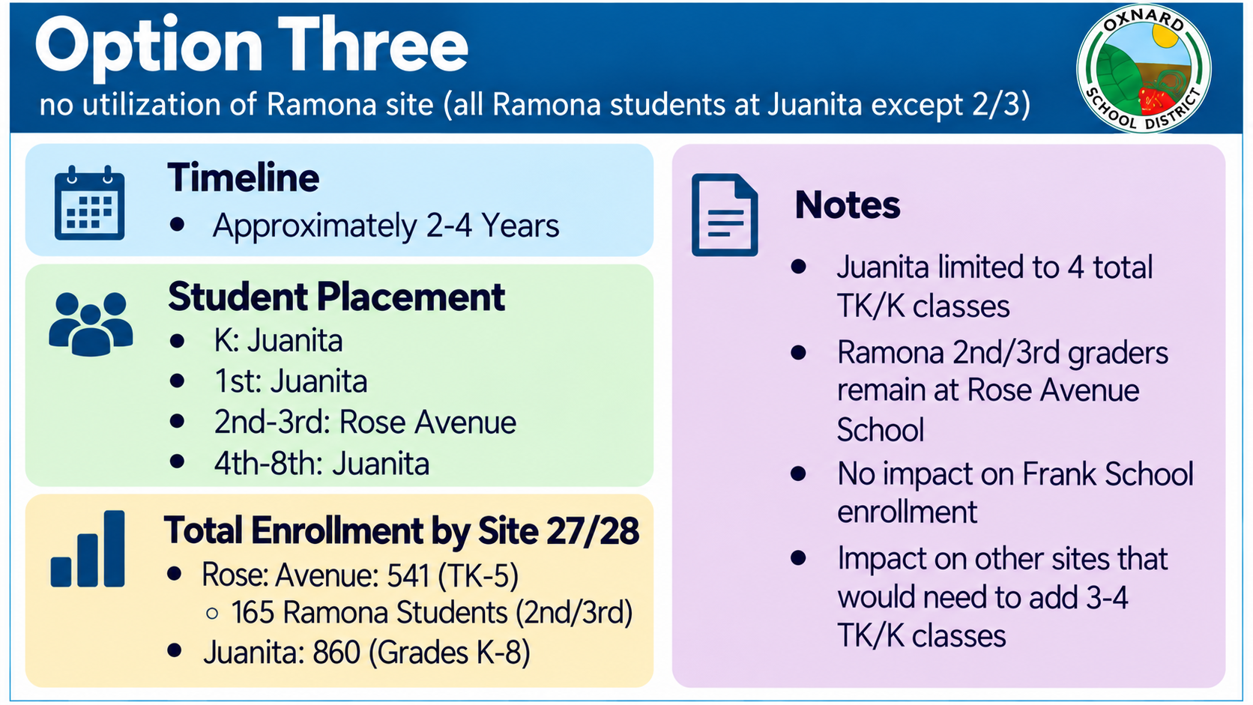

Slide 7
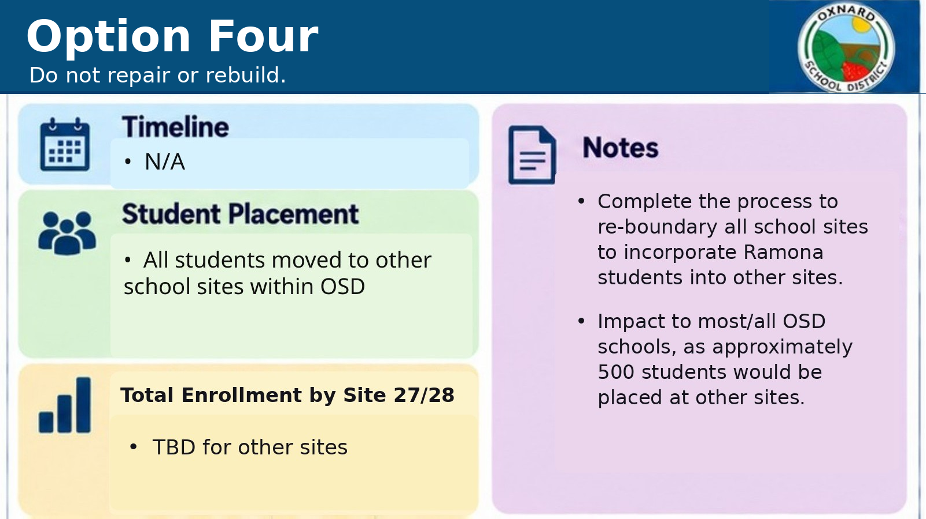

Slide 8
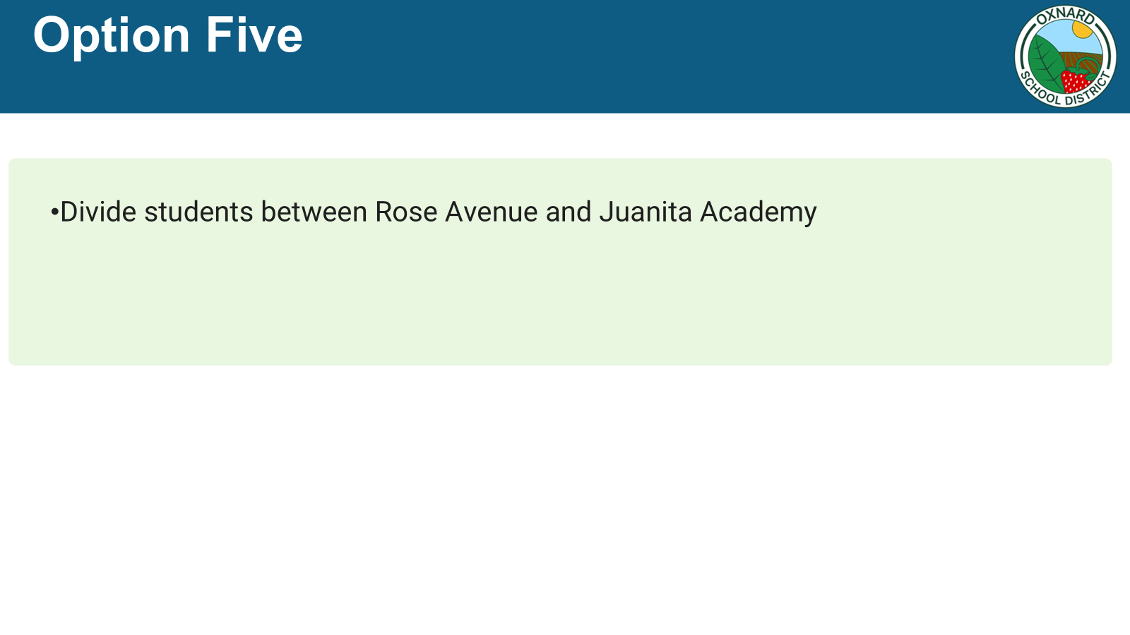

Slide 9




Option Six
Move 6-8 off Juanita
Timeline
Notes
• Approximately 2-4 years
• Juanita 6 additional TK/K classes with addition of 4 portables and use of locker rooms
Ramona grade 1-5 at Juanita
• Frank School increases by approximately 225 students
Student Placement
• TK/Kindergarten: Juanita Site
1st-5th: Juanita
6th – 8th: Frank
Total Enrollment by Site 27/28
• Juanita: 873 (TK – 5)
Frank: 1167
  225 Juanita 6th – 8th Students

Slide 10
RAMONA ELEMENTARY SCHOOL
Staff and Community Communication
Sept 17
Staff & Parent Meetings held
Sept 18
Surveys sent for Ramona staff and families
Sept 21
Survey support for families at Juanita MPR
Sept 23
Special Board Meeting participation encouraged
Survey input closes on September 22
Notes:
Sources and internal basis:
NAC schedule for portables: September 2026 decision to target August 2027, with 2 months design, 2 months DSA, 2 months bidding, and 4 months construction/CA. Lease-based cost estimate is a planning assumption pending actual quote.

Slide 11
IMPACTED SCHOOLS – JUANITA, ROSE AND FRANK
Staff and Community Communication
By Sept 22
Staff & Parent Meetings held
Sept 18
Surveys sent for impacted schools staff and families
Sept 22
Community Zoom Meeting for impacted schools
Sept 23
Special Board Meeting participation encouraged
Survey input closes on September 22
Notes:
Sources and internal basis:
NAC schedule for portables: September 2026 decision to target August 2027, with 2 months design, 2 months DSA, 2 months bidding, and 4 months construction/CA. Lease-based cost estimate is a planning assumption pending actual quote.

Slide 12
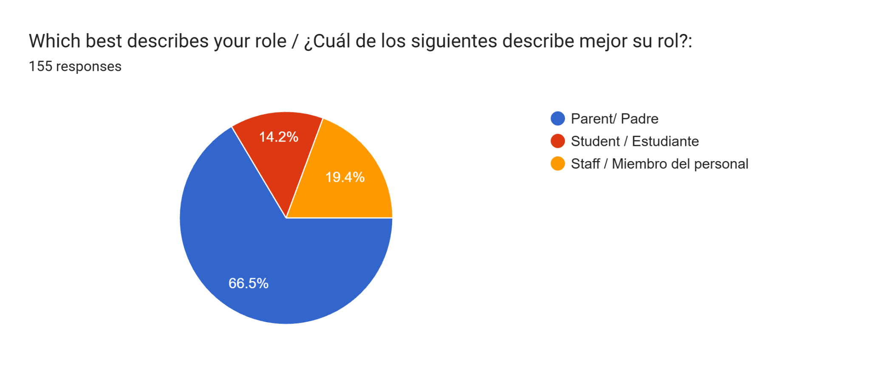
RAMONA ELEMENTARY SCHOOL
Survey results – Ramona Community
Notes:
Sources and internal basis:
Planning basis: TK/K at Ramona with portables; move Juanita 6-8 to Frank; return Ramona 1st/2nd closer to the neighborhood by placing them at Juanita. Reboundary discussion intentionally omitted.

Slide 13
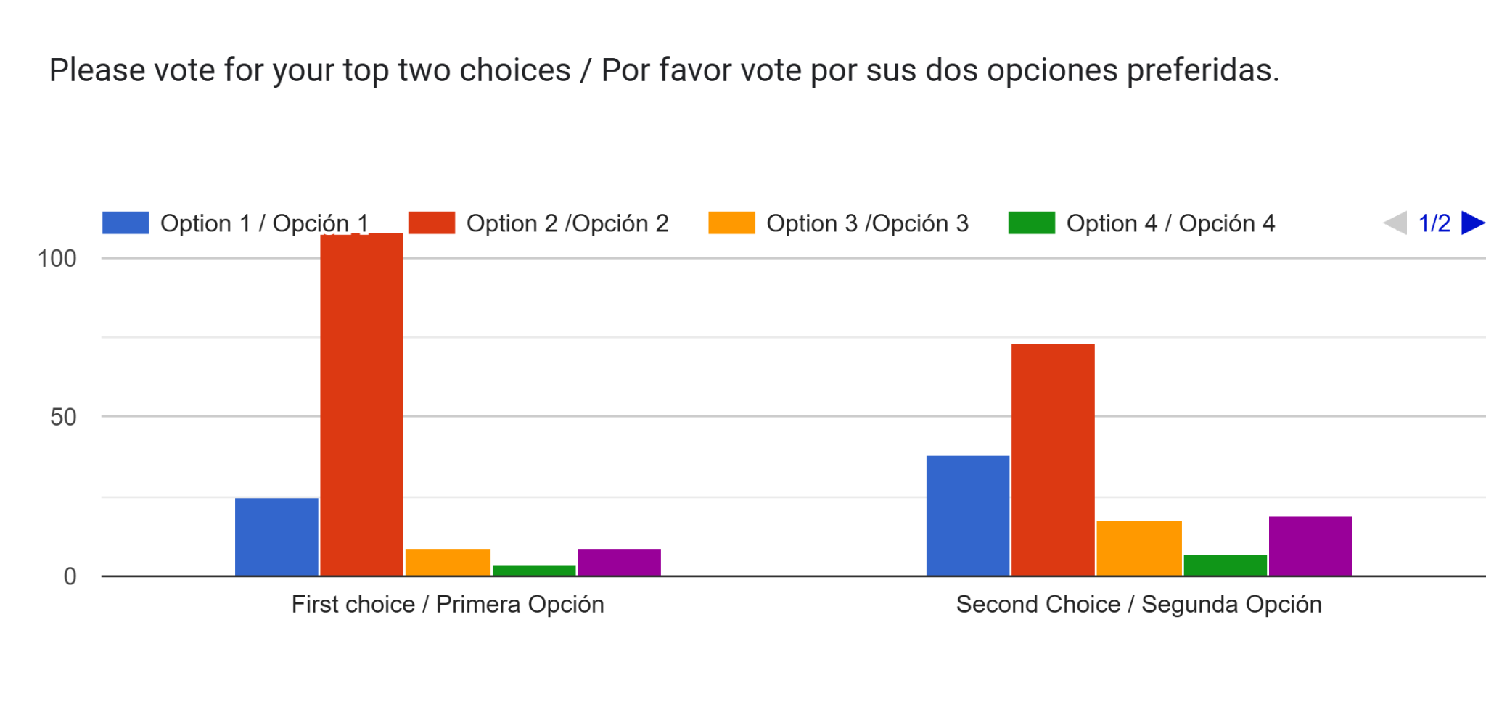
RAMONA ELEMENTARY SCHOOL
Survey results – Ramona Community
Notes:
Sources and internal basis:
Planning basis: TK/K at Ramona with portables; move Juanita 6-8 to Frank; return Ramona 1st/2nd closer to the neighborhood by placing them at Juanita. Reboundary discussion intentionally omitted.

Slide 14
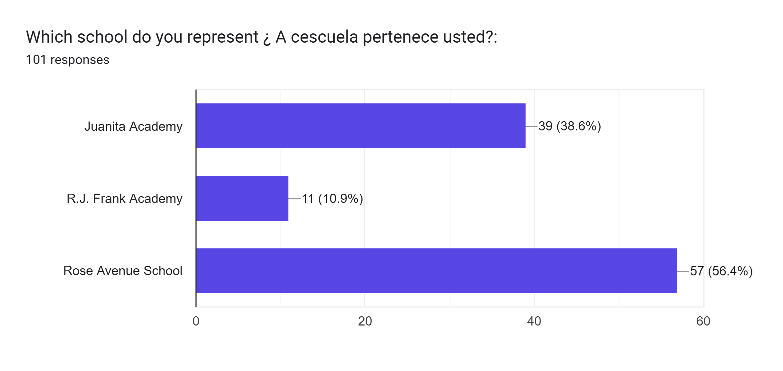
RAMONA ELEMENTARY SCHOOL
Survey results – Juanita, Rose Avenue and Frank Communities
Notes:
Sources and internal basis:
Planning basis: TK/K at Ramona with portables; move Juanita 6-8 to Frank; return Ramona 1st/2nd closer to the neighborhood by placing them at Juanita. Reboundary discussion intentionally omitted.

Slide 15
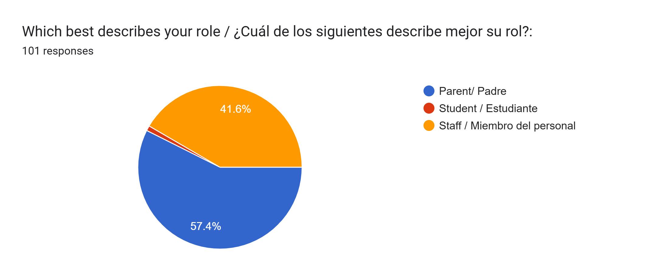
RAMONA ELEMENTARY SCHOOL
Survey results – Juanita, Rose Avenue and Frank Communities
Notes:
Sources and internal basis:
Planning basis: TK/K at Ramona with portables; move Juanita 6-8 to Frank; return Ramona 1st/2nd closer to the neighborhood by placing them at Juanita. Reboundary discussion intentionally omitted.

Slide 16
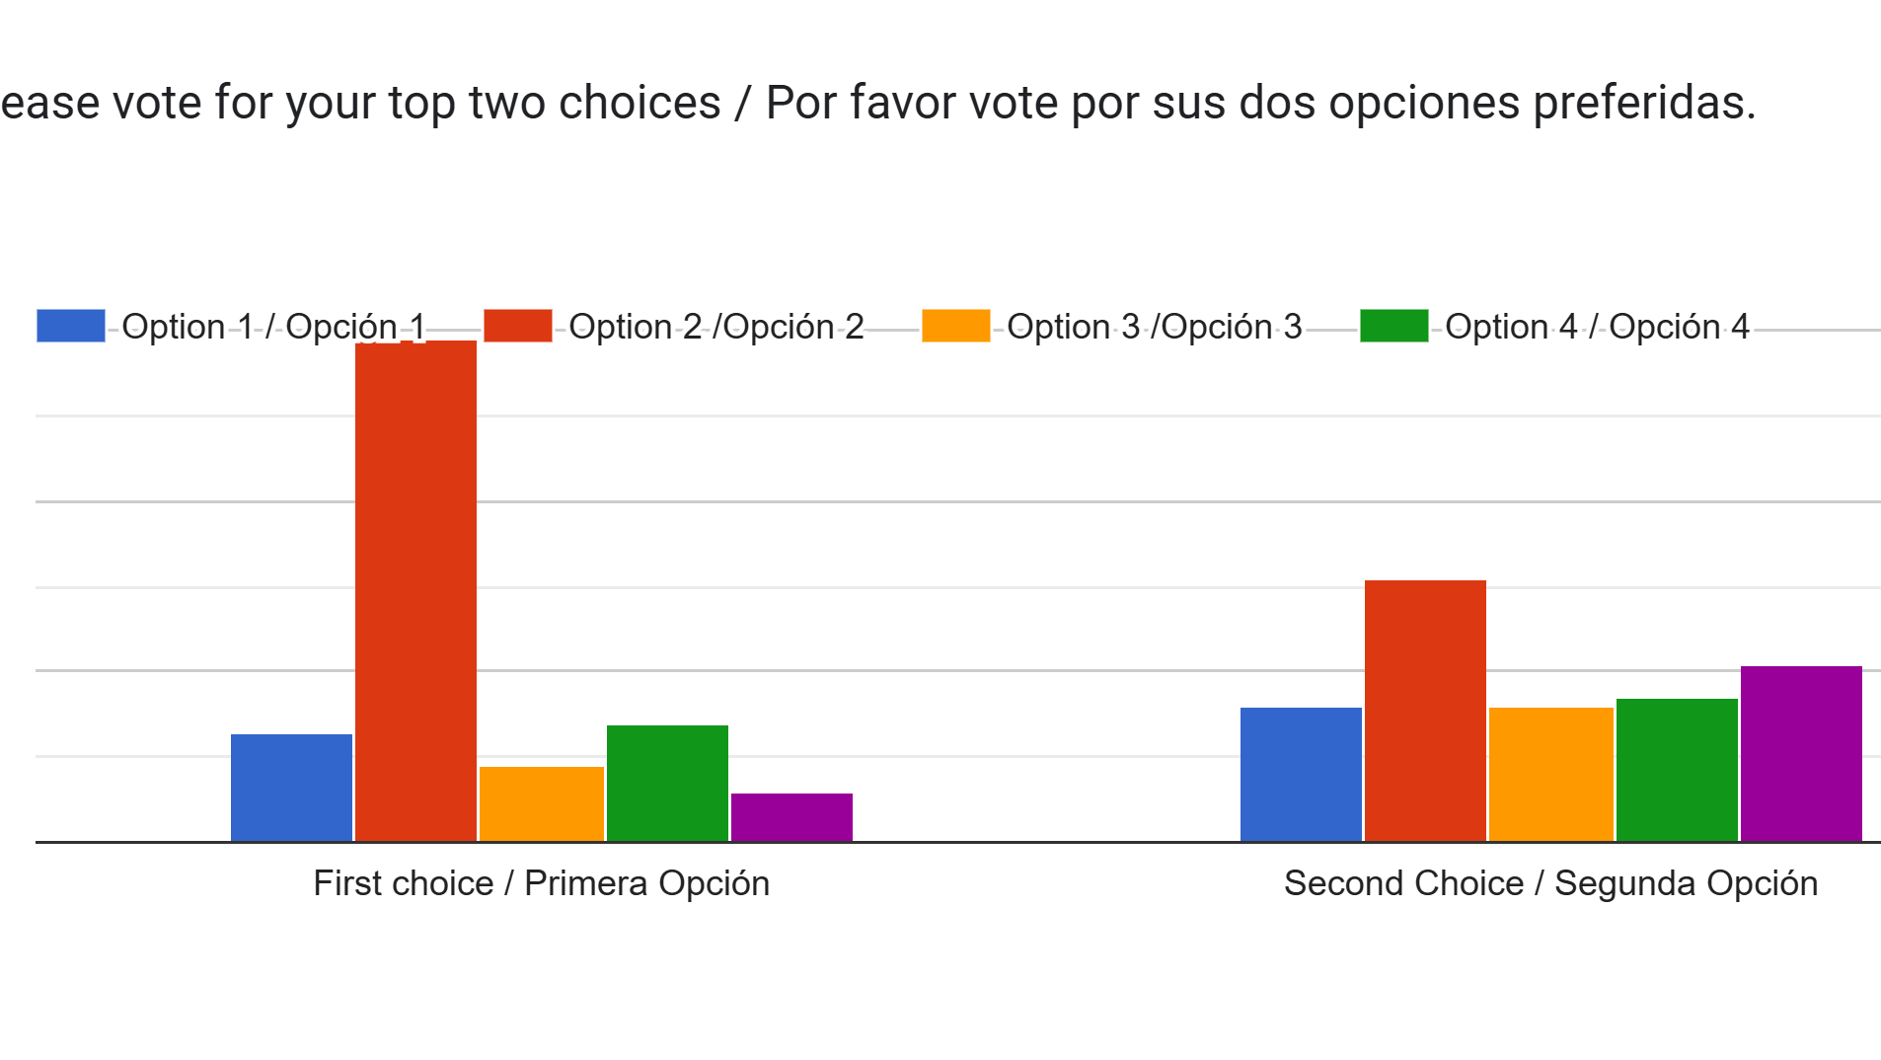
RAMONA ELEMENTARY SCHOOL
Survey results – Juanita, Rose Avenue and Frank Communities
Notes:
Sources and internal basis:
Planning basis: TK/K at Ramona with portables; move Juanita 6-8 to Frank; return Ramona 1st/2nd closer to the neighborhood by placing them at Juanita. Reboundary discussion intentionally omitted.

Slide 17
RAMONA ELEMENTARY SCHOOL
TK/K portable option: timing and cost range
2 mo.
Design
2 mo.
DSA
2 mo.
Bid
4 mo.
Construct
Fall 2027 feasible if the District starts now.
Lease-based planning range: ~$2.2M to ~$4.1M
Purchase-based planning range: ~$2.7M to ~$4.6M
Notes:
Sources and internal basis:
NAC schedule for portables: September 2026 decision to target August 2027, with 2 months design, 2 months DSA, 2 months bidding, and 4 months construction/CA. Lease-based cost estimate is a planning assumption pending actual quote.

Slide 18
Tasks completed since last board meeting:
1. Structural review of Ramona TK/K buildings and portables
Determined to be sound
2. Hygienist testing of Ramona TK/K buildings and portables
Tested on September 17, results expected on September 21

Slide 19
RAMONA ELEMENTARY SCHOOL
Long-term choice: repair or rebuild
Repair*
~26 months
~$18M+
Keeps aging modular buildings
Rebuild
~34–42 months
$45M - $50M
New useful life
*Repair is unusual at this scale: major cost, DSA rehabilitation, and continued use of older modular buildings.
Notes:
Sources and internal basis:
Planning basis: repair cost approaches a major share of replacement value while retaining older modular buildings.

Slide 20
RAMONA ELEMENTARY SCHOOL
Decisions
1. TK/K portable award architect contract
2. Evaluate current master plan
3. Repair or rebuild
Design
DSA review
Bidding
Construction
Notes:
Sources and internal basis:
Planning basis: distinguish long-term campus direction from mid-term student-location strategy and implementation commitments.

Slide 21
RAMONA ELEMENTARY SCHOOL
Questions???
Notes:
Sources and internal basis:
Planning basis: distinguish long-term campus direction from mid-term student-location strategy and implementation commitments.

