Slide 1

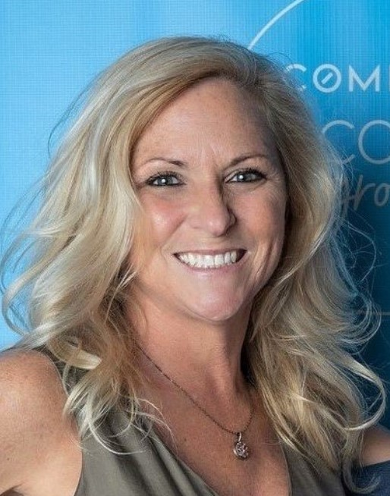

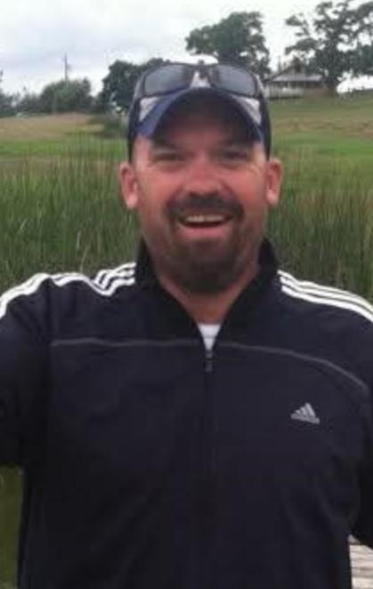

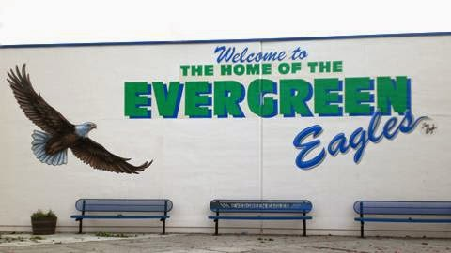
Mr. Hecker
Ms. Blackburn
Ms. Kesler
Mr. McMurtry
8th Grade
Language Arts
and Social Studies

Slide 2
Teacher Contact Info
mailto:sjackson@lwsd.org
You can reach any of us on Parent Square. Students may contact on following emails:
  Val Blackburn vblackburn@lwsd.org
  Nicole Kesler nkesler@lwsd.org
  Kyle McMurtry kmcmurtry@lwsd.org
  Nick Hecker nhecker@lwsd.org

Slide 3



8th grade Language Arts
Reading, Writing, Speaking & Listening
Amplify- Digital Curriculum
Various Short Stories, Poems, Dramas
Frankenstein by Gris Grimly
Whole Class Novels
  May include: The Game, To Kill a Mockingbird, Of Beetles & Angels, The Hotel on the Corner of Bitter and Sweet, All But My Life
Independent Reading Selections
Literature Circles
Literary Analysis
In-Text Citations & Analysis

Slide 4





8th grade Social Studies
Study of Washington State & American History
  Who?
  What?
  When?
  Where?
  Why?/How?
  So What?
  Geography Skills
  Primary Source analysis
Current Events with New York Times UpFront Magazine

Slide 5



Required supplies
Students should have their laptops fully charged for each class.
Students should always have an independent reading selection with them.
Students need to have their basic school supplies including:
  Pencil
  Highlighter
  Pen
  Lined paper and/or history notebook
  A thin folder/binder area to keep documents

Slide 6
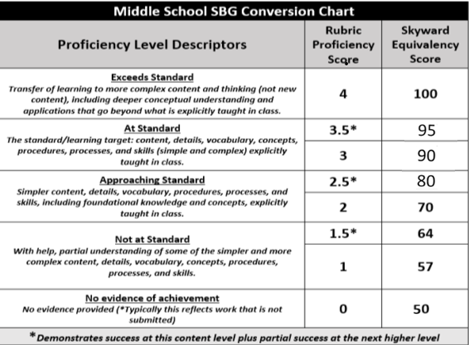
Grading Practices & Homework Expectations
Students need to complete their homework on time. Retakes for major assessments are available provided all unit coursework is turned in and completed prior to the assessment.
Notes:
Grading practices (again, 2-4 highlights of need to know info)

Slide 7
How you can help your child be successful in Language Arts and
Social Studies
Help your student build an organizational routine at home such as charging their laptop, checking their agenda, and preparing for the next school day.
Check Skyward for grade progress every two weeks and encourage your student to seek extra help during FLEX.
Encourage students to advocate for themselves by communicating directly with their teacher for help.
Celebrate effort and improvement, not just performance, to build confidence.
Promote daily reading at home to build fluency, vocabulary, and comprehension.

