Slide 1
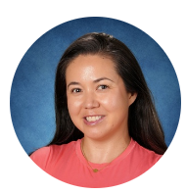
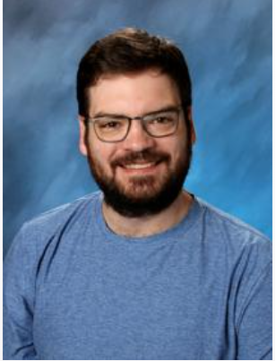
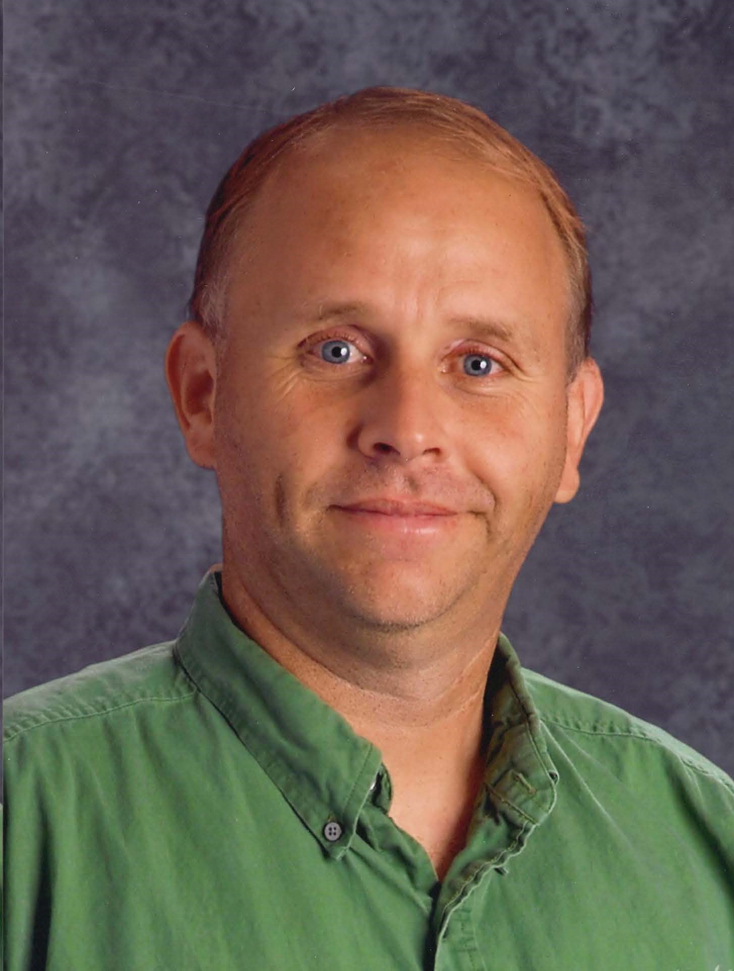
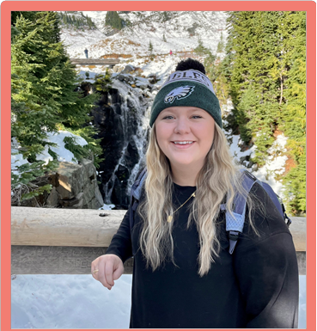


Ms. McClead
Mr. Shannon
Mr. Compton
Ms. Madden
6th Grade Language Arts and Social Studies

Slide 2
Teacher Contact Info
You can reach any of us on Parent Square. Students may contact on following emails:
  Dan Compton dcompton@lwsd.org
  Madisson Madden mmadden@lwsd.org
  Iris McClead imcclead@lwsd.org
  Lucas Shannon lshannon@lwsd.org

Slide 3
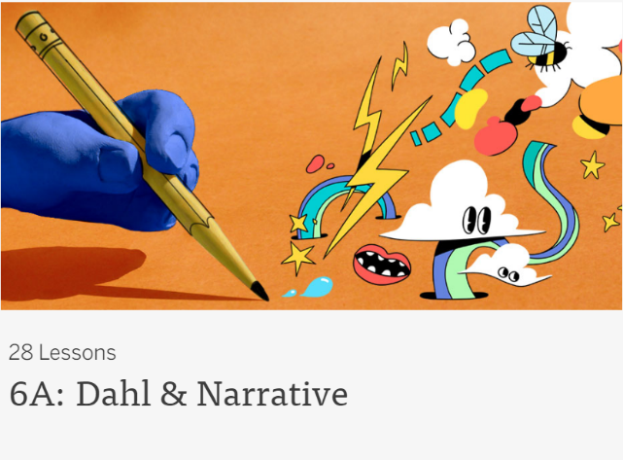

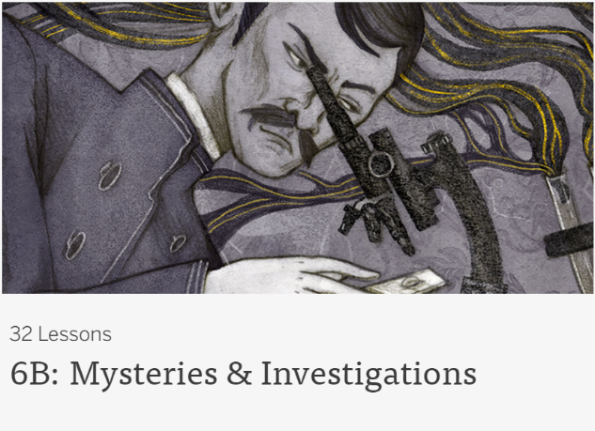

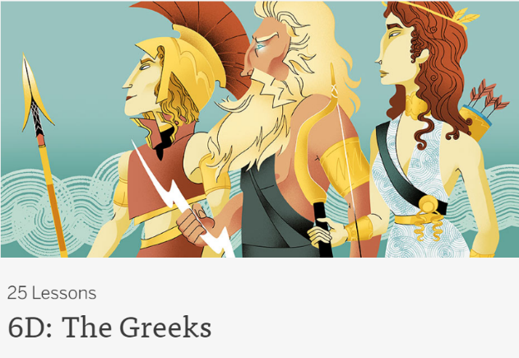
6th grade Language Arts
Reading, Writing, Speaking & Listening
Amplify- Digital Curriculum
Various Short Stories, Poems, Dramas
Schooled by Gordon Korman
The Giver by Lois Lowry
Independent Reading Selections
Literary Elements
In-Text Citations & Analysis

Slide 4

6th grade Social Studies
Hunters/gatherers to civilizations
Ancient Mesopotamia (Sumer)
Ancient Egypt
Ancient Greece
Ancient China
Ancient Mesoamerica
Ancient Rome - Quest
Exploration of Ancient Civilizations answering the questions
  Who?
  What?
  When?
  Where?
  Why?/How?
  So What?
Current Events with Junior Scholastic*

Slide 5



Required supplies
Students should have their laptops fully charged for each class.
Students should always have an independent reading selection with them.
Students need to have their basic school supplies including:
  Pencil
  Highlighter
  Pen
  Lined paper
  A thin folder

Slide 6
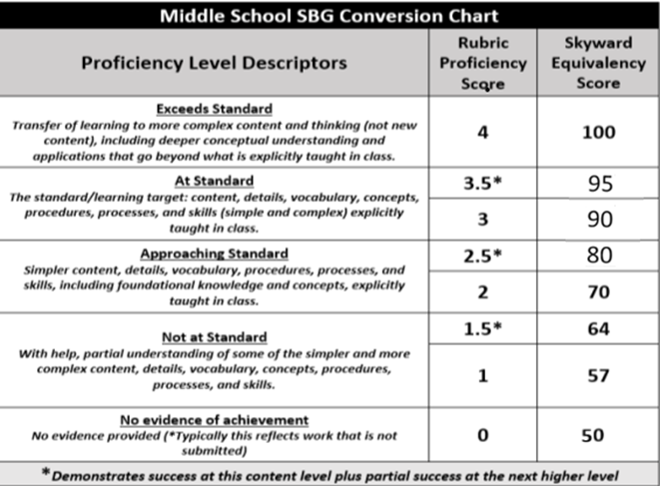
Grading Practices & Homework Expectations
Students need to complete their homework on time. Retakes for major assessments are available provided all unit coursework is turned in and completed prior to the assessment. In Quest, the maximum score increase for a retake is 85 percent . In Gen Ed, it is a 90 percent.
Notes:
Grading practices (again, 2-4 highlights of need to know info)

Slide 7
How you can help your child be successful in LA/SS
Help your student build an organizational routine at home such as charging their laptop, checking their agenda, and preparing for the next school day.
Check Skyward for grade progress every two weeks and encourage your student to seek extra help during FLEX.
Encourage students to advocate for themselves by communicating directly with their teacher for help.
Celebrate effort and improvement, not just performance, to build confidence.
Promote daily reading at home to build fluency, vocabulary, and comprehension.

