Slide 1
Getting Ready to Apply
Public University Admissions – Common Processes

Slide 2
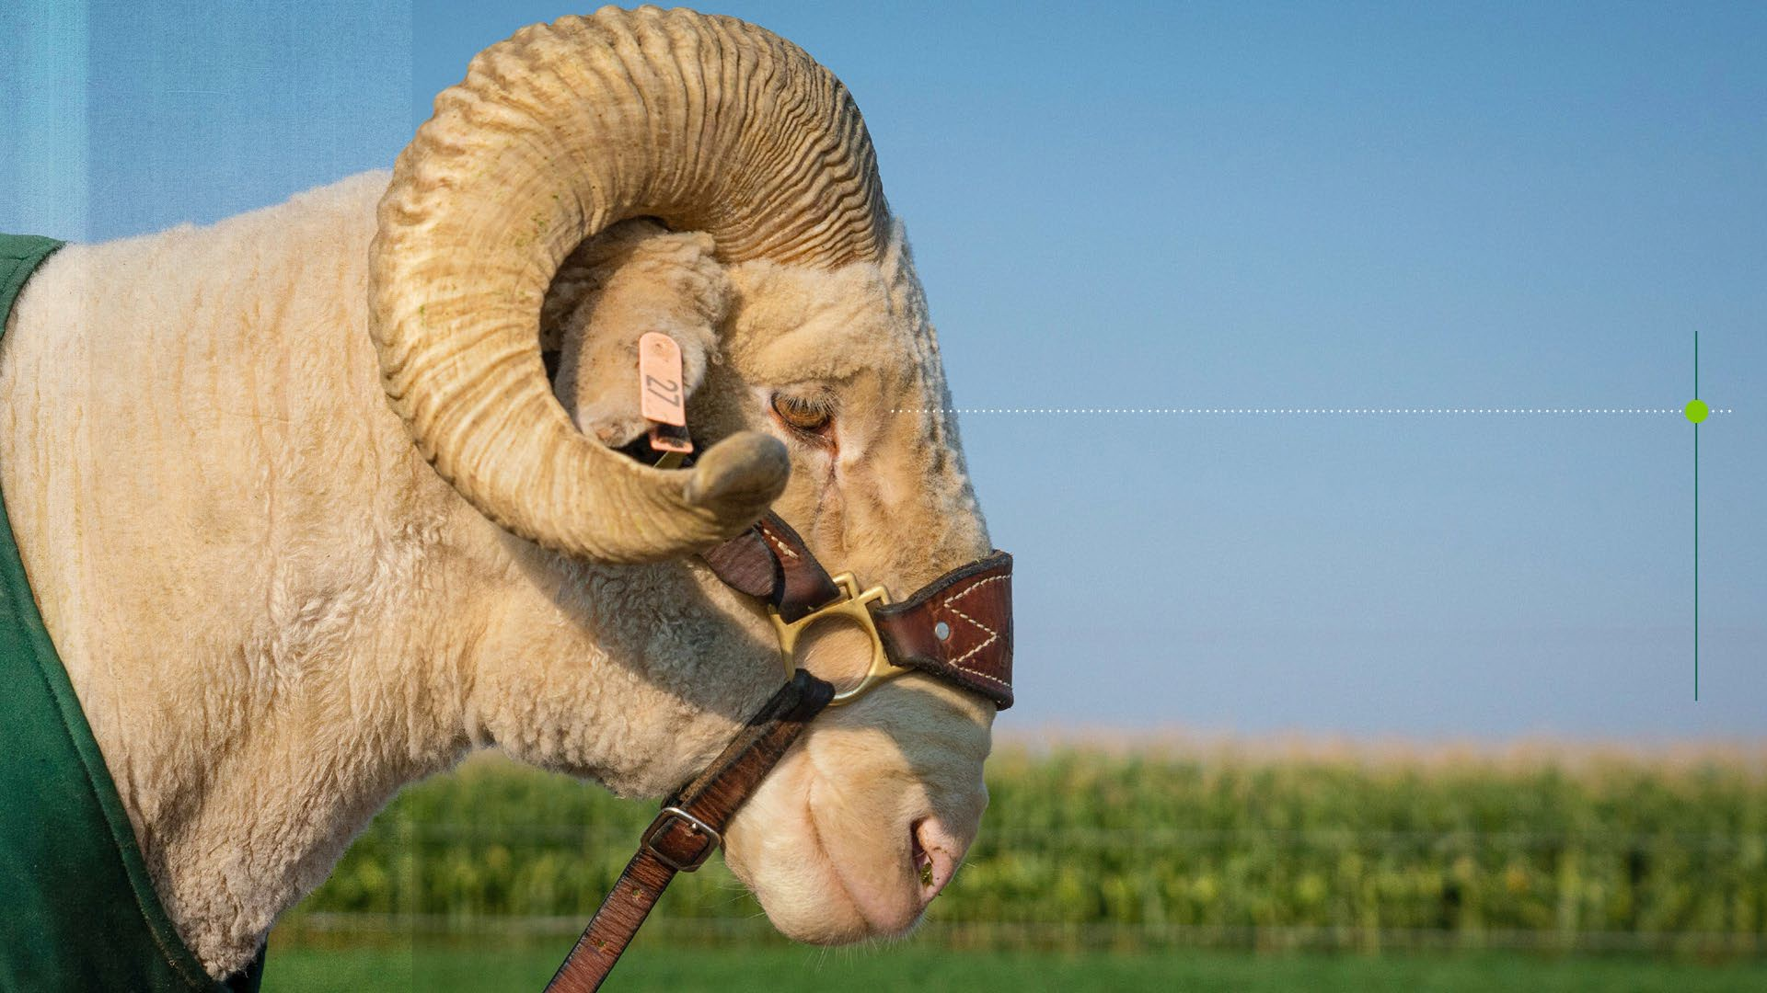

Theresa Figuerado
Office of Admissions
Theresa.figueradomalay @colostate.edu 970-491-5217

Slide 3


Agenda
Admissions "jargon"
What schools need
What schools consider
Senior Year Timeline
Questions

Slide 4
Admissions "Jargon"

Slide 5
"AP/IB/Dual Enrollment"
academic preparedness
college credits

Slide 6
"Rigor"
Higher Education Admission Requirements (HEAR)
Types of courses (e.g., AP, IB, honors)
Number and/or sequencing of courses

Slide 7
"Grade Trends"
Performance in course work over time
Performance in course work by subject

Slide 8
"Holistic"
Holistic admissions review takes into account a student's interests, passions, special talents, personality, background/experiences and academic preparedness.

Slide 9

"Early Action" vs. "Early Decision" vs. "Rolling Admission"
Early Action:
Non-binding
Early Decision:
Binding
Rolling Admission: Decisions are rendered on an ongoing basis as applications become complete.
+ receive early notification of an admission decision
+ allows more time to prepare for the transition from high school to college
+ apply to and compare financial aid offers from other schools
Reply Date Admission: Decisions are pooled and released all at one time.
- cannot compare financial aid offers

Slide 10



What Schools Need
Presenter Notes
2025-09-16 11:07:35
--------------------------------------------
Common App (overview)
How many schools in CO use CA? 14
$25-$80 range
Free app Days (all 32 public institutions in CO participate; all 4 years do) CSU is free always
Essay (some require 1; some require 2...Common App will tell your during supplemental portion) Recs (school based; what does CSU require)
Check with you schools
Test optional (scholarships may require them)
Application for Admission
Application Fee/Fee Waiver
Official Transcripts
Personal Statement /Essay
ACT and/or SAT Scores
Recommendation(s)

Slide 11
What Schools Consider
Presenter Notes
2025-09-16 11:07:35
--------------------------------------------
DI – large state schools may not, but it is sort of an unwritten rule that private/more selective instituitons
Academic Factors
Course Rigor
Course Performance
Preparation for Major
Test Scores
College Credits
Demonstrated Interest
Talking with Admissions Counselor
Attending admission
Personal Factors
Personal Statement
Recommendation(s)
Other supporting
events
documents
Optional Interviews
There are many ways to
do this!

Slide 12

Senior Year Timeline
Fall Semester

Slide 13

Senior Year Timeline
Spring Semester

Slide 14

Resources
High School Counselors
College Board
  CollegeBoard.org
Colorado Council on High School/College Relations (CCHS/CR)
  ColoradoCouncil.org
Colorado Collegiate Handbook
  ColoradoCouncil.org/handbooks
Colorado Department of Higher Education (CDHE)
College Admissions Representatives

Slide 15
Questions?
Presenter Notes
2025-09-16 11:07:37
--------------------------------------------
History of Common App Accepted by over 1000 schools
Some schools are common app only, some have multiple ways to apply Use experts in the room!
Scholarships? Dual Enrollment
How to transfer the credits?
GT credits (Guaranteed Transfer)
Make sure you take/prioritze these; they have already been vetted Weighted GPA
Taking exams to get credits
Clarification on early action/early decision/rolling Work with counselor (legally binding, etc.) Resources
Jobs on campus – what csu does Student disability center?
Tutoring Services
Family Office (Family Programs)
Financial Aid Questions – colleges office (plug The Hub) Pros and Cons of 2yr vs 4 yr
Individual selection Personal goals/needs
Fit for you and your family

Slide 16


Thank you!
C O L O RA DO S TATE U N I VE R S I TY
Theresa Figuerado
Office of Admissions
Theresa.figueradomalay@colostate.edu
970-491-0533

