Slide 1
Curriculum Night
Math 7+
Mr. Erne

Slide 2
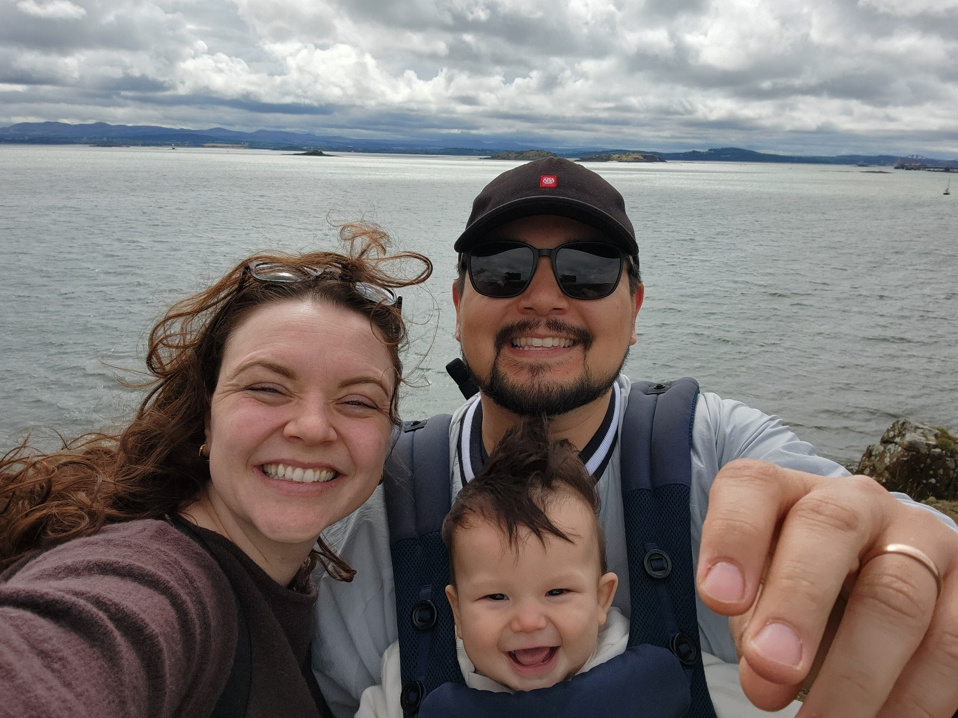
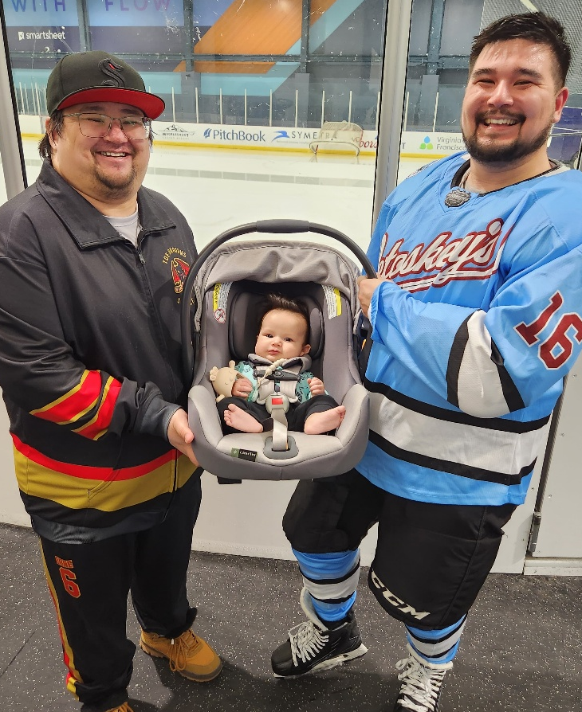

About Mr. Erne
Seattle Pacific University (Bachelors)
Western Governors University (Masters)
First Year Teaching!
Served 6 years in the Army National Guard
Worked as an Electrical Engineer for 7.5
years.
3.5 years with the US Navy and 3 years with Boeing
I have a 9 month old son
In my free time, I love spending time with my family or playing Ice Hockey

Slide 3

Math 7+ Curriculum
Amplify Desmos Math
Students have online access through ClassLink
Lessons include digitally interactive and visual tools.
Practices may be assigned online or on paper depending on the lesson.

Slide 4
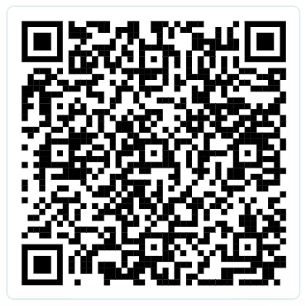
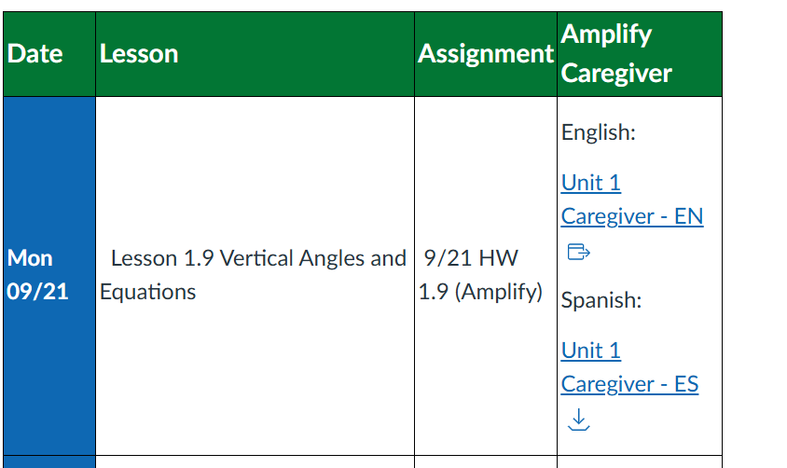
Amplify Caregiver Hub
Unit specific support that includes a summary, glossary, and worked examples. Can be found here
Posted on CANVAS as well in the Week at a Glance
Click on Accelerated 7

Slide 5
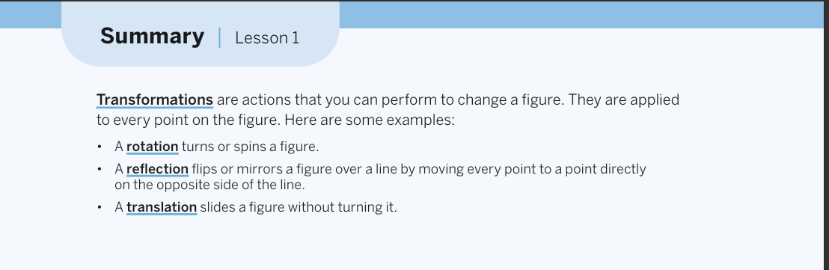
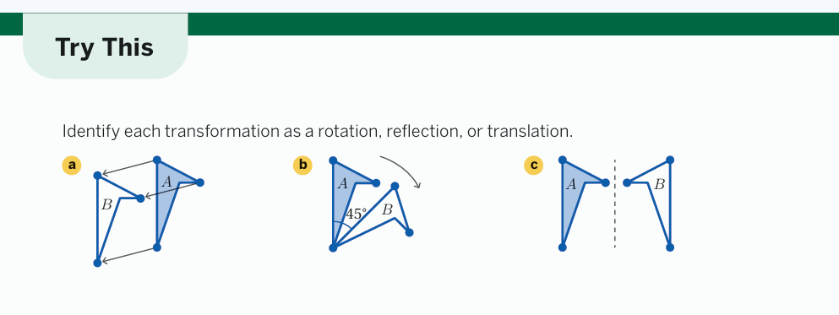

Slide 6
Course Grading
Summative Assessments 90 %
Formative Assessments 5%
Major Assignment 5%
Practice 0%
Assessments– assess knowledge gained at the end of each unit or series of lessons. Students may retake any assessment if they got below an 80% to get up to an 80%. Cannot be missing homework and will need to do a review packet.
Amplify HW assignments and Projects- Graded based on score. Go in MJR Category
Practice– Graded on completion go in 0% most of the time.
Refer to the course syllabus for further details
(sent through ParentSquare and posted on Canvas)

Slide 7
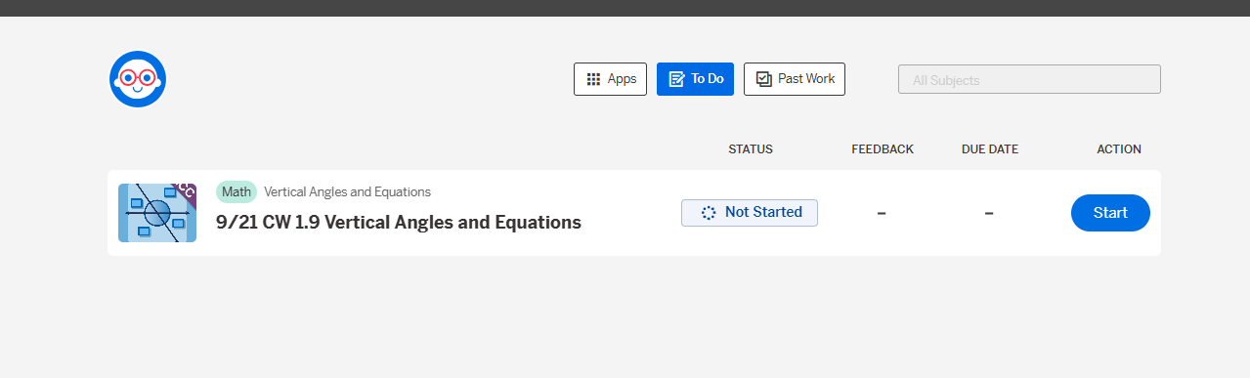
Assignments
Students will either complete assignments on Amplify if it is digital or if it is a worksheet will turn it in at class.
On Amplify, students will find the most current homework and classwork in the “To Do” folder.

Slide 8
Assignments
If it has been more than 5 days since it was assigned, students can find the homework/classwork in the “Past Work”.
Late work is fully accepted as long it is finished within the quarter given. If a student turns in late work or re-does the assignment, they need to email me with the name of the assignment and ask me to recheck it.

Slide 9
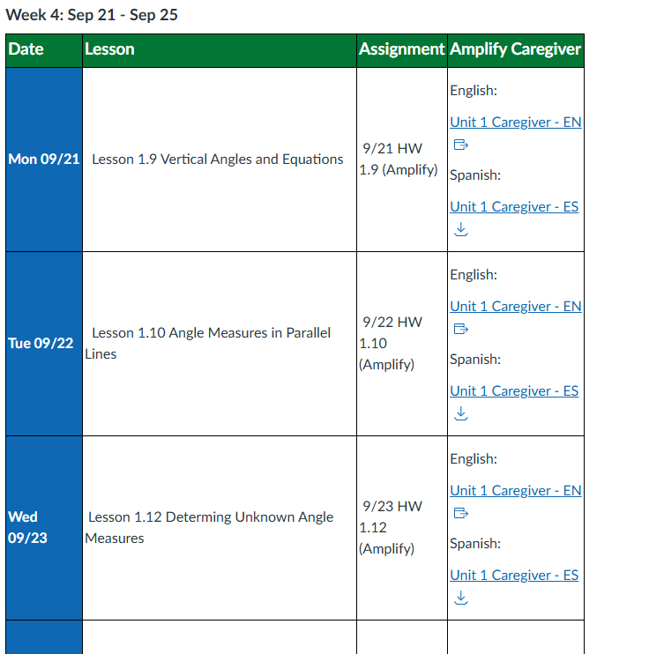
Canvas
All assignments are posted through Canvas.
There is the listed classwork and homework from each day.
The location of the assignment is listed as well.

Slide 10
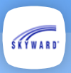
Skyward
Best place to check your students grades or homework completion is on Skyward.
Assignments are put into the gradebook two to three times a week.
*You can turn on email notifications missing assignments

Slide 11
How can parents help at home?
Monitor students as needed based on their personal work habits and independence level.
Student needs more of a challenge:
Math Club
Extension tasks or assignments
If you student is struggling:
Check skyward for missing assignments/assessment scores/grades
Check the Canvas Home Page​
Ask to see student’s work
Encourage students to seek help from the teacher when confused. Teachers are available during flex time.​
Contact the teacher if there is regular frustration or lack of understanding

Slide 12
Contact Information
Andrew Erne
aerne@lwsd.org
The best way to contact me is by email.

