Slide 1

Math 6+ Curriculum
Amplify Desmos Math
Students have online access through ClassLink
Lessons include digitally interactive and visual tools.
Practices may be assigned online or on paper depending on the lesson.

Slide 2
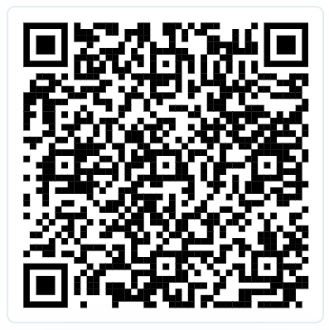
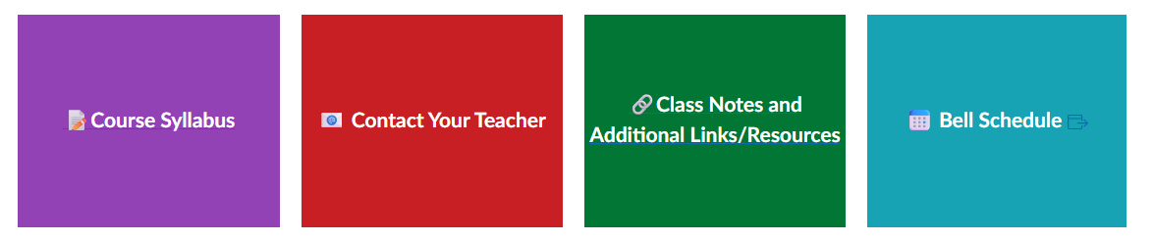
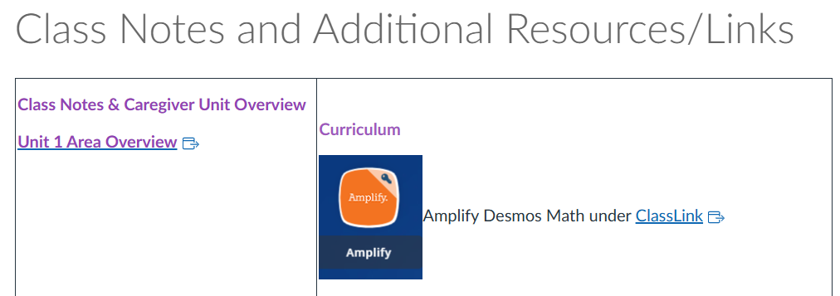
Amplify Caregiver Hub
Unit specific support that includes a summary, glossary, and worked examples. Can be found here
Posted on CANVAS as well under additional links
Click on Accelerated 6

Slide 3
Course Grading
Assessment (ASM) 95 %
Major Assignment (MJR) 5%
Practice (PRC) 0%
Assessments– assess knowledge gained at the end of each unit or series of lessons. Students may retake any assessment if they got below an 80% to get up to an 80%.
Check-ins–guide future instruction and serve as a short-term checkpoint of student understanding for both teacher and student. Does not count as a grade.
Practice– Graded on completion go in 0% most of the time.
Amplify HW assignments and Projects- Graded based on score. Go in MJR Category
Refer to the course syllabus for further details
(sent through ParentSquare and posted on Canvas)

Slide 4
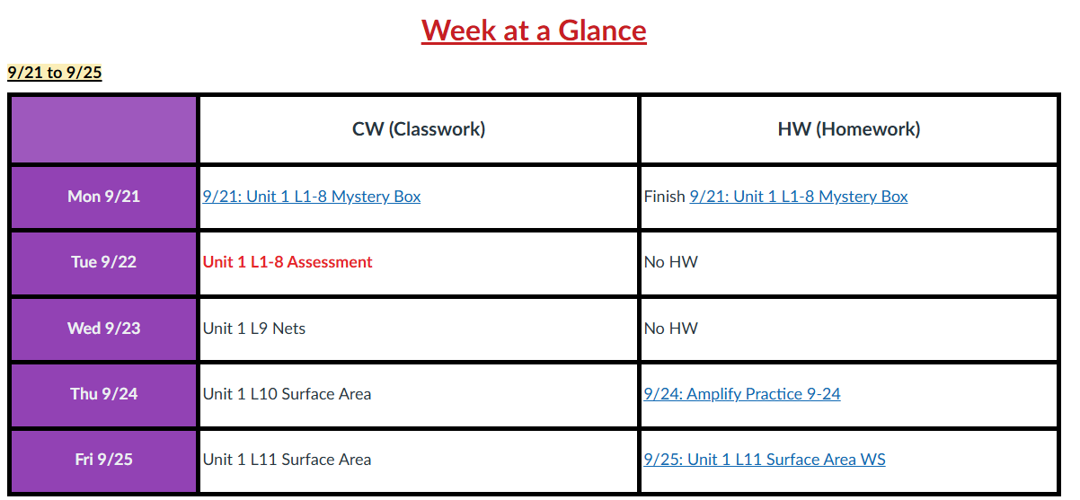
Canvas
All assignments are posted through Canvas.
The homepage has links to assignment information which may direct students to Amplify

Slide 5
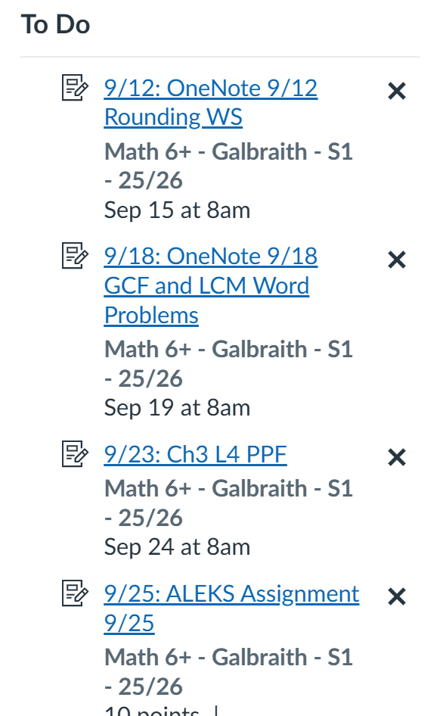
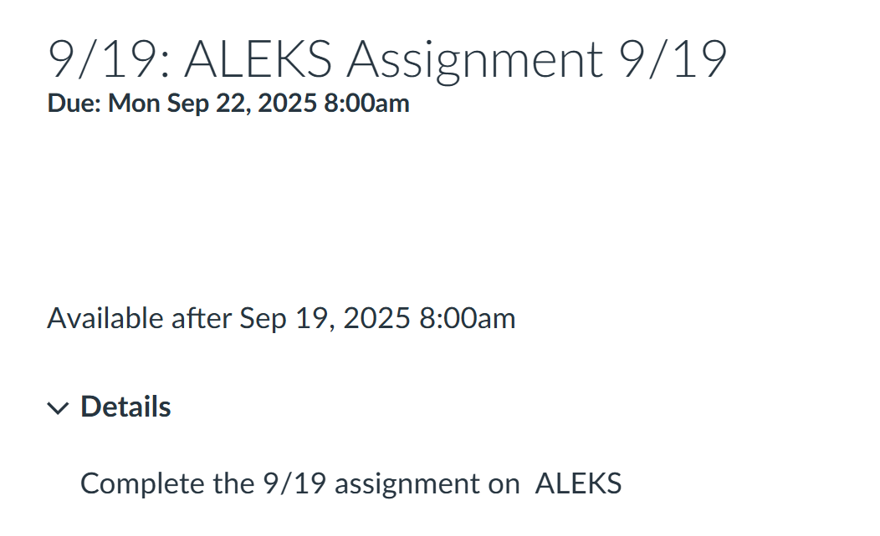
Assignments
Turning assignments in on Canvas means that the student clicked the “submit” button or clicked it off their to do list. It does not necessarily mean that the student fully completed the assignment. For grading, students and parents should check skyward.

Slide 6
Skyward
Click on the grade for detailed information
*You can turn on email notifications missing assignments

Slide 7
How can parents help at home?
Monitor students as needed based on their personal work habits and independence level.
Student needs more of a challenge:
Spicy Problems
Math Club
Extension tasks or assignments
If you student is struggling:
Check skyward for missing assignments/assessment scores/grades
Check the Canvas Home Page​
Ask to see student’s work on paper​
Encourage students to seek help from the teacher when confused. Teachers are available during flex time.​
Contact the teacher if there is regular frustration, lack of understanding, or anxiety.

Slide 8
Math Pathways
8th Grade
Math 6+
Math 7+
Algebra 1
Algebra 1
Geometry
7th Grade
6th Grade
Indicators for Algebra in 7th Grade:
A in Math 6+
Level 4 on SBA
On Track in FastBridge
Able to keep up with level of work in Math 6+ and more
Student interested in taking on challenges in class: Spicy Problems, Enrichment, Etc.

