Slide 1

About Mr. Lin
Education
Undergraduate at UW
  BS in Chemical Engineering
MA in Teaching
  WGU (Secondary Math)
Business Owner of a Test Preparation Site
  20 years Managing, Teaching, and Training
  Taught high school students SAT/ACT
  Chemistry, Calculus, Physics
Owner of 2 Design Patents
Website Designer/Builder
Hobbies: Building outdoor construction, working with coding and solar panels
Notes:
Welcome:
Tonight my focus will be on
Who I am
About the resoursces your child has access to

Slide 2
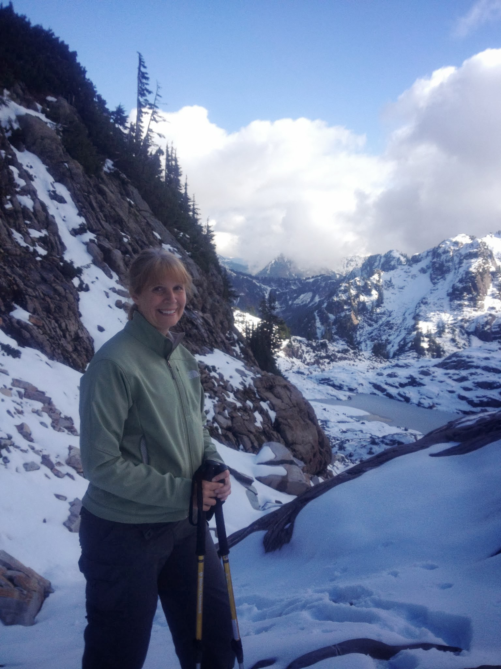
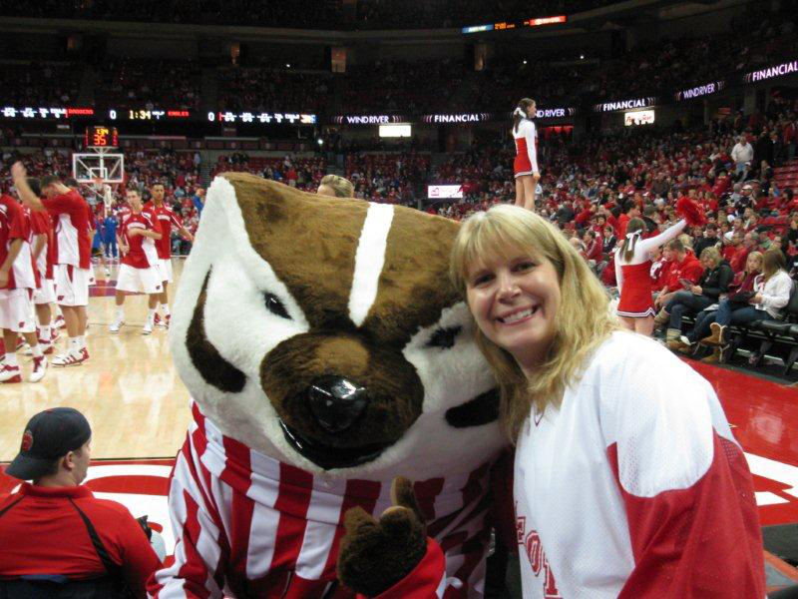

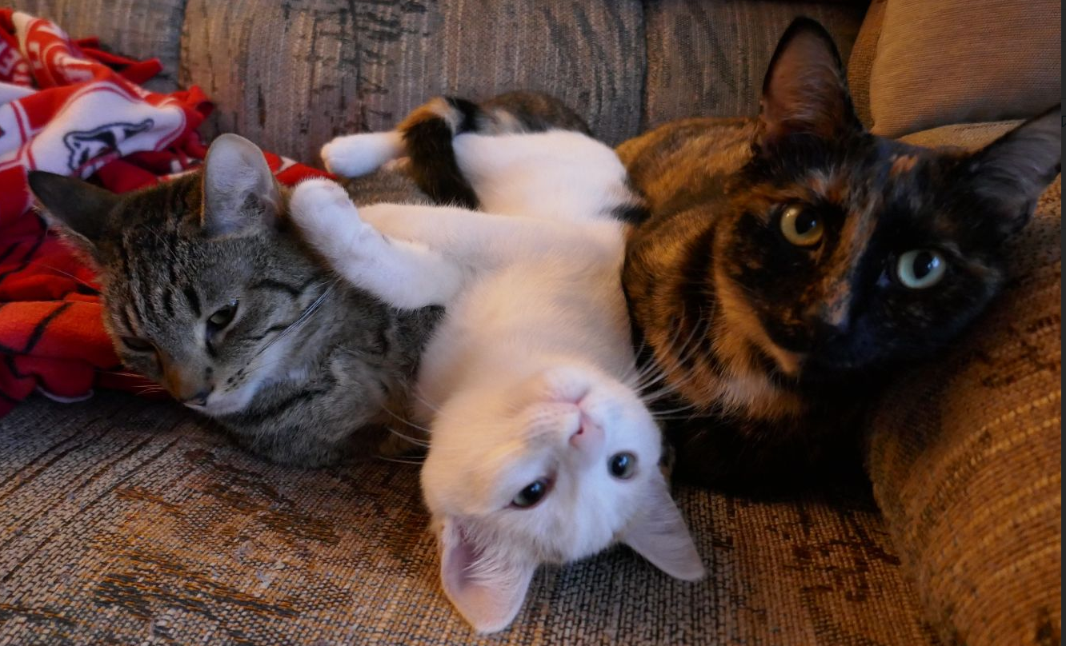
Welcome to Geometry!
Jo Anne Peterson
jopeterson@lwsd.org

Slide 3
Geometry is a very different class.
Details, details…
Showing how is more important than finding the answer.
Growth mindset
Mistakes are OK!!!

Slide 4
Expectations for students
Be on time for class
Be engaged with class
Have notes ready for reference
Assignments are due by the start of the next class. Late work is accepted until the end of the chapter. Late work is accepted for Weekly Algebra until one week past the due date.

Slide 5
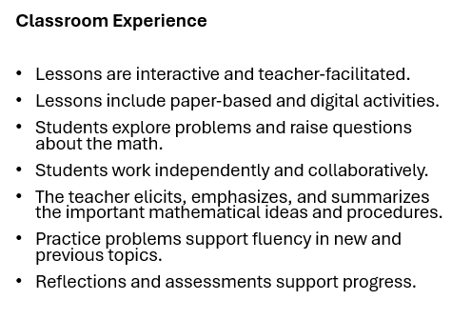
Amplify/Desmos Math: Geometry

Slide 6
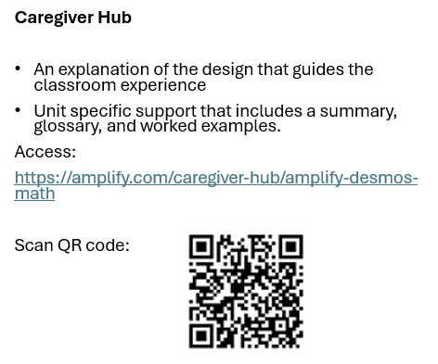
Amplify/Desmos Math: Geometry
Notes:
Mention here about first year using this textbook so we will try things that do not work. Also, all three geometry teachers are working together to teach at the same pace, give the same tests, etc.

Slide 7
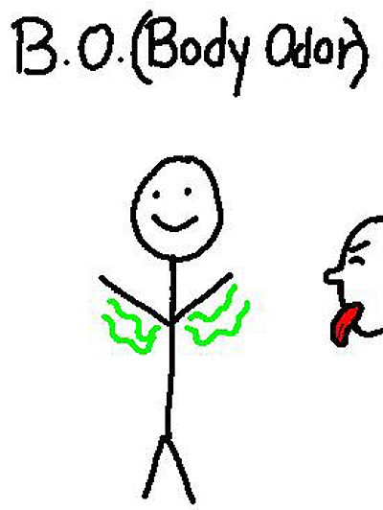
Materials needed for class:
Pencils with erasers
A spiral notebook with graph paper for homework
Another spiral notebook just for taking notes
Straight edge
Compass
Scientific calculator
Don’t bring it to class, but deodorant. Please. Really.

Slide 8
Materials needed for class:
Students should be charging their laptops every night at home.

Slide 9
Communication is critical
Students should be contacting me with questions and concerns.
Help sessions can be set up.
SKYWARD is the place to check on student progress.
CANVAS is the place to find information about assignments.

Slide 10
Grading
Tests and Quizzes make up 90% of the grade. Chapter tests will be announced at least a few days ahead of time. Students are allowed to retake a test once if they scored below an 80% and can earn a maximum score of 80% on the retake. The retake must be taken within a week of when the test is returned during the designated FLEX. An extra review assignment will be expected before a student can retake the test. Students must complete the test review assignment before the original test to be eligible for the retake.
Weekly Algebra is 10% of the grade. Scores are based on how well the students do, and they can be redone one time.
Daily Assignments are not calculated into the overall grade.

Slide 11
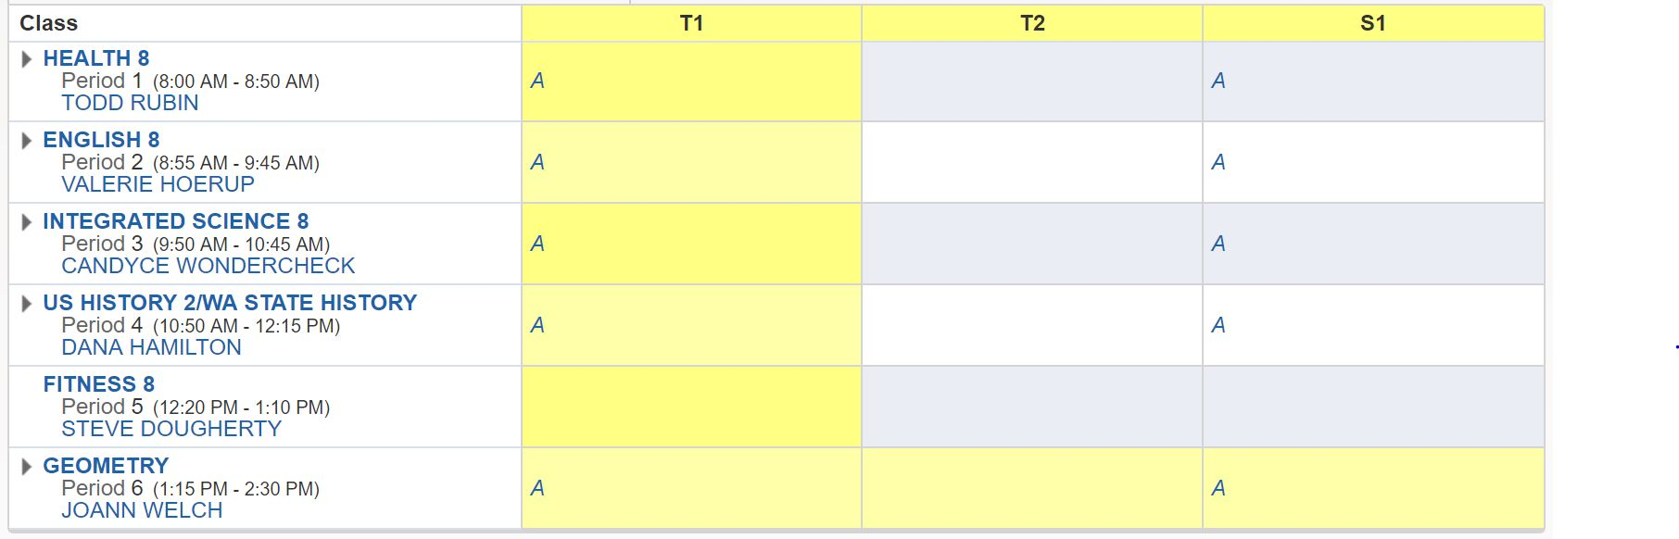
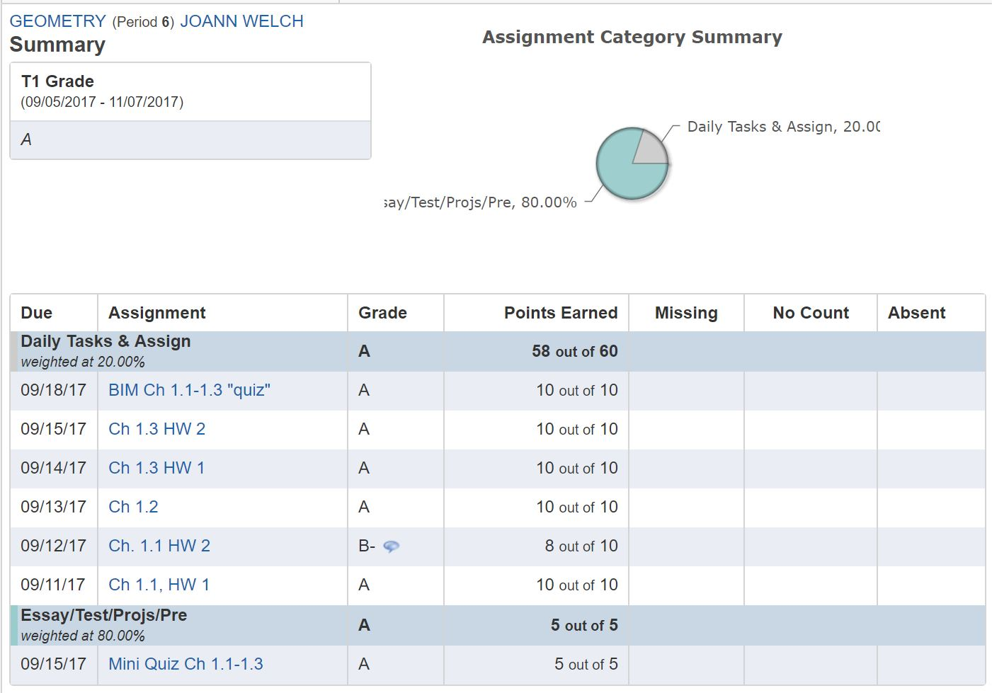
Skyward
Click on the assignment for more info about it. Click on the speech bubble to see my comments about the grade
Click on the grade for detailed info
*You can turn on email notifications for whenever your child is missing an assignment*

Slide 12
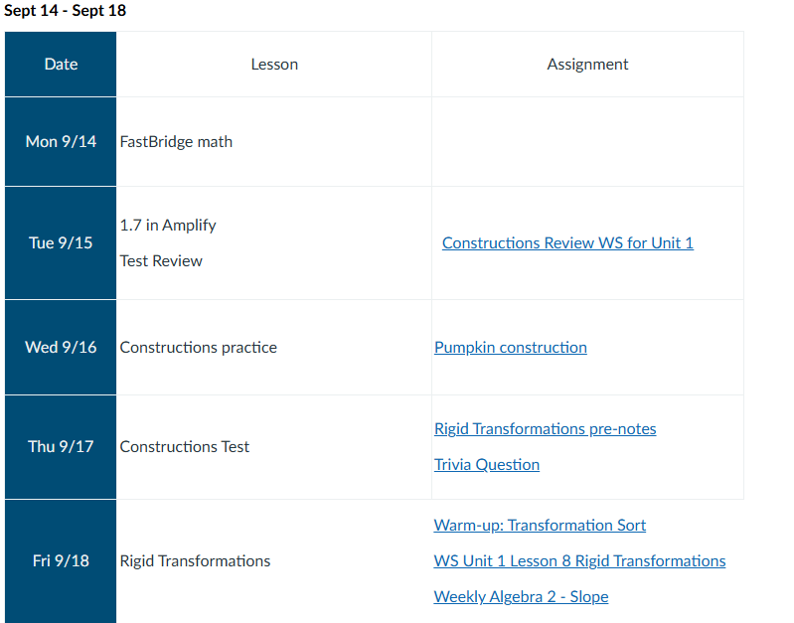
Canvas

Slide 13
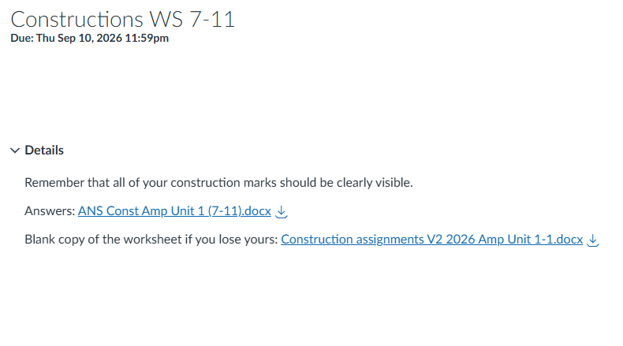
Canvas

Slide 14
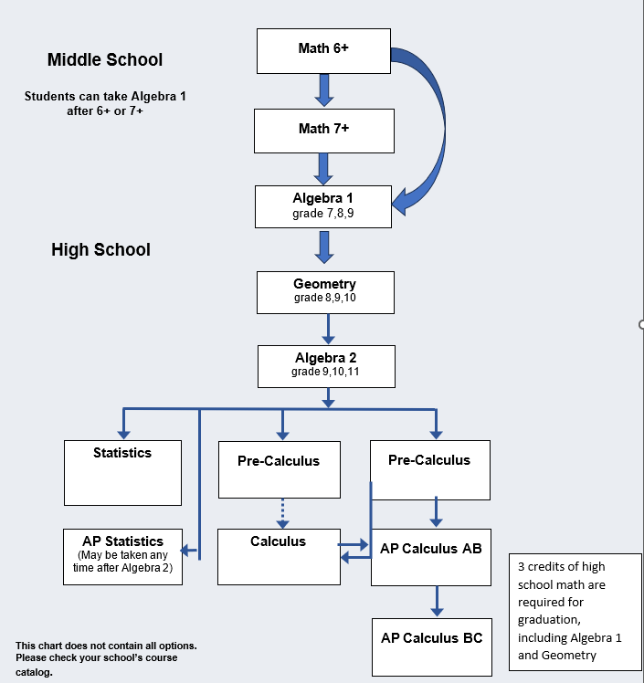
Course Options
3 credits of high school math are required for graduation, including Algebra 1 and Geometry
Algebra 2 is highly recommended to keep future options open
High schools offer a variety of high-level math courses including AP, and dual credit CTE courses that support a wide variety of interests and post high school plans.
Notes:
Students select courses based on their individual interests and post high school plans.

