Slide 1

Quest 6
Jenlee Yin
jyin@lwsd.org

Slide 2
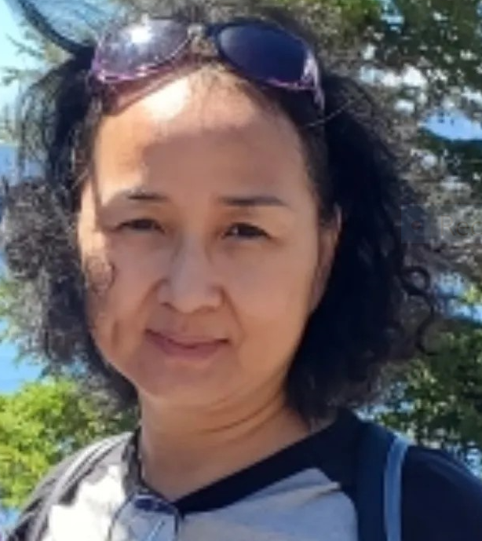
About Ms. Yin
Beijing Normal University B. A
Seattle University M.B.A
Pacific Lutheran University
  Teaching Certificate Program
  Was an accountant before
  becoming a teacher
12th year of teaching, 7th year at EMS
Love reading and hiking

Slide 3

Math 7+(7th and 8th combined): Common Core Standards
Curriculum
Rigid Transformation and Congruence
Scale Drawing, Dilation and Similarities
Equations and Inequalities
Linear Relationships and Systems of Equations
Functions
Associations in Data
Volume and Surface Area
Exponents and Scientific Notation
The Pythagorean theorem and Irrational Numbers
*SBA WOULD be on 6th grade standards*

Slide 4
Projects and Activities
Poker Cards and Math Game Project
Scaled Copy of Cartoon Character
Statistics Project
Student Presentation on Wednesdays
Stock Market Project (if we have time)

Slide 5

Canvas
A daily assignment checklist with detailed instructions is posted to Canvas.
The checklist has links to all assignment information.

Slide 6
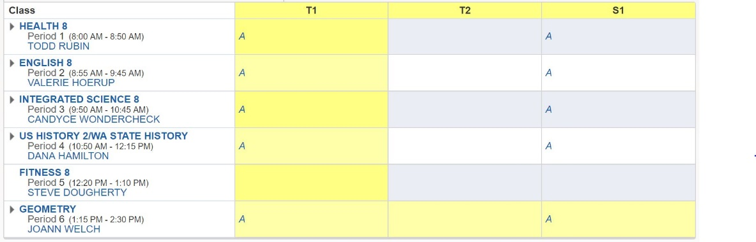
Skyward
*You can turn on email notifications for whenever your child is missing an assignment*
Notes:
Berton/ Reina

Slide 7
Course Grading
Tests 90%
Quizzes 5%
Presentations/Projects 5%
Assignments 0%
Tests– assess knowledge gained at the end of each chapter or series for lessons. Students may retake any Chapter test if they got below an 80% to get up to an 80%.
Quizzes-Quizzes, including subunit tests, are used as formative assessments to check students' understanding and progress during learning.
Major assignments (Amplify assignments)– will be recorded based on completion but will not affect the overall grade.
Refer to the course syllabus for further details (in Canvas)
Notes:
Galbraith

Slide 8
Help/Enrichment
Student needs help.
  Teach them how to study…
  Extra help
    Flex time (Tuesdays &Thursdays)
    Retake Chapter test if score was below 80% (earn up to 80%)
Needs a challenge?
  Enrichment opportunities in class
  Encourage student to reach out!
Join Math Club!
  Never hesitate to contact me –
  You know your child best!
Notes:
Partnership

Slide 9
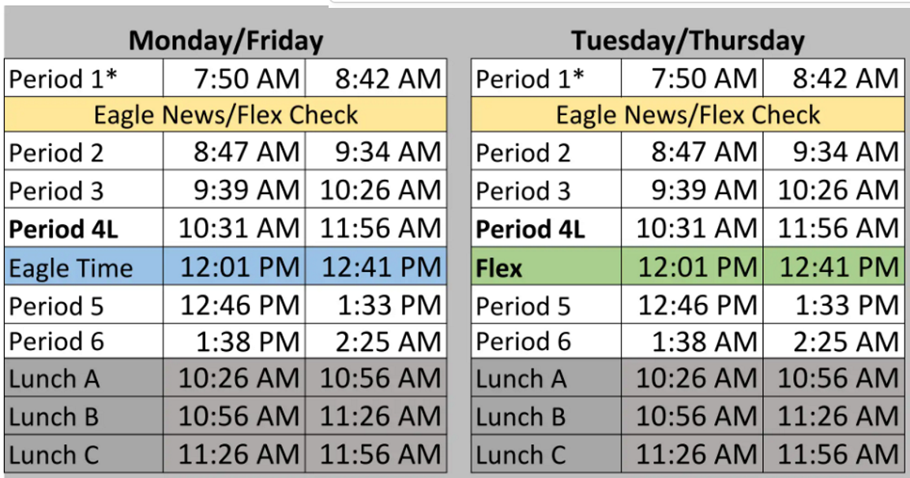
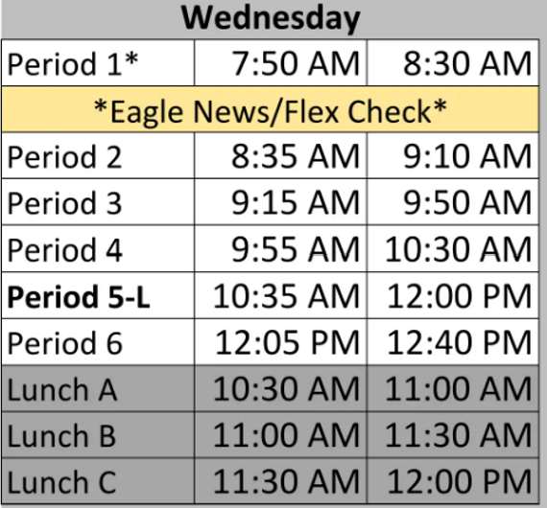
2026-2027 Daily Schedule

Slide 10
Contact Information:
Questions?
Jenlee Yin
Email: jyin@lwsd.org
Email is the best way to contact me!

