Slide 1
Thomasia Mcgee
For
Secretary

Slide 2
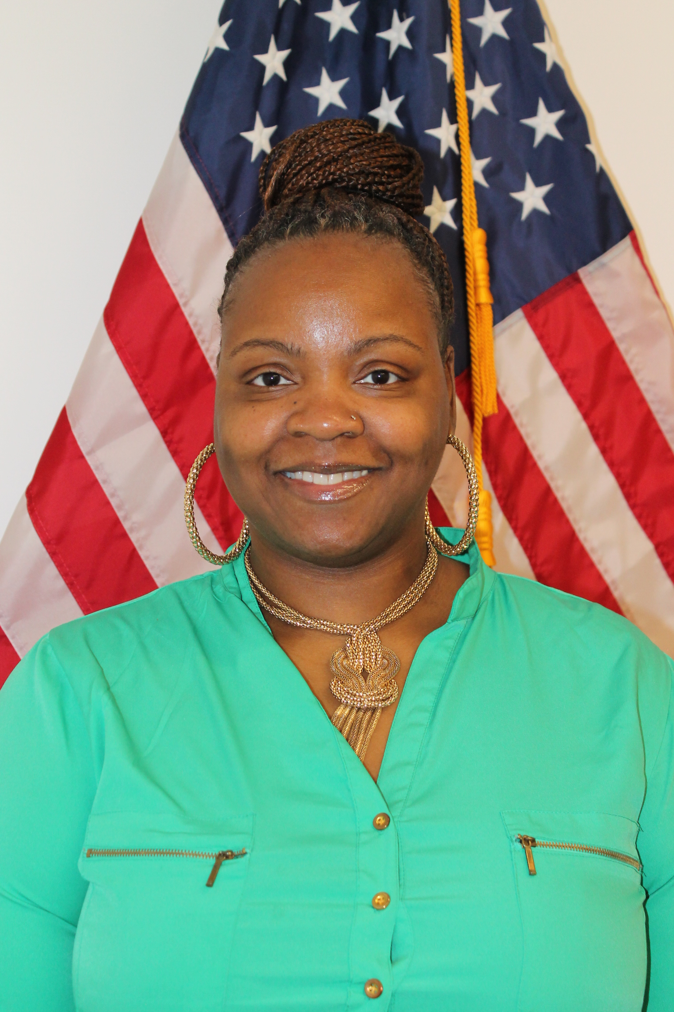
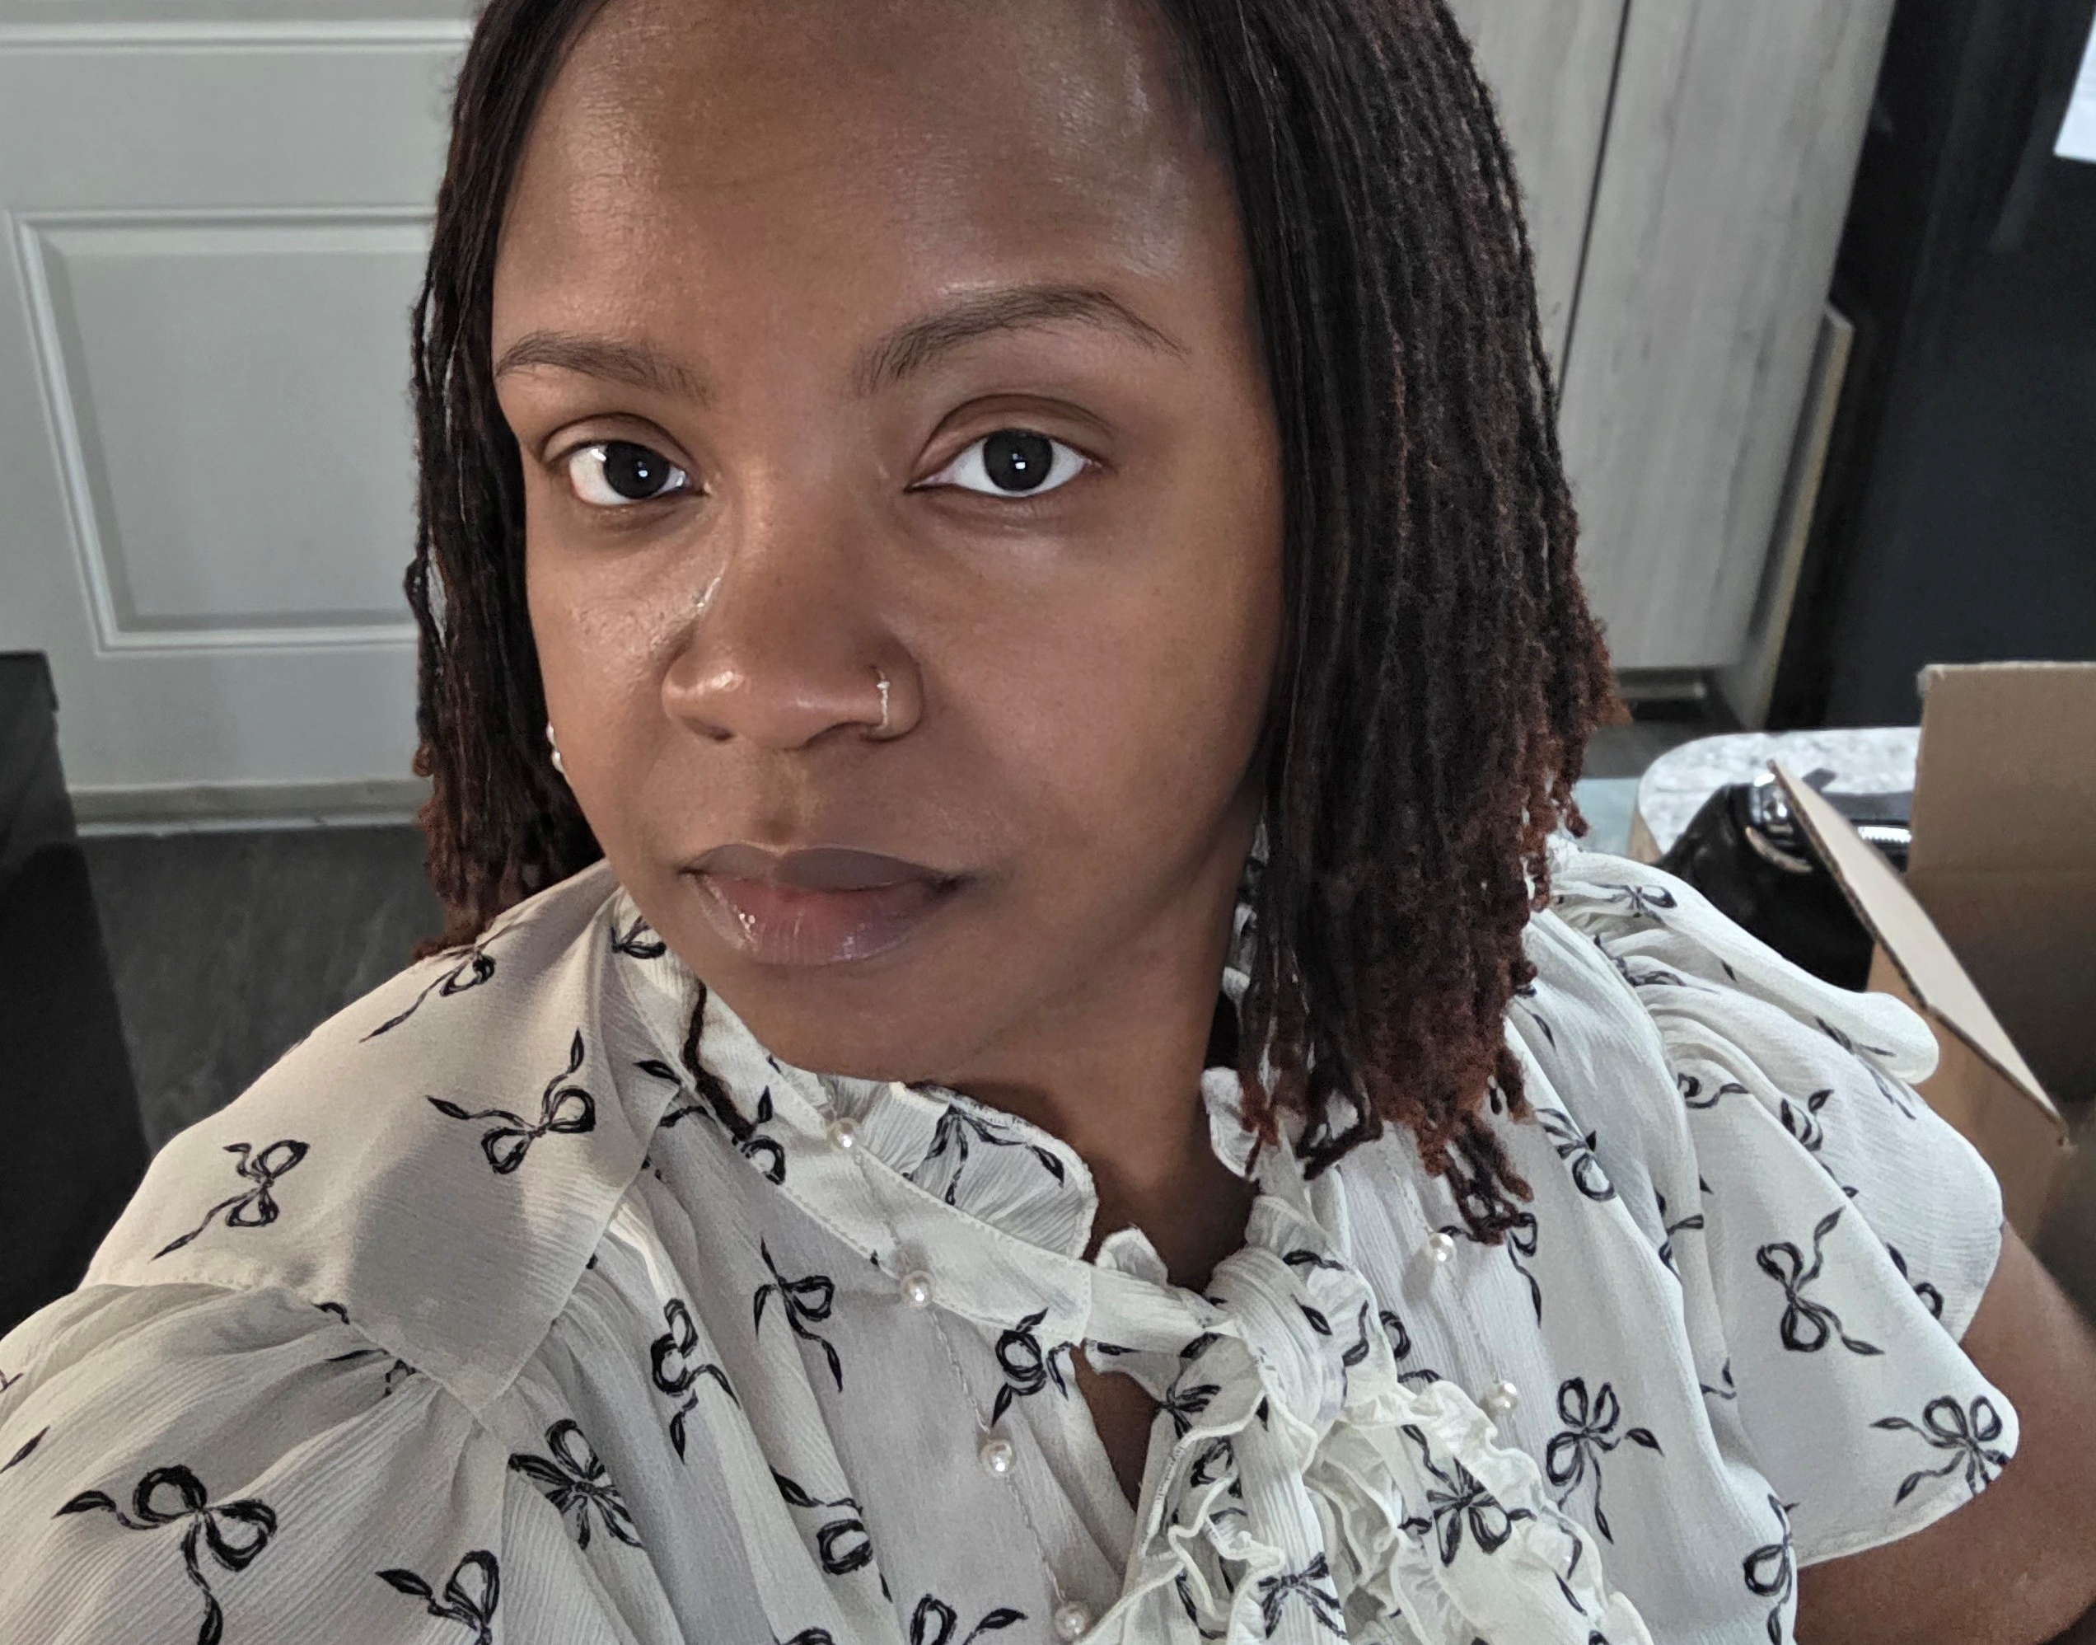
Who Am I
I have a 7th grader here at ARMS, who is a member of the JAGUAR chorus and the National junior honor society (njhs). I work for the federal govt with the veteran’s benefits administration (VBA) division; serving veterans.

Slide 3

Secretary
I believe I would be a great fit for the PTO Secretary position because I am organized, dependable and committed to supporting our students, families, teachers, and school community.
I would bring strong communication and organizational skills to the role.
(I understand the importance of keeping accurate meeting minutes, maintaining records and communicating information)
I want to serve because I care about creating a positive school experience for our children, while strengthening the connection between parents, teachers, and the school.
I will approach the position with enthusiasm, consistency and a genuine desire to make a difference.
My willingness to serve and organizational skills, with commitment, would make me a valuable addition to the PTO leadership team.

Slide 4
MY GOALS
MAKE SURE PTO MEMBERS STAY INFORMED AND ENGAGED
REMAIN PROFESSIONAL
MAINTAIN CONFIDENTIALITY
KEEP MEETINGS ORGANIZED
TRACK IMPORTANT DECISIONS
COMMUNICATE INFORMATION IN A CLEAR AND TIMELY MANNER

Slide 5
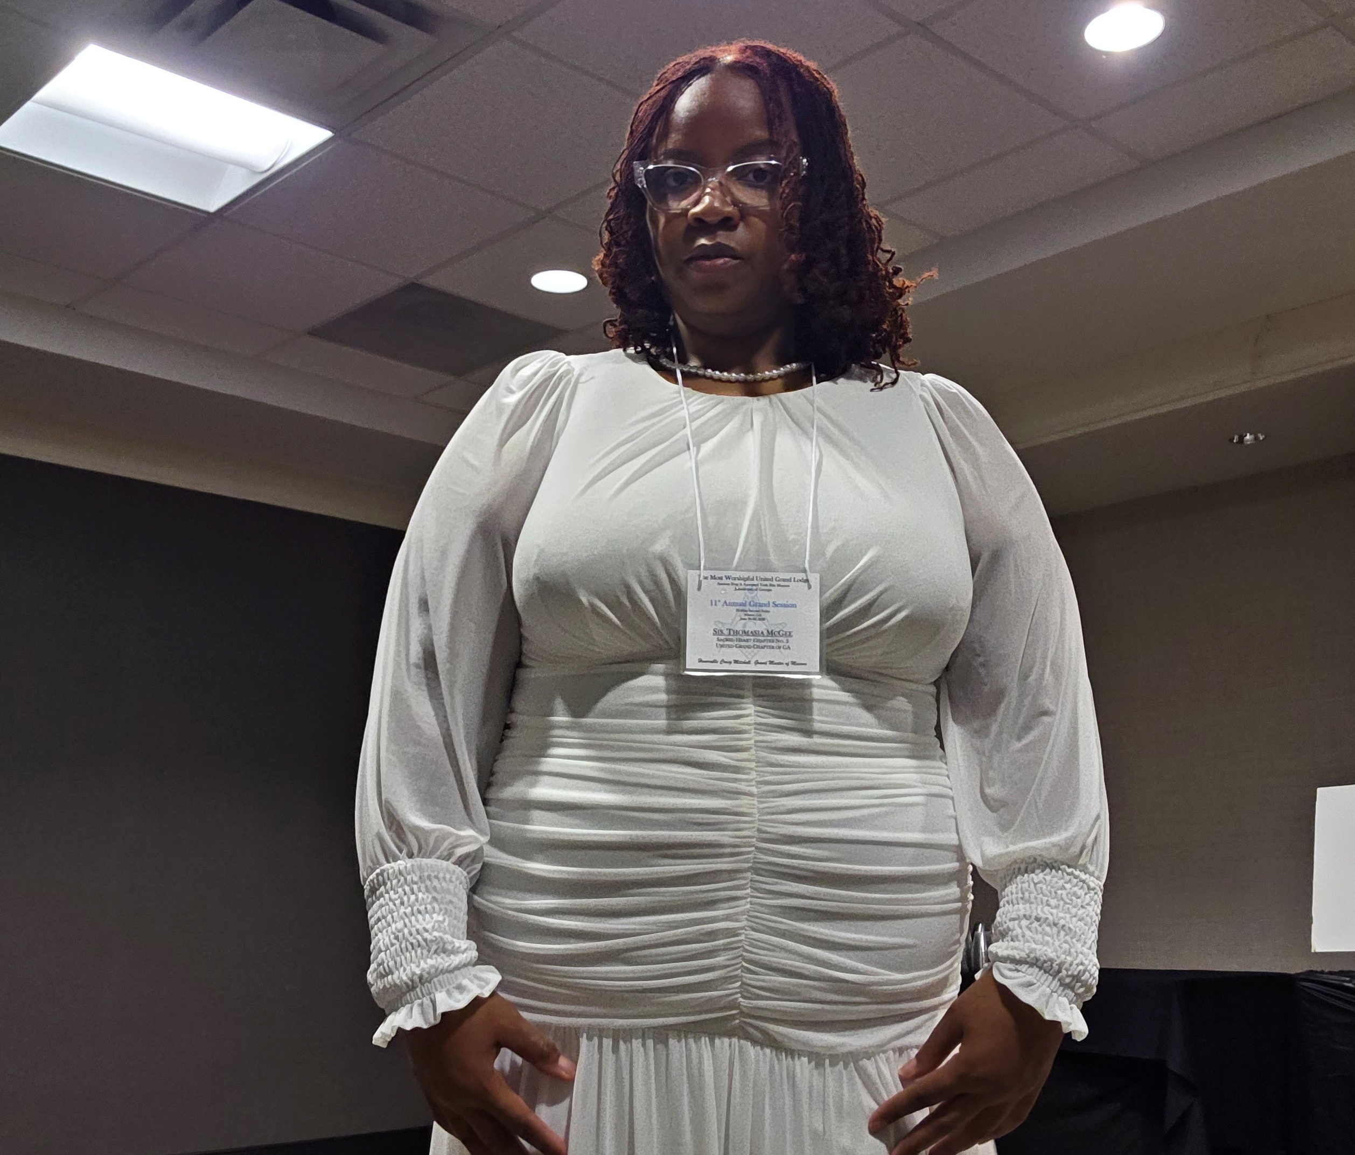
Thank you
Thomasia McGee
thomasia007@yahoo.com
770-568-9006

Slide 6
All great achievements require time.
Maya Angelou

