Slide 1




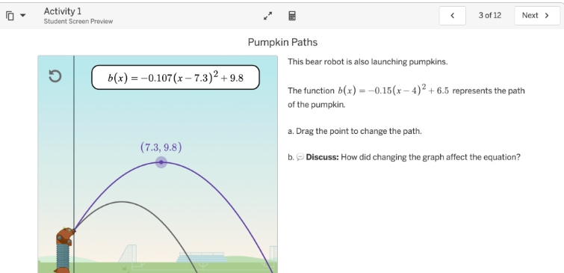
Algebra 1 – 7th & 8th grade

Slide 2
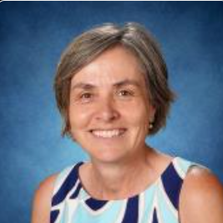
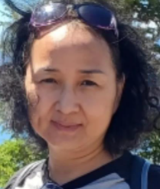

Teachers:
Ms. Alexandra Davydova adavydova@lwsd.org
Ms. Bettina Berton bberton@lwsd.org
Ms. Jenlee Yin jyin@lwsd.org
Mr. Terry Lin tlin@lwsd.org

Slide 3

Curriculum: Amplify Algebra 1
Equations and Inequalities
Linear Functions
Exponential Functions
Radicals
Polynomials
Quadratic Functions & Transformations
Statistics

Slide 4
Grading practices
Tests (90% of overall grade). Consists of unit tests.
Quizzes (10% of overall grade)
Assignments (not calculated in overall grade)

Slide 5
How parents/guardians can support the success of their student in the class
Check Skyward weekly and Canvas to see if assignments are being completed.
Ask to see your student’s notes. Are they taking notes? Are they organized?
Encourage your child to ask for help during Flex and/or after school tutoring at Evergreen Middle School.
Remind them to prepare for upcoming tests. For many students, Algebra is their first high school credit class, and it may require more effort and studying than previous math courses.

