Slide 1
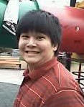
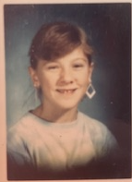
Welcome to
7th Math Extension
with
Mr. Erne and Ms. Palmer

Slide 2
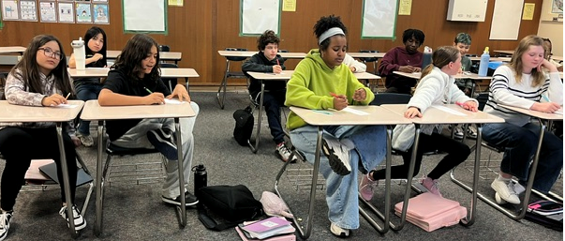
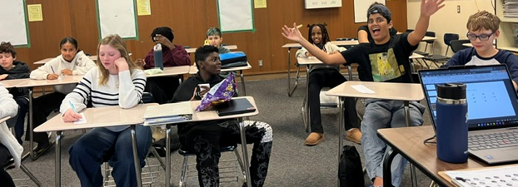
Them

Slide 3
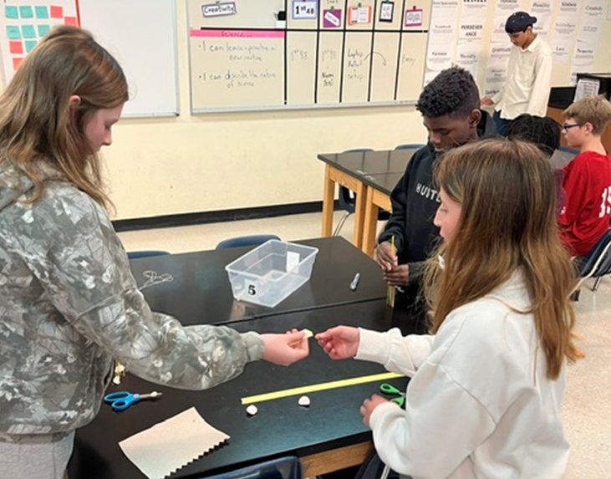
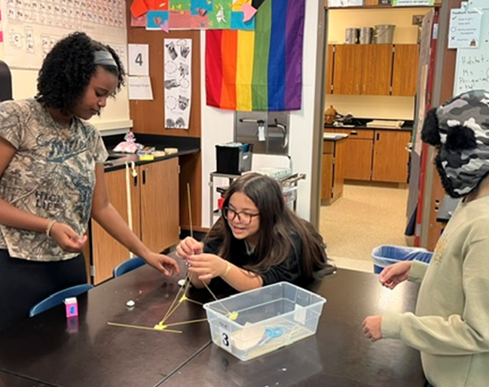
Spaghetti Tower Challengers

Slide 4
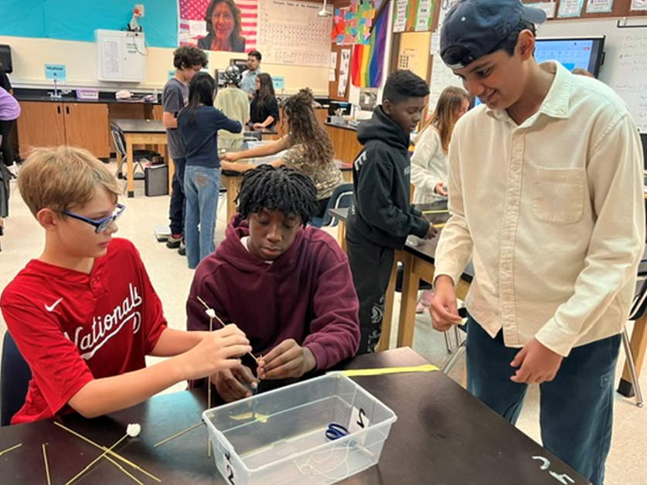
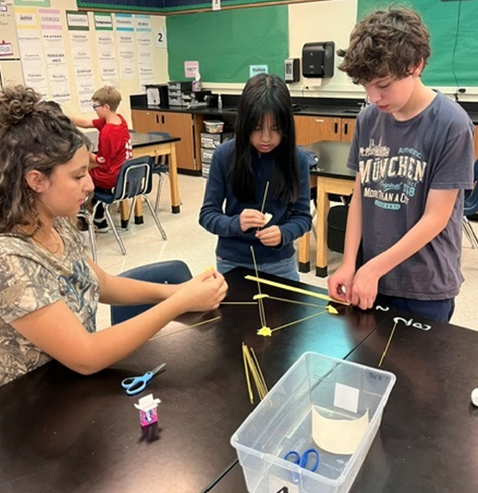
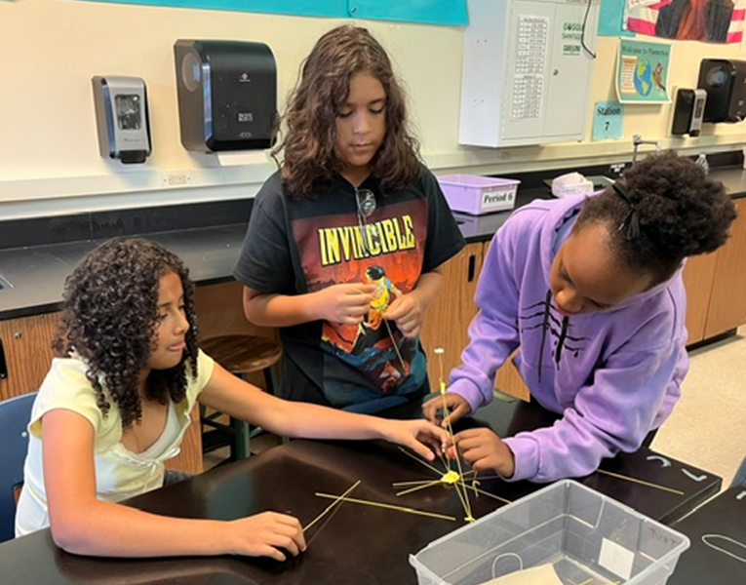

Slide 5
Skills & Content
Foundational Math Skills | Unit Specific Skills and Content Practice
Mental math like: Adding 1 or 2 digit numbers Multiplication “short division” Baseline skills Long Division Add, subtract, multiply, divide decimals Percents Order of Operations Inequalities Graphing | Unit 1: Rigid Transformations and Congruence Unit 2: Scale Drawings, Dilations, and Similarity Unit 3: Equations, and Inequalities Unit 4: Linear Relationships and Systems of Linear Equations Unit 5: Functions Unit 6: Associations in Data Unit 7: Volume and Surface Area Unit 8: Exponents and Scientific Notation Unit 9: Pythagorean Theorem and Irrational Numbers

Slide 6
Week at a Glance
Monday | Tuesday | Wednesday | Thursday | Friday
Foundational Math Skills Practice | Foundational Math Skills Practice | Unit Specific Skills & Content Practice | Foundational Math Skills Practice | Game Day / Homework

Slide 7



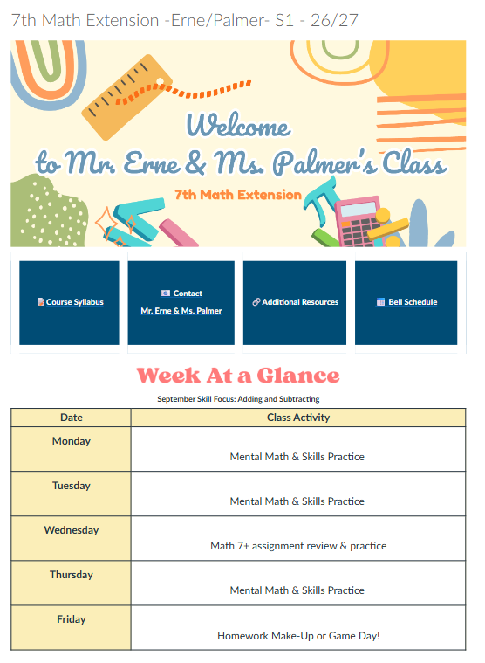
Communication
Week at a Glance,
Assignments
Direct messaging with Mr. Erne and Ms. Palmer
Grades,
Missing Assignments

Slide 8
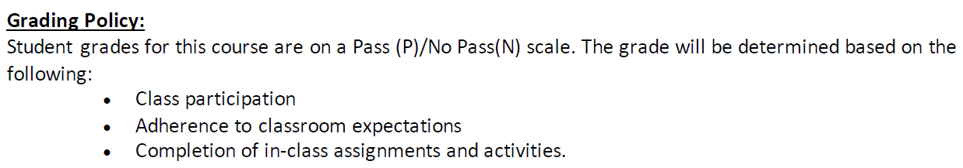
Grading Practices

Slide 9

A bit about us!
Mr. Erne
Ms. Palmer
1st year at EMS, 1st year teaching
Summer I travel and take care of my son.
I play ice hockey and spend time with my family
Prior to teaching, I served in the Army National Guard and was an electrical engineer for the US Navy and Boeing.
13 years at EMS teaching science, math, ELA, interventions
Summers I work as an axewomen of Maine
Prior to teaching I taught High School Science in CO, worked at the District Attorney’s office, finished cabinets and custom furniture, am a licensed 100GT captain, worked with young adolescents that were wards of the state of Massachusetts.

