Slide 1
Welcome to
Foundations
Evergreen Middle School
Taking P.R.I.D.E in ourselves, our school, and our community.

Slide 2
Welcome families!
Foundations is a semester long required elective class for all 6th graders.
This class provides students with the foundational skills to;
Build meaningful, positive relationships and connections with one another.
Be academically successful by practicing executive function skills and routines.
Reflect on and think about who they are or who they want to be as a learner and member of the EMS community.

Slide 3
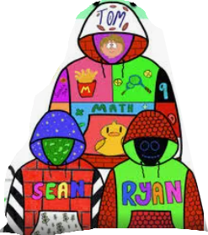
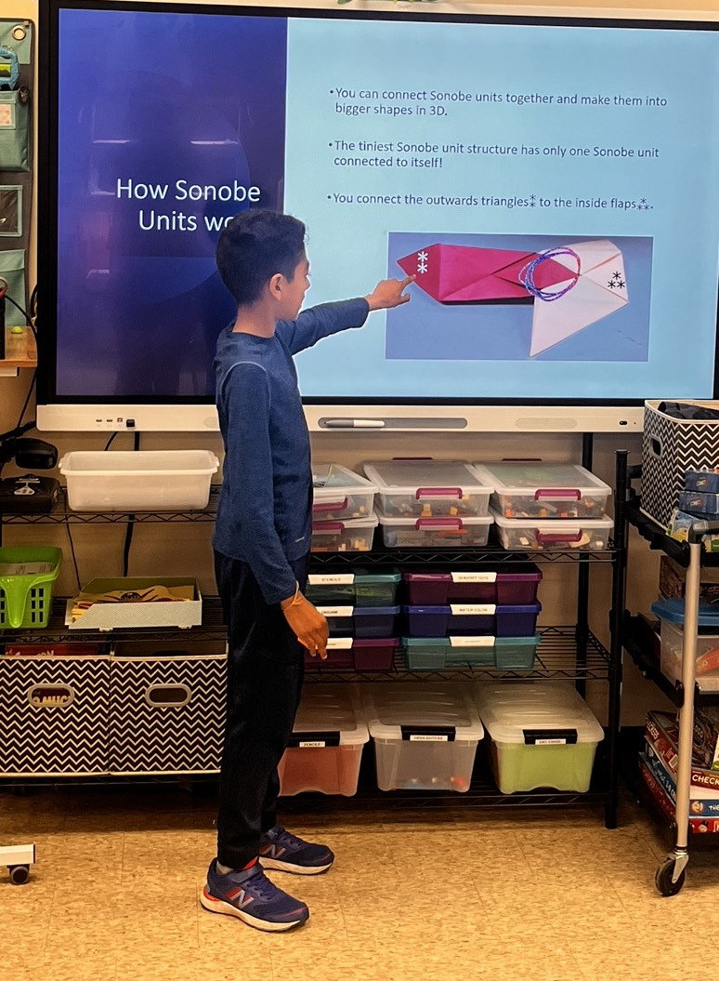
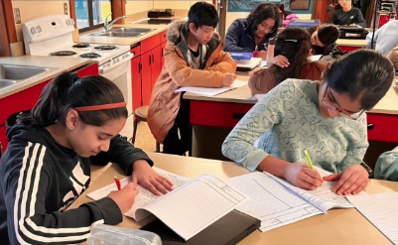
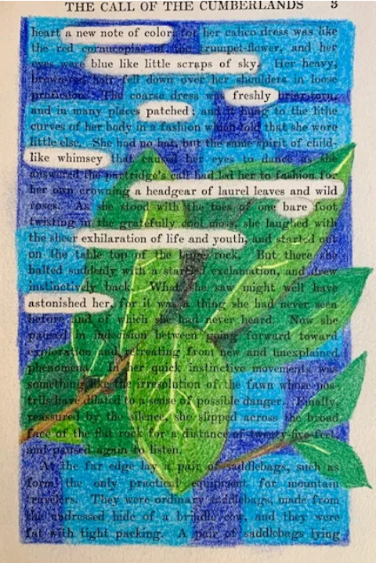
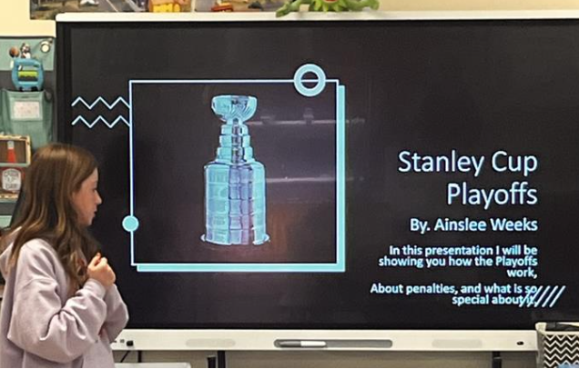
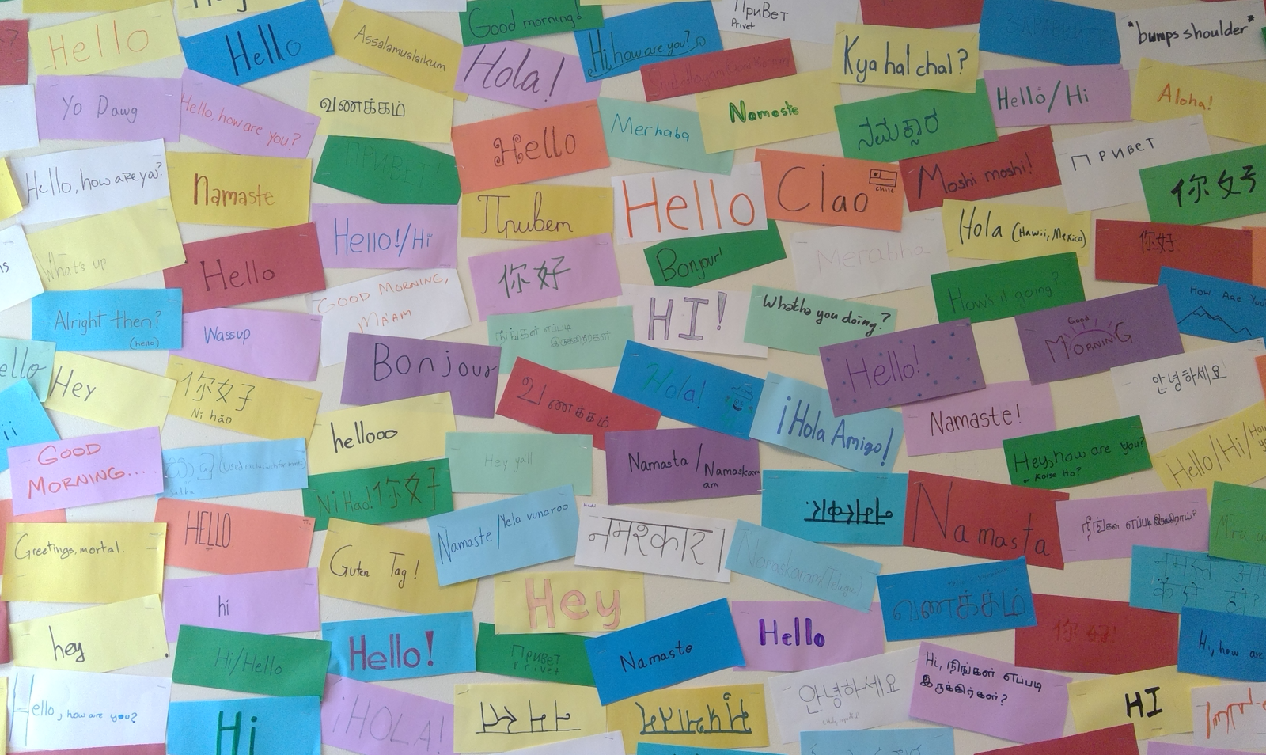
Foundations in Action

Slide 4
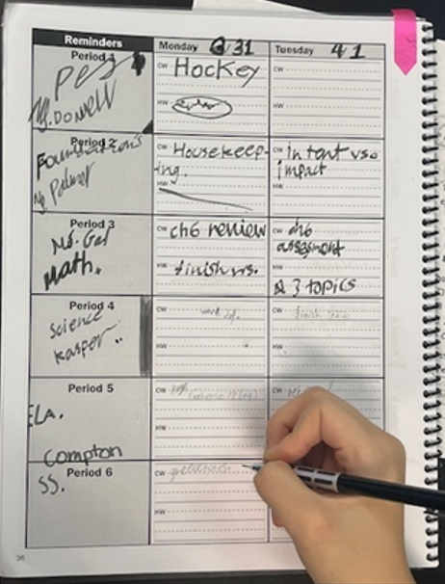
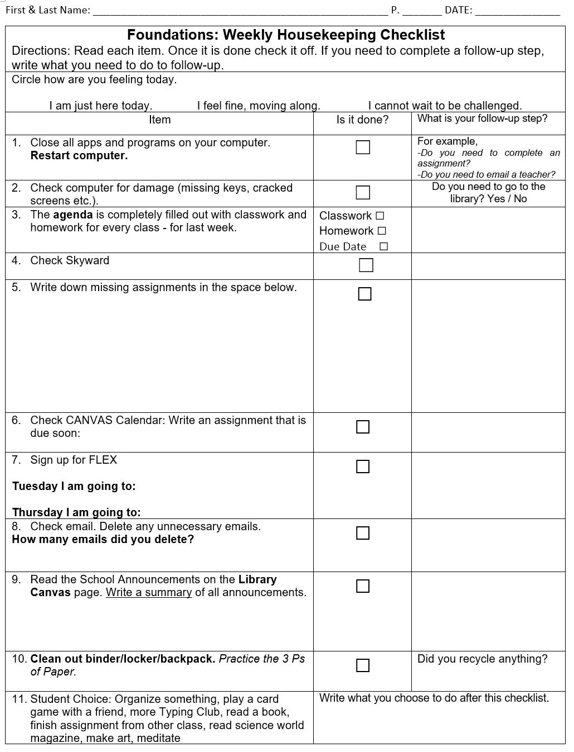
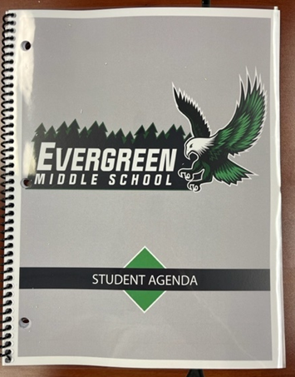
Classroom Expectations
Keep agenda updated every day with every class.
Participate and complete in class activities.
Get organized by completing weekly Housekeeping

Slide 5
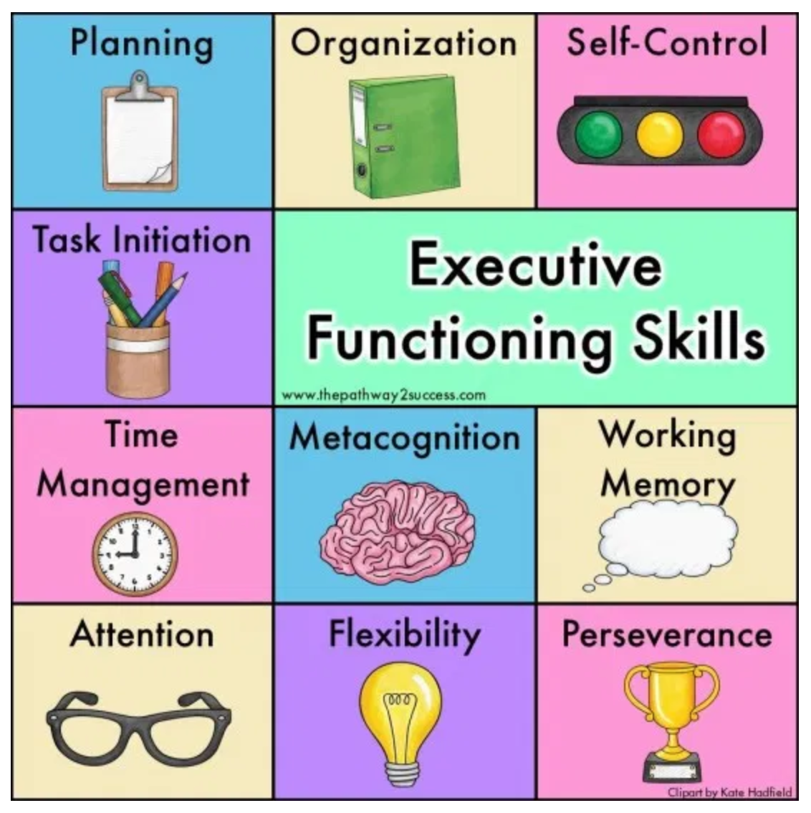
Organization Unit
Setting up Laptops
Learning Microsoft and LWSD Applications
Importance of Agendas
Organizing and Prioritizing Classwork
Writing Reflections

Slide 6
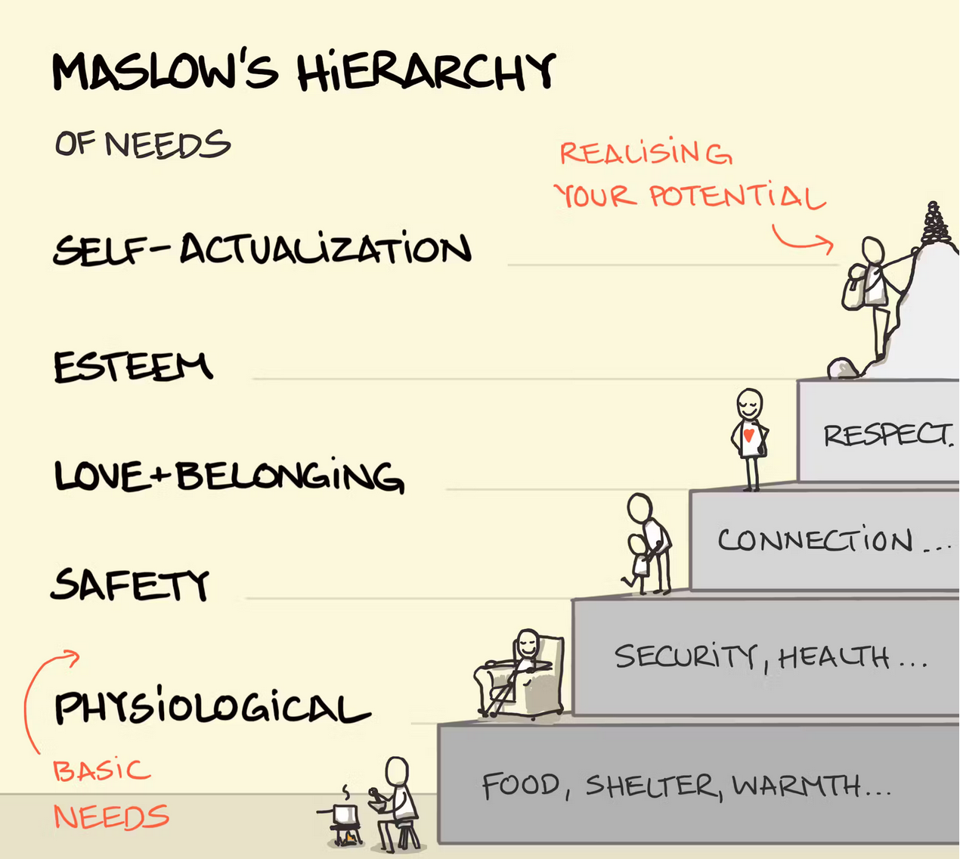

Identity Unit
Maslow's Hierarchy of Needs
Parenting Types
Character Strengths
Nature vs. Nurture
Goal Setting

Slide 7

Communication Unit
Intent vs. Impact
Body language
Facial expression
Tone
Email etiquette
Blackout Poetry

Slide 8
Examples of Activities
Perseverance & Kindess through new games (played silently)
Art projects to practice growth mindset and creativity
Perspective, bravery, and social responsibility through presentations

Slide 9
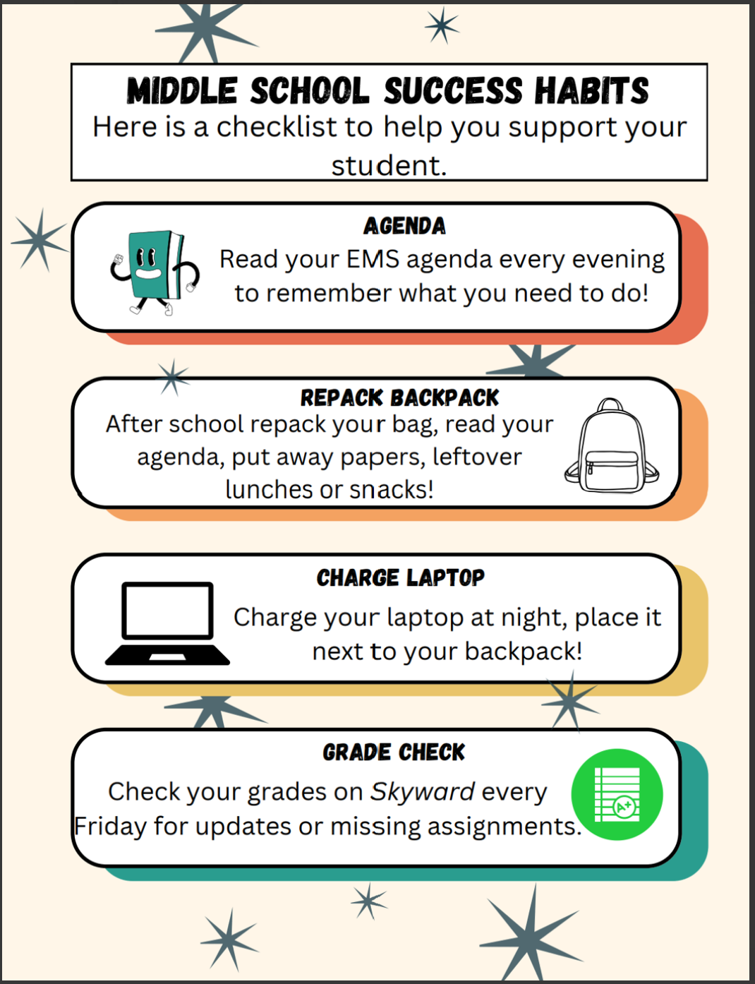


How to support your student
Message through ParentSquare
Check Canvas with your student

