Slide 1
Robert Turner College & Career High School
9th & 10th Grade Parent Presentation

Slide 2

Topics of Discussion
Counselors
Being Successful at THS
Graduation/College Requirements
Life After High School
Resources

Slide 3
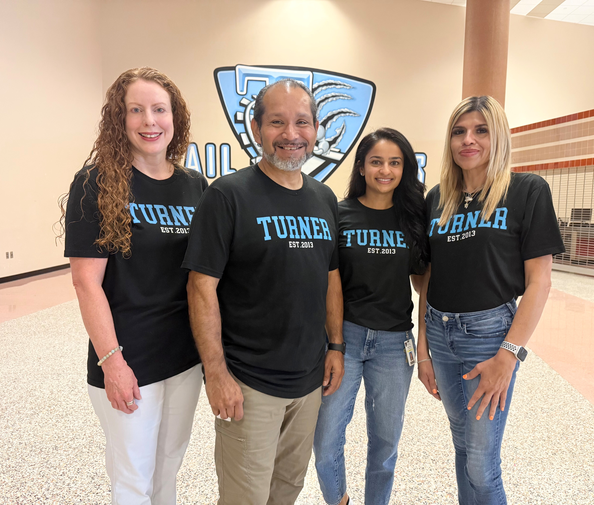
Who is your counselor?
Juan De la Garza: A-Gi
Priya Patel: Gj-O
Leticia Romo: P-Z
ACC Advisor-Jennifer Fuentes
Student Support Counselor-Melissa McDavid
Counseling Secretary – Maria Mosqueda

Slide 4
What does a counselor do? When is a counselor available?
Academic
· Course advisement
· Graduation requirements
Social/Emotional
· Conflict resolution
· Stress
· Problem solving
· Decision making
College/Career
· College and Career planning
· Testing information
ANY questions you may have
Lunch
Anytime a student NEEDS us
WE ARE HERE TO HELP!

Slide 5
How To Be Successful At THS
Build a rapport with your teachers.
Utilize support!
Listen in class.
Attend tutorials during Mega Lunch.
Stay on top of grades & assignments by checking Skyward and Canvas.
Get involved at THS
Be an advocate for yourself!
Know that everyone on campus is there to help.

Slide 6
Involvement = Success
Over 30 clubs on campus
  Most popular clubs include:
  A student can create any club they want
Attend sporting events, school dances, performances, and other after school activities

Slide 7
What to do if your student is struggling?
Review the syllabus and class guidelines with your student
Ask your student where he/she is writing down homework assignments and periodically check that assignments are completed
Check Skyward for student attendance and class grades
Look closely at progress reports and contact teachers DIRECTLY if you have questions
  Email is typically best
Have your student attend tutorials before school, after school, or during Mega Lunch

Slide 8
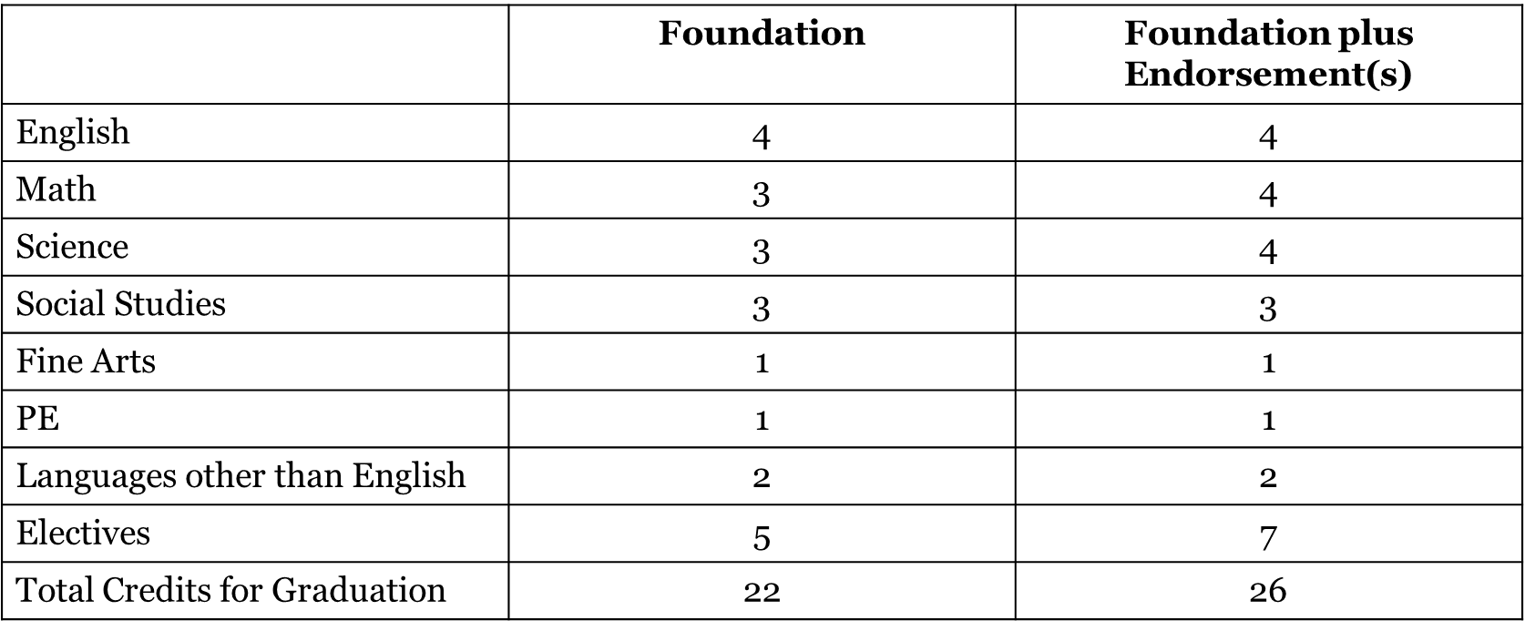
Graduation Requirements

Slide 9
PREPARING FOR LIFE AFTER HIGH SCHOOL
Visit a local college campus
Explore careers by interviewing adults in occupations of interest.
Focus on your academic work and meet your goals to get good grades.
Plan summer activities for school, work or community service
Stay involved in extracurricular activities
Take the PSAT/NMSQT (10th-11th grade)
Prepare to take ACT/SAT Junior Year
(You've completed the necessary coursework (what will be on the test)
  Colleges will have your scores in time to contact you before your senior year
  You have the opportunity to retest
  To understand the layout of the test
  To identify areas of opportunity to improve
Identify at least 5 colleges of interest

Slide 10
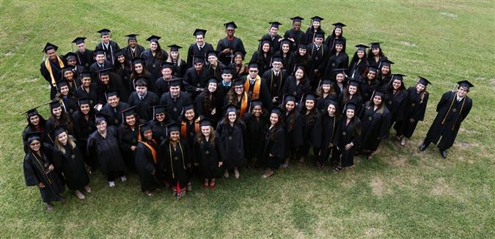
Choices After Graduation
Community College
  Vocational training & 2-year degrees (AA/AS)
Community College then transfer to 4-year college/university
4-year college/university
Vocational/Technical School
Military
Gap Year
  Work or On-the-job training/apprenticeships
  Travel
  Programs

Slide 11



Community College
Requires English & Math placement exams (TSI); no SAT/ACT scores are needed
Specialty programs & 2-year AA degrees
Transfer to 4-year university

Slide 12

College Testing
SAT or ACT
SAT Subject Tests
  Not always required
  Check college/major requirements
  “Recommended” by some UC and Private Colleges
Both ACT and SAT have test prep on their websites
Check out free SAT test prep on Khanacademy.org
Students request score reports through the testing agency to be sent directly to colleges. Deadline is the same as college application deadlines.

Slide 13

Resources
Website: https://www.pearlandisd.org/turner
Call us, email us...ANYTIME! We are here to help!

