Slide 1
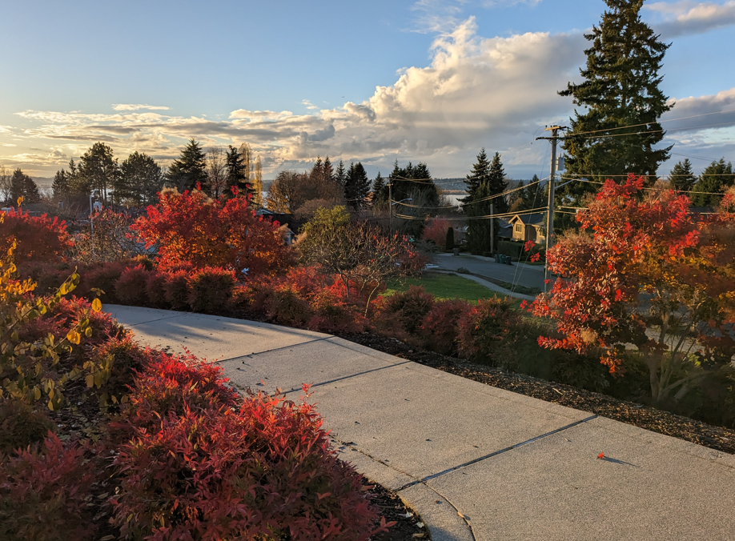

Grades 8 & 9
International Baccalaureate (IB)
Information Night at ICS
January 29th, 2026
WELCOME!!
Notes:
JH

Slide 2

Agenda
Info designed for grades 8 & 9
•What is IB? ICS & IB Philosophy
•Course pathways
•Courses offered at ICS
•IB Core (CAS, EE, and TOK)
•College Admissions and Credit
•Question and Answer
Notes:
JH

Slide 3
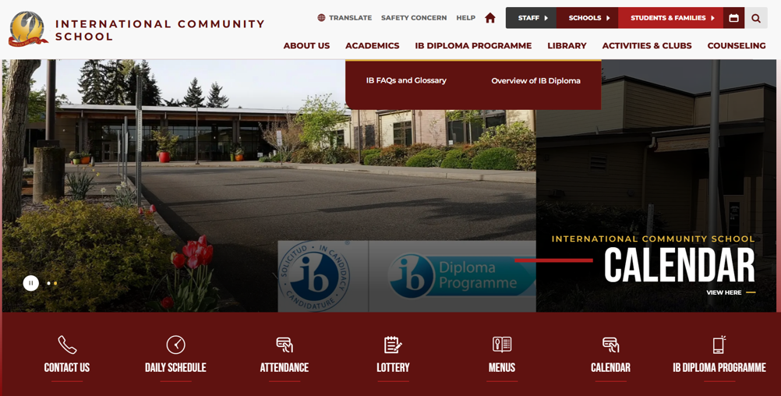
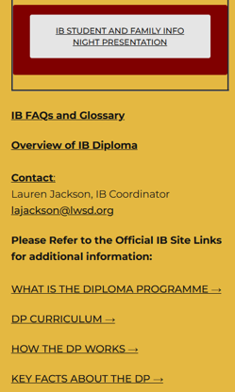
Where can I find more information?
Please read IB information on our ICS Website!
Notes:
JH

Slide 4
ICS IB Programme Leadership
IB Coordinators
Academic & College/Career Guidance
ICS & LWSD Administrators
Lauren Jackson
  IB Diploma (DP) Coordinator
  ICS Humanities Teacher
Jasmine Hanson
  Extended Essay (EE) Coordinator
  ICS Librarian
Jennifer Ann
  Creativity Activity Service (CAS) & Experiential Learning Coordinator
  ICS Science & Health Teacher
Rebecca Zavala
  ICS HS Counselor
Ann Nguyen
  ICS MS Counselor
Jacob Hendrickson
  ICS Principal
Mike O’Donnell
  ICS Associate Principal
Matt Livingston
  LWSD Director of Secondary Education - West Region
Notes:
JH

Slide 5

What is IB?
Notes:
LJ

Slide 6
The IB Mission
Develop inquiring, knowledgeable and caring young people who help to create a better and more peaceful world through intercultural understanding and respect.
Develop challenging programmes of international education and rigorous assessment.
ICS Mission
The International Community School cultivates curiosity, complex reasoning, problem solving, and global awareness in every student
Notes:
LJ

Slide 7
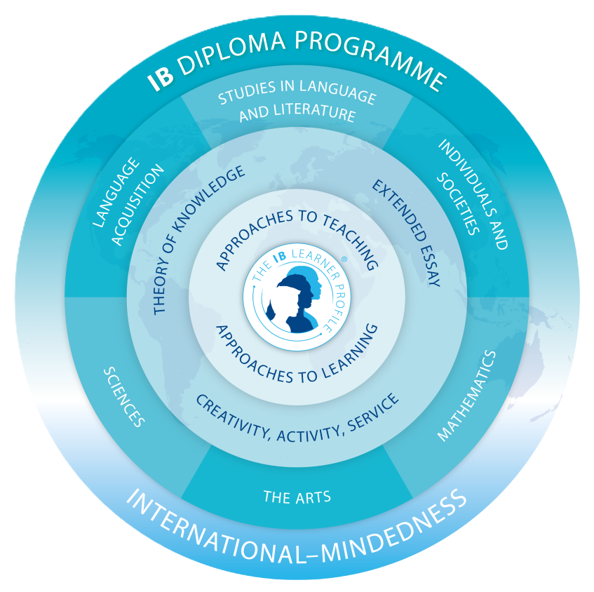
IB Philosophies
Learner Profile
International-Mindedness
Approaches to
Teaching & Learning
Notes:
LJ

Slide 8
IB Teaches Students to
  Ask thoughtful questions
  Think critically, creatively, conceptually and ethically
  Make links: across disciplines, between cultures and contexts
  Develop research skills: compare, validate, prioritize
  Communicate effectively
  Focus on process
  learn how to learn—self-management
  Work collaboratively, form positive relationships
Notes:
LJ

Slide 9
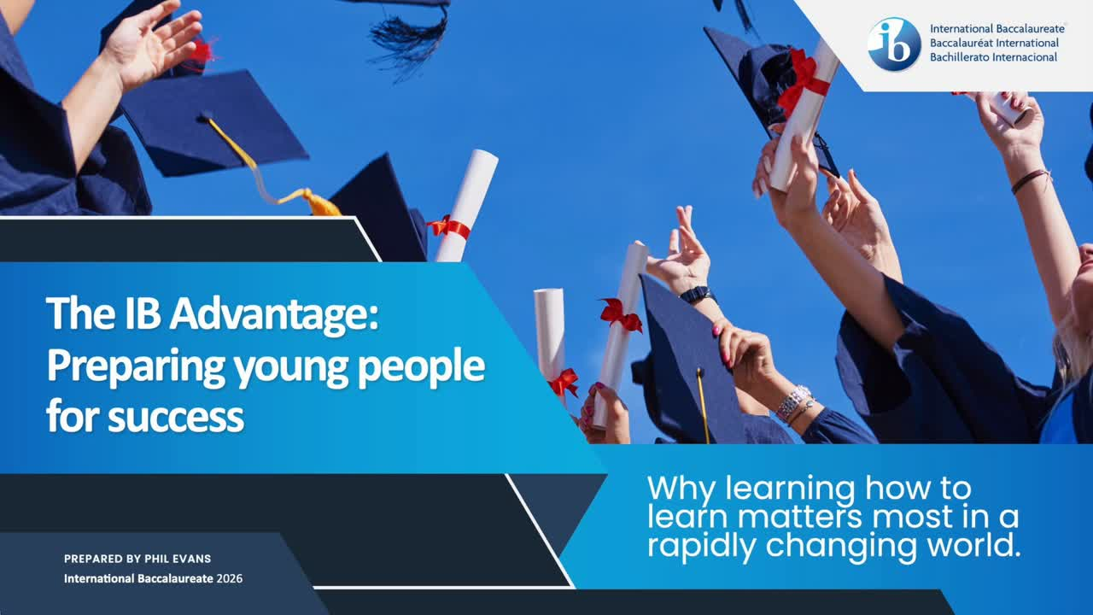
Schoolwide IB:
All students in a school take at least one IB course
Not an elite program for just the top students
Notes:
LJ

Slide 10


ICS IB Pathways
Schoolwide IB
  Full Diploma Programme
  2. IB Courses
Notes:
LJ

Slide 11
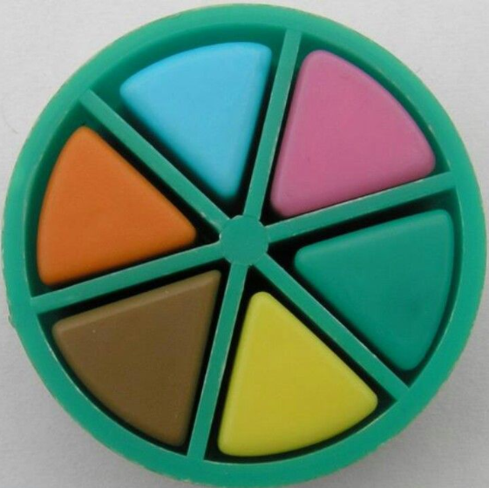
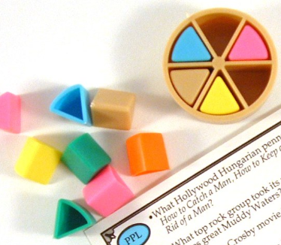
IB DP Students:
  Take 6 2-year courses plus the IB Core
  State graduation requirements waived
IB Course Students:
  Build schedule with ICS courses
  Many subjects will only offer IB courses
Notes:
LJ

Slide 12
Difference between Higher Level (HL) and Standard Level (SL)
HL | SL
2-years | most 2-years some 1-year
240+ hours | 150+ hours
More content/depth some extra assessment | Still rigorous, but less content/depth
More than an AP class | Equivalent to AP class
Notes:
LJ

Slide 13
IB Subjects | Courses at ICS (class of 2029 onwards): Choose 1 in each subject
Studies in Language & Literature | English Language & Literature HL/SL
Language Aquisition | Spanish HL/SL
Individuals & Societies | History of the Americas HL Global Politics SL
Mathematics | Math Analysis & Approaches HL/SL Math Applications & Interpretation SL
Science | Chemistry HL/SL Biology HL/SL Physics HL/SL
The Arts / 6th Subject | Visual Arts HL/SL Chemistry HL/SL, Biology HL/SL, Physics HL/SL Global Politics SL
Notes:
LJ

Slide 14
Full IB Curriculum
  IB: option of 30 2-year courses in 6 subject areas
  IB World Schools: at least 1 course in each of 6 subject areas
  ICS: 10 courses, most at both HL and SL over 2 years (same as 30 one-year courses)
ICS will have the full IB curriculum
Notes:
LJ

Slide 15

Diploma Programme Schedule
  3 SL courses
  3 HL courses
  IB Core course
    before or after school
    TOK, EE & CAS
Notes:
LJ

Slide 16

How to get more STEM:
  Take HL science & Math AA
  Take 2nd science for Group 6
    Biology, Chemistry, Physics SL
How to get more Liberal Arts:
  Take HL English, History, Visual Arts
  Take Visual Arts or Global Politics SL for Group 6
Notes:
LJ

Slide 17

IB Course Students
  Must complete all state & LWSD graduation requirements
  No DP Core
  IB assessments/exams not required
  Can do IB assessments/exams for college credit (like AP)
  Can do TA or late arrival/early dismissal
  Can do part-time Running Start
Notes:
LJ

Slide 18

Schoolwide IB
  All students at ICS take some IB courses
  Course students can take all SL or their choice of HL/SL mix
Notes:
LJ

Slide 19


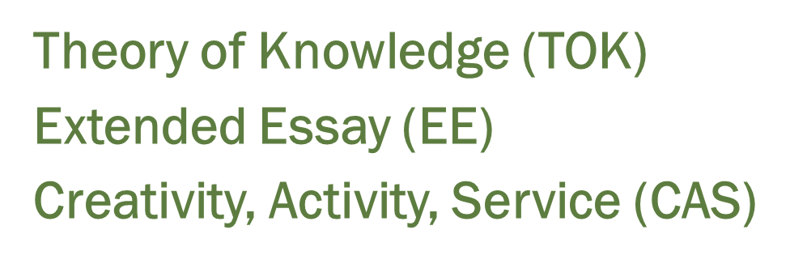
The IB Core
Notes:
LJ

Slide 20
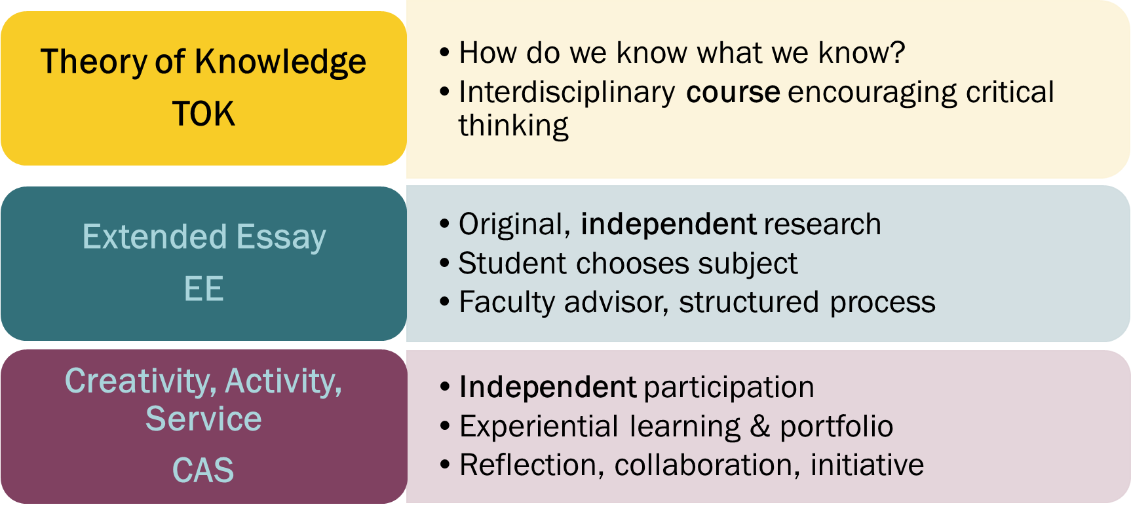
DP Core Class
Notes:
LJ

Slide 21

After ICS
University Perspectives
College Credit
Notes:
RZ

Slide 22
University Admissions
  IB Diploma is valued by universities in the US and internationally
  Credit for IB Course scores higher than 4 (out of 7)
    WA and OR state law
  Admissions value guaranteed curriculum and assessments
  Admissions value focus on writing, inquiry, and self-management
  Selective universities accept a higher percentage of IB DP students than the general population of applicants.
Notes:
RZ

Slide 23
The meaning of IB to admissions officers
“IB is well known to us as excellent preparation. Success in an IB program correlates well with success at Harvard. We are always pleased to see the credentials of the IB Diploma Program on the transcript.”
-Marlyn McGrath, Director of Admissions, Harvard
Notes:
RZ

Slide 24

Notes:
RZ

Slide 25
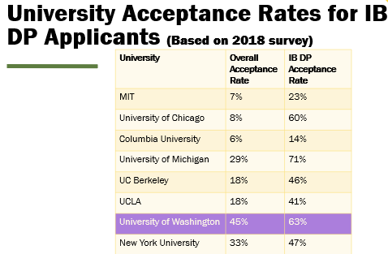
Notes:
RZ

Slide 26
UW Transfer IB Credits
IB Courses | IB Exam Score | UW Credit
Language and Literature HL | 4,5,6,7 | 5 credits
Language B: Spanish SL | 4,5 | 5 credits
Global Politics SL | 4,5,6,7 | 5 credits
Biology HL | 5,6,7 | 10 credits
Math Applications and Interpretation-AI SL | 5,6,7 | 5 credits
Visual Arts HL | 4,5,6,7 | 5 credits
Total possible credits |  | 35 credits
45 credits= 1 full year at UW
SAMPLE
Notes:
RZ

Slide 27
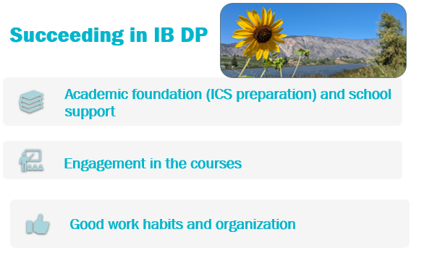
Notes:
LJ

Slide 28
Your Next Steps
Topics to consider
  Reasons for transfer
    Extracurricular activities
    Different options for courses
    Long commute
  School culture and size
  AP vs IB
  Preparedness for IB
Process to transfer
  Email Counselor and/or Registrar to confirm decision to transfer
Notes:
AN

Slide 29
Are You Thinking of Leaving ICS?
If you plan to or are considering leaving ICS please note:
  Registration for classes for the 2026-27 year take place in all Lake Washington schools in February
  Schools build their class schedules based on student course requests in March and April
  Sharing your intention to change schools for the 2026-27 school year after February likely limits the course choices your student will have at their neighborhood school
  We know this is an important decision for your family
Notes:
JH

Slide 30
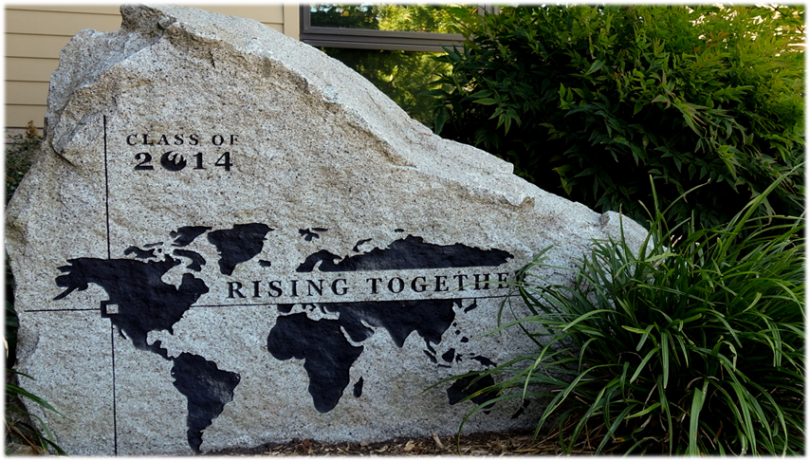
Questions?
Notes:
JH

Slide 31
IB at ICS
Thank you!
Please find more info at ics.lwsd.org/ib-diploma-program
Notes:
JH

