Slide 1


Annual Title I
Parent Meeting
Click the speaker button for an audio recording. →
Tuesday, September 15, 2026
5:00 - 6:30 p.m.
Elementary Cafeteria
Heather Luoto, Superintendent
Joe Brownson, K-12 Administrator
Debra Mersnick, K-6 Reading & Math Intervention

Slide 2

Agenda:
Welcome & Introductions
Purpose of Annual Parent Meeting
What is Title I?
Title Funding & Allocations
Schoolwide Title I vs. Targeted-Assistance Title I Program
Title I at Engadine: General Overview
Educational Standards & Assessments
Title I Parental Rights
Parental Involvement
QR Codes: Family Engagement, Compact, Input Form, Slideshow, Title I Quick Guide Pamphlet
Methods of Communication
Thank you & Questions

Slide 3








Slide 4
Purpose of the
Annual Parent Meeting
To respond to
parent or
guardian
questions and
suggestions
Encourage & gather parent/ guardian input.
Educate, inform, & work as a team.
A Title I parent meeting is required to be held yearly
To explain and discuss the
Title I program
& requirements at ECS
The goal of Title I is for every child to have a higher quality of education.

Slide 5

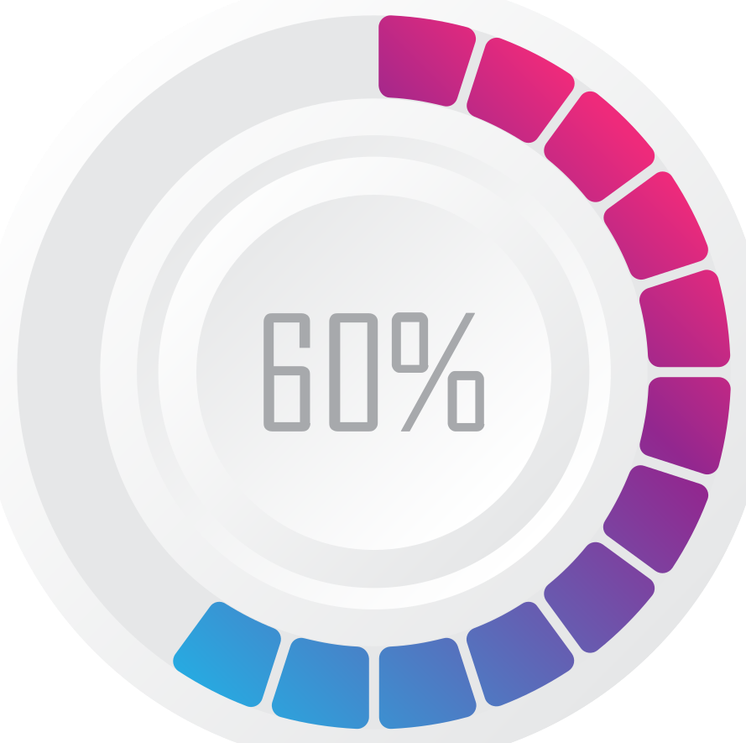
What is Title I?
One of the oldest and largest federal programs that supports elementary and secondary education.
More than 60% of schools in the
USA received
some sort of
Title I funding.
Helps underprivileged and/or underperforming children meet challenging state academic standards.
60%
Title I
Title I funds provide students with extra instructional support beyond the
regular classroom.
Funding is provided through state educational agencies to public schools.

Slide 6



What is Title I?
Title I is based on three important ideas:
All students should have a fair, equal, and significant opportunity to obtain a high-quality education and to reach, at minimum, proficiency on state academic standards and assessments.
Funding should be heavily directed toward continuous training to ensure all educators are highly-qualified and use research-based instructional strategies to close academic achievement gaps.
Schools actively engage families to build academic success through engagement programs, meetings, and involvement in developing compacts, reviewing programs, and providing input and suggestions.

Slide 7

Title Funding & Allocations
TOTAL Title I funding for this year = $180,679
Allocations:
Title I $158,215
Title II $ 11,905
Title IV $ 10,559
Who decides how funds are used?
School leadership makes personnel and instructional decisions based on the specific needs of the student population and data.
Parent input is also used in the decision making process and is encouraged throughout the year by:
Joining teams & meetings
Title I Input form
Title I Parent Meeting (This meeting!)
Parent-Student-Teacher Compact
Parent & Family Engagement Plan
Input Forms from events and family nights
(QR codes later in presentation)

Slide 8
Title I, Funding Allocations:
$158,215 Improving Basic Programs
What These Federal Funds ARE Used For:
Direct Student Support: Extra help for students in reading and math.
More Classroom Resources: Purchasing extra learning materials, technology, and specialized educational software.
Hiring Supplemental Staff: Funding reading specialists, math coaches, counselors, or tutors to work directly with students who need a little extra support.
Family & Parent Engagement: Hosting school literacy nights, math workshops, and family events to help you support your child's learning at home.
What These Funds CANNOT Be Used For:
Everyday School Costs: Replacing state or local budgets to pay for regular classroom supplies, standard textbooks, or general teacher salaries.
School Building Upgrades: Making physical repairs, painting, or remodeling school facilities.
General Rewards or Prizes: Purchasing generic student/parent gift cards, cash awards, or attendance incentives that aren't tied directly to an academic lesson.
Unrelated Field Trips: Funding recreational school trips or activities that lack a clear, documented connection to regular classroom instruction.

Slide 9
Title II Funding Allocations:
$ 11,905 Supporting Effective Instruction
What These Federal Funds ARE Used For:
Better Trained Teachers: High-quality professional development, workshops, and coaching so teachers can bring the best learning strategies into our classrooms.
Stronger School Leaders: Advanced training for principals and school administrators to lead our schools effectively.
Recruiting Great Staff: Programs to attract, support, and retain excellent educators for our students.
What These Funds CANNOT Be Used For:
Direct Student Services: Extra tutoring, summer schools, or student assemblies (these are covered by other funds like Title I).
Supplies & Facilities: Purchasing standard student textbooks, classroom technology, or school building repairs.
Student Medical/Mental Health Care: Direct healthcare or medical services for students.

Slide 10
Title IV, Part A Funding Allocations:
$ 10,559 Healthy & Well-Rounded Students
What These Federal Funds ARE Used For:
Well-Rounded Education: Expanding student access to the arts, music, foreign languages, advanced science/STEAM/STEM programs, and college/career counseling.
Safe and Healthy Schools: Improving school environments through anti-bullying initiatives, school safety upgrades, physical education programs, and student mental health or counseling support.
Effective Use of Technology: Boosting digital literacy by purchasing specialized educational software, providing internet safety training, or implementing blended-learning toolkits.
What These Funds CANNOT Be Used For:
Mandated State Programs: Paying for classes, materials, or programs that Michigan law already requires the school district to provide.
Medical or Substance Treatment: Providing direct medical procedures, clinical healthcare, or drug rehabilitation services for students.
Buying Just Devices (Over Limit): Spending more than 15% of the technology budget on hardware like laptops, tablets, or school-wide wiring.
School Construction: Funding physical building renovations, facility repairs, or school remodeling projects.

Slide 11

Schoolwide Title I vs. Targeted-Assistance Title I Program
Engadine qualifies & operates as a schoolwide program.
In a Targeted-Assistance program:
Services are strictly limited to designated eligible students and their families, rather than the entire student body.
Schools are required to keep a prioritized list of students for intervention who have the greatest academic needs
Parents/guardians must be notified and give consent before intervention begins
Services are mostly push-in models or extended learning time after school, during the summer, or weekend programs.
A Schoolwide Title I program:
Services the entire student body, no eligibility labeling, students move in and out of the program as demonstrated needs are identified or met.
Is guided by data analysis of student performance and gaps to determine eligibility
Allows Title I funds to be combined with other funds sources to upgrade the entire education program of the school
Integrates into the regular education day and can be push-in, pull-out, small group, or individual
Can fund after-school programs, summer school, tutoring activities, and some family events.
Schools must have a child poverty rate of at least 40 percent
to choose to operate a schoolwide program.

Slide 12
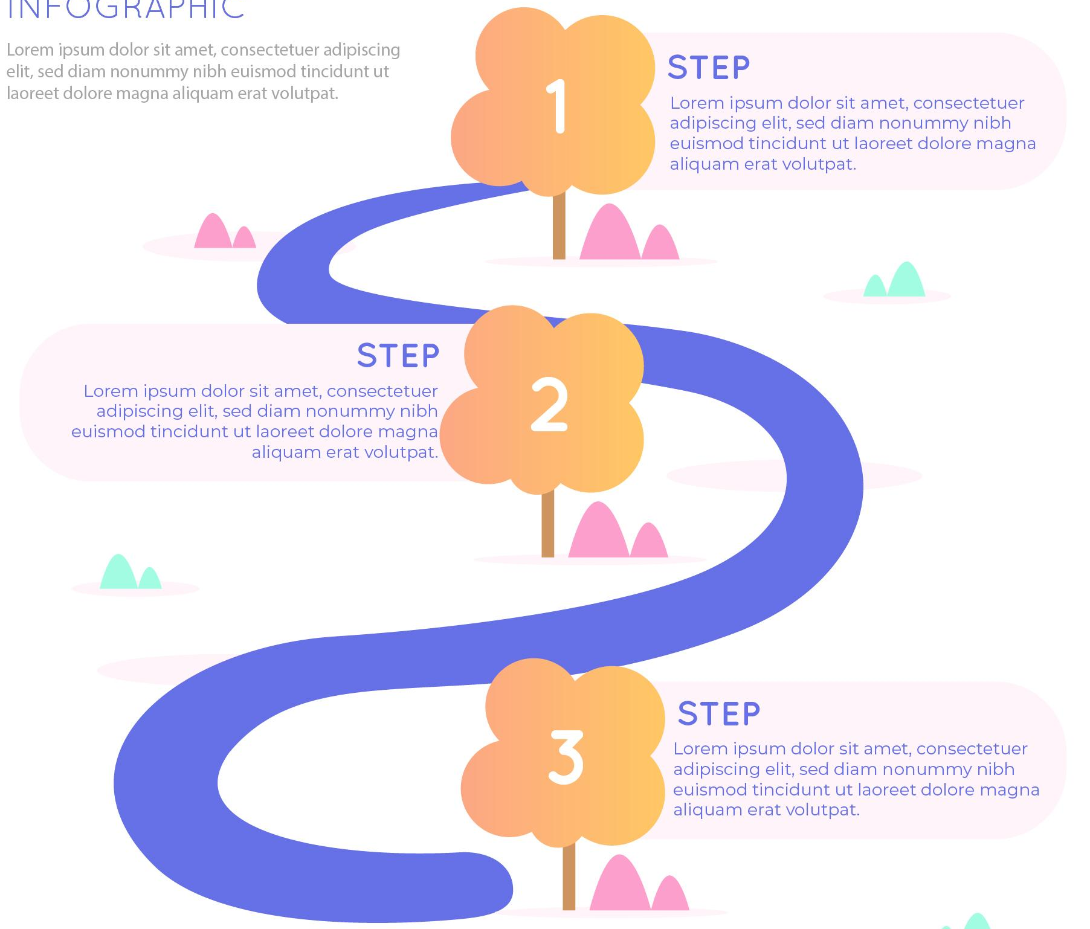
Title I at Engadine:
General Overview
Identify Students:
Screening assessments
Teacher input
Classroom performance
Parent or teacher concern
Service Areas of Most Need & Monitor Progress:
Further assess to determine strengths & weaknesses
Create a learning path & intervention begins.
Monitor progress and interventions, make changes made as needed.
Exit or Move Beyond Intervention:
Students meet criteria and exit program.
If more is needed, the Student Assistance Team is notified. The team of staff, ancillary services, & parents work together to decide on a course of action.
The action plan is put into motion and monitored.
LINKS:
K-6 Intervention Procedures & Protocols
Entrance & Exit Criteria

Slide 13
Title I Decision Tree
Students take NWEA
Teachers and Parents can initiate Title I testing or a SAT at any time.
Scores on/ above norm
Scores below norm
Performance deficit present, teacher and/or parent concern
No deficits reported by teacher, parent, or student
No deficits reported by teacher, parent, or student
The teacher indicates a performance or behavioral problem or parent voices concern
Specific assessments given to pinpoint areas of strength and weakness/deficit
No intervention needed at this time; monitored for changes
No Title I services needed at this time
Intervention/Learning Path is created and implemented
Progress monitoring, data collection, assessment of intervention effectiveness
YES!
NO!
Intervention Working?
Progress being made?
Intervention Works! Keep going.
Make changes or initiate a SAT

Slide 14
Student Assistance Team Process (Overview)
We want parents/guardians to attend and have a voice! YOU are an important part of the process!
Student Assistance Team General Overview
Interventionist/SAT data coordinator is notified of need (Data, Parent, Teacher, Other) & discuss concerns w/ stakeholders
Interventionist/SAT data coordinator sets up data collection with teacher(s) and gathers current data.
SAT coordinator is informed of a need for a meeting and all involved stakeholders are contacted for a mutual meeting date & time
Data collection continues with progress monitoring and assessing how accommodations and/or interventions are working. Changes mede, if needed.
The SAT is held. Run by SAT coordinator. Everyone discusses strengths, weaknesses, concerns, data, suggestions, and paths forward. A consensus is reached.
The action plan is followed. Data is collected until the next meeting to discuss if the plan was effective.
All parties are notified of their roles and duties and a follow-up meeting is scheduled.
Effective?
Continue.
Not Effective?
Make changes.

Slide 15


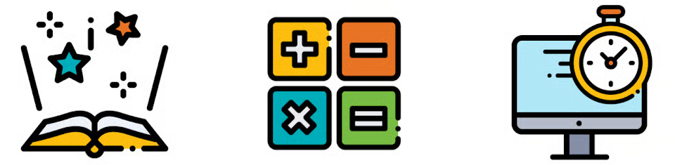
Educational Standards & Assessments
Educational Standards
Engadine’s educational framework is based around the Michigan State Standards and Expectations which establish high expectations for all students for all subjects and classes.
ELA
Math
Social Studies
Art
Music
Technical education & trades
Computer science
Science is based around Michigan’s Next Generation Science Standards.
For more information, please visit https://www.michigan.gov/mde/services/academic-standards
Assessments
Assessments are guided by the Michigan State Standards and Expectations. They assess the level of proficiency for math, reading, science, and more. Assessments are also used for screeners to assess needs, digging deeper, and to monitor progress.
The following slides show the variety of testing at each grade level.
For Title I Criteria, see the Entrance & Exit Criteria for Title I assessments & the K-6 Intervention Procedures & Protocols.

Slide 16
Schoolwide Assessments
NWEA Assessments Grades K-11
  (Northwest Evaluation Association)
  Measures Academic Growth - overall growth
  Fall, Winter, & Spring
  Screener & progress monitoring
M-STEP Grades 3-7
  (Michigan Student Test of Educational Progress)
  Measures Academic Growth
  Once a year in the spring. Parents are sent information from the State.
  3, 4, 6, & 7 ELA & Math
  5 ELA, Math, Science, & Soc. Studies
  8 Science & Soc. Studies (PSAT for Math & Reading)
  11 Science & Soc. Studies (SAT)
PSAT Grades 8-10. SAT, MME, & ACT WorkKeys in Grade 11
  Measures Academic Growth
  Used by colleges and universities
  Can help determine scholarships, grants, and dual enrollment eligibility
District Testing
Taken by all students.
Data is used to drive instruction/intervention and curriculum improvements.
Used to determine growth and/or screen for intervention.
Used for staff evaluations & school performance evaluation.
Improve curriculum gaps
Evaluate program effectiveness
Evaluate teacher effectiveness
PSAT = Preliminary Scholastic Aptitude Test
SAT = Scholastic Aptitude Test
MME Michigan Merit Examination
ACT = American College Testing
Notes:
What assessments are used to measure student performance and progress?
NWEA Reading and Math Assessments - Used as a whole-school screener, growth indicator, and for evaluations
This is an adaptive, standardized, nationwide-normed assessment used to approximate knowledge levels and to prove growth of student knowledge over time
The scores are also used for effectiveness evaluation ratings, individually for the administration and teachers, and, as a whole for the school.
Fountas & Pinnell Reading Benchmark Assessment and Optional Assessments
Used K-6
In Grades K-1st, Assessment is used to determine Letter and sound identification, blending, segmenting, initial sound and matching, rhyming, colors, shapes, and reading of high-frequency words.
In Grades K-6th, the Reading Benchmark assessments are used to determine reading level in terms of accuracy, fluency, and comprehension. It is also used to progress monitor and show growth over time.
LETRS (Language Essentials for Teachers of Reading and Spelling)

Slide 17
Title I Assessments
Reading, Spelling, Comprehension, Vocabulary
LETRS Phonics & Word Reading Survey
LETRS Spelling Survey (K-2 list and 3+ list)
Heggerty - Phonemic Awareness (K-2)
Fountas & Pinnell (F&P) Reading Benchmark Assessment
Fountas & Pinnell Optional Assessments
  Letter and Sound Identification, blending, Segmenting, Rhyming, Colors, & Shapes
PAST Assessment
Words Their Way Spelling Inventory
Teacher-made specific skill assessments
Math Assessments
AVMR Math Recovery®
  Number System, Structure, +, -, x, ÷, & Fractions
General Math Skill Level Assessment (6-8), adapted from LearnMathFastBooks.com
Teacher-made specific skill assessments
Eye Tracking and Body Movement
Eye Tracking Check - basic eye movement check
Movement/Reflex Check - basic movement check
Title I Intervention Assessments
Taken by identified students to further determine need & growth.
Data is used to
  Drive instructional paths for students
  Determine areas of most need
  Monitor success of students and interventions
  Aids in SAT meetings, Retention, and Advancement Placements
  Improve curriculum gaps
  Evaluate program effectiveness
  Evaluate interventionist effectiveness
LETRS = Language Essentials for Teachers of Reading and Spelling
PAST = Phonological Awareness Screening Test
AVMR = Add+Vantage Math Recovery
Notes:
What assessments are used to measure student performance and progress?
NWEA Reading and Math Assessments - Used as a whole-school screener, growth indicator, and for evaluations
This is an adaptive, standardized, nationwide-normed assessment used to approximate knowledge levels and to prove growth of student knowledge over time
The scores are also used for effectiveness evaluation ratings, individually for the administration and teachers, and, as a whole for the school.
Fountas & Pinnell Reading Benchmark Assessment and Optional Assessments
Used K-6
In Grades K-1st, Assessment is used to determine Letter and sound identification, blending, segmenting, initial sound and matching, rhyming, colors, shapes, and reading of high-frequency words.
In Grades K-6th, the Reading Benchmark assessments are used to determine reading level in terms of accuracy, fluency, and comprehension. It is also used to progress monitor and show growth over time.
LETRS (Language Essentials for Teachers of Reading and Spelling)

Slide 18







Title I Parental Rights
Teacher Qualifications:
Request licensing status, major, and credentials of teachers and paraprofessionals.
Shared Policies:
Help design the Parent-Family Engagement Plan and the Parent-Student-Teacher Compact.
Student Performance:
Receive timely data on your child’s state assessment and achievement levels. Review the school’s achievement data, parent handbook, and parental involvement plan.
Curriculum Access:
Review textbooks and instructional materials under Michigan law.
School Meetings:
Attend the mandatory annual Title I meeting to review program goals and funding.
Have opportunities to attend meetings, give input, and attend trainings
Clear Communication:
Access to Title I documents (parent compact and engagement plan) and notices in a language you understand.
Notes:
What assessments are used to measure student performance and progress?
NWEA Reading and Math Assessments - Used as a whole-school screener, growth indicator, and for evaluations
This is an online, adaptive, standardized, nationwide-normed assessment used to approximate knowledge levels and to prove growth of student knowledge over time
The scores are also used for effectiveness evaluation ratings, individually for the administration and teachers, and, as a whole for the school.
Fountas & Pinnell Reading Benchmark Assessment and Optional Assessments
Used K-6
In Grades K-1st, Assessment is used to determine Letter and sound identification, blending, segmenting, initial sound and matching, rhyming, colors, shapes, and reading of high-frequency words.
In Grades K-6th, the Reading Benchmark assessments are used to determine reading level in terms of accuracy, fluency, and comprehension. It is also used to progress monitor and show growth over time.
LETRS (Language Essentials for Teachers of Reading and Spelling)

Slide 19


Parental Involvement
Parents and guardians influence their children’s education
more than anyone else.
Involved & engaged parents:
Increase academic performance by reinforcing learning outside the classroom
Enhance social and emotional skills by fostering self-esteem, helping build strong peer relationships, and developing emotional regulation so children can navigate social environments with confidence.
Have students with greater motivation, higher attendance rates, and significantly fewer behavioral disruptions because they know what is expected.
Have students that understand the teachers and their parents are aligned and that any academic or social struggles will be taken care of and resolved.
Ways to be involved:
Show interest & ask questions about what is being learned or practiced
Provide ample opportunities for your child to read, be read to, and practice basic math computations
Attend school meetings, open house, events, & parent-teacher conferences whenever possible
Volunteer or participate in any capacity you can
Keep communication lines open and professional
Inform the school of changes, especially phone numbers and emergency contacts
Establish & keep routines
How to monitor your child’s progress?
Work with your child's teacher as often as needed to discuss progress.
Be present and available during homework time.
Ask about or review student work and/or check child’s folder nightly.
Engage with your child when reading nightly.
Participate in literacy training activities.
Read and review tips that are included in informational pamphlets and newsletters that are sent home or shared.
Use practice materials sent home by teachers and intervention.

Slide 20
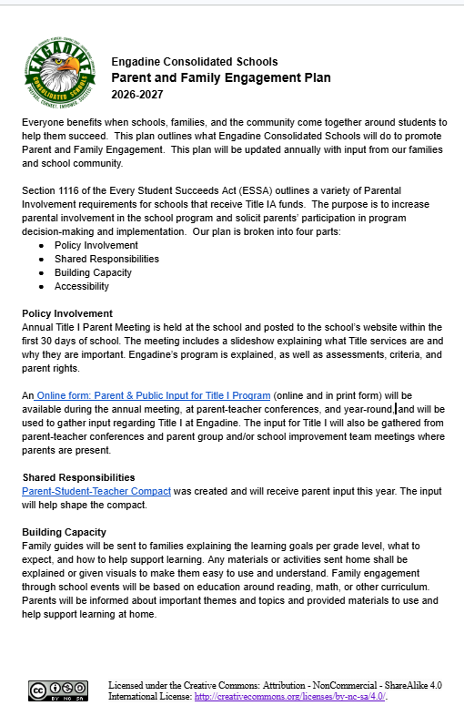
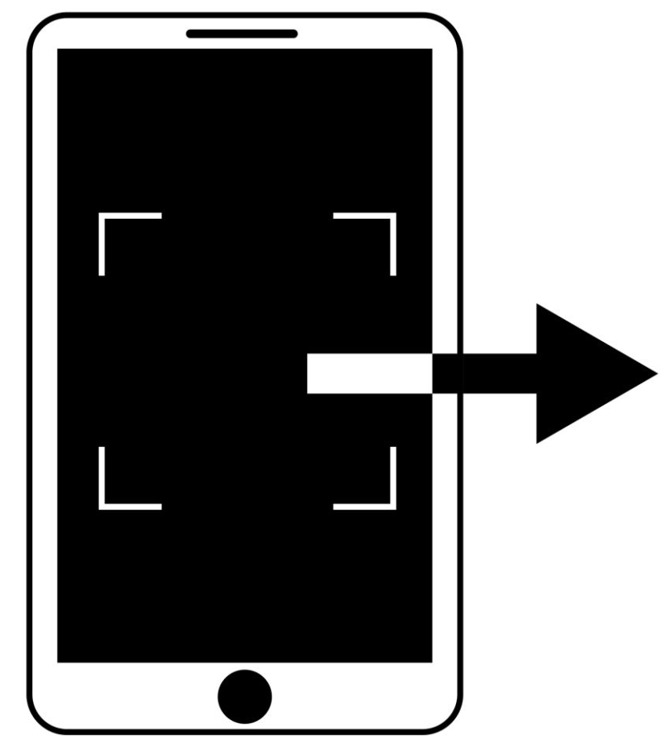
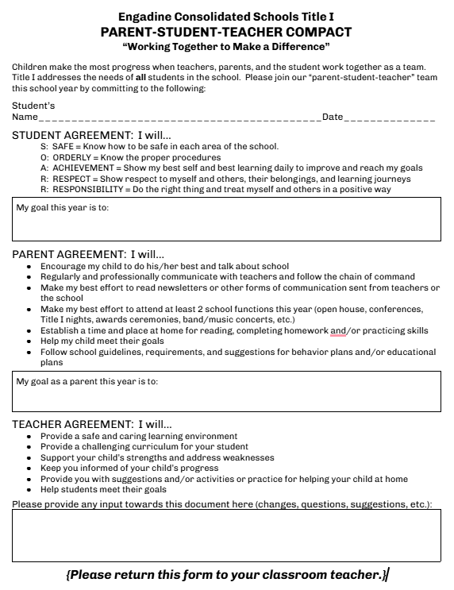
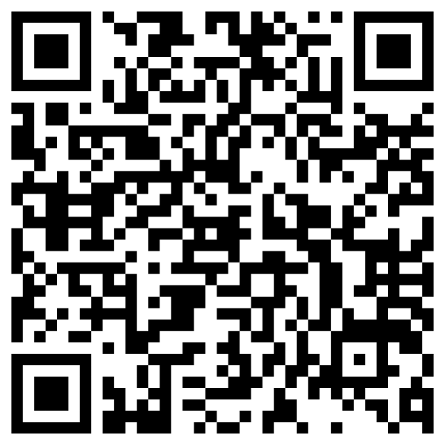
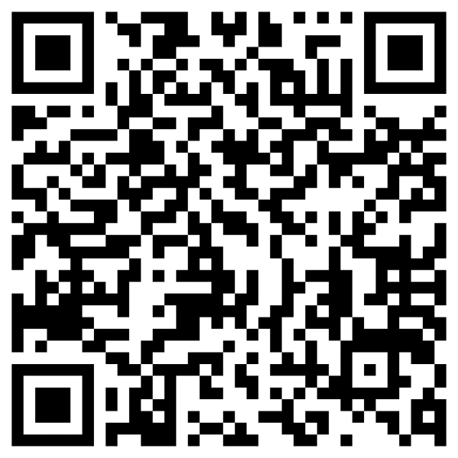
QR Codes: Family Engagement & Compact
Parent & Family Engagement Plan:
Our promise on how we will keep you informed, welcome you into the building, and support you.
https://docs.google.com/document/d/1yFpidXaYdsoKe6VrjecezSR529darVseGDAKX11nO-A/edit?usp=sharing
Parent-Student-Teacher Compact:
A simple agreement showing how teachers, parents, and students all share the responsibility for everyday learning success.
https://docs.google.com/document/d/1O25isIdYqtZtBU6QjVG3pr5cYPDJ2FXcRQz1CxO5s0M/edit?usp=sharing
SCAN QR code
SCAN QR code
Please review these documents and provide your suggestions and questions!
Your input matters!
SCAN QR code

Slide 21

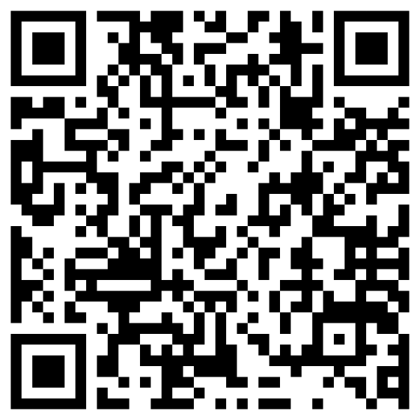
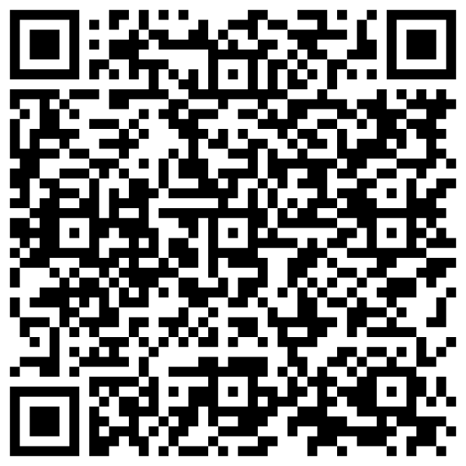
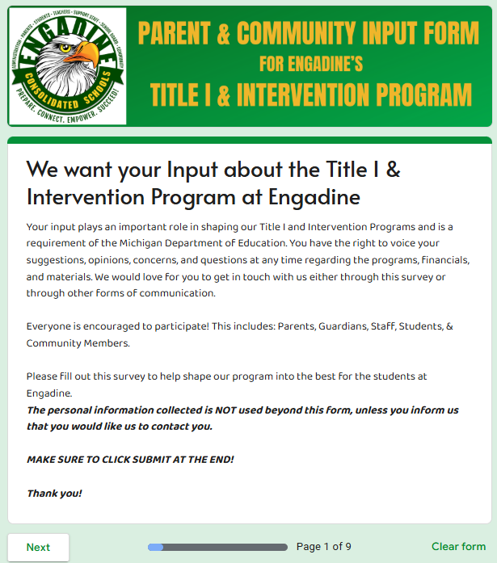
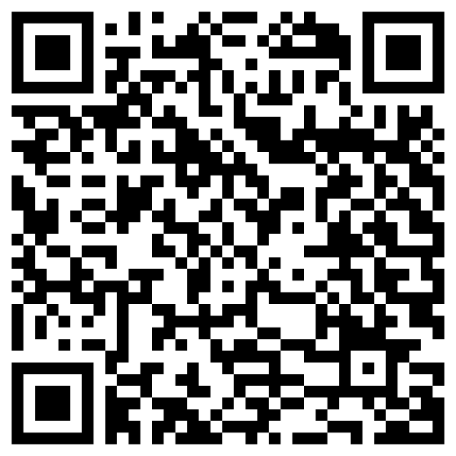

QR Codes: Input & Feedback form & Slideshow
WE WANT YOUR INPUT! Please fill out the digital sign-in and feedback form. This counts as your official attendance and lets you give your input and feedback! https://forms.gle/7TRLGvetCyJFjQZG7
See the Annual Title I Parent Slideshow
with audio recordings here:
https://docs.google.com/presentation/d/1kjlXKEmdHAN7tnyMB8aFYJnGyMcTfDM_YifbrQSBDXQ/edit?usp=sharing
SCAN QR code
View the slideshow with or without the audio recording.
On each slide, click the speaker button in the upper right-hand corner of the slide.
SCAN QR code
Print a physical copy of the Input Form: https://docs.google.com/document/d/1Pa58de3MLTKJVNno5ht9k7dvNytXYijBfYvhxdCiFt0/edit?usp=sharing
Click speaker for recording →
Gathering input is one part of the requirements from the State of Michigan to show a partnership between the school, families, and the community.

Slide 22
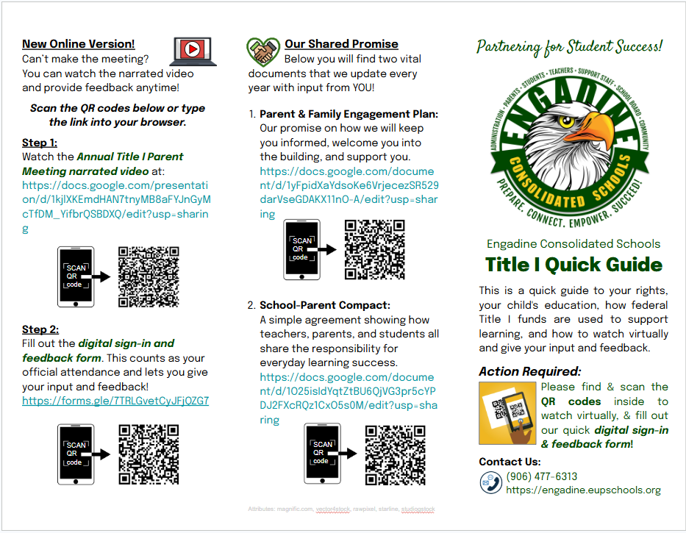
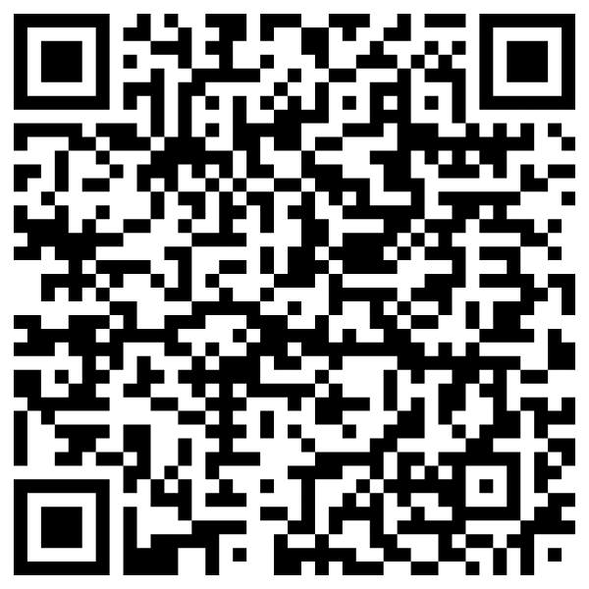
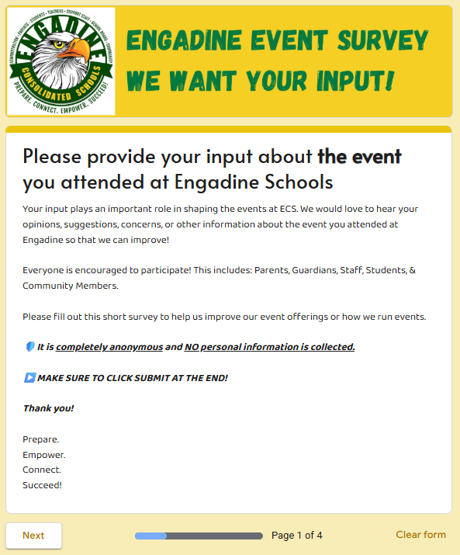
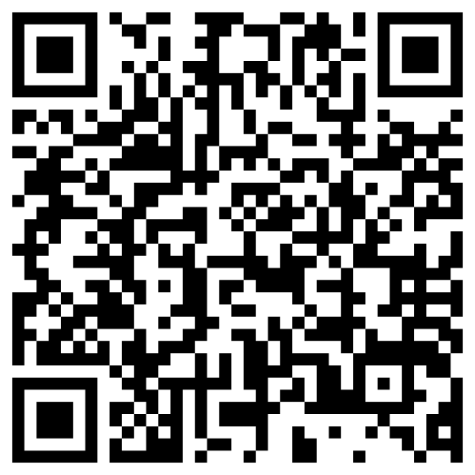

QR Codes: Even Input Form & Title I Quick Guide
Did you attend an event at Engadine? Please provide your input. Filling out this digital feedback form helps to make events at Engadine better for everyone.
https://forms.gle/dobtD2AHB1Z7tcoA7
Title I Quick Guide Tri-Fold Pamphlet:
https://docs.google.com/presentation/d/1OJwxFgHpm8J1uL1C8qZJjL_RlH2MnFptJ-YuglgCT98/edit?usp=sharing
SCAN QR code
SCAN QR code
Gathering input is one part of the requirements from the State of Michigan to show a partnership between the school, families, and the community.

Slide 23




















Methods of Communication
Keep in touch &
Keep informed!
School Phone, messages, automated notification calls, & staff phone calls
Conferences, Meetings, Open House, & Events
Teacher/Staff/Parent Email,
SchoolStatus Connect Messenger
School Website, ECS Facebook Page, & School Status Connect Announcements
Classroom & School
Newsletters, Report Cards, & Progress Reports
Documents, Letters, Informational Handouts, Syllabi, & Notes in your child’s planner/folder

Slide 24


Thank you for attending!
Education is a
SHARED COMMITMENT
between
DEDICATED TEACHERS,
MOTIVATED STUDENTS,
and
ENTHUSIASTIC PARENTS
with high expectations.
ECS staff thanks you for:
Attending the meeting
Being informed
Working together with all staff to ensure success for your child and all children at ECS.
Questions, Comments, or Suggestions?
Please contact Mrs. Luoto or Mr. Brownson at
(906) 477-6313.
Created D. Mersnick: 09/13/2023, Revised: 09/04/2025, 7/19/26, 9/8/2026

