Slide 1



REGENTS Reminders
BR8$8eagles

Slide 2
August 2026 Regents

Slide 3
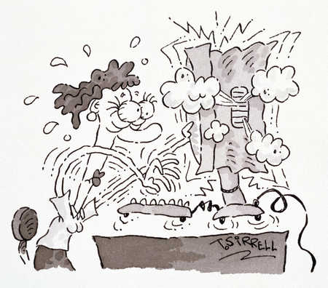
August 2026 Regents

Slide 4
August 2026 Regents
We are working diligently to address all N/A records currently in ASAP
If you can provide any useful information please let us know

Slide 5
Regents January 2026 WORKSHOP!

Slide 6

Regents January 2026 WORKSHOP!
Wednesday December 3rd

Slide 7
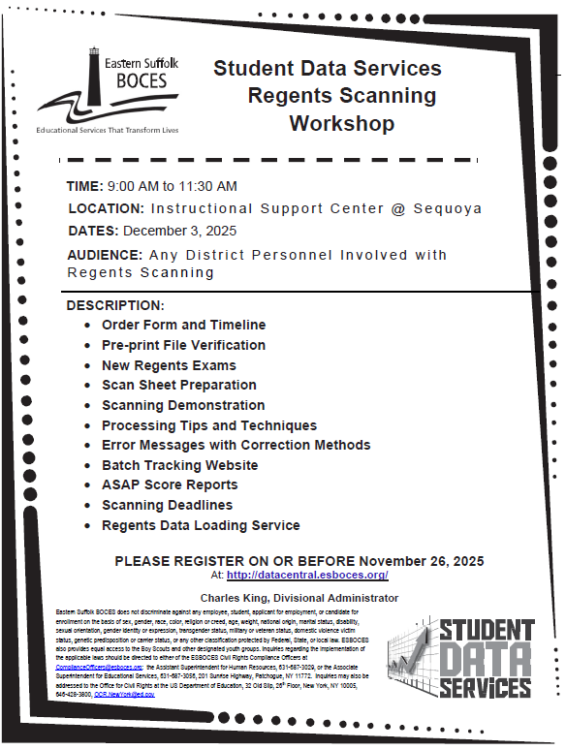
Regents January 2026 WORKSHOP!

Slide 8
Regents January 2027 Schedule

Slide 9
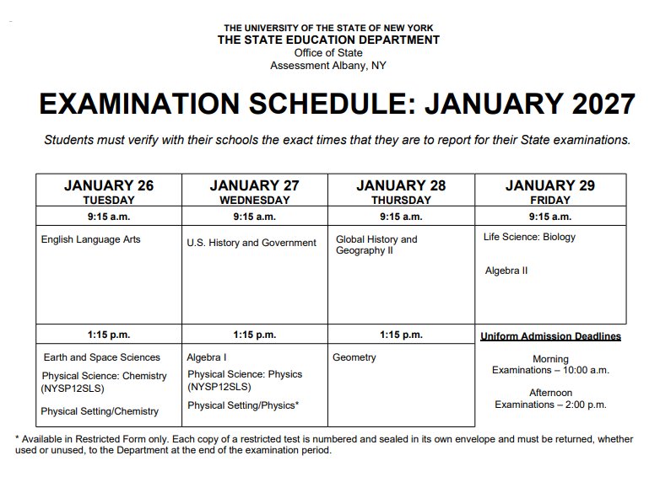
Regents January 2027 Schedule

Slide 10
Regents June 2027 MEMO

Slide 11
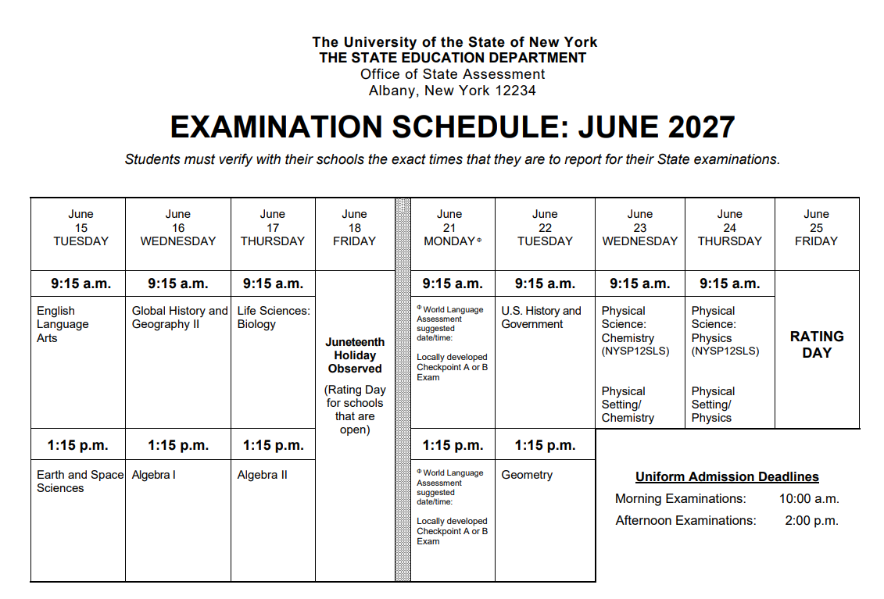
Regents June 2027 MEMO

Slide 12
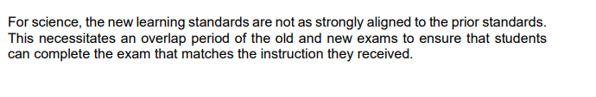
Regents June 2026 MEMO

Slide 13
Regents June 2026 MEMO

Slide 14
Regents June 2026 MEMO

Slide 15

Regents June 2027 MEMO

Slide 16
Regents June 2027 MEMO
Is there a reason any district uses 03101 or 03151 in the 2026-27 school year?

Slide 17
Regents June 2027 MEMO
Is there a reason any district uses 03101 or 03151 in the 2026-27 school year?
Should any district have this code in the course table in Level 0?

Slide 18
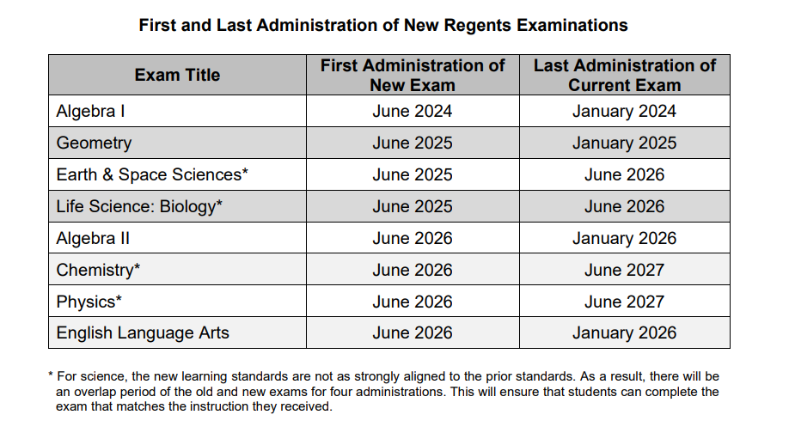
Regents June 2026 MEMO
“You test in what you are taught”

Slide 19
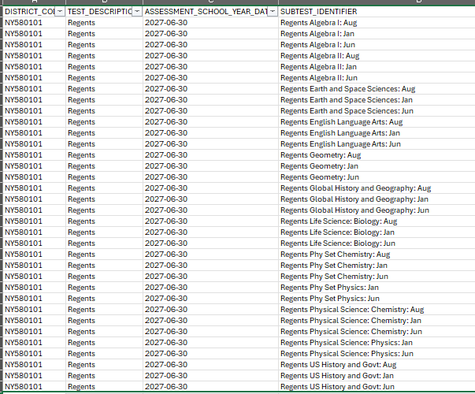
NEW REGENTS TEST DESCRIPTIONS

Slide 20
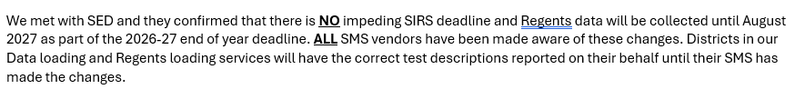
NEW REGENTS TEST DESCRIPTIONS

