Slide 1

Testing Updates
2026-2027

Slide 2

Lessons Learned from 2026
247 students did not have a test status code set in Nextera in 2026-down from 3568 in 2025! Great Job!!
153 students took the NYSESLAT but were not coded 0231 in Level 0-scores can be found on the SIRS 750-Student Profile
64.9% of paper sheets that were ordered were never submitted for processing
Thousands of missing multiple choice bubbles-impacted final scores
Refusal rate lowest in 7 years– down to 32%

Slide 3
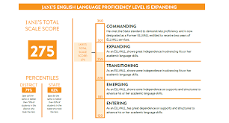
Scores and Score Reports
Scores can be downloaded for each SMS on ReportNet
Scores are in the SIRS 301 and the SIRS 750 on L2RPT
If you are in the ISR printing service:
Digital Files-posted to the SFTP site this week
BULK Printing-should be delivered next week
Mailed-EVI has the materials and should be
sending them out over the next few weeks
Posting service thru EVI-they have all the files

Slide 4
Finding scores for new entrants
Scores can be found on the
SIRS 750-Student Profile
AFTER
Demo and Enrollment have been reported

Slide 5
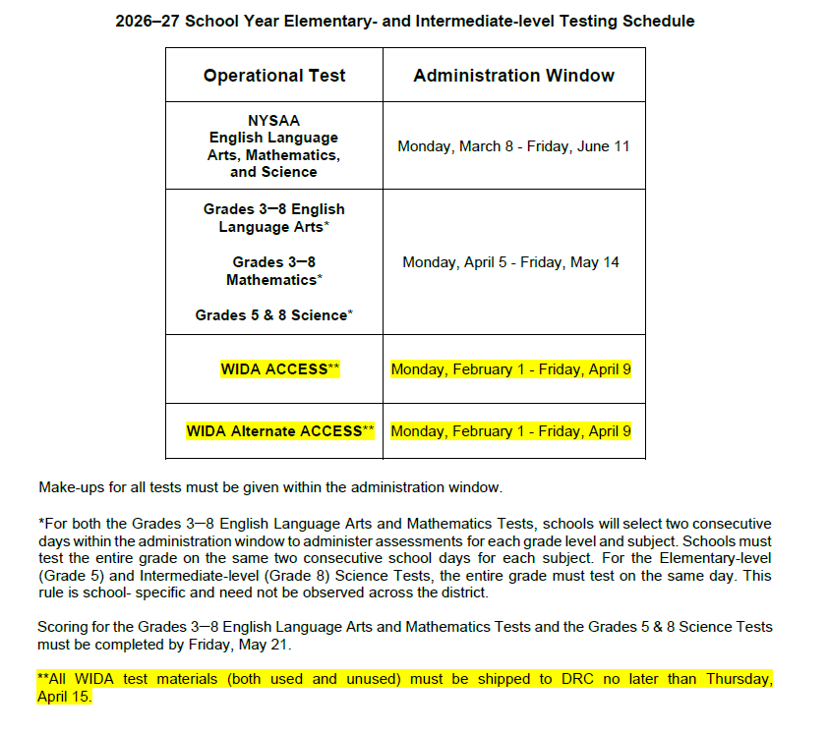
2027 Testing Schedule

Slide 6
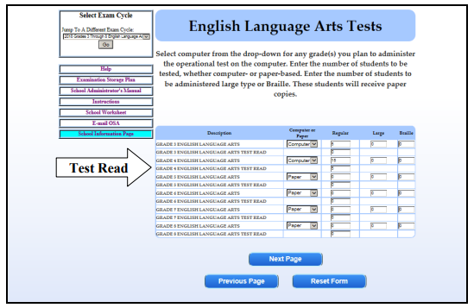
Online Exam Ordering System
Oct 2-Nov 13
Each building is responsible for ordering their exams
Be sure to order paper for test read
Be sure to order the large print and
Be sure to order translated copies needed for Math and Science
DO NOT order CBT Math 8 or Science 8 if the building is not
giving these exams
We will send each DDC the list of what was ordered
Please confirm the accuracy with each building
Lead Scoring Entity-If contracting with BOCES Assessment scoring
select Optimum Solutions Corporation-OSC

Slide 7
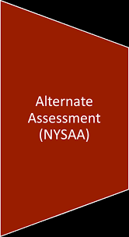
New York State Alternate Assessment
2026–27 NYSAA Test Window:
Monday, March 8, 2027 – Friday, June 11, 2027
The assessment must be completed, or the appropriate special circumstance codes entered, by 5:00 p.m. on Friday, June 11, 2027
NYSED NYSAA Website

Slide 8
Data pull for NYSAA
Programs:
0220-NYSAA Eligible
Type of Disability
Enrollment:
Must be ungraded
November 5, 2026
These students will be uploaded to KITE.
NEW this year:
SED will continue to update student data based on what is reported in Level 0
DTC can no longer edit or move students

Slide 9
2027 Computer Based Testing
Nextera Admin flip began on 9/14 and will be done by the end of the month-no access to the system during this time including constructed responses
All accounts from last year will be deleted
District Testing Coordinators will get their Welcome Letter on 10/2
Tech Readiness Checklist will be available on 10/2
There will be a new secure browser this year-stay tuned for installation guide
Simulation dates 1/11/27-1/22/27-this is required by all schools-school can select the day, the grade and the content area

Slide 10

CBT Training
SED no longer offers live trainings
The recording of the Fall presentation will be posted in
mid-October
All training materials, video presentations and FAQs will be available on cbtsupport.nysed.org
Student Data Services will be offering training workshops on Zoom-dates to be announced soon
If you are a new DDC or have new building staff who need comprehensive training, we can set-up a training for your district

Slide 11
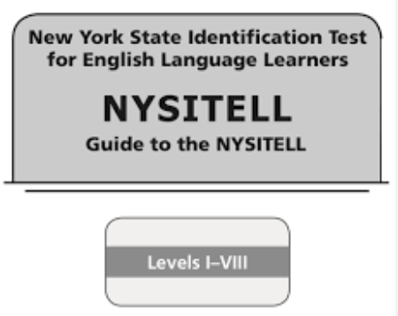
NYSITELL
This is the last year NYSITELL be will on paper
Starting Fall 2027, the assessments will be performed through the WIDA Screener
For this school year, NYSITELL sheets must be ordered from us-submit the form or just email dwtshelp@esboces.org
DOT NOT make copies of the sheets
NYSITELL exams can be ordered through the Online Exam Request System
NYSITELL scores are populated in ASAP within 24 hours of scanning
Check the batch tracker for updates after scanning for errors
Students Scanned over the Summer
SDS reports NYSITELL scores directly to Level 2 and they do not have to be entered into Level 0
Scores will start to be reported to Level 2 after Level 0 opens and demo and enrollment records are uploaded

Slide 12
Data pull for WIDA
Programs:
0231-
ELL Eligible
+
ELL Program
October 29, 2026
These students will be uploaded to WIDA. This is the only data pull for the year. Any new students will have to be manually added.
WIDA CONSORTIUM NEW YORK

Slide 13
Passwords and
Secure Sites

Slide 14
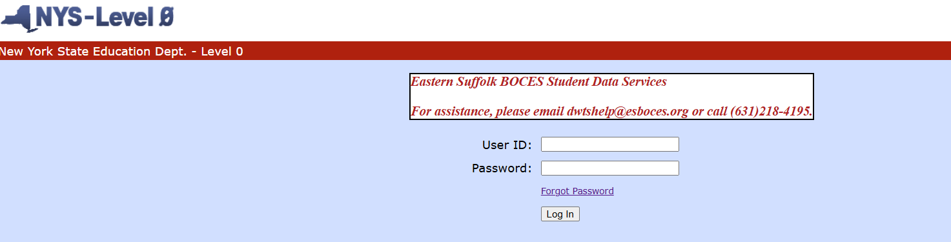
Level 0
Passwords can be reset by clicking Forgot Password on login screen
Level 0 passwords and ASAP passwords are the same
ASAP passwords are also reset on the Level 0 login page
New users need to submit a form

Slide 15
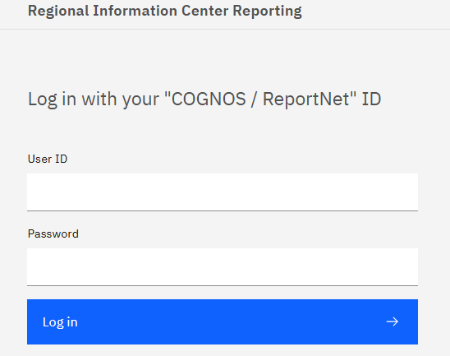
ReportNet/SFTP
Passwords can be reset on dataccentral.esboce.org under Important Links click Account Management
To reset you password you must first enroll in CMP
ReportNet and SFTP use the same passwords
Only 2 users in the district can have STPT access

Slide 16
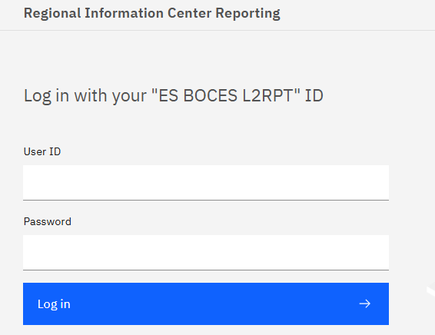
SEDDAS
The same password is used for L2RPT, NYSSIS, PD System and
Level 0 Historical
Passwords can be reset on the NYSED Business Portal-https://portal.nysed.gov/abp/
The Superintendent or someone in your district must set-up your permissions in SEDDAS first
SDS cannot help you change this password

Slide 17

Thank you
Student Data Services
631-218-4195
dwtshelp@esboces.org

