Slide 1


Welcome to Back to School Night
Bienvenidos a Noche de Regreso a Clases
📅 September 9, 2025

Slide 2
Ruus Office Team
Name & Role | Days of Availability | Contact Info
Sam McClymont “Mr. Mack” Principal | By appointment only via Teacher or Office Staff | Phone: 510-723-3885 sm187@husd.k12.ca.us
Felecia Chapman Office Manager Parent Portal & Immunizations | Phone or email: Mon. - Fri. 8:00 AM - 4 PM | Email: fchapman@husd.us Phone: 510-723-3885 ext 27103
Ashiyana Riaz Attendance Clerk To report absences | Phone or email: Mon. - Fri. 7:30 AM - 3:30 PM | Email: ariaz@husd.k12.ca.us Phone: 510-723-3885 ext 27111
Maria Ramirez Family Engagement Specialist (bilingual) | Phone or email TUE-THUR 8:00 AM-2 PM In person: Wed., 12-4 | Email: mr786@husd.k12.ca.us Phone: 510-723-3885 ext. 27216
Jasmine Loaiza Community School Specialist | Phone or Email: Mon-Fri 8:00-3:00 | Email: Jloaiza1@husd.k12.ca.us Phone 510-723-3885 ext. 27404
REACH OUT TO YOUR STUDENT’S TEACHER FOR MORE INFO!

Slide 3
Attendance and Dismissal
School starts daily at 8:15 (after 8:15, students are considered tardy)
Call the attendance office ASAP if child is going to be absent.
Excused vs. Unexcused, 72 hours, doctors note
Cafeteria opens for Breakfast at 7:45-8:00 Cafeteria doors close at 8:10.
TK/K dismissal at 12:15 (No lunch) and 12:35 (Lunch)
Grades 1-3 M,T,Th,F (until October 5) @ 2:50
Grades 4-6 M,T,Th,F 2:50
WEDNESDAY is early dismissal for grades 1-6 at 1:00

Slide 4
Dismissal Location CHANGE
Beginning Monday, October 5, 2026
New Dismissal Locations:
Students in grades 1-3 will dismiss at the front of the school (Dickens ave)
Students in grades 4-6 will dismiss at the rear of the school (Tampa ave)
WHY???
Student safety! Tampa ave is not set up (as a thruway street with buses, etc.) to allow students and parents cross, safely park, etc.
DETAILED INFORMATION (Videos, pictures, maps, calls, emails, etc.) to follow

Slide 5
SIU (Student Information Update) WHY???
We need this information updated
EVERY Year.
Please visit Ms. Maria tonight for further assistance or schedule an appointment.

Slide 6
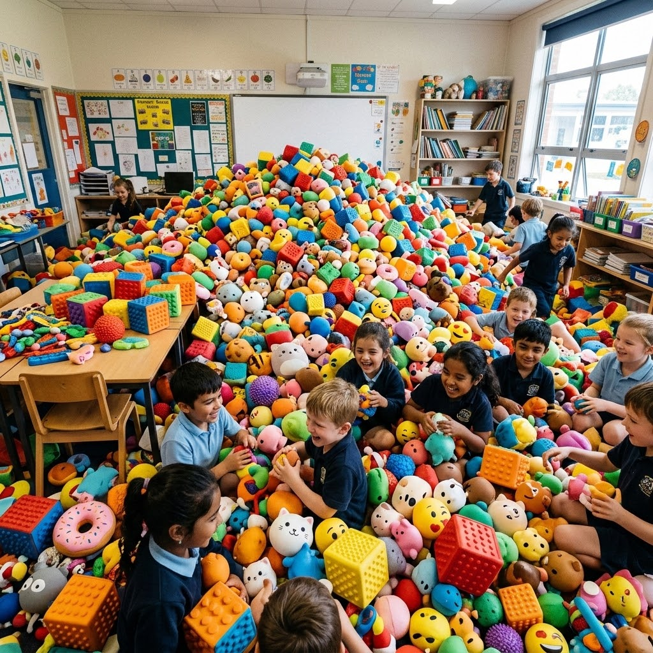
SQUISHIES, AND FIDGETS, AND TOYS, OH MY!

Slide 7
WHAT’S OK? 1 squishy/fidget (being used the CORRECT way a.k.a. not disruptive.
WHATS NOT? Multiple squishies, fidgets, toys, snacks, candy A.K.A. items that can go missing, be disruptive, or are best at home
Please remind your student (check backpacks)
SQUISHIES, AND FIDGETS, AND TOYS, OH MY!

Slide 8
Conflicts vs. Bullying
Conflict:
Disagreement or Argument where both express their views
Equal-ish power between the two parties
Students will generally STOP and CHANGE behavior once they learn (and often reminded) that the behavior is hurtful
Bullying:
Goal is to HURT, HARM, or HUMILIATE
Person doing the bullying general has more-ish power
Continue behavior EVEN WHEN and IN SPITE of knowing and understanding that behavior is hurting/harming/humiliating.

Slide 9
Conflicts vs. Bullying- How to help?
Remind students to practice kindness, seek adult help, and practice empathy and compassion.
Be mindful if you say “defend yourself” that students can interpret this as “being mean is ok…” when someone says or does something that “I don’t like…” even if its expressing a different opinion.
Remember that students often will remember their big feelings about what they experienced and DID NOT like, but can often struggle to remember what they may have done that others DID NOT like.
When we address conflicts and bullying, we are trying to educate, change behavior, and ensure safety.

Slide 10
Chain of Contact (Parent to School)
Step 1: Contact the classroom teacher or subject teacher first via email, phone, or class dojo for academic or classroom concerns.
Step 2: Escalate to administration if the issue remains unresolved after a reasonable timeframe.
Communication practices

Slide 11
ELD/ALD Begins:
Monday, September 28
ELD: English Language Development, specialized instruction supporting students who are multi-lingual learners
ALD: Academic Language Development, specialized instruction for students who are native english speakers/reclassified MLL
1st-3rd grade- 45 min per day- 12:05-12:50pm Every Day
4th-6th grade- 45 min per day- 1:00-1:45 pm M,T, Th, F and Wed. 9:00-9:45am

Slide 12
Staggered Reading Begins:
Monday, October 5th
Staggered reading is only M, T, Th, F
Early Birds (Grades 1-3) drop off at the cafeteria by 08:10
Late Birds drop off outside the cafeteria by 09:00
There is adult supervision in the cafeteria for Late Birds who need to be dropped off early from (8:15-9:05)

Slide 13
Grades 1-3 11:30-11:50 Cafeteria 11:50-12:05 recess
Grades 4-6 12:00-12:20 Cafeteria 12:20-12:35 Recess
TK/K Lunch 12:15-12:35
LUNCHTIME AT RUUS
LUNCH EXPECTATIONS:
Use inside voices
Clean up after yourself
Last 5 minutes are Quiet time (Time to finish food)
Lunch can be dropped off for students on a cart outside of the cafeteria doors

Slide 14
Preschool: Room 1 Maria Ramirez, Room 2 Jeanne Kane
TK: Room 3 Ms. Gaby Biehl
Kinder: Room 4 Lisa Flevotomos Room 9 Rachel Stockwell
1st Grade: Room 8 Natalie Bensky, Room 7 Jihan Johnson
2nd Grade: Room 6 Megan Tripp, Room 11 Kushboo Nair
3rd Grade: Room 21 Jamie Mejia , Room 14 John Rosen
4th Grade: Room 15 Amanda Garcia
4th/5th combo: Room 13 Marnie Buxbaum
5th Grade: Room 12 Rehuna Hussain
5th/6th Grade combo: Summer Ehigiator
6th Grade: Room 19 Jamie Breukers
TK/K SDC: Room 5 Raziel Gordon
K-2 SDC: Room 10 Rose Bere
2-4 SDC: Room 22 Asia Jamison
4-6 SDC: Room 16 Katherine Light-Valrey
Notes:
Have Teachers step forward by grade level and be dismissed.

Slide 15
Physical Education Teacher- 1st-6th grade room 24
Coach Emiliano Leyba, Mon-Thursday
Science Teacher - 1st-6th grade room 26 Lisa Wong Thursday/Friday
Music Teacher - 1st-6th grade Diana Calica (Monday/Tuesday/Wednesday
Instrumental Teacher - Donmelson Varsovia, W only (grades 5 & 6 only)
Meet our Ruus Prep Teachers

Slide 16
RSP Teacher: Room 26 Hunter Hodges
EL Specialist: Room 17 Marisa Perez-Frame
Speech Pathologist: Office, Joycelyn Young
Family Engagement Specialist: Room 30 Maria Ramirez
Community Schools Specialist: Room 30 Jasmine Loaiza
Nurse: Office, Jilla Azad
Meet our Ruus Support Staff

Slide 17
SEL Counselor: Janett Hernandez
Clinical Consultant: Valerie Garcia
STARZ clinicians: Kim Torrez and Maria Lee
Meet our Ruus Mental Health Clinicians

Slide 18
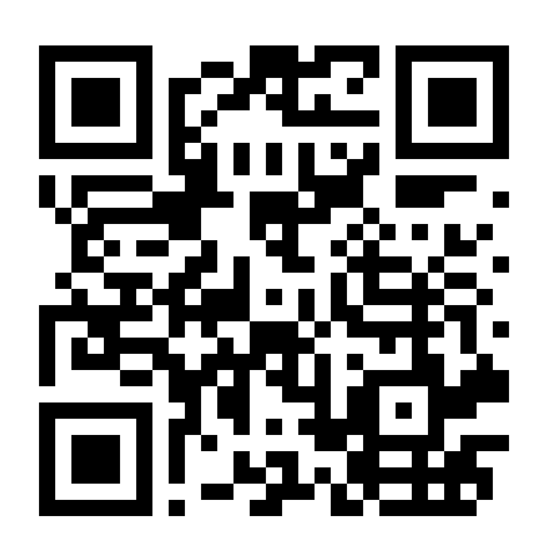
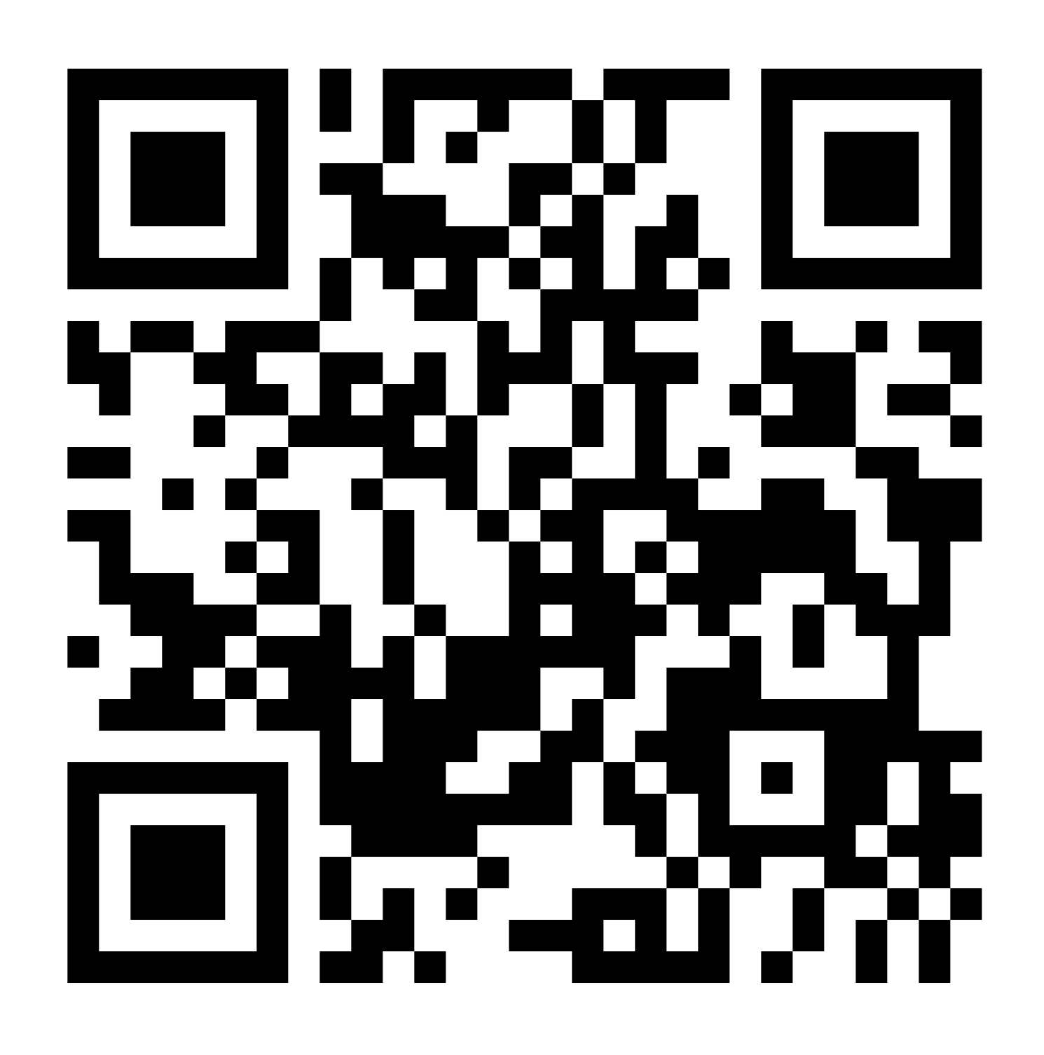
COST stands for Coordination of Services Team
One-Stop-Shop for giving students access to additional resources including counseling!
Did you know, Parents/Guardians can submit COST requests TOO?
RUUS COST TEAM
COST REQUEST (ENGLISH)
COST REQUEST (ESPANOL)

Slide 19
We Need You! ¡Lo/a Necesitamos!
Volunteers shape our community.
Add your voice and service here:
ELAC
SBDM -
SSC
AASAI -
PTA -
Voluntarios forman la comunidad.
Una su voz y su servicio aqui:
- ELAC
- SBDM
- SSC
- AASAI
- PTA
If you are interested in becoming a Parent Volunteer, please contact Ms. Felicia or Ms. Maria Please note: due to Budget reductions, Ruus cannot pay for the processing fee for new volunteers
Notes:
For more information, please click on the links included in the slide.

Slide 20
For more information:
ELAC: contact Ms. Frame- Maperez@husd.k12.ca.us
AASAI: contact Ms. Ehigiator- Se708@husd.k12.ca.us
PTA: contact Pualani Martinez OR Summer Ehigiator- Pd661@husd.k12.ca.us or Se708@husd.k12.ca.us

Slide 21

Follow us on IG- Ruuselementaryjaguars
Remember to check phone/email/text for weekly Friday messages AND sign up for Class DoJo with your teachers

Slide 22
Million Father March:
What- Celebration, March from Ruus Park
When- Friday, September 18 @ 7:45
Where: Ruus Park, then walking together from the park to Ruus
Who: All Parents and Caregivers, but especially Dads and other Males involved in students’ lives
Why: Because our students benefit the most from having involved parents and caregivers.
Notes:
Have Teachers step forward by grade level and be dismissed.

Slide 23

Thank You
Gracias

