Slide 1




Slide 2
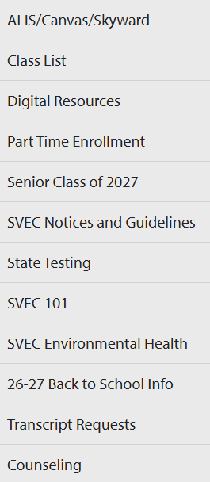
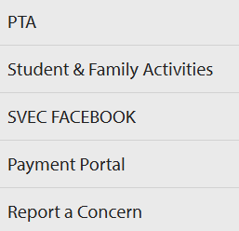
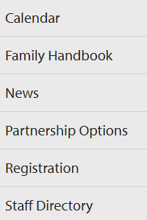
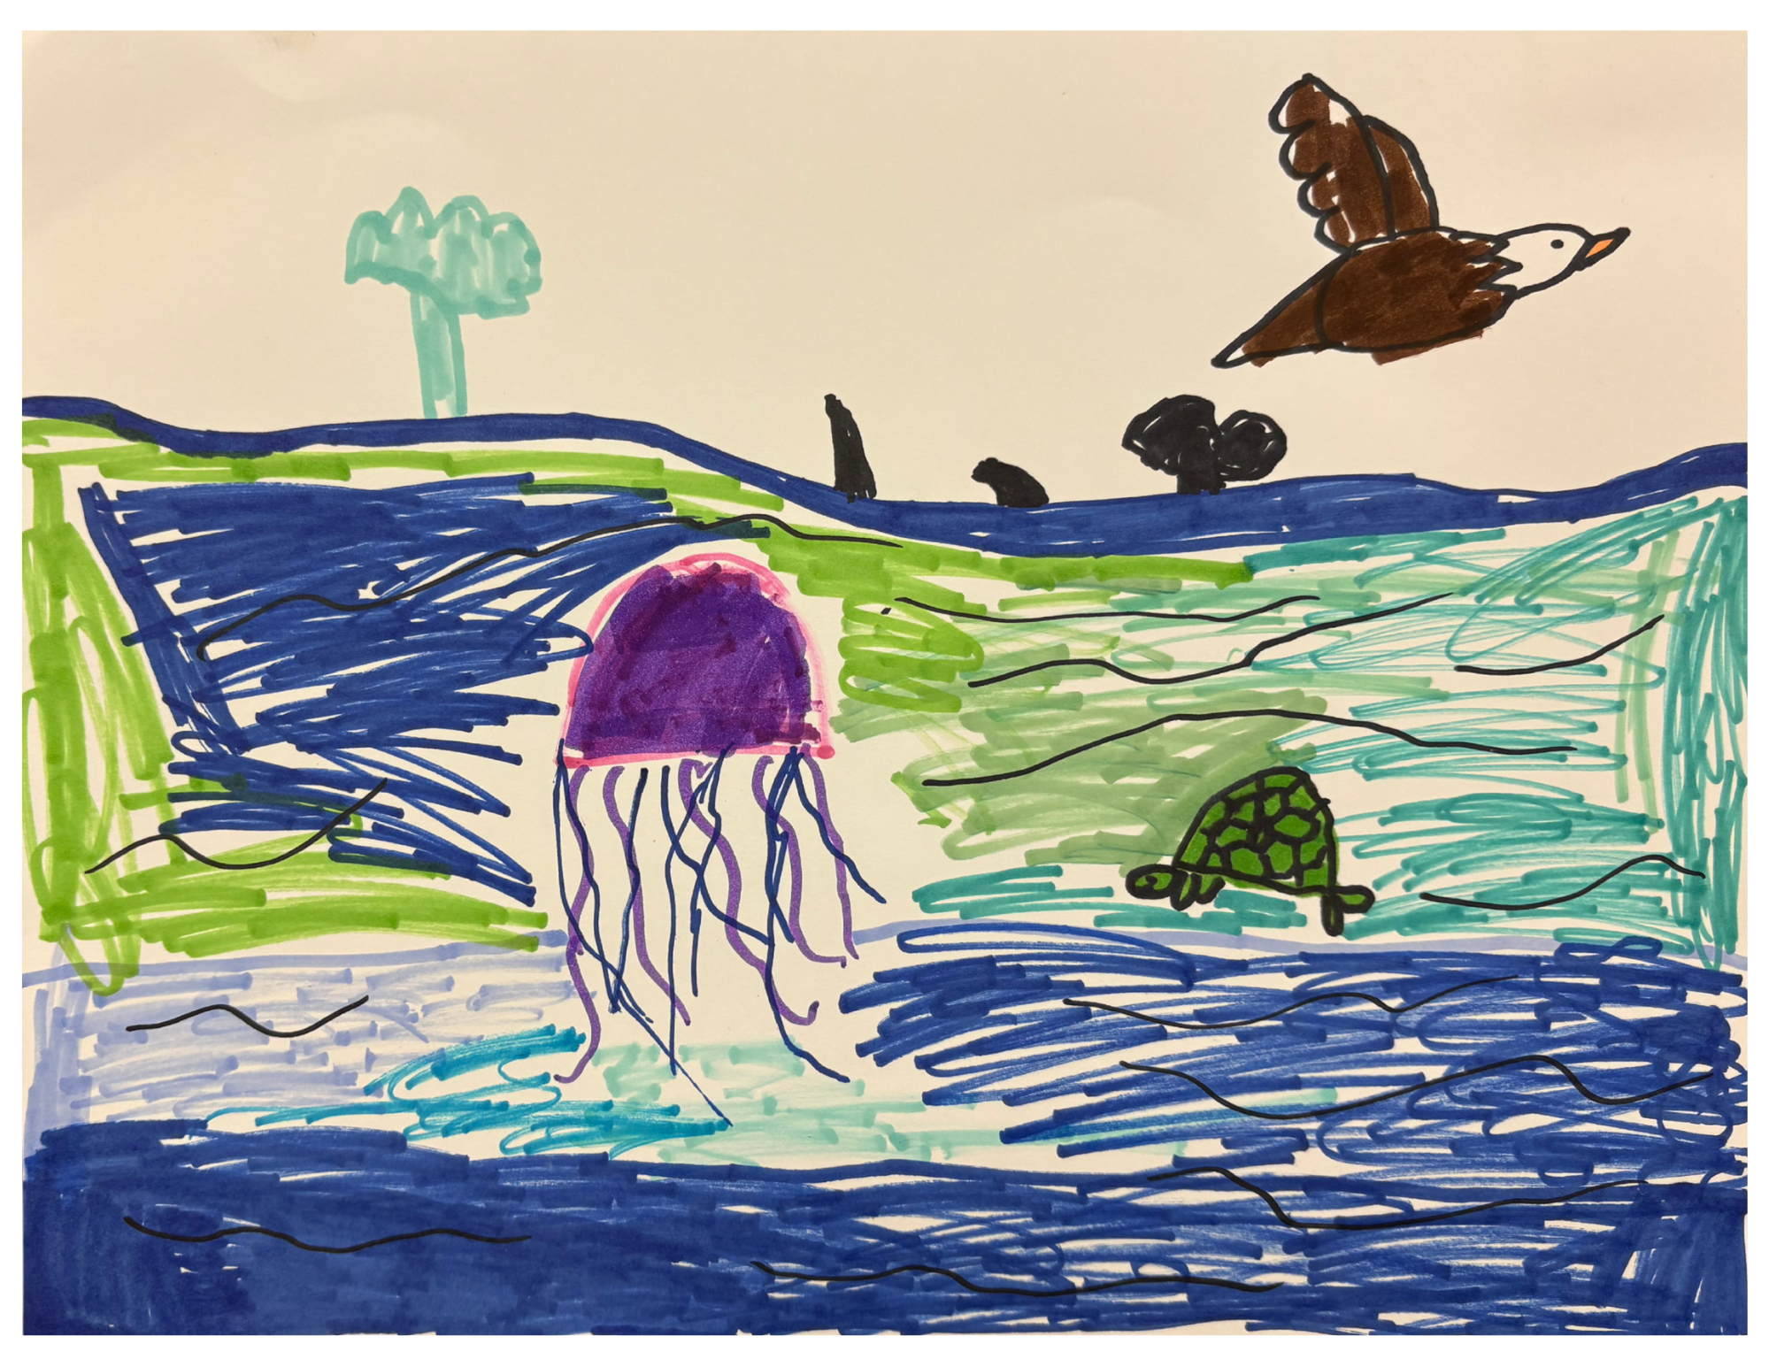
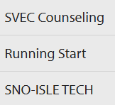
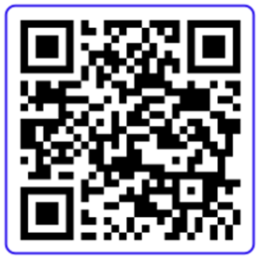
RESOURCES
GET INVOLVED
Our district website is your FIRST STOP for anything and everything
Sky Valley!
The FOUR tabs located on the website banner contain all your wants and needs to assist you in partnering with us.
ABOUT
STUDENT LEARNING
Artwork by,
Talia Zimmers
SUB CATEGORIES ARE SUBJECT TO CHANGE
monroe.wednet.edu/svec

Slide 3

Table of Contents
Parking……………………………………………………………………………….…………….. Campus Map…………………………………………………………………….………………. Code of Conduct………………………………………………………………….……………. Computer Use & Cell Phone Guidelines……………………………….………….. Lego Sheet (learning plan reference sheet)................................. Offsite Classes and Progress………………………………………………….……….. Offsite Course Description Example………………………………………………... Attendance and Weekly Contact.………………………………………….……….… 30 Day Progress & Academic Intervention Plans……………………….…… Statement of Understanding……………………………………………………….…… MSD Athletics………………………………………………………………………………….… Methods of Obtaining High School Credit…………………………………….…. Graduating at SVEC……………………………………………….…………………………. Online Resources……………………………………………………………….……………… Inclement Weather……………………………………………………………………………. Committees………………………………………………………………………………………. PTA………..…………………………………………………………………………………………… Washington State Testing……………………………………………………………….… Canvas…………………………………………………………………………………………….… Behavior…………………………………………………………………………………………….. Monthly Calendar (Sept. 2026- Aug. 2027)................................. Annual Show Stoppers……………………………………………………………………… | 1 2 3 4 5 6 7 8 9 10-11 12 13-15 16 17 18 19 20 21 22 23 24-35 36

Slide 4
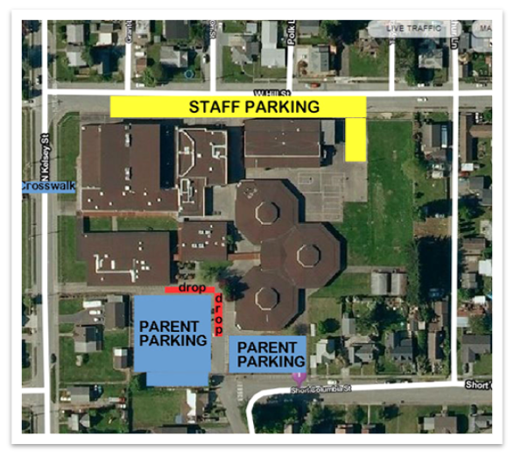


PARKING
YELLOW – STAFF PARKING ONLY (against the building parking is okay) BLUE – FAMILY PARKING RED – STUDENT DROP-OFF
REMEMBER TO KEEP OUR STUDENTS SAFE BY: 20 mph school zone on N. Kelsey, W. Hill, Arthur Lane, and Short Columbia street NO drop-off behind school on West Hill Street, family\student curbside parking on Hill Street is okay Drop off students in front of school office ONLY PLEASE PULL FORWARD ALL THE WAY TO THE Annex Bldg WHEN DROPPING STUDENTS (to reduce traffic backup into street) NO waiting or parking in the drop off/pick up lane Please, NO IDLING in the parking lot. Turn engine off while waiting
Come (30 minutes) earlier than you think you need to.
Especially if you are arriving for a 9am class.
This is the best strategy, Monday through Friday!
Expect the most traffic and congestion Tuesdays, Wednesdays, and Thursdays. And every day between 8:45 am and 9 am.
Be mindful of city parking signs!
We know the traffic can be stressful, but getting towed would be even more stressful! Do not park in No Parking Zones (there's one on Kelsey in particular so be aware!)
Please don't "invent" parking spots.
While we embrace creativity in general at SVEC, "creative parking" is not a good idea. Cars get blocked in, it creates safety concerns, and makes navigating the parking lot even more tricky.
STAFF Parking is available in the back “lot” by the playground with an entrance off of Hill St. The makeshift parking spots against the gym building off of Hill St. along the back of the facility are designated as STAFF PARKING ONLY. Please DO NOT use the back gate entrance off of Hill St. as a drop off or pick up area; vehicles are NOT supposed to enter or block this entrance at any time.
1
1

Slide 5


Hill Street
Storage
Court A
Computer Lab
Storage
Court
C
Storage
Hoop House
23
21B
Trade Shop
Music
Room
Big Gym
Court
D
21A
Trade Shop
Court B
Art Room
Storage
Small Gym
22
Grass Field
Rm. G
Cooking
Music Nook
Courtyard
Kelsey
Street
Café
Elem
Play area
Gathering Room
17
16
Play
Ground
Café
Office
Teen
area
Toddler
Play area
Tech
office
18
North Pod
15
19
14
Administrators
Staff Rm.
F
C
A
20
Office
13
12
Confere-nce Rm.
Library & Resource Center
Counselor
NURSE
11
Counselor
East Pod
E
D
B
10
8
9
1
2
7
Sky Valley Education Center
351 Short Columbia St
Monroe, WA 98272
South
Pod
6
3
4
5
2

Slide 6

Code of Conduct
All of us at Sky Valley Education Center, from babies to grandparents, do our best to follow these simple guidelines:
Respect: Yourself ~ Others ~ Property
Be SAFE & Have FUN
Classroom Rules for Families
Family members who are in the classroom should follow the same behavior expectations that the students follow. This includes NOT using cell phones in class.
Please do your part to limit the distractions in our learning environment and thank you for all of your partnership.
Gathering Room Etiquette
· Set up a table
· Grab your chairs
· Clean your table with school provided cleaning supplies
· Return your table and chairs to their storage locations
· Watch your children to ensure their choices are respectful and appropriate
Resource Center (Library) Etiquette
While not a traditional library, we still want our Resource Center to be a place where parents and students can work and learn!
PLEASE
· Use respectful voices and behavior
· Clean up after yourself
· Keep food/drinks away from computers
· Avoid activities that may distract others
· Computers are for student school work and families supporting their students
Visitors at SVEC
· We welcome visitors to Sky Valley! Please follow these guidelines when hosting a guest at our building:
· If a PARENT wants to bring a guest to see our school, no prior approval is needed. Enjoy your visit. : )
· If a STUDENT wants to bring a visitor, prior approval from the parents AND the school must be obtained. See the office for more information.
Playground Rules
· ALL students MUST be with a parent or guardian when using the play structure.
· Very young students playing chess, tether ball, or just running in the field must be accompanied by a parent or responsible adult as well. Staff will bring unattended young children to the office so we can help them find a parent. We want to make sure we keep them safe!
· Students 12 and older may play in the field or play ball, etc.. unaccompanied, but MAY NOT use the play structure without an accompanying adult.
· Please be courteous to our neighbors and keep the playground equipment from going over the fence!
Wheels on campus..
No wheels on campus please.
This includes scooters, Heelys,
skateboards, etc. We have bike stands
in front of the library for you to park your bikes.
3

Slide 7

Sky Valley Computer Use Guidelines
SVEC has an on-site technology specialist for any and all devices, software, and tech needs. Please reach-out to Josie Fitting: fittingj@monroe.wednet.edu or find her in her office in the North Pod.
We have a school wide, district wide cell phone policy that bans cell phone use in class - and this applies to everyone - students and adults.
There are only a couple of exceptions to this rule- for classes requiring cell phone use as part of the curriculum, or for an individual with a health plan requiring a cell phone. Please help us enforce this expectation.
We provide computers in the Library and North Pod for students and families to use for schoolwork. For downtime, there is a table with two computers in the Gathering Room that can be used for educational games.
While the District provides filtering software for the internet, it is important to consider how vast the internet is, and how we’re all human beings, so it is impossible for filtering to be a perfect solution. Here are some guidelines we should all understand, to help our community:
Cell Phone Policy
No food or drink at the computers
School work has priority even over learning games
No violent games (ie: games that depict aggressive behaviors, including physical (violence like first person shooting, fighting, or other forms of combat between characters)
Social media and chat platforms are not allowed (this includes: Facebook, Instagram, TikTok, Discord, etc.)
Do not install software
Student account logins may change each year. Account info is available on Family Access under “Portfolio”. You may also ask Katie in the library, Josie, or anyone in the office for help.
All district computer activity and any activity on any device, while logged in to a school google account is monitored 24/7. At any given time, the school district office can see what you’re doing. Student discipline including but not limited to loss of computer and network access will be strictly enforced.
Thank you for your partnership!
4

Slide 8

Fundergarten
Montessori
FFS (full day)
Co-op
S2Go/Bookshark
InteGreated Academy
ESS
STEM
ACT
Partnership Options
that
ARE “enough”
5

Slide 9
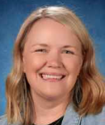

Offsite Classes and Progress
Progress is Important!
Offsite Class consultants are provided for your planning and convenience!
Questions? Contact:
Cara McCrain: mccrainc@monroe.wednet.edu
Full time student learning plans must reflect a certain number of hours, estimated on a weekly basis, in the plan.
Kindergarteners need 14 hours (Except Montessori, Fundergarten, Family Co-op, Family Forest School, School 2 Go and Bookshark which are 28) and 1st- 12th graders need 28 hours.
If your student is enrolled in other options such as Running Start, Sno-Isle or another school, their learning plan hours will be adjusted to reflect their part time status at SVEC.
If your child already has close to the required estimated weekly hours in their learning plan,
AND has 5-7 onsite classes in their schedule AND the schedule has some core subjects then you DO NOT need to worry about adding offsite classes to your learning plan.
Our SLP Consultants can assist you in adding hours to your child’s student learning plan. They will work with you monthly to obtain offsite class progress and are a great resource for curriculum questions.
Students will need to submit a cover sheet with a work sample to the SLP Consultant overseeing their offsite class or classes. Copies of those cover sheets are available from each consultant. Student work samples might include: a test, an essay, copies of workbook pages, a log of time, or other approved work samples. Just talk to your consultant about what is acceptable for submitting work samples or activity logs. *We also have the option for a monthly face to face check-in meeting INSTEAD of the work sample for K-6 Reading and Math.
Student work samples must be turned in to the SLP Consultant in charge of the class by the deadline for each month – which is marked in your family calendar/handbook. Generally, the deadline for submitting work samples for offsite classes is a week before the end of the month, so consultants have time to review them. Consult your calendar for exact dates. If work is not turned in by the deadline, the student will receive unsatisfactory progress for the offsite class for the month.
Repeated failure to turn in work samples by the deadline may result in removal from the program.
6

Slide 10
Off-site Course Description Example If your Learning Plan has close to 28 hours (grades 1-12), or 14 hours (Kindergarten, except Montessori , Fundergarten, Co-op, School 2 Go, BookShark & Family Forest School) of ON-SITE learning, you do NOT need to add any off-site classes. If you have a student grades 9-12 and want credit for an off-site class see the office for details.
You may also follow THIS EXAMPLE Draft below;
Preparing for Your Offsite SLP Meeting Taking a few minutes to jot some things down will make your meeting go quickly and more smoothly. 1. Student Name: _____________________________ 2. Class Name: _________________________________ 3. Approximately how many hours per week will your student be working on this class? _______________________ 4. What is the name of the curriculum you are using? ______________________________________________________ 5. Write a brief description of the class here. (3-5 sentences) __________________________________________________________________________________________________________________________________________________________________________________________________________________________________ 6. What learning activities will your student complete each week? (Some examples may include worksheets, quizzes, tests, written responses, etc.) _________________________________________________________________________________________________________________ 7. How many lessons will your student complete in 10 months (about 40 weeks) of study? __________ 8. How will you know that your student is learning and has mastered the material? __________________________________________________________________________________________________________________________________________________________________________________________________________________________________ *It would be helpful if you were to complete one of these outlines for each class that your family is planning to study offsite* **Copies of this form are available in the office if needed!**
7

Slide 11
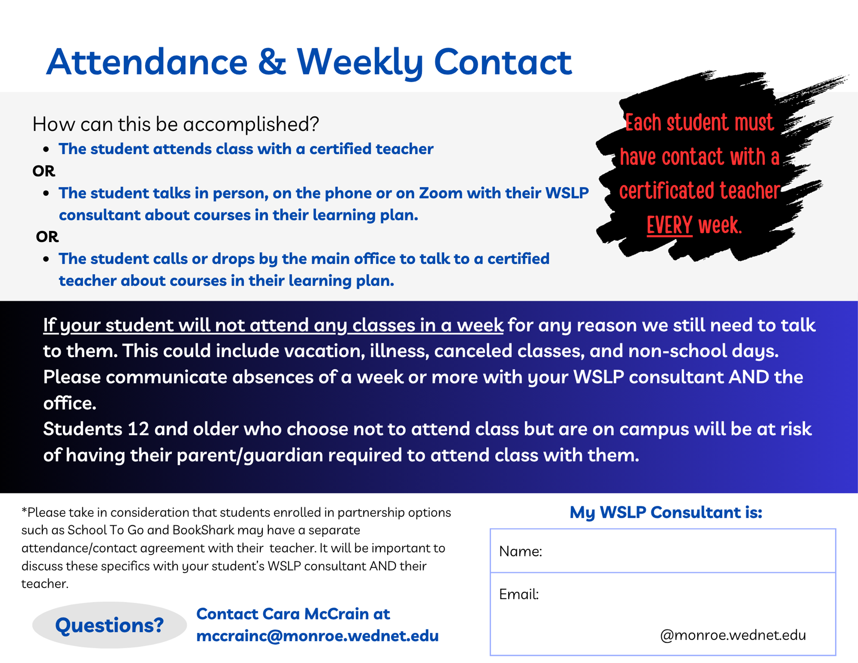
8

Slide 12

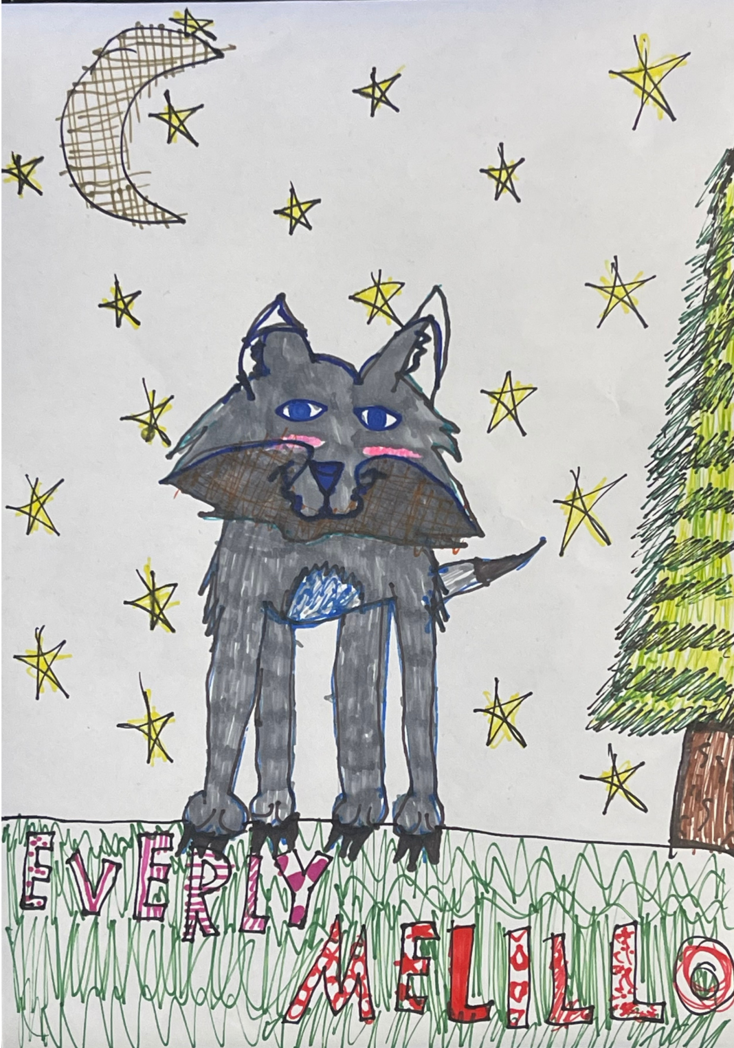
30 Day Progress & Academic Intervention Plans
Unsatisfactory Progress
Students receive monthly progress for ALL of their classes – both on and off site. This class progress is used to determine whether the student is making OVERALL satisfactory progress at Sky Valley. For the purposes of reporting, students with unsatisfactory progress in more than 50% of their classes will receive UNSATISFACTORY OVERALL PROGRESS. Progress is available for students and parents to see 24/7 via the Student Management System (ALIS). Unsatisfactory Progress in a block class or weighted partnership option may result in overall unsatisfactory progress regardless of progress in other classes.
**Please check OVERALL progress at the end of each month in ALIS**
Students who receive OVERALL UNSATISFACTORY progress are required to schedule and attend an intervention plan meeting in the office WITHIN 5 SCHOOL DAYS OF RECEIVING UNSATISFACTORY OVERALL PROGRESS. Failure to attend an intervention plan meeting may result in removal from the program. Students who repeatedly do not make satisfactory progress in multiple classes, whether they receive overall unsatisfactory progress or not, may be counseled to leave SVEC. Our responsibility is to support families in helping students be successful with their learning plan – whatever that learning plan entails. If you have extenuating circumstances, need help with your student’s learning plan, or need assistance helping your child be successful, we are here to help!
9

Slide 13


Statement of Understanding
In accordance with the Alternative Learning Experience implementation standards, reference WAC 392-550, prior to
enrollment parent(s) or guardians shall be provided with documentation attesting to the understanding of the
difference between home-based instruction and enrollment in an alternative learning experience (ALE).
Summary Description of Home Based Instruction
Instruction is provided by the parent or guardian as authorized under RCW 28A,200 and 28A.225.101
Students are not enrolled in public education. Students are not subject to the rules and regulations governing public schools, including course, graduation, and assessment requirements. The public school is under no obligation to provide Instruction or Instructional materials, or otherwise supervise the student’s education.
Alternative Learning Experience
Is authorized under WAC 392-550
Students are enrolled in public education either full time or part time. Students are subject to the rules and regulations governing public school students including course, graduation, and assessment requirements for all portions of the ALE.
Learning experiences are:
· Supervised, monitored, assessed, and evaluated by certified staff.
· Provided via a written student learning plan.
· Provided in whole, or part outside the regular classroom.
Part-time Enrollment of Home Based Instruction Students
Home-based instruction students may enroll in public school programs, including ALE programs, on a part-time basis and retain their home-based instruction status. In the case of part-time enrollment in ALE, the student will need to comply with requirements of the ALE written student learning plan, but not be required to participate in state assessments or meet state graduation requirements. (Unless they are seeking a SVEC diploma)
10
10

Slide 14


I understand that Sky Valley Education Center (SVEC) is a school of choice. As a school of choice, and not my student’s traditional neighborhood public school, I understand that…
· SVEC does not have a food services program for any students.
· SVEC has high expectations of behavior. All students are expected to be respectful, responsible, and conduct themselves at all times with the knowledge that this is a family environment. I understand failure to do so could result in my student being asked to leave and/or a parent being required to be with my student, regardless of age. This applies to any behavior violation, including but not limited to skipping class.
· SVEC relies on parents to provide supervision and support for their students.
· SVEC does not provide transportation to or from school for any students.
· SVEC does not provide a school nurse or health room attendant on campus.
· Our family must be willing and able to teach at home.
· SVEC does not guarantee enrollment in any particular class, program, or subject area, rather it provides resources to support parents, including on site classes, curriculum to support home based learning, online resources, and teachers to support our partnership with you.
· Students under the age of 12 must be accompanied by a parent while on campus. However, regardless of the student’s age, parents may need to attend with students who require additional support, whether for academic, social, emotional, or health needs, regardless of which classes or program they are in. Parents, essentially, are the student’s aide in the classroom and on campus.
· Because it is an open campus without formal supervision, SVEC reserves the right to deny enrollment to students with attendance issues or behavioral concerns.
· Students who require and qualify for special support services (special education, multi-language learners, Title I/LAP, etc.) and are granted enrollment at SVEC will receive those services at one of the traditional neighborhood schools. Enrollment might then be shared between the two schools, which may limit how many classes the student can take at SVEC.
· SVEC does not give letter grades or report cards. Student progress is measured on a monthly basis, and high school students earn credits with designations of “P” for Pass,“NC” or “N” for no credit earned. An “H” for Honors under credit designation is an option for most onsite classes. We do not convert our transcripts into letter grades, but do enter letter grades granted from other institutions if a student transfers to SVEC or attends Running Start or Sno-Isle.
· Failure to make satisfactory progress, whether overall or in individual classes, could result in my student being unable to return to Sky Valley at the semester or the following school year.
· I understand whatever classes I sign my student up for, my student must be able to perform at or near the grade level expectations the class is intended for. If my student is unable to be successful in class, I understand I am responsible for being in class to support them, or I must choose a different class or program.
· I understand it is my responsibility to log into CANVAS, ALIS and the SVEC website frequently to check on my student’s progress, read important news, consult the school calendar for scheduling changes, check on teacher absences and class cancellations, and check for teacher communications.
11

Slide 15


Middle School Sports
6th, 7th and 8th Grades
One time ASB Fee and athletic department fee
Monroe School District belongs to an interscholastic league for seventh and eighth grade athletics. While some of our middle school sports have enough student participants for a school-specific team, Park Place and Hidden River teams are occasionally combined in order to field enough players. There are four sports seasons—Fall, Winter 1, Winter 2, and Spring—each about nine weeks long.
MSD Athletic Schedule
High School Sports
9th through 12th Grades
Fee per sport + one time ASB Fee
FALL
Cross Country
Football
Soccer (Girls)
Swim & Dive
Tennis (Boys)
Volleyball
WINTER Season
Basketball (Boys)
Basketball (Girls)
Unified Baskeball
Gymnastics
Swim & Dive (Boys)
Wrestling (Boys)
Wrestling (Girls)
Competitive Cheer
SPRING
Baseball
Softball
Golf (Boys)
Golf (Girls)
Soccer (Boys)
Tennis (Girls)
Track & Field
*Lacrosse
Unified Soccer
*LAX is run through the Monroe Lacrosse Club. Contact info@monroelacrossewa.com for more information. Registration and fees are different and do not go through MSD.
FALL
Football (7th/8th grade)
Cross Country (7th/8th grade)
Softball​ (7th/8th grade)
WINTER 1st Season
Boys Basketball​ (7th/8th grade)
Girls Soccer (7th/8th grade)
Boys Soccer (7th/8th grade)
Girls Volleyball (7th/8th grade)
WINTER 2nd Season
Wrestling​ combined team (6-8 grade)
Girls Basketball​ (7th/8th grade)
SPRING
Track combined team (7th/8th grade)
NCAA
It is extremely important that any parent concerned about NCAA eligibility for their student speak to a school counselor BEFORE their student begins 9th grade.
Registration
Athletic Registration is completed online in FinalForms. https://monroe-wa.finalforms.com/. Visit the How to Register for Athletics section of the MSD website at: https://www.monroe.wednet.edu/mhs/athletics-activities/athletics/registration
12

Slide 16
METHODS OF OBTAINING HIGH SCHOOL CREDIT TOWARD GRADUATION
Courses taken at Sky Valley Education Center
The course instructor will determine course credit for classes taken at Sky Valley Education Center. This credit will depend on a variety of considerations, class participation, completion of assignments, and the quality of the work performed. Check the course description for details—not all classes are worth the same amount of credit.
Since all SVEC courses do not meet on a daily basis, students are expected to take their classroom learning and apply it to activities and assignments outside the classroom walls. It is reasonable to expect students to spend more time on outside activities and assignments than the time they spend in class. This additional work may be practicing a particular skill, working on class assignments, or completing additional/enrichment work provided by the student’s parent.
When coursework meets Sky Valley’s high standards, an instructor will award credit for the work and the counseling office staff will enter that credit on a student’s transcript. This granting of credit is usually done in February and June. According to Monroe School District policy, 7th & 8th grade students who are enrolled in an academic high school core courses on site OR online class (World Language, English, Health, Math, Science, or Social Studies) may earn high school credit if they complete all of the course requirements at a satisfactory HS level, but other high schools may count it as an elective credit or apply it toward a similar graduation requirement, depending on the policies of that school-please check with the high school your student plans to attend as final credit decisions are made by the principals or their designee. If you do not want your 7th or 8th grader to earn HS credit, please communicate this to the teacher and the office.
** Monthly progress is NOT the same as earning high school credit. **
Sky Valley does NOT award letter grades
When credit is earned a student will be given a “P” for passing. If a student’s work is exceptional and they have demonstrated additional learning through additional projects or research, the teacher may give the student an “Honors” designation for that class. Teachers have high expectations for students who receive credit. For example, it is not unusual for classes to require students to meet standard on all assignments and all assessments. This may mean that your student may have assignments and assessments that they will have to redo in order to meet the standard set for receiving a “P” in the class. Please read the “Progress Criteria/Methods of Evaluation” for the classes that your student is signed up for in order to understand what is expected to earn a “P” or credit in the class. Students interested in earning “Honors” should talk to their teacher at the BEGINNING of the term to find out what extra requirements they will have to meet to earn the “Honors” designation on their transcript.
Incompletes
Students have one semester to make up incomplete assignments to receive a grade. After that all incompletes “NC” will permanently become an “N” on the student’s transcript. Incompletes may only be granted in EXTREME circumstances.
13

Slide 17
METHODS OF OBTAINING CREDIT (continued)
OFF-SITE and Home Based Credit Portfolio (Grades 9-12):
The following guidelines are intended to assist students and parents as they present their off site classes for approved credit on the student’s transcript.
1) If you have <28 hours in your learning plan, work with your WSLP consultant to add it to your student’s learning plan. If you have >28 hours in your learning plan, complete the pink sheet in the office instead. In either case, PREAPPROVAL of offsite or home based classes protects you and your student!
2) Have the student do the work as directed.
3) The STUDENT schedules an appointment in the office and presents their completed work to be reviewed. Please note that the end of the year is the busiest time, so plan ahead.
4) If the offsite class is on the SLP, then the student MUST meet monthly progress criteria AND submit work samples AND compile a portfolio of all work AND meet with someone in the office when they complete the course.
As a student progresses through the above steps, they need to be putting together a portfolio of work that represents all of their learning experiences. Credit is granted or denied by admin or counselors after reviewing a student’s learning portfolio with the student. KEEP EVERYTHING! The portfolio should include the following information, in a complete and organized portfolio:
CORE Courses: English, Math, Science, Social Studies, etc…
1) Coversheet: Title, student name, date and type of credit requested.
2) Table of Contents
3) Evidence of Learning: Completed questions/answers, tests, quizzes, papers,
projects, field trips, references and resources page, etc… ALL work completed.
4) Materials Used: Students bring in the textbooks, videos, computer software, etc…
*** Curriculum must be at the HS level or higher. *** Please ask if you are unsure.
TIME LOG Courses: PE, Music, Vocational and Art
1) Coversheet: Title, student name, date and type of credit requested.
2) Documentation: You must provide a detailed log of hours and activities with the total
hours for the course computed.
1.0 Credit = 150-180 hours .5 credit = 75-90 hours .25 credit = 45 hours
Based on the course content, provide the following if applicable: list of any materials used,
pictures, journal, letter from your supervisor, etc...You must include some documentation other
than just a log.
3) Summary: Written summary of student experience and skills learned through course.
4) Other documentation: Photos, certificates, artifacts, etc.
*Students are not guaranteed enrollment in a particular site based class, regardless of graduation requirements.
*You MUST document, keep and present ALL student work so that the evaluator can be sure that the student met an appropriate level of learning. We have sample portfolios in the office if you’d like to see an example.
14

Slide 18
METHODS OF OBTAINING CREDIT (continued)
Courses Transferred In From Another High School Program
When a student enrolls at Sky Valley and has earned high school credit(s) at another school those grades and credits may be transferred onto the student’s high school transcript pending the accreditation of the other school. The parent will need to provide an official transcript from the previously attended school or work with the office to obtain one. The grades on the transferring student’s transcript will be entered onto the Sky Valley transcript when all transfer requirements have been met.
Running Start Credit
Sky Valley Education Center students at the junior or senior level are encouraged to attend Running Start (RS). When enrolled at a neighboring community college the student will earn both high school credit and community college credit. Usually a 5-credit community college course will count for 1.0 credit at Sky Valley. Courses with less community college credit will receive proportionally less Sky Valley credit. Grades earned at Running Start will be entered on the Sky Valley Education Center transcript.
A student’s total enrollment cannot exceed 1.3 FTE. What that means is students who are enrolled full time in RS (usually 15 credits) may only take 1 or 2 classes at SVEC. Off-site classes don’t “count” towards that limit. See a school counselor for more information. **If you are planning on being a RS student at ANY time during the school year, stop in and let the office know. *
Sno-Isle Tech Center
Sno-Isle Tech Center is a regional public school run by the Mukilteo School District that offers technical training to junior and senior students that are enrolled in public schools in Snohomish County. Sno-Isle Tech currently offers 24 courses in five different career pathways. You can view courses/classes listed by pathway or in alphabetical order on their website at http://www.snoisletech.com/.
Graduation Alliance & ALEKS.com
Graduation Alliance/ALEKS online content is available to 9th-12th grade students. We have informational flyers in office and online.
Home Based Classes
Contract based learning credits can be earned at SVEC by secondary students in grades 9-12. Curriculum is available for grades 9 and up or a family may choose to design their own. Each contract based class counts as one of your weight of classes. Make an appointment in the office to get more information. Depending on the course, these credits may not be recognized by 4yr college and universities. Families are strongly encouraged to complete the pre-approval for Offsite/Homebased Credit form (the “pink sheet”) before starting a home based class to ensure the course will count for high school credit.
Passing score on SBAC ELA, MATH, or HS Science
Parents may request up to 1 credit for each subject with a passing score on the high school SBA and WCAS exams. Content is available to 9th-12th grade students. We have informational flyers in the office.
World Language Competency Testing
Students may earn 1-4 credits. Please stop by the office or email Pexa at clarka@monroe.wednet.edu to find out more about Word Language Competency Testing.
***Adequate Progress***
Students NOT making substantial progress in their chosen goals or programs maynot be able to attend Sky Valley Education Center the following school year or term.
15

Slide 19
Graduating and Participating
in the Ceremony at SVEC
There are multiple ways to graduate at SVEC. There are multiple diplomas that can be earned in order to participate in the ceremony. They are: SVEC high school diploma, private school diploma, Associates of Arts or Science (AS), and home school diploma.
Some students work towards and earn a SVEC high school diploma. Those who do must complete all of the district AND state requirements. They include 24 credits (In English, Math, Science, Social Studies, etc), completion of Washington State History, a graduation pathway in English and Math, and completion of their High School and Beyond Plan. You can view the graduation credits in SKYWARD, on our website under Student Learning/SVEC Counseling, or pick up a graduation checklist sheet in the office. Please contact the Counseling department with ANY questions.
Students who may be earning other types of diplomas may also participate in our graduation ceremony, even if they are not earning a Monroe School District/SVEC diploma. Any student earning a diploma from an accredited or recognized school, whether public or private, AND students earning AA Degrees through Running Start are also eligible to “walk” in the SVEC Ceremony, regardless of what credits they have earned, although they will not receive SVEC diplomas. If you have any questions about whether your chosen school is accredited or recognized, please inquire in the main office.
Students earning homeschool diplomas may also participate in our graduation ceremony. Again, students earning a homeschool diploma will not receive a SVEC diploma, but may “walk” in our ceremony.
Our desire is to honor all students who are graduating, regardless of the type of diploma they are earning. At SVEC we strive to “walk our talk;” and since we say that all students learn differently and take different paths, it is important that we celebrate with ALL of our graduates, no matter which diploma they are earning.
If you have any questions about graduating or earning a diploma, we are here to help! Stop in or call the office any time with questions.
** Please Note: If your child is earning a diploma from an entity other than SVEC, but you want to participate in the SVEC ceremony, it is your responsibility to provide us with documentation of that diploma prior to the SVEC ceremony. **
16

Slide 20
Online Resources With Global School Licenses
ALEKS: Accessing a Grad Alliance or ALEKS course will “count” as 1 of a students 7 weight of classes for each class taken. Email Dan Brown, (brownd@monroe.wednet.edu) with questions.
BrainPop/BrainPop Jr: BrainPOP Jr (K-3rd) BrainPop (3rd-12th) is an animated educational site for kids (math, language arts,social studies, science). Site address: www.brainpop.com (Log into student google account for SSO)
Britannica School: Encyclopedia Britannica divided into learning levels and with fun learning paths and options
Britannica School Log-in Page >Scroll to the very bottom until you see product access then choose: log into Britannica School Username: monroe Password: msd103 or through any course in Canvas
Epic Books: Grade level digital reading platform for children 5-12 years old. 40K popular high quality books. Site address: https://www.getepic.com/
i-Ready (1-8th): iReady offers online math/reading assessments (1st-8th), beginning, middle, and end windows
Site address: https://login.i-ready.com/ Contact (oritza@monroe.wednet.edu) for more information.
Sora/Overdrive: Audiobooks, eBooks, books in Spanish, and Read-Alongs. To access the Monroe district subscription: Log into your student google account and on the Sky Valley web page under Resources, click on Sora/Overdrive. This resource is also available on phones & tablets through the app. Go to your app store and download the Sora, by Overdrive app. Search for my school: Monroe School District 103. Sign in with your students email account and password.
Starfall (PreK-3rd): An animated educational site for kids which includes math, reading, and language arts.
Username: skyvalley@monroe.wednet.edu Password: family
Type to Learn: Online keyboarding program, assess student skill level. Contact Deanne Hermes with questions, (hermesd@monroe.wednet.edu).
Zearn Math: Zearn is an award winning complete math curriculum for grades K-8. Lessons are interactive and parents receive a report showing progress. Site address: www.zearn.org
17

Slide 21


You will be notified of closures and delays automatically through Parent Square via email, text, and phone.
Alternatively, you can:
Check the Monroe School District website at monroe.wednet.edu. The MSD site is updated soon as the superintendent approves schedule changes.
Call the district transportation 24 hr phone hotline at 360-804-2950 for a recorded message.
Inclement
Weather
At SVEC a 2 hour late start means; ·9AM and 10AM classes are cancelled (including Fundergarten) ·10:30 classes start at 11AM · Montessori, STEM, ESS, ACT, and Family Co-op would all start at 11AM.
In the event our campus is hosting an event or workshop, those events will also start 2 hrs late
Artwork by,
Tea Duffy
Monroe School District’s first priority is the safety of our students, parents and staff. When ice and/or snow make driving on our local roads hazardous, the district will cancel school or delay the start of school by 2 hours to allow time for the roads to clear/thaw.
18

Slide 22

Committees…Get Involved!
SVEC is a partnership school and a community of volunteerism. We go to great lengths to foster opportunities for families to make connections that lead to a sense of belonging. Our committees are one of those opportunities. We appreciate each family choosing at least one committee to serve on.
What to expect - how you will receive committee communications: Our amazing Volunteer & Events Coordinator, Vanessa Dunnells, dunnellsv@monroe.wednet.edu, organizes and communicates via email with each committee throughout the year as needed.
How to register for a committee:
Open ALIS, choose CLASSES, choose ALL CLASS SECTIONS, use the Group Type drop-down and choose COMMITTEE, add the committee(s) of your choice.
SVEC General & Annual Events Committee
Parking Lot support (Sept, Dec, Feb, Apr)
Fall Workshop (Oct)
Teen Mixers (Oct & Feb)
First Responders Week (Nov)
Pop-Up Share Fairs (fall & on Earth Day)
Food Bank Drive (Nov & on Earth Day)
Welcome Back display (Jan)
Kindness Week (Feb)
Spelling Bee (Feb) SVECtacular (May)
EOY Carnival (June)
These volunteers help build and foster a sense of belonging for everyone at SVEC.
Tutoring & Student Support
Committee
*throughout the school year as needed
These volunteers are able to tutor math, reading, and writing at the middle and high school level. They are on-call for when a parent or teacher sees a need for extra academic support.
Resource Room
(aka: Library) Committee
*weekly needs that continue throughout the school year
These volunteers organize and tidy our library learning space, stack chairs, and straighten shelves. *Members of this committee who are willing to take on additional responsibilities, may be trained as needed, as Deputy Librarians.
Gathering Room Committee
*weekly needs that continue throughout the school year
This committee needs 6-8 volunteer-leads who are willing to wear the “I can help you” hat so families have a go-to person to help them understand how to “Do it for Dean” and keep our Gathering Room clean and organized.
Playground Committee
*needs families who will make a “day a week” commitment throughout the school year
These volunteers would be in charge of keeping the school’s playground equipment pumped up, collected and returned to the ball cart at the end of each day, as well as suggesting new types of sports and recreation equipment.
Supporting our Graduates
Committee
*Sr. Strut and Send-Off (June), graduation ceremony & reception (June)
These volunteers will help plan and facilitate events for this year’s graduating class including the graduation ceremony and reception.
Gardening & Grounds Committee
*Oct-Nov, before SVECtacular, throughout June before graduation
These volunteers provide maintenance and beautification to many areas of our campus.
19

Slide 23

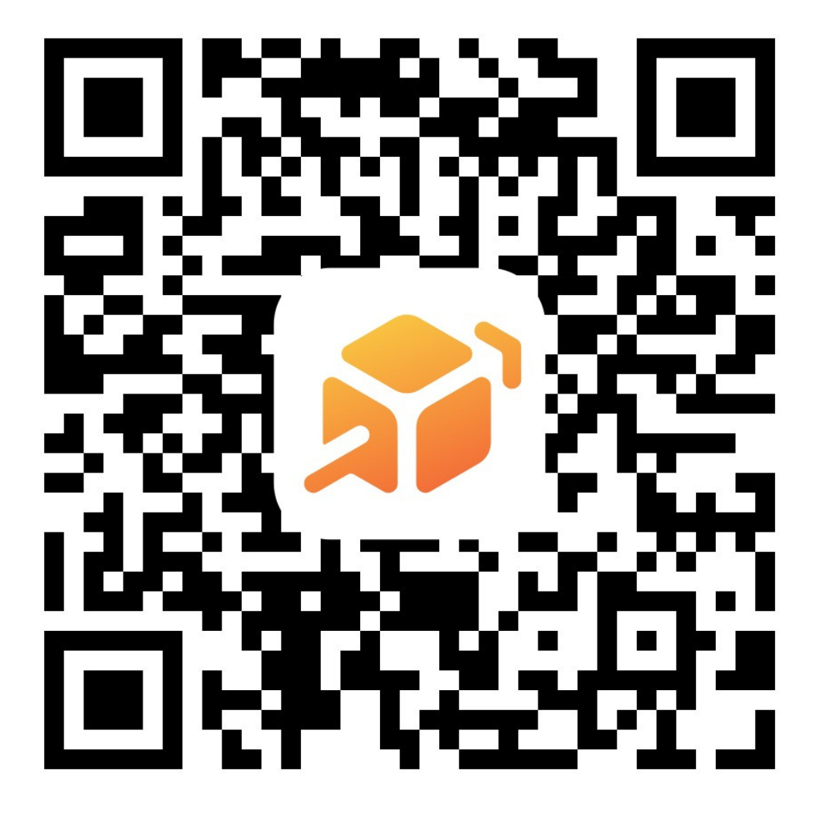
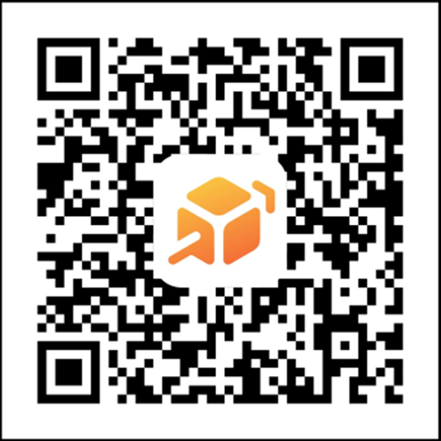

Our PTA is a vital part of our school community. We work to support critical academic needs, build a stronger, more inclusive school culture, and act as a collective voice on decisions that impact your child's education and well-being.
2026-2027 Meeting Schedule:
Oct 1st
Nov 3rd
Dec 2nd
Jan 7th
Feb 2nd
Mar 3rd
Apr 1st
May TBD
June 2nd
Every meeting begins at Noon and runs roughly 30 minutes to an hour.
PTA General
Memberships
SVEC PTA has a Cheddar Up Online Store. Pay for memberships, donations and more!
Did you know that increasing our membership—even by just one—helps make amazing programs, resources, and events possible for all students? We can do more together than apart. Please consider joining or renewing your membership today at https://www.wastatepta.org/focus-areas/membership/
20

Slide 24


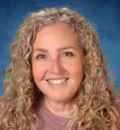

As a public school, SVEC participates in ALL required state testing. The state measures the success of our school based on the testing scores. Every student who opts out, receives a ZERO score. Those zero’s are factored in to our school’s passing rate.
We encourage all students to participate in state testing. Most importantly, we are here to help and support in every way.
Who Tests?
3rd, 4th, 5th, 6th, 7th, 8th & 10th graders: Smarter Balanced Assessments in English and Math
5th, 8th and 11 graders: Washington Comprehensive Assessment of Science
9th graders in WA State DO NOT test. They get a year off!!
11th & 12th graders who need the English and/or Math assessments to satisfy their graduation pathway requirement will be notified by the counseling team about testing.
Students test over 2 days starting at 8:45 am each day.
English is taken on one day
Math and Science are scheduled on the same day.
Students can test on days they are typically on campus with a teacher they know or a sibling.
Workshops for test taking strategies and practice sessions will be held in the library. Dates and times will be communicated as we approach testing week, in May.
What to Expect:
All students in 3rd, 4th, 5th, 6th, 7th, 8th & 10th grade will be scheduled to take the test. We ask that all families RSVP and confirm testing dates by contacting the office at 360-804-2700 or
email: Amber Ortiz: ortiza@monroe.wedent.edu.
High school students can earn credit in English, 3rd year Math or Science with a passing score.
High School students who plan to earn a SVEC school district diploma must meet the credit and testing pathway requirements to graduate.
21

Slide 25

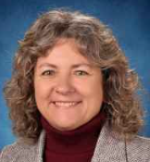

CANVAS is a student management platform that allows teachers to embed links to videos and other multimedia into student assignments. It allows for easier and more direct communication between teachers, students and parents. CANVAS is used by all of the community colleges in the area as well as most of the 4yr state colleges.
FOR PARENTS
As a parent, you have 2 options for logging into Canvas: using an online browser or using the Canvas phone app.
Online Browser: For best success, use the Chrome browser
1. Go to - https:svec.instructure.com/login/canvas#
2. Select forgot password.
3. Enter your home email address (NOTE: This is the email you have in SKYWARD).
4. Go to your email and click on link to change password.
5. Change your password and go directly to step 6.
6. Go back to https://svec.instructure.com/login/canvas and log in.
You should now see the published courses of your children along with their assignments and grades.
FOR STUDENTS
Student Canvas site - https://svec.instructure.com
Students will need their school email address and password to log into CANVAS. Students logging into Canvas for the first time need to follow these directions:
Step 1: Go to mail.google.com
Step 2: Log in using your school district email account and school district password
Step 3: After authenticating email address go to above link - student should be logged in now.
Questions?
DeAnne Hermes is our on site Instructional Tech. You can reach her at hermesd@monroe.wednet.edu
CANVAS PARENT APP
Step 1: Download the blue colored Canvas Parent App from the app store
Step 2: You'll need to open your student's Canvas account on another device and then:
Step 3: Click on Account, then settings, and on the right: "pair with observer". You will use the generated code to pair to your app:
Step 4: Open the Parent app and under school search for: Sky Valley Education Center (Parents Access)
Step 5: Click: Create account
Step 6: Add in your information. You can use any email and password you'd like. Add the pairing code you generated from your student account.
Step 7: Click Start Participating
CANVAS NOTIFICATIONS
Managing the Email Monster!
Follow these steps to change how often you are notified of all things Canvas:
Step 1: Log into your observer account through the Parent App or online
Step 2: In the left menu, choose Account
Step 3: Click Notifications
Step 4: Go through the menu items and turn off or select how often you receive notifications for each of the Canvas features
22

Slide 26

Behavior at SVEC
Since our school is a K-12, family environment, behavior expectations are HIGH. We know our families come to Sky Valley, in part, because of this positive family climate. We need everyone's support to maintain this culture of high expectations for conduct. Here is what you can do to help.
See Something, Say Something If you see or hear anything you believe is inappropriate in a setting with children of all ages, please feel free to politely correct the behavior. "Excuse me, language like that isn't okay at school," is something you could say, for example. Remember to show kindness and grace to other people's children; treat them the way you would want others to treat your kids. If you do not feel comfortable saying something, please please please report the behavior or language to the office immediately. We are most likely to be successful if we can deal with the situation right away - in that moment. Waiting to say something decreases the likelihood that we will be able to address and correct the behavior! Discuss Behavior Expectations With Your Family You can support our school by reminding your kids that at our school we expect everyone to remember that this is a family environment with high expectations for behavior. Use of foul language or gestures, overly physical displays of affection, aggression, unkind behavior, or any conduct that isn't appropriate at our school. Sometimes it is helpful to talk about the difference in expectations depending on where you are; for example what may be appropriate at home, or with a group of teenage friends, may not be okay at school. Your support can make all the difference! Be Prepared to Be On Campus Remind your students age 12 and older that being on campus without a parent or other family member is a privilege, not a right, and it is a privilege that can be taken away by you or the school. We know many parents look forward to the day their student turns 12 and they can be on campus without them. It is somewhat a right of passage at Sky Valley! But if a student's behavior demonstrates they need more direct supervision, please remember we will depend on you for that supervision. This includes the behavior expectation to be on time to classes.
What are the types of behaviors that are not appropriate at school? It is difficult to create an exhaustive list of do's and don't for behavior. If you or your student have any questions about whether something is okay or not, please don't hesitate to ask. And consult the district handbook online and section of our handbook about bullying for more information as well. Here are some examples of behaviors that are not okay at our school - even if they are okay in other places: rough housing, wrestling, pushing, shoving, or other aggression, even between friends or siblings swearing signs of affection beyond hand holding, a quick hug, or a peck on the cheek skipping class or repeated tardiness threats to another, even in jest disrespect name calling or teasing
Again, this is certainly not a complete list of inappropriate behaviors - and this list doesn't mention many of the more egregious violations of behavior.
Please know that if you have any questions regarding behavior expectations, ask one of the administrators for clarification. And thank you for your help in keeping our campus a family-friendly place for all!
Artwork by,
Cat Bradley
23

Slide 27







2026
Sun | Mon | Tues | Wed | Thurs | Fri | Sat
 |  | 1 | 2 | 3 | 4 | 5
 |  |  |  | Staff Learning Day | 10am Parent Orientation
6 | 7 | 8 | 9 | 10 | 11 | 12
 |  | 1pm Parent Orientation | 10am & 1pm Parent Orientation | 10am & 1pm Parent Orientation
13 | 14 | 15 | 16 | 17 | 18 | 19
Week 1 Of 36
20 | 21 | 22 | 23 | 24 | 25 | 26
Week 2 Of 36
27 | 28 | 29 | 30
Week 3 Of 36 |  | 1 pm Special Services Parent Advisory

Slide 28

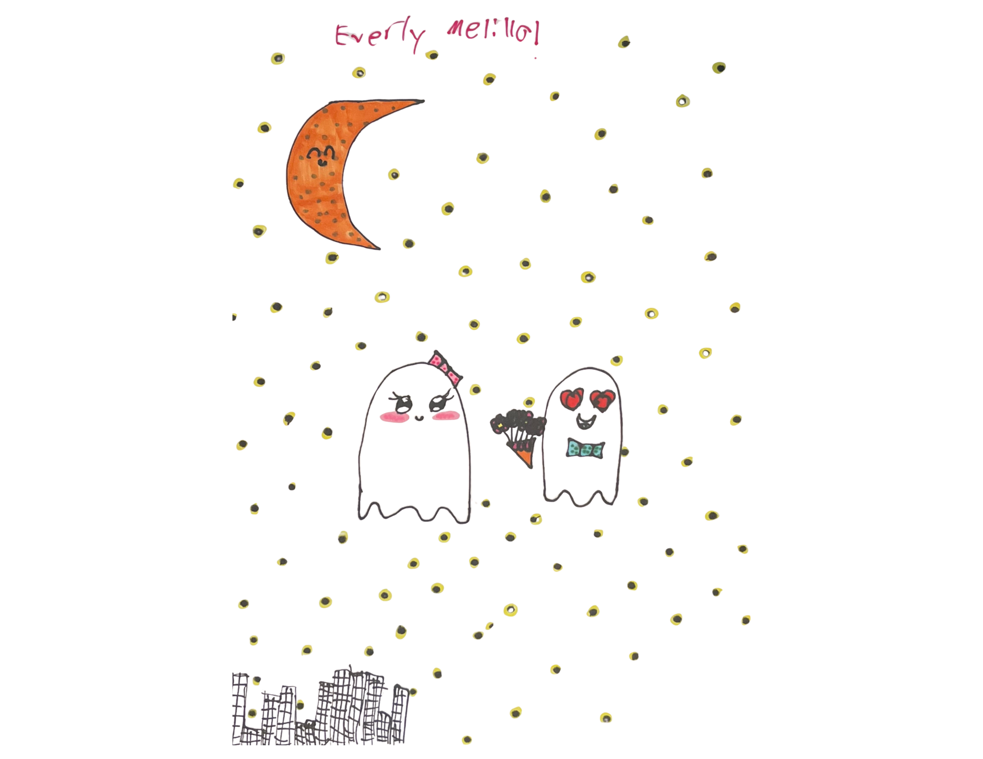



2026
Sun | Mon | Tues | Wed | Thurs | Fri | Sat
 |  |  |  | 1 | 2 | 3
 |  |  |  | 12 pm PTA Meeting
4 | 5 | 6 | 7 | 8 | 9 | 10
Week 4 Of 36 |  |  |  | 9:15 am Parent Advisory | 12:30 pm Fall Mixer Gr. 6 -12
11 | 12 | 13 | 14 | 15 | 16 | 17
Week 5 Of 36 | 10am-2pm Learning Differences Resource Fair |  | NO SCHOOL
18 | 19 | 20 | 21 | 22 | 23 | 24
Week 6 Of 36 | NO SCHOOL
25 | 26 | 27 | 28 | 29 | 30 | 31
Week 7 Of 36 |  | 1 pm Special Services Parent Advisory | 1:00 pm Principal Chat | NO REGULAR CLASSES

Slide 29




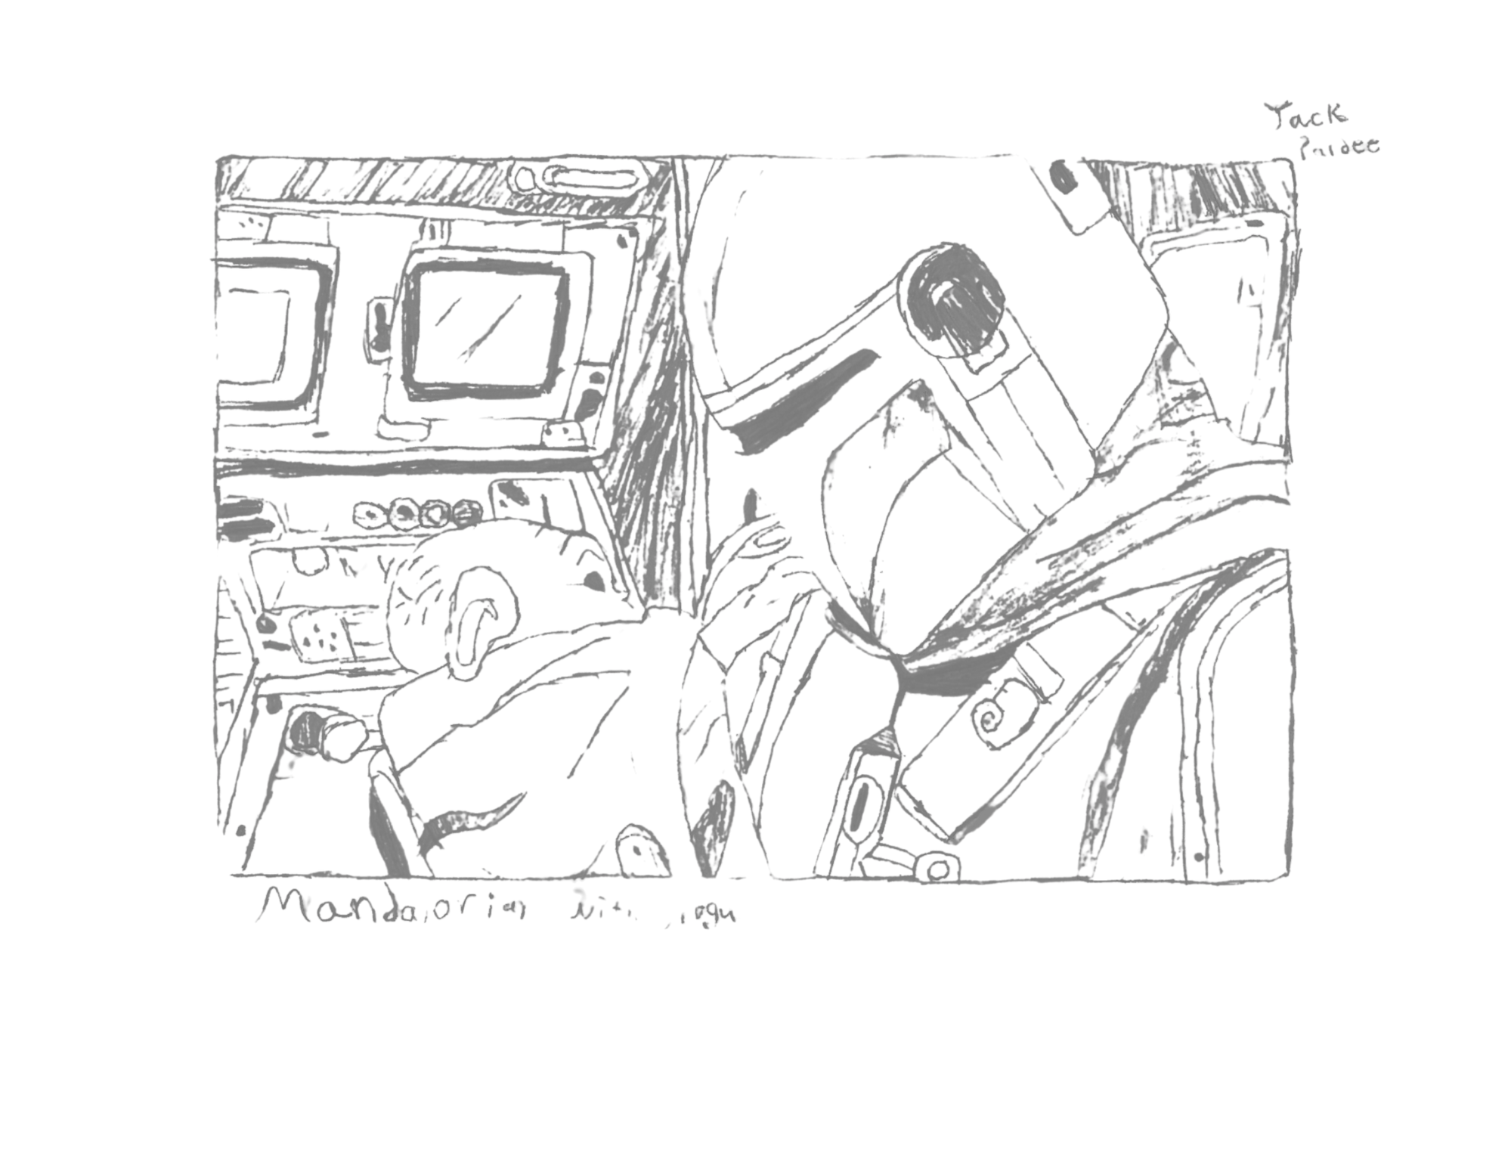
2026
Sun | Mon | Tues | Wed | Thurs | Fri | Sat
1 | 2 | 3 | 4 | 5 | 6 | 7
Week 8 Of 36 |  | 12 pm PTA Meeting
8 | 9 | 10 | 11 | 12 | 13 | 14
Week 9 Of 36 |  |  |  | 9:15 am Parent Advisory
15 | 16 | 17 | 18 | 19 | 20 | 21
Week 10 Of 36 |  | NO SCHOOL
22 | 23 | 24 | 25 | 26 | 27 | 28
Week 11 Of 36 |  |  | Early Release 11:50 am |  | NO SCHOOL
29 | 30
Week 12 Of 36
Artwork by,
Jack Pardee

Slide 30

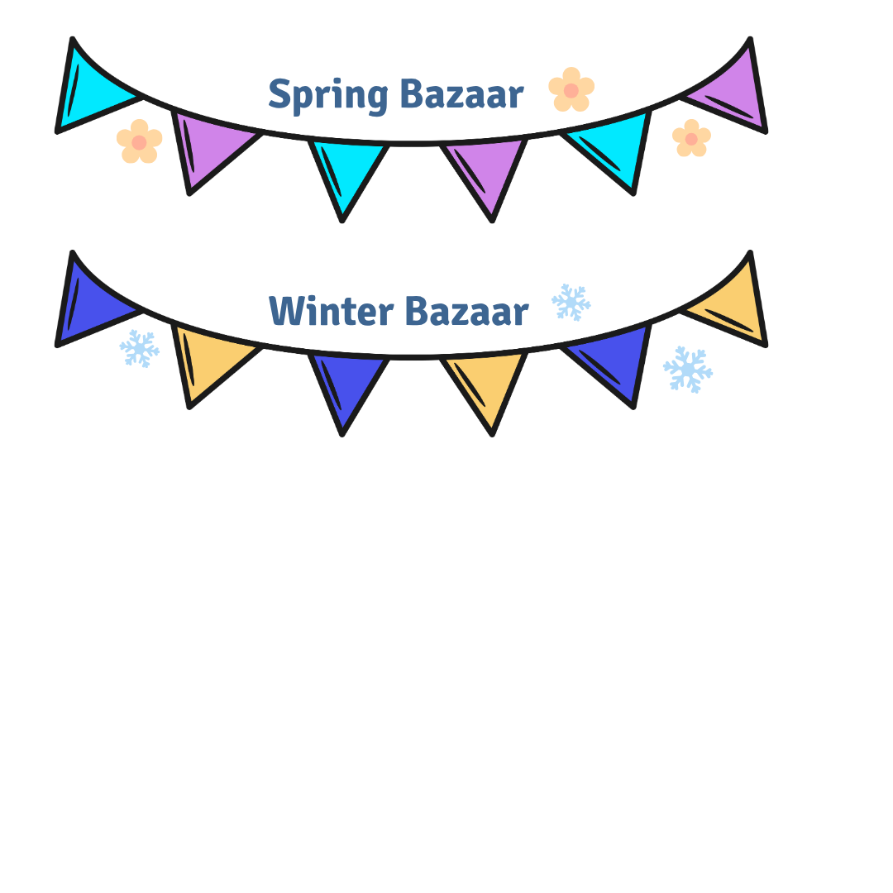


2026
Sun | Mon | Tues | Wed | Thurs | Fri | Sat
 |  | 1 | 2 | 3 | 4 | 5
 |  | 1 pm Special Services Parent Advisory | 12 pm PTA Meeting
6 | 7 | 8 | 9 | 10 | 11 | 12
Week 13 Of 36 |  |  |  | 9:15 am Parent Advisory
13 | 14 | 15 | 16 | 17 | 18 | 19
Week 14 Of 36 |  |  | 1:00 pm Principal Chat |  | Early Release 11:50 am
20 | 21 | 22 | 23 | 24 | 25 | 26
27 | 28 | 29 | 30 | 31

Slide 31



2027
Sun | Mon | Tues | Wed | Thurs | Fri | Sat
 |  |  |  |  | 1 | 2
3 | 4 | 5 | 6 | 7 | 8 | 9
Week 15 Of 36 |  |  |  | 12 pm PTA Meeting
10 | 11 | 12 | 13 | 14 | 15 | 16
Week 16 Of 36 |  |  | NO SCHOOL | 9:15 am Parent Advisory
17 | 18 | 19 | 20 | 21 | 22 | 23
Week 17 Of 36
24 | 25 | 26 | 27 | 28 | 29 | 30
Week 18 Of 36 |  | 1 pm Special Services Parent Advisory |  |  | NO SCHOOL | 31

Slide 32





2027
Sun | Mon | Tues | Wed | Thurs | Fri | Sat
 | 1 | 2 | 3 | 4 | 5 | 6
Week 19 Of 36 |  | 12 pm PTA Meeting
7 | 8 | 9 | 10 | 11 | 12 | 13
Week 20 Of 36 |  |  |  | 9:15 am Parent Advisory
14 | 15 | 16 | 17 | 18 | 19 | 20
Week 21 Of 36
21 | 22 | 23 | 24 | 25 | 26 | 27
Week 22 Of 36 |  | NO SCHOOL | 1:00 pm Principal Chat | Spelling Bee
28
Week 23 Of 36
Artwork by,
Jada Goodwin

Slide 33


2027
Sun | Mon | Tues | Wed | Thurs | Fri | Sat
 | 1 | 2 | 3 | 4 | 5 | 6
 |  |  | 12 pm PTA Meeting
7 | 8 | 9 | 10 | 11 | 12 | 13
Week 24 Of 36 |  |  |  | 9:15 am Parent Advisory
14 | 15 | 16 | 17 | 18 | 19 | 20
Week 25 Of 36 |  |  |  |  | 12:30 pm Spring Mixer Gr. 6 -12 | Regional History Day @ SVEC!
21 | 22 | 23 | 24 | 25 | 26 | 27
Week 26 Of 36
28 | 29 | 30 | 31
Week 27 Of 36 |  | 1 pm Special Services Parent Advisory | NO SCHOOL

Slide 34






Artwork by,
Talia Zimmers
2027
Sun | Mon | Tues | Wed | Thurs | Fri | Sat
 |  |  |  | 1 | 2 | 3
 |  |  |  | 12 pm PTA Meeting
4 | 5 | 6 | 7 | 8 | 9 | 10
11 | 12 | 13 | 14 | 15 | 16 | 17
Week 28 Of 36
18 | 19 | 20 | 21 | 22 | 23 | 24
Week 29 Of 36 |  | 1 pm Special Services Parent Advisory |  | No Regular Classes
25 | 26 | 27 | 28 | 29 | 30
Week 30 Of 36 |  | NO SCHOOL | 1:00 pm Principal Chat

Slide 35









2027
Sun | Mon | Tues | Wed | Thurs | Fri | Sat
 |  |  |  |  |  | 1
2 | 3 | 4 | 5 | 6 | 7 | 8
 |  | No Regular Classes |  |  | No Contact Required this week
9 | 10 | 11 | 12 | 13 | 14 | 15
Week 31 Of 36 | Spring Share Fair |  |  | 9:15 am Parent Advisory Family Checkout Begins!
16 | 17 | 18 | 19 | 20 | 21 | 22
Week 32 Of 36
Week 33 Of 36 23 | 24 | 25 | 26 | 27 | 28 | 29
Week 34 30 Of 36 | 31 | 1 pm Special Services Parent Advisory
31

Slide 36








2027
Sun | Mon | Tues | Wed | Thurs | Fri | Sat
 |  | 1 | 2 | 3 | 4 | 5
Week 34 Of 36 |  |  | 12 pm PTA Meeting
6 | 7 | 8 | 9 | 10 | 11 | 12
Week 35 Of 36 |  |  |  |  |  | 1 pm SVEC Graduation
13 | 14 | 15 | 16 | 17 | 18 | 19
Week 36 Of 36 |  |  | 10-2 pm Annual Carnival
20 | 21 | 22 | 23 | 24 | 25 | 26
 | Possible Snow Make up Days
27 | 28 | 29 | 30

Slide 37


2027
Sun | Mon | Tues | Wed | Thurs | Fri | Sat
 |  |  |  | 1 | 2 | 3
4 | 5 | 6 | 7 | 8 | 9 | 10
11 | 12 | 13 | 14 | 15 | 16 | 17
18 | 19 | 20 | 21 | 22 | 23 | 24
25 | 26 | 27 | 28 | 29 | 30 | 31

Slide 38
2027
Sun | Mon | Tues | Wed | Thurs | Fri | Sat
1 | 2 | 3 | 4 | 5 | 6 | 7
8 | 9 | 10 | 11 | 12 | 13 | 14
15 | 16 | 17 | 18 | 19 | 20 | 21
22 | 23 | 24 | 25 | 26 | 27 | 28
29 | 30 | 31

Slide 39



Family Workshop (Mythology) - Thursday, 10/29
Talent Show - Friday, 3/26
Family Workshop - (Earth Day) -Thursday, 4/22
SVECtacular - Monday, 4/26
Spotlight Nights:
Monday, 5/24 - Guitar/Bass/Uke/Flute Night
Wednesday, 5/26 - Piano
Friday, 6/4 - Choir Concert
Monday, 6/7 - Orchestra and Ballet
Monday, 6/14 - Irish Dance
351 Short Columbia St.
Monroe, WA 98272
Phone: (360) 804-2700
Office Hours: Monday-Friday 8:00am-3:30pm
Website: https://www.monroe.wednet.edu/svec
SVEC OFFICIAL Facebook: facebook.com/SkyValleyEducationCenter/
PTA contact info: skyvalley.pta@gmail.com PTA Website: svecpta.org/
36

Slide 40

SEE WEBSITE FOR A FULL MSD HANDBOOK WITH ALL DISTRICT POLICIES
WWW.MONRE.WEDNET.EDU/SVEC/ABOUT/FAMILY-HANDBOOK

