Slide 1
WELCOME TO VAAE!
Visual Arts Advanced Enrichment
Please read all instructions very carefully before creating your portfolio for submission!
The professionals who will be reviewing your portfolios will be looking for individuals who display their creativity, passion for art, willingness to use a variety of media, and are able to articulate their creative choices and connections to the pieces they create.
You will need to create a presentation slide for a minimum of three pieces that will include a clear image of your artwork along with an artist statement. You are more than welcome to include more than three, but quality is more important than quantity.
The submission deadline is a hard deadline, so your portfolios and teacher recommendation forms must be emailed no later than midnight on Friday December 12th.
Before submitting your portfolio, please proofread any written material.

Slide 2
CREATING YOUR PORTFOLIO…
Use the template to add your information. Any slide in this document with a BLUE background are the template slides where you should add your picture and artist statement. Any slides that have a GREY background should be deleted before submission. Your slides must all include the required information… feel free to change the color of the background, add personal touches to the slides, just be aware to not let them distract from the required information.
Slide 1 should be the STUDENT INFORMATION slide… you may include a personal photo of yourself making sure to provide all information on the left.
Slides 2, 3, and 4 (or any added by you) should have a clear image of your artwork, your artist statement that includes a title (optional), media, and a few sentences that explains your piece, your artistic decisions in creating it, and your personal connections to the artwork.
Before saving and sending, make sure you delete the grey slides. Make sure your first and last name is in the file name.
You may either email the portfolio as an attachment to kemiddl@carrollk12.org or follow the directions on the following slide to share with Ms. Middleton.
Portfolios must be received no later than Friday December 12th at 11:59pm. Anything submitted after this will not be considered.

Slide 3
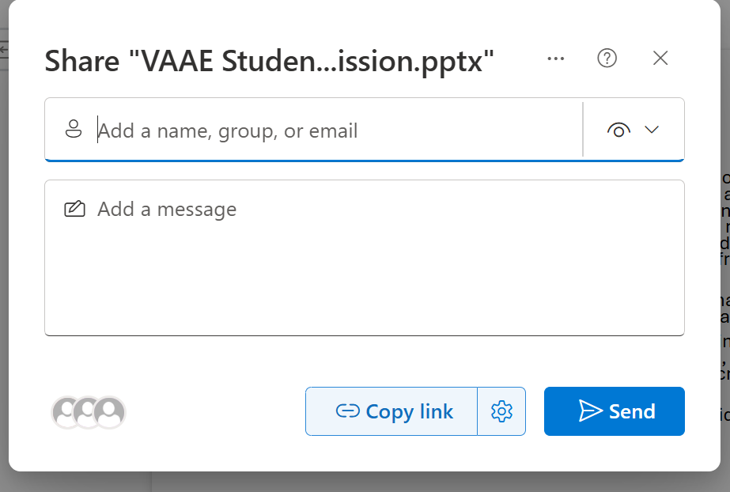

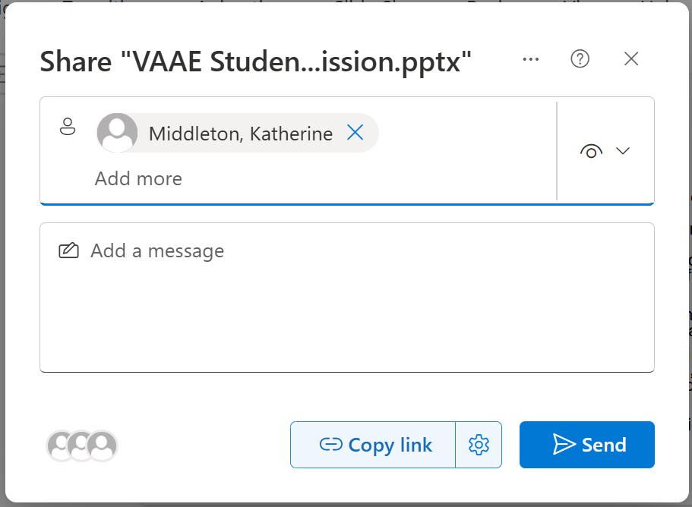
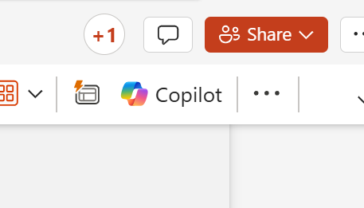

How to submit your portfolio:
  Double check that all of the information in your portfolio presentation is complete and correct.
  Make sure your teacher has completed and submitted your teacher recommendation form.
  Click the share button in the top right-hand corner of your screen.
4. When the share menu drops down, type the name ‘Katherine Middleton’ where it says ‘people who have access’
Type Katherine Middleton here
5. After Ms. Middleton has been selected, there will be a message box. Please write your First and Last Name and school in that box. Then click Send.
Type your name and school here
Portfolios must be received no later than Friday December 12th at 11:59pm. Anything submitted after this will not be considered.

Slide 4
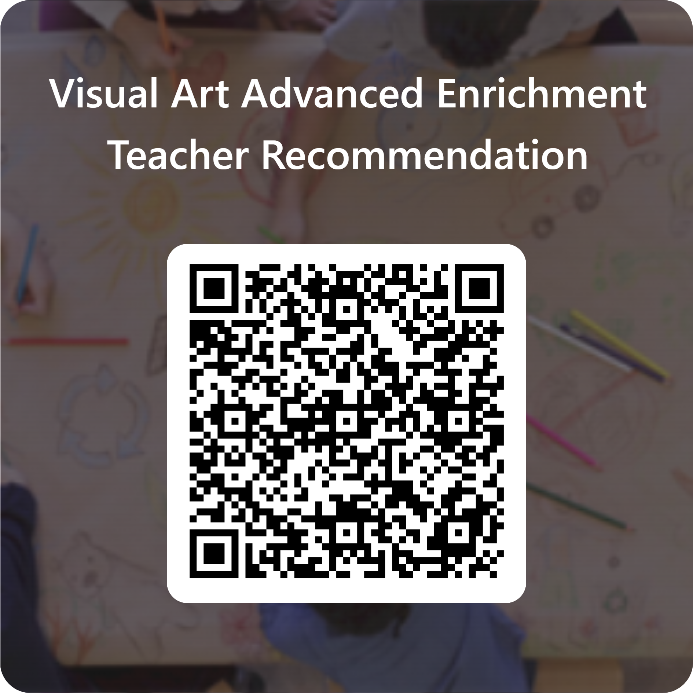



Teacher Recommendation Form
Each student applying to VAAE is required to submit a teacher recommendation form as well. Simply forward this link or share this QR code with a teacher of your choice. Your teacher will fill out this simple form (using the CCPS email), and responses will be sent directly to the VAAE Portfolio Team. Teachers must have this form filled out by Friday December 12th so make sure you send it to him/her before December 12th!
Visual Art Advanced Enrichment Teacher Recommendation – Fill out form
email this link to your teacher
QR code to letter of rec form

Slide 5

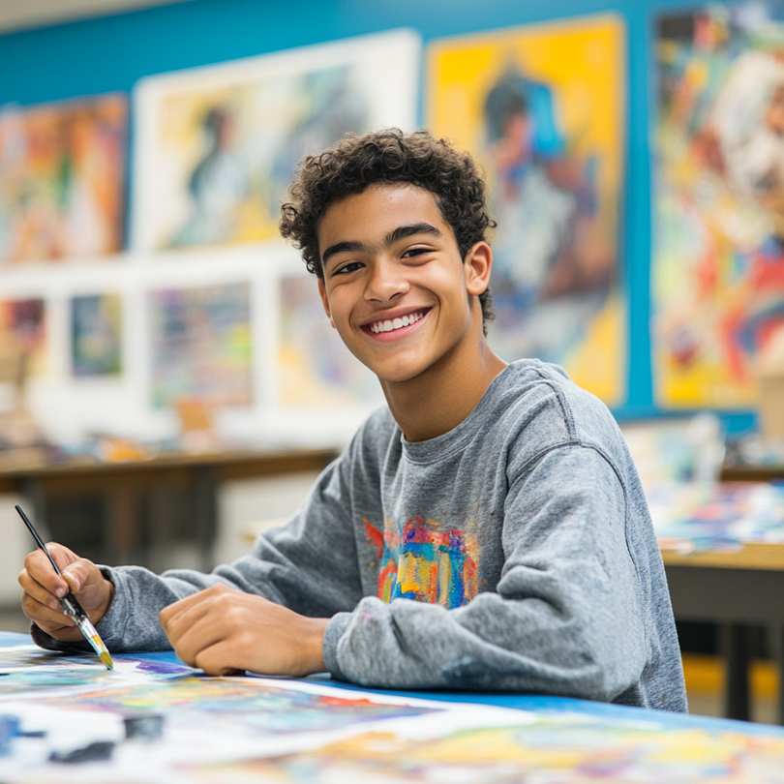
Sample Student Information Slide
Student Full Name: Sebastian Hughes
School: West Middle
Grade: 8th
Parent Email: carahughes@gmail.com
Parent Cell Number: (410) 555-1234
optional student pic or selfie

Slide 6
Artist Statement:
Each artwork you choose to include in your portfolio must have an accompanying artist statement that briefly describes your inspiration for creating it, your artistic choices regarding materials and techniques, and your personal connections to the piece. You may also add anything unique or special about the piece you would like to share.
Please write your artist statement and place it in your slide next to the image of your art.
(see portfolio sample slide)

Slide 7
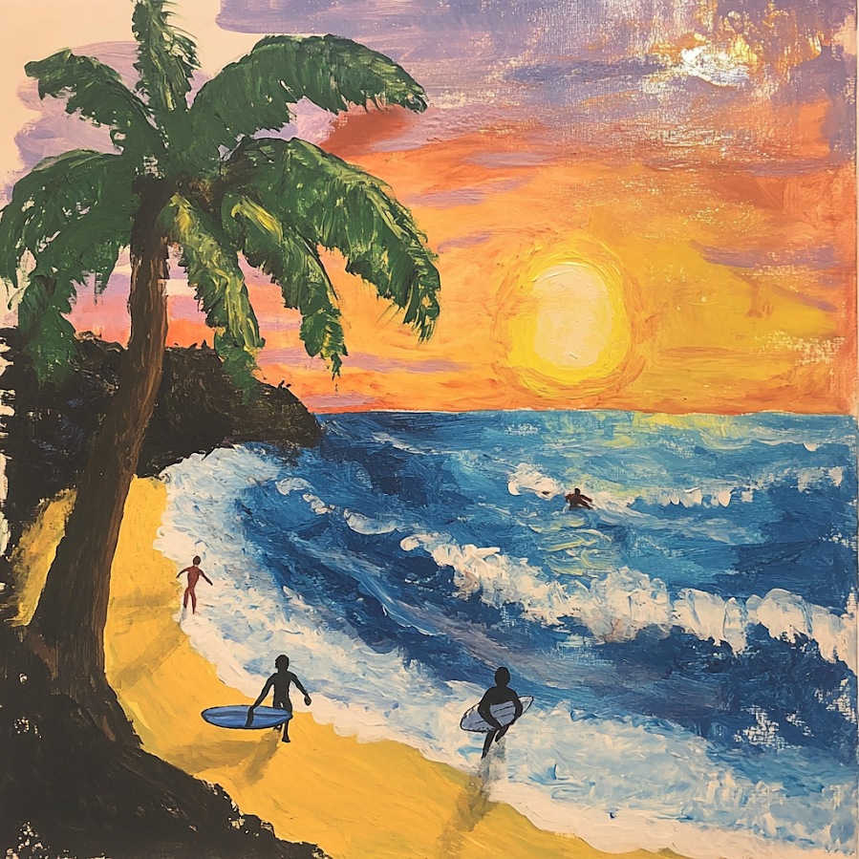
Sample Slide for Artwork…
SLIDE 1
Title: Coast at Sunset
Media: Acrylic Paint
Artist Statement: I painted this after our yearly trip to visit my grandparents in San Diego, CA. I learned to surf this trip- and wanted to make a painting to remember it. I used acrylic paints because it allowed me to mix the beautiful colors of the sunset and show highlights on the palm tree
This is where you will include the title (if not untitled), the media used, and the artist statement about the piece.
Please place a clear image of your artwork on this side.

Slide 8
Student Information:
Student Full Name:
School:
Grade:
Parent Email:
Parent Cell Number:
Optional student pic or selfie!

Slide 9
Slide 1
(Insert photo here)
Title:
Media:
Artist Statement:

Slide 10
Slide 2
(Insert photo here)
Title:
Media:
Artist Statement:

Slide 11
Slide 3
(Insert photo here)
Title:
Media:
Artist Statement:

